Slide 1



Simple Calibration of Non-overlapping Cameras with a Mirror
Ram Krishan Kumar¹, Adrian Ilie¹, Jan-Michael Frahm¹ , Marc Pollefeys^{1,2}
Department of Computer Science
¹UNC Chapel Hill ²ETH Zurich
USA Switzerland
&
CVPR, Alaska, June 2008

Slide 2
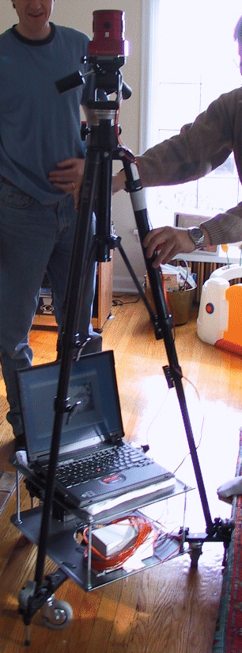
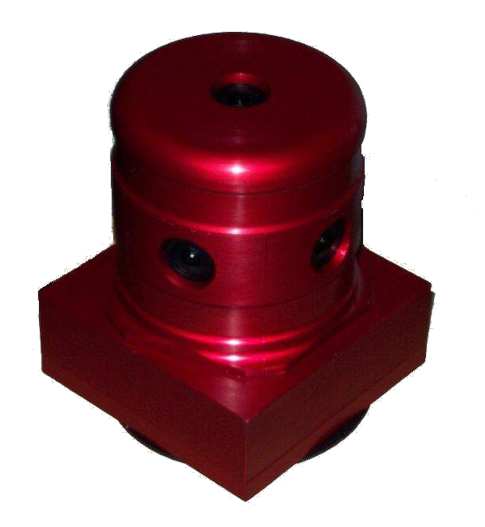
Motivation
Courtesy: Microsoft Research

Slide 3
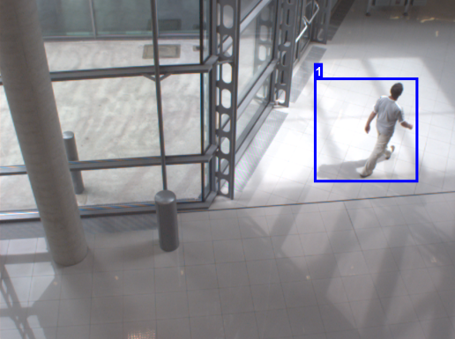
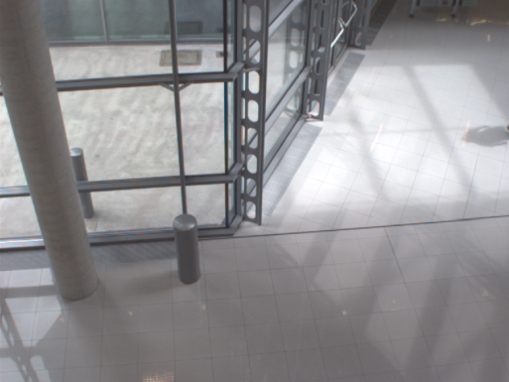
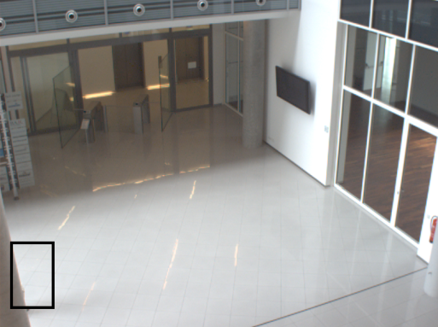
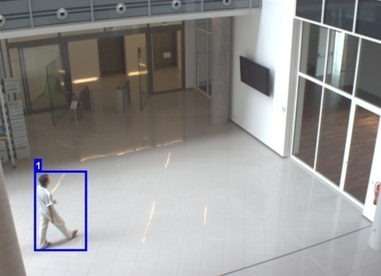
Motivation
Surveillance:
Camera 1
Camera 2
Non-overlapping cameras
Notes:
Having different cameras pointing in different directions. Since, we want to cover up the maximum area we generally have a minimal overlap in their FOVs
Ram these cameras have substantial overlap it seems to me!!!

Slide 4
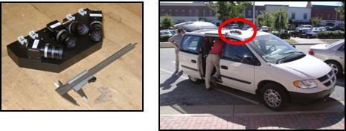
Motivation
3D reconstruction:
UrbanScape cameras: cameras with minimal overlap

Slide 5
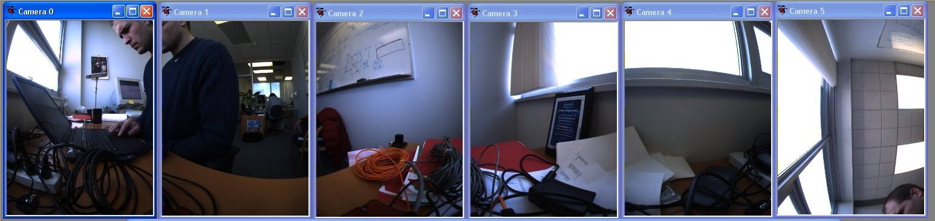
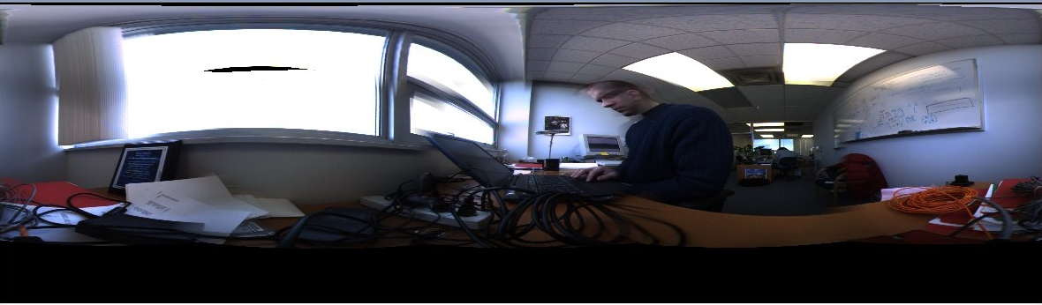
Motivation
Panorama stitching
Courtesy: www.ptgrey.com
Notes:
A minimum overlap in the views of the cameras; For stitching the panoramas, we need to know the calibration of each camera.
RAM: Here you need to reference the source of your images

Slide 6
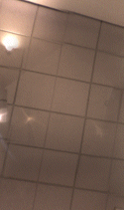
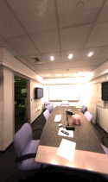
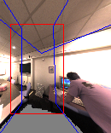
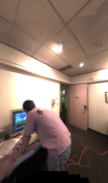
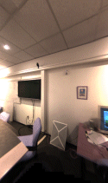
Motivation
(Only 4 of 6 images shown here)
Courtesy: Microsoft Research

Slide 7
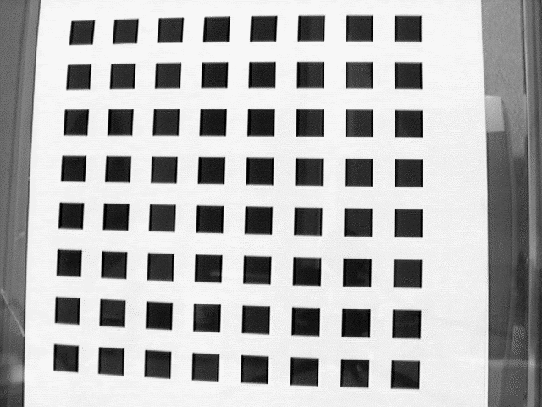
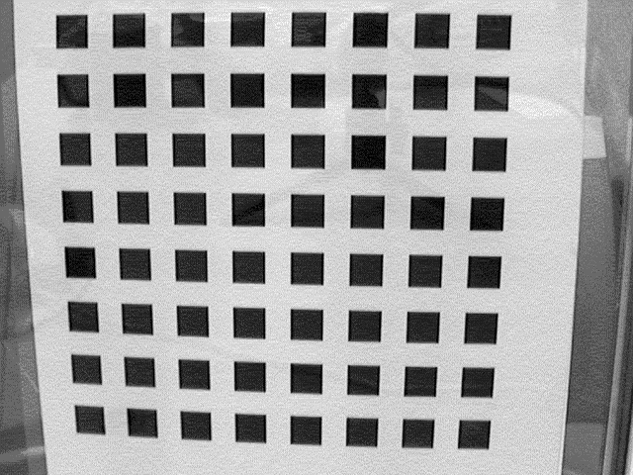
Previous Work
Single camera calibration
  Fixed 3D Geometry Tsai (1987)
  Plane based approach Zhang (2000)
Multiple images of the checker board pattern assumed at Z=0 are observed
Notes:
Ram Tsai is not 1897!!!!

Slide 8
Previous Work
Single camera calibration
  Fixed 3D Geometry Tsai (1987)
  Plane based approach Zhang (2000)
Yields both internal and external camera parameters

Slide 9
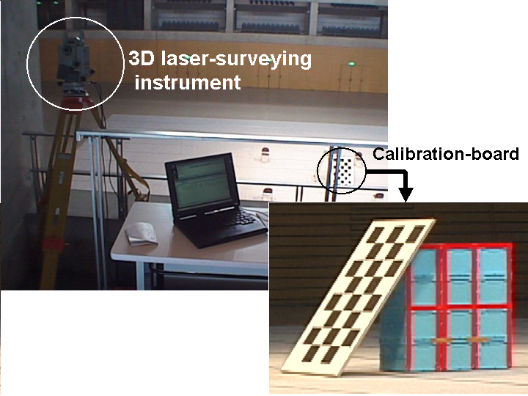
Previous Work
Multi-camera environment
  Calibration board with 3D laser pointer Kitahara et al. (2001)
Notes:
All of these method on the overlap of Fovs of cameras and can not be reliably used in the cases where there is no overlap

Slide 10
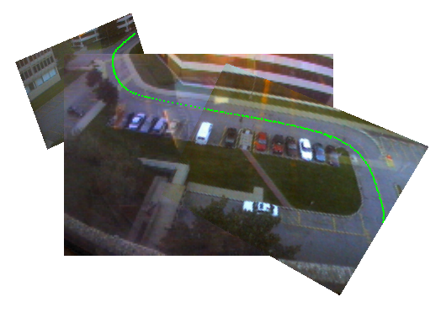
Previous Work
Multi-camera environment
  Calibration board with 3D laser pointer Kitahara et al. (2001)
  All cameras observe a common dominant plane and
  track objects moving in this plane (e.g. ground) Lee et al.(2000)
Notes:
All of these methods rely on the overlap of Fovs of cameras and can not be reliably used in the cases where there is no overlap
Ram: I don’t understand as long as they have the same plane accurately estimated it should be just fine.

Slide 11
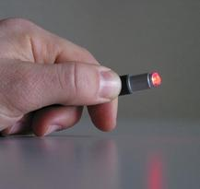
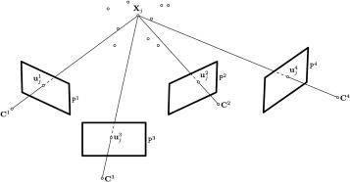
Previous Work
Multi-camera environment
  Calibration board with 3D laser pointer Kitahara et al. (2001)
  All cameras observe a common dominant plane and
  track objects moving in this plane (e.g. ground) Lee et al.(2000)
  Automatic calibration yielding complete camera projections using only a laser pointer Svoboda et al. (2005)
Notes:
All of these method on the overlap of Fovs of cameras and can not be reliably used in the cases where there is no overlap

Slide 12
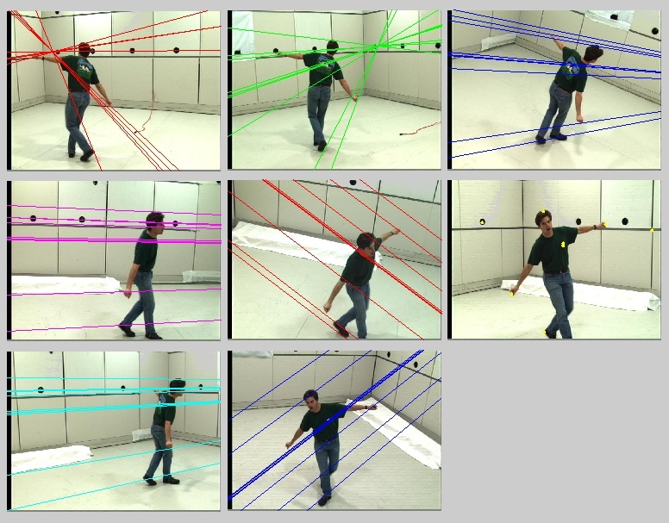
Previous Work
Multi-camera environment
  Calibration board with 3D laser pointer Kitahara et al. (2001)
  All cameras observe a common dominant plane and
  track objects moving in this plane (e.g. ground) Lee et al.(2000)
  Automatic calibration yielding complete camera projections using only a laser pointer Svoboda et al. (2005)
  Camera network calibration from dynamic silhouettes
  Sinha et al (2004)
Notes:
All of these method on the overlap of Fovs of cameras and can not be reliably used in the cases where there is no overlap

Slide 13
Previous Work
Multi-camera environment
  Calibration board with 3D laser pointer Kitahara et al. (2001)
  All cameras observe a common dominant plane and
  track objects moving in this plane (e.g. ground) Lee et al.(2000)
  Automatic calibration yielding complete camera projections using only a laser pointer Svoboda et al. (2005)
  Camera network calibration from dynamic silhouettes
  Sinha et al.(2004)
  All of these methods require an overlap in field of views (FOVs) of the cameras
Notes:
All of these method on the overlap of Fovs of cameras and can not be reliably used in the cases where there is no overlap

Slide 14
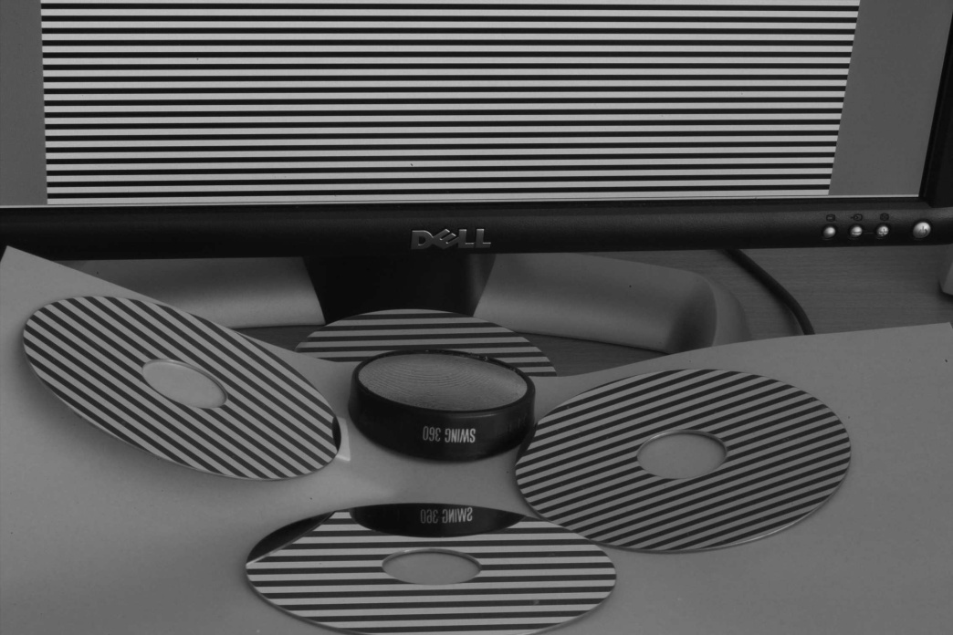
Previous Work
Pose computation of object without direct view
Sturm et al. (2006)
Rely on computing the mirror plane

Slide 15
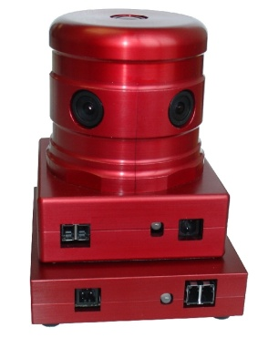
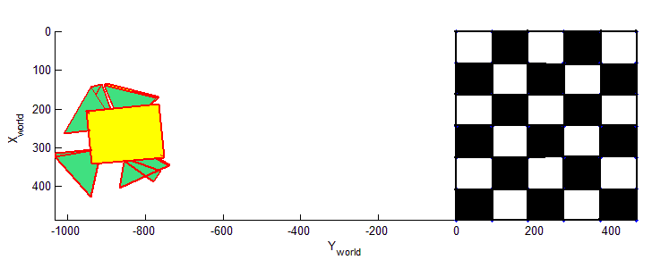
Proposed Approach
mirror
mirror
Calibration Pattern

Slide 16
Using a Planar Mirror
A real camera observing point X’ is equivalent to a mirrored camera observing the real point X itself
Real camera pose
C
Point on calibration pattern
.
X
x’
RHS to LHS
mirror
.
x
X’
C’
Mirrored camera pose

Slide 17
Proposed Approach
.
C
X
x’
Real camera pose
mirror
x
Mirrored camera pose
C’
Notes:
Ram: What are the light gray lines for in this slide? Could you remove them if they are not serving any purpose or color them differently if they are serving a purpose.

Slide 18
Proposed Approach
Move the mirror to a different position
C
.
X
x’
mirror
x
C’

Slide 19
Proposed Approach
.
X
C
x
C’

Slide 20
Proposed Approach
.
X
mirror
mirror
x
x
x
x
x
Family of mirrored camera pose

Slide 21
Proposed Approach
Reduces to Standard calibration method:
Use any standard technique that give extrinsic camera parameters in addition to internal camera parameters.
.
X
mirror
mirror
x
x
x
x
x
Family of mirrored camera pose
Notes:
Ram: here you should blend them in mirror & mirrored camera for each position otherwise nobody will get this.

Slide 22
Recovering Internal Parameters
A two stage process
STAGE 1: Internal calibration
Image pixel x= x’
=>intrinsic parameters & radial distortion are the same
C
.
X
x’
mirror
.
x
X’
C’
Notes:
You can say more here but keep the text on the slide short

Slide 23
Proposed Approach
A two stage process :
STAGE 2 : External camera calibration
r₃
.
C
r₂
X
x’
Real camera pose
r₁
C-C’
mirror
.
r₁’
X’
x
Mirrored camera pose
r₂’
C’
r₃’
23

Slide 24
Recovery of External Parameters
r₁ + r₁’
r₃
r₂
r₂’
C
r₁’
Real camera pose
r₁
C-C’
mirror
r₂’
3 Non-linear constraints
<r₁ + r₁’,C’-C> = 0
Mirrored camera pose
r₁’
<r₂ + r₂’,C’-C> = 0
C’
<r₃ + r₃’,C’-C> = 0
r₃’
(C’-C)^{T} (r_{k}’ + r_{k} ) = 0 for k = 1, 2, 3
24

Slide 25
Recovery of External Parameters
r₁ + r₁’
r₃
r₂
r₂’
C
r₁’
Real camera pose
r₁
C-C’
mirror
3 Non-linear constraints
r₁’
<r₁ + r₁’,C’-C> = 0
Mirrored camera pose
r₂’
<r₂ + r₂’,C’-C> = 0
C’
<r₃ + r₃’,C’-C> = 0
r₃’
C’^{T} r_{k}’ + C’^{T} r_{k} - C^{T} r_{k}’ - C^{T} r_{k} = 0 for k = 1, 2, 3
Non-linear
25

Slide 26
Recovery of External Parameters
r₃
r₁ + r₁’
r₂
C
r₁’
r₁
mirror
r₁’
r₂’
C’
r₃’
Each mirror position generates 3 non-linear constraints
Unknowns : r₁ , r₂ , r₃ , C (12)
Equations : 3 constraints for each mirror position + 6 constraints of rotation matrix

Slide 27
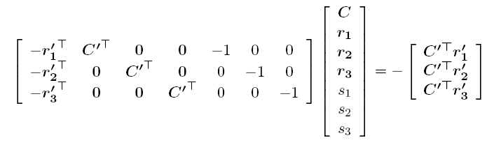
Recovery of External Parameters
C’^{T} r_{k}’ + C’^{T} r_{k} - C^{T} r_{k}’ - C^{T} r_{k} = 0 for k = 1, 2, 3
linearize
C^{T} r_{k} = s_{k} (Introduced variables)
Number of unknowns: 12 + 3 (s_{1,} s_{2,} s₃ ) ;
At least 5 images are needed to solve for the camera center and rotation matrix linearly

Slide 28
Recovery of External Parameters
Once we have obtained the external camera parameters, we apply bundle adjustment to minimize the reprojection error
Enforce r₁, r₂ , r₃ to constitute a valid rotation matrix
R = [r₁ r₂ r₃ ]

Slide 29
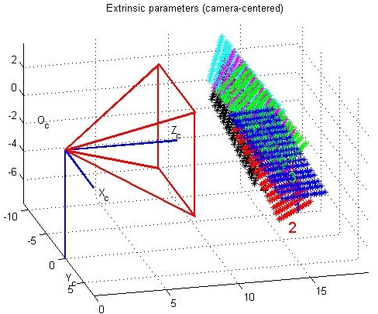
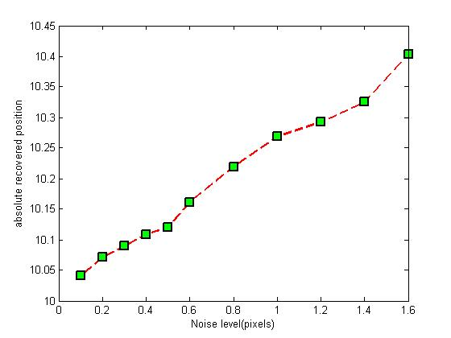
Experiments
Five randomly generated mirror positions which enable the camera to view the calibration pattern
Error in recovered camera center vs noise level in pixel
Notes:
Ram: we discussed not to show a percentage error here since it is meaningless. So put absolute numbers

Slide 30
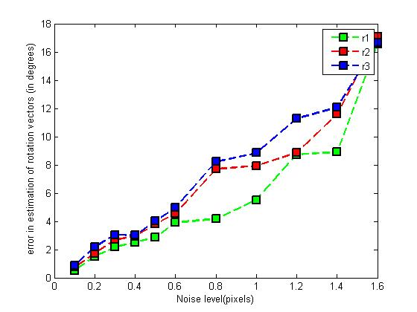
Experiments
Five randomly generated mirror positions which enable the camera to view the calibration pattern
Error in rotation matrix vs noise level in pixel
Notes:
Ram: switch this plot to axis angle

Slide 31
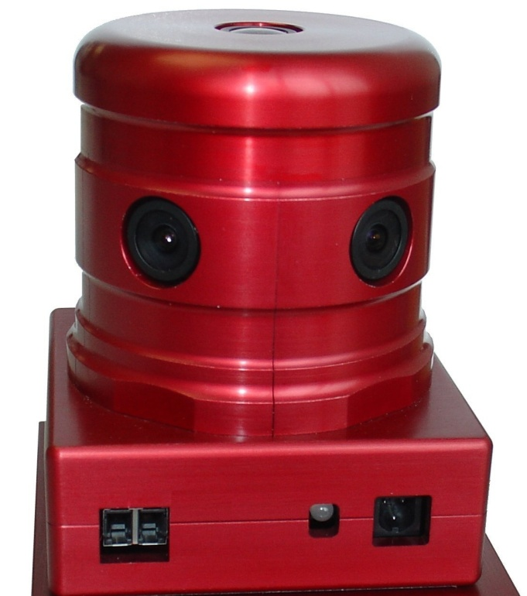
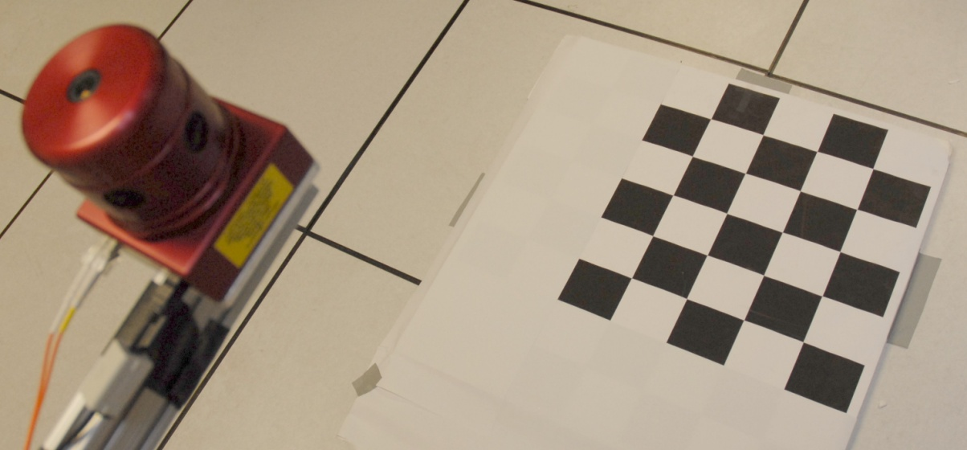
Evaluation on Real Data
Experimental Setup with checkerboard pattern kept on the ground
Ladybug Cameras

Slide 32
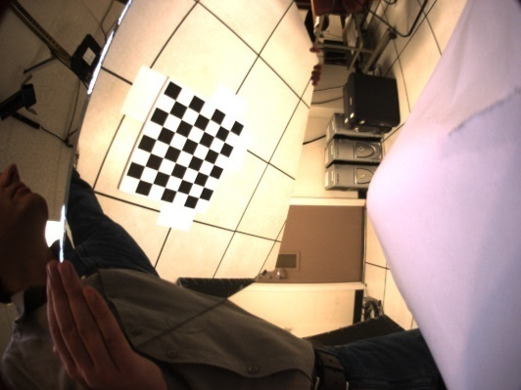
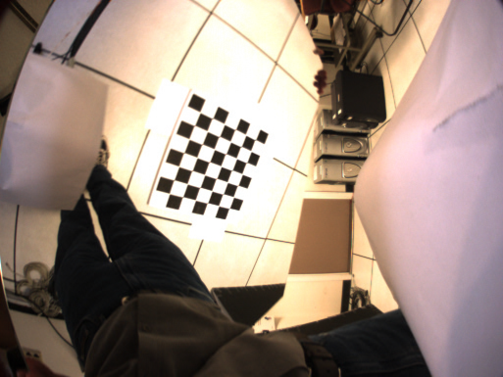
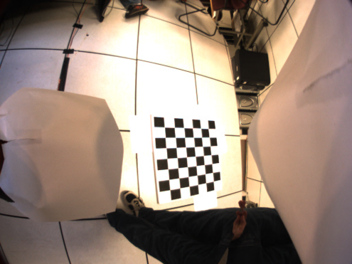
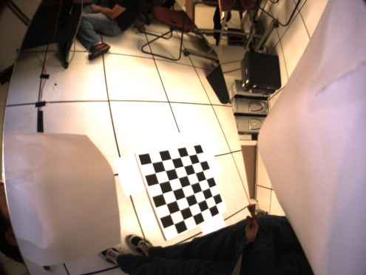
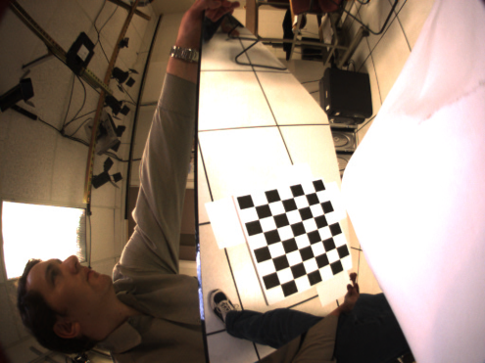
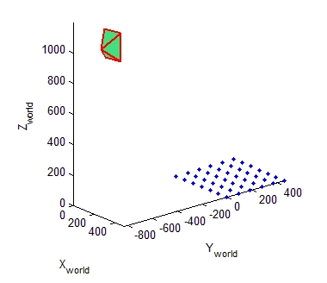
Evaluation on Real Data
Camera 1
Notes:
Ram: switch the next slides accordingly and make the animation for this one so that one image comes in after the other (for the other slides just blend the whole stack in at once)

Slide 33
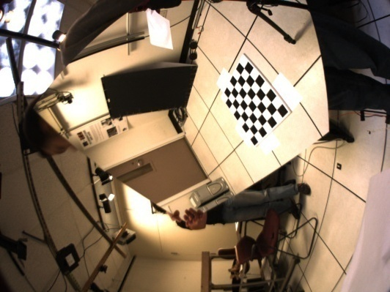
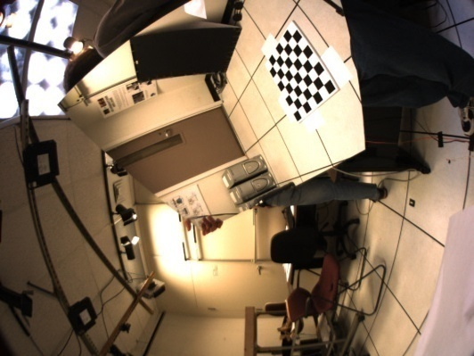
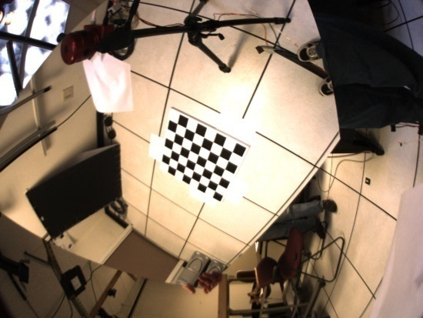
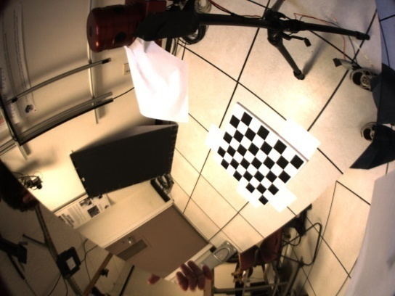
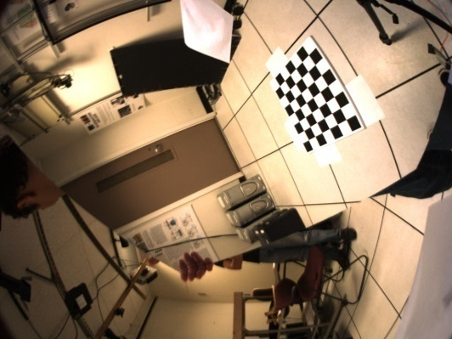
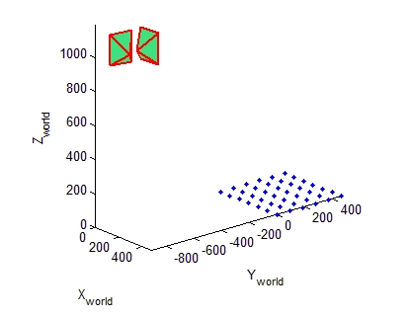
Evaluation on Real Data
Camera 2

Slide 34
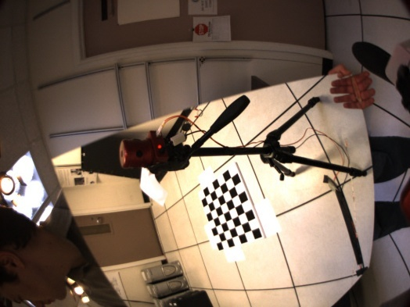
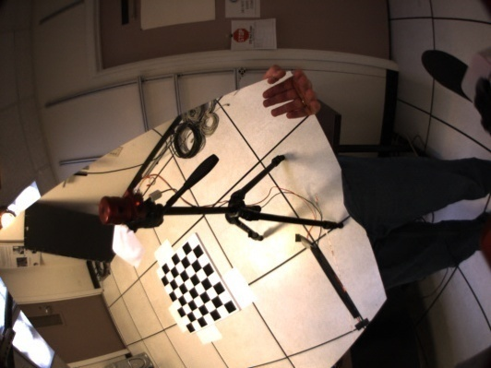
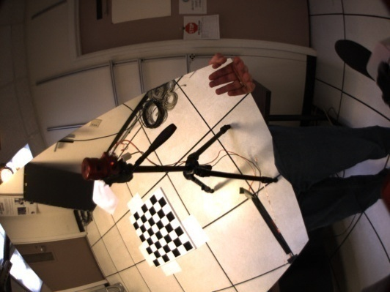
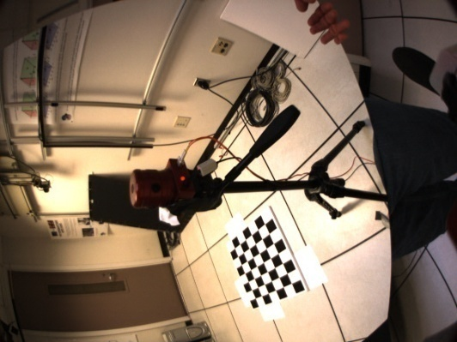
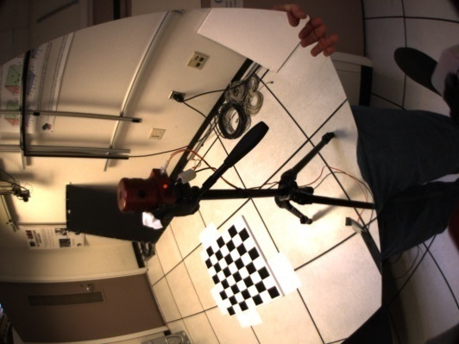
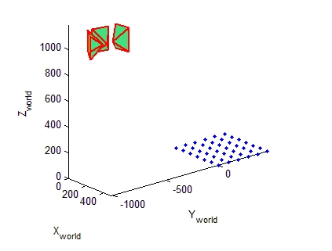
Evaluation on Real Data
Camera 3

Slide 35
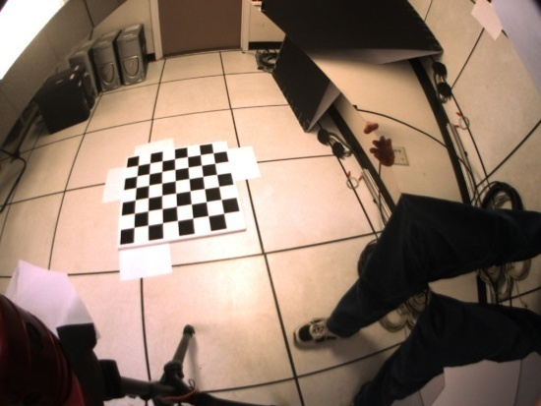
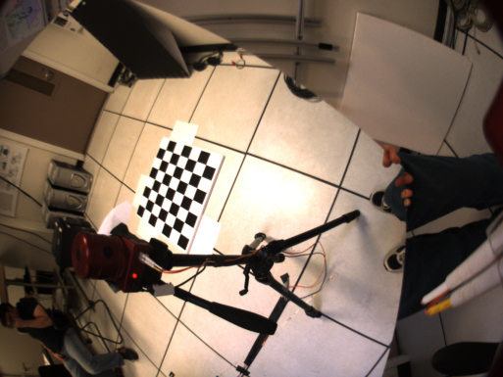




Evaluation on Real Data
Camera 4

Slide 36






Evaluation on Real Data
Camera 5

Slide 37






Evaluation on Real Data
Camera 6

Slide 38
Evaluation on Real Data
Top View: Initial estimate of the recovered camera poses

Slide 39

Evaluation on Real Data
Top View : Recovered camera poses after Bundle adjustment
Notes:
Ram add comparison with specs of the Ladybug

Slide 40

Evaluation on Real Data
Result:
37.3 cm
35.1 cm
37.6 cm
36.2 cm
34.7 cm
Actual radius: 37.5 cm

Slide 41
Summary
Using a plane mirror to calibrate a network of camera
Cameras need not see the calibration object directly
Knowledge about mirror parameters is not required !

Slide 42
Practical Considerations
Need a sufficiently big calibration object so that they occupy a significant portion in the image
Use any other calibration object and any other calibration technique which gives both intrinsic and extrinsic parameters

Slide 43
Acknowledgements
We gratefully acknowledge the partial support of the IARPA VACE program, an NSF Career IIS 0237533 and a Packard Fellowship for Science and Technology
Software at:
http://www.cs.unc.edu/~ramkris/MirrorCameraCalib.html

Slide 44
Questions

Slide 45
Take Away Ideas
.

