Slide 1
Ray Tracing
Christian Lauterbach
COMP 770, 2/11/2009

Slide 2
Overview
Ray Tracing vs. rasterization
Ray/Object intersection algorithms
Ray Tracing methods
  Recursive ray tracing
  Distributed ray tracing

Slide 3
Rasterization
Viewer
Screen

Slide 4
Ray Tracing
Viewer
Screen

Slide 5
Rasterization vs. Ray Tracing
Rasterization
  For each primitive:
    For each pixel:
      Is Pixel in Primitive?
        Yes: Test depth / write color
Ray Tracing
  For each pixel: generate ray
    For each primitive:
      Does ray hit primitive?
        Yes: Test depth / write color

Slide 6
Ray Tracing
“Tracing a ray” = find first hit with scene object
Naïve:
  Test against all scene objects
  Like testing all pixels in rasterization!
In reality:
  Acceleration structure gives quick estimate of potentially visible objects for ray
  (topic of 2nd lection on RT)

Slide 7
Ray Tracing algorithms
So what’s the big deal?
Ray Tracing far more flexible paradigm
  Not limited to primary visibility!
  Recursive (Whitted) ray tracing:
    Reflections, Refractions, Shadows
  Distributed ray tracing
  ...and many more applications

Slide 8
Overview
Ray Tracing vs. rasterization
Ray/Object intersection algorithms
Ray Tracing methods
  Recursive ray tracing
  Distributed ray tracing

Slide 9
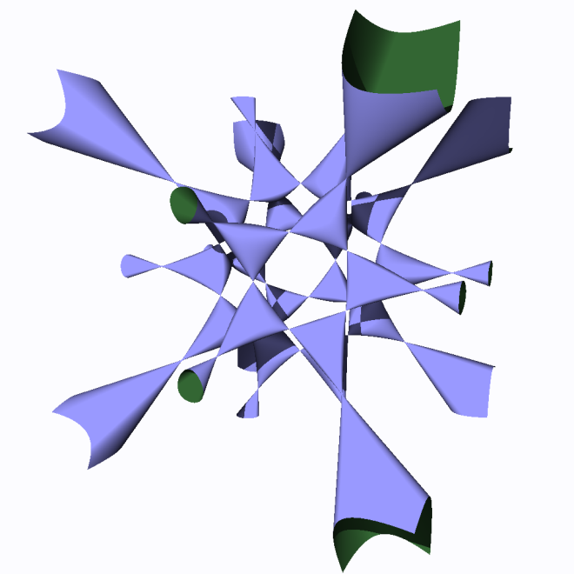
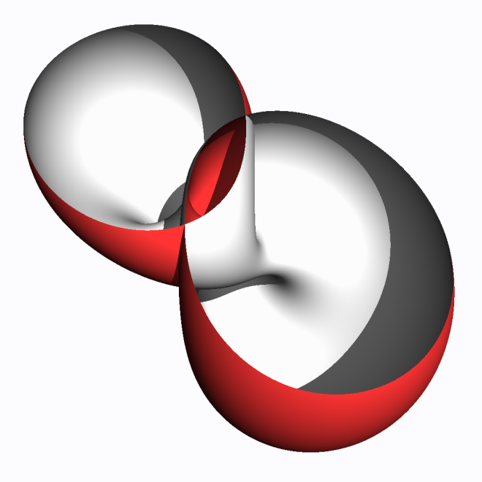
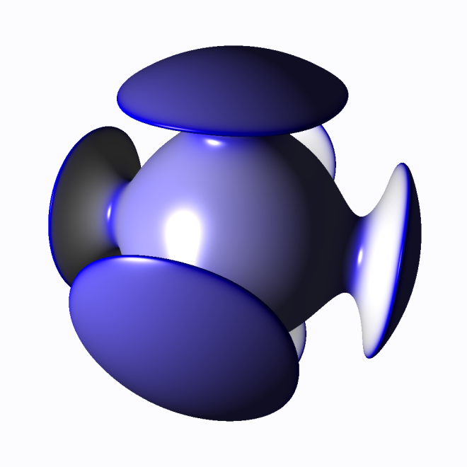
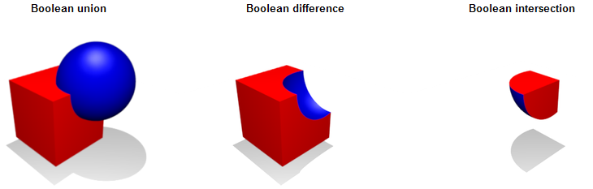
Ray/Object intersection
Can intersect ray with many objects
  Triangles, Planes
  Spheres, Cylinders, Cones
  Boxes (axis-aligned or otherwise)
  General polyhedra and many more
Even procedural/implicit objects!
  Constructive solid geometry (CSG)
  Implicit surfaces / equations

Slide 10
Ray/Object intersection
Ray:
  Origin x
  Direction d
Ray formula:
  x + t*d
  t > 0
d
x

Slide 11
Example: Ray/Sphere Intersection
Sphere equation:
  (p – S)² – r² = 0
So let’s plug in ray equation!
    ((x + t*d)– S)² – r² = 0
Simplify a bit, let v = (x – S)
  (t*d + v)² – r² = 0
Expand:
    t²d² + 2dvt + v² - r² = 0
r
S

Slide 12
Example: Ray/Sphere Intersection
From last slide:
    t²d² + 2dvt + v² - r² = 0
  Quadratic equation of t of form
  At² + Bt + C = 0
  Easy to solve
    t_{1,2} = -B ± sqrt[ ¼B² – C ]
  Two real solutions: why?
r
S

Slide 13
Ray/sphere intersection
This is only one possible algorithm
Many more optimized versions exist
  E.g. early exits or less branches
  Sometimes best intersection algorithm is hardware specific, too
  One solution: auto-tuning

Slide 14
Overview
Ray Tracing vs. rasterization
Ray/Object intersection algorithms
Ray Tracing methods
  Recursive ray tracing
  Distributed ray tracing

Slide 15
Recursive ray tracing: shadows
Light
Shadow ray
Viewer
If first hit of shadow ray closer than distance to light ⇨ in shadow

Slide 16
Recursive Ray Tracing: Reflection
Light
Reflection ray
Viewer

Slide 17
Recursive Ray Tracing: Refraction
Light
Refraction ray
Viewer

Slide 18
Where’s the recursion?
Light
Reflection ray
Reflection ray
Viewer
Refraction ray

Slide 19
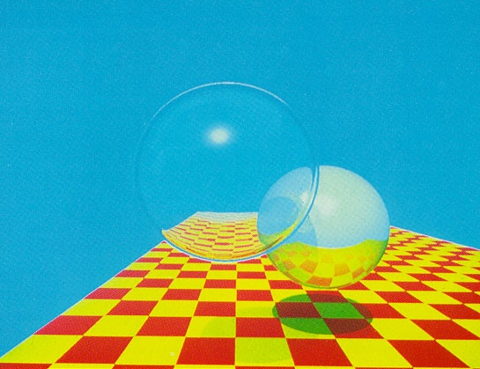
Recursive Ray Tracing: Example
(from [Whitted80])

Slide 20
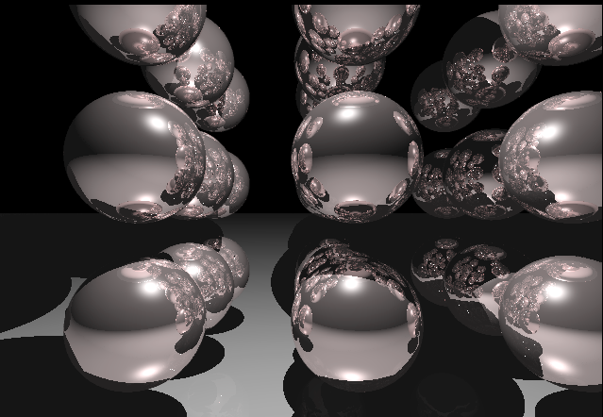
Recursive Ray Tracing: Example

Slide 21
Computing ray colors
How to get the final pixel color?
  Every material has local color c
  Define reflexivity, refraction factors ρ
  (i.e. between 1.0 (mirror) and 0.0 (no reflection)
  Each hit returns its color down the chain
End result:
  Color = (1 –ρ) c₁ + ρ₁ ( (1- ρ₂)c₂ + ρ₂ (c_{3 ….} )))
  Local color also influenced by shadow rays!

Slide 22
Computing reflection rays
Reflection is pretty simple
  Incident angle = Exit angle
    Incident ray: x + t*d
    Reflection ray: a + t*(d – 2*n*dot(n,d))
    (careful, assumes n and d normalized!)
n
a

Slide 23
Computing refraction rays
Refraction occurs at material boundaries
  E.g. air-glass
  Depends on refractive index n of materials
Snell’s law:
  n ₁ * sin(θ₁) = n₂ * sin(θ₂)
Special case:
  total internal reflection
    denser to less dense material
    θ > critical angle
n₁
θ₁
n₂
θ₂

Slide 24
Overview
Ray Tracing vs. rasterization
Ray/Object intersection algorithms
Ray Tracing methods
  Recursive ray tracing
  Distributed ray tracing

Slide 25
Distributed ray tracing
Ray Tracing: too idealistic!
  No point light sources in nature
  No perfect reflections etc.
Distributed ray tracing idea
  Substitute exact single rays with several probabilistically generated rays

Slide 26
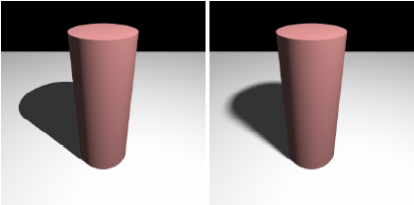
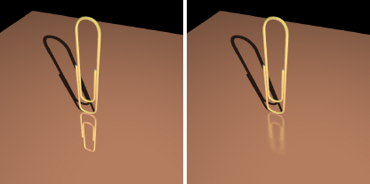
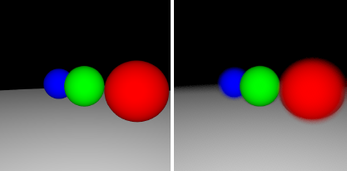
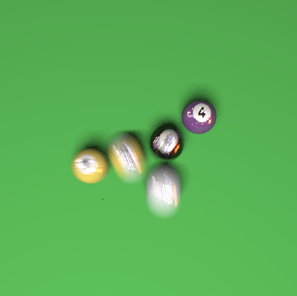
Distributed Ray Tracing
Allows many physically correct effects:
  Soft area shadows
  Glossy, imperfect reflections and refractions
  Depth of Field
  Motion blur
(from [Boulos07])

Slide 27
Area shadows with DRT
Light
Shadow ray
Viewer

Slide 28
Area shadows with DRT
n shadow rays for randomly
selected points on light
Area light
Viewer
Lighting now determined by #rays reach light / #rays shot

Slide 29
Other effects
Reflections, Refraction similar
  E.g. sample rays inside cone defined by direction
Depth of field
  Sample different viewer positions on lens
Motion blur
  Sample different time points
All work together!

Slide 30
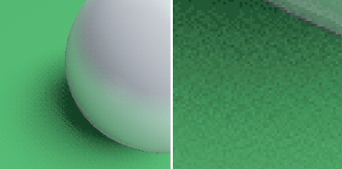
Stochastic sampling
One new disadvantage:
sampling needs to be high, or artifacts visible
  Manifests as high-frequency noise
  Good sample generation is art in itself
  Much, much slower than simple ray tracing
(from [Boulos07])

Slide 31
Conclusion
Ray Tracing advantages
  Reflections, refraction, shadows
  Rendering of arbitrary objects
    Does not even need explicit representation
  Used for global illumination, many others
Disadvantages
  Usually much slower
  (no hardware acceleration, either)

