Slide 1
Voronoi Diagrams and
Problem Transformations
Steven Love, supervised by:
Jack Snoeyink and Dave Millman

Slide 2
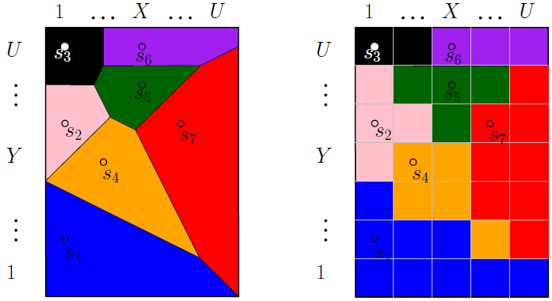
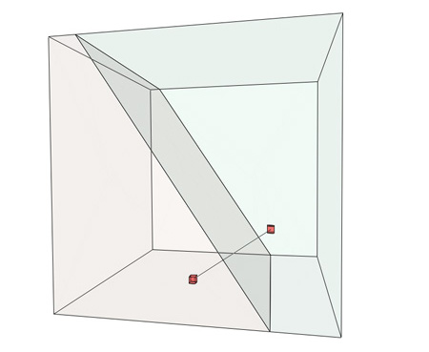
What is a Voronoi Diagram?
A spatial decomposition
    A set of polygons A set of polyhedra
Vanhoutte 2009

Slide 3
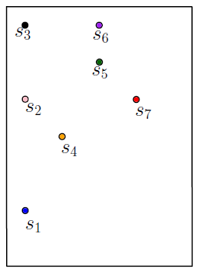
What is a Voronoi Diagram?
Given n Sites
  Special points in the space
Create n Cells
  Regions of points that are
  closest to each site

Slide 4
What is a Voronoi Diagram?
Given n Sites
  Special points in the space
Create n Cells
  Regions of points that are
  closest to each site

Slide 5
Why do we care?
Name Field Date Discovery
Descartes Astronomy 1644 “Heavens”
Dirichlet Math 1850 Dirichlet tesselation
Voronoi Math 1908 Voronoi diagram
Boldyrev Geology 1909 area of influence polygons
Thiessen Meteorology 1911 Thiessen polygons
Niggli Crystallography 1927 domains of action
Wigner & Seitz Physics 1933 Wigner-Seitz regions
Frank & Casper Physics 1958 atom domains
Brown Ecology 1965 areas potentially available
Mead Ecology 1966 plant polygons
Hoofd et al. Anatomy 1985 capillary domains
Icke Astronomy 1987 Voronoi diagram
Okabe et al. Spatial Tessellations

Slide 6
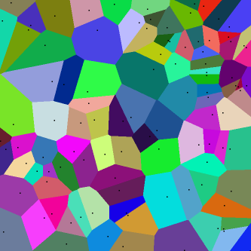
Why do we care?
Examples
  Post Office Problem
  Toxic Waste Dump
  Max-clearance path planning
  Delaunay Triangulation

Slide 7
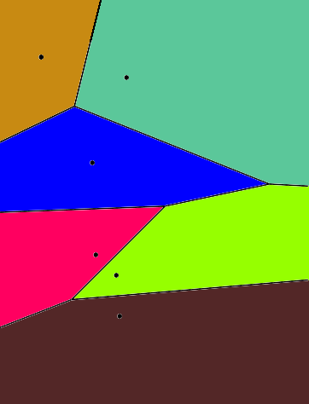
Why do we care?
Examples
  Post Office Problem

Slide 8
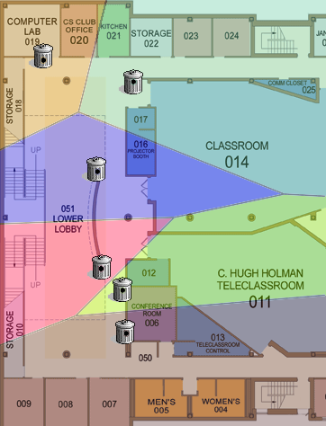
Why do we care?
Examples
  Trash Cans in Sitterson

Slide 9
Discretized Voronoi Diagram
n Sites
n Cells
U x U Grid
U^2 Pixels

Slide 10
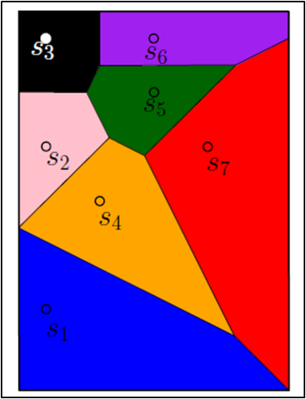
Discretized Voronoi Diagram
n Sites
n Cells
U x U Grid
U^2 Pixels
s

Slide 11
Discretized Voronoi Diagram
n Sites
n Cells
U x U Grid
U^2 Pixels
s

Slide 12
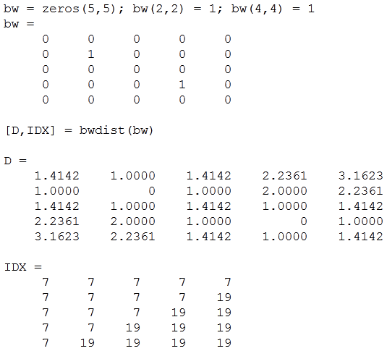
Discretized Voronoi Diagram
2 sites
2 cells
5x5 grid
25 pixels
D is ‘distance’ transform, IDX is discrete Voronoi
MathWorks MATLAB R2012a Documentation for bwdist

Slide 13


Background (Precision of Algorithms)
Idea: minimize arithmetic precision requirements
  Liotta, Preparata, and Tamassia
    “degree-driven analysis of algorithms”
Example:
  Testing pixel ‘q’ to see which site (‘i’ or ‘j’) is closer,
  given their coordinates
  intermediate calculations use twice as many bits as input

Slide 14
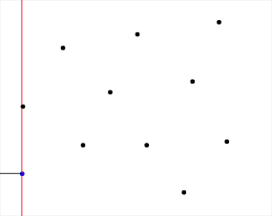
Background (Precision of Algorithms)
Name | Name | Time | Degree | Time | Degree
Fortune | Fortune | O(n lg n) | 5 | O(lg n) | 6
Breu et al. | Breu et al. | O(U^2) | 4 | O(1) | 0
Hoff et al. | Hoff et al. | O(n*U^2) | Z-buffer | O(1) | 0
Maurer, Chan | Maurer, Chan | O(U^2) | 3 | O(1) | 0
Us 1 | Our UsqLgU | O(U^2 lg U) | 2 | O(1) | 0
Us 2 | Our Usq | O(U^2) | 2 | O(1) | 0
Name | Time | Degree | Time | Degree
Fortune | O(n lg n) | 5 | O(lg n) | 6
Breu et al.
Hoff et al.
Maurer, Chan
Our UsqLgU
Our Usq

Slide 15
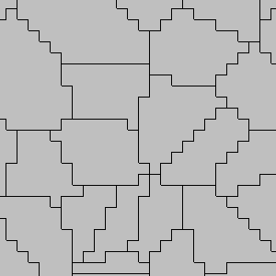
Background (Precision of Algorithms)
Name | Time | Degree | Time | Degree
Fortune | O(n lg n) | 5 | O(lg n) | 6
Breu et al. | O(U^2) | 4 | O(1) | 0
Hoff et al.
Maurer, Chan
Our UsqLgU
Our Usq
McNeill, 2008

Slide 16
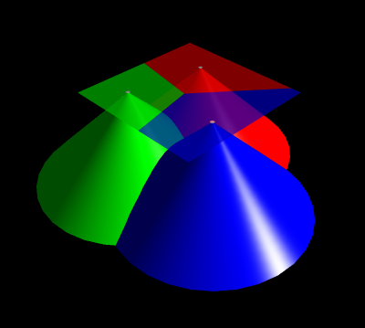
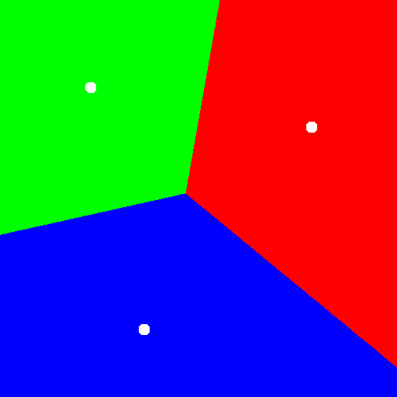
Background (Precision of Algorithms)
Name | Time | Degree | Time | Degree
Fortune | O(n lg n) | 5 | O(lg n) | 6
Breu et al. | O(U^2) | 4 | O(1) | 0
Hoff et al. | O(n*U^2) | Z-buffer | O(1) | 0
Maurer, Chan
Our UsqLgU
Our Usq

Slide 17
Background (Precision of Algorithms)
Name | Time | Degree | Time | Degree
Fortune | O(n lg n) | 5 | O(lg n) | 6
Breu et al. | O(U^2) | 4 | O(1) | 0
Hoff et al. | O(n*U^2) | Z-buffer | O(1) | 0
Maurer, Chan | O(U^2) | 3 | O(1) | 0
Our UsqLgU
Our Usq

Slide 18
Background (Precision of Algorithms)
Name | Time | Degree | Time | Degree
Fortune | O(n lg n) | 5 | O(lg n) | 6
Breu et al. | O(U^2) | 4 | O(1) | 0
Hoff et al. | O(n*U^2) | Z-buffer | O(1) | 0
Maurer, Chan | O(U^2) | 3 | O(1) | 0
Our UsqLgU | O(U^2 lg U) | 2 | O(1) | 0
Our Usq

Slide 19
Background (Precision of Algorithms)
  asdfasdfasd
Name | Time | Degree | Time | Degree
Fortune | O(n lg n) | 5 | O(lg n) | 6
Breu et al. | O(U^2) | 4 | O(1) | 0
Hoff et al. | O(n*U^2) | Z-buffer | O(1) | 0
Maurer, Chan | O(U^2) | 3 | O(1) | 0
Our UsqLgU | O(U^2 lg U) | 2 | O(1) | 0
Our Usq | O(U^2) | 2 | O(1) | 0

Slide 20
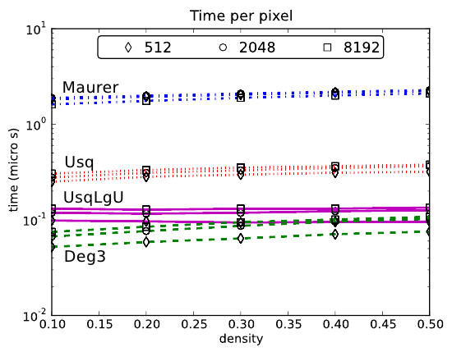
Experimental Data
Precision
Speed
Chan

Slide 21
Problem Transformation
Problem: compute discrete Voronoi on a U x U grid
Split into U different sub-problems
Each sub-problem computes one row

Slide 22
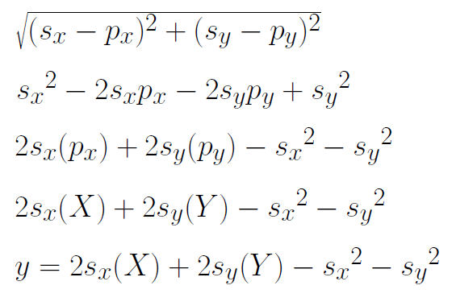
Problem Transformation
Find the site s that minimizes distance to pixel p
Minimize
Minimize
Maximize
Maximize

Slide 23
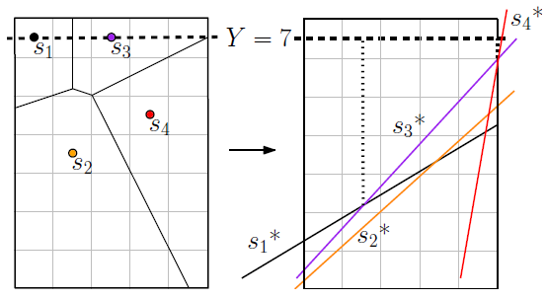
Problem Transformation
Maximize
Maximize

Slide 24
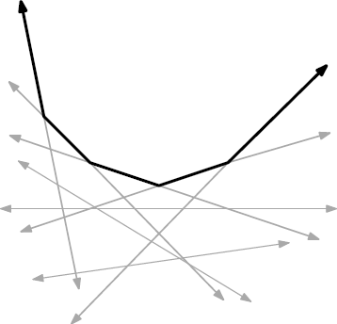
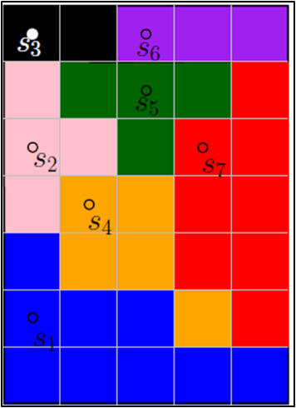
Upper Envelope
Set of line segments that are higher than all other lines
Include segments with Greatest y for a chosen x

Slide 25
Discrete Upper Envelope
For each x in [1,U] we assign the index of the highest line
A naïve algorithm is O(n*U) for n lines

Slide 26
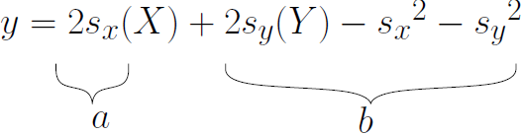
Discrete Upper Envelope
We calculate U DUEs, one for each row
DUEs consist of subsets of lines of the form y = a*x + b
a is degree 1, b is degree 2
Goal: compute the DUE in O(U) and degree 2

Slide 27
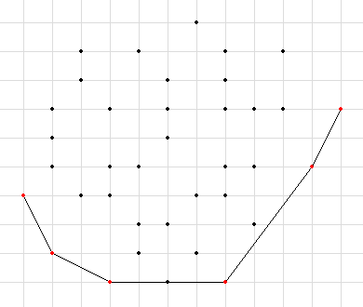
Discrete Upper Envelope
Lower Convex Hull: O(U) time, degree 3
Binary Search
Randomization

Slide 28
Discrete Upper Envelope
Lower Convex Hull: O(U) time, degree 3
Binary Search: O(U lg U) time, degree 2
Randomization

Slide 29
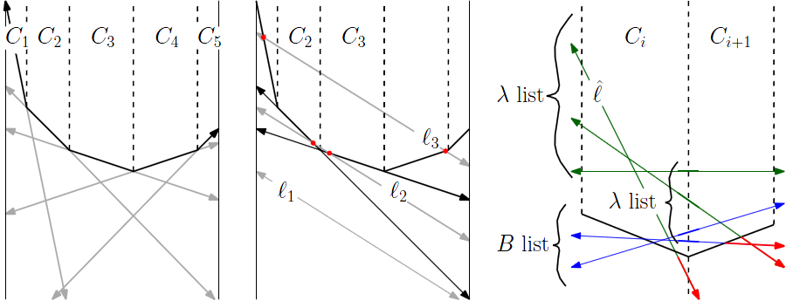
Discrete Upper Envelope
Lower Convex Hull: O(U) time, degree 3
Binary Search: O(U lg U) time, degree 2
Randomization: O(U) expected time, degree 2

Slide 30
Timings for computing Discrete Voronoi
Lower Convex Hull
  Chan
Binary Search
  UsqLgU
Randomization
  Usq
Chan

Slide 31
Future Work
Minimizing degrees of other geometric algorithms
Visualizations for these complex algorithms

