Slide 1
Estimation of physical properties of real world objects
Rohan Chabra & Akash Bapat

Slide 2
Motivation
3D Scene Understanding
Intelligent systems that predict collisions between objects in an environment.
This system can be used in robot industry to guide robots in unexpected scenarios.
Construction of VFX and special effects.

Slide 3
Background
Object tracking : Track object even though it is occluded
“Binding vision to physics based simulation: The case study of a bouncing ball”. By N. Kyriazis, I. Oikonomidis, and A. Argyros. In Proc. BMVC, 2011.
Computer Vision
Physics based simulation
Graphics
Data

Slide 4
Background
Estimation of motion properties of objects in a video. Parameters such as:-
position,
linear velocity
angular velocity
assuming the environment and physical properties are known.

Slide 5
Data acquisition
Microsoft Kinect 1.0 is used in the present setup.
  FPS= 30
  Difficulties in tracking in 3D
  Motion blur at high velocities
Depth data is recorded in mm
3D world point is estimated using camera matrix transformation

Slide 6
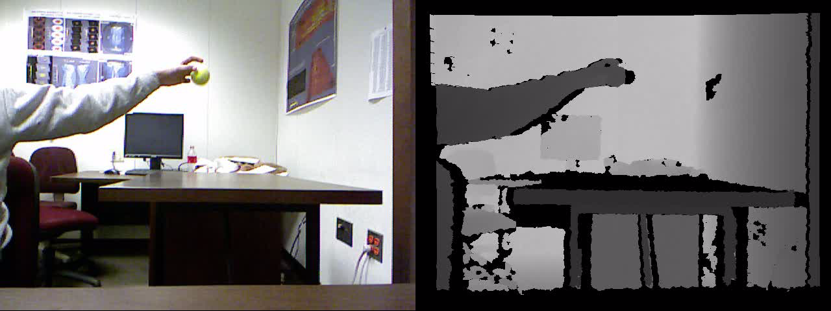
Data acquisition- bouncing ball

Slide 7
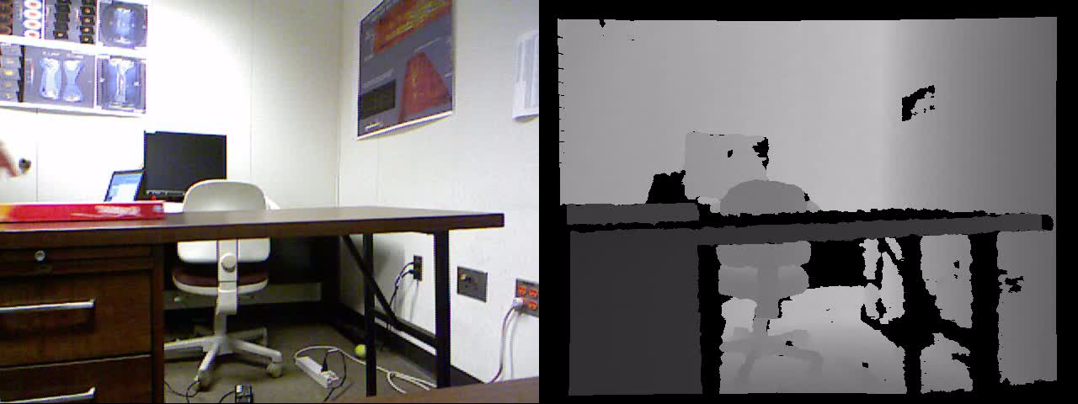
Data acquisition – sliding friction

Slide 8
3D tracking
Fast versions of 3D tracking algorithms assume accurate depth maps.
Most tracking algorithms assume small motion.
3D data are piecewise planar, hence keypoint-based detectors tend to fail.
Hence, online-MIL tracker is uses learning for tracking
Normal plane estimation is done using RANSAC or regression.

Slide 9
Coefficient of restitution-data

Slide 10
Coefficient of restitution

Slide 11
Velocity changes in x & z
We noticed that velocities in x & z directions also change at every bounce.
We applied SVD to find out impulse responsible for this.
N is number of bounces , Δv is averaged over time
  J=Δ t F = m Δv
  µmg Δ t =m Δv
  Log (µ_{x}) + log(Δ t ) = log(Δv_{x}/g)
  Log (µ_{z}) + log(Δ t ) = log(Δv_{z}/g)
  µ_{x} = 0.04 , µ_{z}=0.08 , Δ t = 0.1 s
  µ = 5*10e-3
2N equations, N+2 unknowns

Slide 12
Sliding friction -data

Slide 13
Sliding friction

Slide 14
Numerical simulation
Bullet physics is used for simulation
  Inaccurate for calculating sliding friction due to multiple collisions and impulses.
  Hence, we are using a pseudo-force
  We plan to use another physics platform, or write our own code.
OpenGL is used for rendering.

Slide 15
Coefficient of restitution
e= sqrt(h₂/h₁)
E_{seed}= random value between 0-1
ΔH = difference in heights
Error = α *signum(ΔH)*e_{RMS}.
E_{new}=E_{prev} – Error
where α is learning factor

Slide 16
Coefficient of restitution

Slide 17
Coefficient of restitution-data

Slide 18
 | Alpha = 0.005 | Initial or Seed COR = 0.5
Iteration | Error | Estimated COR
1 | -3.01837 | 0.545553
2 | -6.53181 | 0.758875
3 | -4.18844 | 0.846591
4 | -3.25559 | 0.899585
5 | 5.689057 | 0.737758
6 | -4.00487 | 0.817953
7 | -3.39035 | 0.875426
8 | -3.19764 | 0.92655
9 | 7.160681 | 0.670173
10 | -5.05082 | 0.797727
11 | 1.615586 | 0.784677
12 | 1.115937 (Least Error magnitude) | 0.77845
13 | 1.144201 | 0.771904
14 | -4.05838 | 0.854256
15 | 3.747356 | 0.784043
16 | 1.261047 | 0.776092
17 | 1.141743 | 0.769574
18 | -3.95387 | 0.847739
19 | -3.23747 | 0.900145
20 | 5.70068 | 0.737656
 |  | Final Estimated COR = 0.77845

Slide 19
Sliding friction
0.5mv² = F_{fr} . s , where F_{fr} = µ m g
V_{seed} is random velocity & µ_{seed} ≈ 0
ΔX = avg(Kinect position – simulated position)
E = RMS_{error} (ΔX)
Error = signum(ΔX)*E
V_{new}= V_{prev} + Error *α
µ _{new}= µ_{prev} + V²/2gs * β
β is to be selected such that s_{simulated} ≈ s_{Kinect}

Slide 20
Estimated µ
V²_{simulated}/2gs_{simulated} | µ_{simulated}
0.313 | 0.297
0.278 | 0.250
0.271 | 0.188
0.316 | 0.295
0.267 | 0.252

Slide 21
Sliding friction

Slide 22
Comparison

Slide 23

Demo :sliding friction

Slide 24
Future Work
Incorporation of mesh
Stereo estimation at 60/120 fps for better accuracy.
Estimation of rolling friction.
Validation using actual physics experiments.
  For ground truth,
  Accelerometer and gyroscope can be used to estimate ω and v
Use of real-time 3D tracking algorithms
Experiment with different surface pairs & objects of different sizes/shapes.

Slide 25
Questions?

