Slide 1



Towards kHz 6-DoF Visual Tracking Using an Egocentric Cluster of Rolling Shutter Cameras
Akash Bapat¹, Enrique Dunn^{1,2} & Jan-Michael Frahm¹,
UNC Chapel Hill, USA¹,
Stevens Institute of Technology, USA²

Slide 2
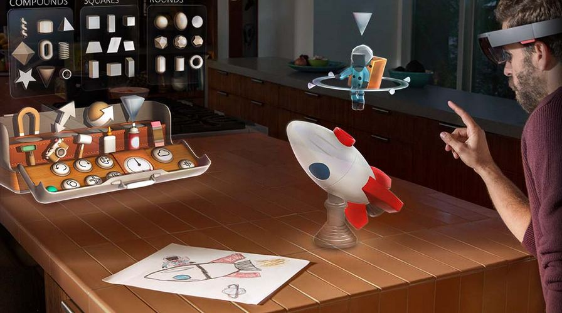
AR/VR System Components
Tracking
Rendering
Display
Image source : http://static3.gamespot.com/uploads/original/1179/11799911/2786939-hololens7.jpg

Slide 3
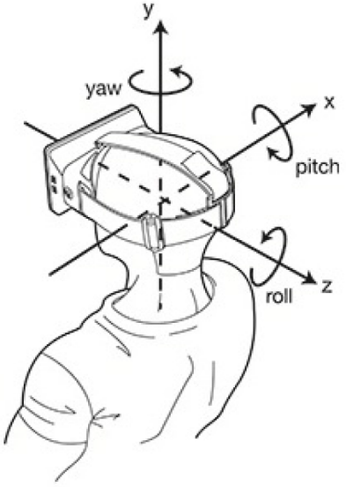
AR/VR System Components
Tracking
Rendering
Display
T_{y}
T_{x}
T_{z}
Find 6-DoF head pose¹
LaValle etal, Head Tracking for Oculus Rift

Slide 4
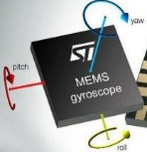
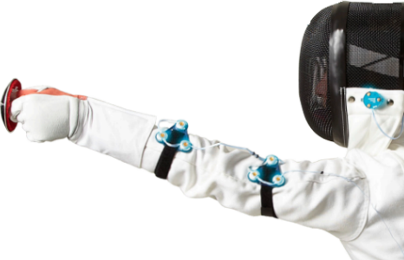
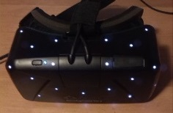
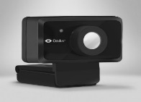
Tracking Systems
Oculus Rift DK2
Our
NDI Optotrak Certus¹
Tracking frequency ≈ 5kHz
State of the art
NDI
Frequency
HiBall
Orientation tracking
IMU at 1000 Hz ^{4,5}
Self-tracker
DK2
Positional tracking ^{2,3} Camera fps = 60 fps
Complexity or cost
http://certus.ndigital.com
http://vrshoot.ru/sites/default/files/oculus-rift-dk2-cam.jpg
http://i.imgur.com/64LA9Kv.jpg
http://cdn.pocketnow.com/wp-content/uploads/2011/04/gyro.jpg
LaValle etal, Head Tracking for Oculus Rift

Slide 5
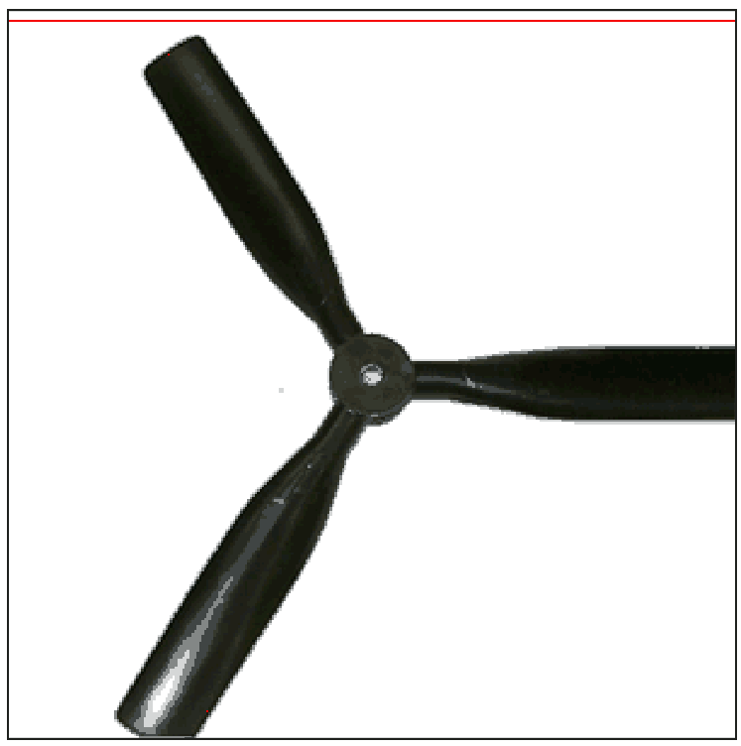
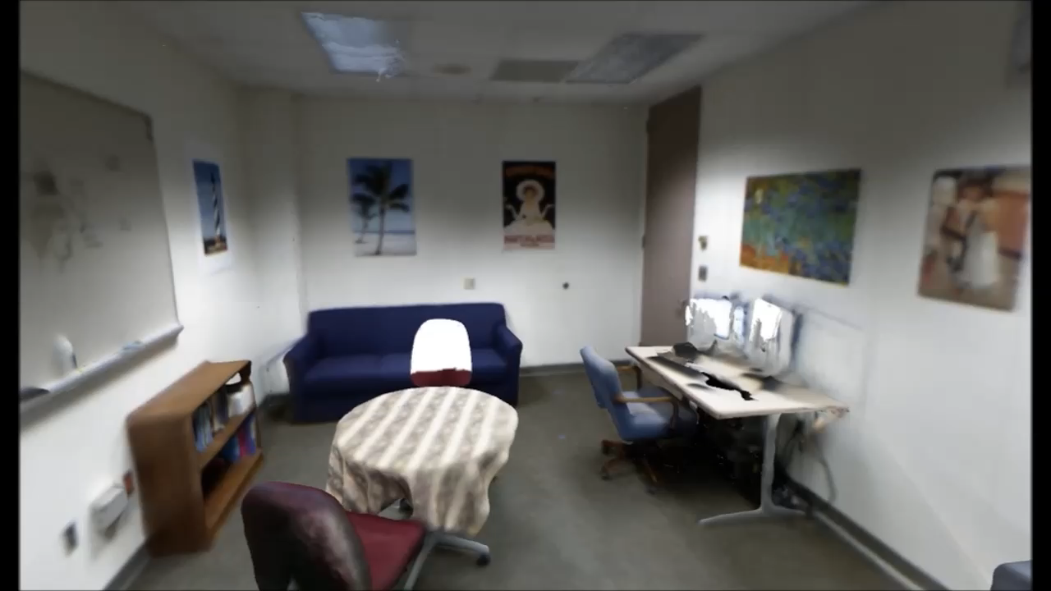


Rolling Shutter
Row-by-row acquisition of linescan snapshots at slightly different times
Stream of row-images
Rolling shutter capture¹
http://jasmcole.com/2014/10/12/rolling-shutters/

Slide 6
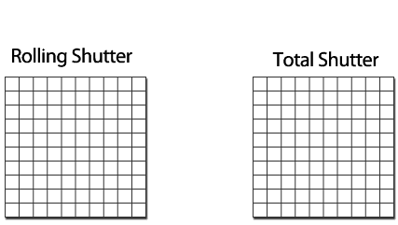

Stream of Rows
Rolling shutter¹
Frequency of row-samples
  F = FPS * Height
  = 120 * 720 > 80kHz
http://www.diyphotography.net/everything-you-wanted-to-know-about-rolling-shutter/

Slide 7
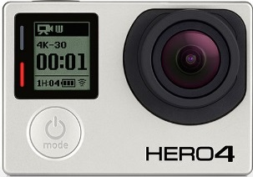
Our Tracker
Enabling component for rendering
    Zheng et al., 2014
    Lincoln et al., 2016
Use commodity cameras
Tracking frequency
  Up to 80 kHz
Break frame-rate barrier
  Process each row of image
>30 kHz tracker
30 kHz Renderer
GoPro¹
http://shop.gopro.com/hero4/hero4-black/CHDHX-401.html

Slide 8
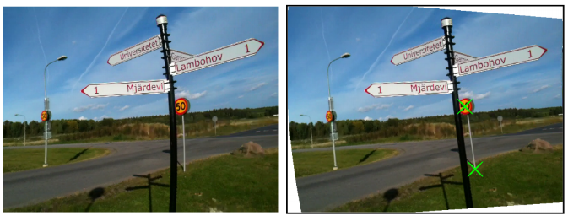
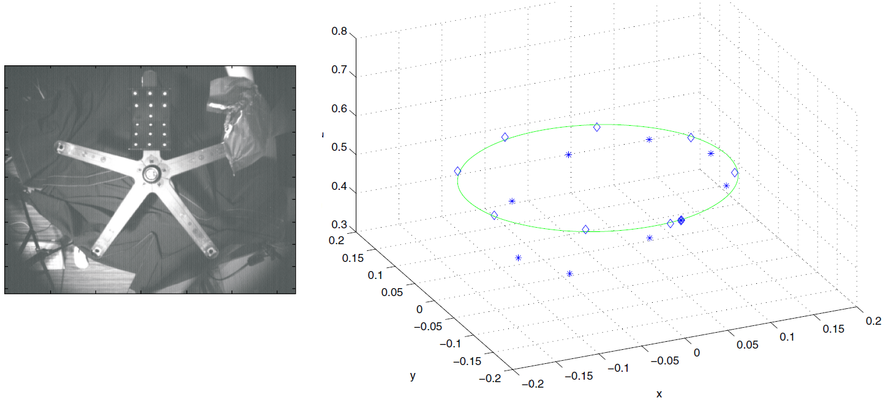
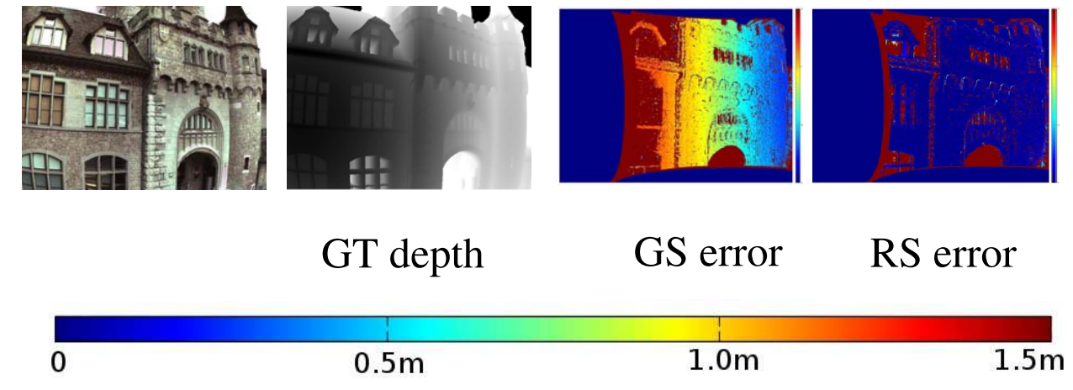
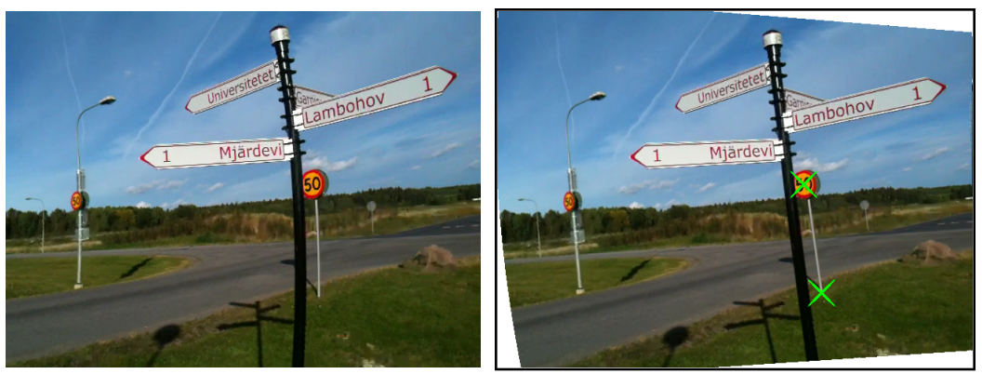
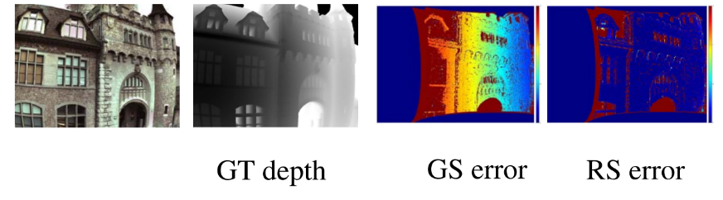
Related Work
Artifact visualisation¹
Removing rolling shutter
  Forssen et al., CVPR 2010
  Track points using KLT tracker, estimate rotation
  Parametrize intra-frame rotation as spline
Geometric problems
  Multi-view stereo: Saurer et al., ICCV 2013
  Adapt plane sweep stereo for rolling shutter
Velocity estimation
  Ait-Aider et al., ICVS 2006
  Solve for pose and velocity using bundle adjustment
  Use 2D-3D correspondence, similar to camera calibration
http://jasmcole.com/2014/10/12/rolling-shutters/

Slide 9
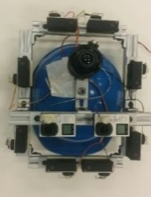
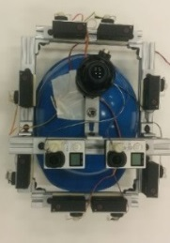
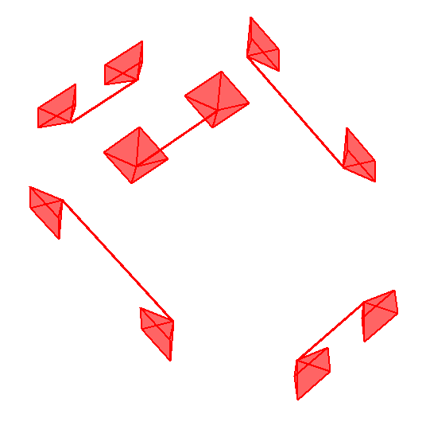
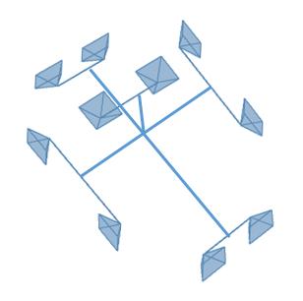
Approach Overview
Cluster
Estimation Framework
Camera Cluster
High frequency 6DoF tracking
Stream of rows
Spatial Stereo
Temporal Stereo
Input
Our approach
Output

Slide 10
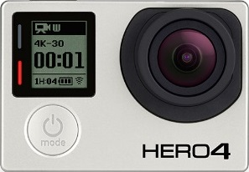
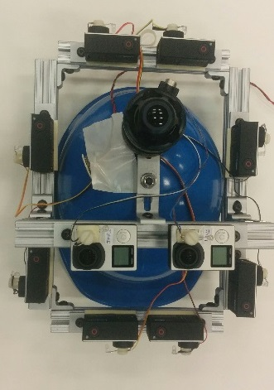
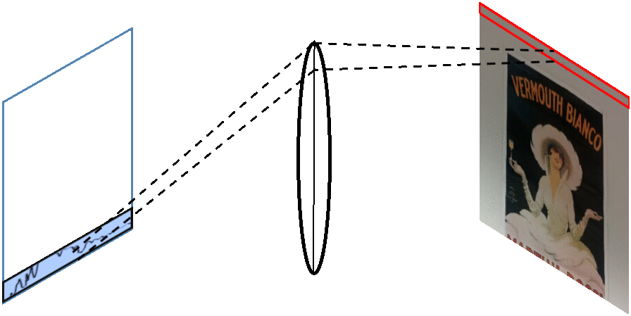

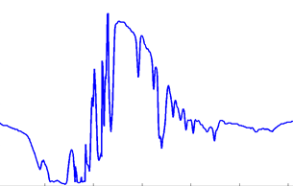
Our Cluster
Cluster
Spatial
Stereo
Temporal
Stereo
GoPro¹
Estimation Framework
Dynamic sensor with periodic movement²
Small vertical FoV
http://shop.gopro.com/hero4/hero4-black/CHDHX-401.html
http://users.erols.com/njastro/faas/image001/CCD2.jpg

Slide 11
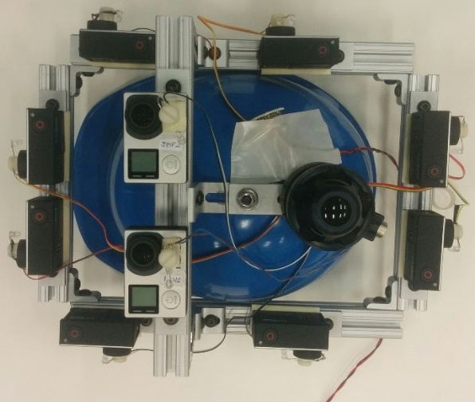
Our Cluster
Cluster
Spatial
Stereo
Temporal
Stereo
N stereo-pairs of rolling shutter camera, N=5
  Precalibrated intrinsic and extrinsics
  Temporal sync
  Known history of motion
Hi-Ball for ground truth
2
Estimation Framework
1
H
3
5
4
Geometry of cluster
H

Slide 12

Motion Model
Cluster
Spatial
Stereo
Temporal
Stereo
Estimation Framework
3D point
$$X_{cami}^{t+1} = M_{cami} {V1 X}_{cami}^{t}$$
3D point X

Slide 13

Motion Model
Cluster
Spatial
Stereo
Temporal
Stereo
Estimation Framework
Moved 3D point
3D point
$$X_{cami}^{t+1} = M_{cami} {V1 X}_{cami}^{t}$$
Motion of camera
3D point X

Slide 14


Motion Model
Cluster
Spatial
Stereo
Temporal
Stereo
Estimation Framework
Moved 3D point
3D point
$$X_{cami}^{t+1} = M_{cami} {V1 X}_{cami}^{t}$$
$$X_{cami}^{t+1} = Vi Mcluster { V_{i}^{−1} X}_{cami}^{t}$$
V_{i}
cam_{i}
RS cluster

Slide 15
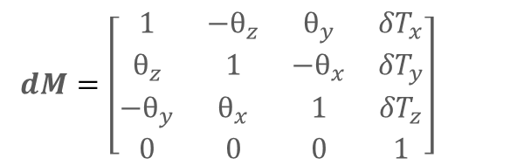

Linearized Motion Model
Cluster
Spatial
Stereo
Temporal
Stereo
Estimation Framework
$$X_{cami}^{t+1} = M_{cami} {V1 X}_{cami}^{t}$$
$$X_{cami}^{t+1} = Vi Mcluster { V_{i}^{−1} X}_{cami}^{t}$$
$dM=\left[\begin{matrix}1 & {−θ}_{z} & θ_{y} & {δT}_{x} \\ θ_{z} & 1 & {−θ}_{x} & {δT}_{y} \\ {−θ}_{y} & θ_{x} & 1 & {δT}_{z} \\ 0 & 0 & 0 & 1\end{matrix}\right]$
$M_{cluster}=\left[\begin{matrix}R(θ_{x},θ_{y},θ_{z}) & T \\ 0 & 1\end{matrix}\right]$

Slide 16
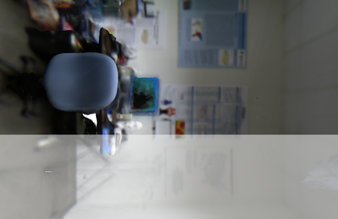


Motion Estimation
Cluster
Spatial
Stereo
Temporal
Stereo
Estimation Framework
$$X_{cami}^{t+1} = Vi Mcluster {{ V}_{i}^{−1} X}_{cami}^{t}$$
$X_{cami}^{t}=\left[\begin{matrix}0 & y & d & 1\end{matrix}\right]T$
Stereo in space

Slide 17

Motion Estimation
Cluster
Spatial
Stereo
Temporal
Stereo
Estimation Framework
$$X_{cami}^{t+1}=\left[\begin{matrix}∆x & y+∆y & d+∆d & 1\end{matrix}\right]T$$
$$X_{cami}^{t+1} = Vi Mcluster {{ V}_{i}^{−1} X}_{cami}^{t}$$

Slide 18
Stereo Estimation
Cluster
Spatial
Stereo
Temporal
Stereo
Estimation Framework
Spatial stereo s_{d}
  Use stereo-pair of cameras
  Measure pixel disparity
Temporal stereo s_{t}
  Measure small shifts in pixel
  Compare row at time t and t-k
t1
t2

Slide 19
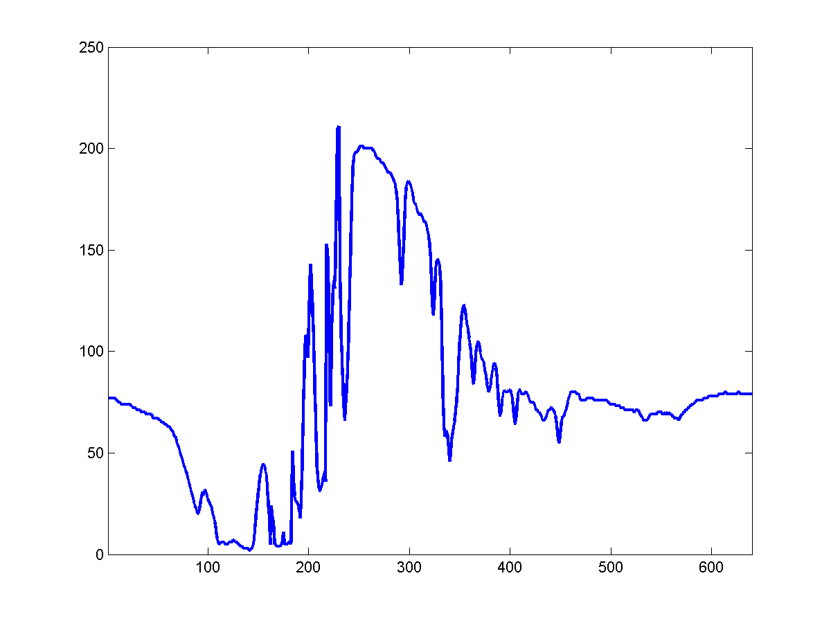

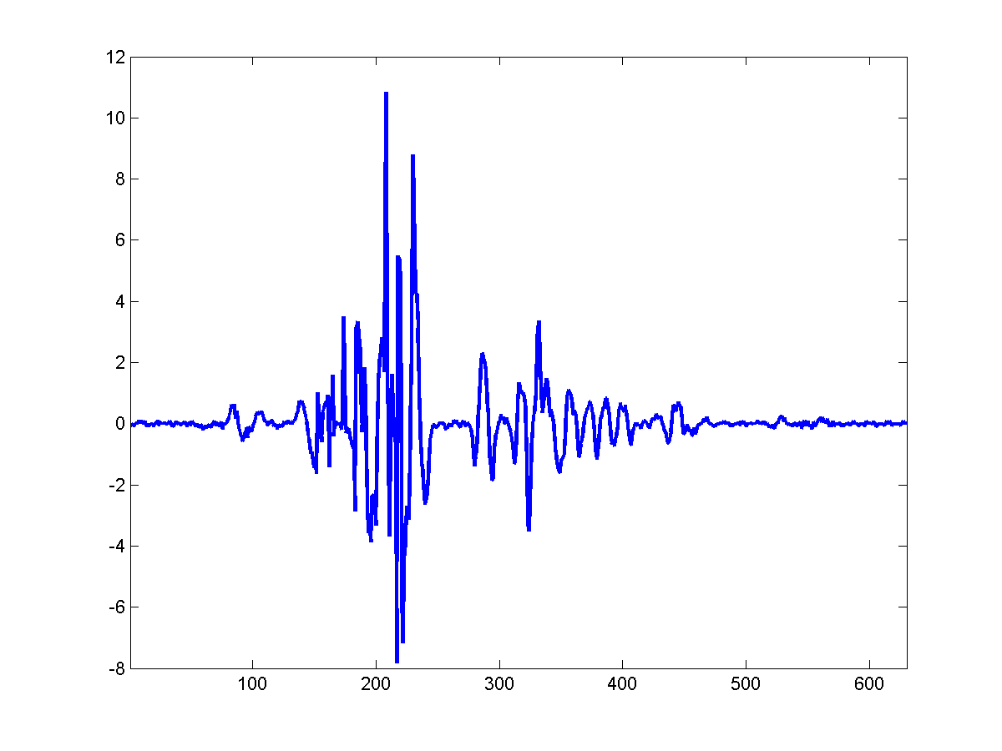

Binary Row Descriptor
Cluster
Spatial
Stereo
Temporal
Stereo
Estimation Framework
…
Visualization of row-image
(296th)
$$\frac{d^{2}G(x,0,σ)}{dx^{2}} ∗row$$
Sign
2nd derivative

Slide 20



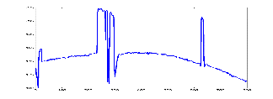
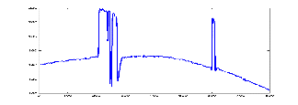


Spatial Stereo : Measure Disparity
Cluster
Spatial
Stereo
Temporal
Stereo
Estimation Framework
Compare binary descriptor of rows of stereo cameras
Fast hamming cost matching
$depth= \frac{focal ∗baseline}{disparity}$
Stereo Pair
Reconstructed row using homography
Row samples of stereo pair
P (x,y,d)
Binary descriptor
Binary descriptor
Stereo in space
x_{L}
x_{R}
focal
length
s_{t}
s_{d}
Previous frame
Current frames
baseline

Slide 21



Temporal Stereo: Measure Shift s_{t}
Cluster
Spatial
Stereo
Temporal
Stereo
Different regions in space are captured at different timestamps
Stereo in time
  Need snaps of same space but at different timestamps
Estimation Framework
Row-wise homography
Known [R |t] per row
Reference time
Current time
Warped to match reference time pose
Compare
Previous Frame

Slide 22
Cluster
Temporal Stereo: Measure Shift s_{t}
Spatial
Stereo
Temporal
Stereo
Estimation Framework
Reconstruct row using per- row homography
Use binary descriptors and hamming distance
One Camera of Stereo Pair
Reconstructed row using homography
Row sample of stereo pair
Binary descriptor
Binary descriptor
s_{x}
Sampled from previous frame
Current frame

Slide 23

Adaptive Reference
Cluster
Spatial
Stereo
Temporal
Stereo
Leave sufficient motion
  Row-to-row motion
  Interpolation & pixel measurement noise
Satisfy small-motion assumption
  Reference should not be far away
Estimation Framework
Reference row: t-k
Current Row (t)
Current frame
Noisy measurements
Small motion assumption invalid
Estimation reliability
0
k

Slide 24
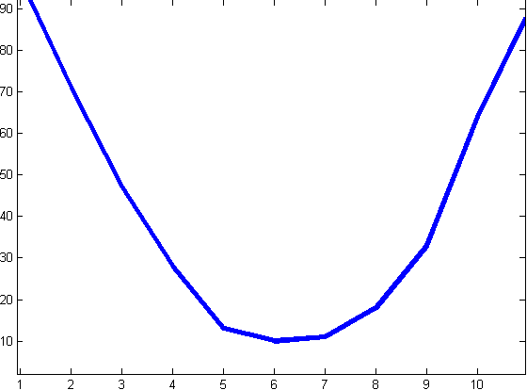
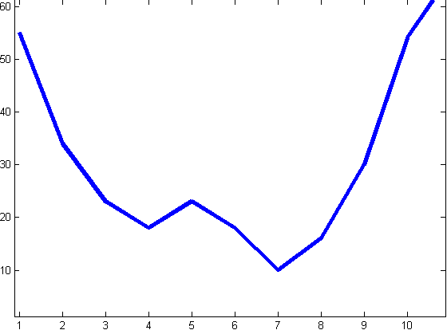
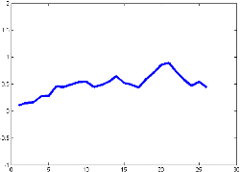
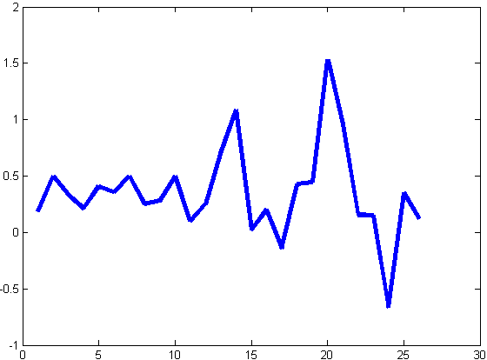
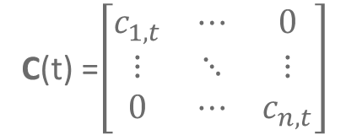
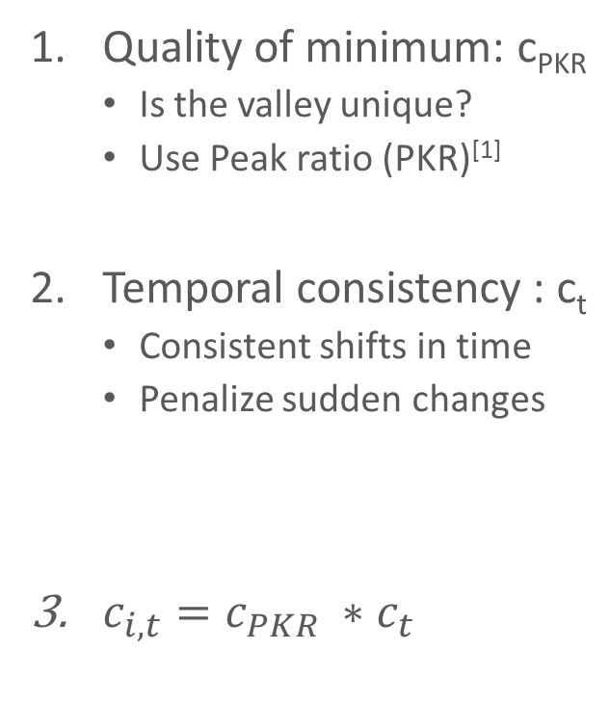
Confidence Scores
Cluster
High confidence
Low Confidence
Spatial
Stereo
Temporal
Stereo
Estimation Framework
Quality of minimum: c_{PKR}
  Is the valley unique?
  Use Peak ratio (PKR)^{[1]}
Temporal consistency : c_{t}
  Consistent shifts in time
  Penalize sudden changes
$c_{i,t}=c_{PKR} ∗c_{t}$
Hamming distance
Shift
Shift
Shift
Time
Time
C(t) =$\left[\begin{matrix}c_{1,t} & ⋯ & 0 \\ ⋮ & ⋱ & ⋮ \\ 0 & ⋯ & c_{n,t}\end{matrix}\right]$
X. Hu and P. Mordohai. A quantitative evaluation of confidence measures for stereo vision, PAMI 2012

Slide 25


Motion Estimation
Cluster
Spatial
Stereo
Temporal
Stereo
Estimation Framework
$$X_{cami}^{t+1}=\left[\begin{matrix}∆x & y+∆y & d+∆d & 1\end{matrix}\right]T$$
$$X_{cami}^{t+1} = Vi Mcluster {V_{i}^{−1} X}_{cami}^{t}$$
Stereo in time
$X_{cami}^{t}=\left[\begin{matrix}0 & y & d & 1\end{matrix}\right]T$
Stereo in space

Slide 26


Weighted Linear System
Cluster
Spatial
Stereo
Temporal
Stereo
Estimation Framework
$X_{cami}^{t+1}=Vi Mcluster {Vi}^{−1}X_{cami}^{t}$
  One equation from each camera
  Use more cameras for robustness
$C A \left[\begin{matrix}\begin{aligned}δT_{x} \\ δT_{y}\end{aligned} \\ \begin{aligned}δT_{z} \\ θ_{x} \\ θ_{y} \\ θ_{z}\end{aligned}\end{matrix}\right]= C B$

Slide 27

Approach Summary
Our approach
Spatial Stereo
Stream of rows
Weighted Least Squares
High frequency 6DoF tracking
Temporal Stereo
Confidence Scores
Input
Output

Slide 28
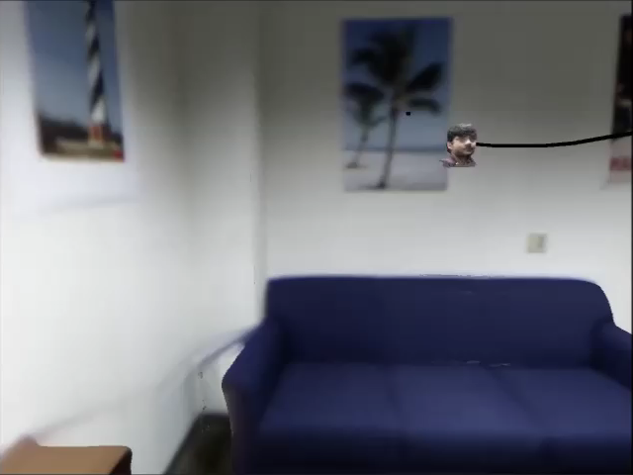
Simulator
Developed in OpenGL+Qt and Unity3D
  Support for Hi-Ball tracker data
  Motion Blur

Slide 29
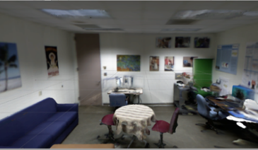
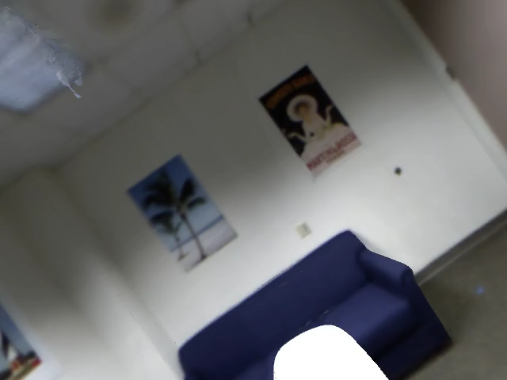
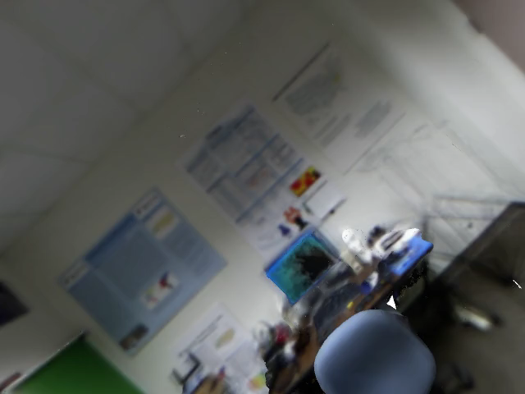
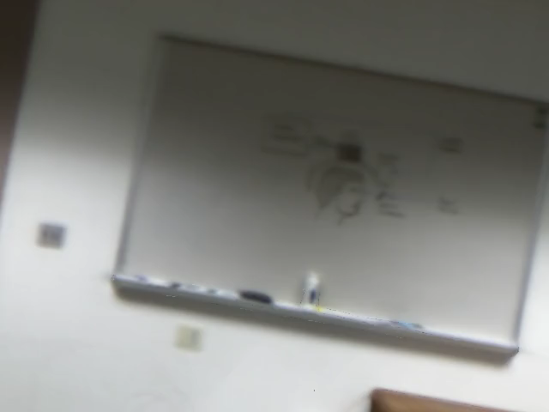
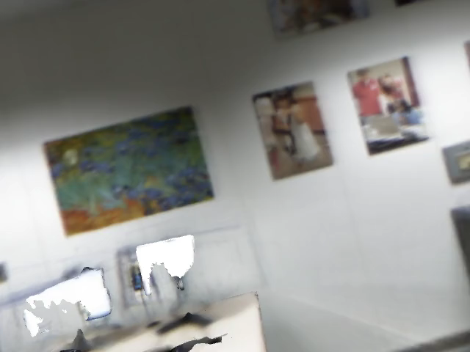
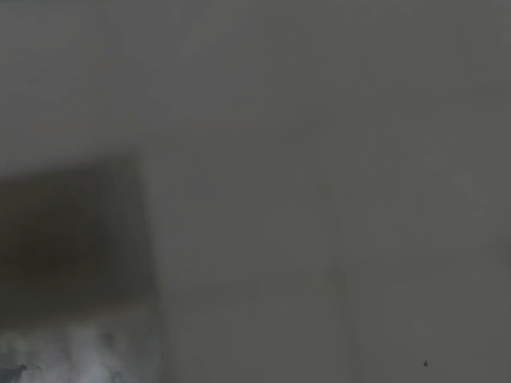
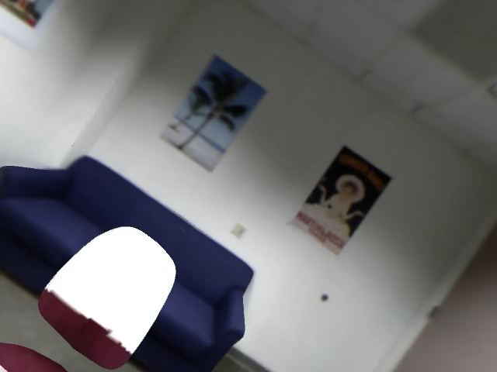
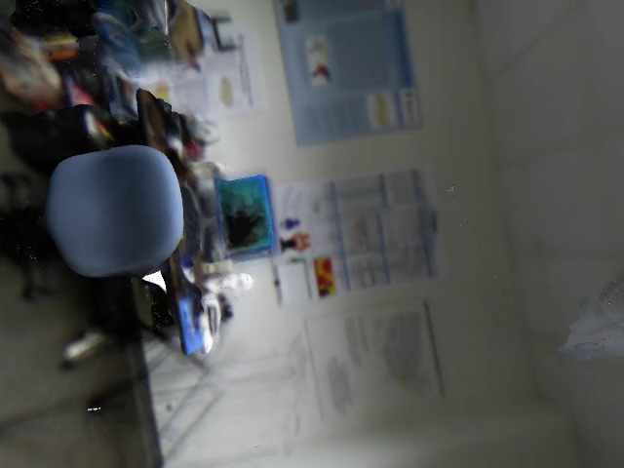
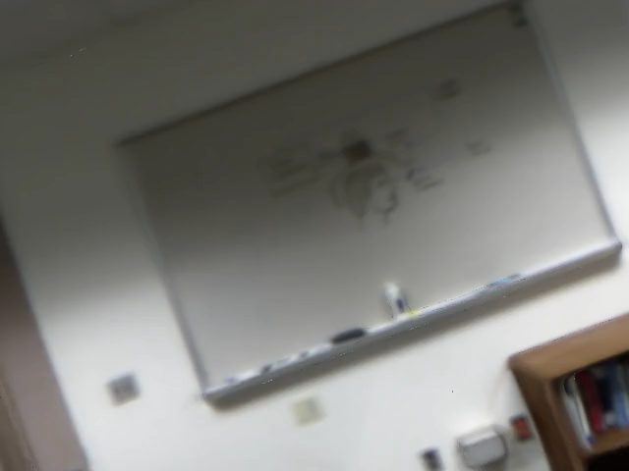
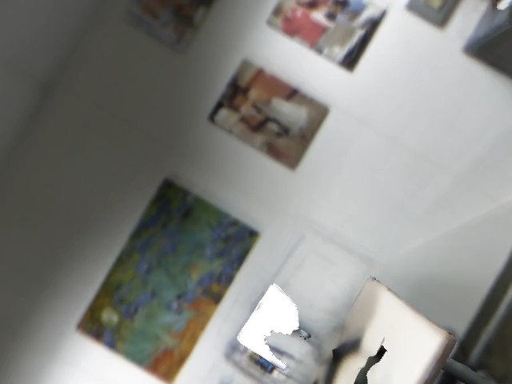

Experiments
Camera specs:
  640 × 480 pixels
  FoV = 60°
  Stereo pairs = 10
  120 fps
Quantify errors in terms of display pixel errors
  Display specs : HTC Vive
    120° FoV
    1080 × 1200 pixels per eye
    Point 1m in front
1.Mingsong Duo et al, Exploring high-level plane primitives for indoor 3d reconstruction with a hand-held rgb-d camera, ACCV 2012

Slide 30

Display Pixel Error
Pixels shown in HMD

Slide 31



Experiments : Real motion¹ in Synthetic Room
f= 56.7kHz
Frame i
i+1
i+2
i+3
i+4
…
1. Hi-Ball tracker data

Slide 32



Experiments: Synthetic Large Motion
f= 56.7kHz
v= 1.4 m/s
ω= 120 deg/s

Slide 33


Experiments : Synthetic Extreme Motion
f= 56.7kHz
v= 1.4 m/s
ω= 500 deg/s
Sampling not possible

Slide 34


Results for Real Imagery
f= 80.4kHz

Slide 35
Conclusion
High frequency visual tracker
  Up to 80 kHz
  Off-the-shelf cameras
High Frequency
Rolling Shutter
Direct pixel comparison
Redundant cameras
Motion linearization

Slide 36
Thank you!
Contact: akash@cs.unc.edu

Slide 37


Camera tracking : The spectrum
Global Shutter
Rolling Shutter as 1-D sensor
1-D sensor
1-D camera¹
No distortion
Drift correction
High cost
Low fps ≈ 200Hz
Higher noise
Distortion
Drift correction
Cheap
High fps, 56 kHz
Low noise
No distortion
No drift correction
High Cost
High fps, till 87 kHz
Higher noise

