Slide 1
Real-Time Multiprocessor Scheduling: Connecting Theory and Practice
James H. Anderson
University of North Carolina at Chapel Hill
November 2010

Slide 2
Outline
What… is LITMUS^{RT}?
Why… was LITMUS^{RT} developed?
How… do we use LITMUS^{RT}?
Which… lessons have we learned?
  About the “experimental process”.
  About multiprocessor scheduling.
Where… is the LITMUS^{RT} project going next?

Slide 3

LITMUS^{RT}
Linux Testbed for Multiprocessor Scheduling
in Real-Time systems
UNC’s real-time Linux extension.
  (Multiprocessor) scheduling and synchronization algorithms implemented as “plug-in” components.
  Developed as a kernel patch (currently based on Linux 2.6.34).
  Code is available at http://www.cs.unc.edu/~anderson/litmus-rt/.

Slide 4
LITMUS^{RT}
Our focus today.
Linux Testbed for Multiprocessor Scheduling
in Real-Time systems
UNC’s real-time Linux extension.
  (Multiprocessor) scheduling and synchronization algorithms implemented as “plug-in” components.
  Developed as a kernel patch (currently based on Linux 2.6.34).
  Code is available at http://www.cs.unc.edu/~anderson/litmus-rt/.

Slide 5

LITMUS^{RT} Design
P-EDF
RT
LITMUS^{RT}
Core
sched.
interface
RT sys.
calls
G-EDF
RT
Policy
Plugins
RT
…
RT
Apps
Plugs into the
Linux Scheduler
PFAIR
…
RT
Linux 2.6.34
std. sys.
calls
RT

Slide 6
LITMUS^{RT} Tracing Facilities
Debug messages.
Plain text.
TRACE()
Scheduler events.
e.g. job completions
Binary stream.
LITMUS^{RT}
Core
sched_trace
Feather-Trace
Fine-grained overhead
measurements.
Binary stream.
B. Brandenburg and J. Anderson, " Feather-Trace: A Light-Weight Event Tracing Toolkit ", Proc. of the Third International Workshop on Operating Systems Platforms for Embedded Real-Time Applications, pp. 20-27, July 2007.

Slide 7
(Current) LITMUS^{RT} Scheduling Plugins
Other plugins exist internally to UNC.
LITMUS^{RT} 2010.2 contains four plugins.
Partitioned
Global
C-EDF
G-EDF
P-EDF
EDF-fm
EDF-WM
S-PD²/PD²
“semi-partitioned”
(coming soon)
NPS-F
C-NPS-F

Slide 8
Outline
What… is LITMUS^{RT}?
Why… was LITMUS^{RT} developed?
How… do we use LITMUS^{RT}?
Which… lessons have we learned?
  About the “experimental process”.
  About multiprocessor scheduling.
Where… is the LITMUS^{RT} project going next?

Slide 9
Why?
Multicore, of course…
Core 1
…
Core M
L1
L1
L2

Slide 10
Why?
Multicore, of course…
Multicore has the potential of enabling more computational power with…
  … lower SWAP requirements.
    SWAP = size, weight, and power.
Has spurred much recent theoretical work on RT scheduling and synchronization…

Slide 11
Theoretical Research
Lots of proposed multiprocessor scheduling algorithms …
  Pfair, partitioned EDF, global EDF, partitioned static priority, global static priority, non-preemptive global EDF, EDZL,…
And synchronization protocols…
  MPCP, DPCP, FMLP, OMLP, PPCP, MBWI,…
Which are the best to use in practice?
We define best w.r.t schedulability.
Before discussing schedulability, let’s
first review some terms and notation…

Slide 12
Sporadic Task Systems
(We’ll Limit Attention to Implicit Deadlines)
For a set τ of sporadic tasks:
2
5
T₁ = (2,5)
One Processor Here
…
T₂ = (9,15)
job release
0
5
10
15
20
25
30
job deadline

Slide 13
Sporadic Task Systems
(We’ll Limit Attention to Implicit Deadlines)
For a set τ of sporadic tasks:
  Each task T_{i} = (e_{i},p_{i}) releases a job with exec. cost e_{i} at least p_{i} time units apart.
    T_{i}’s utilization (or weight) is u_{i} = e_{i}/p_{i}.
    Total utilization is U(τ) = Σ_{Ti} e_{i}/p_{i}.
2
5
T₁ = (2,5)
One Processor Here
…
T₂ = (9,15)
job release
0
5
10
15
20
25
30
job deadline

Slide 14
Sporadic Task Systems
(We’ll Limit Attention to Implicit Deadlines)
For a set τ of sporadic tasks:
  Each task T_{i} = (e_{i},p_{i}) releases a job with exec. cost e_{i} at least p_{i} time units apart.
    T_{i}’s utilization (or weight) is u_{i} = e_{i}/p_{i}.
    Total utilization is U(τ) = Σ_{Ti} e_{i}/p_{i}.
2
5
T₁ = (2,5)
One Processor Here
…
T₂ = (9,15)
job release
0
5
10
15
20
25
30
job deadline

Slide 15
Sporadic Task Systems
(We’ll Limit Attention to Implicit Deadlines)
For a set τ of sporadic tasks:
  Each task T_{i} = (e_{i},p_{i}) releases a job with exec. cost e_{i} at least p_{i} time units apart.
    T_{i}’s utilization (or weight) is u_{i} = e_{i}/p_{i}.
    Total utilization is U(τ) = Σ_{Ti} e_{i}/p_{i}.
2
5
T₁ = (2,5)
2/5
One Processor Here
…
T₂ = (9,15)
job release
0
5
10
15
20
25
30
job deadline

Slide 16
Sporadic Task Systems
(We’ll Limit Attention to Implicit Deadlines)
For a set τ of sporadic tasks:
  Each task T_{i} = (e_{i},p_{i}) releases a job with exec. cost e_{i} at least p_{i} time units apart.
    T_{i}’s utilization (or weight) is u_{i} = e_{i}/p_{i}.
    Total utilization is U(τ) = Σ_{Ti} e_{i}/p_{i}.
  Each job of T_{i} has a relative deadline given by p_{i}.
2
5
T₁ = (2,5)
One Processor Here
…
T₂ = (9,15)
job release
0
5
10
15
20
25
30
job deadline

Slide 17
Sporadic Task Systems
(We’ll Limit Attention to Implicit Deadlines)
For a set τ of sporadic tasks:
  Each task T_{i} = (e_{i},p_{i}) releases a job with exec. cost e_{i} at least p_{i} time units apart.
    T_{i}’s utilization (or weight) is u_{i} = e_{i}/p_{i}.
    Total utilization is U(τ) = Σ_{Ti} e_{i}/p_{i}.
  Each job of T_{i} has a relative deadline given by p_{i}.
2
5
T₁ = (2,5)
One Processor Here
…
T₂ = (9,15)
job release
0
5
10
15
20
25
30
job deadline

Slide 18
Sporadic Task Systems
(We’ll Limit Attention to Implicit Deadlines)
For a set τ of sporadic tasks:
  Each task T_{i} = (e_{i},p_{i}) releases a job with exec. cost e_{i} at least p_{i} time units apart.
    T_{i}’s utilization (or weight) is u_{i} = e_{i}/p_{i}.
    Total utilization is U(τ) = Σ_{Ti} e_{i}/p_{i}.
  Each job of T_{i} has a relative deadline given by p_{i}.
This is an example of a earliest-deadline-first (EDF) schedule.
2
5
T₁ = (2,5)
One Processor Here
…
T₂ = (9,15)
job release
0
5
10
15
20
25
30
job deadline

Slide 19
Real-Time Correctness
HRT: No deadline is missed.
SRT: Deadline tardiness (extent of deadline miss) is bounded.
  Can be defined in different ways.
  This is the definition we will assume.

Slide 20
Scheduling vs. Schedulability
W.r.t. scheduling, we actually care about two kinds of algorithms:
  Scheduling algorithm (of course).
    Example: Earliest-deadline-first (EDF): Jobs with earlier deadlines have higher priority.
  Schedulability test.
Utilization loss occurs when test requires
utilizations to be restricted to get a “yes” answer.
no timing requirement
will be violated if τ is
scheduled with EDF
yes
Test for
EDF
τ
a timing requirement
will (or may) be
violated …
no

Slide 21
Multiprocessor Real-Time Scheduling
A More Detailed Look
Two Basic Approaches:
Partitioning
Global Scheduling
Steps:
Assign tasks to processors (bin packing).
Schedule tasks on each processor using uniprocessor algorithms.
Important Differences:
One task queue.
Tasks may migrate among the processors.

Slide 22
Scheduling Algs. We’ll Consider Today
Partitioned EDF: PEDF.
Global EDF: GEDF.
Clustered EDF: CEDF.
  Partition onto clusters of cores, globally schedule within each cluster.
clusters
C
C
C
C
C
C
C
C
C
C
C
C
L1
L1
L1
L2

Slide 23
Scheduling Algs. (Continued)
PD², a global Pfair algorithm.
  Schedules jobs one quantum at a time at a “steady” rate.
    May preempt and migrate jobs frequently.
EDF-FM, EDF-WM, NPSF.
  Semi-partitioned algorithms.
    “Most” tasks are bin-packed onto processors.
    A “few” tasks migrate.
How do these algorithms (in theory)
compare w.r.t. schedulability?

Slide 24
PEDF
Util. Loss for Both HRT and SRT
Example: Partitioning three tasks with parameters
(2,3) on two processors will overload one processor.
In terms of bin-packing…
Under partitioning & most global algorithms, overall utilization must be capped to avoid deadline misses.
  Due to connections to bin-packing.
Exception: Global “Pfair” algorithms do not require caps.
  Such algorithms schedule jobs one quantum at a time.
    May therefore preempt and migrate jobs frequently.
    Perhaps less of a concern on a multicore platform.
Under most global algorithms, if utilization is not capped, deadline tardiness is bounded.
  Sufficient for soft real-time systems.
Task 1
1
Task 2
Task 3
0
Processor 1
Processor 2

Slide 25
Semi-Partitioned Algorithms
May or May Not Be Util. Loss
Semi-partitioned algorithms eliminate some or
all bin-packing related loss by allowing tasks that
“don’t fit” to migrate…
Under partitioning & most global algorithms, overall utilization must be capped to avoid deadline misses.
  Due to connections to bin-packing.
Exception: Global “Pfair” algorithms do not require caps.
  Such algorithms schedule jobs one quantum at a time.
    May therefore preempt and migrate jobs frequently.
    Perhaps less of a concern on a multicore platform.
Under most global algorithms, if utilization is not capped, deadline tardiness is bounded.
  Sufficient for soft real-time systems.
Task 1
migrates
1
Task 2
Task 3
0
Processor 1
Processor 2

Slide 26
PD²
Optimal ⇒ No Util. Loss for either HRT or SRT (assuming…)
Under partitioning & most global algorithms, overall utilization must be capped to avoid deadline misses.
  Due to connections to bin-packing.
Exception: Global “Pfair” algorithms do not require caps.
  Such algorithms schedule jobs one quantum at a time.
    May therefore preempt and migrate jobs frequently.
    Perhaps less of a concern on a multicore platform.
Under most global algorithms, if utilization is not capped, deadline tardiness is bounded.
  Sufficient for soft real-time systems.
Previous example under PD²…
On Processor 1
On Processor 2
T₁ = (2,3)
T₂ = (2,3)
T₃ = (2,3)
0
5
10
15
20
25
30

Slide 27
GEDF
HRT: Loss, SRT: No Loss
Under partitioning & most global algorithms, overall utilization must be capped to avoid deadline misses.
  Due to connections to bin-packing.
Exception: Global “Pfair” algorithms do not require caps.
  Such algorithms schedule jobs one quantum at a time.
    May therefore preempt and migrate jobs frequently.
    Perhaps less of a concern on a multicore platform.
Under most global algorithms, if utilization is not capped, deadline tardiness is bounded.
  Sufficient for soft real-time systems.
Previous example scheduled under GEDF…
deadline miss
T₁ = (2,3)
T₂ = (2,3)
Note: “Bin-packing” here.
T₃ = (2,3)
0
5
10
15
20
25
30

Slide 28
Schedulability Summary
Research focus of the LITMUS^{RT} project:
How do these (and other) algorithms
compare on the basis of schedulability
when real overheads are considered?
HRT SRT
PEDF util. loss util. loss (same as HRT)
GEDF util. loss no loss
CEDF util. loss slight loss
PD² no loss no loss
EDF-FM N/A no loss (if all util.’s ≤ ½)
EDF-WM slight loss slight loss
NPS-F no loss (if δ → ∞) no loss (if δ → ∞)
In other words, how well do these
schedulablity results translate to practice?
semi-partitioned

Slide 29
Outline
What… is LITMUS^{RT}?
Why… was LITMUS^{RT} developed?
How… do we use LITMUS^{RT}?
Which… lessons have we learned?
  About the “experimental process”.
  About multiprocessor scheduling.
Where… is the LITMUS^{RT} project going next?

Slide 30
Our Experimental Methodology
After using 1.5 interquartile
range outliers removal
technique, use monotonic
piecewise linear interpolation
to compute overhead
expressions as a function of N.
We use worst-case (average-case)
overheads for HRT (SRT).
Implement schedulers.
Implement as
LITMUS^{RT} plugins.
Generate several million random
task sets and check schedulability
with overheads considered. Done
on a 500+ node research cluster.
Can take a day or more.
Record overheads.
Involves tracing the
behavior of 1,000s of
synthetic tasks in
LITMUS^{RT} on test
platform. Usually takes
8-12 hours. Yields many
gigabytes of trace data.
Distill overhead expressions.
Run schedulability experiments.

Slide 31
Overheads
Two basic kinds of overheads:
  Kernel overheads.
    Costs incurred due to kernel execution (which takes processor time away from tasks).
  Cache-related Preemption/Migration Delays (CPMDs).
    Costs incurred upon a preemption/migration due to a loss of cache affinity.
Can account for overheads by inflating task execution costs.
  Doing this correctly is a little tricky.

Slide 32
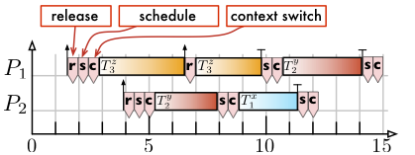
Kernel Overheads
Release overhead.
  Cost of a one-shot timer interrupt.
Scheduling overhead.
  Time required to select the next job to run.
Context switch overhead.
  Time required to change address spaces.
Tick overhead.
  Cost of a periodic timer interrupt.

Slide 33
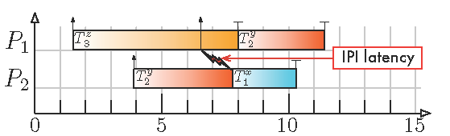
Kernel Overheads (Cont’d)
To provide some idea about the
magnitude of overheads, we’ll look
at a few from a recent study.
Inter-processor interrupts (IPIs).
  A new job may be released on a processor that differs from the one that will schedule it.
  Requires notifying the remote processor.
  IPI overhead accounts for the resulting delay.
First, the hardware platform
in that study…

Slide 34
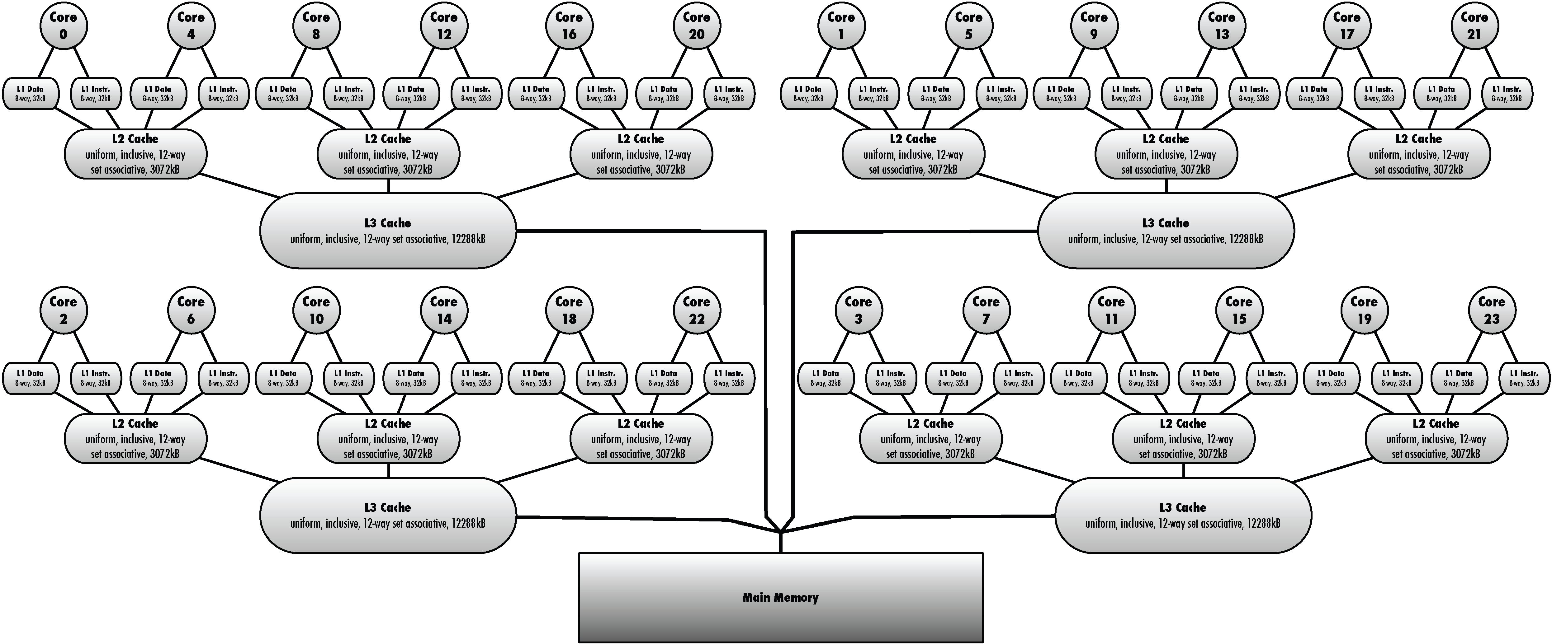
Test Platform
Intel Xeon L7455 “Dunnington”
6 cores per socket.
4 physical sockets.

Slide 35
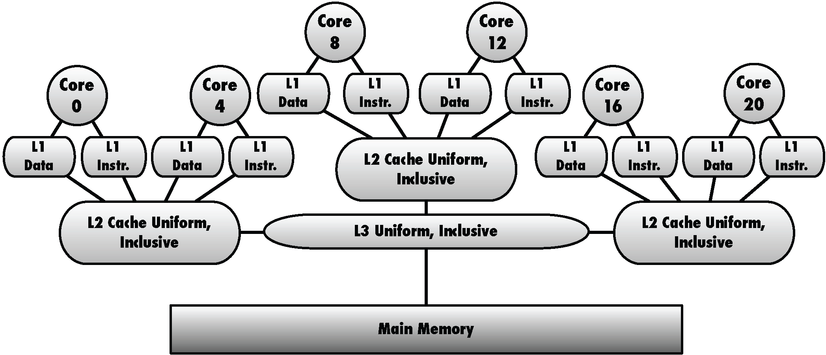
Test Platform
Intel Xeon L7455 “Dunnington”
12 MB L3 Cache.

Slide 36
Test Platform
Intel Xeon L7455 “Dunnington”
3 MB L2 Cache.

Slide 37
Test Platform
Intel Xeon L7455 “Dunnington”
32 KB + 32 KB L1 Cache.
12 MB L3 Cache.

Slide 38
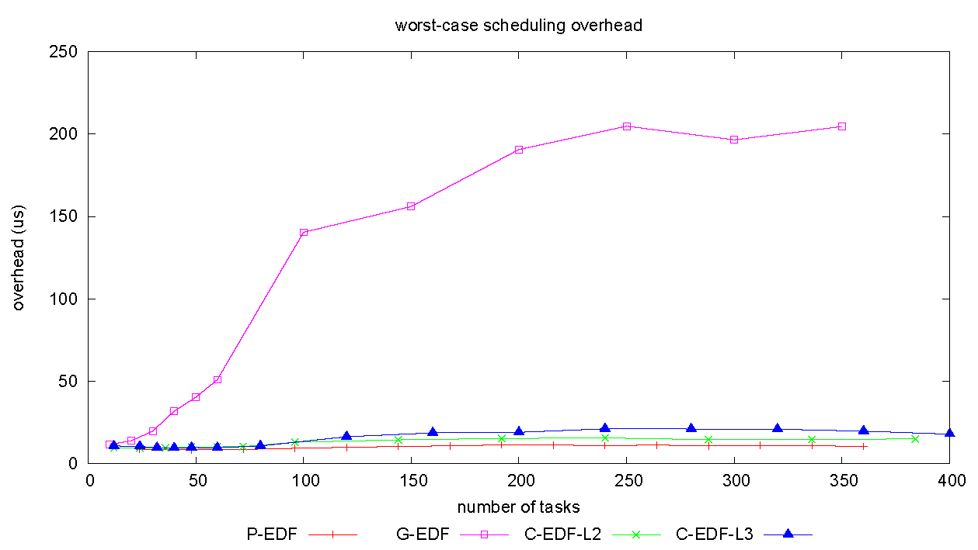
Kernel Overheads
Most kernel overheads were found to
be quite small on this platform, e.g.,
2-30 μs.
GEDF
Major Exception: Scheduling overhead
under GEDF.
CEDF-L3, CEDF-L2, PEDF

Slide 39
CPMDs
Measured assuming a 128K working set and 75/25 read/write ratio.
Is this OK
to assume?
Worst-Case Overheads (in μs, idle system)
Preempt | L2 Migr. | L3 Migr. | Memory Migr.
1.10 | 14.95 | 120.47 | 98.25
Worst-Case Overheads (in μs, system under memory load)
Preempt | L2 Migr. | L3 Migr. | Memory Migr.
525.08 | 520.77 | 484.50 | 520.55

Slide 40
Schedulability Experiments
Some of the Distributions We Use
Period distributions:
  Uniform over
    [3ms, 33ms] (short),
    [10ms, 100ms] (moderate),
    [50ms, 250ms] (long).
Utilization distributions:
  Uniform over
    [0.001,01] (light),
    [0.1,0.4] (medium), and
    [0.5,09] (heavy).
  Bimodal with utilizations distributed over either [0.001,05) or [0.5,09] with probabilities of
    8/9 and 1/9 (light),
    6/9 and 3/9 (medium), and
    4/9 and 5/9 (heavy).
  Exponential over [0,1].

Slide 41
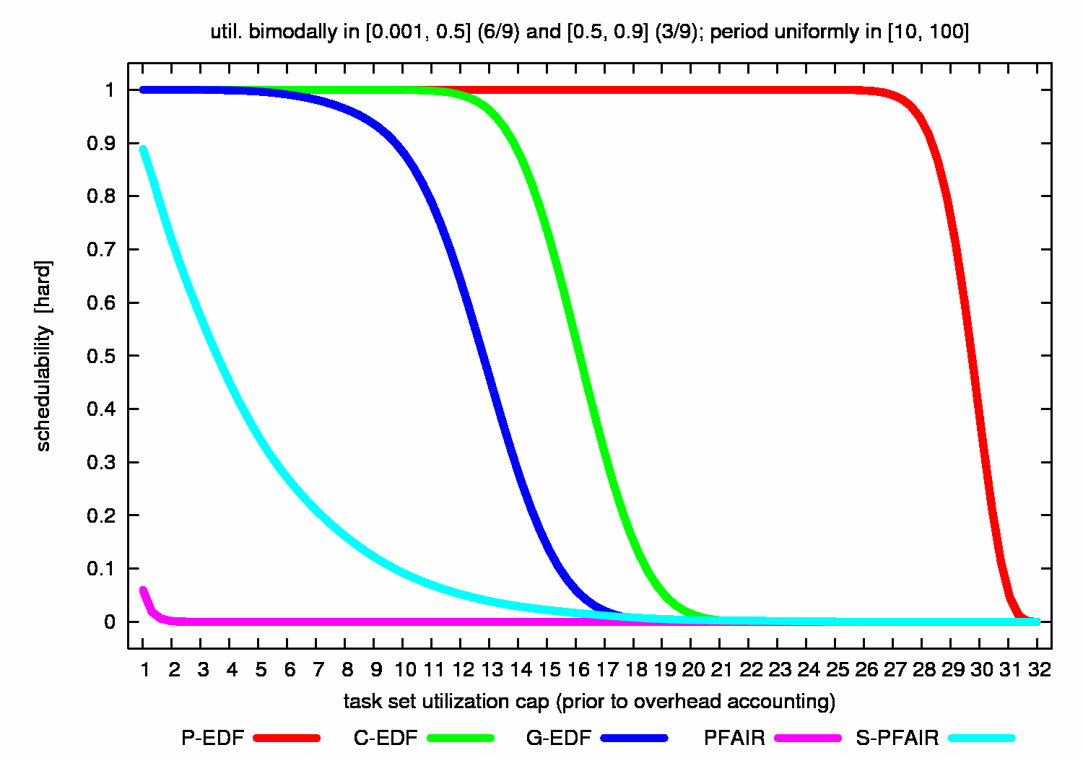
Example Schedulability Graph
Sun Niagara, 8 Cores, 4 HW Threads/Core
A typical experimental study
(e.g., for one paper) may yield
1,000 or more such graphs.
For Util. cap = 13, GEDF
correctly scheduled about
45% of generated task systems.
Frac. of Gen.’d Sys. that were Schedulable
Utilization Cap

Slide 42
Outline
What… is LITMUS^{RT}?
Why… was LITMUS^{RT} developed?
How… do we use LITMUS^{RT}?
Which… lessons have we learned?
  About the “experimental process”.
  About multiprocessor scheduling.
Where… is the LITMUS^{RT} project going next?

Slide 43
Outline
What… is LITMUS^{RT}?
Why… was LITMUS^{RT} developed?
How… do we use LITMUS^{RT}?
Which… lessons have we learned?
  About the “experimental process”.
  About multiprocessor scheduling.
Where… is the LITMUS^{RT} project going next?

Slide 44
Experimenting With Bad Code is Pointless
Have coding standards and code reviews.
  See Documentation/CodingStyle in the Linux Kernel source.
Need to review schedulability scripts too.
Make your code open source.
Allow sufficient time!
  This is a time-consuming process.
    (Pseudo-polynomial tests can be problematic.)
Work with a real OS: user-level experiments are too inaccurate.

Slide 45
Be Careful How You Interpret Your Results
Be careful about what you say about the “real world”.
  Can really only interpret w.r.t. your particular setup.
  Beyond that is speculation.
Watch out for statistical glitches.
  Ex: Determining valid maximums requires a consistent sample size (less important for averages).
  (It pays to have an OR guy in your group!)

Slide 46
Can be Tricky to Determine if a Scheduler Implementation is Correct
Is this a correct G-EDF schedule?
T₁ (2,3)
T₂ (3,5)
T₃ (4,8)
Time (ms)
Execution on CPU1
Execution on CPU2
Overhead

Slide 47
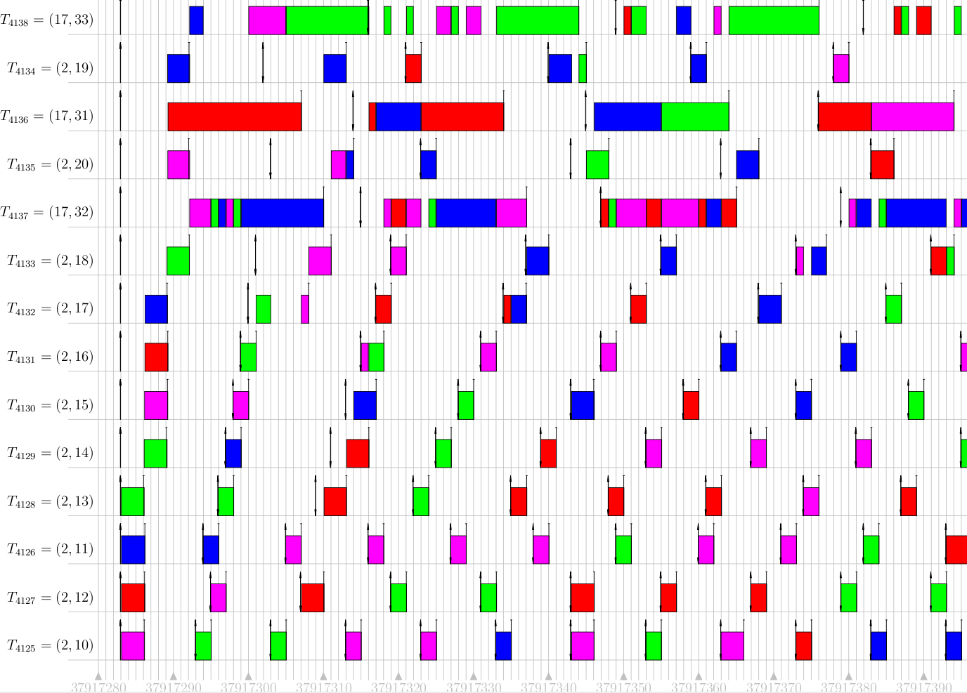
Can be Tricky to Determine if a Scheduler Implementation is Correct
How about this?
We now have (some) automated
support for checking scheduler output.
See http://www.cs.unc.edu/~mollison/
unit-trace/index.html.

Slide 48
Proper Overhead Accounting is Tricky
This needs to be team-reviewed too.
Sometimes accounting is just tedious, sometimes rather difficult.
  Ex: Semi-partitioned algs. that use “first fit.”
    Task shares are assigned to processors.
    In theory, such an assignment is OK if the processor is not over-utilized.
    In practice, assigning a task share to a processor can change the overhead charges (and hence needed shares) of previously-assigned tasks.

Slide 49
Proper Overhead Accounting is Tricky
This needs to be team-reviewed too.
Sometimes accounting is just tedious, sometimes rather difficult.
  Ex: Some semi-partitioned algorithms.
    Task shares are assigned to processors.
    In theory, such an assignment is OK if the processor is not over-utilized.
    In practice, assigning a task share to a processor can change the overhead charges (and hence needed shares) of previously-assigned tasks.
Adding two “items” (tasks) to one “bin” (processor)…
causes “sizes” (utilizations) to change!
Task 1
1
Task 2
Task 1
Task 2
0
Processor 1

Slide 50
Measuring CPMDs is Tricky Too
CPMD = Cache-related Preemption/Migration Delay
In early studies, we used a “schedule-sensitive method.”
  Involves measuring CPMDs as a real scheduler (e.g., GEDF) runs.
    Adv.: Reflects true scheduler behavior.
    Disadv.: Scheduler determines when preemptions happen and inopportune preemptions can invalidate a measurement.
We now augment this with a new “synthetic method.”
  Use fixed-prio. scheduling policy (e.g., SCHED_FIFO).
  Artificially trigger preemptions and migrations.
    Adv.: Get lots of valid measurements.
    Disadv.: Cannot detect dependencies of scheduling policy.

Slide 51
Working Set Size Biases Should Be Avoided
Previously, we looked at CPMDs assuming a WSS of 128K working set and 75/25 read/write ratio.
Such a choice is completely arbitrary.

Slide 52
WSS-Agnostic Approach
Measurements tell us which
range of D values is reasonable.
WSS-agnostic approach:
  CPMD is parameter of the task generation procedure.
  Schedulability (S) depends on utilization (U) and CPMD (D).
  Displaying results is problematic (3D graphs).
  Thus, we use weighted schedulability W(D):
    Weights schedulability by U.
    “High-utilization task sets have higher value.”
    Exposes ranges of CPMD where a particular scheduler is competitive.
    Reduces results to 2D plots.
    Can similarly index by “WSS” instead of “D”.
Notes:
Don’t explain formula, show examples.

Slide 53
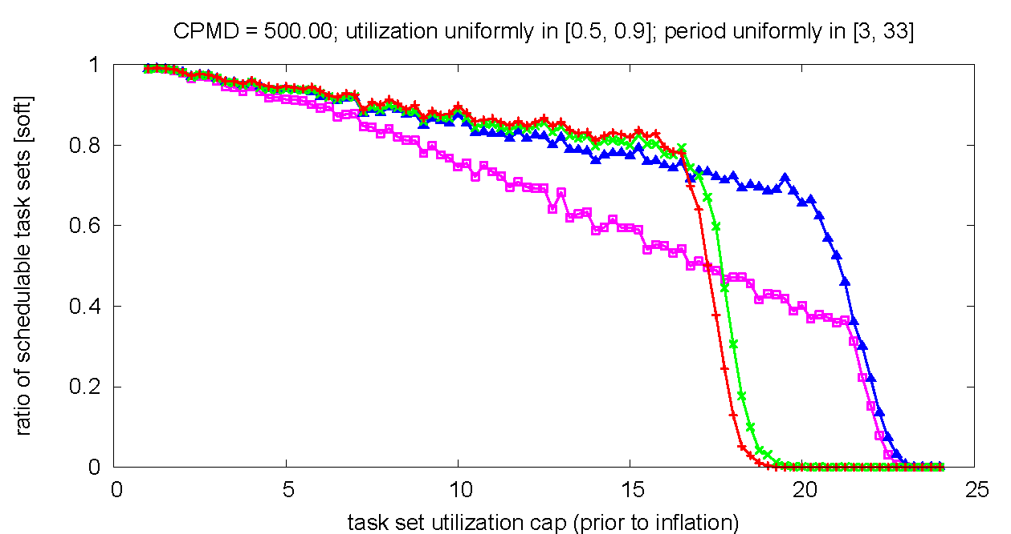
Fixed-CPMD Schedulability
Here, CMPD is fixed at 500μs
SRT Schedulable Task Sets
CEDF-L3
PEDF
Increasing utilization

Slide 54
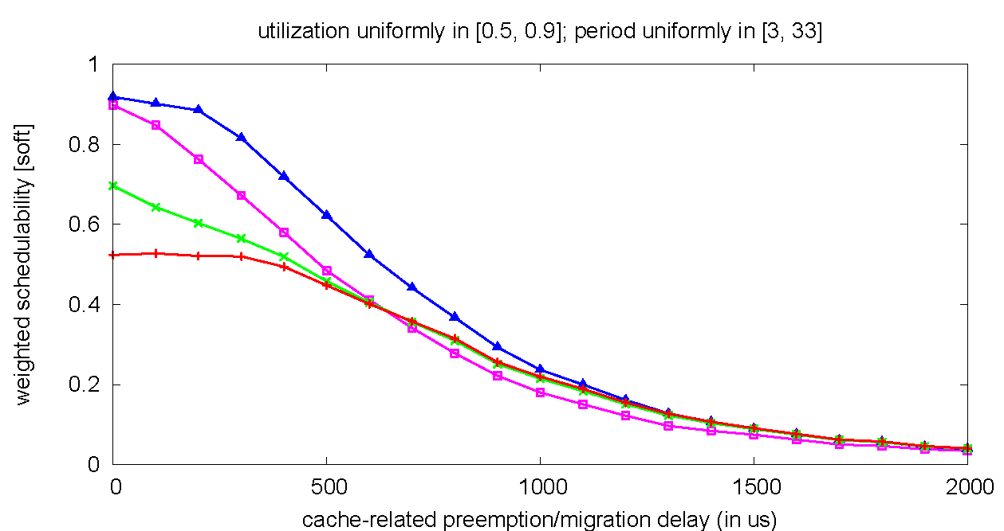
Weighted Schedulability
Meas. Show CPMD May Realistically Range over [0,2000]μs
Weighted schedulability
CEDF-L3
PEDF
Increasing CPMD (us)
Compacts 350 plots to 12 plots.
Notes:
Classic schedulability “zip” into 4 points @ CPMD = 500. Zipping allows 350 -> 12 plots.
C-EDF-L3 always superior to P-EDF if CPMD < 600 even if preemption cost = 0.

Slide 55
Outline
What… is LITMUS^{RT}?
Why… was LITMUS^{RT} developed?
How… do we use LITMUS^{RT}?
Which… lessons have we learned?
  About the “experimental process”.
  About multiprocessor scheduling.
Where… is the LITMUS^{RT} project going next?

Slide 56
Outline
What… is LITMUS^{RT}?
Why… was LITMUS^{RT} developed?
How… do we use LITMUS^{RT}?
Which… lessons have we learned?
  About the “experimental process”.
  About multiprocessor scheduling.
Where… is the LITMUS^{RT} project going next?

Slide 57
Preemption Aren’t Necessarily Cheaper Than Migrations
In idle systems, preemption cost < migration cost thru L2 < migration cost thru L3 ≅ migration thru main memory.
Under load, they are all essentially the same.
  Moreover, costs become unpredictable if WSSs get too large.

Slide 58
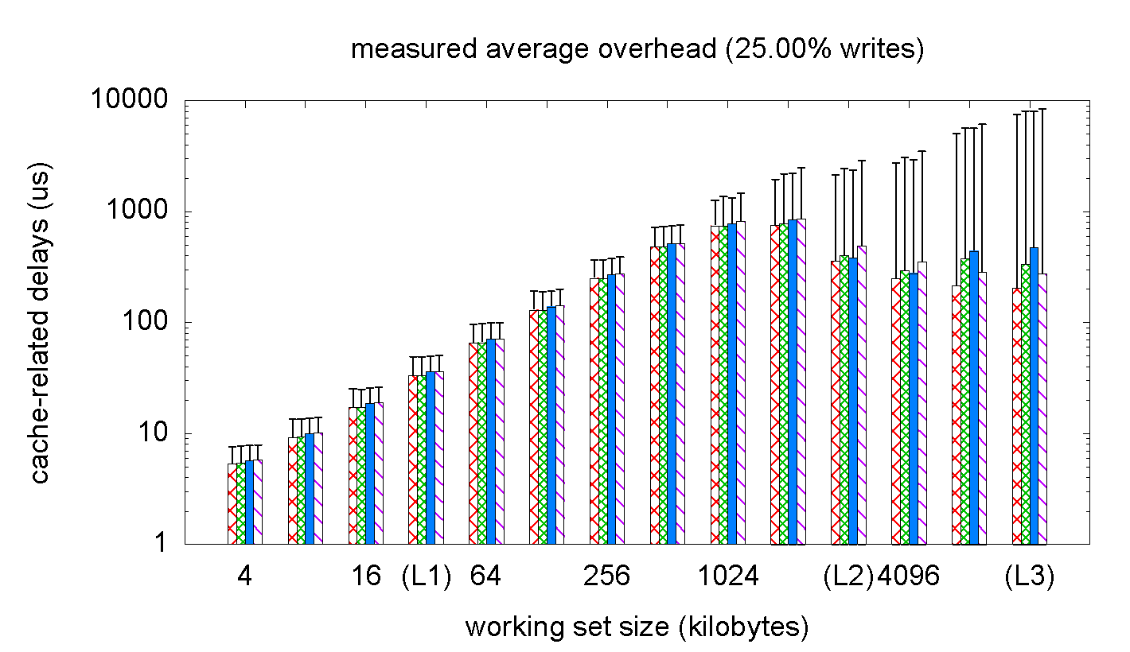
Cache-Related Delays
(Study Done on 24-Core Intel System)
Four bars are preemption
and migration through
L2, L3, and memory.
Avg. CMPD computed using the synthetic method under load.
  Only predictable for WSSs < L2 cache.
  No significant P/M differences in a system under load.
Std. Dev.
delays (us)
WSS (KB)

Slide 59
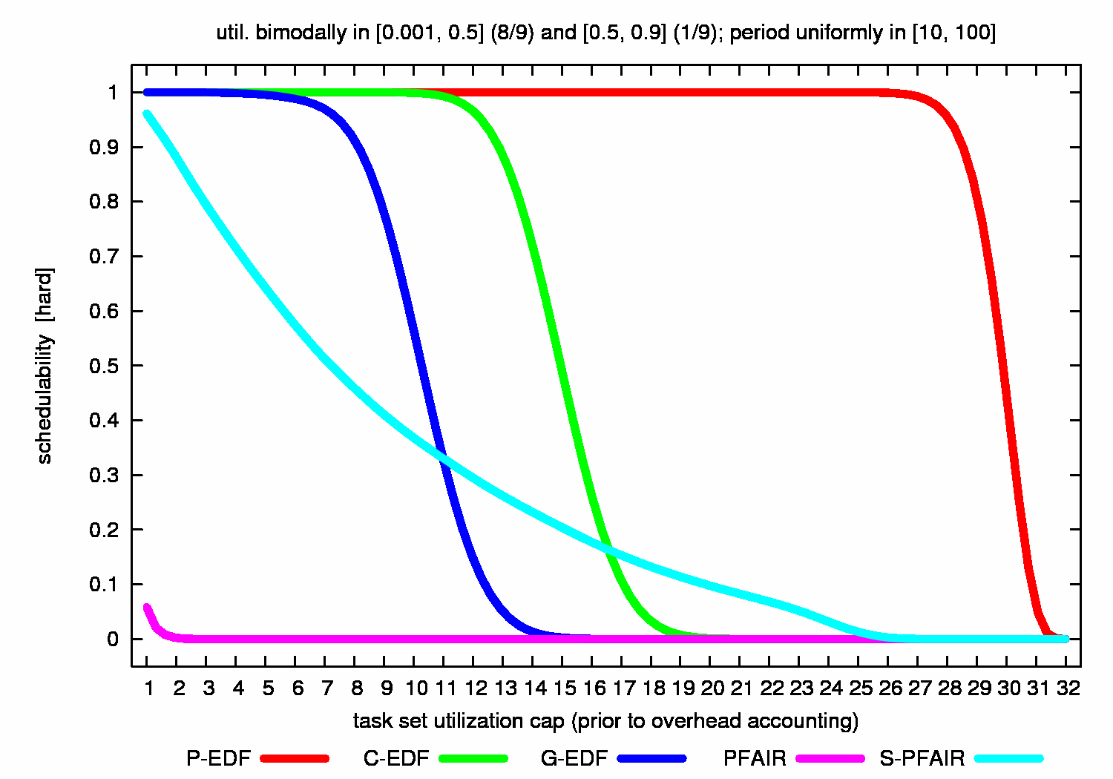
Optimality Can Be Expensive
(HRT Sched. on Sun Niagara w/ 8 Cores, 4 HW Threads/Core)
PEDF
Pfair

Slide 60
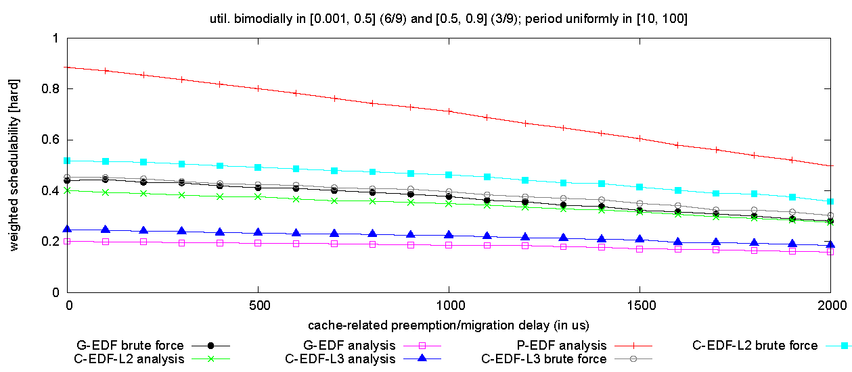
For HRT, GEDF/CEDF Can’t Catch PEDF
(Weighted HRT Schedulability on 24-Core Intel System)
PEDF
CEDF-L2 W(D)
CEDF-L3 W(D)
GEDF W(D)
“Brute force” tests that upper bound
the analysis of CEDF & GEDF.

Slide 61
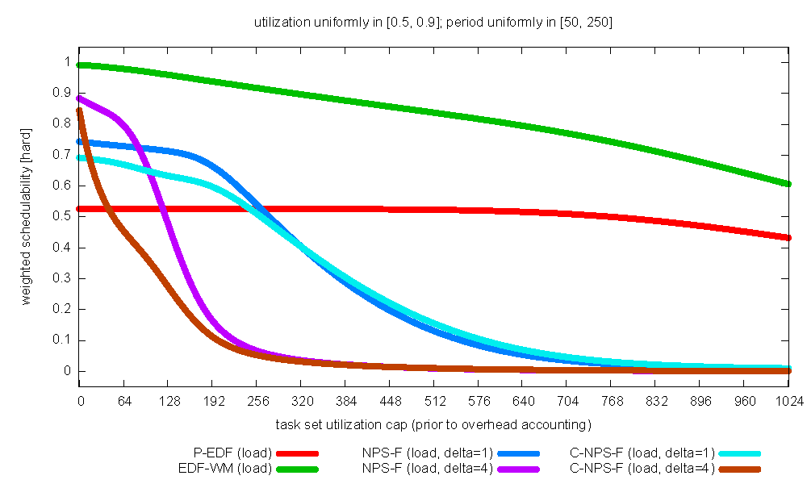
But (Some) Semi-Partitioned Algs. Can
(Weighted SRT Schedulablity on 24-Core Intel System)
EDF-WM
(Semi-Partitioned)
PEDF
working set size

Slide 62
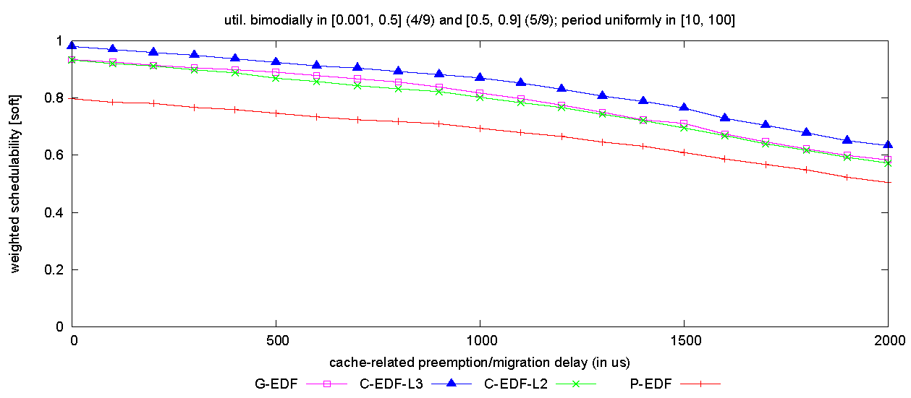
For SRT, CEDF is the Best
(Weighted SRT Schedulability on 24-Core Intel System)
CEDF-L3
Practically speaking, global scheduling
research should focus on modest
processor counts (e.g., ≤ 8).
GEDF
PEDF
Similarly, GEDF is the best on small platforms.

Slide 63
Implementation Choices Really Matter
In one study, we looked at seven different implementations of GEDF.
Why so many?
  Many design choices:
    Event- vs. quantum-driven scheduling.
    Sequential binomial heap (coarse-grained locking) vs. fine-grained heap vs. hierarchy of local & global queues.
    Interrupt handling by all vs. one processor.
To make the point that implementations matter, we’ll just look at one graph…

Slide 64
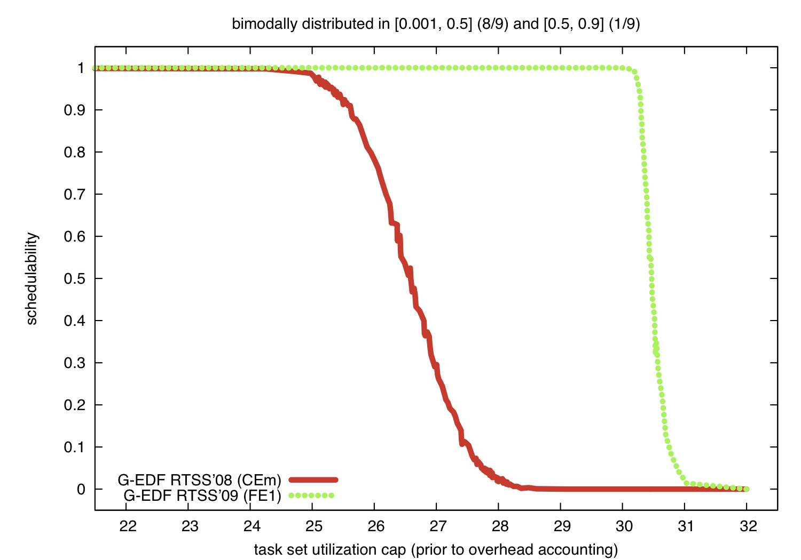
SRT, Bimodal Light
(SRT Sched. on Sun Niagara w/ 8 Cores, 4 HW Threads/Core)
Red Curve: Implementation from prior study
  event-driven scheduling, coarse-grained locking,
  all processors handle interrupts.
Green Curve:
  event-driven scheduling, fine-grained locking,
  a dedicated processor handles all interrupts.

Slide 65
SRT, Bimodal Light
(SRT Sched. on Sun Niagara w/ 8 Cores, 4 HW Threads/Core)

Slide 66
Outline
What… is LITMUS^{RT}?
Why… was LITMUS^{RT} developed?
How… do we use LITMUS^{RT}?
Which… lessons have we learned?
  About the “experimental process”.
  About multiprocessor scheduling.
Where… is the LITMUS^{RT} project going next?

Slide 67
Future Work
Produce definitive studies on real-time synchronization.
Consider other H/W platforms, most notably:
  Embedded ARM platforms;
  Heterogeneous platforms (becoming more commonplace).
Evolve LITMUS^{RT} beyond a testbed to host real applications.

Slide 68
Take Home Messages
Prototyping efforts are (obviously) necessary if real systems are to be impacted.
Such efforts can be informative to theoreticians too!
Quick and dirty prototyping efforts do more harm than good.
Implementation work should be open source.
  Results must be re-producible (like other sciences)!

Slide 69
Thanks!
Questions?
available at:
http://www.cs.unc.edu/~anderson/litmus-rt

