Slide 1
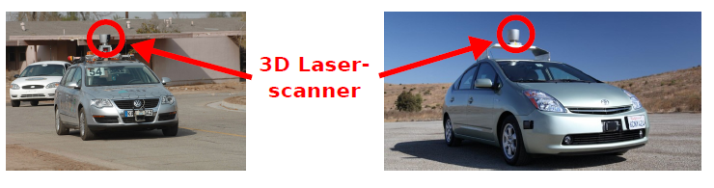
Autonomous Driving
Localization, path planning, obstacle avoidance
Heavy use of Velodyne and detailed(recorded) map
TOO EXPENSIVE
  Let’s do it with cheap camera!

Slide 2
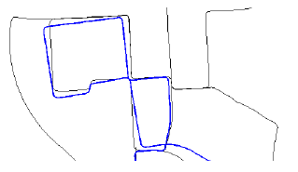
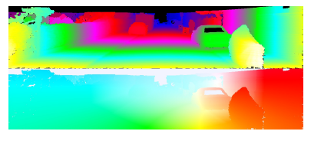
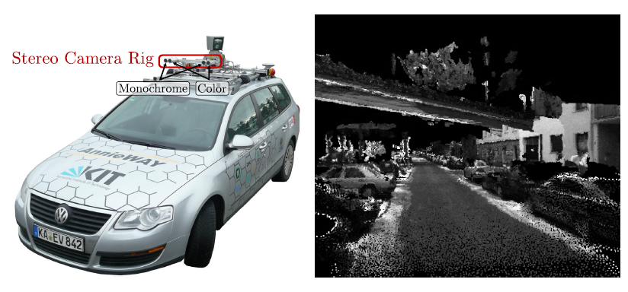
Problem of Computer Vision
Stereo, optical flow, visual odometry, structure-from-motion, 3D reconstruction
Notes:
visual odometry is the process of determining the position and orientation of a robot by analyzing the associated camera images

Slide 3
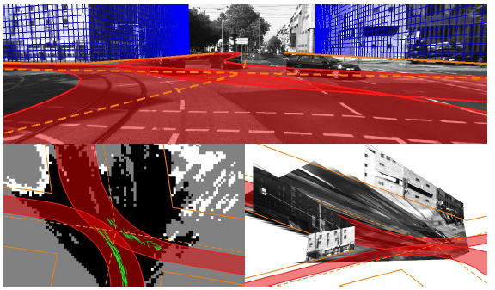
Problem of Computer Vision
3D scene understanding
  Geometric properties, e.g., street orientation
  Topological properties, e.g., number of intersecting streets
  Semantic activities, e.g., traffic situations at an intersection

Slide 4
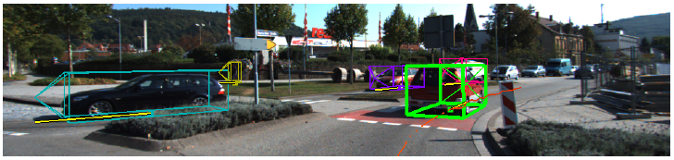
Problem of Computer Vision
Object detection, recognition, and tracking
Notes:
visual odometry is the process of determining the position and orientation of a robot by analyzing the associated camera images

Slide 5
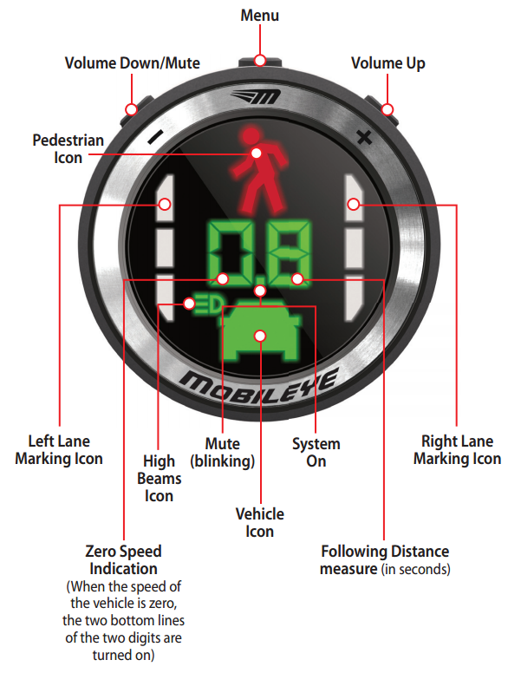
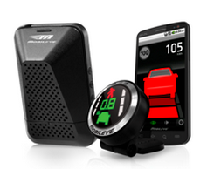
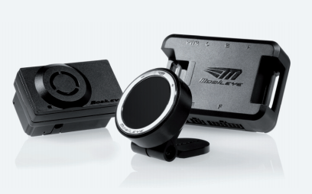
Mobileye ADAS
Notes:
The Vision Sensor Unit with the compact High Dynamic Range CMOS (HDRC) camera, Mobileye EyeQ2 chip, proprietary algorithms and audio alert that attaches to the inside of the vehicle’s windshield.
The user-friendly, high visibility EyeWatch display

Slide 6
Mobileye ADAS
Pedestrian Collision Warning
Lane Departure
Forward Collision Warning
Headway Monitoring
Mobileye Intelligent high-Beam
Speed Limit Indication

Slide 7
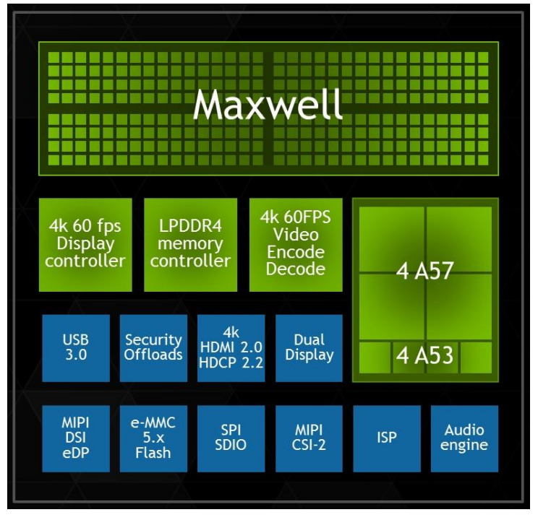
NVIDIA Solution
NVIDIA Tegra X1 Mobile Processor
Notes:
ARM® Cortex® A57/ A53 64/32-bit CPU architecture that delivers high performance and power
efficiency.
Maxwell GPU architecture that utilizes 256 cores to deliver class-leading performance and
power efficiency for the next generation of visual computing applications

Slide 8
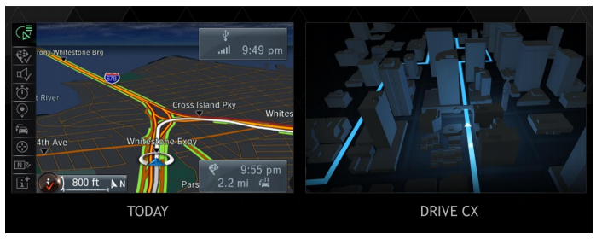
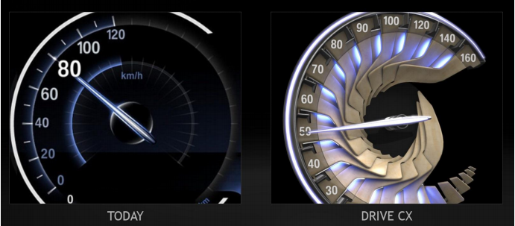
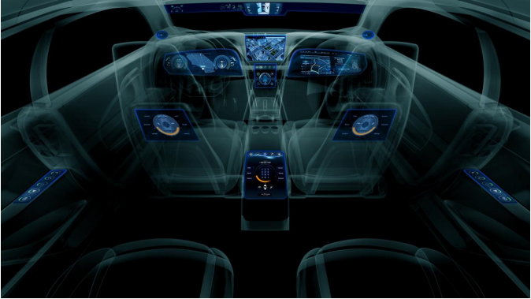
NVIDIA Solution
NVIDIA DRIVE CX Cockpit Computer

Slide 9
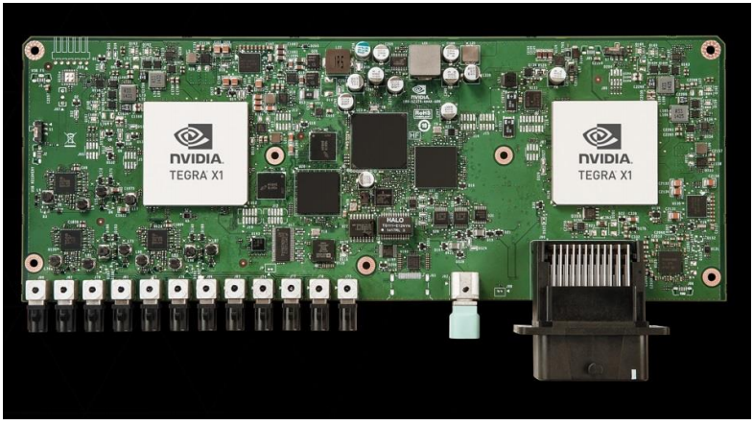
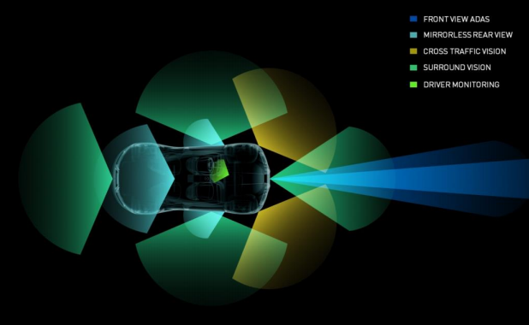
NVIDIA Solution
NVIDIA DRIVE PX
  complete auto-pilot computing development platform that comes with software modules for advanced features such as surround vision, Auto-Valet parking, contextual driver assistance and more, at fraction of the cost to car makers.
Notes:
Development platform(12 camera inputs)
The NVIDIA DRIVE PX Auto-Pilot Platform is a
complete auto-pilot computing development platform that comes with software modules for advanced
features such as surround vision, Auto-Valet parking, contextual driver assistance and more, at fraction
of the cost to car makers.

Slide 10
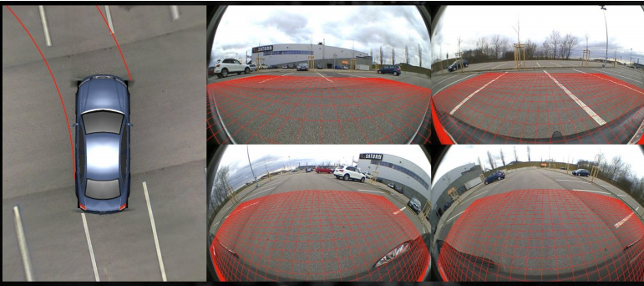
NVIDIA Solution
NVIDIA DRIVE PX – surround view solution, self-parking
  Structure From Motion (SFM) algorithm to create 3D world
  Parking spot detector algorithm
  a path-planning algorithm to control the steering, brakes, and accelerator of the car

Slide 11
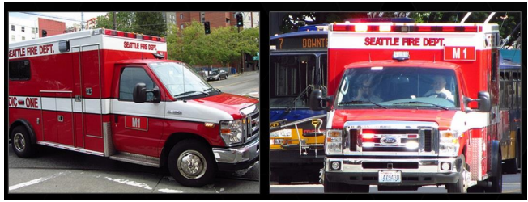
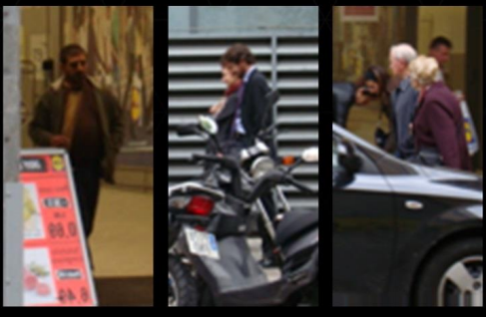
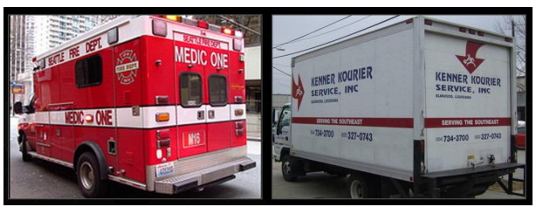
NVIDIA Solution
NVIDIA DRIVE PX – Difficulty and Limitations of current ADAS
Notes:
lighting conditions such as rain, night time, and bright reflections
as humans we would be more wary and drive more carefully when we see a distracted pedestrian who is crossing the road while talking on the phone, as compared to when we see a pedestrian who is aware of an approaching car and crosses the road more carefully

Slide 12
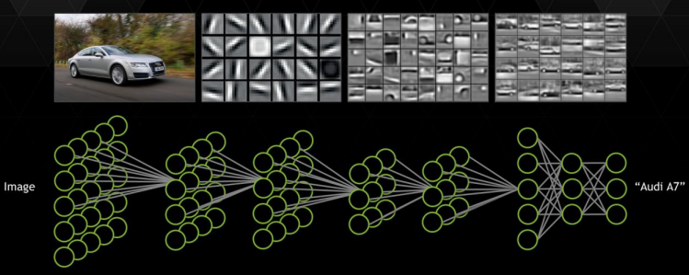
NVIDIA Solution
NVIDIA DRIVE PX – Contextual ADAS
  Deep learning and neural networks

Slide 13
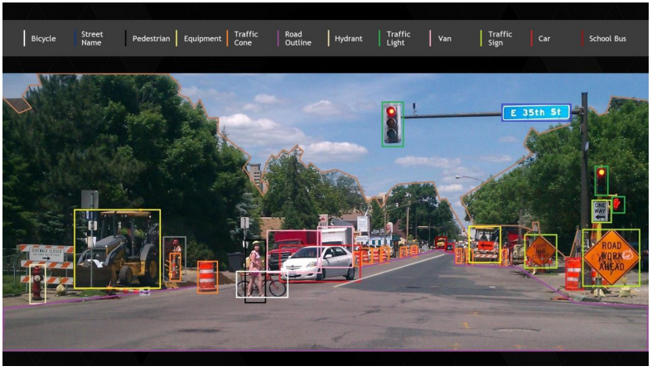
NVIDIA Solution
NVIDIA DRIVE PX – Contextual ADAS
  Deep learning and neural networks
Notes:
Real-time?

Slide 14
Ford’s Smart Mobility
25 global mobility experiments launched this year to test new ideas
  Big Data Drive: Dearborn, Michigan
  Fleet Insights: United States
  Data Driven Insurance: London
  Remote Repositioning: Atlanta
  City Driving On-Demand: London
  Dynamic Social Shuttle: New York, London
  Car Swap: Dearborn, Michigan
  Ford Carsharing: Germany
  Share-Car: Bangalore, India
  Rapid Recharge & Share: Dearborn, Michigan
  Data Driven Healthcare: The Gambia, West Africa
  Parking Spotter: Atlanta
  Info Cycle: Palo Alto, California
  Painless Parking: London

Slide 15
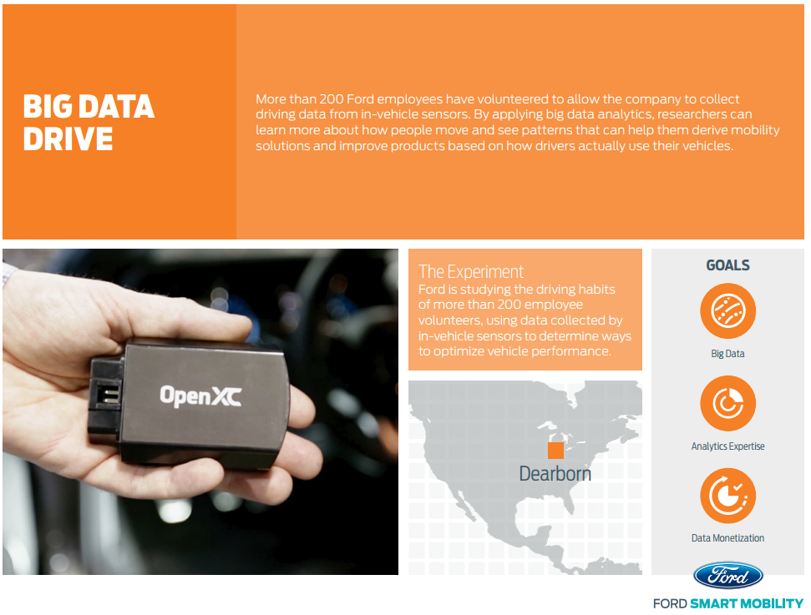
Ford’s Smart Mobility
Big Data Drive
Notes:
Gather all data
Vehicle speed, the number of times that break has been pressed, location information, how much fuel was being used, wheather, open window, air conditioning, everything. how drivers interact with external factors

Slide 16
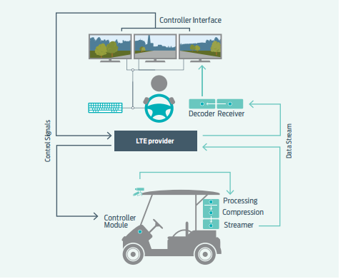
Ford’s Smart Mobility
Remote Repositioning
Notes:
Via LTE, vehicle sent visual scene to remote driver.

Slide 17
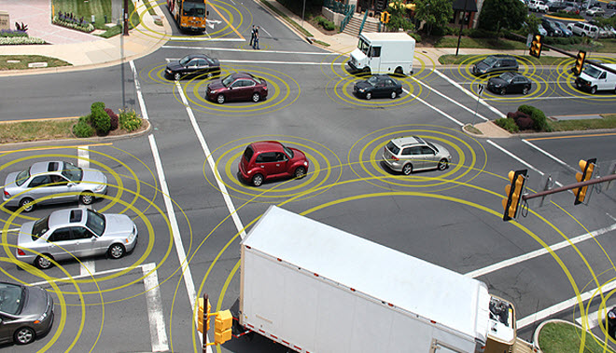
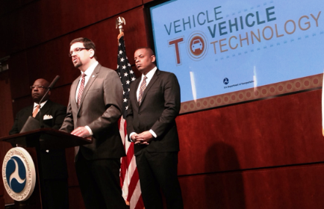
Connected Vehicles
Vehicle-to-vehicle (V2V) communications comprises a wireless network where automobiles send messages to each other with information about what they’re doing
  speed, location, direction of travel, braking, and loss of stability
Notes:
U.S. Department of Transportation announcing early this year that it plans to start taking steps to enable V2V communication.
Virtual airbag

Slide 18
Connected Vehicles
Definition
  Connected vehicles interact with each other (v2v), the roadside (v2i), and beyond (v2x) via wireless communications
Technologies
  3G/4G
  5.9Hz Dedicated Short Range Communication(DSRC)
Benefits
  Most Effective when vehicles, roadside infrastructure(such as roads and highways), and back-end (telecommunications and Internet backbones) work together

