Slide 1
Depth Estimation
Cameras, Pinhole Geometry, and Stereo
Kecheng Yang
2/4/2015
Most of the slides come from Prof. Alex Berg’s COMP 790-134 Computational Photography

Slide 2
Image formation
Let’s design a camera
  Idea 1: put a piece of film in front of an object
  Do we get a reasonable image?
Slide source: Seitz

Slide 3
Pinhole camera
Idea 2: add a barrier to block off most of the rays
  This reduces blurring
  The opening known as the aperture
Slide source: Seitz
Notes:
Q: How does this transform the image? A: It gets inverted

Slide 4
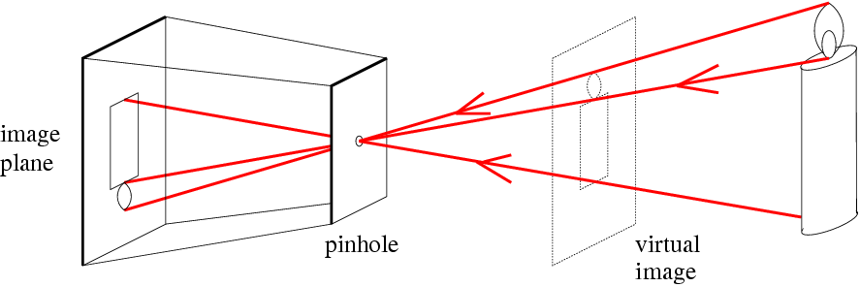
Pinhole camera
f
c
f = focal length
c = center of the camera
Figure from Forsyth

Slide 5
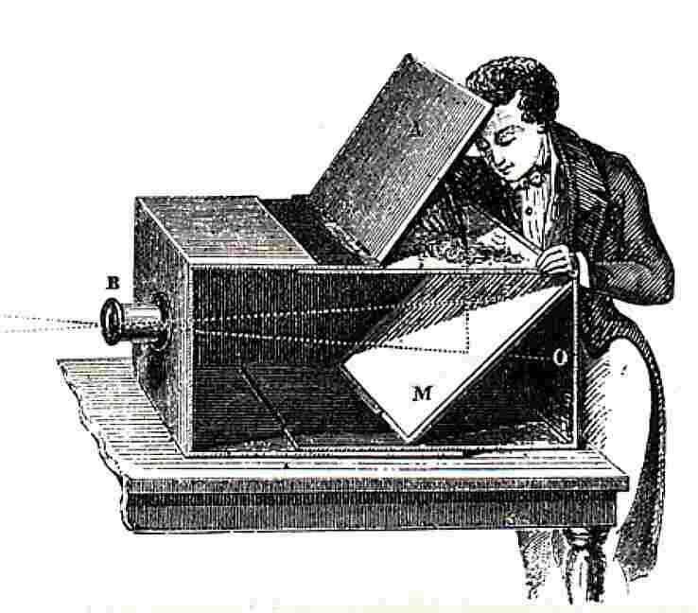
Pinhole Camera Model
Sildes from Derek Hoiem, University of Illinois

Slide 6
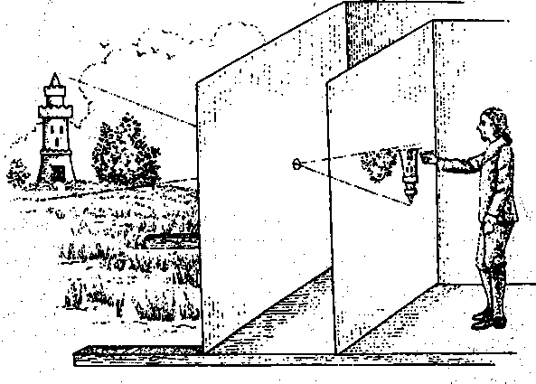
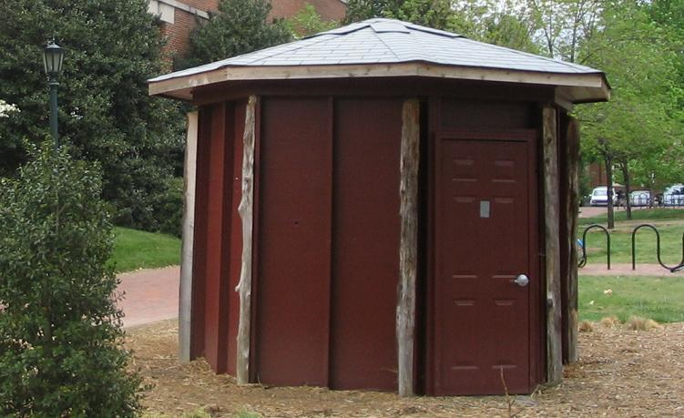
Camera obscura: the pre-camera
First idea: Mo-Ti, China (470BC to 390BC)
First built: Alhacen, Iraq/Egypt (965 to 1039AD)
Illustration of Camera Obscura
Freestanding camera obscura at UNC Chapel Hill
Photo by Seth Ilys

Slide 7
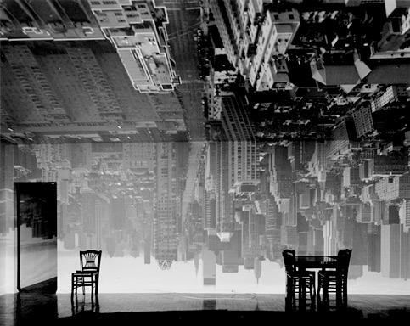
“I made my first picture using camera obscura techniques in my darkened living room in 1991.”
-- Abelardo Morell
I cover all windows with black plastic in order to achieve total darkness.”
-- Abelardo Morell
“In setting up a room to make this kind of photograph,

Slide 8
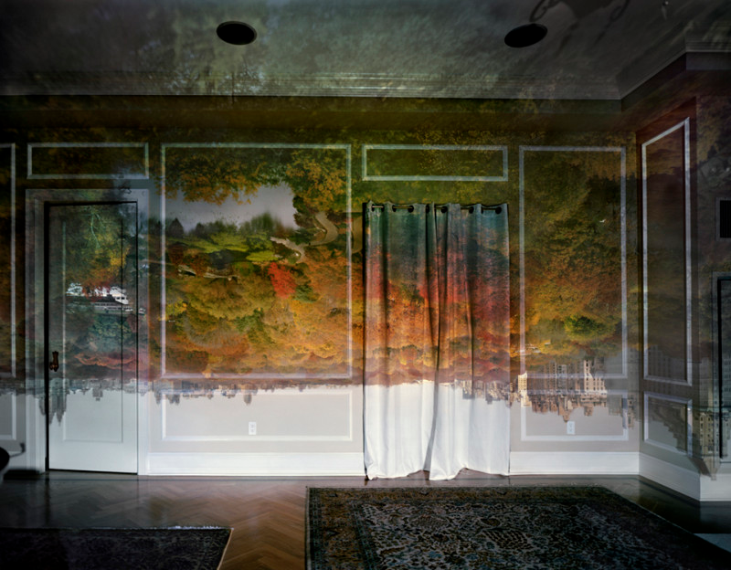
“I made my first picture using camera obscura techniques in my darkened living room in 1991.”
-- Abelardo Morell
I cover all windows with black plastic in order to achieve total darkness.”
-- Abelardo Morell
“In setting up a room to make this kind of photograph,

Slide 9
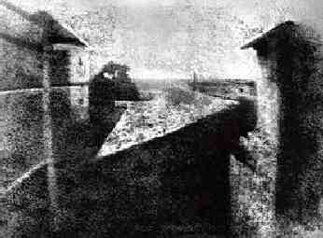
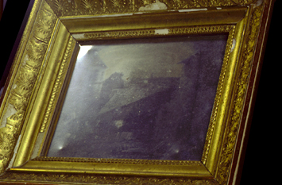
First Photograph
Oldest surviving photograph
  Took 8 hours on pewter plate
Photograph of the first photograph
Joseph Niepce, 1826
Stored at UT Austin
Niepce later teamed up with Daguerre, who eventually created Daguerrotypes

Slide 10
Dimensionality Reduction Machine (3D to 2D)
3D world
2D image
Figures © Stephen E. Palmer, 2002

Slide 11
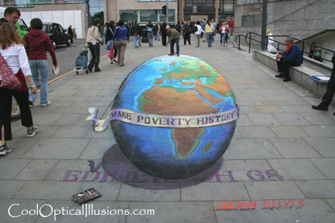
Projection can be tricky…
Slide source: Seitz

Slide 12
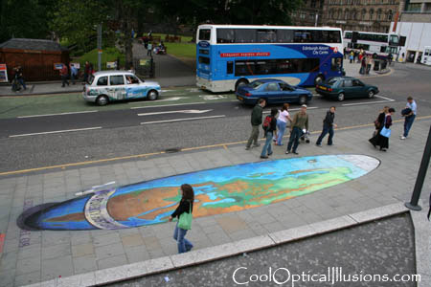
Projection can be tricky…
Slide source: Seitz

Slide 13
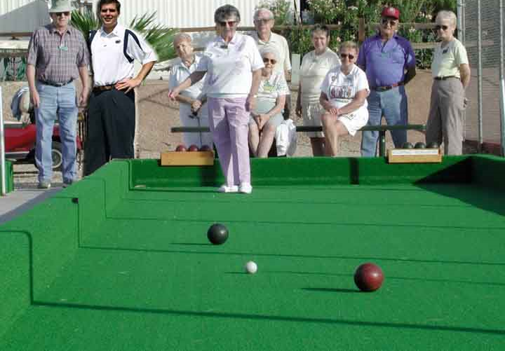
Single-view Geometry
How tall is this woman?
How high is the camera?
What is the camera rotation?
What is the focal length of the camera?
Which ball is closer?

Slide 14
Projective Geometry
What is lost?
Length
Who is taller?
Which is closer?

Slide 15
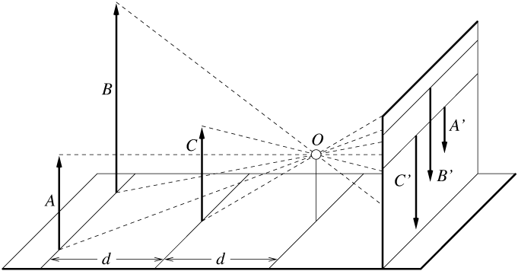
Length is not preserved
A’
C’
B’
Figure by David Forsyth

Slide 16
Projective Geometry
What is lost?
Length
Angles
Parallel?
Perpendicular?

Slide 17
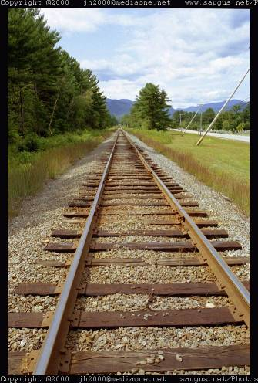
Vanishing points and lines
Parallel lines in the world intersect in the image at a “vanishing point”
Notes:
Go to board, sketch out various properties of vanishing points/lines

Slide 18
Projective Geometry
What is preserved?
Straight lines are still straight

Slide 19
Projection: world coordinates→image coordinates
.
Optical Center (x₀, y₀)
.
.
f
Z
Y
.
y
Camera Center (t_{x}, t_{y}, t_{z})
x

Slide 20
How is depth estimated?

Slide 21
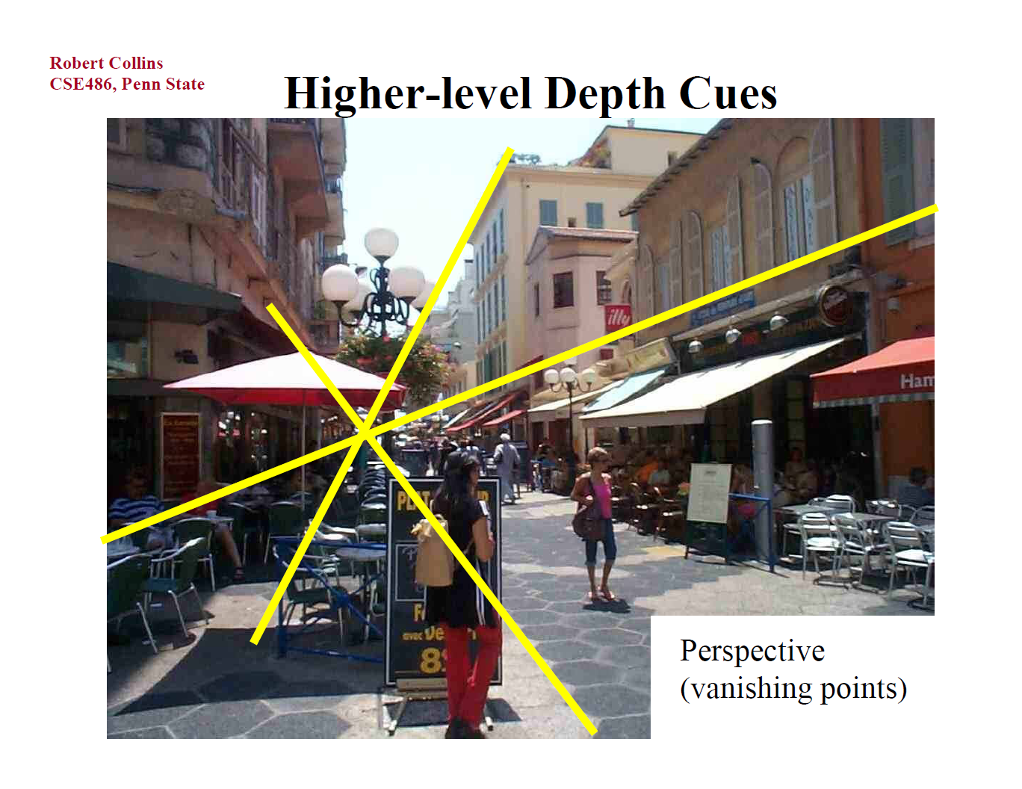

Slide 22
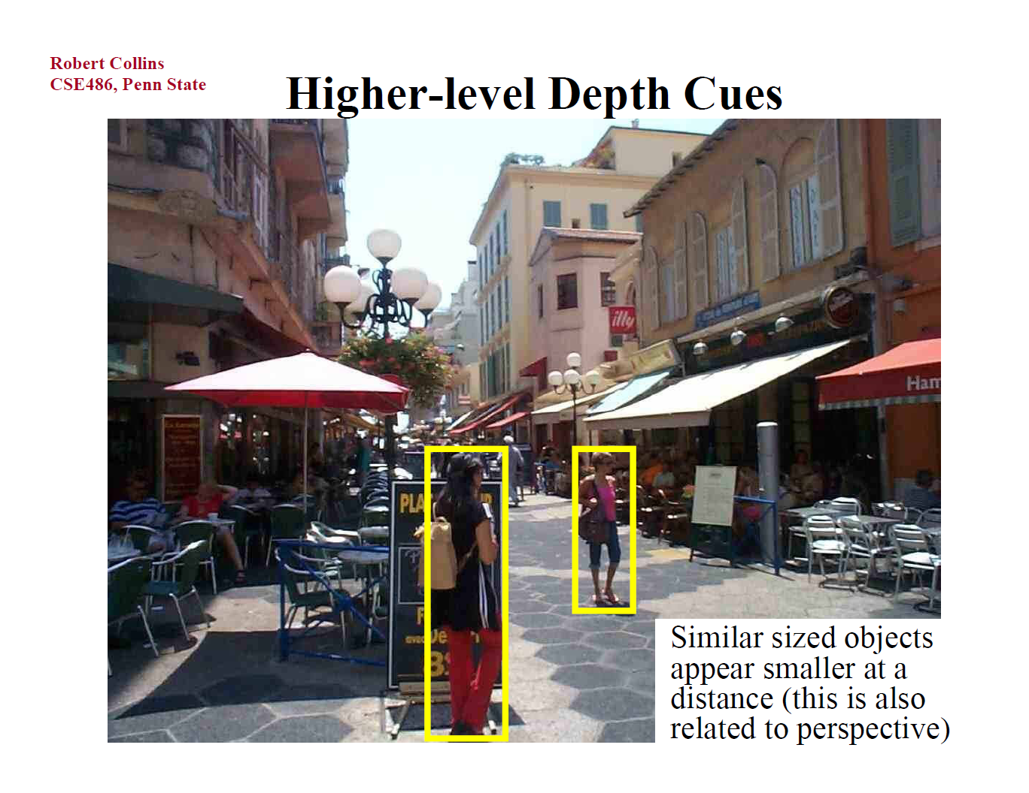

Slide 23
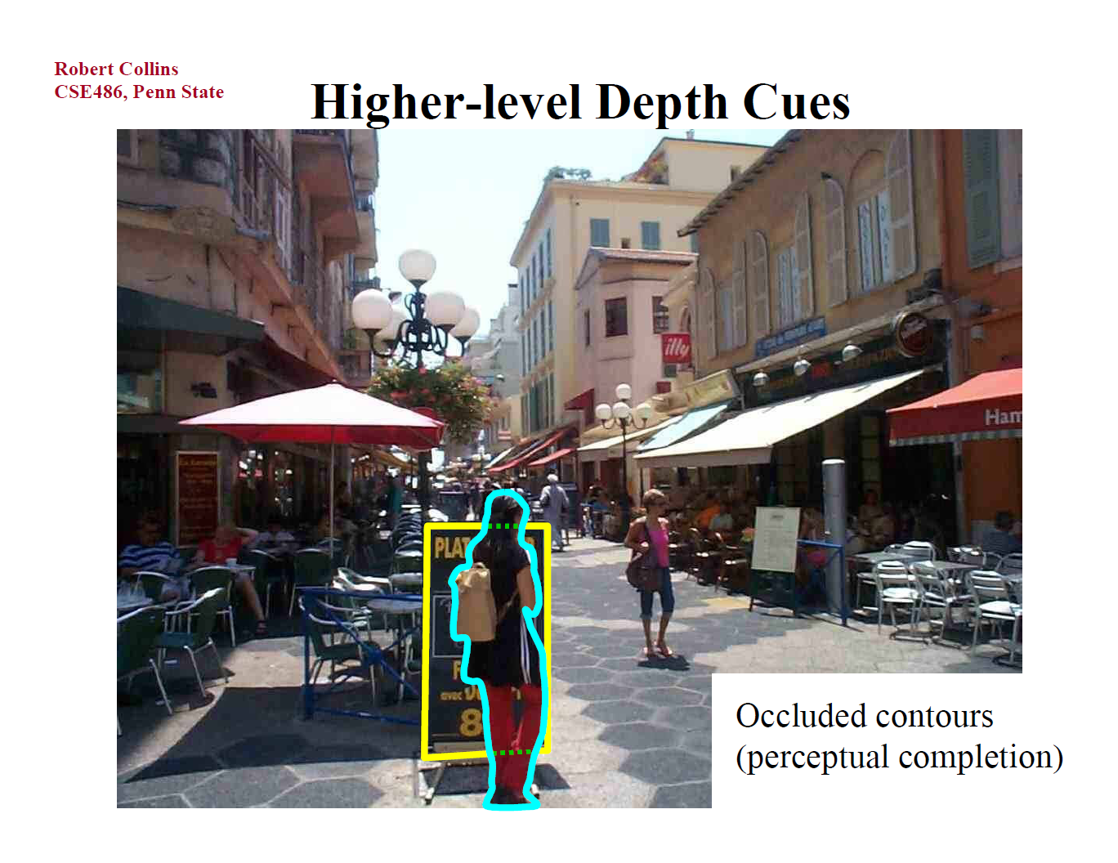

Slide 24
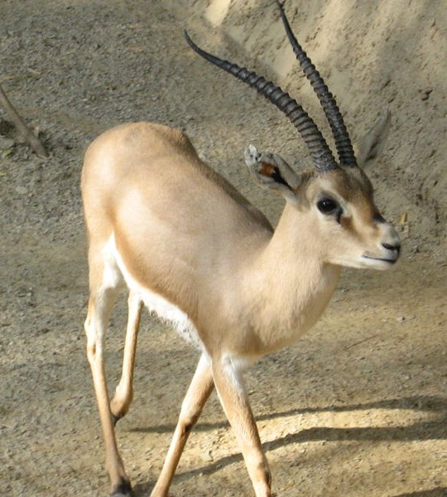
Stereo Vision
Not that important for humans, especially at longer distances. Perhaps 10% of people are stereo blind.
Many animals don’t have much stereo overlap in their fields of view.

Slide 25
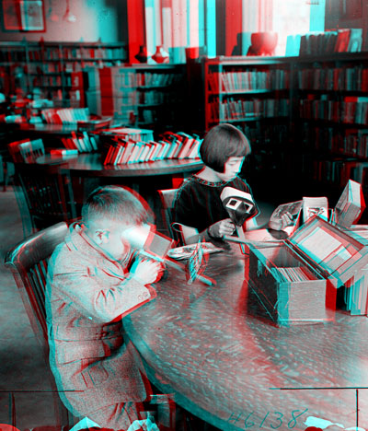

Public Library, Stereoscopic Looking Room, Chicago, by Phillips, 1923

Slide 26
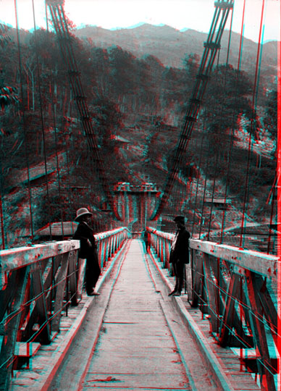
Teesta suspension bridge-Darjeeling, India

Slide 27
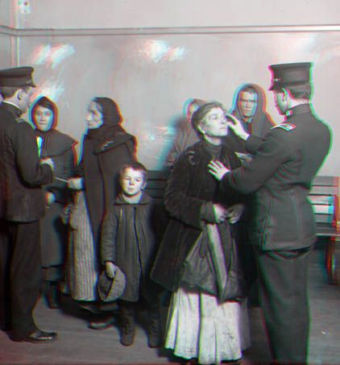
Woman getting eye exam during immigration procedure at Ellis Island, c. 1905 - 1920 , UCR Museum of Phography

Slide 28
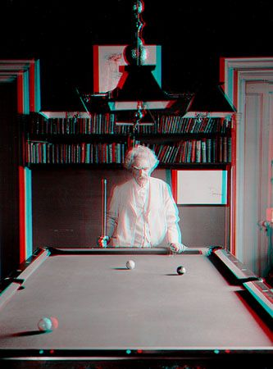
Mark Twain at Pool Table", no date, UCR Museum of Photography

Slide 29
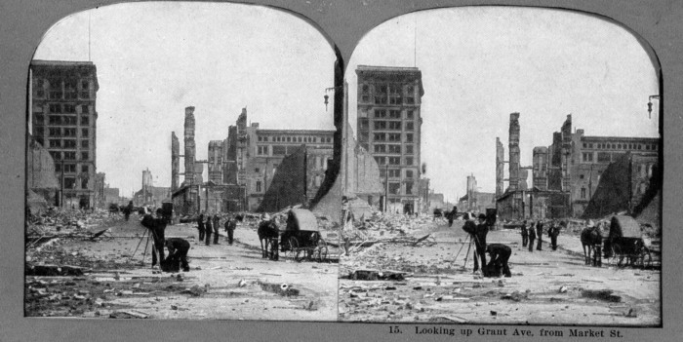
San Francisco Post-Earthquake 1906
http://www.sfog.us/earthquake

Slide 30
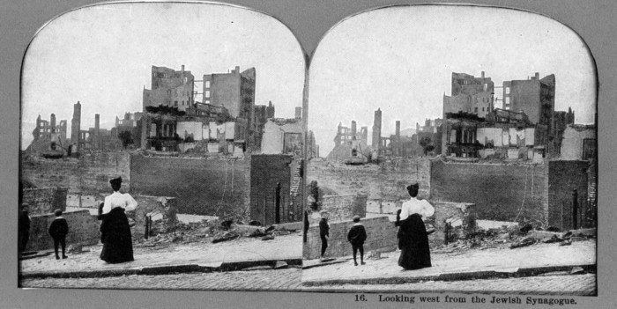
San Francisco Post-Earthquake 1906
http://www.sfog.us/earthquake

Slide 31
Projection: world coordinates→image coordinates
.
Optical Center (x₀, y₀)
.
.
f
Z
Y
.
y
Camera Center (t_{x}, t_{y}, t_{z})
x

Slide 32
Pinhole camera
f
c
f = focal length
c = center of the camera
Figure from Forsyth

Slide 33
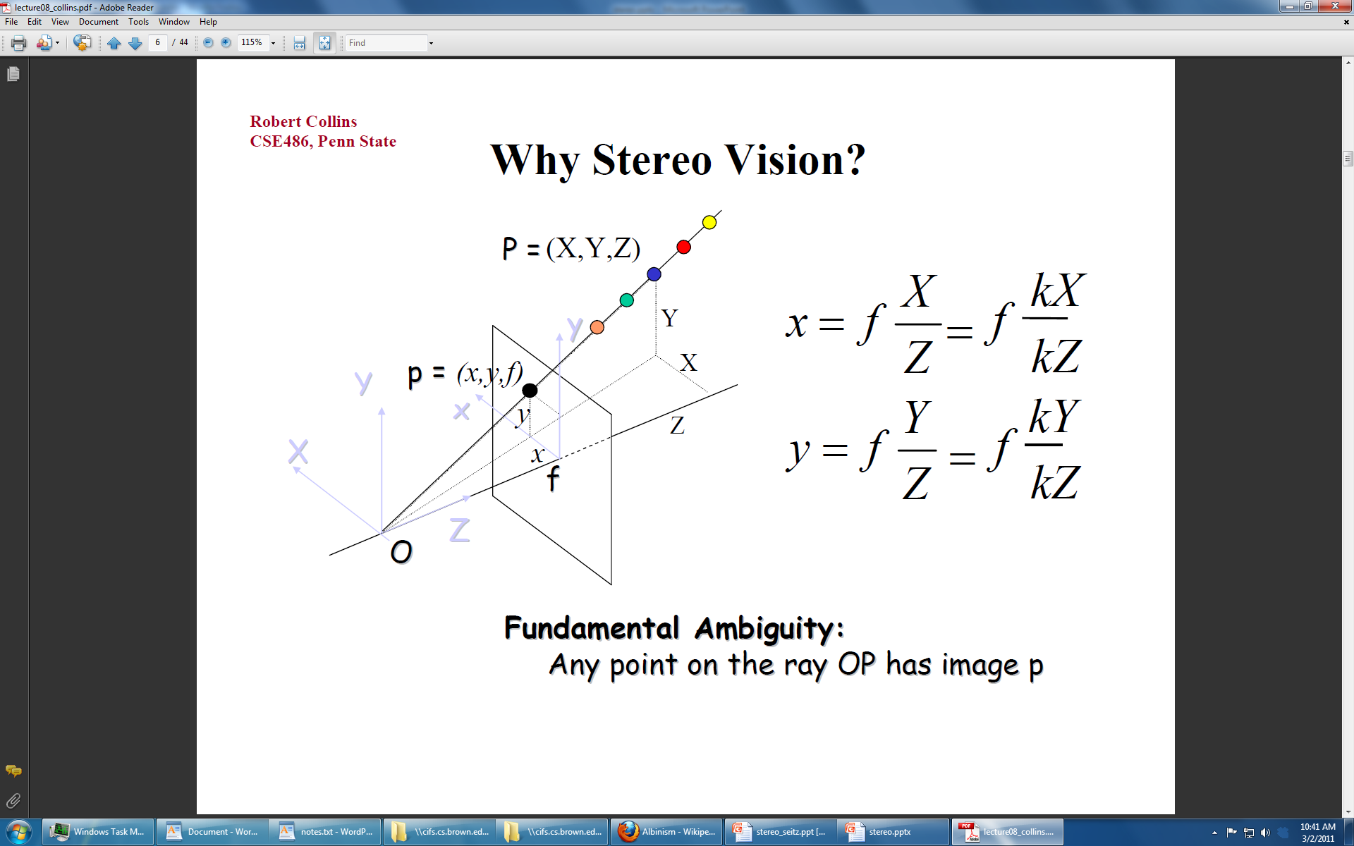

Slide 35
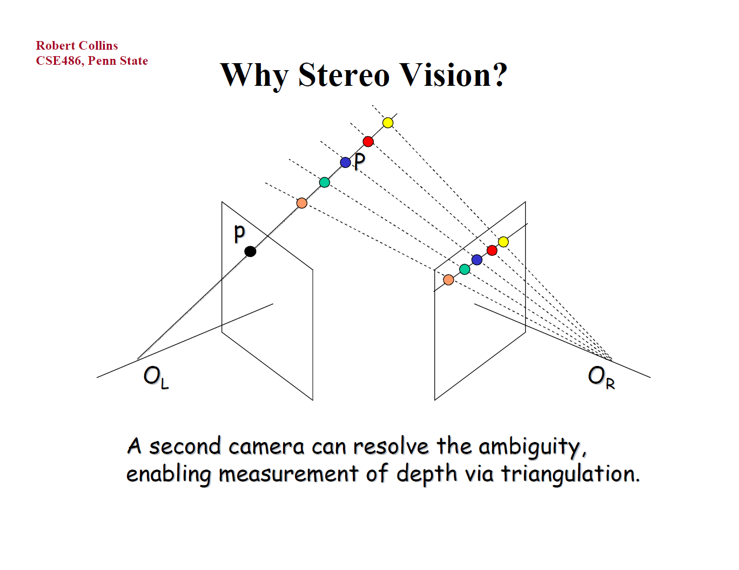

Slide 36
Stereo
scene point
image plane
optical center

Slide 37
Stereo
Basic Principle: Triangulation
  Gives reconstruction as intersection of two rays
  Requires
    camera pose (calibration)
    point correspondence

Slide 38
Stereo image rectification

Slide 39
Stereo image rectification
reproject image planes onto a common
plane parallel to the line between optical centers
pixel motion is horizontal after this transformation
C. Loop and Z. Zhang. Computing Rectifying Homographies for Stereo Vision. IEEE Conf. Computer Vision and Pattern Recognition, 1999.

Slide 40
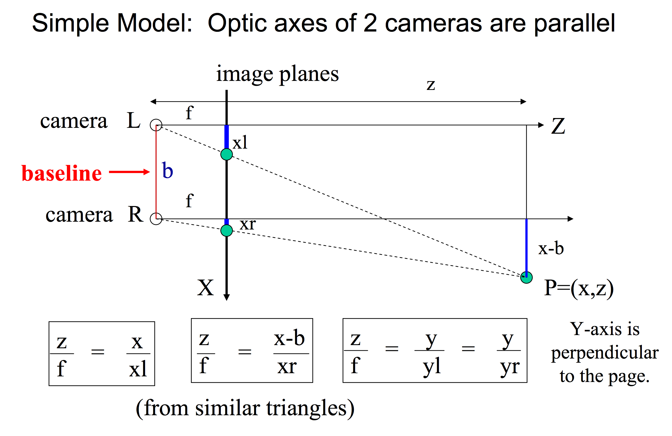
Simple Stereo Geometry
Slide from Steve Seitz

Slide 41
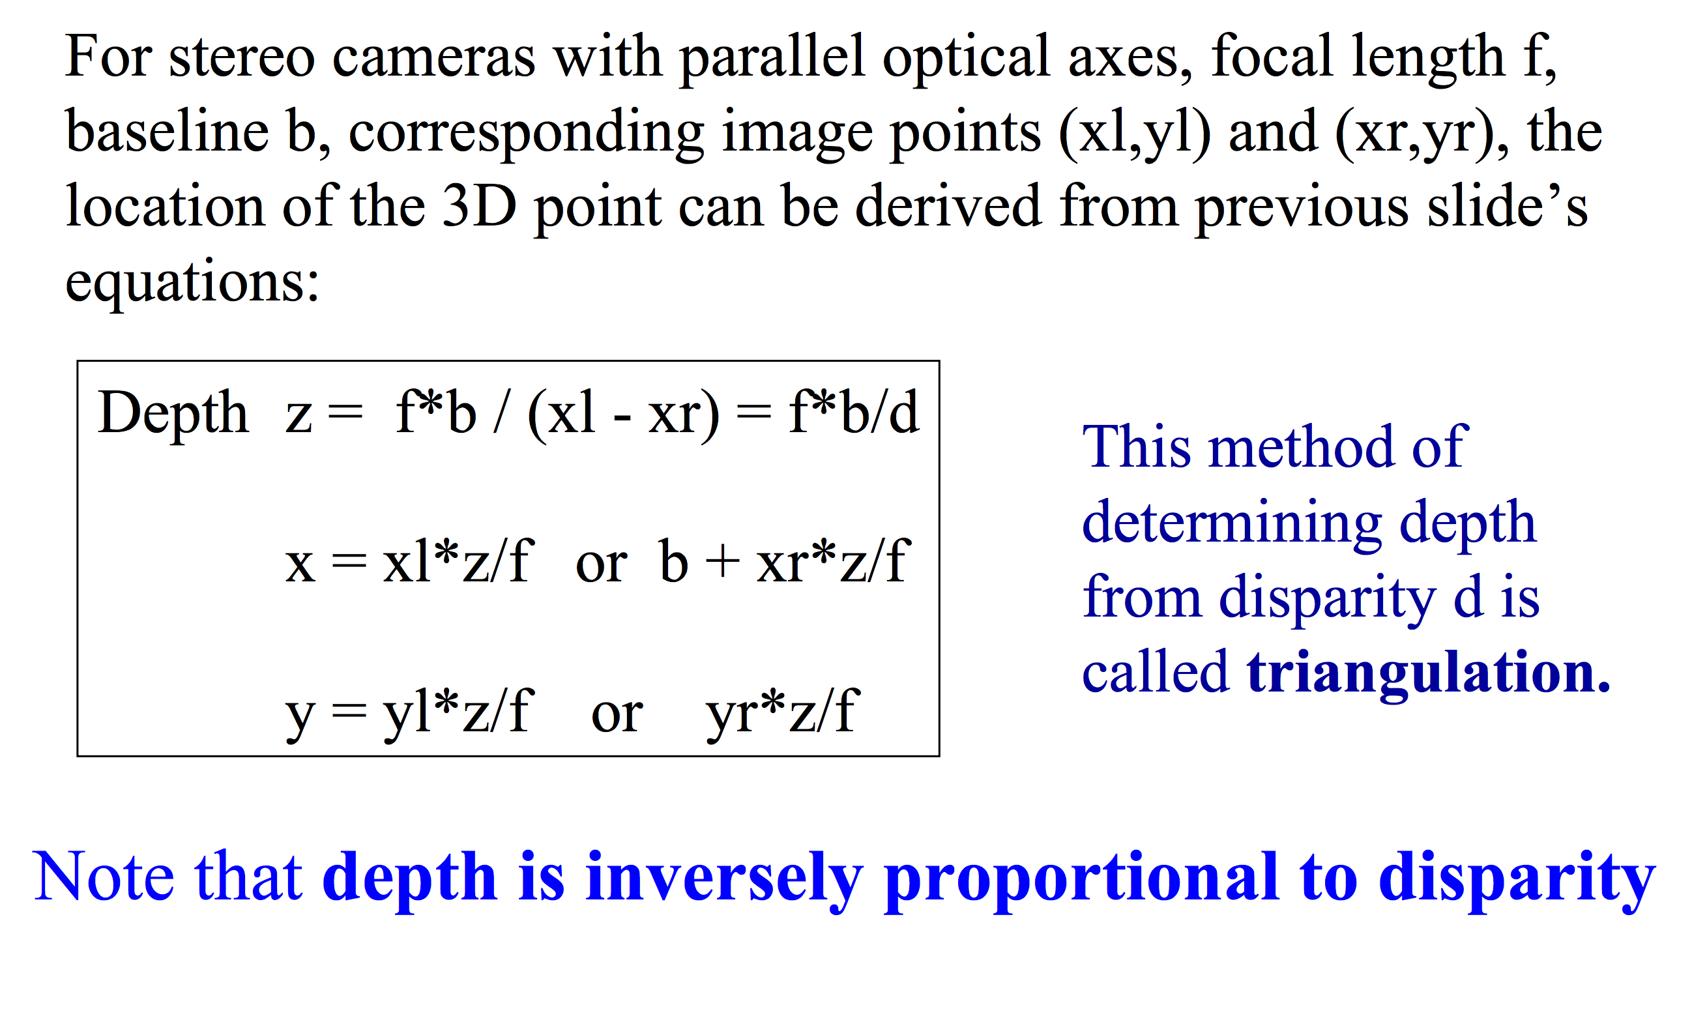
Simple Stereo Geometry
Slide from Steve Seitz

Slide 42
Questions
How big is a pixel?
What is the range of depths where stereo helps?

Slide 43
Stereo matching algorithms
Match Pixels in Conjugate Epipolar Lines
  Assume brightness constancy
  This is a tough problem
  Numerous approaches
    A good survey and evaluation: http://www.middlebury.edu/stereo/

Slide 44
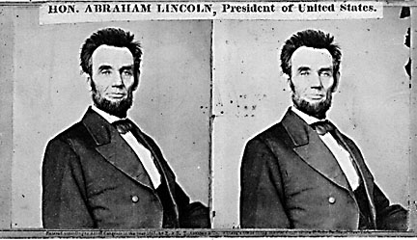
Your basic stereo algorithm
For each epipolar line
For each pixel in the left image
    compare with every pixel on same epipolar line in right image
    pick pixel with minimum match cost
Improvement: match windows
  This should look familar...

Slide 45
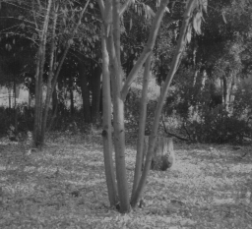
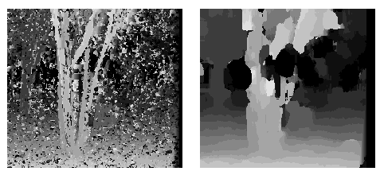
Window size
W = 3
W = 20
Effect of window size
Better results with adaptive window
  T. Kanade and M. Okutomi, A Stereo Matching Algorithm with an Adaptive Window: Theory and Experiment,, Proc. International Conference on Robotics and Automation, 1991.
  D. Scharstein and R. Szeliski. Stereo matching with nonlinear diffusion. International Journal of Computer Vision, 28(2):155-174, July 1998
  Smaller window
  Larger window
Notes:
smaller window: more detail, more noise
bigger window: less noise, less detail

Slide 46
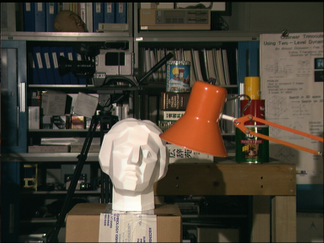

Stereo results
  Data from University of Tsukuba
  Similar results on other images without ground truth
Scene
Ground truth

Slide 47
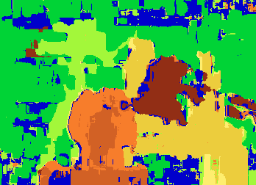

Results with window search
Window-based matching
(best window size)
Ground truth

Slide 48
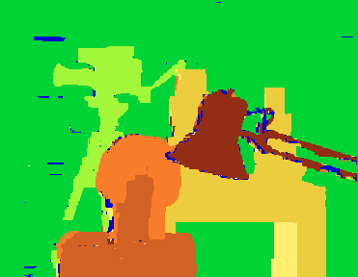
Better methods exist...
Better Method
  Boykov et al., Fast Approximate Energy Minimization via Graph Cuts,
  International Conference on Computer Vision, September 1999.
Ground truth
    For the latest and greatest: http://www.middlebury.edu/stereo/

