Slide 1
Introduction of
Pedestrian Detection
Cheng-Yang Fu
02/04/2015

Slide 2
Source
PAMI 2009

Slide 3
Why Pedestrian Detection is hard?
Articulated pose
Clothing
Lightning
Background
Occlusion
Notes:
Talk about why Pedestrian Detection is hard?
A lot of variety

Slide 4
Why Pedestrian Detection is hard?
Articulated pose
Clothing
Lightning
Background
Occlusion
Credit from : Markerless Articulated Human Body Tracking from Multi-View Video with GPU-PSO

Slide 5
Why Pedestrian Detection is hard?
Articulated pose
Clothing
Lightning
Background
Occlusion
Credit from : Retrieving Similar Styles to Parse Clothing

Slide 6
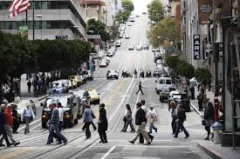
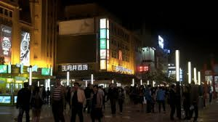
Why Pedestrian Detection is hard?
Articulated pose
Clothing
Lightning
Background
Occlusion

Slide 7
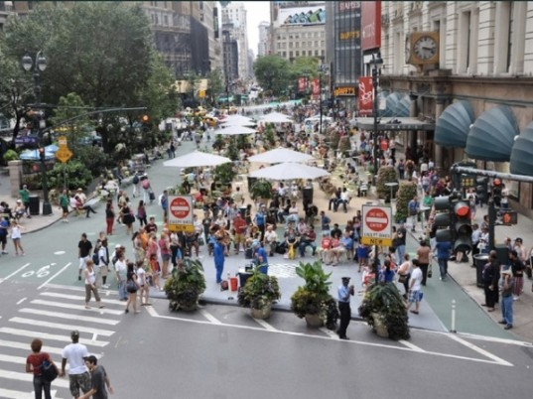
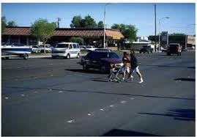
Why Pedestrian Detection is hard?
Articulated pose
Clothing
Lightning
Background
Occlusion
City
Rural Area
Desert

Slide 8
Why Pedestrian Detection is hard?
articulated pose
Clothing
Lightning
Background
Occlusion
Credit from : CVC-05 Partially Occluded Pedestrian Dataset

Slide 9
State-of-the-art systems of Pedestrian Detection
 | Resolution | Speed
HoG / Linear SVM | Higher | Low
Wavelet-based AdaBoost cascade | Lower | near real time

Slide 10
Flowchart
Training
Testing
Extract Training Sample
Multiple Scales
Feature Extraction
Sliding Window
Classifier Selection
Feature Extraction
Validation
Classify

Slide 11
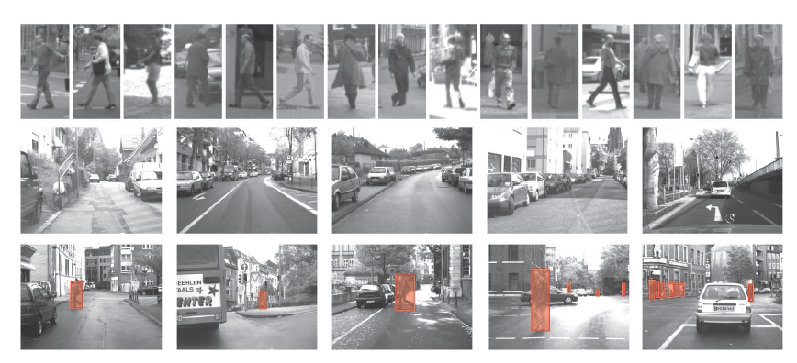
Extract Training Sample
Extract Training Sample
Feature Extraction
Dataset : Daimler-DB
Classifier Selection
Positive
Validation
Negative
Test
source : Monocular Pedestrian Detection Survey and Experiments, PAMI 2009

Slide 12
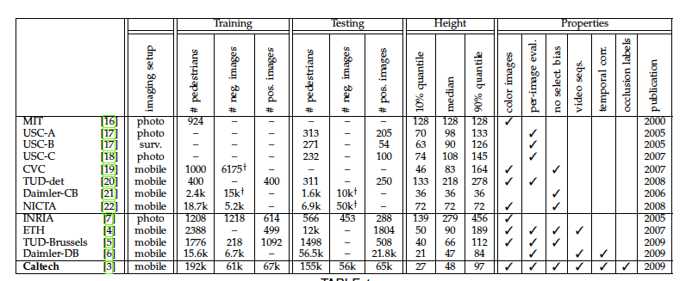
Extract Training Sample
Extract Training Sample
Feature Extraction
Classifier Selection
Validation
source :Pedestrian Detection: An Evaluation of the State of the Art, PAMI 2012

Slide 13
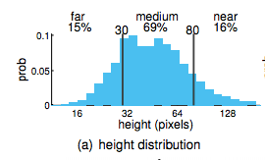
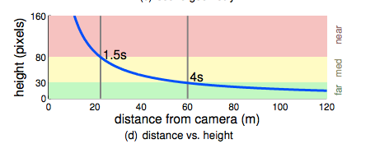
Statics of pedestrian dataset
source :Pedestrian Detection: An Evaluation of the State of the Art, PAMI 2012
Notes:
a variety of statistics on current pedestrian detection dataset : height distribution, position distribution, occlusion distribution

Slide 14
HoG + Linear SVM

Slide 15
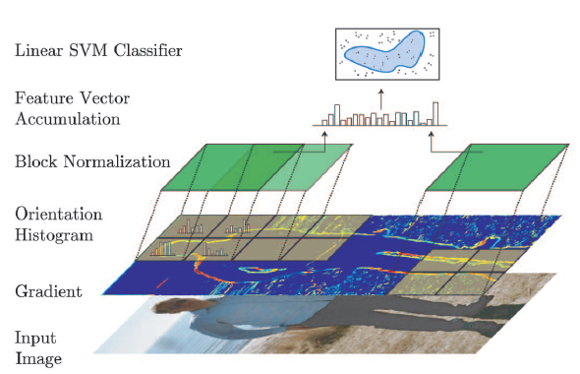
Feature Extract
Extract Training Sample
Feature Extraction
HoG ( Histogram of Orientated Gradient)
Classifier Selection
Validation
Notes:
Introduce HoG

Slide 16
HoG
Gradient
Kernel
Magnitude
Orientation
1
0
-1
-1 | 0 | 1
v
h
Notes:
How to calculate gradient ?
1 use two kernels to decide the magnitudes of horizontal and vertical.
2 Then use simple calculus to decide the magnitude and orientation

Slide 17
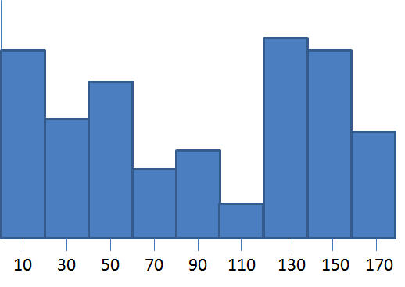
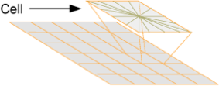
HoG
Orientation Histogram
9 bins for gradient orientations (0 - 180 degrees)
Cell size : typically 8x8 pixels
number of cells : 16x8
Figure from : Dr. Edgar Seemann
Notes:
Quantization
Number is not important, because these are adjustable. Based on your application

Slide 18
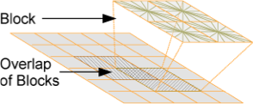
HoG
Block Normalization
Normalize histograms within overlapping blocks of cells(typically 2x2 cells, i.e. 7x15 blocks)
Figure from : Dr. Edgar Seemann
Notes:
Quantization
Number is not important, because these are adjustable. Based on your application

Slide 19
HoG
Block Normalization
Normalize histograms within overlapping blocks of cells(typically 2x2 cells, i.e. 7x15 blocks)
feature = 9 *4
HoG =[ 1st rectangles]
Notes:
Quantization
Number is not important, because these are adjustable. Based on your application

Slide 20
HoG
Block Normalization
Normalize histograms within overlapping blocks of cells(typically 2x2 cells, i.e. 7x15 blocks)
feature = 9 *4
HoG =[ 1st rectangles; 2st rectangles]
Notes:
Quantization
Number is not important, because these are adjustable. Based on your application

Slide 21
HoG
Block Normalization
Normalize histograms within overlapping blocks of cells(typically 2x2 cells, i.e. 7x15 blocks)
feature = 9 *4
HoG =[ 1st rectangles; 2st rectangles; … 7x15 rectangles;]
Notes:
Quantization
Number is not important, because these are adjustable. Based on your application

Slide 22
HoG
Concatenate features
Each cell -> 9
Each block ( 2x2 cell) -> 2 * 2* 9 = 36
Total blocks (7x15) -> 7*15*36 = 3780
Figure from : Dr. Edgar Seemann
Notes:
Talk about feature dimension and computation efficiency problem !

Slide 23
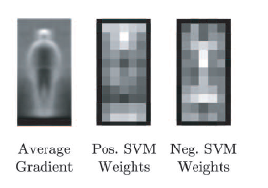
Classifier Selection
Extract Training Sample
Feature Extraction
Linear SVM
Classifier Selection
Validation
source :Pedestrian Detection: An Evaluation of the State of the Art, PAMI 2012
Notes:
Introduce HoG

Slide 24
The process of Detection
Multiple Scales
Sliding Window
Feature Extraction
Classify

Slide 25
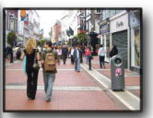
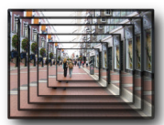
The process of Detection
Multiple Scales
Generate multiple images on different scales
Sliding Window
Feature Extraction
Classify
Figure from : Pedestrian detection at 100 frames per second
Notes:
Why need this step ? Size invariant

Slide 26
The process of Detection
Multiple Scales
use sliding window on all locations
Sliding Window
Feature Extraction
Classify
Figure from : Pedestrian detection at 100 frames per second

Slide 27
The process of Detection
Multiple Scales
use sliding window on all locations
Sliding Window
Feature Extraction
Classify
Figure from : Pedestrian detection at 100 frames per second

Slide 28
The process of Detection
Multiple Scales
use sliding window on all locations
Sliding Window
Feature Extraction
Classify
Figure from : Pedestrian detection at 100 frames per second

Slide 29
The process of Detection
Multiple Scales
use sliding window on all locations
normal image size : 480*640
Sliding Window
Feature Extraction
Classify
Figure from : Pedestrian detection at 100 frames per second

Slide 30
The process of Detection
Multiple Scales
Extract HoG from current window
Sliding Window
Feature Extraction
Classify
Figure from : Pedestrian detection at 100 frames per second

Slide 31
The process of Detection
Multiple Scales
Use LinearSVM to classify
Accurate Criteria
Normally if >= 0.5, we consider it is correct.
Sliding Window
Feature Extraction
Classify
Figure from : Pedestrian detection at 100 frames per second
Notes:
intersection over union

Slide 32
Wavelet-based AdaBoost cascade

Slide 33
Haar Wavelet
A set of predefined wavelets
40
80

Slide 34
Haar Wavelet
A set of predefined wavelets
40
= sum(white) - sum(black)
80
Notes:
Use the predefined wavelet to extract feature!

Slide 35
Haar Wavelet
A set of predefined wavelets
40
80
= sum(white) - sum(black)
Notes:
Use the predefined wavelet to extract feature!

Slide 36
Haar Wavelet
Calculate on different location
40
40
80
80

Slide 37
Haar Wavelet
Calculate on different location
40
40
80
80

Slide 38
Problem ? Length of Features
For example : 14 waveslets* 40x80 locations * 3scales * 3channels = 403,200
Curse of high dimensionality
The curse of dimensionality refers to various phenomena that arise when analyzing and organizing data in high-dimensional spaces (often with hundreds or thousands of dimensions) that do not occur in low-dimensional settings such as the three-dimensional physical space of everyday experience.
Cited from Wikipedia
Notes:
How do we solve this problem ?

Slide 39
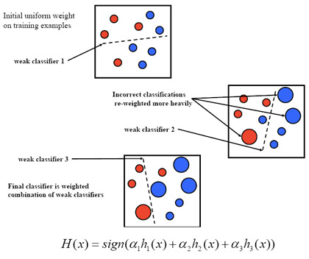
Classifier : AdaBoost
Feature Selection in Training
Randomly Sample a set of features
A weighted linear combination of selected features
Notes:
Only select a subset of features !
How to select?
Should we select the best N features? No, normally a lot of features are overlapped

Slide 40
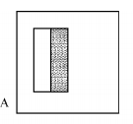
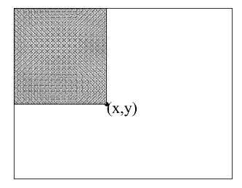
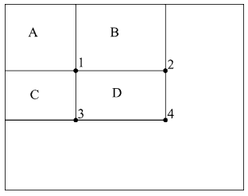
Speed up the feature extraction : Integral Images
More efficient way to calculate the sum of window
Integral Image : value at (x, y) = sum of all the pixels above and to the left.
How to calculate D ? Answer : 4+1 - (2+3)
Source from : Robust Real-Time Face Detection

Slide 41
Cascade Model
To handle sliding window problems
h*w resolution, s scales
e.g. at run time, we need to do O(h*w*s) class-action

Slide 42
Cascade Model
Basic Idea :
At Stage 1
is there a pedestrian in the current window?
Yes -> go to stage 2
No -> this window does not contain a pedestrian
False
Input
Image
AdaBoost Classifier
1
True
AdaBoost Classifier
2
True
True
AdaBoost Classifier
N
…
True

Slide 43
Cascade Model
Basic Idea :
At Stage 2
is there a pedestrian in the current window?
Yes -> go to stage 3
No -> this window does not contain a pedestrian
False
Input
Image
AdaBoost Classifier
1
True
AdaBoost Classifier
2
True
True
AdaBoost Classifier
N
…
True

Slide 44
Cascade Model
Basic Idea :
At Stage N (last one)
is there a pedestrian in the current window?
Yes -> Contain a pedestrian
No -> this window does not contain a pedestrian
False
Input
Image
AdaBoost Classifier
1
True
AdaBoost Classifier
2
True
True
AdaBoost Classifier
N
…
True

Slide 45
Cascade Model : Training
At Stage 1
initial N pedestrian training samples
Randomly sample N nonpedestrian samples
Train criteria -> 50% false positive, at 99.5% detection rate
False
AdaBoost Classifier
True
AdaBoost Classifier
True
True
AdaBoost Classifier
…
True

Slide 46
Cascade Model : Training
At Stage 2
same N pedestrian training samples
Collect a set of N false positives of the cascade up to the previous layers
Train criteria -> 50% false positive, at 99.5% detection rate
False
AdaBoost Classifier
True
AdaBoost Classifier
True
True
AdaBoost Classifier
…
True

Slide 47
Cascade Model Idea
The first stages prune most of the false positives.
Average computation time is significantly reduced
More efficiency in testing time.

Slide 48
State-Of-the-Arts
Pedestrian detection at 100 frames per second, CVPR 2012
Extract the learned features more efficient
FAST , 100 frames per second
Use CPU+GPU
https://www.youtube.com/watch?v=htLRKbVaSDw

Slide 49
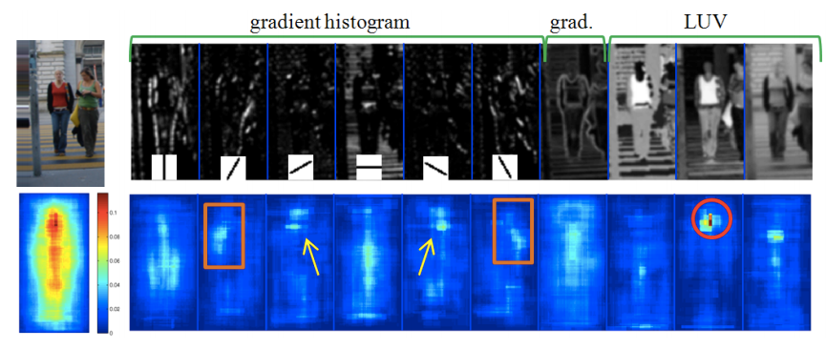
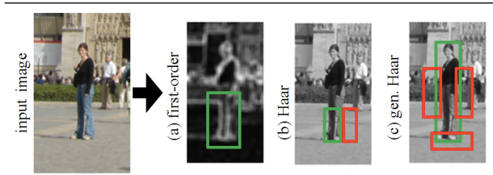
More Complicated features from Haar Wavelets
Notes:
Channels
talk about more complicated wavelets

Slide 50
N Models, 1 image scale
scales N is usually in the order of ~50 scales
Need a lot of data for this method!
overfitting

Slide 51
1 model, N image scales
training a canonical scale is delicate
how to decide the size?
high resolution scales and blurry low scales
Recompute features multiple times in runtime
Notes:
High resolution image and blurry low resolution image will exist and same time

Slide 52
1 model, N/K image scales
rescale at feature space directly.
HoG cannot

Slide 53
N/K model, 1 image scales
Get approximated models quickly
for example, N=50, K=10
5 models *K = 50
Notes:
Instead of retrained models,they synthesize more models from current 5 models

Slide 54
The weaker learner
In Random Forests or Adaboost
A weak learner consists of
a channel
rectangles(size, location)
a decision threshold

Slide 55
The weaker learner
After rescaling S
A weak learner consists of
a channel -> same
rectangles ->scale by S
a decision threshold ->scale by r(S)
Approximation
Notes:
get new weak learner by approximation quickly

Slide 56
Ideas
Use features which can be rescaling directly
Get multiple classifier models by synthesizing from few models

Slide 57
What’s more ?
Different features
Current HoG is dominant, people tries to concatenate this with other features
Extract HoG on different color space (LUV)
Learned from neural networks(deep learning)

Slide 58
What’s more ?
Different Classifiers
NonLinear SVM ?
too slow in testing time
Efficient kernel in testing time?
Random Forests
Neural Network(Deep Learning)
Notes:
random forests can do several computer vision problems in real time. Kinect

Slide 59
What’s more ?
Reduce number of windows
Cascade models
BING: Binarized Normed Gradients for Objectness Estimation at 300fps, CVPR 2014

Slide 60
More about current status
Monocular Pedestrian Detection: Survey and Experiments, Markus Enzweiler, and Dariu M. Gavrila, PAMI 2009
Pedestrian Detection: An Evaluation of the State of the Art, , Piotr Doll ´ ar, Christian Wojek, Bernt Schiele, and Pietro Perona, PAMI 2012

Slide 61
Thank you for your Attention & Questions

