Slide 1
Introduction to Fault-Tolerance
Amos Wang
Credit from:
Dr. Axel Krings, Dr. Behrooz Parhami, Prof. Jalal Y. Kawash, Kewal K.Saluja, and Paul Krzyzanowski

Slide 2
Introduction
Fault tolerance is related to dependability
  Availability
  Reliability
  Safety
  Maintainability

Slide 3
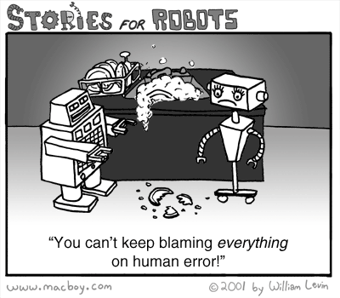
Faults
Due to a variety of factors
  Hardware failure
  Software bugs
  Operator errors
  Network errors/outages
Duration
  transient faults
  intermittent faults
  permanent faults

Slide 4
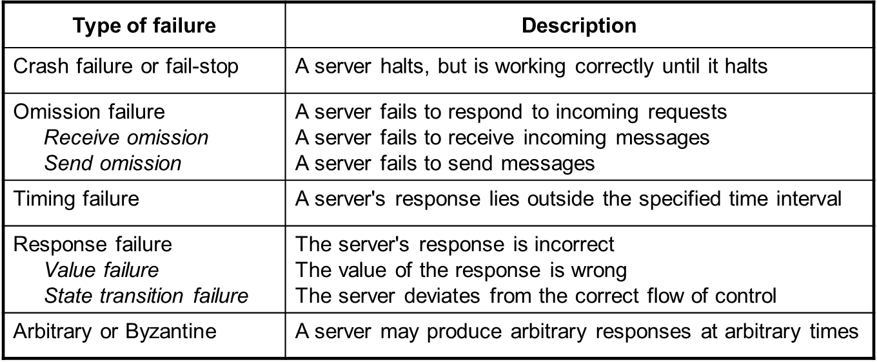
Failure Models
Notes:
A Byzantine fault is an arbitrary fault that occurs during the execution of an algorithm by a distributed system. It encompasses both omission failures and response failures.
When a Byzantine failure has occurred, the system may respond in any unpredictable way.

Slide 5
Fault Tolerance
Fault Avoidance
  Design a system with minimal faults
Fault Removal
  Validate/test a system to remove the presence of faults
Fault Tolerance
  Deal with faults!

Slide 6
Redundancy
Redundancy types:
  time redundancy
    Timeout & retransmit
  software redundancy
    N-versions
  information redundancy
    Hamming codes, parity memory ECC memory
  hardware redundancy
    RAID disks, backup servers

Slide 7
Time redundancy
Key Concept - do a job more than once over time
  examples
    re-execution
    re-transmission of information
  different faults and capabilities of different schemes
    transient faults
      re-execution and re-transmission can detect such faults provided we wait for transient to subside
    permanent faults
      send or process shifted version of data
      send or process complemented data during second transmission

Slide 8
Software Redundancy
Multiple teams of programmers
Write different versions of software for the same function
The hope is that such diversity will ensure that not all the copies will fail on the same set of input data

Slide 9
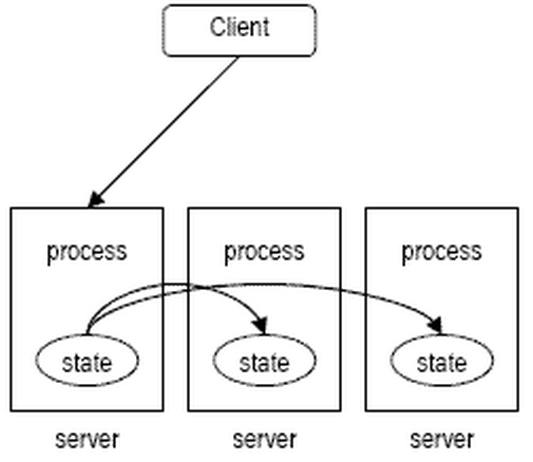
Distributed System
Passive Replication
  Only one server processes client’s request

Slide 10
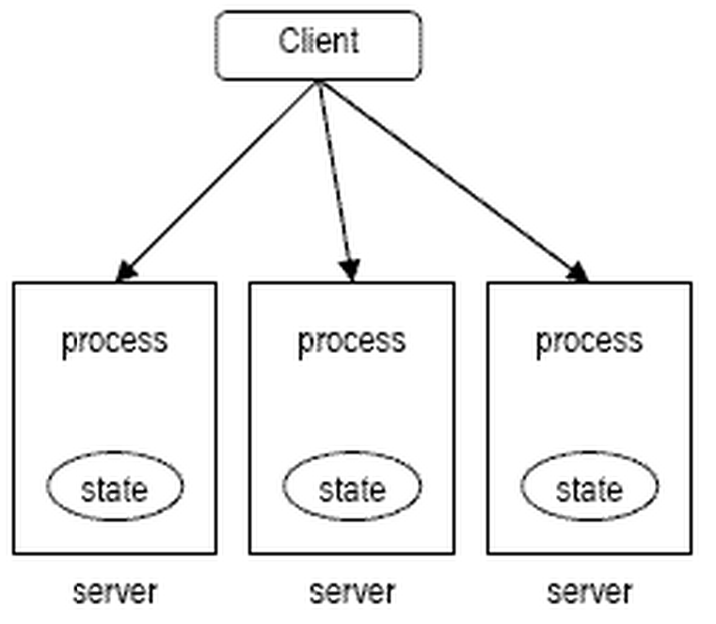
Distributed System
Active Replication
  Client’s request processed by all servers
  Atomic broadcast
  Tolerate byzantine faults

Slide 11
Information Redundancy
Key concept - add redundancy to information/data
  all schemes use Error detecting or Error correcting coding
  helps to catch system induced errors
  parity checks
  Ex: Error-Correcting Parity Codes, Hamming code, Cyclic code

Slide 12
Error-Correcting Parity Codes
Simplest scheme: data is organized in a 2-dimensional array
A single-bit error anywhere will cause a row and a column to be erroneous
0 | 0 | 0 | 1 | 1 | 1 | 1
1 | 0 | 1 | 0 | 1 | 1 | 0
1 | 1 | 0 | 0 | 0 | 0 | 0
0 | 0 | 0 | 1 | 1 | 1 | 1
1 | 1 | 1 | 1 | 1 | 1 | 0
1 | 0 | 0 | 1 | 0 | 0 | 0

Slide 13
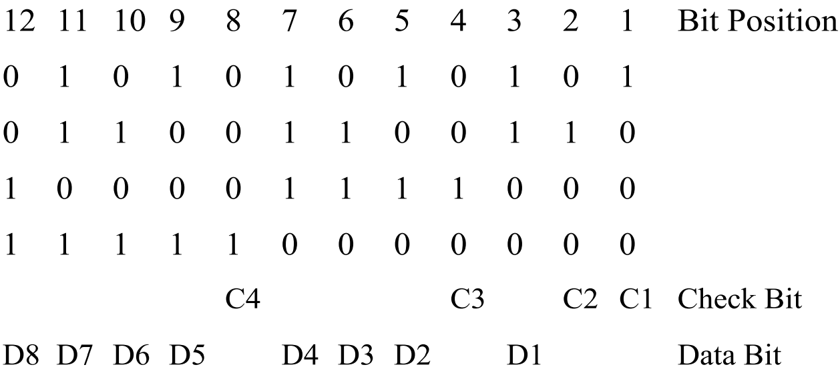

Hamming Code
${m≤2}^{n}$; $k=n+1$ (m is data bit)

Slide 14
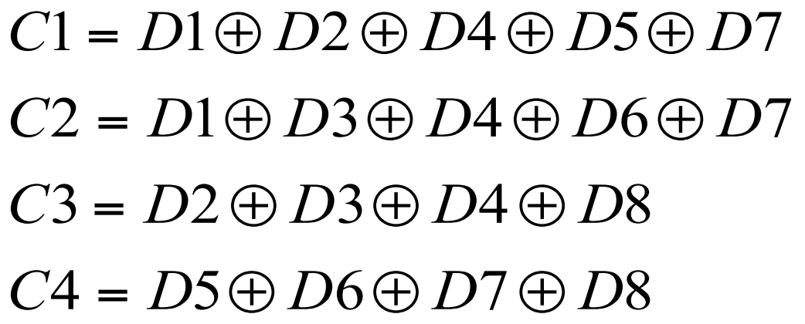
Compute Check

Slide 15

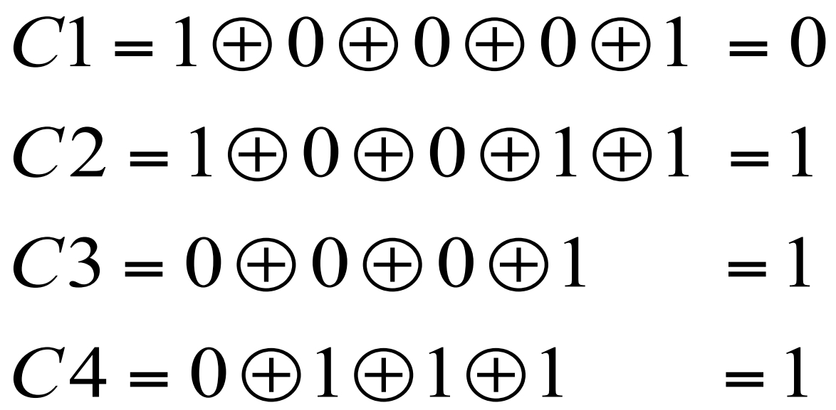
Overlapped Parity
Example
  data = 1110 0001
  compute check bits:

Slide 16
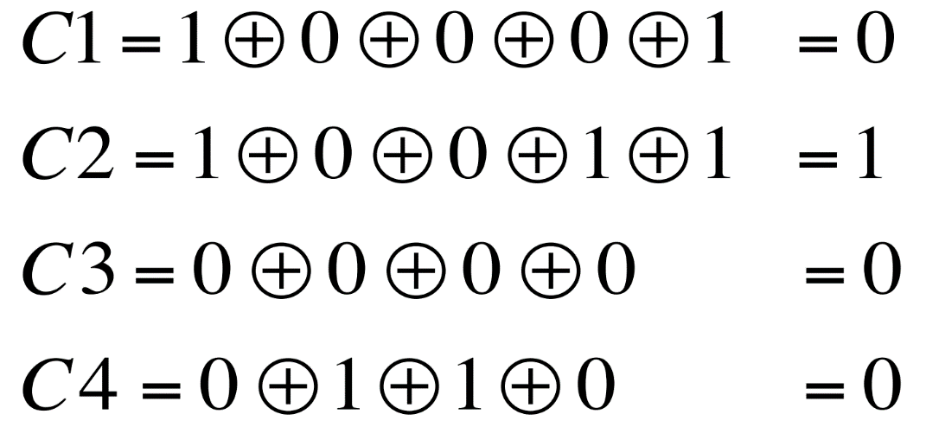
Overlapped Parity
Example
  data sent is 1110 0001; transmitted check bits are 1110
  assume received data is: 0110 0001
    » note that most sig. bit has been corrupted/flipped
  received check bits are: 1110
  recomputed check bits:

Slide 17
Overlapped Parity
Syndrome: 1110 XOR 0010 = 1100 (D8 as faulty)

Slide 18
Hardware Redundancy
Passive (static)
  – uses fault masking to hide occurrence of fault
  – e.g. voting
Active (dynamic)
  – uses comparison for detection and/or diagnoses
  – remove faulty hardware from system
Hybrid

Slide 19
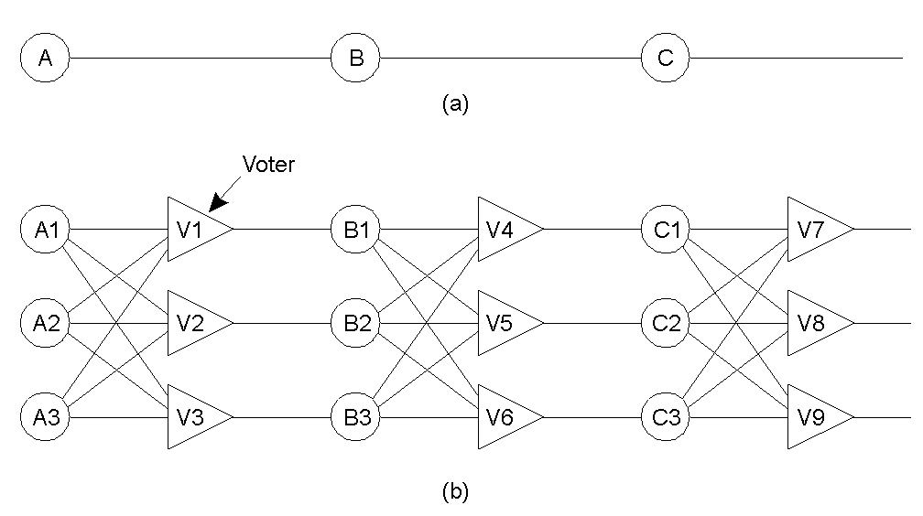
Passive Hardware Redundancy
N-Modular Redundancy (NMR)
  – N independent modules replicate the same function
  – requirements: N >= 3 !
TMR (Triple Modular Redundancy)

Slide 20
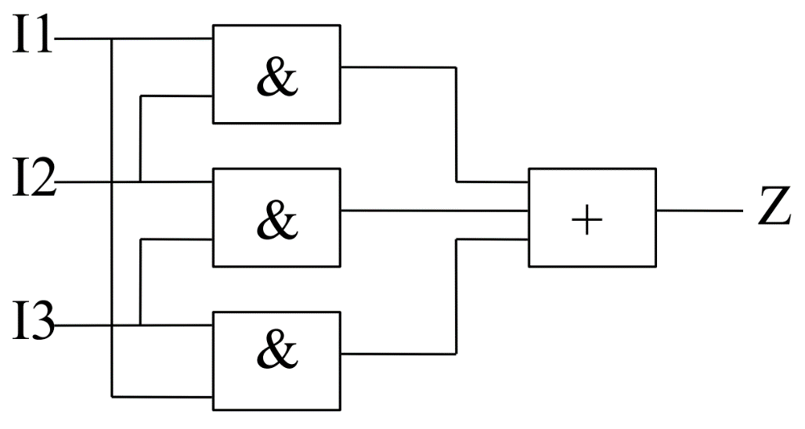

Voting
if inputs are independent, the NMR can mask up to$\left\lfloor \frac{(N−1)}{2}\right\rfloor$ faults
e.g. 1 bit majority voter (3 AND gates ORed)

Slide 21
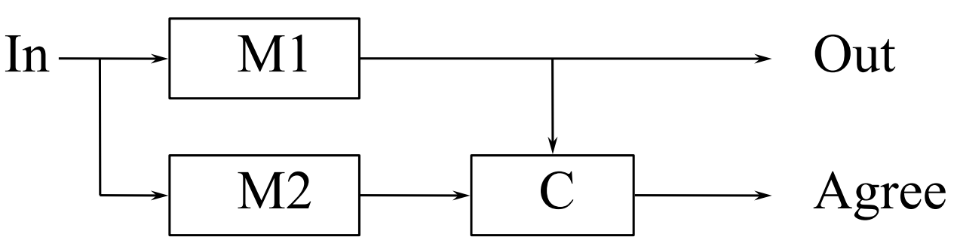
Active Hardware Redundancy
Duplicate and Compare
  can only detect, but NOT diagnose
  comparator is single point of failure

Slide 22
Active Hardware Redundancy
Stand-by-sparing
  only one module is driving outputs
  error detection => switch to a new module

Slide 23
Active Hardware Redundancy
Pair and Spare
  duplication combined with compare & spare
  2 modules are always on-line

Slide 24
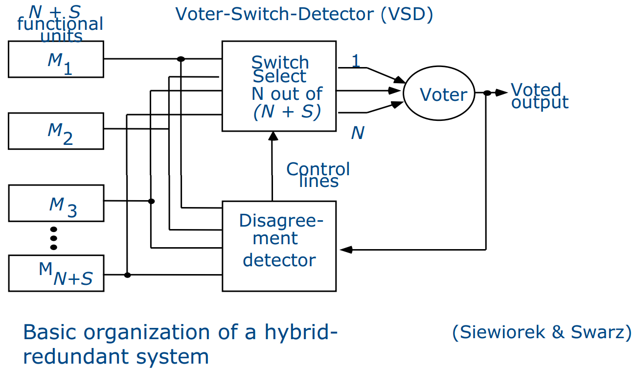
Hybrid Hardware Redundancy
NMR with spares
  N active + S spare modules (off-line)
  replace erroneous module from spare pool
  maintains N constant
  uses N-of-(N+S) switch

Slide 25
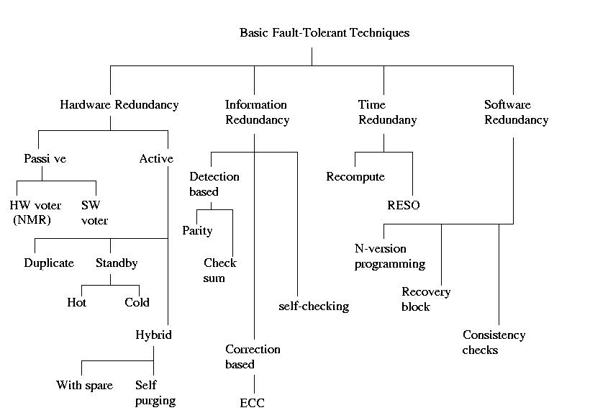
Summary

Slide 26
Reference
http://en.wikipedia.org/wiki/Fault_tolerance
http://www2.cs.uidaho.edu/~krings/CS449/
http://www.ece.ucsb.edu/Faculty/Parhami/ece_257a.htm
http://www.ecs.umass.edu/ece/koren/FaultTolerantSystems

Slide 27
Fault tolerance in automotive systems
Namhoon Kim

Slide 28
Fault Behavior
Fail-operational (FO): One failure is tolerated. This is required if no safe state exists immediately after the component fails.
Fail-safe (FS): After one (or several) failure(s), the component directly reaches a safe state (passive fail-safe) or is brought to a safe state by a special action (active fail-safe).
Fail-silent (FSIL): After one (or several) failure(s), the component exhibits quiet behavior externally and therefore does not wrongly influence other components.

Slide 29
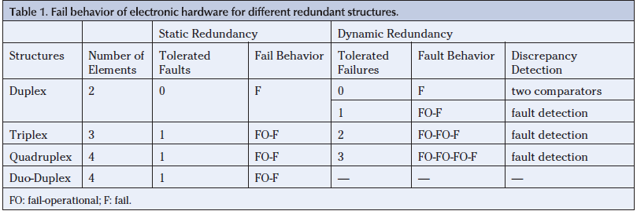
Fail Behavior
Credit from Fault-Tolerant Drive-by-Wire Systems
Notes:
This table shows degradation steps to fail-operational for different redundant structures.

Slide 30
Automotive Electronic Systems
Communications network
Sensors and actuators
Electronic Control Unit (ECU)
Notes:
In an automotive system, it is required that fault-tolerance should be provided in these application domain.

Slide 31
Communication Network
Figure from: Expanding automotive Electronic Systems

Slide 32
Reliable Communication
The network should remain active and working even in case of an error
Active redundancy and error detection
Two directions of operation
  Event-triggered (ET) systems
    transmissions are driven by the occurrence of events
  Time-triggered (TT) systems
    transmissions are driven by the progress of time

Slide 33
Time-triggered vs. Event-triggered
Dependability is much easier to ensure using a TT bus
  Access to the medium is deterministic
  Adding new nodes without affecting existing ones is simple
  The behavior of a TT system is predictable
  Message transmission can be used as “heartbeats”

Slide 34
Fault Tolerance In Communication
EMIs (Electro-Magnetic Interferences)
  EMIs can be radiated by in-vehicle devices (switches, relays, and etc.)
  Use a resilient physical layer (e.g., optical)
  Or replicate the transmission channels
  Cyclic Redundancy Check (CRC) can detect the corrupted frame.

Slide 35
Fault Tolerance In Communication
Bus guardian component
  Avoids “babbling idiots” situation
  Restricts the node’s ability to transmit
  Allows transmission only when the node exhibits a specified behavior
  Ideally, the bus guardian should have its own copy of the communication schedule and its own power supply and should be able to construct the global time itself
  Due to cost, these assumptions are not fulfilled in general

Slide 36
In-Vehicle Networks
Two or three separate controller area networks (CANs)
  A low-speed CAN (< 125kbps) manages “comfort electronics”
  A high-speed CAN runs more real-time-critical functions
  A very cost and performance effective solution during the last 20 years
Local interconnect network (LIN)
  A cheap serial network
  A master-slave, time-triggered protocol
  On-off devices (door locks, sunroofs, rain sensors, door mirrors)

Slide 37
In-Vehicle Networks
Media-oriented systems transport (MOST)
  A fiber-optic network protocol with capacity for high-volume streaming
  For multimedia networking in automobiles
  Redundant double ring configurations for safety-critical applications
  Developed by more than 50 firms (including Audi, BMW, Daimler-Chrysler, Toyota, Volkswagen, Volvo)

Slide 38
In-Vehicle Networks
FlexRay
  BMW, Bosch, GM, Daimler-Chrysler, Philips, and Motorola are collaborating on FlexRay
  A fault-tolerant protocol designed for high data rate applications
    time-triggered communication with bus guardian and clock synchronization on dual wires
  Allow event-triggered behavior
  Real-time data transmission with bounded latency
  Full use of FlexRay was introduced in 2008 in the new BMW 7 Series

Slide 39
Sensors and Actuators
Sensors are the first in the information flow
Static or dynamic redundancy with cold or hot standby can be used
The fail-silence property of actuators is essential
  Fail-silent: After a failure the component remains silent, so that it can not wrongly influence other components

Slide 40
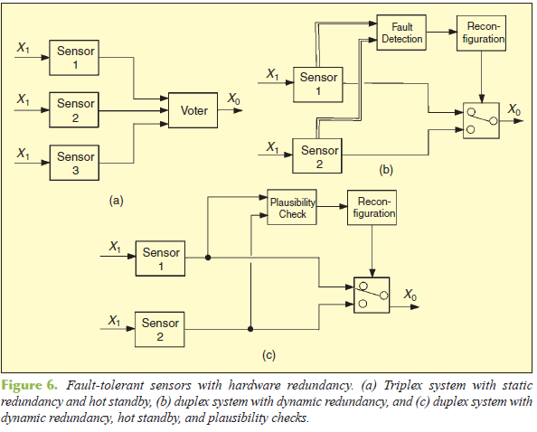
Fault-Tolerant Sensors
Credit from Fault-Tolerant Drive-by-Wire Systems

Slide 41
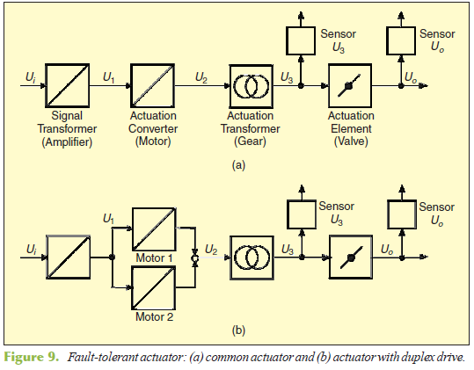
Fault-Tolerant Actuator
Credit from Fault-Tolerant Drive-by-Wire Systems

Slide 42
An Example Brake-by-Wire System
Electromechanical brake, developed by Continental Teves, Germany
The system consist of
  4 electromechanical wheel brake modules
  An electromechanical brake pedal module
  A communication and power system
  A central brake management computer
Credit from Fault-Tolerant Drive-by-Wire Systems

Slide 43
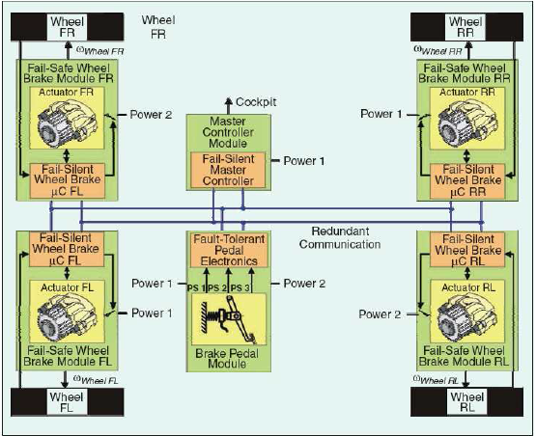
An Example Brake-by-Wire System
The communication system and power system have dynamic redundancy with hot standby.
Figure from Safety in automotive by-wire systems

Slide 44
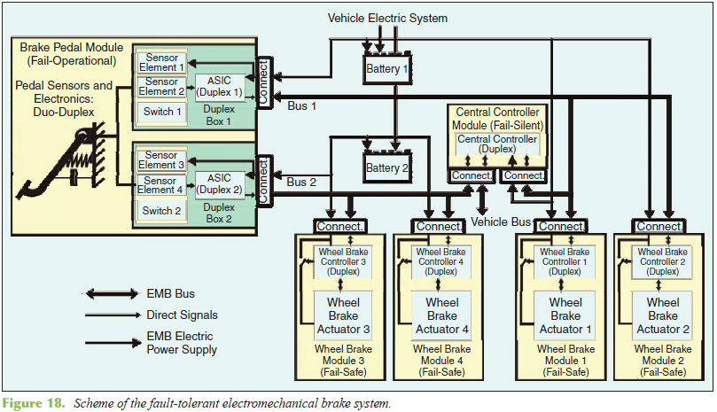
An Example Brake-by-Wire System
Figure from Safety in automotive by-wire systems

Slide 45
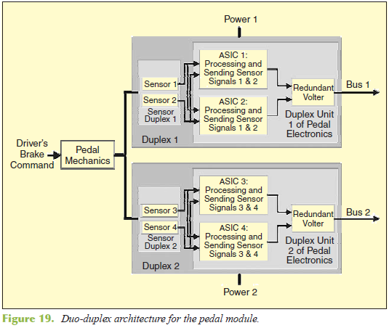
An Example Brake-by-Wire System
Figure from Safety in automotive by-wire systems

Slide 46
ECU
Lock-step dual processor architecture
Figure from Fault Tolerant Platforms for Automotive Safety Critical Applications

Slide 47
Lock-Step Architecture
Two processors referred to as the master and the checker
Execute the same code being strictly synchronized
The master has access to the system memory and drives all system outputs
While, the checker continuously executes the instructions fetched by the master
The compare logic checks the consistency of their data-, address- and control-lines.
Notes:
The detection of a disagreement on the value reveals the presence of a fault on either CPU.

Slide 48
ECU
Loosely-synchronized dual processor architecture
Figure from Fault Tolerant Platforms for Automotive Safety Critical Applications

Slide 49
Loosely-Synchronized Arch.
Two CPUs run independently having access to distinct memory subsystems
A real-time operating system handles interprocessor communication and synchronization
The OS is responsible for error detection (cross-checks), correction and containment
Critical tasks are executes in parallel as software replicas
Notes:
Two CPUs can run different non-critical tasks in parallel.

Slide 50
ECU
Triple modular redundant (TMR) architecture
Figure from Fault Tolerant Platforms for Automotive Safety Critical Applications

Slide 51
TMR Architecture
Three identical CPUs execute the same code in lock-step
A majority vote of the outputs masks any possible single CPU fault
The memory and communication faults can be masked employing ECC techniques

Slide 52
ECU
Dual lock-step architecture
Figure from Fault Tolerant Platforms for Automotive Safety Critical Applications

Slide 53
Dual Lock-Step Architecture
Consists of the combination of two fail-silent channels
Each one consists of a lock-step architecture
Can be used in different configurations
  Two core execute the same code in lock-step → provides fault-tolerance capability
  Two channels can operate independently → behaves like a traditional dual processor solution

Slide 54
References
M. Davies, Safety in automotive by-wire systems, Vienna University of Technology, Jun. 2004.
G. Leen and D. Heffernan, Expanding Automotive Electronic Systems, IEEE Computer, vol. 35, no. 1, pp. 88-93, Jan. 2002.
R. Isermann, R. Schwarz, and S. Stoelzl, Fault-Tolerant Drive-by-Wire Systems, IEEE Control Systems, vol. 22, no. 5, pp. 64-81, Oct. 2002.
N. Navet and F. Simonot-Lion, Fault Tolerant Services For Safe In-Car Embedded Systems, in The Embedded Systems Handbook, CRC Press, Aug. 2005.
M. Baleani, A. Ferrari, L. Mangeruca, A. Sangiovanni-Vincentelli, M. Peri, and S. Pezzini, Fault-Tolerant Platforms for Automotive Safety-Critical Applications, In Proceedings of the International Conference on Compilers, Architectures and Synthesis for Embedded Systems, pp. 170-177, 2003.
D. Wanner, A. Trigell, L. Drugge, and J. Jerrelind, Survey on Fault-Tolerant Vehicle Design, In Proceedings of 26th Electric Vehicle Symposium, May 2012.

