Slide 1
Performance of Computer Vision
Amos Wang

Slide 2
Computer Vision with Real-Time
Real-Time standard in computer vision is 30 frames per second
However, there is no guarantee that the system always reach 30 frames per second.

Slide 3

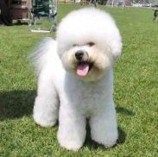
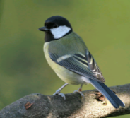

A common computer vision pipeline for image classification
Feature Extraction
Feature Extraction
Coding
K-means Clustering
Pooling
dictionary
Classifier
Slide credit: http://ufldl.stanford.edu/eccv10-tutorial/

Slide 4

Flowchart
Training
Testing
Extract Training Sample
Multiple Scales
Feature Extraction
Sliding Window
Classifier Selection
Feature Extraction
Validation
Classify

Slide 5
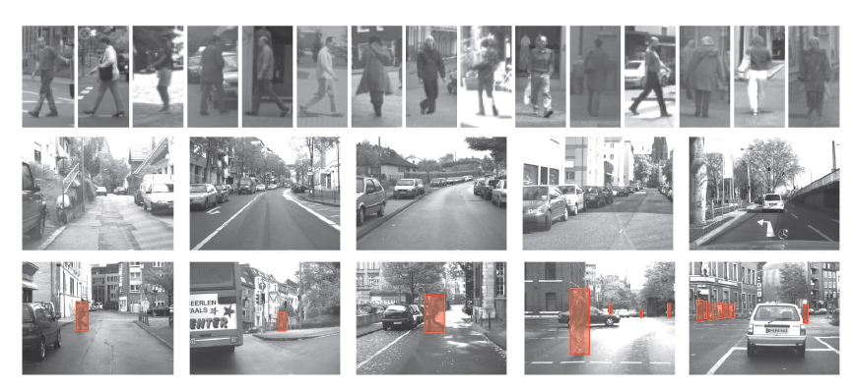
Extract Training Sample
Extract Training Sample
Feature Extraction
Dataset : Daimler-DB
Classifier Selection
Positive
Validation
Negative
Test
source : Monocular Pedestrian Detection Survey and Experiments, PAMI 2009

Slide 6
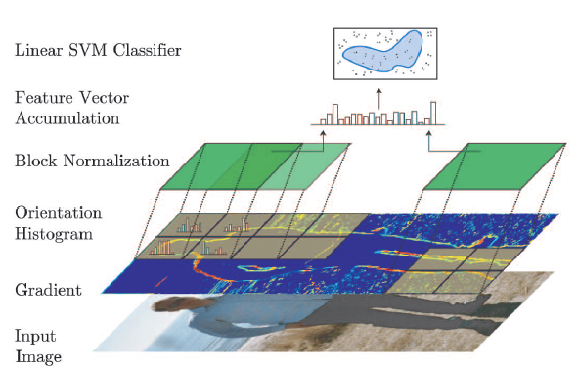
Feature Extract
Extract Training Sample
Feature Extraction
HoG ( Histogram of Orientated Gradient)
Classifier Selection
Validation

Slide 7
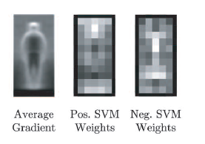
Classifier Selection
Extract Training Sample
Feature Extraction
Linear SVM
Classifier Selection
Validation
  source :Pedestrian Detection: An Evaluation of the State of the Art, PAMI 2012

Slide 8
Paper I
Real-time pedestrian detection and tracking at nighttime for driver-assistance systems, Ge, J., Yupin L., and Gyomei T., Intelligent Transportation Systems, IEEE Transactions on 10.2 (2009).
  produce a detection rate of more than 90%
  as fast as 30 FPS on a Pentium IV 3.0-GHz

Slide 9
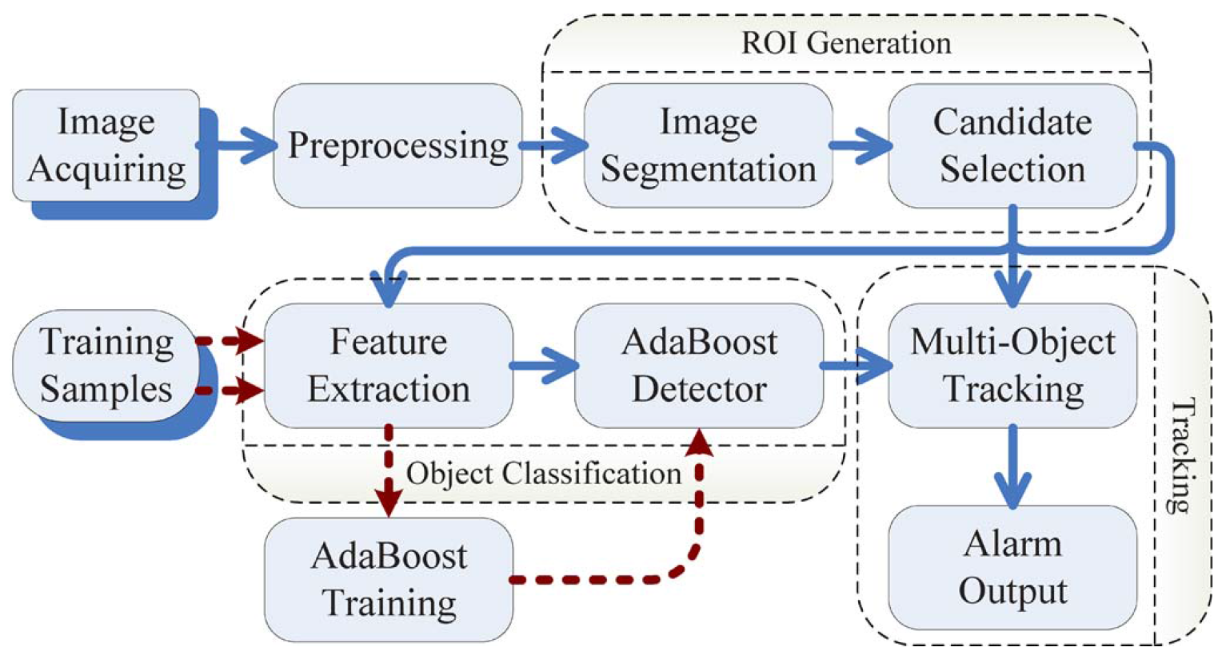
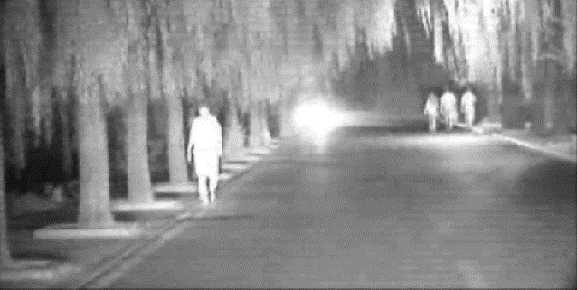
Overview of the system modules

Slide 10
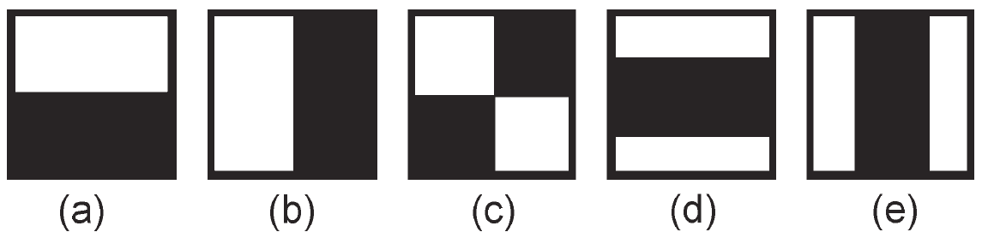
Pedestrian classification
Challenge: high performance and real-time constraint vs. the large intra class variability in the pedestrian class
  Solution:
  a tree-structured two-stage detector
  based on Haar-like and HOG features

Slide 11
Paper II
Hardware architecture for high-accuracy real-time pedestrian detection with CoHOG features , Hiromoto, Masayuki, and Ryusuke Miyamoto, Computer Vision Workshops, 2009 IEEE 12th International Conference on. IEEE, 2009.
  the proposed architecture is implemented on a Xilinx Virtex-5 FPGA
  achieves real-time pedestrian detection on 38 fps 320x240 video

Slide 12
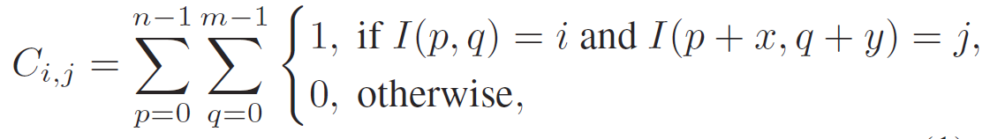
CoHOG features
A high-dimensional feature descriptor that uses pairs of gradient orientations
Each co-occurrence matrix C with an offset (x, y) can be expressed as a 64-dimensional vector fk,x,y.

Slide 13
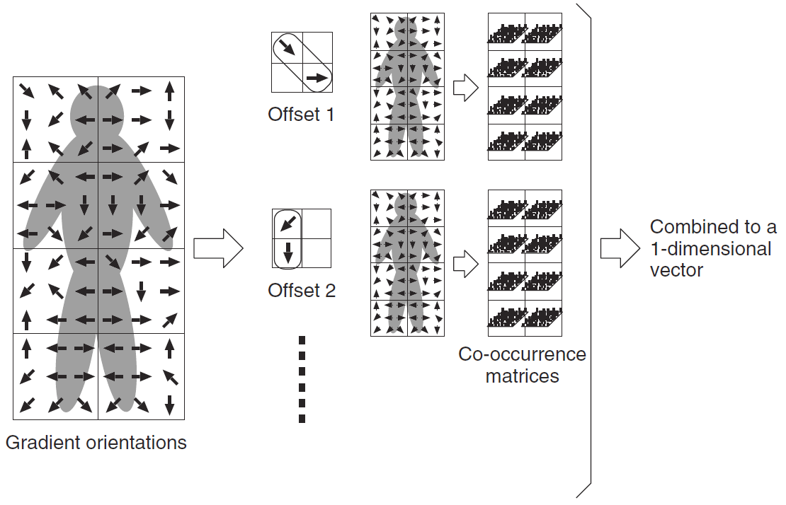
Parallel calculation of histograms
Ex: K × 31 co-occurrence matrices for all combinations of block k and offset (x, y) are calculated
  K × 31 parallelism at its maximum with this parallelization approach

Slide 14
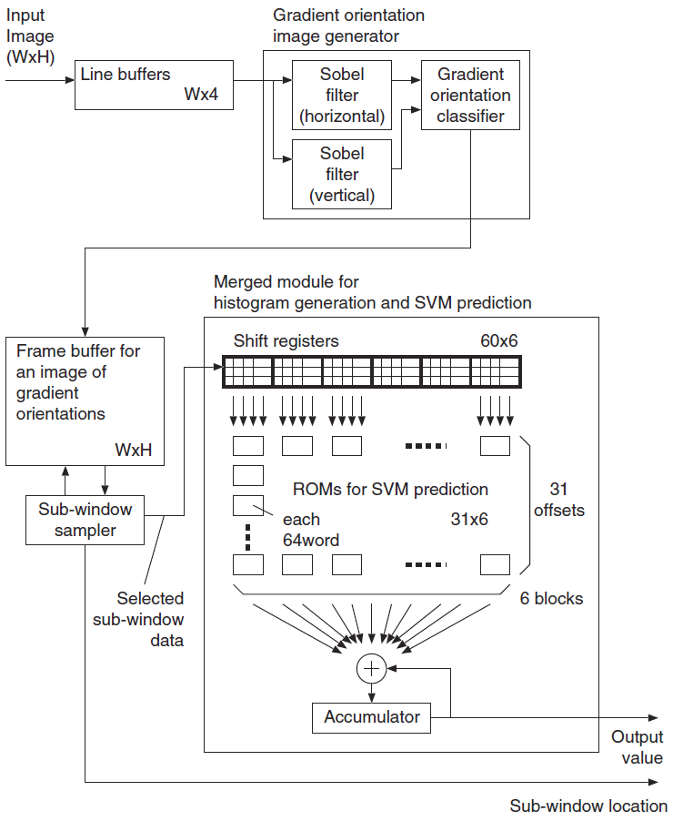

Slide 15
Paper III
Pedestrian detection at 100 frames per second, Benenson, Rodrigo, et al., Computer Vision and Pattern Recognition (CVPR), 2012 IEEE Conference on. IEEE, 2012.
  on a single CPU+GPU desktop machine
  reach 135 fps

Slide 16
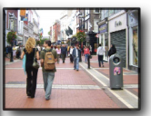

The process of Detection
Multiple Scales
Generate multiple images on different scales
Sliding Window
Feature Extraction
Classify
Figure from : Pedestrian detection at 100 frames per second

Slide 17
The process of Detection
Multiple Scales
use sliding window on all locations
Sliding Window
Feature Extraction
Classify
Figure from : Pedestrian detection at 100 frames per second

Slide 18

The process of Detection
Multiple Scales
Extract HoG from current window
Sliding Window
Feature Extraction
Classify
Figure from : Pedestrian detection at 100 frames per second

Slide 19

The process of Detection
Multiple Scales
Use LinearSVM to classify
Accurate Criteria
Normally if >= 0.5, we consider it is correct.
Sliding Window
Feature Extraction
Classify
Figure from : Pedestrian detection at 100 frames per second

Slide 20
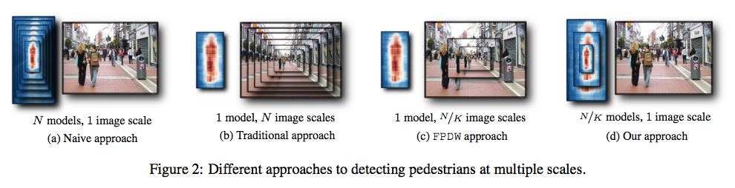
N Models, 1 image scale
scales N is usually in the order of ~50 scales
Need a lot of data for this method!
  overfitting

Slide 21
1 model, N image scales
training a canonical scale is delicate
  how to decide the size?
  high resolution scales and blurry low scales
Recompute features multiple times in runtime

Slide 22
1 model, N/K image scales
rescale at feature space directly.
  HoG cannot

Slide 23
N/K model, 1 image scales
Get approximated models quickly
  for example, N=50, K=10
  5 models *K = 50

Slide 24
Let’s go back to real-time issue
In order to implement a real-time, there are some possible ways as following
  Use real-time programming language: Ada 95, Real-Time Java and Real-Time POSIX
  Get help from RTOS: LynxOS, QNX, RTLinux, and Litmus^{RT}

