Slide 1
Formal Verification of Cyberphysical Systems
Micaiah Chisholm

Slide 2
Future Certification Methods
As policies shift towards formal verification techniques, what tools do we use?
Problem studied by multiple groups. A few proposed solutions.

Slide 3
KeYMaera
http://symbolaris.com/info/KeYmaera.html
Verification tool for hybrid systems
Used to verify algorithms in several cyber-physical domains
Railway
Automotive
Aviation
Robotics
Circuits
Notes:
Hybrid systems: Systems with dynamics that interact with both discrete and continuous dynamics.
KeYMaera: Developed by Andre Platzer, Associate Professor at CMU

Slide 4
Application: Distributed Car Control
V2V vs V2I
Vehicle to vehicle
Vehicle to roadside infrastructure
Distributed car control
Verifying V2V and V2I communication vs. V2V and V2I coordination
How to ensure local decisions don’t have unforeseen consequences?
Notes:
Example: An autonomous vehicle suddenly stops to avoid a crash, and as a result, is rear-ended.

Slide 5
Application: Adaptive Cruise Control
Adaptive cruise control: Hybrid, distributed, and now formally verified.
In Michael Butler and Wolfram Schulte, editors, 17th International Symposium on Formal Methods, FM, Limerick, Ireland, Proceedings, volume 6664 of LNCS, pages 42-56. Springer, 2011.

Slide 6
ACC Algorithms Formally Verified
First study to use general formal verification techniques to the specific problem
Uses formal proof calculus
Compared studies:
Examine simulated results for algorithms
Formally analyze highly restricted cases
Notes:
Other studies examine simulated results for proposed algorithms. A few formally analyze certain use cases (ACC for two cars with a third driving wrong way)

Slide 7
ACC Algorithms Formally Verified
Defines control system as a quantified hybrid program (QHP)
Four QHPs:
Local Lane Control
Collision-free for 2 cars in 1 lane
Global Lane Control
Collision-free for any unchanging number of cars in 1 lane
Local Highway Control
Collision-free varying number of cars in 1 lane
Collision-free for multiple lanes
Collision-freedom for multiple lanes
Collision-freedom defined using predicate calculus
Verified using KeYmaera
Notes:
Example of QHP for LLC: Applies constraints on certain ecceleration behavior: maximum breaking of car in front, resulting restricting of car behind)

Slide 8
Future Work
Consider limitations of sensor data
Inaccuracies
Time synchronization
Asynchronous sensors

Slide 9
ModelPlex
Automatically generates “model monitors” that observe sequences of state for compliance with models.
Monitors generated for models validated in KeyMaera
Adaptive cruise control
Traffic control
Train control systems

Slide 10
Formal Methods in Avionics Certification

Slide 11
DO-333
Formal Methods Supplement to DO-178C
Formal Method Case Studies for DO-178C
http://shemesh.larc.nasa.gov/people/bld/ftp/NASA-CR-2014-218244.pdf
NASA report providing 3 case studies of formal methods used to meet DO-178C specifications
Examples illustrate:
Theorem proving
Model checking
Abstract interpretration

Slide 12
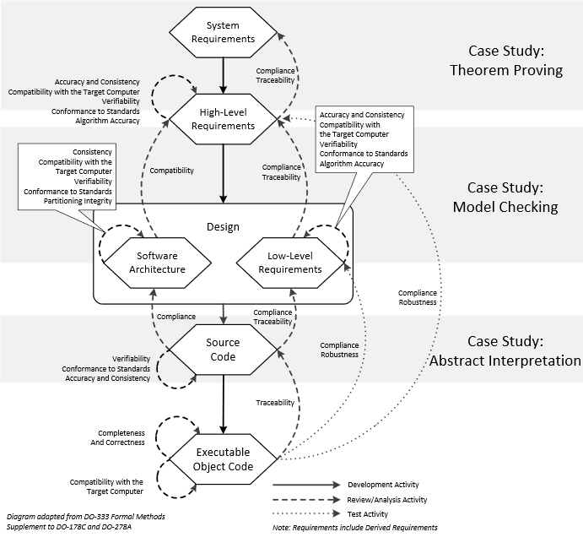

Slide 13
Flight Guidance System
Theorem proving applied to
Synchronization of dual channels
Model checking applied to
Mode logic of one channel
Abstract interpretation applied to
Source code of one FGS control law

Slide 14
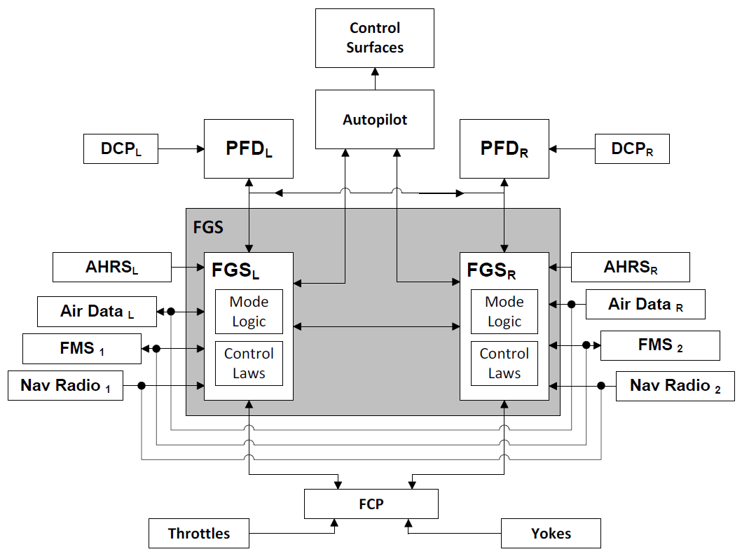
Notes:
Attitude Heading Reference System (AHRS)
Flight Management System (FMS)
Flight Control Panel (FCP)
Primary Flight Panel (PFD)
Display Control Panel (DCP) (Selecting Navigation sources), controls PFD display
Control Laws: Takes current and desired state of aircraft to compute pitch/roll guidance commands
Different laws active at different times
Mode Logic: Controls the control laws. Determines what lateral and vertical modes of operation are active

Slide 15
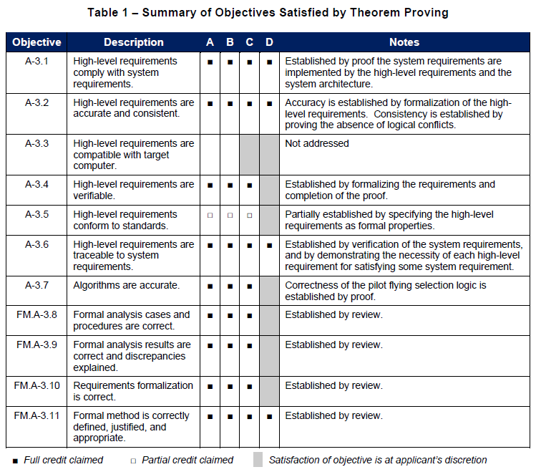

Slide 16
Certifying the Certification
FM.A requirements
Justify formal methods used
Prove reliability of proof tools
Must show certification tool provides “confidence at least equivalent” to process replaced

Slide 17
Case Studies Take Away
A broad range of formal methods apply
Can be used at most stages of development process
Some methods less automated than others
Formal methods must be certifiable
Formal method automation must be certifiable
BUT, no clear guidance as to what methods to use

