Slide 1
Response time analysis in real-time distributed automotive systems
Kecheng Yang

Slide 2
Reference Papers
Synthesis of task and message activation models in real-time distributed automotive systems.
W. Zheng, M. Di Natale, C. Pinello, P. Giusto, and A. S. Vincentelli. In DATE'07.
Optimizing end-to-end latencies by adaptation of the activation events in distributed automotive systems.
M. Di Natale, W. Zheng, C. Pinello, P. Giusto, and A. S. Vincentelli. In RTAS'07.
Period optimization for hard real-time distributed automotive systems.
A. Davare, Q. Zhu, M. Di Natale, C. Pinello, S. Kanajan, and A. S. Vincentelli. In DAC'07.

Slide 3
Motivation
Distributed architectures supporting the execution of real-time applications are common in automotive, avionic, and industrial control systems.
Different design and scheduling methodologies are used.

Slide 4
Scheduling methodologies
Avionic systems: static, time-driven schedules.
Automotive systems: many of them are designed based on run-time priority-based scheduling of tasks and messages

Slide 5
Automotive systems scheduling
run-time priority-based
Why: resource efficiency and
ultimately price concerns
Examples:
OSEK operating system standard*
the CAN bus arbitration model**

Slide 6
Task model
Dataflow, represented with a Directed Acyclic Graph, denoted {V,E,R}
The set of vertices V={o₁,...,o_{n}} is the set of objects. Each object o_{i} can be a task or a message.
The set of edges E={l₁,...,l_{m}} is the set of links.
A link l_{i} =(o_{h},o_{k}) connects the output port of o_{h}(the source) to the input port of o_{k}(the sink).
R={R₁,...,R_{z}}is the set of shared resources supporting the execution of the tasks (CPUs, ECUs) and the transmission of the messages (bus, CAN).

Slide 7
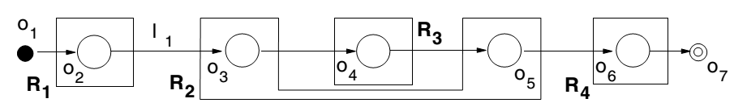
Task model example
A functional chain or Path from o_{i} to o_{j},or P_{i,j},is an ordered sequence P =[l₁,...,l_{n}] of links that, starting from o_{i} =src(l₁), reach o_{j} =snk(l_{n}) crossing a unique sequence of n+1 objects such that snk(l_{k})=src(l_{k+1}). o_{i} is the chain’s source and o_{j} its sink.

Slide 8
Notations
o_{i} is characterized by a maximum time requirement C_{i} and a resource R_{oi} that it needs to execute or for its transmission.
All objects are scheduled according to their priority π_{i} and indexes are assigned by decreasing priority levels. hp(i) denote the set of objects that have higher priorities than o_{i}.
r_{i} is the worst case response time of o_{i}.
w_{i} is defined as the worst case time spent from the instant the job is released with maximum jitter J_{i}.
r_{i} = J_{i} + w_{i}

Slide 9
Activation models
Periodic activation model: tasks are activated periodically, message transmission is triggered periodically.
better schedulability, worse end-to-end latency
Data driven activation model: task executions and message transmissions are triggered, respectively, by the arrival of the input data and by the availability of the signal data.
better end-to-end latency, worse schedulability (due to potential bursty activations)

Slide 10
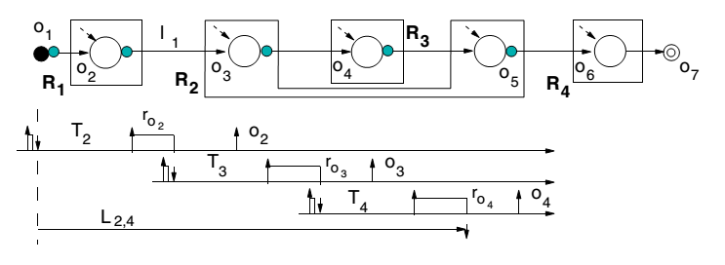
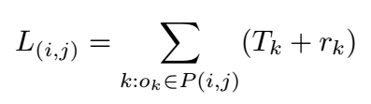
Periodic activation model
end-to end latency

Slide 11
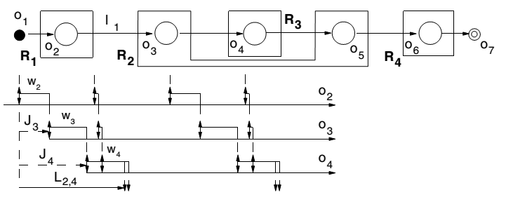

Data driven activation model
end-to end latency

Slide 12
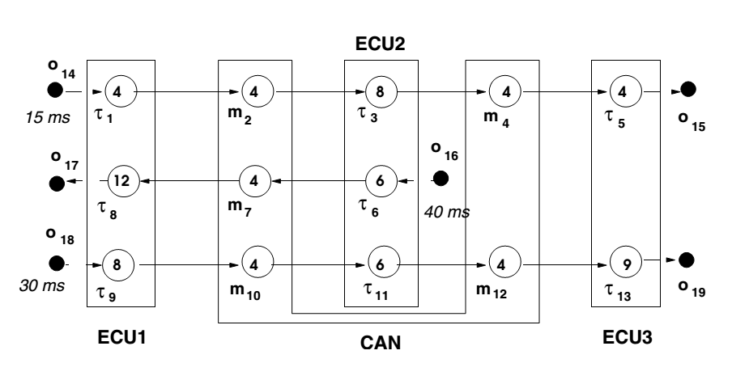
An example

Slide 13
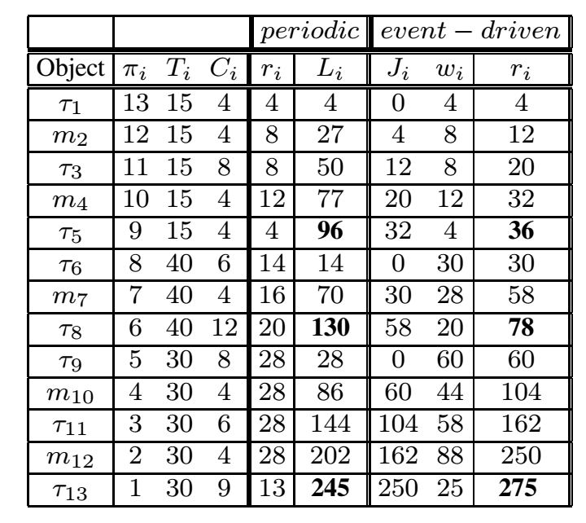

Slide 14
The problem
Deadlines may miss, applying either of the activation models.
E.g., deadlines of the three dataflows are
80, 120, 260

Slide 15
Hybrid
A subset of tasks and messages is periodic, and the remaining is event-driven.
Synthesis of task and message activation models in real-time distributed automotive systems.
W. Zheng, M. Di Natale, C. Pinello, P. Giusto, and A. S. Vincentelli. In DATE'07.
Optimizing end-to-end latencies by adaptation of the activation events in distributed automotive systems.
M. Di Natale, W. Zheng, C. Pinello, P. Giusto, and A. S. Vincentelli. In RTAS'07.

Slide 16
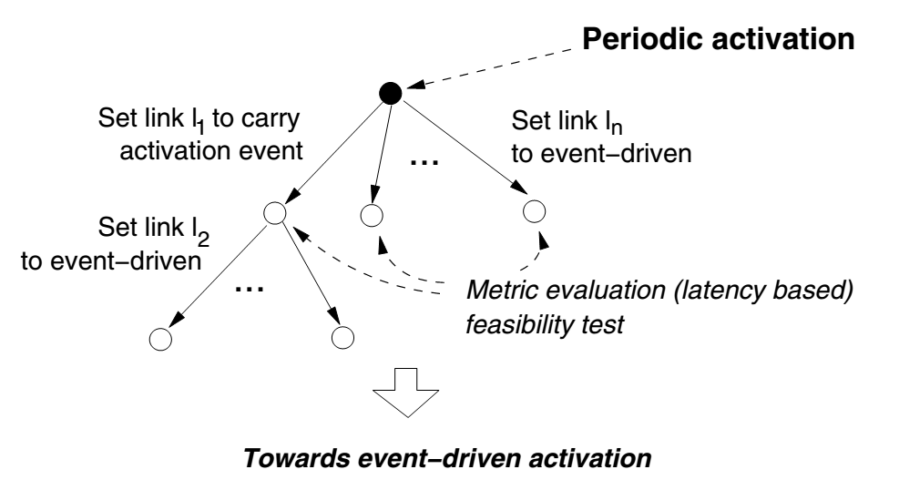
RTAS'07
proposed a search algorithm

Slide 17
DATE'07
mixed integer linear programming (MILP)
a set of linear constraints
different objective functions for various purposes of optimizing.
F₁=minimization of the number of event buffers
F₂ =minimization of the sum of the path latencies
F₃ =minimization of the sum of weighted lateness for all the paths exceeding the deadline
F₄ =minimization of the lowestpriority path latency

Slide 18
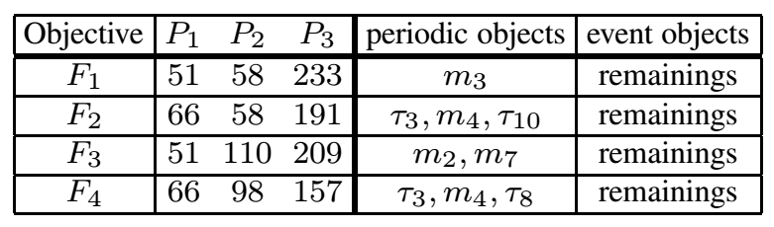
Result for the example system (DATE'07)

Slide 20
The problem (revisit)
Deadlines may miss, applying either of the activation models.
E.g., deadlines of the three dataflows are
80, 120, 260

Slide 21
Result for the example system (DATE'07)

Slide 22
Another optimization direction
Period optimization for hard real-time distributed automotive systems.
A. Davare, Q. Zhu, M. Di Natale, C. Pinello, S. Kanajan, and A. S. Vincentelli. In DAC'07.
Best paper award in DAC'07

Slide 23
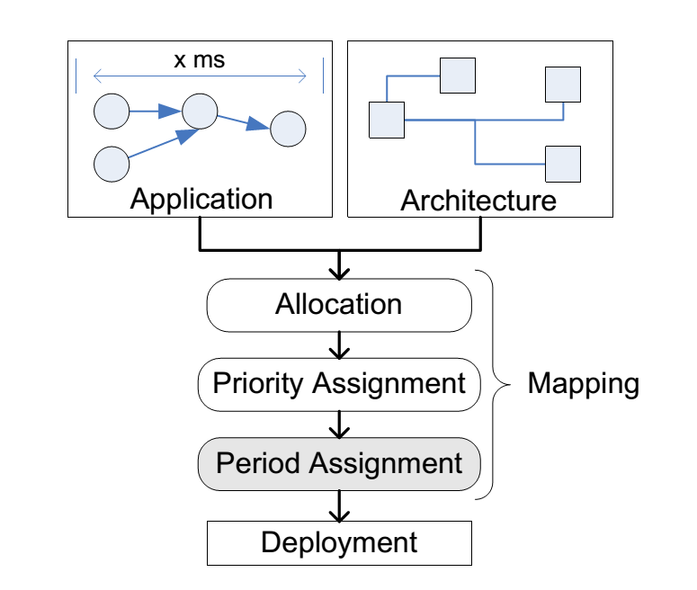
Design flow

Slide 24
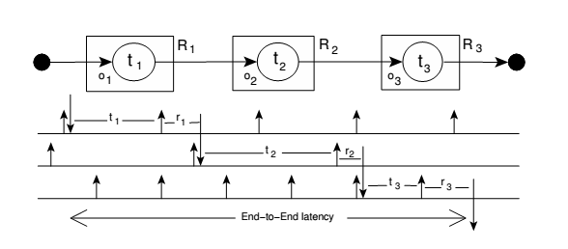

Activation model
the periodic activation model
end-to-end latency

Slide 25


Response Times
Task
Message

Slide 26
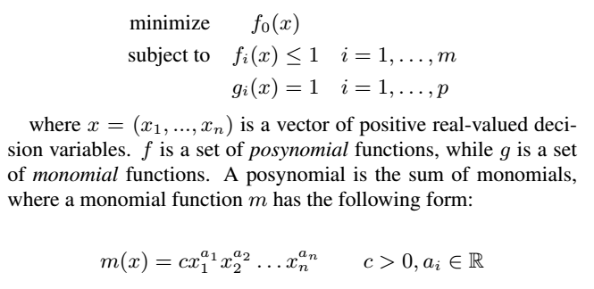
Geometric Programming (GP)
If x contains both integral and real-valued decision variables,
the resulting problem is a
mixed-integer geometric program (MIGP).

Slide 27
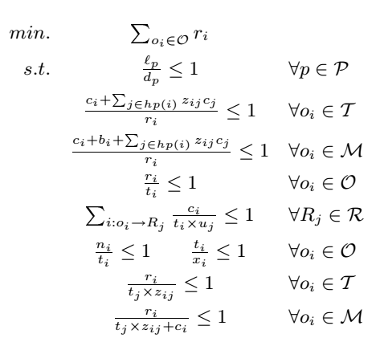
The MIGP
Integers

Slide 28
MIGP to GP
MIGP is difficulty to solve
So approximate the MIGP to a GP by introducing a set of parameters α_{i,j}
the lager α_{i,j}, the more pessimistic approximation
pessimistic approximation is safe, but may result in infeasibility GP instance.

Slide 29

Iterative procedure
Let s_{i} denote the approximated response time.
Let e_{i} denote the approximation error
Iteratively compute α_{i,j} based on e_{i}
until max{|e_{i}|} satisfies the input threshold

Slide 30
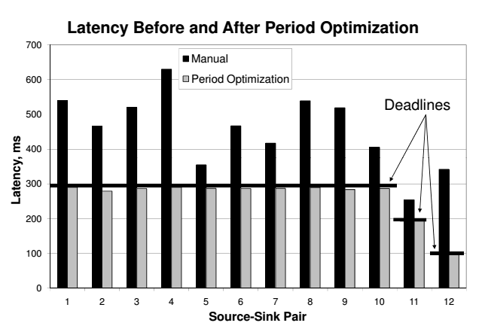
A case study
Just by designer’s intuition
The GP problem takes 24 seconds to solve on a 1.6
GHz Pentium M processor with 768 MB of RAM.
The average period increases by 90%.

Slide 31
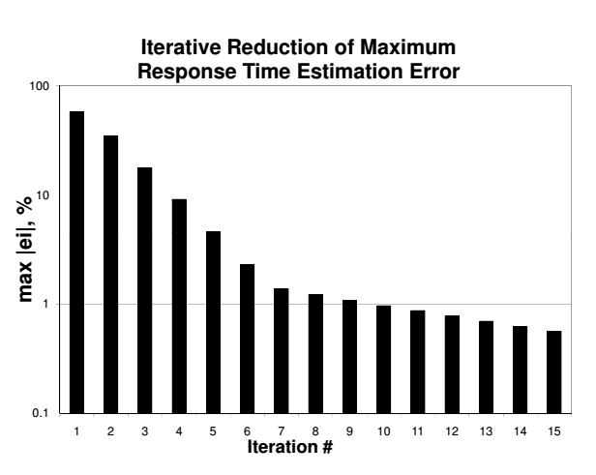
Effectiveness of the iterative procedure
log
scaled

Slide 32
Thank you!

