Slide 1
Scheduling on CAN
Rui Liu
04/15/2015

Slide 2
Outline
Recap on CAN
Scheduling Model
Schedulability Results

Slide 3
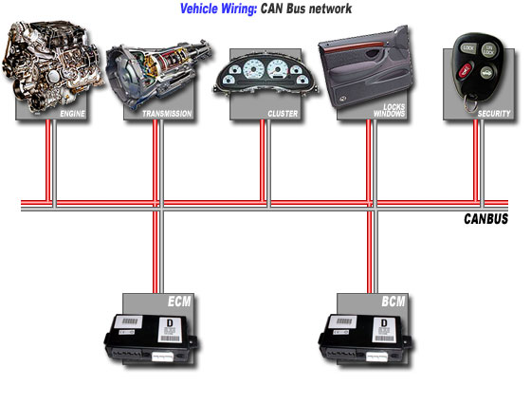
Recap on CAN
Controller Area Network
  A multi-master serial data bus which uses Carrier Sense Multiple Access/Collision Resolution to determine access.
Notes:
ECM: Electronic/engine Control Module
BCM: Brake Control Module

Slide 4
History of CAN on automotive
Developed in 1983; first controller chip by Intel and Philips in 1987; ISO standard in 1993.
Mercedes was the first to deploy CAN in a production car (1993).
In mid 1990s, number of ECUs grew rapidly. As a result, point-to-point wiring became impractical (lots of copper wire).
CAN started to be adopted as the solution to increase electronics content.
By 2004, over 50 different microprocessor families with on-chip CAN capability.
The Environmental Protection Agency mandated the use of CAN in all cars from model year 2008 onwards.

Slide 5
A brief look at CAN protocal
Message transfer over CAN is controlled by 4 types of frame:
  data frames
  remote transmit request frames
  overload frames
  error frames
Normally, CAN nodes (ECUs) are only allowed to start transmitting when the bus is idle.
Different CAN nodes may not have synchronized clocks. So nodes will re-synchronize through the start of frame bit on each message transmission.

Slide 6
Error Detection
15-bit Cyclic Redundancy Check is used to check errors in the transmitted messages.
When error detected, the node sends error flag ‘000000’ or ‘111111’. The transmission of an error flag usual causes other nodes to also detect the error.
Since bit patterns ‘000000’ and ‘111111’ have special meanings, we need to avoid them in the variable part of the transmitted messages.

Slide 7
Bit Stuffing
Bit-stuffing: A bit of the opposite polarity is inserted by the transmitter whenever 5 bits of the same polarity are transmitted. This process is reversed by the receiver.
Example:

Slide 8
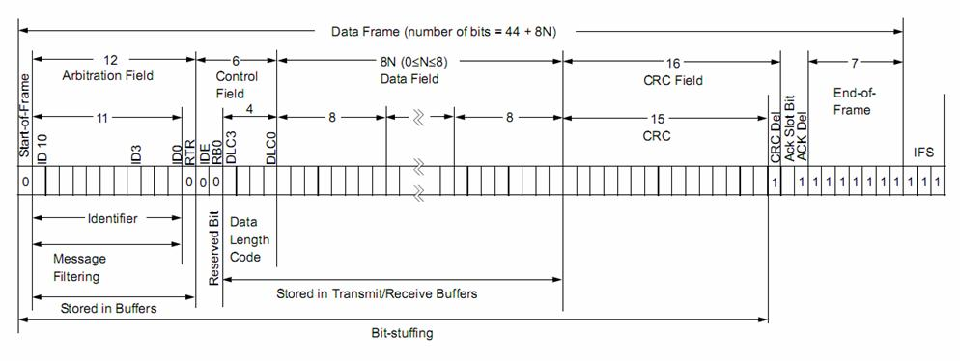
CAN Data Frame Format
Notes:
CRC: Cyclic Redundancy Check

Slide 9
Scheduling Model
The system is comprised of a number of nodes (microprocessors) connected via CAN.
The system is assumed to contain a static set of hard real-time messages. Each message m is statically assigned to a node.
Each message m has a fixed identifier (thus a unique priority), and each node attempts to transmit the highest priority message queued at that node.

Slide 10
Scheduling Model (cont.)
Each message has a max number of data bytes s_{m} and max transmission time C_{m}.
Each message is assumed to be queued by a software task (triggered by events). To account for the clock drift due to the lack of synchronized clock, this task needs a bounded amount of time between 0 and J_{m} to queue a message ready for transmission. J_{m} is referred as queuing jitter.
The event that triggers the queuing of message m is assumed to occur with a min inter-arrival time of T_{m}, referred as period.

Slide 11
Scheduling Model (cont.)
Each message m has a hard deadline D_{m}, corresponding to the max permitted time from the occurrence of the triggering event to the end of successful transmission of the message, i.e. all nodes require m have received it. Receiving nodes may have different timing requirements, and we assume D_{m} to be the tightest.
The worst-case response time R_{m}.
Message m is scheduable iff R_{m} ≤ D_{m.}

Slide 12
Summary of Scheduling Model
Messages are sent as if all the nodes on the network shared a single global priority-based queue.
Messages are sent on the bus according to a fixed priority non-preemptive schedule.
However, the real timing behavior of CAN in an actual system can be much more complicated.

Slide 13
Survey of Related Scheduling Result
Before Tindell et al. (1994), there is a misconception about CAN that
  Transmitting highest priority message with low latency
  Not possible to guarantee less urgent signals -> low priority messages would miss their deadlines.
Tindell’s paper provides a Worst-Case Response Time bound based on uniprocessor fixed-priority preemptive scheduling.
Prior to Tindell’s work, bus utilization was in 30% - 40%. After, bus utilization raised to 80%.

Slide 14
Survey of Related Scheduling Result(cont.)
In fact, non-preemptive scheduling is effectively a special case of preemptive scheduling
Tindell’s seminal paper led to numerous work on CAN related schedulability theory including. Starting from 1995, this work has been used in the configuration of production vehicles.
However, Tindell’s approach is flawed
  Can provide optimistic worst-case response times for messages from the 3rd highest priority to the lowest priority
Davis et al. (2007) revised Tindell’s approach and remove the optimism in the worst-case response time bound. This paper is built upon the analysis of both preemptive and non-preemptive fix priority scheduling.

Slide 15
Consequences of Flawed Analysis
CAN Schedulability Analysis
  Implement the revised analysis.
Commercial CAN Application
  Usually incorporated extra pessimism, but still need to recheck the details.
Faults in Deployed System
  Deadline misses due to flawed analysis is extremely hard to encounter.
  Due to some known problems, the basic form of CAN (presented here) is not used in safety critical systems.

Slide 16
Dealing with Faults
Since we are essentially considering a message-passing system (distributed system – sort of), the problem becomes much more complicated as we started to consider faults.
CAN provides error detection and recovery features
  Simply put: retransmitting any corrupted messages.
Thus, faults can cause extra overhead and delay message on the bus
  Schedulability analysis needs to take care of this.

Slide 17
Assumption about faults
Standard/old assumption about faults:
  There exists a minimum inter-arrival time between faults.
However, not realistic:
  Communication and network faults in CAN are mainly caused by Electromagnetic Interference. Minimum separation time may not exist.
A general model:
  F(t) to count the number of errors occurred up to time t.

Slide 18
Why Poisson Process?
Widely applied to model occurrence of event
  Memory-less property
  The occurrence of events are distributed uniformly on any interval of time.

Slide 19
Schedulability Result with Faults
Basic approach:
  Account for recovery overhead and retransmitting cost as a extra factor in the cost function (like blocking terms).
A distribution of the worst-case response time.

Slide 20
More issues
Priority Assignment
  Optimal Priority Assignment Policy exists.
  Several more efficient heuristics exists.
How different fault models apply to the revised analysis.

Slide 21
Reference
Probabilistic Analysis of CAN with faults
Ian Broster, Alan Burns, Guillermo Rodriguez-Navas
Controller Area Network (CAN) Schedulability Analysis: Refuted, Revisited and Revised
Robert I. Davis, Alan Burns, Reinder J. Bril and Johan J. Lukkien

Slide 22
Thank you!
Question?

