Slide 1
Uniprocessor EDF Scheduling of AVR Task Systems
Zhishan Guo and Sanjoy Baruah
Department of Computer Science, UNC Chapel Hill
ICCPS 2015, Seattle

Slide 2
Adaptive Varying-Rate (AVR) Tasks
Tasks are activated in relation to specific system variables
Each activation of some recurrent processes (tasks) in CPS is triggered by the values of variables describing the state of the physical system.
Notes:
Rigorous model-based design (MBD) approaches are widely used in the development of complex cyber-physical systems.

Slide 3

Adaptive Varying-Rate (AVR) Tasks
Tasks are activated in relation to specific system variables
Each activation of some recurrent processes (tasks) in CPS is triggered by the values of variables describing the state of the physical system.
Notes:
fuel injection in the Engine Control Unit (ECU) of an automobile is dependent upon the position of each piston (which is a function of the crankshaft angular position)

Slide 4

Adaptive Varying-Rate (AVR) Tasks
Tasks are activated in relation to specific system variables
Each activation of some recurrent processes (tasks) in CPS is triggered by the values of variables describing the state of the physical system.
Notes:
fuel injection in the Engine Control Unit (ECU) of an automobile is dependent upon the position of each piston (which is a function of the crankshaft angular position)

Slide 5
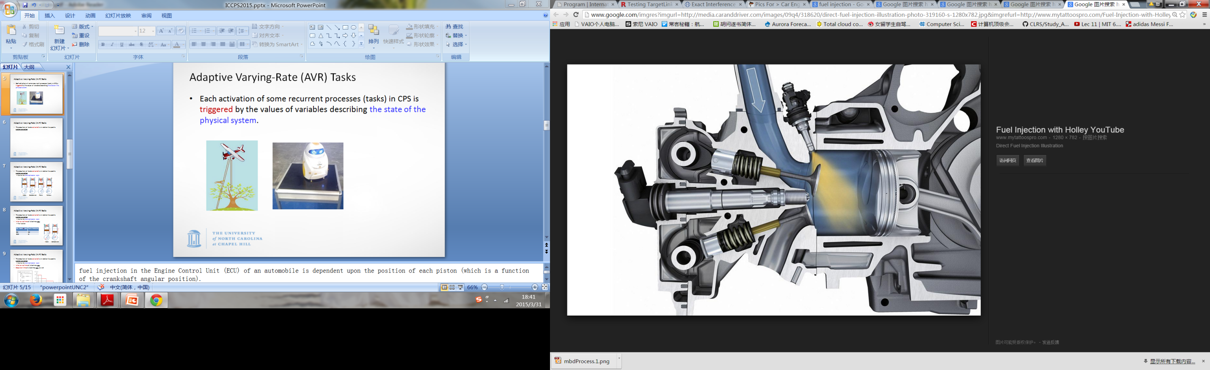
Adaptive Varying-Rate (AVR) Tasks
Tasks are activated in relation to specific system variables
Each activation of some recurrent processes (tasks) in CPS is triggered by the values of variables describing the state of the physical system.
Notes:
fuel injection in the Engine Control Unit (ECU) of an automobile is dependent upon the position of each piston (which is a function of the crankshaft angular position)

Slide 6
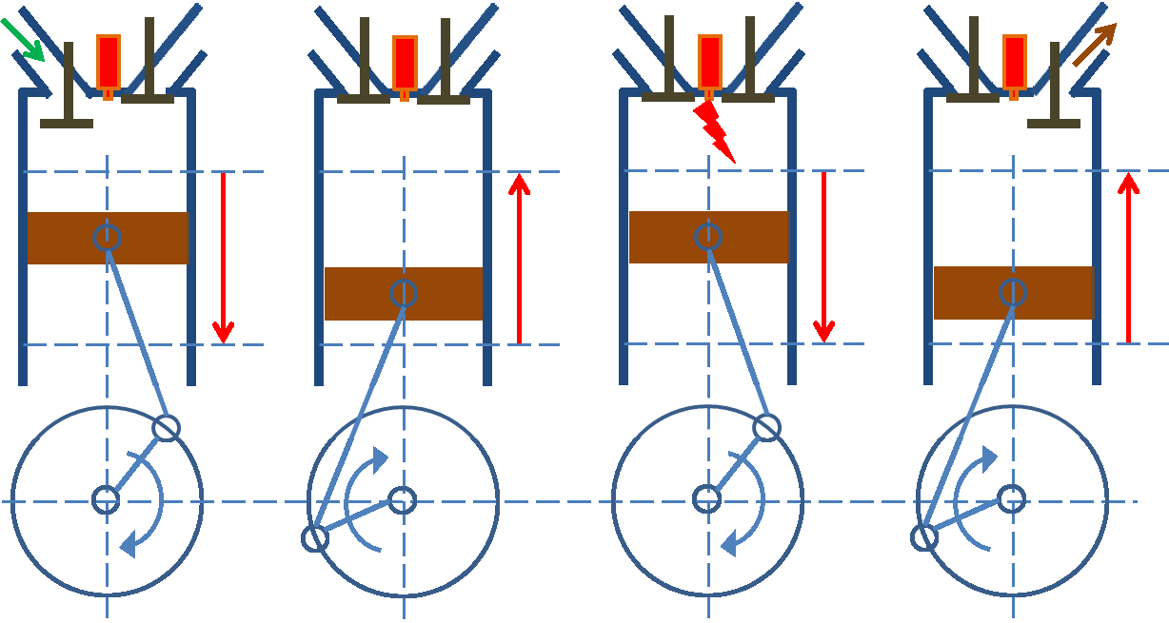
Adaptive Varying-Rate (AVR) Tasks
Tasks are activated in relation to specific system variables
  Such as the crankshaft rotation angle
Intake Compression Power Exhaust
Notes:
four strokes

Slide 7
Adaptive Varying-Rate (AVR) Tasks
Tasks are activated in relation to specific system variables
  Such as the crankshaft rotation angle
Inter-arrival time of a task may vary
  Fuel injection
Ang. Speed ω (rpm) | Task’s Period (ms)
600 | 100
6000 | 10
ω
ω
Intake Compression
Notes:
Rigorous model-based design (MBD) approaches are widely used in the development of complex cyber-physical systems.

Slide 8
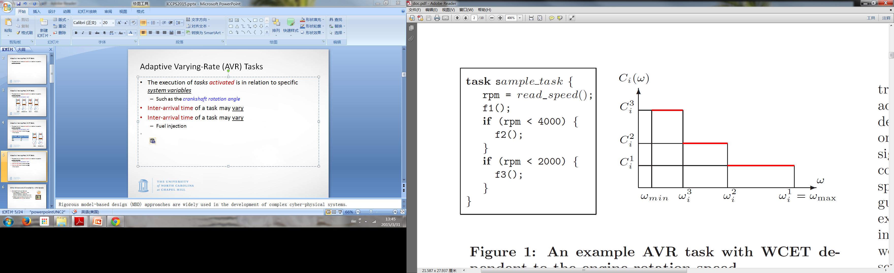
Adaptive Varying-Rate (AVR) Tasks
Tasks are activated in relation to specific system variables
  Such as the crankshaft rotation angle
Inter-arrival time of a task varies
Execution time of a task varies as well
To prevent overload at high rates, certain task functions are disabled after given speeds.
Notes:
To prevent overload at high rates, certain task functions are disabled after given speeds

Slide 9
Adaptive Varying-Rate (AVR) Tasks
Tasks are activated in relation to specific system variables
  Such as the crankshaft rotation angle
Inter-arrival time of a task varies
Execution time of a task varies as well
Notes:
To prevent overload at high rates, certain task functions are disabled after given speeds

Slide 10
Motivation
Rigorous model-based design (MBD) approaches are widely used in the development of complex CPS.
Notes:
Rigorous model-based design (MBD) approaches are widely used in the development of complex cyber-physical systems.

Slide 11
Motivation
Rigorous model-based design (MBD) approaches are widely used in the development of complex CPS.
There is not always a perfect fit between the models of MBD and the lower-level ones of scheduling theory, and consequently the mapping is achieved by introducing additional pessimism.
Notes:
Rigorous model-based design (MBD) approaches are widely used in the development of complex cyber-physical systems.

Slide 12
Motivation
Rigorous model-based design (MBD) approaches are widely used in the development of complex CPS.
There is not always a perfect fit between the models of MBD and the lower-level ones of scheduling theory, and consequently the mapping is achieved by introducing additional pessimism.
High variability of task parameters lead to significant resource under-utilization during run-time.
Notes:
Rigorous model-based design (MBD) approaches are widely used in the development of complex cyber-physical systems.

Slide 13
Related Work
Real-time scheduling theory has begun looking at developing new low-level task models that are inspired by requirements of actual physical systems.
Notes:
RTAS 2014: using ILP programming and quantization on the speed domain

Slide 14
Related Work
Real-time scheduling theory has begun looking at developing new low-level task models that are inspired by requirements of actual physical systems.
  Kim, Lakshmanan, and Rajkumar@ ICCPS 2012
  Preliminary work on a simplified model
  Pollex et al. @ DATE 2013
  Sufficient analysis with constant speed
  Buttazzo, Bini, and Buttle @ DATE 2014
  Analysis in dynamic condition under EDF (triggers our work)
  Davis et al. @ RTAS 2014
  Sufficient analysis in dynamic condition under FP (ILP + Quantization)
  Biondi, et al. @ ECRTS 2014
  Exact Interference under FP (Brute-Force + Tree Pruning)
Notes:
RTAS 2014: using ILP programming and quantization on the speed domain

Slide 15
This Work
  We focus on providing EDF schedulability analysis for workloads including AVR tasks.

Slide 16
This Work
  We focus on providing EDF schedulability analysis for workloads including AVR tasks.
  Implicit Systems (relative deadline = period)
    Sufficient & fast schedulability test
    Speedup factor as a function of engine speed
    Conditions for a necessary schedulability test to be sufficient
    as well (that could be satisfied easily in practice)

Slide 17
This Work
  We focus on providing EDF schedulability analysis for workloads including AVR tasks.
  Implicit Systems (relative deadline = period)
    Sufficient & fast schedulability test
    Speedup factor as a function of engine speed
    Conditions for a necessary schedulability test to be sufficient
    as well (that could be satisfied easily in practice)
  Constrained Systems (relative deadline <= period)
    Transform into the digraph based task model
    Demand based function analysis
    Schedulability experiments (outperforms the current state of the art)

Slide 18
This Work
  We focus on providing EDF schedulability analysis for workloads including AVR tasks.
  Implicit Systems (relative deadline = period)
    Sufficient & fast schedulability test
    Speedup factor as a function of engine speed
    Conditions for a necessary schedulability test to be sufficient
    as well (that could be satisfied easily in practice)
  Constrained Systems (relative deadline <= period)
    Transform into the digraph based task model
    Demand based function analysis
    Schedulability experiments (outperforms the current state of the art)

Slide 19
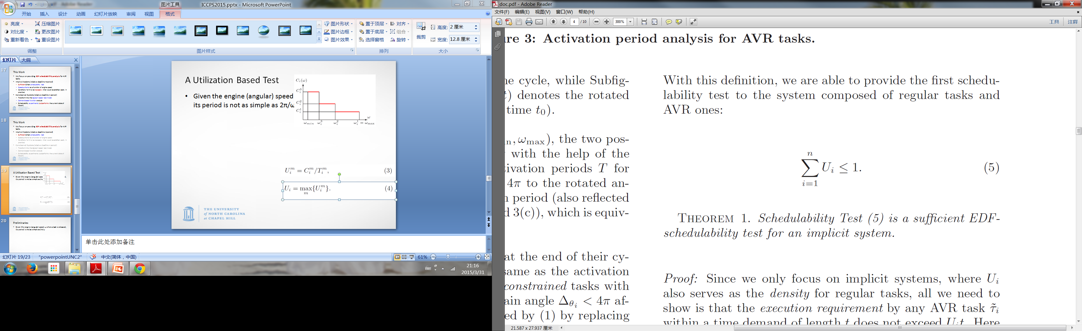
A Sufficient Utilization Based Test

Slide 20
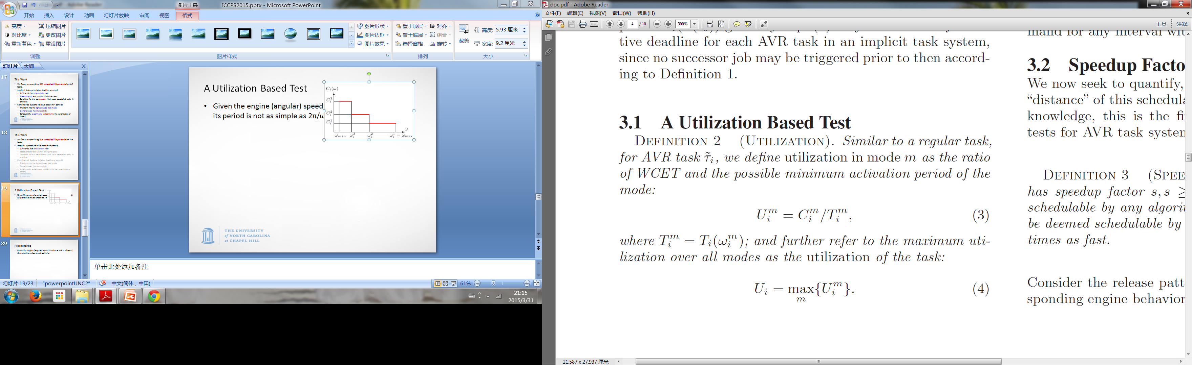
A Sufficient Utilization Based Test

Slide 21
A Sufficient Utilization Based Test
Given the engine (angular) speed ω when a task is released, its period is not as simple as 2π/ω

Slide 22
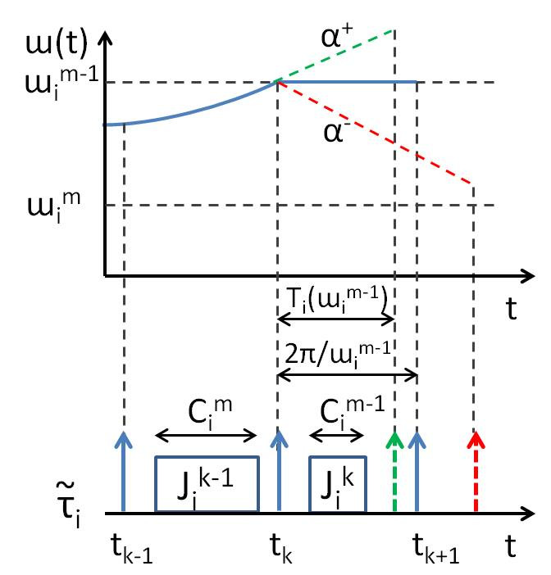
Preliminaries
Given the engine (angular) speed ω when a task is released, its period is not as simple as 2π/ω
Worst Case!
T_{i} - Shortest period under maximum acceleration
(possible mode changes)

Slide 23
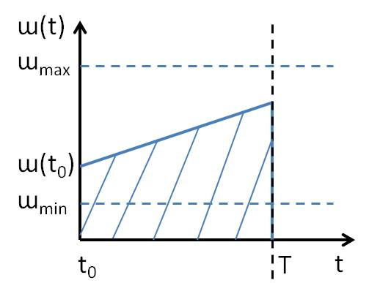
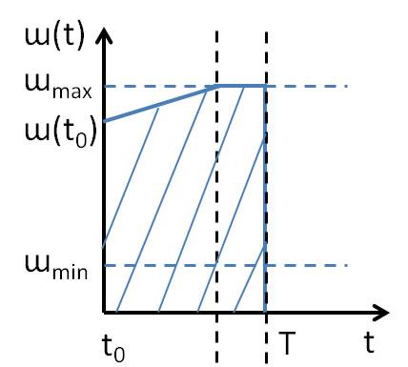
Preliminaries
Given the engine (angular) speed ω when a task is released, its period is not as simple as 2π/ω

Slide 24
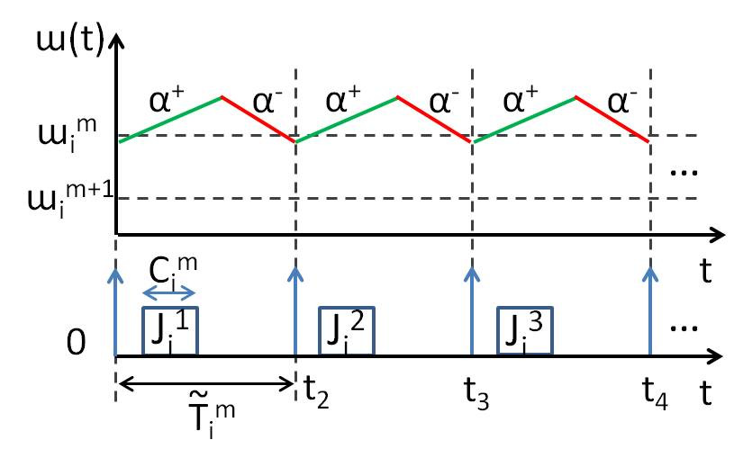
Preliminaries
Besides the T_{i} we’ve defined…
There is T_{i}
  Shortest period for staying in current mode
~
Worst Case!

Slide 25
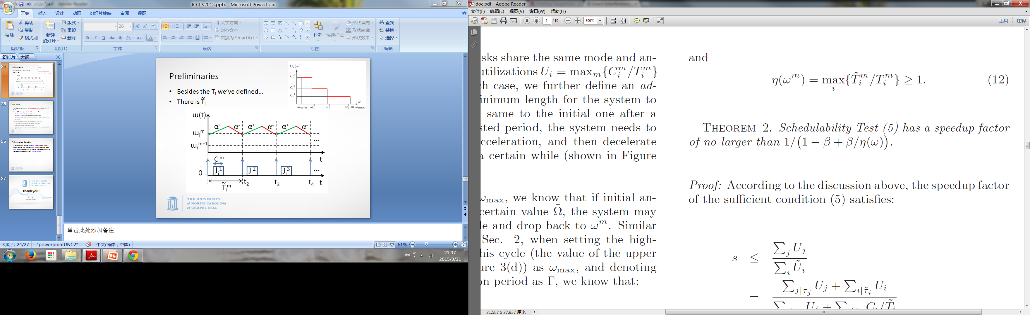
Preliminaries
Besides the T_{i} we’ve defined…
There is T_{i}
  Shortest period for staying in current mode
~

Slide 26
This Work
  We focus on providing EDF schedulability analysis for workloads including AVR tasks.
  Implicit Systems (relative deadline = period)
    Sufficient & fast schedulability test
    Speedup factor as a function of engine speed
    Conditions for a necessary schedulability test to be sufficient
    as well (that could be satisfied easily in practice)
  Constrained Systems (relative deadline <= period)
    Transform into the digraph based task model
    Demand based function analysis
    Schedulability experiments (outperforms the current state of the art)

Slide 27
Preliminaries - Speedup
A schedulability test has speedup factor s, s>=1, if any mixed task set that is schedulable by any algorithm on a unit-speed processer, will be deemed schedulable by this test upon a processor that is s times as fast.

Slide 28
Preliminaries - Speedup
A schedulability test has speedup factor s, s>=1, if any mixed task set that is schedulable by any algorithm on a unit-speed processer, will be deemed schedulable by this test upon a processor that is s times as fast.
Given a mixed task set, if any algorithm could schedule it on a 1/s-speed processer, our algorithm will be able to schedule it on a unit-speed processer.

Slide 29
Speedup of the Utilization Based Test
~
η >=1 is the ratio between Ti and Ti, which is closely related to max angular acceleration/deceleration, and the gap between neighborhood modes
β <=1 is the AVR task utilization ratio

Slide 30
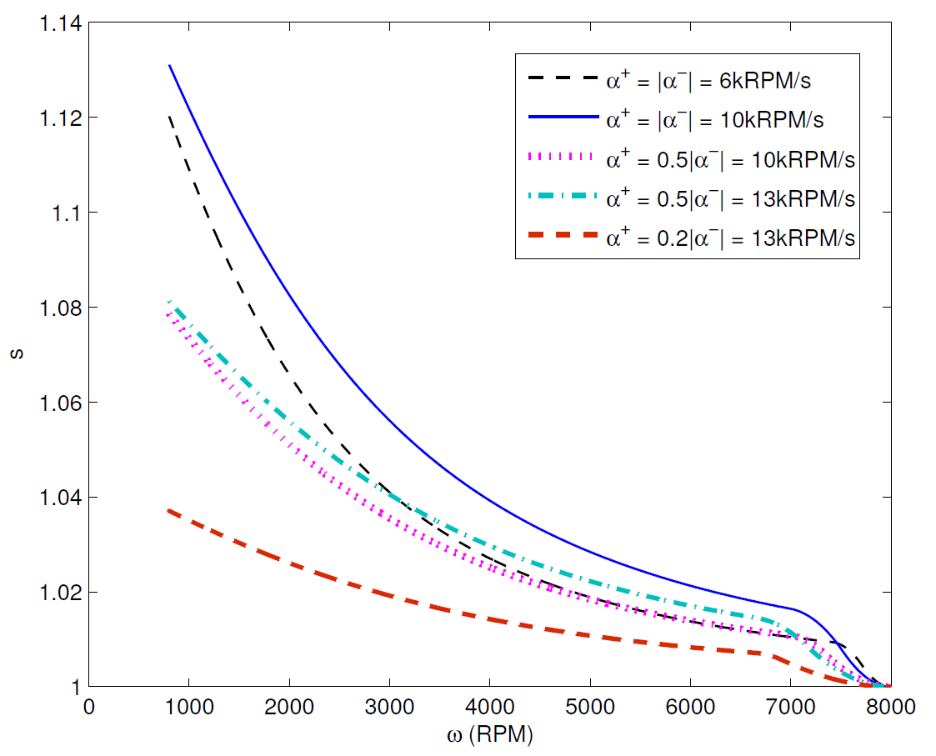
Speedup of the Utilization Based Test

Slide 31
This Work
  We focus on providing EDF schedulability analysis for workloads including AVR tasks.
  Implicit Systems (relative deadline = period)
    Sufficient & fast schedulability test
    Speedup factor as a function of engine speed
    Conditions for a necessary schedulability test to be sufficient
    as well (that could be satisfied easily in practice)
  Constrained Systems (relative deadline <= period)
    Transform into the digraph based task model
    Demand based function analysis
    Schedulability experiments (outperforms the current state of the art)

Slide 32
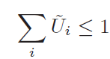
A Necessary Utilization Based Test

Slide 33
A Necessary Utilization Based Test
Δ_{ω}
α⁺, α⁻

Slide 34
A Necessary Utilization Based Test
Δ_{ω}
α⁺, α⁻
PRACTICAL
Assumption
Thm 3: The schedulability test is sufficient if the system will always stay in the current mode or its neighboring modes within two revolutions

Slide 35
This Work
  We focus on providing EDF schedulability analysis for workloads including AVR tasks.
  Implicit Systems (relative deadline = period)
    Sufficient & fast schedulability test
    Conditions for a necessary schedulability test to be sufficient
    as well (that could be satisfied easily in practice)
    Speedup factor as a function of engine speed
  Constrained Systems (relative deadline <= period)
    Transform into the digraph based task model
    Demand based function analysis
    Schedulability experiments (outperforms the current state of the art)
Notes:
Traditional sporadic task systems with constrained deadlines have been well-studied, and a pseudo-polynomial time feasibility test has been derived [4] for systems with utilization capped (strictly) below 1.

Slide 36
A Transformation
Digraph-based model - structures of jobs in terms of order and timing can be expressed via a directed graph.
[Stigge, Ekberg, Guan, Wang Yi, @RTAS2011]
It is recognized as the most expressive task model for which pseudo-polynomial time EDF-schedulability testing algorithms are known.
~
~
~
T(ω³)
T(ω²)
T(ω¹)
T(ω³)
T(ω²)
v₃
v₂
v₁
T’(ω³)
T’(ω²)
{C³, D(ω³)}
{C², D(ω²)}
{C¹, D(ω¹)}

Slide 37
A Transformation - Steps
Determine # nodes
Identify C^{i} and D(ω^{i})
Self loops with T(ω^{i})
Intra-vertex edges for possible mode change within a period (calculate according to parameters)
~
~
~
T(ω³)
T(ω²)
T(ω¹)
T(ω³)
T(ω²)
v₃
v₂
v₁
T’(ω³)
T’(ω²)
{C³, D(ω³)}
{C², D(ω²)}
{C¹, D(ω¹)}

Slide 38
This Work
  We focus on providing EDF schedulability analysis for workloads including AVR tasks.
  Implicit Systems (relative deadline = period)
    Sufficient & fast schedulability test
    Conditions for a necessary schedulability test to be sufficient
    as well (that could be satisfied easily in practice)
    Speedup factor as a function of engine speed
  Constrained Systems (relative deadline <= period)
    Transform into the digraph based task model
    Demand based function analysis
    Schedulability experiments (outperforms the current state of the art)

Slide 39
Experiment Set Up
  Task set generation - adopt exactly the methodology described in [Davis et al. @RTAS 2014].

Slide 40
Experiment Set Up
  Task set generation - adopt exactly the methodology described in [Davis et al. @RTAS 2014].
  Compared to:
    RTA-SP: Use the maximum WCET, minimum period, and minimum deadline to represent all modes to model each AVR task as a traditional sporadic task.

Slide 41
Experiment Set Up
  Task set generation - adopt exactly the methodology described in [Davis et al. @RTAS 2014].
  Compared to:
    RTA-SP: Use the maximum WCET, minimum period, and minimum deadline to represent all modes to model each AVR task as a traditional sporadic task.
    Exact-CON: Compute the maximum interference with additional constraints from the physical system via the exact analysis in [Biondi et al. @ECRTS 2014] instead of Integer Linear Programming [Davis et al. @RTAS 2014], which is the current state of the art analysis technique for AVR task systems under fixed priority scheduling.

Slide 42
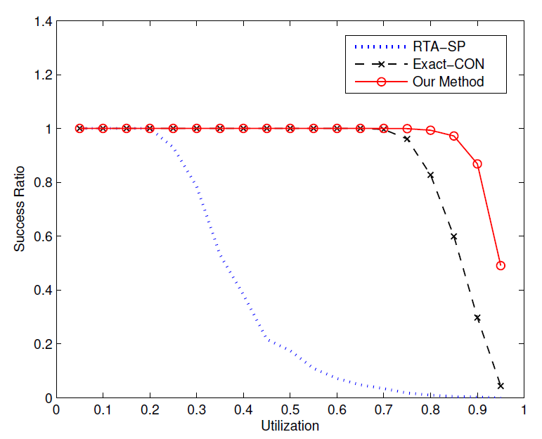
Experimental Comparison
Lightly loaded
Heavily loaded

Slide 43
Experimental Comparison
Schedulability

Slide 44
Experimental Comparison
86% of the sets with utilization 0.9 is schedulable under our method

Slide 45
Experimental Comparison

Slide 46
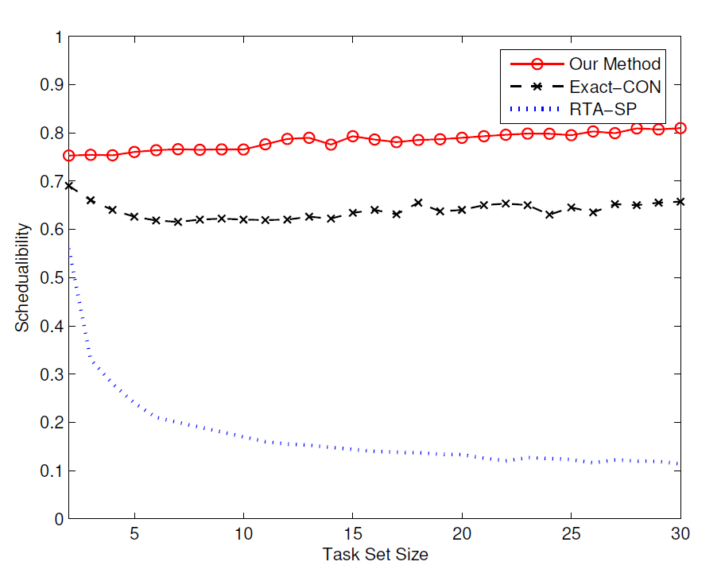
Experimental Comparison
Parameter Study:
Different task size n
Similarity of modes
Proportion of AVR tasks

Slide 47
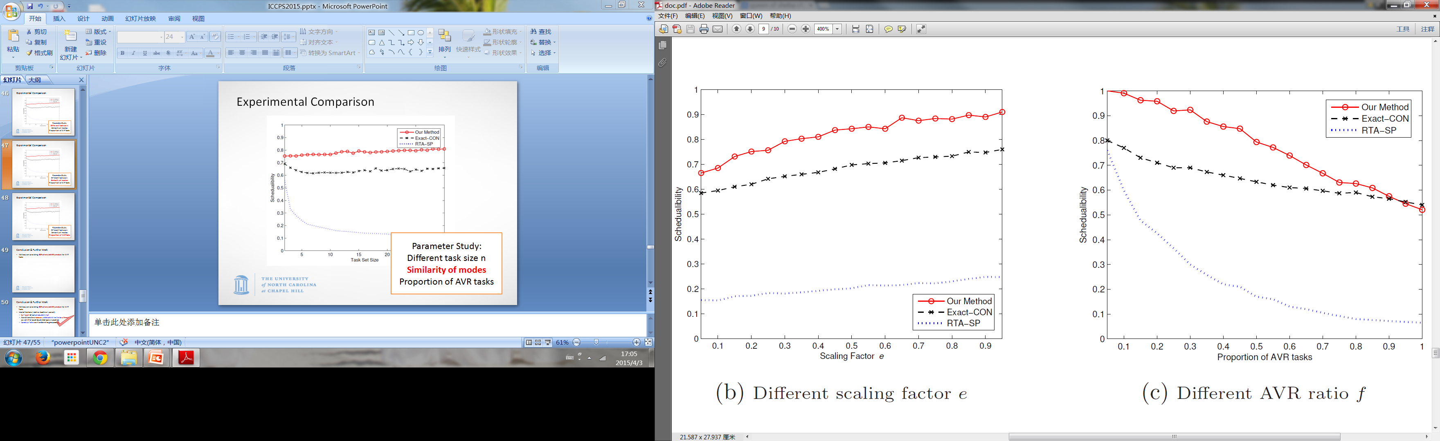
Experimental Comparison
Parameter Study:
Different task size n
Similarity of modes
Proportion of AVR tasks

Slide 48
Experimental Comparison
Parameter Study:
Different task size n
Similarity of modes
Proportion of AVR tasks

Slide 49
Conclusion & Further Work
  We focus on providing EDF schedulability analysis for workloads including AVR tasks.

Slide 50
Conclusion & Further Work
  We focus on providing EDF schedulability analysis for workloads including AVR tasks.
  Implicit Systems (relative deadline = period)
    Sufficient & fast schedulability test
    Conditions for a necessary schedulability test to be sufficient
    as well (that could be satisfied easily in practice)
    Speedup factor as a function of engine speed

Slide 51
Conclusion & Further Work
  We focus on providing EDF schedulability analysis for workloads including AVR tasks.
  Implicit Systems (relative deadline = period)
  Constrained Systems (relative deadline <= period)
    Transform into the digraph based task model
    Demand based function analysis
    Schedulability experiments (outperforms the current state of the art)

Slide 52
Conclusion & Further Work
  We focus on providing EDF schedulability analysis for workloads including AVR tasks.
  Implicit Systems (relative deadline = period)
  Constrained Systems (relative deadline <= period)
    Transform into the digraph based task model
    Demand based function analysis
    Schedulability experiments (outperforms the current state of the art)
We do lose something during this transformation…

Slide 53
Conclusion & Further Work
  We focus on providing EDF schedulability analysis for workloads including AVR tasks.
  Implicit Systems (relative deadline = period)
  Constrained Systems (relative deadline <= period)
    Transform into the digraph based task model
    Demand based function analysis
    Schedulability experiments (outperforms the current state of the art)
Not very fast --
Study of digraph based task model is still on going…

Slide 54
Conclusion & Further Work
  We focus on providing EDF schedulability analysis for workloads including AVR tasks.
  Implicit Systems (relative deadline = period)
  Constrained Systems (relative deadline <= period)
    Transform into the digraph based task model
    Demand based function analysis
    Schedulability experiments (outperforms the current state of the art)
That’s when we submitted the paper, not now…

Slide 55
Thank you!
Zhishan Guo
zsguo@cs.unc.edu

