Slide 1

Basic Concepts
Prasun Dewan
Department of Computer Science
University of North Carolina at Chapel Hill
dewan@cs.unc.edu

Slide 2
CONCEPTS COVERED
Implementation Issues
RTCALendering: MIT (Sarin ’85)
WYSIWIS
Cognoter outliner: Xerox (Stefik ’85)
Non WYSIWIS
CES (Collaborative Editing System): MIT (Greif ‘86)
Process Control
Implicit Transactions
Grove outliner: MCC (Ellis ’89)
Social Conc. Control
ShrEdit: U. Mich (Olson ‘91)
Access Control
GroupDraw : U. Calgary (Greenberg ’94)
Complete Awareness
Summary Awareness
Optimistic Locking
What You See Is What I See

Slide 3
CONCEPTS COVERED
NLS (Engelbart ’68, Post Xerox)
Shared Screen
Colab (Stefik ’85, Xerox)
Shared Objects
VConf (Lantz ’86, Stanford)
Fixed Coupling
Rapport (Ahuja ’89, Bell Labs)
Replicated
Disconnection
XTV (Abdel-Wahab ’91, UNC/ODU)
Shared Window
Rendezvous (Patterson ’90, Bellcore)
Centralized
Summary Widgets
Weasel (Graham ’95, York)
Flexible Views
Suite (Dewan’92.., Purdue/UNC)
Constraints
Message Efficiency
GroupKit (Greenberg ’95, Calgary)
Parameters
Sync (Munson ’96, UNC)
Shared C Types
Dynamic Architecture
GT (Greenberg ’09, U. Calgary)
Fine-grained coupling, locking,
Logger (Chung, Junuzovic’06, UNC)
Shared Tables

Slide 4
CONCEPTS IN
Infrastructure
Details
MeetingPlace (Cisco)
Window sharing and online presentation and conferencing solution
CollaborateNow (IBM)
Window sharing and online presentation and conferencing solution
Webex
Window sharing and online presentation and conferencing solution
LiveMeeting (Microsoft)
Window sharing and online presentation and conferencing solution
Meeting Space (Vista)
Window sharing

Slide 5
CONCEPTS IN
Infrastructure
Details
Microsoft Groove
Toolkit for Desktop Applications allowing disconnection
Google Wave
Toolkit for Web Applications (???)

Slide 6
DISCIPLINES
Discipline
Contribution
Operating Systems
Distributed files, shared memory, process scheduling, “OS-based” IM
Database Systems
Concurrency control, recovery
Programming Languages
Shared object construct
User Interface Systems
I/O distribution of window systems, toolkits
Software Engineering
Application area, process control, patterns

Slide 7
CASE STUDIES
NLS (Engelbart ’68, Post Xerox)
Shared Screen
Colab (Stefik ’85, Xerox)
Shared Objects
VConf (Lantz ’86, Stanford)
Fixed Coupling
Rapport (Ahuja ’89, Bell Labs)
Replicated
Disconnection
XTV (Abdel-Wahab ’91, UNC/ODU)
Shared Window
Rendezvous (Patterson ’90, Bellcore)
Centralized
Summary Widgets
Weasel (Graham ’95, York)
Flexible Views
Suite (Dewan’92.., Purdue/UNC)
Constraints
Message Efficiency
GroupKit (Greenberg ’95, Calgary)
Parameters
Sync (Munson ’96, UNC)
Shared C Types
Dynamic Architecture
GT (Greenberg ’09, U. Calgary)
Fine-grained coupling, locking,
Logger (Chung, Junuzovic’06, UNC)
Shared Tables

Slide 8
CASE STUDIES
Infrastructure
Details
Java Remote Method Invocation
Distribution support in Java

Slide 9
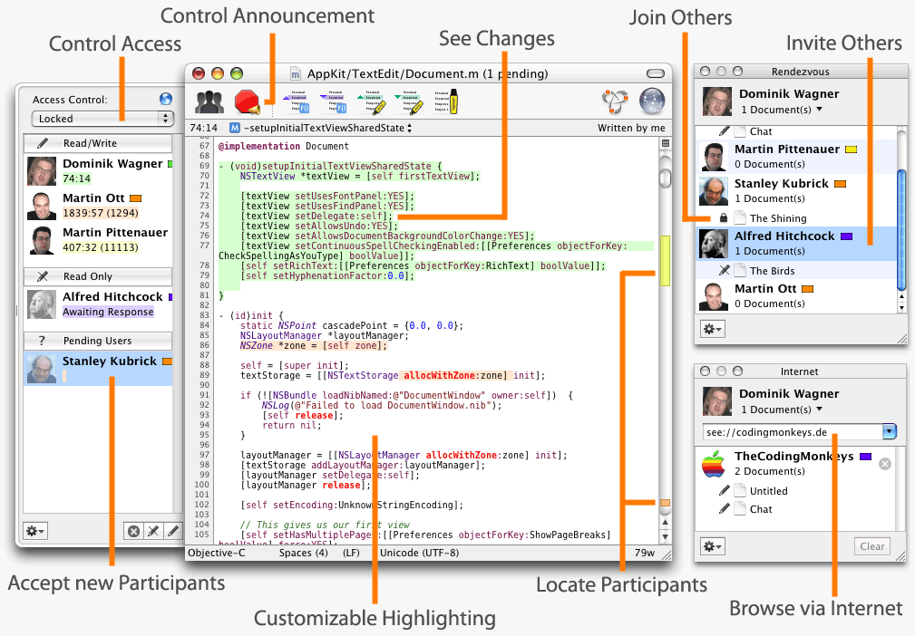
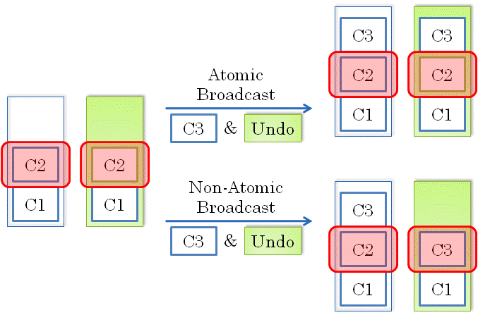
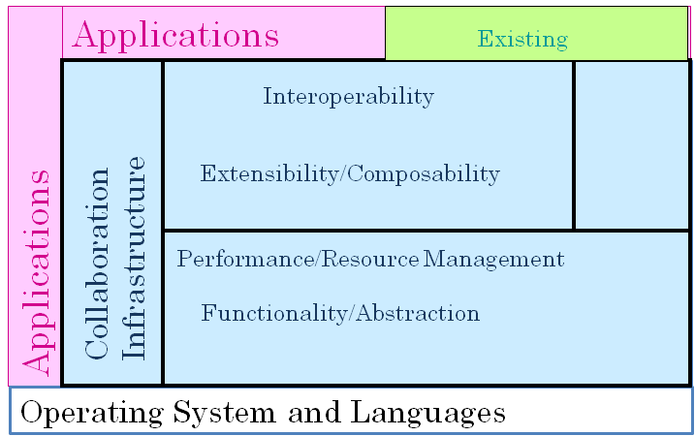
UI Design vs. Implementation vs. Infrastructure
UI Design
Implementation
How
Infrastructure
What

Slide 10
COUPLING
Issue
Description
Session Management
How do distributed users create, destroy, join, and leave collaborative sessions?
Single-user Interface
What are the application semantics if there is a single user in the session?
Coupling
What is the remote feedback of a user command and when is it given?
Access Control
How do we ensure that users do not execute unauthorized commands?
Concurrency Control
How do we ensure that concurrent users do not enter inconsistent commands?

Slide 11
Coupling?
Large design space
Difficult to choose appropriate points
Colab. Application
  If chooses wrong, users share more or little than they desire.
Colab. Infrastructure
  How to define it in application independent fashion.
  Mapping between input and local feedback is application dependent.
  Implies mapping between input and remote feedback is also app-dependent.
  Relationship between local and remote feedback may be app-independent.

Slide 12
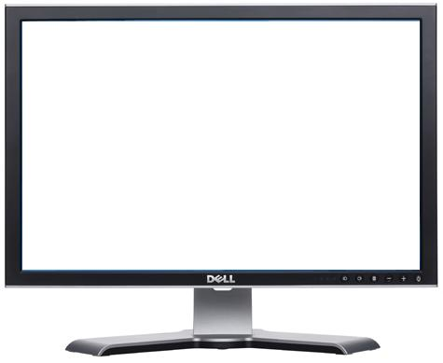
“Simplest” Coupling Definition
When: If all interaction stopped remote user will eventually get feedback.
Remote Feedback = Local Feedback
Application
What: Remote user sees everything local user sees
When: Remote user feels collaboration is real time.
When: Remote user does not notice delay (< 50 ms)
U1
U2
U3
When: “Best effort” to give immediate feedback
Coupling
Coupling

Slide 13
STRICT WYSIWIS COUPLING
User 1
If user 1 moves green window
Then green window moves on user 2’s screen
If user 2 scrolls up in orange window
Then orange window scrolls up on user 2’s screen
User 2

Slide 14
STRICT WYSIWIS COUPLING
User 1
Pros
Easy to understand
Application-independent
Automatable
How to automate?
Cons
Window and scroll wars
Size and view wars
Communication overhead
User 2

Slide 15
Automation & Pre-Requisites
Automation: Some application-independent infrastructure provides some functionality.
  UI toolkit automates widgets,
Use assumptions to provide the automation.
  Swing and AWT assume applications do not want round widgets.
Need to make similar assumptions.

Slide 16
Automating WYSIWIS Coupling
Must ensure that all users see local output.
Need access to input and/or output
Application
Assume I/O can be tapped.
Must allow multiple users to input.
Assume certain properties of I/O
U2
U3
Coupling
Coupling

Slide 17
Shared I/O Systems
Assume application uses some I/O system
Collaboration –Unaware Application
Will put a proxy module in between application and I/O system, if possible
Input/Output
To the application it behaves like the I/O system.
Collaboration-Aware Proxy
To the I/O system it behaves like the application.
Collaboration-Unaware I/O System
Application and I/O system are collaboration-unaware.
Proxy (infrastructure) is collaboration-aware
User 1

Slide 18
Console I/O
Programming languages and OS’s provide teletype (console library)
Collaboration –Unaware Application
Cannot handle graphics
read(input)
Input/Output
Collaboration-Aware Proxy
print(output)
Collaboration-Unaware Console Library
User 1

Slide 19
Toolkit Library I/O
Toolkit provides widgets such as text box, slider, and buttons.
Collaboration –Unaware Application
Input is notifications about state changes.
textChanged
Input/Output
“Output” sets and gets widget state
Collaboration-Aware Proxy
setText
Widget automation bound to specific toolkit (Swing, AWT)
Collaboration-Unaware User-Interface Toolkit
Toolkits are built on top of window system
User 1

Slide 20
Window System (Simple Model)
Window are untyped rectangular screen areas in which point is a pixel.
Collaboration –Unaware Application
Input indicates keyboard and mouse operations.
a ^, w1, x, y
Input/Output
Output draws text, shapes.
Collaboration-Aware Proxy
Application = programmer-defined code + toolkit
draw a, w1, x, y
Window-level automation accommodates all toolkits
Collaboration-Unaware Window System
Architecture with N users?
Press a
User 1

Slide 21
Centralized shared Window System
The shared application runs on the (master) computer of only one of the collaborators.
Collaboration –Unaware Application
Proxy Window System runs on all (master and slave) computers.
Input/Output
Collaboration-Aware Proxy
Collaboration-Aware Proxy
Each user’s input relayed to application through proxies.
Collaboration-Unaware Window System
Collaboration-Unaware Window System
Each output of application broadcast to all users through proxies.
Master computer
Slave computer
User 1
User 2

Slide 22
Proxy Functions
Slave proxy relays input to app through master proxy.
Window Application
a ^, w1, x, y
Master proxy broadcasts output to all slave proxies, which relay to local window system.
draw a, w1, x, y
Output Broadcaster & I/O Relayer
Proxies translate window ids.
a ^, w1, x, y
I/O Relayer
I/O Relayer
draw a, w1, x, y
a ^, w2, x, y
draw a, w2, x, y
draw a, w3, x, y
Window System
Window System
Window System
Press a
User 1
User 2
User 3

Slide 23
Concurrent/Interleaved Interaction
User inputs can get (un) desirably mixed
Window Application
b ^, w1, x, y
Can multiple users generate a stream not creatable by one user?
a ^, w1, x, y
Output Broadcaster & I/O Relayer
I/O Relayer
I/O Relayer
Window System
Window System
Window System
Press b
Press a
User 1
User 2
User 3

Slide 24
Explicit Floor Control
Window Application
Multiple users can generate input sequence that cannot be generated by single user
leftButton ^, w1, x1, y1
Can break (explicit/implicit) assertions of collaboration-unaware code
leftButton ^, w1, x2, y2
Output Broadcaster & I/O Relayer
Solution: Explicit Floor Control
One user interacts at a time and explicitly gives floor to another.
I/O Relayer
I/O Relayer
Window System
Window System
Window System
Press leftButton
Press leftButton
User 1
User 2
User 3

Slide 25
Window Manipulation Events
Window state changing events such as move, minimize, maximize, change of stacking order are processed by window system
Collaboration-Unaware Application
move w*
Input/Output
move ok*
Application can OK in some systems.
Window System
Assuming window manager part of window system
move w
window moves
User 1

Slide 26
Coupling Window Manipulation Events (No Application Intervention)
Window Application
Broadcast in response to user or OK event.
Not broadcasting can prevent window wars.
Output Broadcaster & I/O Relayer
Not all systems couple window manipulation events (XTV)
move w3
move w1
I/O Relayer
I/O Relayer
move w2
move w3
move w1
Window System
Window System
Window System
window moves
move w2
window moves
window moves
User 1
User 2
User 3

Slide 27
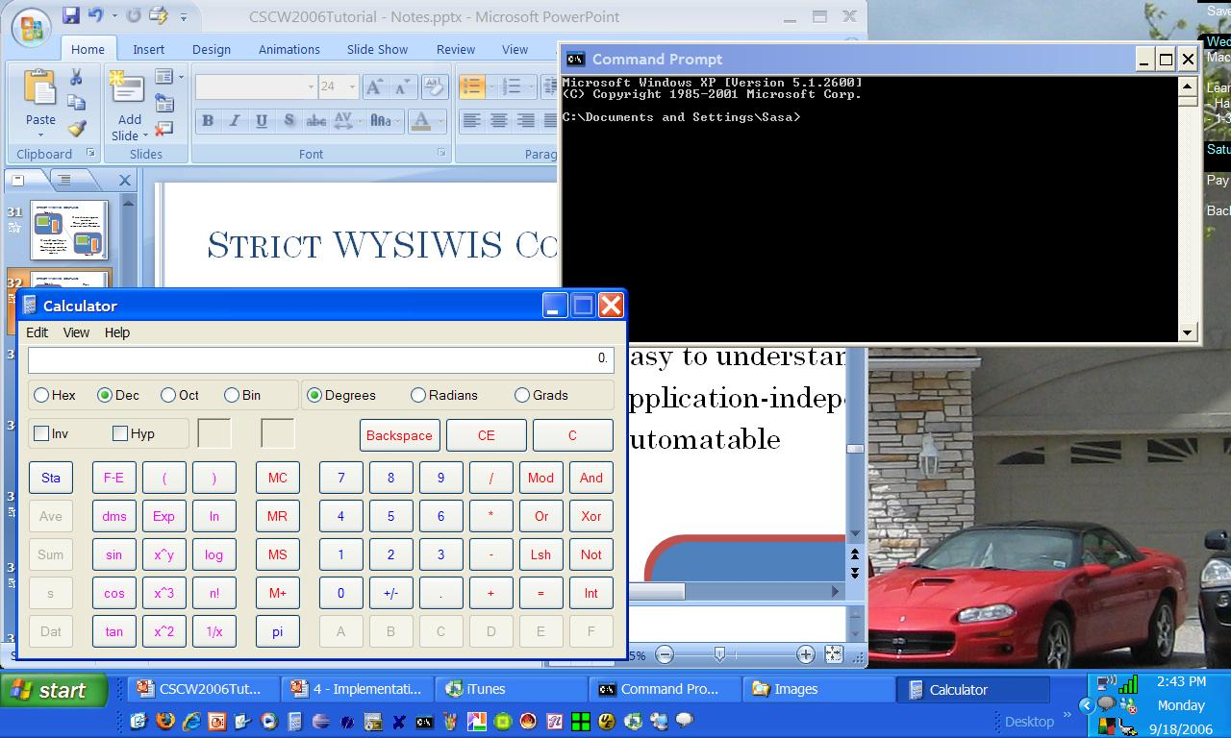
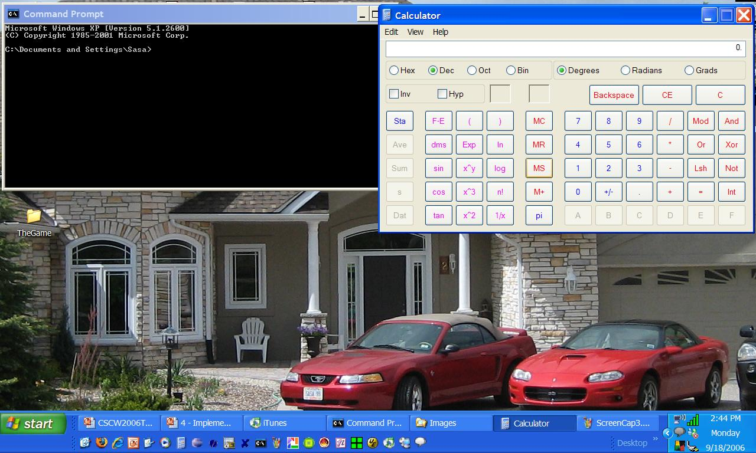
RELAXED WYSIWIS COUPLING
Implemented in XTV
Independent Window Positions
Independent Window Minimization

Slide 28
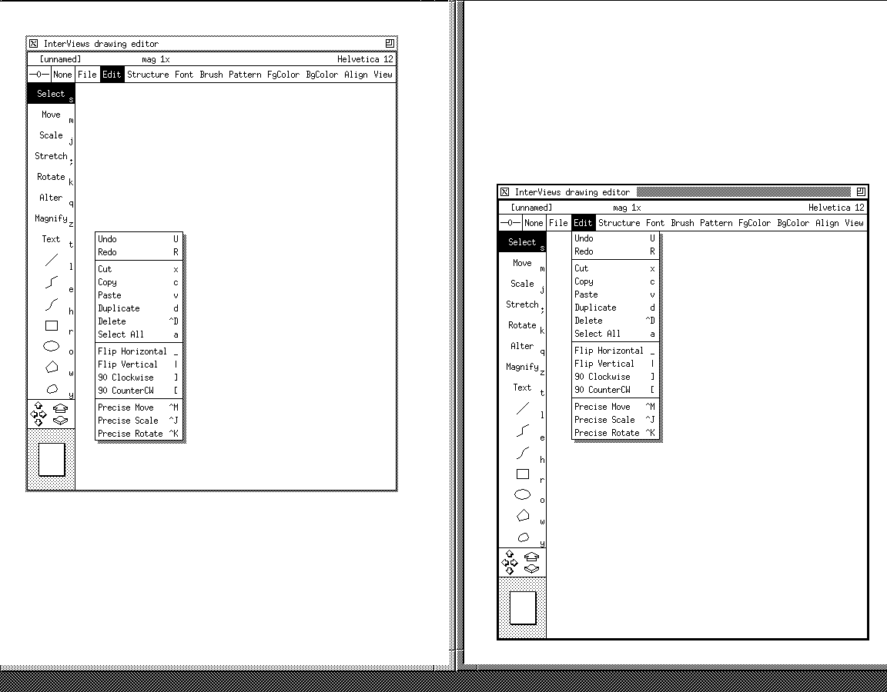
Pop-Up Menus Problem with Uncoupled Window State
Pop-up menus are top-level windows drawn at absolute positions by application.
Inner windows drawn relative to containing window.

Slide 29
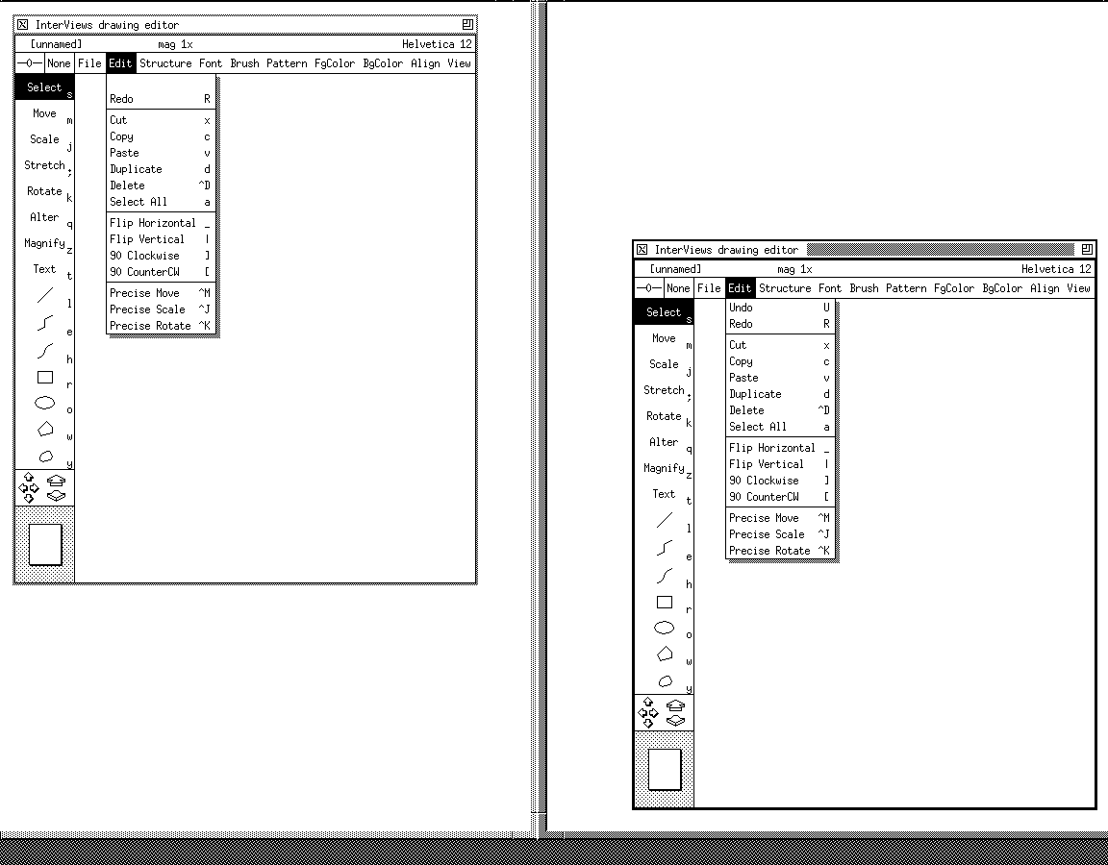
Correct Pop-Up Menus
Proxy keeps track of root window and translates.
More than a proxy – understands underlying window system.
Not uncommon in proxies.

Slide 30
Semantic Issue
Should window state be coupled?
Coupled → window wars (Stefik et al ’85)
Uncoupled → no referential transparency
  Cannot refer to the “upper left” shared window
Compromise
  Create a virtual desktop on a slave computer for physical desktop of the master user

Slide 31
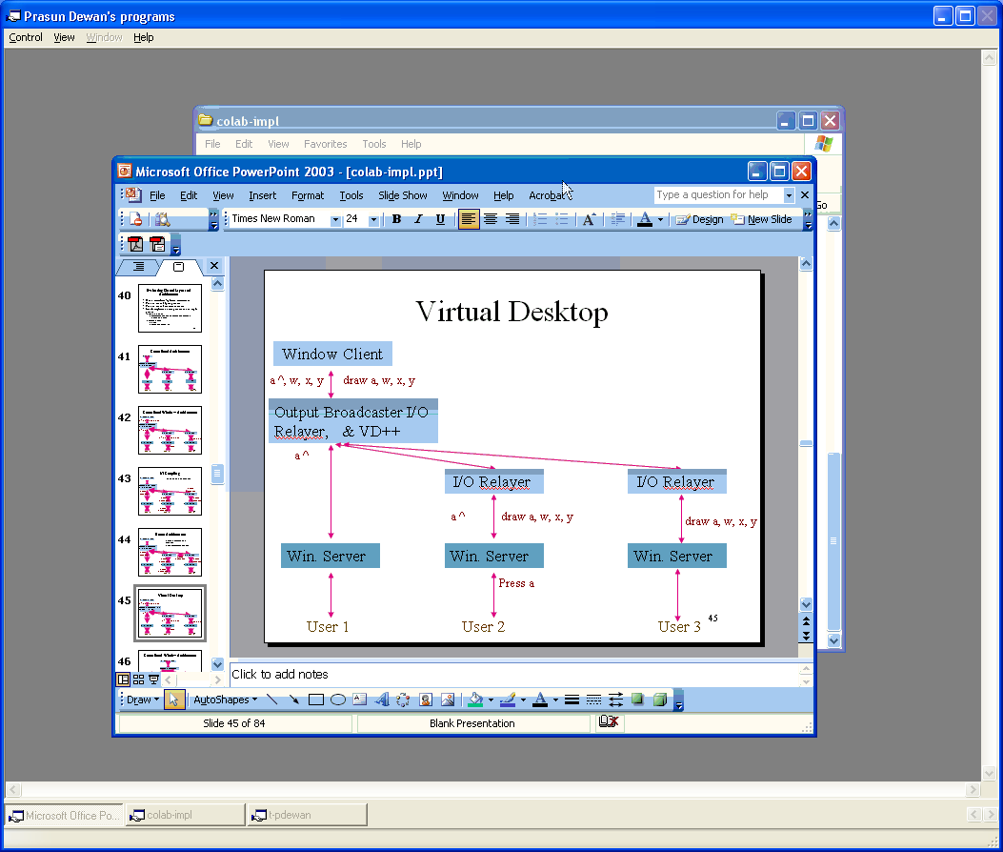
Virtual Desktop
Privately scrollable , movable window representing master screen
Nested, shared , WYSIWIS master window

Slide 32
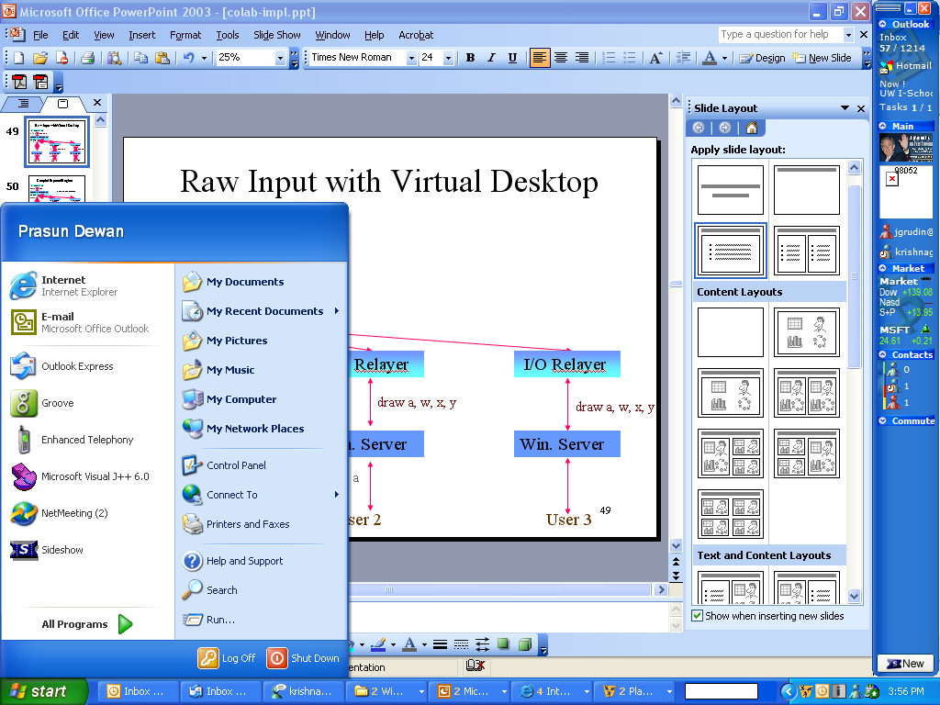
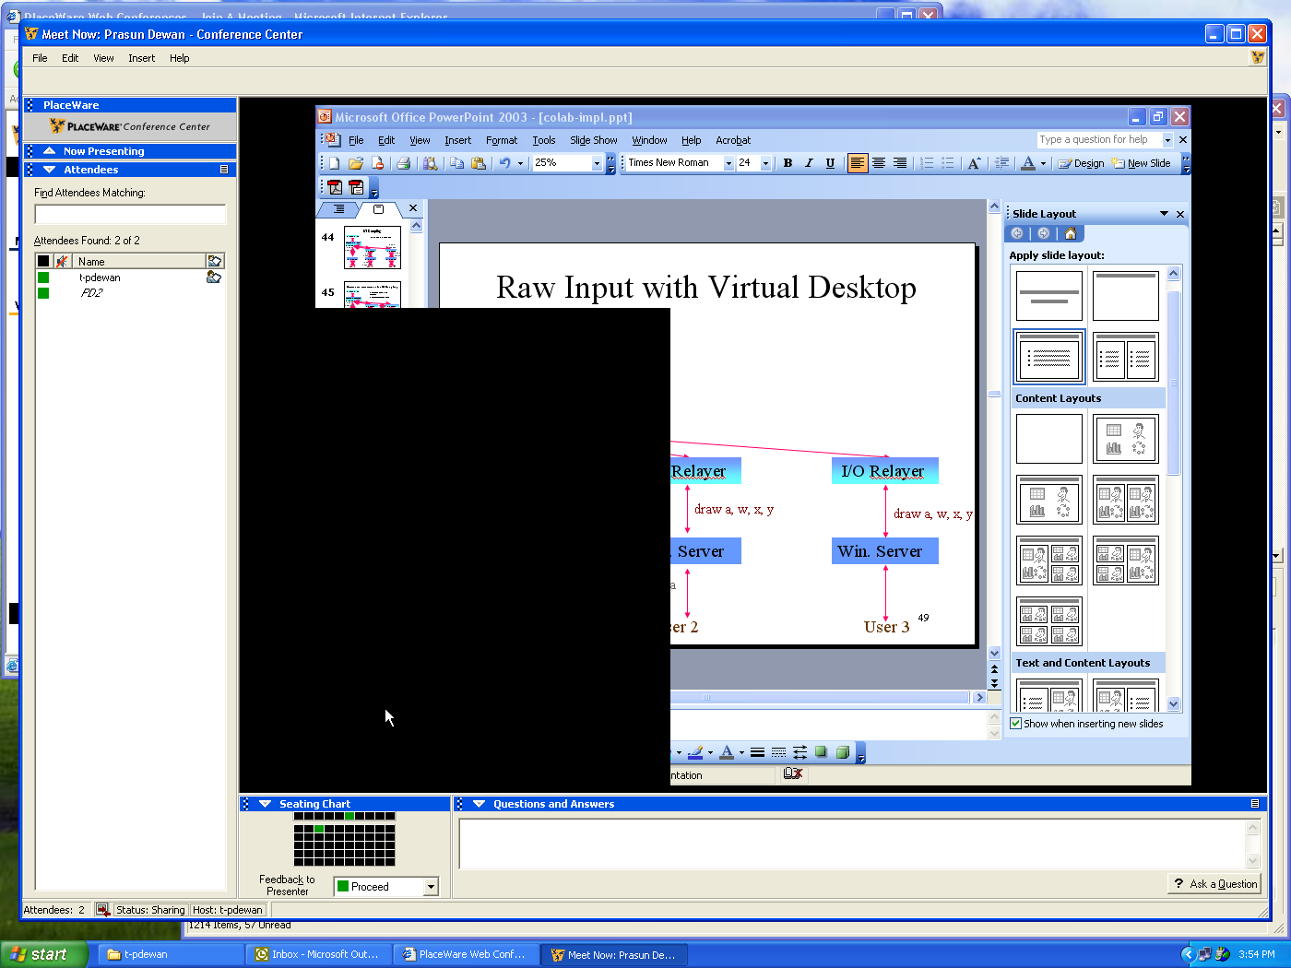
COUPLING OF UNEXPOSED REGIONS?

Slide 33
Expose Events
When a window is resized, or (un) obscured expose event is sent to it with exposed regions.
Collaboration-Unaware Application
Application is expected to draw only exposed regions.
expose w, rects
draw exposed w
OR
May draw complete window
draw complete w
Window System
Window system clips in case it app. drawn outside window bounds
clip w
resize, (un) obscure w
User 1

Slide 34
COUPLING OF UNEXPOSED REGIONS? (review)

Slide 35
Expose Events (review)
When a window is resized, or (un) obscured expose event is sent to it with exposed regions.
Collaboration-Unaware Application
Application is expected to draw only exposed regions.
expose w, rects
draw exposed w
OR
May draw complete window
draw complete w
Window System
Window system clips in case it app. drawn outside window bounds
clip w
resize, (un) obscure w
User 1

Slide 36
Application Draws Exposed regions
Each computer shows only regions exposed in master.
Window Application
expose w1, rects
Black holes left in slaves.
draw exposed w1
Output Broadcaster & I/O Relayer++
Expose events not sent from slaves.
Window may be exposed differently on different computers.
draw exposed w1
expose w1, rects
I/O Relayer
I/O Relayer
draw exposed w1
draw exposed w2
draw exposed w3
Window System
Window System
Window System
clip w1
clip w2
clip w3
resize, (un) obscure w
User 1
User 2
User 3

Slide 37
Application Draws in Full Window
No black holes in clients
Window Application
But slaves can see what master cannot.
expose w1, rects
draw w1
Output Broadcaster & I/O Relayer++
draw w1
expose w1, rects
I/O Relayer
I/O Relayer
draw w1
draw w2
draw w3
Window System
Window System
Window System
clip w1
clip w2
clip w3
resize, (un) obscure w
User 1
User 2
User 3

Slide 38
Expose Coupling
Send expose event to all proxies
Window Application
They can then filter draw requests to only show exposed regions.
expose w1, rects
draw w1
Output Broadcaster & I/O Relayer++
expose w1, rects
draw w1
expose w1, rects
I/O Relayer
I/O Relayer
draw w1
draw rects
draw rects
Window System
Window System
Window System
clip w1
clip w2
clip w3
resize, (un) obscure w
User 1
User 2
User 3

Slide 39
Window System Model
Input /Event: transfer info to app.
Window Application
Output/Request/Call: transfer info from app.
a ^, w1, x, y
move w*
expose w, rects
draw a, w1, x, y
move ok*
draw in exposed w
listFonts
Window System
Press a
move w
resize, (un) obscure w
“Output” /Request/Call: transfer info to app.
Window system more than I/O processor.
Window system maintains its own and application I/O state such as fonts.
User

Slide 40
“Output” Calls with Return Values
Window Application
A call with return value may be unicast to master window system.
5, 9, 11
listFonts()
Output Broadcaster & I/O Relayer++
5, 9, 11
I/O Relayer
I/O Relayer
listFonts()
Window System
Window System
Window System
User 1
User 2
(Has Floor)
User 3

Slide 41
Calls with Return Values
A call with return value may be unicast to any window system.
Window Application
3, 9, 11
listFonts()
Unicast to slave involves network delay and translation.
Output Broadcaster & I/O Relayer++
3, 9, 11
I/O Relayer
I/O Relayer
3, 9, 11
listFonts()
Window System
Window System
Window System
User 1
User 2
(Has Floor)
User 3

Slide 42
Broadcasting Calls with Return Values
Window Application
A call with return value may be broadcast to all window systems.
9, 11
listFonts()
Master proxy combines replies.
Output Broadcaster & I/O Relayer++
5, 9, 11
1, 9, 11
I/O Relayer
I/O Relayer
3, 9, 11
1, 9, 11
3, 9, 11
listFonts()
listFonts()
listFonts()
Window System
Window System
Window System
User 1
User 2
(Has Floor)
User 3

Slide 43
Calls with Return Values
Window Application
Application may draw at pointer location.
w1, x, y, leftButton^
A call with return value may need to be unicast to window system with floor.
queryPointer()
Output Broadcaster & I/O Relayer++
Should really listen to event than poll.
Some window system designs are more conducive to sharing.
w1, x, y, leftButton^
I/O Relayer
I/O Relayer
w2, x, y, leftButton^
queryPointer()
Window System
Window System
Window System
User 1
User 2
(Has Floor)
User 3

Slide 44
Problems of Centralized Application
Master-slave asymmetry
Collaboration-Unaware Application
Active user’s feedback can involves network delays.
Potentially large output sent over the network.
Input/Output
Proxy Window System
Proxy Window System
Replicate so active user’s output is produced by local code.
Window System
Window System
User 1
User 2
Master Computer
Slave Computer

Slide 45
Problems of Centralized Application
Collaboration-Unaware Application
Collaboration-Unaware Application
Input/Output
Proxy Window System
Proxy Window System
Window System
Window System
User 1
User 2
Master Computer
Master Computer

Slide 46
REPLICATED WINDOW SYSTEM
Application
Application
Application
a^, w1, x, y
a^, w2, x, y
a^, w3, x, y
Input Distributor
a^, w1, x, y
Input Distributor
a^, w3, x, y
Input Distributor
a^, w2, x, y
draw a, w1, x, y
draw a, w2, x, y
draw a, w3, x, y
Win. System
Win. System
Win. System
press a
Updating other displays?
Output does not require network transmission
User 1
User 2
User 3

Slide 47
NON-DETERMINISM
Collaboration-Unaware Application
Collaboration-Unaware Application
Different users will see different output.
a^, w1, x, y
Display random number
a^, w2, x, y
Display random number
Behavior of centralized and replicated different.
Proxy Window System
Proxy Window System
Assumption: Output should be function only of user input.
Window System
Window System
Master Computer
Master Computer
Non-Determinism
User 1
User 2

Slide 48
Writing to External Centralized Resources
a
aa
File
write f, a
write f, a
Collaboration-Unaware Application
Collaboration-Unaware Application
Each replica writes to the file!
Write is not idempotent
a^, w1, x, y
a^, w2, x, y
Proxy Window System
Proxy Window System
Executing idempotent operation once is same executing it multiple times.
Window System
Window System
Master Computer
Master Computer
User 1
User 2

Slide 49
Replicate External Resources
a
a
write f, a
write f, a
Collaboration-Unaware Application
Collaboration-Unaware Application
a^, w1, x, y
a^, w2, x, y
Proxy Window System
Proxy Window System
Window System
Window System
Master Computer
Master Computer
User 1
User 2

Slide 50
Other Non Idempotent Resources
Mail Server
mail msg
mail msg
Cannot neutralize problems of all non-idempotent operations
Collaboration-Unaware Application
Collaboration-Unaware Application
a^, w1, x, y
a^, w2, x, y
Proxy Window System
Proxy Window System
Window System
Window System
Master Computer
Master Computer
User 1
User 2

Slide 51
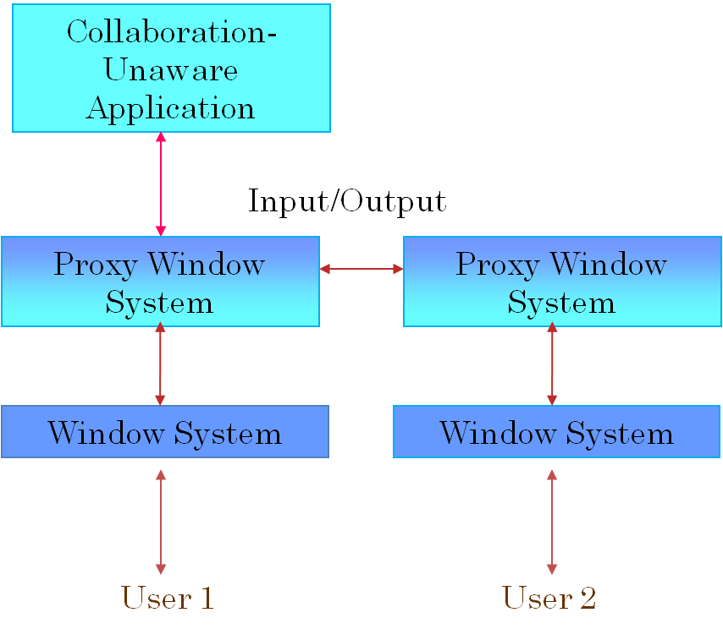
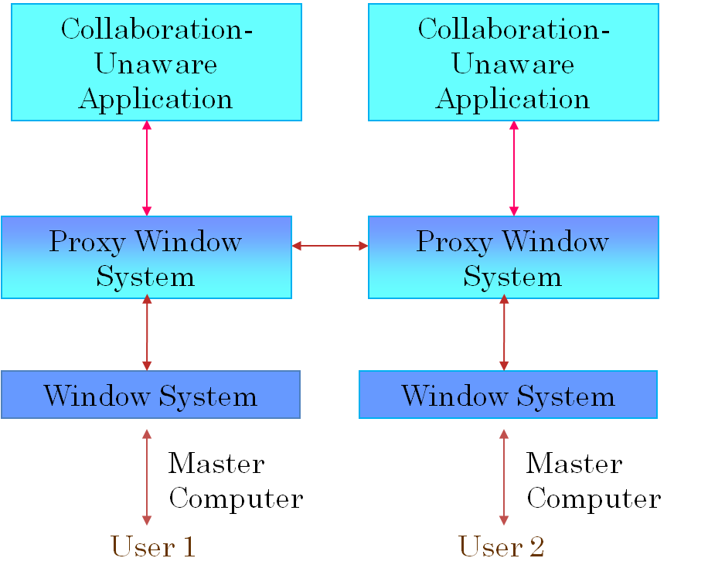
Correctness of Centralized and Replicated Shared Window Systems
Both require floor control for correctness.
Replicated requires determinism, replicated files, and idempotent operations on external state.
Will look at issues other than correctness later, which tend to favour replicated
Will look at issues other than correctness later.

Slide 52
RESEARCH INFRASTRUCTURES
VConf (Lantz ’86, Stanford)
Rapport (Ahuja ’89, Bell Labs)
Replicated
XTV (Abdel-Wahab ’91, UNC/ODU)
MeetingPlace (Cisco)
Centralized
CollaborateNow (IBM)
Webex
LiveMeeting (Microsoft)
Meeting Space (Vista)
Research systems tried both architectures.
Commercial ones implement centralized.

Slide 53
Proxy Addition in Client-Server Architecture
Window App
Window App
setenv hostid:port’.0
setenv hostid:port.0
Proxy Window System
setenv hostid:port.0
Window System
Window System
Window system is Window Server
X Window System
Window App and System run in different processes

Slide 54
Window System Library
Window App
Library proxy possible but not common.
Can assume input sent via observer pattern.
Window System
Microsoft Windows
Window App and System run in same process

Slide 55
Observer/Observable Pattern
Observer registers for some class of events
Observer 1
Event sent to all observers registered for it.
event
register()
register()
Observable
Observer 2
event

Slide 56
Intercepting Input
Window App
a^, w, x, y
addKeyListener()
addKeyListener()
addMouseListener()
addMouseListener()
Window
Shared Window System
a^, w, x, y
a pressed
Window System must allow enumeration of all windows of an application

Slide 57
Intercepting Output
Call in the window system/widget usually does not result in notifications
Window App
Local infrastructure module can send screen diffs to other computers
draw a, w, x, y
Must poll and send periodically
draw pixrect₁, pixrect_{n}
Window
Shared Window System

Slide 58
Window-based Coupling
Mandatory
  Window sizes
  Window contents
Optional
  Window positions
  Window stacking order
  Window exposed regions
Optional can be done with or without virtual desktop

