Slide 1
Shared Objects
Prasun Dewan
Department of Computer Science
University of North Carolina at Chapel Hill
dewan@cs.unc.edu

Slide 2
Concepts
Model View Controller (MVC)
Distributed MVC
Distributed computing and compiler issues
Replicated MVC
Disconnection in MVC

Slide 3
Window-based Coupling
Mandatory
Window sizes
Window contents
Optional
Window positions
Window stacking order
Window exposed regions
Optional can be done with or without virtual desktop
Lower Coupling?

Slide 4
What You See Is Not What I See (WYSINWIS)
Different window sizes, contents
Application
Need to know what it is rather than what it is not
U1
U2

Slide 5
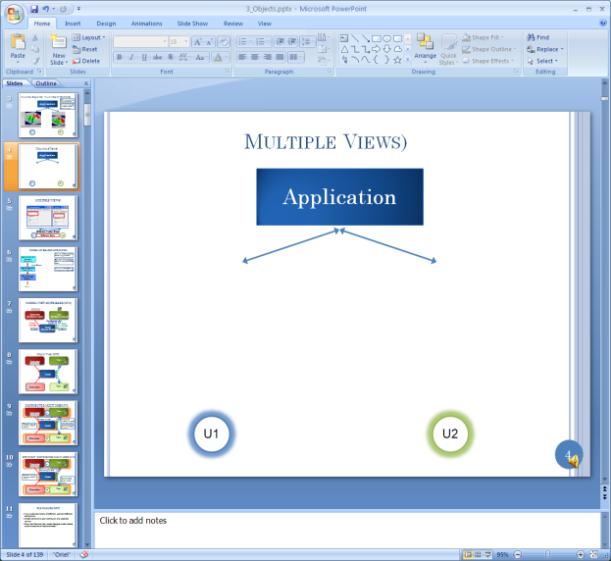
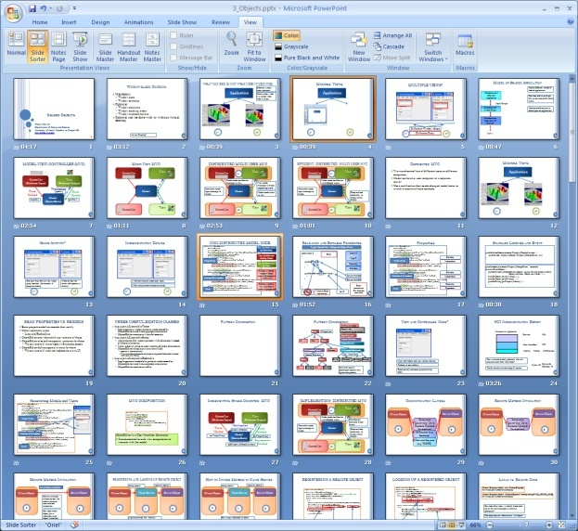
Multiple PPT Views
Application
U1
U2

Slide 6
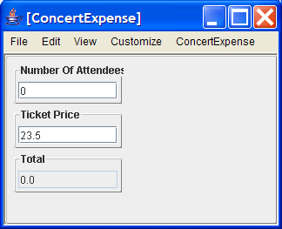
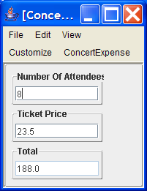
MULTIPLE USER VIEWS?
Different Window Sizes
U1
A Degree of Asynchrony
U2

Slide 7
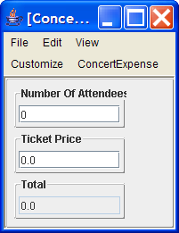
Sharing on Commits
Left User Enters Ticket Price Without Committing
Right User does not See Updated Ticket Price

Slide 8
Sharing on Commits
Left User Commits Ticket Price Change
Right User Sees Updated Ticket Price

Slide 9
Group Activity?
One user may find out the ticket price, another the number of people attending
Whoever has the latest info updates it directly or one user may be responsible for each field.
U1
U2

Slide 10
Model of Shared Application
Need a different model of shared application.
Collaboration –Unaware Application
One that allows multiple UIs to be created for same state.
Input/Output
Collaboration-Aware Proxy
Need an architecture to decompose an application.
Collaboration-Unaware I/O System
User 1

Slide 11
MODEL-VIEW-CONTROLLER (MVC)
Controller
(Performs Input)
View
(Performs Output)
Notification
Write Method
update ()
Read Method
Model (Stores State)
magnify()
getPlot ()

Slide 12
Concrete Example

Slide 13
MODEL CODE
public class AConcertExpense implements ConcertExpense {
float unitCost = 0;
int numberOfAttendees = 0;
Vector<Observer> observers= new Vector() ;
public float getTicketPrice() { return unitCost; }
public void setTicketPrice(float newVal) {
unitCost = newVal;
notify();
}
public int getNumberOfAttendees() { return numberOfAttendees; }
public void setNumberOfAttendees(int newVal) {
numberOfAttendees = newVal;
notify();
}
public float getTotal() {return unitCost*numberOfAttendees; }
public void addObserver(Observer observer) {
observers.add(observer);
}
void notify() {
for (Observer observer: observers) {
obsever.update();
}
}
}
Set methods called by Controller
View notifications fired by Model
Get methods called by View
Model allows registration of observers

Slide 14
Listener Interface
public interface Observer {
public void update();
}

Slide 15
Manual View and Controller Code?
Must learn about and use toolkits details.
Tedious to use toolkits.
Substantially increases programming effort.

Slide 16
GUI Implementation Effort
Interactive Application
Service
50%
User Interface
50%
Library
Toolkit
I/O Routines
Can we automatically generate the view and controller from the model?
Myers ‘95
Sutton & Sprague ‘78
We will use a UI generator called ObjectEditor.

Slide 17
ObjectEditor
OE Controller
OE View (Observer)
Performs Input
Performs Output
Notification Method
Model (Observable)
Write method
ReadMethod
Registration Method

Slide 18
MVC COMPOSITION
package main;
import budget.ConcertExpense;
import budget.AConcertExpense
import bus.uigen.ObjectEditor;
public class MVCBudget {
public static void main(String[] args) {
ConcertExpense model = new AConcertExpense ();
ObjectEditor.edit(model);
}
}
ObjectEditor is a User Interface Generator
Creates controller and view components to interact with the model

Slide 19
Multi View MVC
Controller
View
Model
Controller
View

Slide 20
DISTRIBUTED MULTI USER MVC
Controller
View
U1
Model
Controller
View
U2

Slide 21
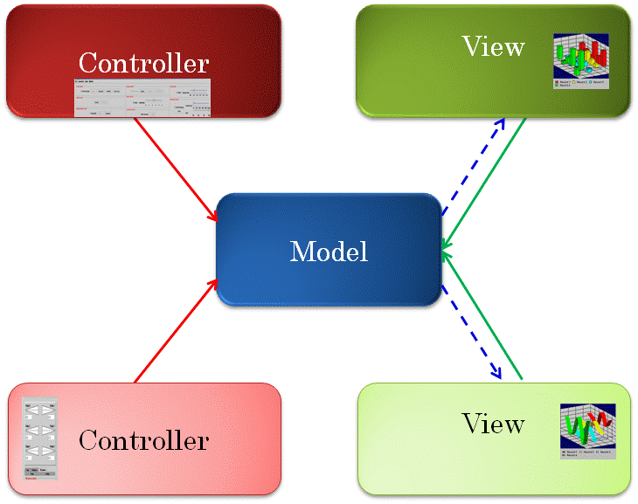
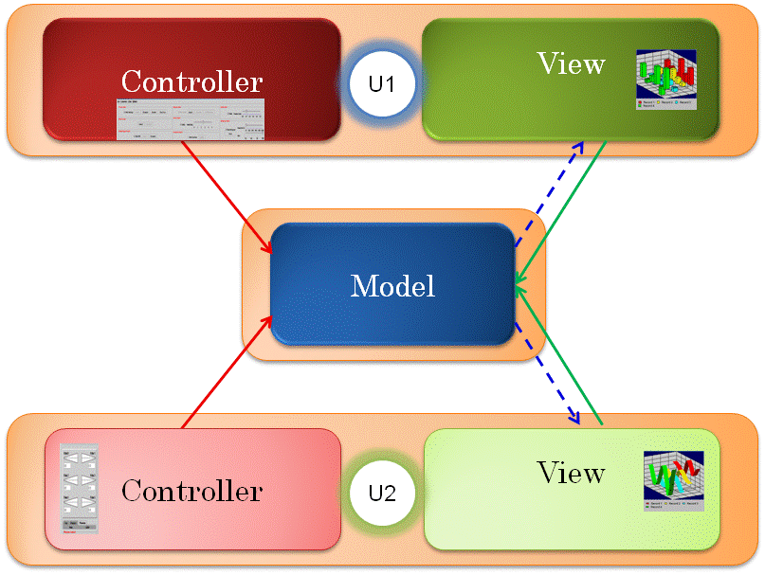
Decomposing an Object
Issue: Might want fine-grained locking, access control, merging, undo, coupling.
Issue: How to decompose an object?

Slide 22
Decomposing an Object
float unitCost = 0;
int numberOfAttendees = 0;
Vector<Observer> observers= new Vector() ;
Variable name
Class or primitive type of value stored in variable
numberOfAttendees
int
AConcertExpense
observers
Vector
??
unitCost
??
float
Physical structure can change and infrastructure should not rely on it!

Slide 23
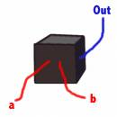
Encapsulation
public interface ConcertExpense {
public float getTicketPrice() ;
public int getNumberOfAttendees() ;
public void setNumberOfAttendees(int newVal);
public void setTicketPrice(float newVal);
public float getTotal() ;
public void addObserver(Observer observer) ;
}
ConcertExpense
Logical decomposition independent of physical structure?

Slide 24
Logical Structure
Property name
float unitCost = 0;
int numberOfAttendees = 0;
Vector<Observer> observers= new Vector() ;
Class or primitive type of property value
numberOfAttendees
int
total
AConcertExpense
float
Total does not correspond to an instance variable
ticketPrice
float
Observers does not correspond to a property.
Logical structure derived from public methods.

Slide 25
Formal Rules for Deriving Properties (names and types)?
TicketPrice: float
public interface ConcertExpense {
public float getTicketPrice() ;
public int getNumberOfAttendees() ;
public void setNumberOfAttendees(int newVal);
public void setTicketPrice(float newVal);
public float getTotal() ;
public void addObserver(Observer observer) ;
}
NumberOfAttendees: int
Total: int
Needed in an Object-Independent Infrastructure

Slide 26
Read-only and Editable Properties
Typed, Named Unit of Exported Object State
public class C
{
Name P
Type T
Bean
public T getP() {
...
}
Read-only
Editable
public void setP(T newValue) {
...
}
Getter method
Setter method
Bean convention:
for humans and tools
}
obtainP
Violates Bean convention
newP

Slide 27
Programming Patterns
Relationship among signatures of a specific class.
Bean pattern is one example of a programming pattern.
Used in bean builders, testing tools, and several others.
Useful in collaboration.
Design patterns are relationships among multiple classes.

Slide 28
Property ⬄ Logical Component?
TicketPrice: float
public interface ConcertExpense {
public float getTicketPrice() ;
public int getNumberOfAttendees() ;
public void setNumberOfAttendees(int newVal);
public void setTicketPrice(float newVal);
public float getTotal() ;
public void addObserver(Observer observer) ;
}
NumberOfAttendees: int
Total: int

Slide 29
Property ⬄ Logical Component?
public interface ConcertExpense {
public float getTicketPrice() ;
public int getNumberOfAttendees() ;
public void setNumberOfAttendees(int newVal);
public void setTicketPrice(float newVal);
public float getTotal() ;
public void addObserver(Observer observer) ;
public Vector getObservers();
}
TicketPrice: float
NumberOfAttendees: int
Total: int
property = static component
Can define special handling for Vector, List, Set, and other popular dynamic collections.

Slide 30
Programmer-Defined List
public interface StringHistory {
public void addElement(String element);
public int size();
public String elementAt(int index);
}
History cannot be edited

Slide 31
Pattern for Variable-Sized Collection
Collection of elements of type T
Write methods (optional)
public void addElement (T t);
public T elementAt (int index);
public int size();
public Any setElementAt(T t, int index);
public Any removeElementAt(int index);
public Any removeElementAt(T t);
public Any insertElementAt(T t, int index);
Element Type.
Read methods
Convention based on Vector
Unconstrained Type (void or T in practice)
Can create other conventions

Slide 32
Pattern for Tables
Table mapping key type K to element type E
Write methods (optional)
public Any put (K k, E e);
public Any remove(K k);
public E get (K k);
public Enumeration keys();
Convention based on Hashtable
Read methods
Can create other conventions

Slide 33
Programmer-Defined Table
public interface StringToConcertExpense {
public ConcertExpense get(Key string);
public void put(Key string, ConcertExpense expense) ;
public Enumeration<String> keys();
}

Slide 34
Pattern Composition
Primitive values
Predefined objects not implementing patterns
Bean
Properties
Bean Pattern
Vector Pattern
int
enum
Bean
Table Pattern
Vector
boolean
Hashtable
Indexed Elements
Key, Value Pairs
Bean
Bean
String
Boolean
String
Boolean
Patterns used to decompose objects into logical components and identify read/write methods
float
String
float
String

Slide 35
Read vs. Write Methods
Programming Patterns
Decompose objects
Identify read and write methods.
Read Methods
Used to get components of object
Getter methods
size(), elementAt(), get()
Write Methods
Used to change components of object
Setter methods
addElement(), removeElement(), setElementAt(), put()
Distinction independent of conventions
Needed to provide read/write locks, rights.
Also used for UI generation by ObjectEditor

Slide 36
Programmer-Defined Object Not Implementing Pattern
public interface ConcertExpense {
public float obtainTicketPrice() ;
public int numberOfAttendees() ;
public void writeNumberOfAttendees(int newVal);
public void ticketPrice(float newVal);
public float computeTotal() ;
public void addObserver(Observer observer) ;
}
ConcertExpense
Treated as a bean with no properties.

Slide 37
Generating Models and Views
public interface ConcertExpense {
public float getTicketPrice() ;
public int getNumberOfAttendees() ;
public void setNumberOfAttendees(int newVal);
public void setTicketPrice(float newVal);
public float getTotal() ;
public void addObserver(Observer observer) ;
}
Widget structure created from logical stricture
Read and write methods used to keep them consistent.
Notification used to refresh display.

Slide 38
ObjectEditor
OE Controller
OE View (Observer)
Performs Input
Performs Output
Notification Method
Model (Observable)
Write method
ReadMethod
Registration Method

Slide 39
MVC COMPOSITION
package main;
import budget.ConcertExpense;
import budget.AConcertExpense
import bus.uigen.ObjectEditor;
public class MVCBudget {
public static void main(String[] args) {
ConcertExpense model = new AConcertExpense ();
ObjectEditor.edit(model);
}
}
ObjectEditor is a User Interface Generator
Creates controller and view components to interact with the model

Slide 40
Decomposing an Object
Issue: Might want fine-grained locking, access control, merging, undo, coupling.
Issue: How to decompose an object?
Answer: Programming patterns.

Slide 41
Communication Cost
Issue: Message transmission over network much more costly than local method call.

Slide 42
MVC Communication
Controller
View
U1
Model sends notification message to view.
View sends message to model requesting state
Model
Controller sends input message to model.
Model sends state to view
Controller
View
U2

Slide 43
Inefficient Model Code
public class AConcertExpense implements ConcertExpense {
float unitCost = 0;
int numberOfAttendees = 0;
Vector<Observer> observers= new Vector() ;
public float getTicketPrice() { return unitCost; }
public void setTicketPrice(float newVal) {
unitCost = newVal;
observers.notify();
}
public int getNumberOfAttendees() { return numberOfAttendees; }
public void setNumberOfAttendees(int newVal) {
numberOfAttendees = newVal;
observers.notify();
}
public float getTotal() {return unitCost*numberOfAttendees; }
public void addObserver(Observer observer) {
observers.add(observer);
}
void notify() {
for (Observer observer: observers) {
obsever.update();
}
}
}
View notifications fired by Model
Model keeps track of observers

Slide 44
Efficient Model Code
public class AConcertExpense implements ConcertExpense {
float unitCost = 0;
int numberOfAttendees = 0;
PropertyChangeSupport propertyChange = new PropertyChangeSupport(this);
public float getTicketPrice() { return unitCost; }
public void setTicketPrice(float newVal) {
if (newVal == unitCost) return;
float oldVal = unitCost; int oldTotal = getTotal();
unitCost = newVal;
propertyChange.firePropertyChange("ticketPrice", oldVal, newVal);
propertyChange.firePropertyChange("total", oldTotal, getTotal());
}
public int getNumberOfAttendees() { return numberOfAttendees; }
public void setNumberOfAttendees(int newVal) {
if (numberOfAtendees == newVal) return;
int oldVal = numberOfAttendees; int oldTotal = getTotal();
numberOfAttendees = newVal;
propertyChange.firePropertyChange("numberOfAttendees", oldVal, newVal);
propertyChange.firePropertyChange("total", oldTotal, getTotal());
}
public float getTotal() {return unitCost*numberOfAttendees; }
public void addPropertyChangeListener(PropertyChangeListener l) {
propertyChange.addPropertyChangeListener(l);
}
}
Avoids unnecessary communication and also stops cycles if model is replicated
Send old and new state to allow stateless observers
Property change support keeps track of broadcasts to observers
Defines standard view interface in terms of properties

Slide 45
Standard Listener and Event
public interface java.beans.PropertyChangeListener {
public void propertyChange (PropertyChangeEvent evt);
}
public class java.beans.PropertyChangeEvent extends java.util.EventObject {
public PropertyChangeEvent (Object source, String propertyName,
Object oldValue, Object newValue) {…}
public Object getNewValue() {…}
public Object getOldValue() {…}
public String getPropertyName() {…}
….
}

Slide 46
PropertyListener MVC
OE Controller
OE View (Observer)
Performs Input
Performs Output
propertyChange (PropertyChangeEvent)
Model (Observable)
Write method ( setTicketPrice(float))
ReadMethod (getTicketPrice())
addPropertyChangeListener(PropertyChangeListener listener

Slide 47
ObjectEditor Observer Protocol
ObjectEditor implements the standard PropertyChangeListener interface
public class ObjectEditorView implements PropertyChangeListener {
public void propertyChange(PropertyChangeEvent event) {
...
}
}

Slide 48
Pattern Composition
Primitive values
Predefined Objects not implementing patterns
Bean
Properties
Bean Pattern
Vector Pattern
int
float
Bean
Table Pattern
Vector
Boolean
Hashtable
Indexed Elements
Key, Value Pairs
Bean
Bean
String
Boolean
String
Boolean
int
String
int
String
List and Table Notifications?
Java does not support them!

Slide 49
VectorListener MVC
OE Controller
OE View (Observer)
Performs Input
Performs Output
updateVector (VectorChangeEvent)
Model (Observable)
Write method ( addElement(Object))
ReadMethod (elementAt(index))
addVectorListener(VectorListener vectorListener)

Slide 50
VectorListener Interface
package util.models;
public interface VectorListener {
public void updateVector(VectorChangeEvent evt);
}

Slide 51
VectorListener Interface
package util.models;
public class VectorChangeEvent {
// constants to be used for event type
public static final int AddComponentEvent = 1,
DeleteComponentEvent = 2,
ChangeComponentEvent = 3,
InsertComponentEvent = 4,
CompletedComponentsEvent = 5,
ClearEvent = 6,
UndefEvent = 1000;
// constructor, oldObject can be null when no value is replaced
public VectorChangeEvent(Object theSource, int type, int posn, Object oldObject, Object newObject, int newSize) {
…
}
…
}

Slide 52
Notifying StringHistory
import util.models.VectorChangeSupport;
import util.models.VectorListener;
public class AnObservableStringHistory extends AStringHistory {
VectorChangeSupport vectorChange = new AVectorChangeSupport(this);
public void addVectorListener(VectorListener vectorListener) {
vectorChange.addVectorListener(vectorListener);
}
public void addElement(String element) {
super.addElement(element);
// vectorChange constructs VectorChangeEvent
vectorChange.elementAdded(element);
}
}

Slide 53
VectorMethodsListener Interface
package util.models;
public interface VectorMethodsListener<ElementType> {
public void elementAdded(Object source, ElementType element, int newSize);
public void elementInserted(Object source, ElementType element, int pos, int newSize);
public void elementChanged(Object source, ElementType element, int pos);
public void elementRemoved(Object source, int pos, int newSize);
public void elementRemoved(Object source, ElementType element, int newSize);
...
}

Slide 54
Notifying StringHistory Extension
import util.models.VectorChangeSupport;
import util.models.VectorListener;
import util.models.VectorMethodsListener;
public class AnObservableStringHistory extends AStringHistory {
VectorChangeSupport vectorChange = new AVectorChangeSupport(this);
public void addVectorListener(VectorListener vectorListener) {
vectorChange.addVectorListener(vectorListener);
}
public void addVectorMethodsListener(VectorMethodsListener vectorListener) {
vectorChange.addVectorMethodsListener(vectorListener);
}
public void addElement(String element) {
super.addElement(element);
// vectorChange notifies both kinds of listeners
vectorChange.elementAdded(element);
}
}

Slide 55
HashtableListener MVC
OE Controller
OE View (Observer)
Performs Input
Performs Output
keyPut(), keyRemoved()
Model (Observable)
Write method ( put(Object, Object))
ReadMethod (get(Object))
addHashTableListener(HashtableListener hashtableListener)

Slide 56
HashtableListener Interface
package util.models;
public interface HashtableListener {
public void keyPut(Object source, Object key, Object value, int newSize);
public void keyRemoved(Object source, Object key, int newSize);
}

Slide 57
Notifying StringHistory
import util.models.HashtableChangeSupport;
import util.models.HashtableListener;
public class AnObservableStringToConcertExpense implements StringToConcertExpense {
Hashtable contents = new Hashtable();
HashtableChangeSupport tableChange = new AHashtableChangeSupport(this);
public void addHashtableListener(HashtableListener tableListener) {
tableChange.addHashtableListener(tableListener);
}
public void put (String element, ConcertExpense expense) {
contents.addElement(element);
tableChange.elementPut(element, expense);
}
public void get(String element) {
return contents.get(element);
}
public Enumeration keys() {
return contents.keys();
}
}

Slide 58
Pattern Composition
Primitive values
Predefined Objects not implementing patterns
Bean
Properties
Bean Pattern
Vector Pattern
int
float
Bean
Table Pattern
Vector
Boolean
Hashtable
Indexed Elements
Key, Value Pairs
Bean
Bean
String
Boolean
String
Boolean
int
String
int
String
Vector and Hashtable do not support the non standard notifications.

Slide 59
Pattern Composition Using Observables
Primitive values
Predefined Objects not implementing patterns
Bean
Properties
Bean Pattern
Vector Pattern
int
float
Bean
Table Pattern
AListenableVector
Boolean
AListenableHashtable
Indexed Elements
Key, Value Pairs
Bean
Bean
String
Boolean
String
Boolean
Listenable versions of these do. Using vector and hashtable events.
int
String
int
String

Slide 60
Pattern Composition Using Observables
Java string is immutable, model only knows a new String is assigned to a property.
Bean
Properties
Model may need incremental changes to a string.
int
float
Bean
Model may do spelling checking.
AListenableVector
Boolean
AListenableHashtable
Indexed Elements
Key, Value Pairs
Bean
Bean
String
Boolean
String
Boolean
AListenableString is mutable and notifies model of incremental changes using Vector notifications.
int
String
int
AListenableString

Slide 61
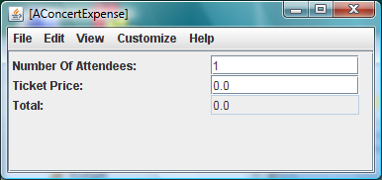
Displaying Logical Structures and Type→Widget
import java.beans.PropertyChangeListener;
public interface ConcertExpense {
public float getTicketPrice();
public void setTicketPrice(float newVal);
public int getNumberOfAttendees();
public void setNumberOfAttendees(int newVal);
public float getTotal();
public void addPropertyChangeListener(PropertyChangeListener l);
}
number, String → TextField
Widget structure visualizes logical structure

Slide 62
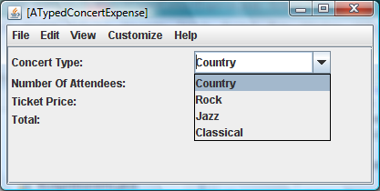
Enum→Widget
public enum ConcertType {
Country, Rock, Jazz, Classical
};
public interface TypedConcertExpense extends ConcertExpense {
public ConcertType getConcertType();
public void setConcertType(ConcertType newVal);
}
Enums→ ComboBox

Slide 63
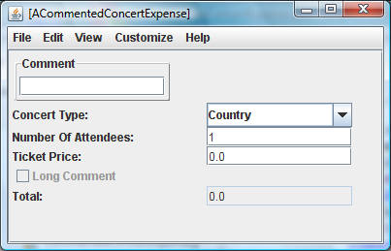
Boolean and AListenableString→Widget
public interface CommentedConcertExpense extends TypedConcertExpense {
public boolean getLongComment();
public AListenableString getComment();
public void setComment(AListenableString newVal);
}
boolean → CheckBox
AListenableString → TextBox

Slide 64
List and Hashtable
public static void main(String[] args) {
TypedConcertExpense firstConcert = new ACommentedConcertExpense();
TypedConcertExpense secondConcert = new ACommentedConcertExpense();
AListenableVector<TypedConcertExpense> list = new AListenableVector();
list.addElement(firstConcert);
list.addElement(secondConcert);
ObjectEditor.edit(list);
Hashtable<String, TypedConcertExpense> table = new AListenableHashtable();
table.put("Concert 1", firstConcert);
table.put("Concert 2", secondConcert);
ObjectEditor.edit(table);
}
String and AListenableString indistinguishable so far
List → Widget List
Key
Value
Hashtable → (Key, Value) Table Widget

Slide 65
Registering with Observables
Root: Object passed as parameter to ObjectEditor.edit()
Bean
Properties
Register method called by ObjectEditor view(s)
int
float
Bean
AListenableVector
Boolean
AListenableHashtable
Indexed Elements
Key, Value Pairs
Bean
Bean
String
Boolean
String
Boolean
int
String
int
AListenableString

Slide 66
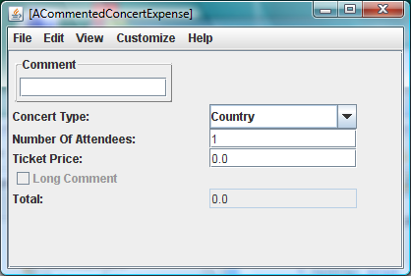
Event Processing
Initial State
ObjectEditor.edit(new ACommentedConcertExpense())

Slide 67
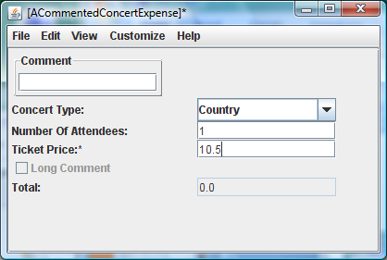
Incremental Edit
User edits ticket price text field but does not hit Enter
Total does not change
By default controller does not send incremental, possibly erroneous, input to model.
* Shown to indicate text has not been processed

Slide 68
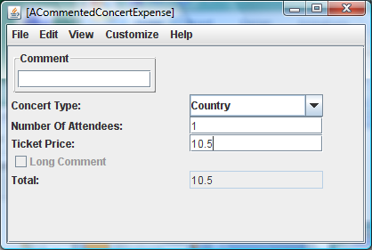
Incremental Edit
User hits Enter
Total updated
Write method invoked when user hits Enter.
Property change sent to listeners.
OE View updates display in response to property change.
OE View registered itself with the model when it displayed it.

Slide 69
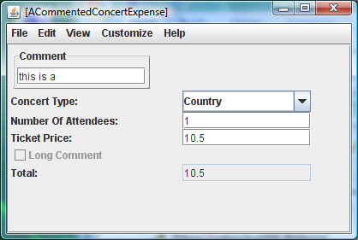
Incremental Edit of AListenableString
User edits comment field but does not hit enter
No star shown when AListenableString is being incrementally edited.
AListenableString fires vector change events.

Slide 70
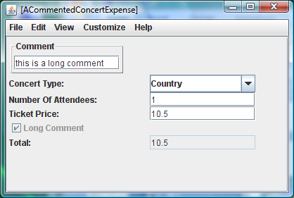
Incremental Edit of AListenableString
Model updates LongComment property during incremental editing
It listens to vector events fired by AListenableString.

Slide 71
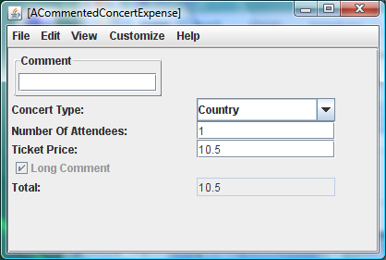
Committing AListenableString
User presses Enter.
Enter key calls the write method for the associated property.
Model clears mutable AListenableString when the write method for it is called.
ObjectEditor registered itself as listener of events of the AListenableString

Slide 72
Incremental Edit of AListenableString (Review)
User edits comment field but does not hit enter
No star shown when AListenableString is being incrementally edited.
AListenableString fires vector change events.

Slide 73
Incremental Edit of AListenableString (Review)
Model updates LongComment property during incremental editing
It listens to vector events fired by AListenableString.

Slide 74
Committing AListenableString
User presses Enter.
Enter key calls the write method for the associated property.
Model clears mutable AListenableString when the write method for it is called.
ObjectEditor registered itself as listener of events of the AListenableString

Slide 75
Processing Increments and Commits
public class ACommentedConcertExpense extends ATypedConcertExpense implements VectorListener, CommentedConcertExpense {
AListenableString comment = new AListenableString();
static int LONG_COMMENT_SIZE = 10;
boolean longComment = false;
public ACommentedConcertExpense() {
comment.addVectorListener(this);
}
public boolean getLongComment(){return comment.size() > LONG_COMMENT_SIZE;}
public AListenableString getComment() {return comment;}
public void setComment(AListenableString newVal) {
comment = newVal;
comment.clear();
}
boolean oldLongComment = false;
public void updateVector(VectorChangeEvent evt) {
boolean newLongComment = getLongComment();
propertyChange.firePropertyChange("longCommentType", oldLongComment,
newLongComment);
oldLongComment = newLongComment;
}
}

Slide 76
THREE USEFUL EXISTING CLASSES
bus.uigen.AListenableVector
Implements a vector pattern (understood by ObjectEditor and Sync) and fires appropriate events
ObjectEditor creates a list of elements.
bus.uigen.AListenableString
Implements the vector pattern with character instead of object elements.
Fires vector events as user inserts, deletes, characters
ObjectEditor displays it as a text field
Updates it incrementally, which fires vector events.
Write method of associated property/sequence/hashtable invoked when user hits Enter
bus.uigen.AListenableHashtable
Implements a hashtable pattern understood by ObjectEditor and fires appropriate events
ObjectEditor creates a table

Slide 77
Communication Cost
Issue: Message transmission over network much more costly than local method call.
Answer: Send part of the state that changed with notification.
Answer: Need pattern-based notification standard for each pattern.

Slide 78
Remote Operation Invocation
Issue: How do we invoke remote operations

