Slide 1
Collaboration Architectures
Prasun Dewan
Department of Computer Science
University of North Carolina at Chapel Hill
dewan@cs.unc.edu

Slide 2
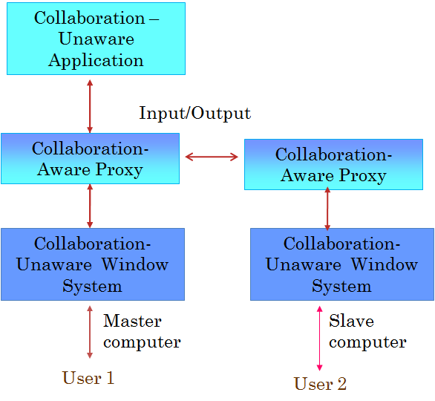
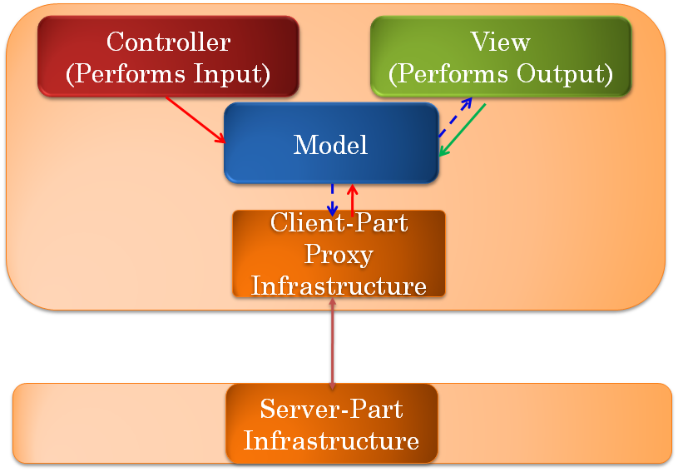
Specific Abstractions vs. General Issues
Abstraction-independent issues
Architecture

Slide 3
Architectures
Design Space
Implementation of design space
Evaluation of design space
Metrics
  Functionality
  Programmability
  Performance

Slide 4

Architecture?
Controller
View
Model
Infrastructure Proxy
Controller
View

Slide 5
Software Architecture
Controller
View
Model
Static logical components
Infrastructure Proxy
Metric: Separation of concerns
Application and infrastructure
Infrastructure forces componentization

Slide 6
Distributed Centralized Architecture
Controller
View
Model
Physical components placed on distributed nodes
Infrastructure Proxy
Controller
View

Slide 7
Distributed Replicated Architecture
Controller
View
Model
Physical components placed on distributed nodes
Infrastructure Proxy
Infrastructure Proxy
Model
Controller
View

Slide 8
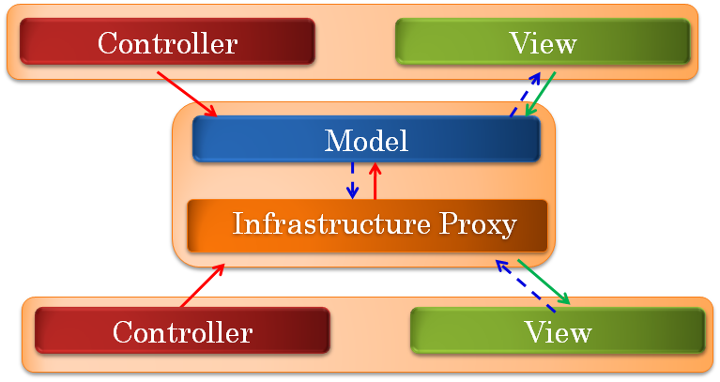
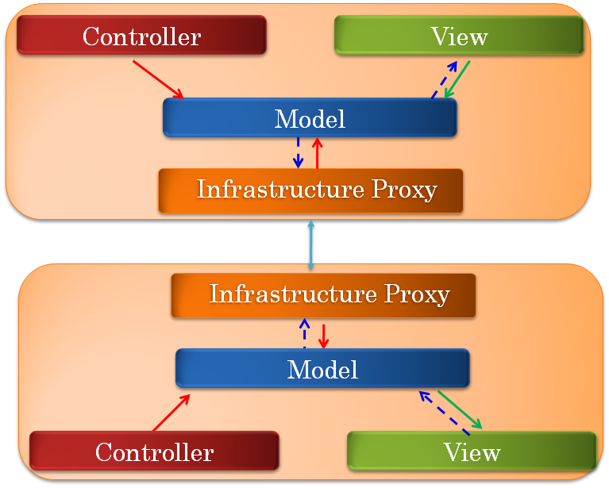
Logical vs. Physical Component
Physical component centralized or replicated instance of logical component

Slide 9
More Architectures
Collaboration-Unaware Application
Proxy Window System
Proxy Window System
Window System
Window System
Replicated Shared Window System

Slide 10
More Architectures
Collaboration-Unaware Application
Collaboration-Unaware Application
Proxy Window System
Proxy Window System
Window System
Window System
Replicated Shared Window System

Slide 11
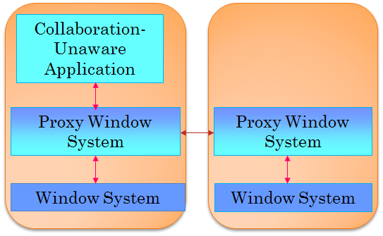
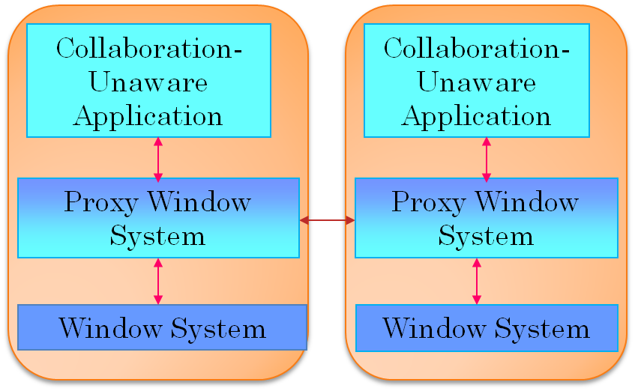
Many More Architectures

Slide 12


Architectural Design Space?
Dimensions?

Slide 13
Dimensions?

Slide 14
Shared Window vs. Model
Shared Model
Shared Window

Slide 15
Centralized vs. Replicated
Centralized
Replicated

Slide 16

Comparing Centralized Architectures
Centralized
Need to capture degree of centralization

Slide 17
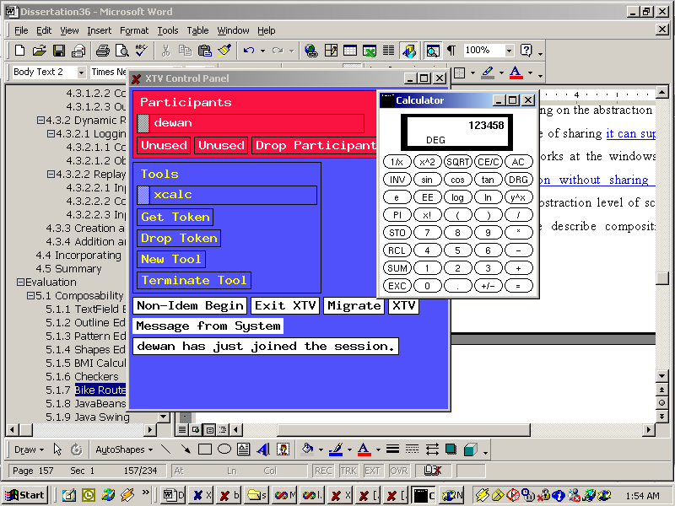
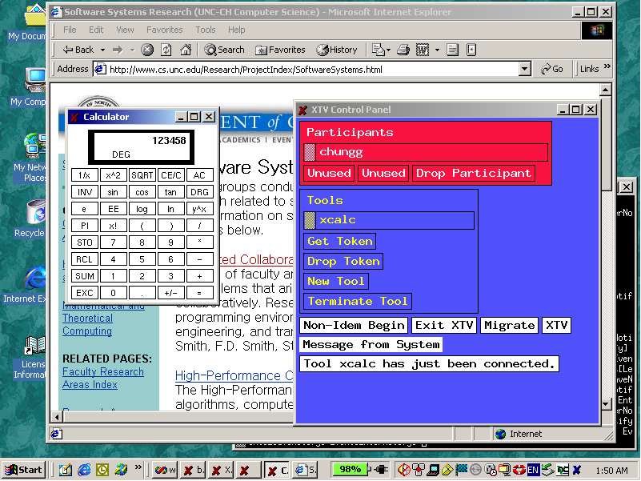
Shared Window → Shared Model

Slide 18
! (Shared Model → Shared Window)
Need to capture degree of sharing.

Slide 19
1-User Layer Stack
Layer 0
Layer 0
Layer 1
Layer 1
Increasing Abstraction
Communication Layers
I/O Layers
Layer N-1
Layer N-1
Layer N
Layer N
PC
Physical Devices

Slide 20
Example Stack
10
6.2
Data
Abstraction
Increasing Abstraction
Interactor
Widget
Abstraction
6.2
Abstraction Representation
Syntactic Sugar
Window
Interactor
Abstraction
PC
Framebuffer
Interactor
Syntactic sugar ~ IF keyword, packet header

Slide 21
Single-User Interaction
Layer 0
Layer 1
Increasing Abstraction
Layer N-1
Layer N
PC

Slide 22
Identifying the Shared Layer
Higher layers will also be shared
Layer 0
10
6.2
Program Component
Shared Layer
Layer S
6.2
Increasing Abstraction
Lower layers may diverge
6.2
Layer S+1
6.2
User-Interface Component
Layer N
PC

Slide 23
“Replicating” UI Component
Layer S+1
Layer S+1
Layer S+1
Layer N
Layer N
Layer N
PC
PC
PC

Slide 24
Centralized Architecture
Layer 0
Layer S
Layer S+1
Layer S+1
Layer S+1
Layer N
Layer N
Layer N
PC
PC
PC

Slide 25
Replicated (P2P) Architecture
Layer 0
Layer 0
Layer 0
Layer S
Layer S
Layer S
Layer S+1
Layer S+1
Layer S+1
Layer N
Layer N
Layer N
PC
PC
PC

Slide 26
Centralized Architecture Implementation
Layer 0
Layer S
Master Input Relayer Output Broadcaster
Slave I/O Relayer
Slave I/O Relayer
Layer S+1
Layer S+1
Layer S+1
Layer N
Layer N
Layer N
PC

Slide 27
Replicated Architecture Implementation
Layer 0
Layer 0
Layer 0
Layer S
Layer S
Layer S
Inp. Broadcaster
Inp. Broadcaster
Inp. Broadcaster
Layer S+1
Layer S+1
Layer S+1
Layer N
Layer N
Layer N
PC

Slide 28

Architectural Design Space?
Two fundamental dimensions
Model
Several others later
Shared Layer
Why architectural design space?
Window
Why design space?
Centralized
Replicated
Mapping between Program and UI Component

Slide 29



Why Design Space?
Concise description of existing points
Classification of points to compare and contrast features
Process Management
Identify issues, possibilities for designers
File System
Identify holes - missing points
User Interface
Common implementation modules
“Dimensions” may have sub dimensions and may not be completely orthogonal
Common multidimensional analysis

Slide 30
Classifying and Concisely Understanding Existing Systems
Sync, Groove, NetMeeting, LiveMeeting, WebexWhiteboards, Presenters
Data
Google Docs, Suite, Rendezvous, Weasel
Covered in depth already
Toolkit
Habanero, JCE (AWT), GroupKit
Shared Layer
XTV (X), Vconf, Rapport, LiveMeeting, Webex, NetMeeting App Sharing
Vconf, Rapport
Window
Framebuffer
Shared VNC
Centralized
Replicated
Mapping between Program and UI Component
Holes?
No replicated Framebuffer
No centralized shared widgets

Slide 31
FrameBuffer
OS + Apps
key and mouse events
draw pixels
Framebuffer
PC

Slide 32
FrameBuffer Screen Coordinates
Screen coordinates
OS + Apps
right button ^, w1, x, y
right button ^, x, y
Framebuffer
PC

Slide 33

Replicated Shared FrameBuffer
OS + Apps
OS + Apps
right button ^, x, y
right button ^, x, y
draw pixels
draw pixels
Framebuffer
Framebuffer
The most impractical assumption about common software
PC
PC

Slide 34
Replicated Screen Sharing?
Replication hard if not impossible
  Each computer shares input
  Requires replication of entire computer state
    Either all computers are identical and receive same input from when they were bought
    Or at start of sharing session download one computer’s entire environment

Slide 35
Centralized Shared FrameBuffer
Output size?
OS + Apps
right button ^, x, y
draw pixels
draw pixels
Framebuffer
Framebuffer
The most practical assumption about common software
PC
PC

Slide 36

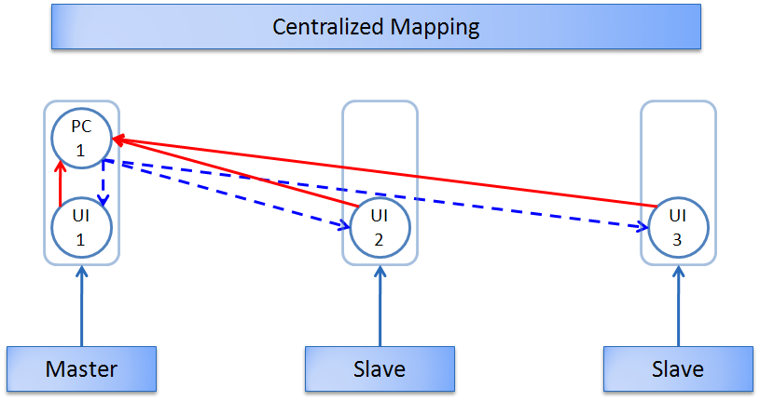
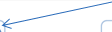
Screen Diffs
Insert “line”
Send smallest pixel rectangles including the changed areas
Network

Slide 37
Remote Draw Pixels
OS + Apps
right button ^, x, y
draw pixels
update pixrect₁, pixrect_{n}
Distributed Sharing Infrastructure
draw pixels
Framebuffer
Framebuffer
PC
PC

Slide 38
Centralized Screen Sharing?
Everyone has framebuffer and it can be put in virtual desktop
The simplest I/O protocol – very few calls to intercept by sharing infrastructure
No common state to be assumed (e.g. fonts)
Framebuffer updates can be expensive
  Compression techniques later

Slide 39
Layers Considered So Far
Sync, Groove, NetMeeting, LiveMeeting, WebexWhiteboards, Presenters
Data
Google Docs, Suite, Rendezvous, Weasel
Toolkit
Habanero, JCE (AWT), GroupKit
Shared Layer
XTV (X), Vconf, Rapport, LiveMeeting, Webex, NetMeeting App Sharing
Vconf, Rapport
Window
Framebuffer
Shared VNC
Centralized
Replicated
Mapping between Program and UI Component
No centralized shared widgets

Slide 40
Shared Widgets
Layer above window is Toolkit
Abstractions offered
  Text
  Sliders
  Other “Widgets”

Slide 41
Sharing the (Swing) Toolkit Layer
Different window sizes
Different looks and feel
Independent scrolling
Merge changes to different widgets
Merge changes to text widget

Slide 42
Toolkit Is A Library
Toolkit App
Library proxy possible but not common.
Can assume input sent via observer pattern
Toolkit
Toolkit App and System run in same process

Slide 43
Intercepting Input
Toolkit App
a^, w, x, y
addKeyListener()
addKeyListener()
addMouseListener()
addMouseListener()
Toolkit
Shared Toolkit System
a^, w, x, y
a pressed
Need way to enumerate all widgets of an application
Toolkit not part of OS
Would need some collaboration awareness in application to get at least top level widgets.

Slide 44
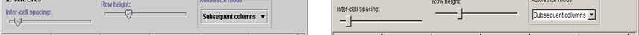
Intercepting Output
Call in the window system/widget usually does not result in notifications
Toolkit App
Local infrastructure module can send screen diffs to other computers
setText(“hello”)
Must poll and send periodically
draw pixrect₁, pixrect_{n}
Toolkit
Shared Toolkit System
Toolkit allows non WYSIWIS interaction
Screen updates will not work
Replicated architecture does not require output transmission

Slide 45
Intercepting Input
Toolkit App
a^, w, x, y
addKeyListener()
addKeyListener()
addMouseListener()
addMouseListener()
Toolkit
Shared Toolkit System
a^, w, x, y
a pressed
Would need some collaboration awareness in application to get at least top level widgets.
Collaboration aware techniques that also allow interception of output?

Slide 46
Proxy Library Layer
Toolkit App
a^, w, x, y
addKeyListener()
setText(“hello”)
addMouseListener()
Shared Toolkit System
a^, w, x, y
setText(“hello”)
addKeyListener()
addMouseListener()
Toolkit
a pressed

Slide 47
Proxy Library Layer For Centralized
Toolkit App
a^, w, x, y
addKeyListener()
setText(“hello”)
addMouseListener()
b^, w, x, y
Shared Toolkit System
a^, w, x, y
addKeyListener()
setText(“hello”)
setText(“hello”)
addMouseListener()
Toolkit
a pressed

Slide 48
Specifying Proxy Library Layer
Toolkit App
sharedswing.JTextField
a^, w, x, y
setText()
addKeyListener()
addMouseListener()
Shared Toolkit System
javax.swing.JTextField
addKeyListener()
setText()
addMouseListener()
Programmer uses different package
Toolkit
Depending on the language, may be able to interpose library without requiring changes to imports

Slide 49
Proxy Library Layer Overhead
Toolkit App
sharedswing.JTextField
sharedswing.JSlider
setText()
addKeyListener()
setValue()
addMouseListener()
Shared Toolkit System
javax.swing.JTextField
javax.swing.JSlider
addKeyListener()
setText()
Toolkit programmer overhead
addMouseListener()
setValue()
Toolkit
Must change proxy classes as new toolkit classes created

Slide 50
Shared Toolkit
Intermediate point between model and window sharing.
Like model sharing
  Independent window sizes and scrolling
  Concurrent editing of different widgets
  Merging of concurrent changes to replicated text widget
Like window sharing
  No new programming model/abstractions

Slide 51
Why no Replicated Shared Toolkit
Unlike window system, toolkit not a network layer currently
Intercepting output requires imports to be changed and programming of large number of proxy classes
Hence replicated architecture

Slide 52
Why Design Space?
Sync, Groove, NetMeeting, LiveMeeting, WebexWhiteboards, Presenters
Concise description of existing points
Data
Google Docs, Suite, Rendezvous, Weasel
Classification of points to compare and contrast features
Toolkit
Habanero, JCE (AWT), GroupKit
Shared Layer
Identify issues, possibilities for designers
XTV (X), VConf, Rapport, LiveMeeting, Webex, NetMeeting App Sharing
Vconf, Rapport
Window
Identify holes - missing points
Framebuffer
Shared VNC
Common implementation modules
Centralized
Replicated
Mapping between Program and UI Component
Common multidimensional analysis

Slide 53
Centralized Architecture
Layer 0
Layer S
Master Input Relayer Output Broadcaster
Slave I/O Relayer
Slave I/O Relayer
Layer S+1
Layer S+1
Layer S+1
Only layer dependent aspect is definition of input and output.
Layer N
Layer N
Layer N
Separate distribution from I/O interception and delivery
PC

Slide 54
Replicated Architecture
Layer 0
Layer 0
Layer 0
Layer S
Layer S
Layer S
Inp. Broadcaster
Inp. Broadcaster
Inp. Broadcaster
Layer S+1
Layer S+1
Layer S+1
Layer N
Layer N
Layer N
Can have single distributor that runs in centralized and/or replicated mode
PC

Slide 55
Implementation
Adaptive Distributor
  Master (Centralized)
  Slave (Centralized)
  Peer (Replicated)
Abstract Inter-layer Communication Protocol
System-specific translator between specific and abstract protocol

Slide 56
Implementation
Layer 0
Layer 0
Layer 0
Layer S
Layer S
Layer S
Layer N-1
Layer N-1
Layer N-1
Translator
Translator
Translator
Adaptive Distributor
Adaptive Distributor
Adaptive Distributor
Layer N
Layer N
Layer N
PC

Slide 57
Sharing Higher Layer
Layer 0
Layer 0
Layer 0
Layer S
Layer S
Layer S
Translator
Translator
Translator
Adaptive Distributor
Adaptive Distributor
Adaptive Distributor
Layer S+1
Layer S+1
Layer S+1
Translator switches changes shared layer
Layer N
Layer N
Layer N
How to switch between replicated and centralized?
PC

Slide 58
Hybrid
Layer 0
Layer 0
Layer 0
Layer S
Layer S
Layer S
Translator
Translator
Translator
Adaptive Distributor
Adaptive Distributor
Adaptive Distributor
Layer S+1
Layer S+1
Layer S+1
Can have single distributor that runs in centralized and replicated mode
Layer N
Layer N
Layer N
PC
Mapping in each distributor: peers masters and slaves
Change mapping to change between replicated, centralized and hybrid

Slide 59
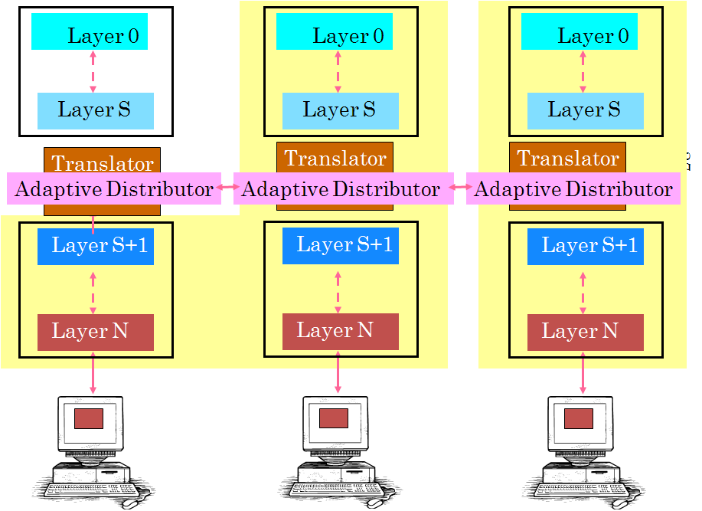
Hybrid Distributor Steps
1
Forward Input to Peers
2
Process Input
3
Send Output to Slaves
4
Display Output

Slide 60
Hybrid
Layer 0
Layer 0
Layer 0
Layer S
Layer S
Layer S
Translator
Translator
Translator
Adaptive Distributor
Adaptive Distributor
Adaptive Distributor
Layer S+1
Layer S+1
Layer S+1
Layer N
Layer N
Layer N
PC
Mapping in each distributor gives peers masters and slaves
Change mapping to change between replicated, centralized and hybrid

Slide 61
Centralized
Layer 0
Layer 0
Layer 0
Layer S
Layer S
Layer S
Translator
Translator
Translator
Adaptive Distributor
Adaptive Distributor
Adaptive Distributor
Layer S+1
Layer S+1
Layer S+1
Layer N
Layer N
Layer N
PC
Mapping in which master has no peers

Slide 62
Replicated
Layer 0
Layer 0
Layer 0
Layer S
Layer S
Layer S
Translator
Translator
Translator
Adaptive Distributor
Adaptive Distributor
Adaptive Distributor
Layer S+1
Layer S+1
Layer S+1
Layer N
Layer N
Layer N
Mapping in which master has no slaves
Distributor is a meta infrastructure
PC

Slide 63
Infrastructure vs. Meta-Infrastructure
Toolkit is both centralized and replicated
Text Editor
Outline Editor
application
application
Pattern Editor
application
application
application
application
application
Checkers
application
Java’s Swing
X
JavaBeans
VNC
Translator
Infrastructure
Meta-Infrastructure

Slide 64
Why Design Space?
Sync, Groove, NetMeeting, LiveMeeting, WebexWhiteboards, Presenters
Concise description of existing points
Data
Google Docs, Suite, Rendezvous, Weasel
Classification of points to compare and contrast features
Toolkit
Habanero, JCE (AWT), GroupKit
Shared Layer
Identify holes - missing points
XTV (X), Vconf, Rapport, LiveMeeting, Webex, NetMeeting App Sharing
Vconf, Rapport
Window
Common implementation modules
Framebuffer
Shared VNC
Common multidimensional analysis
Centralized
Replicated
Mapping between Program and UI Component

Slide 65
Metrics?
Sync, Groove, NetMeeting, LiveMeeting, WebexWhiteboards, Presenters
Metrics?
Data
Google Docs, Suite, Rendezvous, Weasel
Functionality
Programmability
Toolkit
Habanero, JCE (AWT), GroupKit
Performance
Shared Layer
XTV (X), Vconf, Rapport, LiveMeeting, Webex, NetMeeting App Sharing
Vconf, Rapport
Window
Framebuffer
Shared VNC
Centralized
Replicated
Mapping between Program and UI Component

Slide 66
Metrics?
Sync, Groove, NetMeeting, LiveMeeting, WebexWhiteboards, Presenters
Metrics?
Data
Google Docs, Suite, Rendezvous, Weasel
Functionality
Habanero, JCE (AWT), GroupKit
Coupling
Toolkit
Shared Layer
Conc. Ctrl.
XTV (X), Vconf, Rapport, LiveMeeting, Webex, NetMeeting App Sharing
Vconf, Rapport
Window
Access Ctrl.
Merging
Framebuffer
Shared VNC
Interopera-bility
Centralized
Replicated
Mapping between Program and UI Component
Correctness

Slide 67
Functions vs. Layers
Sync, Groove, NetMeeting, LiveMeeting, WebexWhiteboards, Presenters
Metrics?
Data
Google Docs, Suite, Rendezvous, Weasel
Functionality
Habanero, JCE (AWT), GroupKit
Coupling
Toolkit
Shared Layer
Conc. Ctrl.
XTV (X), Vconf, Rapport, LiveMeeting, Webex, NetMeeting App Sharing
Vconf, Rapport
Window
Access Ctrl.
Merging
Framebuffer
Shared VNC
Interopera-bility
Centralized
Replicated
Mapping between Program and UI Component
Correctness

Slide 68
Example Stack
10
6.2
Data
Widget
6.2
Abstraction Representation
Coupling
Syntactic Sugar
Conc. Ctrl.
Window
Access Ctrl.
Merging
PC
Framebuffer
Interopera-bility
PC
Correctness
Atomic abstraction → (semantically meaningful) atomic interactor
Atomic interactor → atomic abstraction

Slide 69
Collab. Functions vs. Layers
Sync, Groove, NetMeeting, LiveMeeting, WebexWhiteboards, Presenters
Data
Google Docs, Suite, Rendezvous, Weasel
Toolkit
Habanero, JCE (AWT), GroupKit
Looser coupling
Finer-grajned Meaningful AC, CC, Merging
Shared Layer
XTV (X), Vconf, Rapport, LiveMeeting, Webex, NetMeeting App Sharing
Vconf, Rapport
Window
Framebuffer
Shared VNC
Centralized
Replicated
Atomic interactor → atomic abstraction
Mapping between Program and UI Component
Atomic abstraction → (semantically meaningful) atomic interactor
At higher layer, coupling of more abstract representation and no coupling of syntactic sugar

Slide 70
Interoperability with No MVC
Sync, Groove, NetMeeting, LiveMeeting, WebexWhiteboards, Presenters
Data
Toolkit dependent monolithic code
Google Docs, Suite, Rendezvous, Weasel
Toolkit
Habanero, JCE (AWT), GroupKit
Many toolkits per language
Interoperability
Shared Layer
XTV (X), Vconf, Rapport, LiveMeeting, Webex, NetMeeting App Sharing
Vconf, Rapport
Few OS-specific window systems
Window
Framebuffer
Standard, parameterized framebuffer
Shared VNC
Centralized
Replicated
Mapping between Program and UI Component

Slide 71
Interoperability with MVC
Sync, Groove, NetMeeting, LiveMeeting, WebexWhiteboards, Presenters
Layer-Independent Model
Model
Google Docs, Suite, Rendezvous, Weasel
Toolkit-dependent View and Controller
Toolkit
Habanero, JCE (AWT), GroupKit
Shared Layer
XTV (X), Vconf, Rapport, LiveMeeting, Webex, NetMeeting App Sharing
Vconf, Rapport
Interoperability
Window
Framebuffer
Shared VNC
Centralized
Replicated
Mapping between Program and UI Component

Slide 72
Sharing Low-Level vs. High-Level Layer
Sharing a layer nearer the data
  Greater view independence
  Finer-grained access and concurrency control
    Shared window system support floor control.
  Replication problems better solved with more app semantics
    More on this later.
Sharing a layer nearer the physical device
  Have referential transparency
    Green object no meaning if objects colored differently
  Higher chance layer is standard.
    Sync vs. VNC
    promotes reusability and interoperability

Slide 73
Mapping vs. Functionality
Sync, Groove, NetMeeting, LiveMeeting, WebexWhiteboards, Presenters
Data
Google Docs, Suite, Rendezvous, Weasel
Toolkit
Habanero, JCE (AWT), GroupKit
Shared Layer
XTV (X), Vconf, Rapport, LiveMeeting, Webex, NetMeeting App Sharing
Vconf, Rapport
Window
Framebuffer
Shared VNC
Centralized
Replicated
Mapping between Program and UI Component

Slide 74
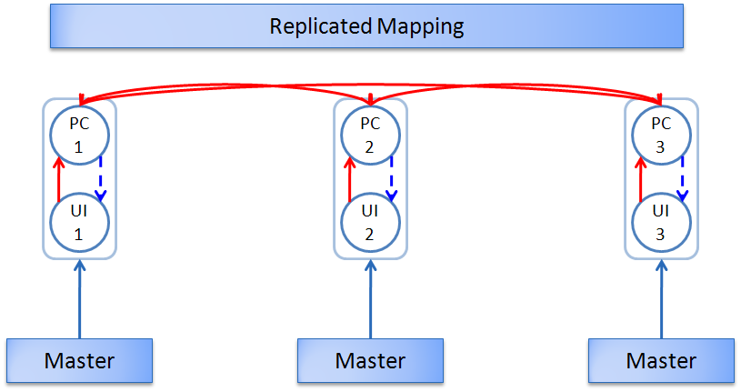
Mapping vs. Functionality
Mapping should ideally make no difference to functionality
In both cases a single logical program component shared
Replication has correctness problems seen earlier
Replicated allows user to make progress in disconnected state
Input
Output

Slide 75
Mapping vs. Interoperability
Centralized component requires presence of only the shared layer
Replicated requires presence of shared layer and all layers above it.
Input
Output

Slide 76
Metrics?
Sync, Groove, NetMeeting, LiveMeeting, WebexWhiteboards, Presenters
Metrics?
Data
Google Docs, Suite, Rendezvous, Weasel
Functionality
Programmability
Toolkit
Habanero, JCE (AWT), GroupKit
Shared Layer
Performance
XTV (X), Vconf, Rapport, LiveMeeting, Webex, NetMeeting App Sharing
Vconf, Rapport
Window
Framebuffer
Shared VNC
Centralized
Replicated
Mapping between Program and UI Component

Slide 77
Metrics?
Sync, Groove, NetMeeting, LiveMeeting, WebexWhiteboards, Presenters
Metrics?
Data
Google Docs, Suite, Rendezvous, Weasel
Functionality
Programmability
Toolkit
Habanero, JCE (AWT), GroupKit
Shared Layer
Flexibility
XTV (X), Vconf, Rapport, LiveMeeting, Webex, NetMeeting App Sharing
Vconf, Rapport
Coding effort
Window
Framebuffer
Shared VNC
Centralized
Replicated
Mapping between Program and UI Component

Slide 78
Effort vs. Flexibility of Infrastructure
C vs. Java
Garbage collection vs. manual management
Pure Prolog vs. Java
Flexibility
Automatic vs. manual control flow
Degree to which programmers has control
Flexibility and effort in collaborative systems?
OS vs. Database
Automatic vs. manual queries
ObjectEditor vs Toolkit
Effort
Automatic vs. manual view and controller
Effort required to use infrastructure

Slide 79
Effort vs. Flexibility in Colab Infrastructures
Flexibility = function (awareness, layer, mapping)
Awareness= function (flexibility, layer, mapping)
Flexibility
Degree to which collaboration (functions) can be customized by application programmers
When considering a parameter, will assume other parameters are fixed
Awareness for zero default flexibility is an important point
Awareness
Amount of collaboration-specific code added by application programmer

Slide 80
Default Sharing?
10
6.2
Data
Widget
6.2
Abstraction Representation
Syntactic Sugar
Window
PC
Framebuffer
PC

Slide 81
Default Sharing
System chooses which abstractions/interactors in a layer are shared
  Cannot share nothing
  Sharing of all objects (of some type) is usual
System chooses when changed to shared objects are sent to others
  Must be sent eventually
  Immediately is usual
System chooses granularity of merging, cc, ac
  Finest possible is usual (window, widget, primitive model objects)

Slide 82
Flexibility vs. Layers
Sync, Groove, NetMeeting, LiveMeeting, WebexWhiteboards, Presenters
Data
Google Docs, Suite, Rendezvous, Weasel
Toolkit
Habanero, JCE (AWT), GroupKit
Shared Layer
XTV (X), Vconf, Rapport, LiveMeeting, Webex, NetMeeting App Sharing
Vconf, Rapport
Window
Framebuffer
Shared VNC
Centralized
Replicated
Mapping between Program and UI Component

Slide 83
Flexibility Desired
10
6.2
Data
Widget
6.2
Abstraction Representation
Coupling
Syntactic Sugar
Conc. Ctrl.
Window
Access Ctrl.
Merging
PC
Framebuffer
Might want to control granularity of coupling, conc./access ctrol, merging
PC

Slide 84
Example of Variable Granularity
Model layer can lock entire drawing or individual shapes
Toolkit and window layers can only lock entire drawing

Slide 85
Flexibility vs. Layers
Sync, Groove, NetMeeting, LiveMeeting, WebexWhiteboards, Presenters
Data
Google Docs, Suite, Rendezvous, Weasel
Toolkit
Habanero, JCE (AWT), GroupKit
Variation in granularity of Coupling, AC, CC, Merging
Shared Layer
XTV (X), Vconf, Rapport, LiveMeeting, Webex, NetMeeting App Sharing
Vconf, Rapport
Window
Framebuffer
Shared VNC
Centralized
Replicated
Mapping between Program and UI Component
Hierarchical structures at each level
Programmer could choose any node
Nodes in higher layers coalesce in lower layers

Slide 86
Flexibility vs. Mapping
Sync, Groove, NetMeeting, LiveMeeting, WebexWhiteboards, Presenters
Data
Google Docs, Suite, Rendezvous, Weasel
Toolkit
Habanero, JCE (AWT), GroupKit
Shared Layer
XTV (X), Vconf, Rapport, LiveMeeting, Webex, NetMeeting App Sharing
Vconf, Rapport
Window
Framebuffer
Shared VNC
Centralized
Replicated
Mapping between Program and UI Component

Slide 87
Flexibility vs. Layers
In collaboration-unaware a single logical program component shared
In collaboration-aware program, only selected replica state may be shared
Programmer would have to explicitly replicate private state in centralized
For fixed collaboration awareness, replicated is more flexible
Input
Output

Slide 88
Metrics?
Sync, Groove, NetMeeting, LiveMeeting, WebexWhiteboards, Presenters
Metrics?
Model
Google Docs, Suite, Rendezvous, Weasel
Functionality
Programmability
Toolkit
Habanero, JCE (AWT), GroupKit
Shared Layer
Collaboration Flexibility
XTV (X), Vconf, Rapport, LiveMeeting, Webex, NetMeeting App Sharing
Vconf, Rapport
Window
Collaboration Awareness
Framebuffer
Shared VNC
Centralized
Replicated
Mapping between Program and UI Component

Slide 89
Awareness vs. Layers
Unaware if programming patterns, replicated, implicit binding
Sync, Groove, NetMeeting, LiveMeeting, WebexWhiteboards, Presenters
Data
Google Docs, Suite, Rendezvous, Weasel
Habanero, JCE (AWT), GroupKit
Expose top-level widget
Toolkit
Shared Layer
XTV (X), Vconf, Rapport, LiveMeeting, Webex, NetMeeting App Sharing
Vconf, Rapport
Window
Collaboration unaware
Framebuffer
Collaboration unaware
Shared VNC
Centralized
Replicated
Mapping between Program and UI Component
Consider default sharing

Slide 90
Awareness vs. Mapping
Sync, Groove, NetMeeting, LiveMeeting, WebexWhiteboards, Presenters
Data
Google Docs, Suite, Rendezvous, Weasel
Toolkit
Habanero, JCE (AWT), GroupKit
Shared Layer
XTV (X), Vconf, Rapport, LiveMeeting, Webex, NetMeeting App Sharing
Vconf, Rapport
Window
Framebuffer
Shared VNC
Centralized
Replicated
Mapping between Program and UI Component
Consider zero flexibility: default sharing

Slide 91
Awareness vs. Functionality
In default sharing, a single logical program component shared in both cases
Application code same in both cases, except for possibly for some exposure of application semantics to correct correctness problems in replication
Input
Output
Consider default sharing

Slide 92
Metrics?
Sync, Groove, NetMeeting, LiveMeeting, WebexWhiteboards, Presenters
Metrics?
Model
Google Docs, Suite, Rendezvous, Weasel
Functionality
Programmability
Toolkit
Habanero, JCE (AWT), GroupKit
Shared Layer
Performance
XTV (X), Vconf, Rapport, LiveMeeting, Webex, NetMeeting App Sharing
Vconf, Rapport
Bandwidth
Window
Framebuffer
Shared VNC
Centralized
Replicated
Mapping between Program and UI Component

