Slide 1

Response Times and Firewalls
Prasun Dewan
Department of Computer Science
University of North Carolina at Chapel Hill
dewan@cs.unc.edu

Slide 2

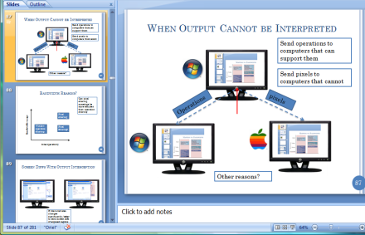

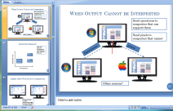
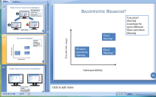

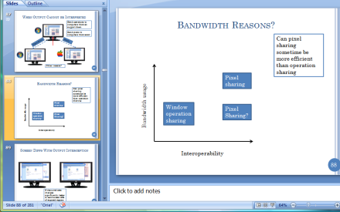
Cost of Compression?
Response time?
Pixmap1
Issue for mobile devices
Time
Pixmap1 (0, 0, 300, 200)
Increases response time
Space
Pixmap1

Slide 3
Response Times
Local Response Times
User₁
User₁
time
Local Response Time
Some User Enters Command
That User Sees Output for Command
Enters Command
‘Draw Red Circle’
User₁ Sees Red Circle

Slide 4
Response Times
Remote Response Times
Also Important¹
User₁
User₃
time
Remote Response Time
Some User Enters Command
Another User Sees Output for Command
Enters Command
‘Draw Red Circle’
User₂ Sees Red Circle
[1] C. A. Ellis and S. J. Gibbs, "Concurrency control in groupware systems," SIGMOD Record, vol. 18, no. 2, Jun. 1989.

Slide 5
Shared Layer vs. Response Times
Sync, Groove, NetMeeting, LiveMeeting, WebexWhiteboards, Presenters
Model
Google Docs, Suite, Rendezvous, Weasel
Larger output size can take time to transmit
Toolkit
Habanero, JCE (AWT), GroupKit
Larger times
Shared Layer
XTV (X), Vconf, Rapport, LiveMeeting, Webex, NetMeeting App Sharing
Vconf, Rapport
Window
Compression schemes can take processing time
Framebuffer
Shared VNC
Centralized
Replicated
Mapping between Program and UI Component
No experimental study to validate

Slide 6
Mapping vs. Response Times
Sync, Groove, NetMeeting, LiveMeeting, WebexWhiteboards, Presenters
Model
Google Docs, Suite, Rendezvous, Weasel
Toolkit
Habanero, JCE (AWT), GroupKit
Shared Layer
XTV (X), Vconf, Rapport, LiveMeeting, Webex, NetMeeting App Sharing
Vconf, Rapport
Window
Framebuffer
Shared VNC
Centralized
Replicated
Mapping between Program and UI Component

Slide 7
Impact of Mapping on Response Times
Which Mapping Favors Local Response Times?
Intuitively
Yes
No
Yes
No
In replicated, network delays not part of local response time
Parameters other than network delay and architecture?

Slide 8





Response Time Params
P5
P2
P4
P3
72 ms
0 ms
162 ms
Think Time
Input and Output Costs
Processing Powers
Network Latencies
U1
U2
U3
P1
Performance
P1
P3
Mapping
Number of Users
Subset of actual parameters
Precision requires assumptions

Slide 9
Generalized Adaptive Algorithm at Each Node
U_{m}
U_{j}
U_{m’}
1
Forward Input
2
Process Input
3
Send Output
P_{m}
P_{m’}
4
Process Output
Other orderings also make sense

Slide 10
Single-Threaded Execution
U_{m}
U_{j}
U_{m’}
1
Forward Input
2
Process Input
3
Send Output
P_{m}
P_{m’}
4
Process Output
Assume single-threaded execution

Slide 11
Processing Power
User enters input
Master
U_{m}
U_{j}
U_{m’}
Forward Input
P_{m}
P_{m’}
Process Input
Send Output
Processing Power Decreases
Process Output
All times increase
Processing time increases
time

Slide 12
Input Processing Cost
User enters input
Master
U_{m}
U_{j}
U_{m’}
Forward Input
P_{m}
P_{m’}
Process Input
Send Output
<
Input Processing Cost Increases
Process Output
Processing time increases
time
Notes:
12

Slide 13
Input Size
User enters input
Master
U_{m}
U_{j}
U_{m’}
Forward Input
P_{m}
P_{m’}
Process Input
Send Output
Next Slide
<
Start Show
Input Size Increases
Process Output
Forwarding time increases
time

Slide 14
Number of Master Computers
User enters input
Master
U_{y}
U_{m}
U_{j}
U_{m’}
U_{x}
Forward Input
P_{y}
P_{m}
P_{m’}
P_{x}
Process Input
Send Output
Pair programming
State of the union
Number of masters increases
Process Output
Forwarding time increases
time

Slide 15
Cluster Size
User enters input
Master
U_{x}
U_{m}
U_{j}
U_{m’}
U_{y}
Forward Input
P_{m}
P_{m’}
Process Input
Send Output
Pair programming
State of the union
Cluster size increases
Process Output
Send Output Time Increases
time

Slide 16
Output Processing Cost
User enters input
U_{m}
U_{j}
U_{m’}
Forward Input
P_{m}
P_{m’}
Process Input
Send Output
<
Output processing cost increases
Next Animation
Process Output
Output processing time increases
time

Slide 17
Output Size
User enters input
Master
U_{m}
U_{j}
U_{m’}
Forward Input
P_{m}
P_{m’}
Process Input
Send Output
<
Output Size Increases
Next Animation
Process Output
Send Output Time Increases
time

Slide 18
Generalized Adaptive Algorithm at Each Node (Review)
U_{m}
U_{j}
U_{m’}
1
Forward Input
2
Process Input
3
Send Output
P_{m}
P_{m’}
4
Process Output
Other orderings also make sense

Slide 19
Response Time Params (Review)
P5
P2
P4
P3
72 ms
0 ms
162 ms
Think Time
Input and Output Costs
Processing Powers
Network Latencies
U1
U2
U3
P1
Performance
P1
P3
Mapping
Number of Users
Subset of actual parameters

Slide 20
Processing Power (Review)
User enters input
Master
U_{m}
U_{j}
U_{m’}
Forward Input
P_{m}
P_{m’}
Process Input
Send Output
Processing Power Decreases
Process Output
All times increase
Processing time increases
time

Slide 21
Input Processing Cost (Review)
User enters input
Master
U_{m}
U_{j}
U_{m’}
Forward Input
P_{m}
P_{m’}
Process Input
Send Output
<
Input Processing Cost Increases
Process Output
Processing time increases
time
Notes:
21

Slide 22
Cluster Size (Review)
User enters input
Master
U_{x}
U_{m}
U_{j}
U_{m’}
U_{y}
Forward Input
P_{m}
P_{m’}
Process Input
Send Output
Pair programming
State of the union
Cluster size increases
Process Output
Send Output Time Increases
time

Slide 23
Master vs. Slave User
Master
Slave
User enters input
User enters input
U_{m}
U_{j}
U_{m’}
Forward Input
P_{m}
P_{m’}
Process Input
Send Output
U_{m}
U_{j}
Master vs. Slave User
Process Output
P_{m}
P_{m}
time
Notes:
23

Slide 24
Master vs. Slave User
Master
Slave
User enters input
U_{m}
U_{j}
U_{m’}
Send Input
Forward Input
P_{m}
P_{m’}
Process Input
U_{m}
U_{j}
Master vs. Slave User
Send Output
P_{m}
P_{m}
Process Output
time
Notes:
24

Slide 25



Network Latencies
Master
Slave
User enters input
U_{m}
U_{j}
U_{m’}
Send Input
Forward Input
P_{m}
P_{m’}
Process Input
Network Latencies Increase
Send Output
Process Output
Send Times Increase
time
Notes:
25

Slide 26
Think Times
Master
Slave
U_{m}
U_{j}
U_{m’}
Process Input
Process Output
P_{m}
P_{m’}
Send Output
Think Time
Small Think Times
Send Input
Process Output
Master not ready to accept input
Next input arrives at master
Master ready to process next input
time
Notes:
26

Slide 27
Think Times
Master
Slave
U_{m}
U_{j}
U_{m’}
Process Input
Process Output
P_{m}
P_{m’}
Send Output
Think Time
Think Time
Large Think Times
Send Input
Process Output
Master ready to accept input
Next input arrives at master
Master ready to process next input
time
Notes:
27

Slide 28
Precise Equations: More Assumptions
Assumptions
Large think times (no command queuing)
Communication has zero computation cost
Output processing has zero computation cost
Significant network r(ound) t(rip) t(ime)
Uniform c(ost of operation)
p(rocessing speed)_{r(eplica)}
1
Forward Input
2
Process Input
3
Send Output
4
Process Output

Slide 29
Master/Replicated User
Master
Slave
User enters input
User enters input
U_{m}
U_{j}
U_{m’}
Forward Input
P_{m}
P_{m’}
Process Input
Send Output
U_{m}
U_{j}
Master vs. Slave User
Process Output
P_{m}
P_{m}
c/ p_{r(eplica)}
c/ p_{m(aster)}
c(ost of operation) in cycles
p(rocessing speed) in cycles/unit time
rtt (round trip time)
time
Notes:
29

Slide 30
Slave User
Master
Slave
User enters input
U_{m}
U_{j}
U_{m’}
Send Input
Forward Input
P_{m}
P_{m’}
Process Input
U_{m}
U_{j}
Master vs. Slave User
Send Output
P_{m}
P_{m}
Process Output
c(ost of operation) in cycles
p(rocessing speed) in cycles/unit time
rtt (round trip time)
time
rtt + c/ p_{master)}
Notes:
30

Slide 31
Local/Remote Response times
Replicated case:
  c/ p_{r(eplica)}
Centralized case:
  Master: c / p_{m(aster)}
  Slave: rtt + c / p_{m}
Central Master - Replicated:
  c (1 / p_{m} - 1/ p_{r})
Central Slave - Replicated:
  rtt + c (1 / p_{m} - 1/ p_{r})
Replicated case:
  rtt/2 + c/ p_{r(eplica)}
Centralized case:
  Master: rtt/2 + c / p_{m(aster)}
  Slave: rtt + c / p_{m}
Central Master- Replicated:
  c (1 / p_{m} - 1/ p_{r})
Central Slave - Replicated:
  rtt/2 + c (1 / p_{m} - 1/ p_{r})
c(ost of operation) in cycles
p(rocessing speed) in cycles/unit time
rtt (round trip time)

Slide 32
Equal Processing Power or Zero Processing Cost
Central Master- Replicated:
  c (1 / p_{m} - 1/ p_{r})
Central Slave- Replicated:
  rtt + c (1 / p_{m} - 1/ p_{r})
Central Master- Replicated:
  c (1 / p_{m} - 1/ p_{r})
Central Slave- Replicated:
  rtt/2 + c (1 / p_{m} - 1/ p_{r})
Central Master- Replicated:
  0
Central Slave- Replicated:
  rtt
Central Master- Replicated:
  0
Central Slave - Replicated:
  rtt/2
Replicated wins!
IM
Video Viewing

Slide 33
Case Study: Colab. Video Viewing

Slide 34
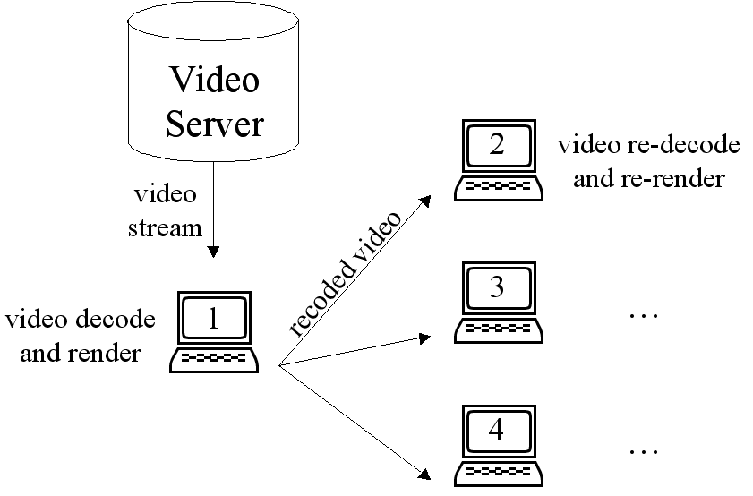
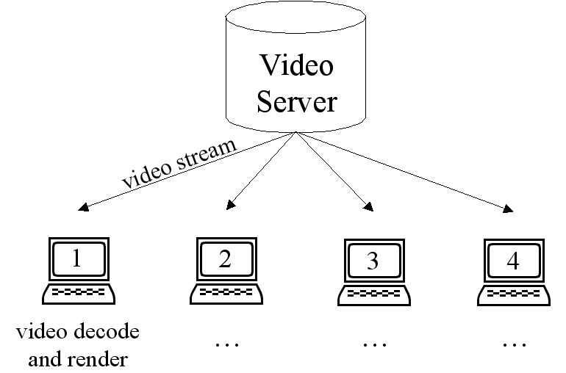
Case Study: Collaborative Video Viewing (Cadiz, Balachandran et al. 2000)
Two users collaboratively executing media player commands
Centralized NetMeeting sharing added unacceptable video latency
Part of problem in centralized system sharing video through window layer
Replicated architecture created using T 120 later

Slide 35
Zero Round Trip Time
Central Master - Replicated:
  c (1 / p_{m} - 1/ p_{r})
Central Slave - Replicated:
  rtt + c (1 / p_{m} - 1/ p_{r})
Central Master - Replicated:
  c (1 / p_{m} - 1/ p_{r})
Central Slave - Replicated:
  rtt/2 + c (1 / p_{m} - 1/ p_{r})
Central Master - Replicated:
  c (1 / p_{m} - 1/ p_{r})
Central Slave - Replicated:
  c (1 / p_{m} - 1/ p_{r})
Central Master - Replicated:
  c (1 / p_{m} - 1/ p_{r})
Central Slave - Replicated:
  c (1 / p_{m} - 1/ p_{r})
Checkers

Slide 36
Performance Params
P5
P2
P4
P3
72 ms
0 ms
162 ms
Think Time
Input and Output Costs
Processing Powers
Network Latencies
U1
U2
U3
P1
Performance
P1
P3
Architecture
Number of Users
Network latency is only one parameter.
Low network latency and slow local processor can favor centralized.
So what?
Can choose architecture based on parameters.
Is architecture choice a panacea?

Slide 37

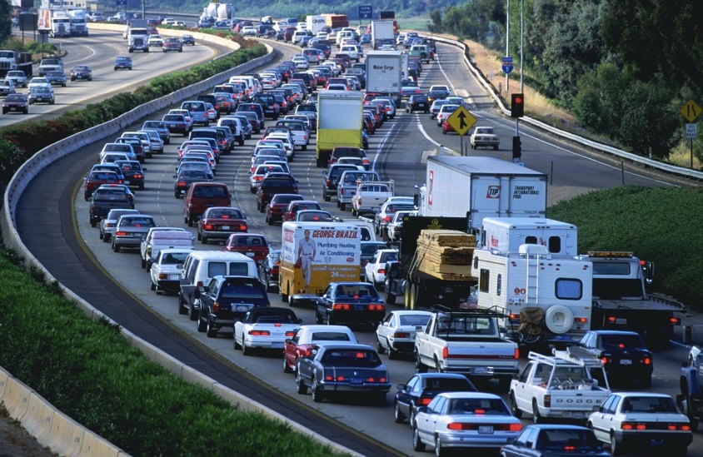
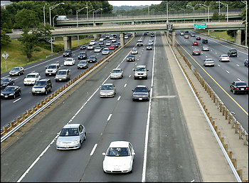
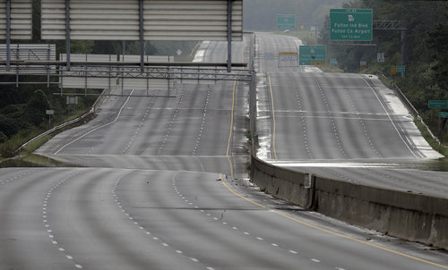
Window of Opportunity¹ for
Improving Performance
Performance Requirements
Window of Opportunity
Insufficient Resources
Sufficient but Scarce Resources
Always Poor Performance
Improve Performance from Poor to Good
Abundant Resources
Always Good Performance
Resources
[1] Jeffay, K. “Issues in Multimedia Delivery Over Today’s Internet,” IEEE Multimedia Tutorial, 1998.

Slide 38
Improving Performance in
Multimedia Networking
Performance Requirements
End-to-end latency <=250ms¹
Video Frames per Second >=10¹
Audio-video Sync [-80ms,+80ms]¹
>98% Bandwidth Utilization
90-98% Bandwidth Utilization
Insufficient Resources
Need Congestion Control Algorithms to Satisfy Requirements²
Sufficient but Scarce Resources
Abundant Resources
<90% Bandwidth Utilization
Resources
[1] Jeffay, K. “Issues in Multimedia Delivery Over Today’s Internet,” IEEE Multimedia Tutorial, 1998.
[2] Le, L., Aikat, J., Jeffay, K., and Smith, D. “Differential Congestion Notification: Taming the Elephants,” ICNP, 2004.

Slide 39
Window of Opportunity in
Collaborative Systems
Performance Requirements
Local response time <= 50-100 ms
Remote response time <= 50-100ms
Architecture and other changes
Insufficient Resources
Sufficient but Scarce Resources
Abundant Resources
Resources

Slide 40
Performance Params
P5
P2
P4
P3
72 ms
0 ms
162 ms
Think Time
Input and Output Costs
Processing Powers
Network Latencies
U1
U2
U3
P1
Performance
P1
P3
Architecture
Number of Users
Low network latency and slow local processor can favor centralized.
Can choose architecture based on parameters.
Dynamic changes?

Slide 41
Dynamic Transitions
Motivation
  Delays can change dynamically
  So can processing cost and fraction of input
  Dynamic joining and leaving can change set of computers and network delays

Slide 42
Collaboration Example
Example task:
Layout of internet access room
Whiteboard for layout
Chat for discussion

Slide 43

Desktop Application Sharing
Program
Program
Program
Program
Alice@UNC
Bob@ UNC
Cathy@ Purdue
David@ Wisc
Alice and Bob responsible for this conference
Cathy and David did it last time and consult.
Replicated because:
Wide-area collaboration
Computers symmetrical

Slide 44

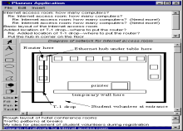
Migrating to Mobile Computers
Program
Program
Alice@Airplane
Bob@ Airplane
Replicated again because symmetric computers
One set of replicas replaced by another set
Alice and Bob transfer conference to hand-helds
Cathy and David leave conference

Slide 45
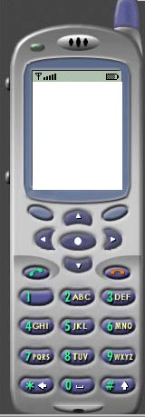
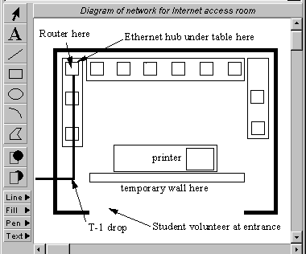
Multi Device Collaboration
Program
Program
Program
Alice@Hotel
Bob@ Hotel
Ellis@ Hotel
Cathy@ Soccer
David@ Pool
Hybrid architecture with replication and centralization
Replicated → Hybrid

Slide 46
Transition to Pure Centralized
Program
Alice@Hotel
Bob@ Hotel
Ellis@ Hotel
Users with replicas leave
Hybrid → Centralized

Slide 47
Hosting user leaves
Program
Alice@Hotel
Bob@ Hotel

Slide 48
Transition to Pure Replicated
Program
Program
Alice@Hotel
Bob@ Hotel
Centralized → Replicated

Slide 49
Primitives for Changing Mapping
Dynamic User Interface Replication
Dynamic Program Instance Replication
1. Dynamic User Interface Replication
2. Dynamic Program Instance Replication
Program Instance
Program Instance
Program Instance
Program Instance
User Interface Server
User Interface Server
User Interface Server
User Interface Server
User 1
User 2
User 1
User 2
Program Instance
Program Instance
Program Instance
User Interface Server
User Interface Server
User Interface Server
User Interface Server
User Interface Server
User Interface Server
User 1
User 2
User 1
User 2
User 3
Notes:
Two of the components are

Slide 50
General Process Migration and Replication
e.g.
Process
Migration
Notes:
Migrating a client or a process is not a new idea. It has been supported for load balancing in previous systems. These systems use what we call the image copy method. So, here I am illustrating this approach using the example of DEMOS/MP, which was developed at UC Berkeley.In this system, a process is migrated from the source to the destination by copying its state, such as the process image, its message queue and the links to other processes. This approach is quite efficient, but has three drawbacks. First, non-traditional custom operating systems have to be installed on all the workstations involved to marshall and unmarshall the process state. Second, these two machines should have the same architecture, and third, any resource referenced by the process, such as the links, should be location independent, and most current systems do not provide location independent resource references. As a result, this approach has only been used in research operating systems.

Slide 51
General Logging Approach
Dynamic Program Replication
Dynamic User Interface Replication
Logger
Program 1
Program 2
Input Log
Add
Add
Recorded Messages
Add
Draw
Add
Draw
Add
Loggable
Add
Draw
Draw
Replayed Messages
Output Log
User Interface 1
Draw
User Interface 2
Draw

Slide 52
Alternatives for General State Recreation
State Copying
  Efficient, but not general
(Command-based) Logging
  Inefficient, but general
(Object-based ) Logging: Can keep using the logging approach, but improve on the log size by compressing.

Slide 53
Serialization For Dynamic Program Creation in Model Sharing
lookup (name)
register(name, object)
Associate User
Associate Name Server
Associate Registerer and User
C
N
S
Server object consistent with other replicas – client gets latest state
Serialized object copy returned by lookup
Special case of log compression

Slide 54
Dynamic UI Creation in Model Sharing
Controller
View
Instantiate View and Controller and connect them to local or remote model.
Model
View reads state (special case of log compression)
Controller
View

