Slide 1
Firewalls and Communication Intermediaries
Prasun Dewan
Department of Computer Science
University of North Carolina at Chapel Hill
dewan@cs.unc.edu

Slide 2

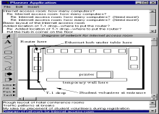

Current Architecture
Program
Alice@Hotel
Bob@ Hotel

Slide 3
Next Architecture
Program
Program
Assume both architectures possible
Assume any user computer can connect to another online computer
Alice@Hotel
Bob@ Hotel
Centralized → Replicated

Slide 4
Why Not Arbitrary Connection
site 1
site 2

Slide 5
Problems of Arbitrary Connection
Other party can flood/compromise protected computer with messages
protected computer
Flooding, compromise
Force protected computer to communicate with trusted parties
other party

Slide 6
Problems of Arbitrary Connection (Review)
Other party can flood/compromise protected computer with messages
protected computer
Flooding, compromise
Force protected computer to communicate with trusted parties
other party

Slide 7
Basic Firewall: No Open-In
protected site
Do not allow other sites to initiate connections to protected sites
Home networks
Can do bi-directional communication on channel opened by trusted channel
open(1)
send(1)
open(1)
send(1)
close(1)
other party

Slide 8
Protected Organization Site
Organization
protected site
What if protected site makes a mistake (e.g. phishing) or trusted site is compromised?
Protected site can compromise whole organization
System administrators should be able to close connection
open(1)
send(1)
open(1)
send(1)
close(1’)
other party

Slide 9
Firewall Closeable by Organization
Organization
Demilitarized zone is buffer between organization and rest of the world
Protected sites connect through proxies in DMZ that can be closed if problems
Proxy is a special trusted process in demilitarized zone with unrestricted access
protected site
send(1)
DMZ
open(1)
send(1)
unprotected proxy
open(1)
open(1’)
send(1’)
close(1’)
send(1’)
other party
Indirection once again!
Allow bare minimum communication to outside world
How to prevent the need to close sites?

Slide 10
Protocol-based Firewall
Proxies can allow connections to be made only to certain sites, ports, and associated protocols
Organization
protected site
protected site
Could cheat and use protocol not associated with a service(e.g. 80)
  Proxy can process messages to catch cheaters
trusted protocol
send(1)
DMZ
open(1)
send(1)
unprotected proxy
open(1)
Supported protocols
  HTTP
    Asymmetric
  SIP (IM) (Maybe)
    Symmetric
open(1’)
send(1’)
close(1’)
send(1’)
trusted protocol
other party

Slide 11
Asymmetric Communication
Organization
Organization
Other site cannot initiate send
One-way communication may allow replies
protected site
one-way protocol
send(1)
DMZ
open(1)
send(1)
unprotected proxy
open(1)
send(1’)
close(1’)
open(1’)
send(1’)
one-way protocol
other party

Slide 12
Call Reply
Organization
protected site
Server can reply to synchronous send that waits for reply
Such send also called RPC though it may not be supported by programming language
Regular RPC built on top of such HTTP RPC (Web Services: SOAP/WSDL
Parameters serialized to/un-serialized from HTTP text messages
Textual layered RPC less efficient than binary direct RPC
one-way protocol
reply(1)
DMZ
open(1)
call(1)
unprotected proxy
open(1)
reply(1’)
close(1’)
open(1’)
call(1’)
one-way protocol
other party

Slide 13
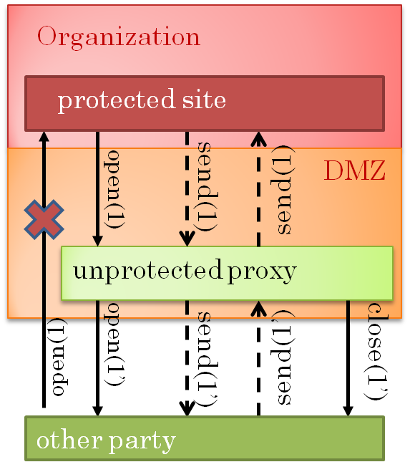
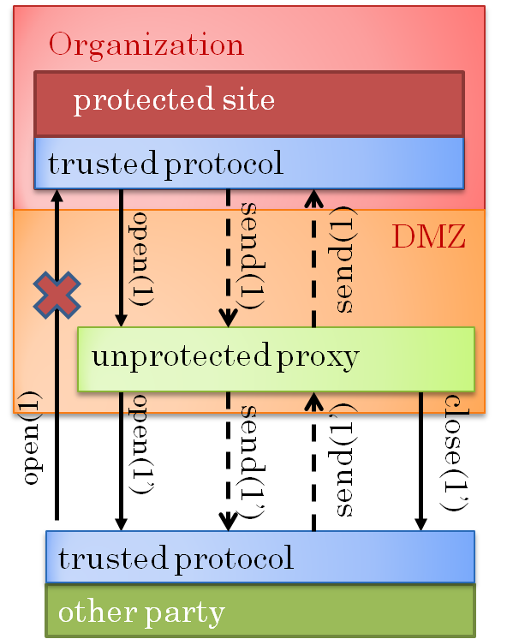
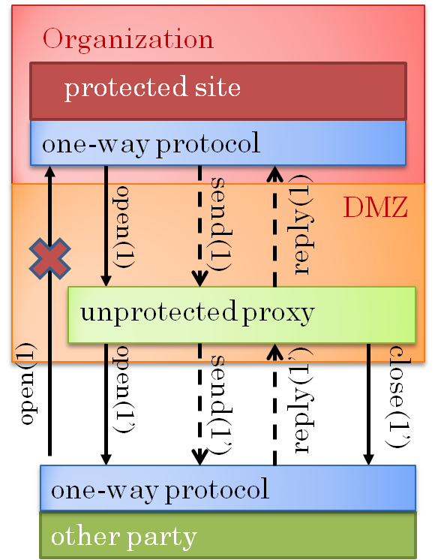
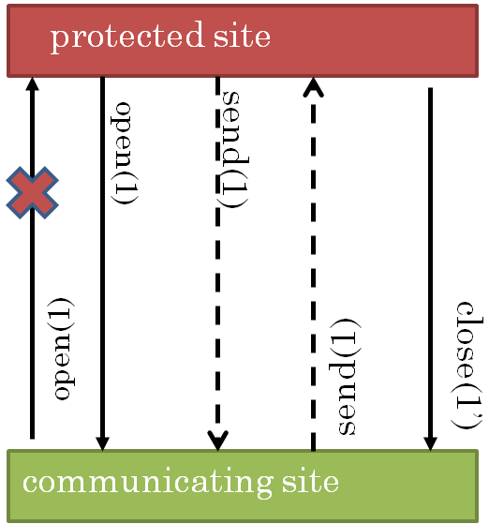
Degrees of Firewall
+ Externally Closeable
+ Trusted protocols
+ One-way RPC
No open-in
Degree of Restriction

Slide 14
Degrees of Firewall and Client-Server
+ Externally Closeable
+ Trusted protocols
+ One-way RPC
No open-in
Degree of Restriction
Arbitrary client-server application can be supported by most restrictive firewall
Firewall awareness?

Slide 15
Degrees of Firewall and Client-Server
+ Externally Closeable
+ Trusted protocols
+ One-way RPC
No open-in
Degree of Restriction
If no protocol restriction, use efficient binary direct RPC
If two-way trusted protocol, use inefficient RPC

Slide 16
Degrees of Firewall and Client-Server
+ Externally Closeable
+ Trusted protocols
+ One-way RPC
No open-in
Degree of Restriction
In client-server communication one party is distinguished (e.g. not on protected site)
In peer-to-peer neither party is distinguished.
Client-Server vs. Peer to Peer?

Slide 17
Initiating Collaboration in Peer-to-Peer
+ Externally Closeable
+ Trusted protocols
+ One-way RPC
No open-in
Degree of Restriction
Approach often used for NetMeeting (e.g. Microsoft → UNC)
What if session initiator is user at communicating site?
Use email, phone or some special protocol (SIP) to ask protected site to initiate session.
What if both parties behind firewalls?

Slide 18
Both Parties Behind Firewalls
protected site
Neither site can initiate an open!
open(1)
unprotected proxy
Another level of indirection?
open(1’)
unprotected proxy
protected site

Slide 19
Both Parties Behind Firewalls
All communicating parties connect to session manager using session name, s
protected site
open(1,s)
send(1)
unprotected proxy
Session manager forwards packets to sites in the same session
open(1’,s)
send(1’)
session manager
open(2’,s)
send(2’)
Centralization even in replicated architecture!
unprotected proxy
open(2,s)
send(2)
protected site

Slide 20
Asymmetric Protocol and Peer To Peer
protected site
How to send unsolicited input to a party?
open(1,s)
send(1)
unprotected proxy
open(1’,s)
send(1’)
session manager
open(2’,s)
send(2’)
unprotected proxy
open(2,s)
send(2)
protected site

Slide 21
Call-reply
protected site
open(1,s)
call (1,a)
reply(1,b)
Assume call-reply protocol
unprotected proxy
open(1’,s)
call(1’,a)
reply(1’b)
How to receive unsolicited input
session manager
open(2’,s)
call(2’,a)
reply(2,b)
unprotected proxy
open(2,s)
reply(2,b)
call(2,a)
protected site

Slide 22
Polling
protected site
Protected site polls session manager for data from other sites
reply(1,0)
reply(1,0)
reply(1,m)
call (1,0)
call (1,0)
call (1,0)
unprotected proxy
Sender sends data (m) as argument to call
reply(1’,0)
reply(1’,0)
reply(1’,m)
call(1’,0)
call(1’,0)
call(1’,0)
session manager
Session manager forwards data as argument to reply
call(2’,m)
reply(2’,0)
Argument of one call becomes reply of another!
unprotected proxy
call(2,m)
reply(2,0)
protected site

Slide 23
Blocked Call
protected site
Call from information receiver is blocked until information sender makes call.
reply(1,m)
call (1,0)
unprotected proxy
reply(1’,m)
RPC call connection longer than usual.
call(1’,0)
session manager
Some firewalls will close such connections
call(2’,m)
reply(2’,0)
unprotected proxy
call(2,m)
reply(2,0)
protected site

Slide 24
Degrees of Firewall and Peer-to-Peer
+ Externally Closeable
+ Trusted protocols
+ One-way RPC
No open-in
Degree of Restriction
If no protocol restriction, use efficient binary direct RPC
If two-way trusted protocol, use inefficient RPC
If HTTP RPC, use blocked calls if not closed
Otherwise use inefficient polling

Slide 25
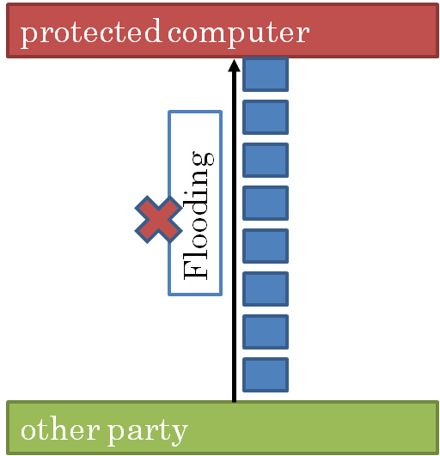
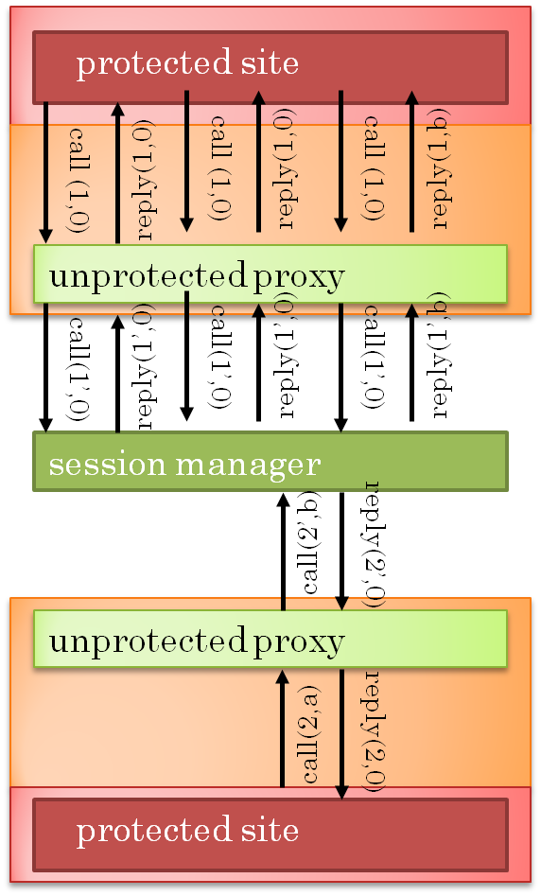

Effectiveness of Firewalls
Proxy can close connection
Problem
Problem for collaboration
Problem if session members distrusted
Strictest solution

Slide 26
Intermediary and Performance
unprotected site
protected site
Network Traffic
Congestion Control
unprotected proxy
Response Time
session manager
unprotected proxy
protected site
unprotected site

Slide 27
Intermediary and Performance (Review)
unprotected site
protected site
Network Traffic
Congestion Control
unprotected proxy
Response Time
session manager
unprotected proxy
protected site
unprotected site

Slide 28
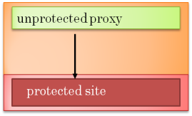
Intermediary + Multi-caster
unprotected site
protected site
unprotected proxy
Router
session manager
Assume session manager is on the path to destinations
Only one message sent to router upstream of session manager
Less congestion!
Problems with congestion control?

Slide 29
TCP I/P Congestion Window
Congestion window: # unacked messaged that can be sent
Source
Dropped packet
Acks
Messages
Router
Dropped packet reduces window size
Acks
Messages
Acked packet increases window size
Destination
Rate of decrease > rate of increase

Slide 30
Intermediary and Congestion Control
unprotected site
protected site
unprotected proxy
Different congestions!
Messages can get queued up at proxies
session manager
Need to implement end to end congestion above network layer (T 120)
unprotected proxy
protected site
unprotected site

Slide 31

Multiple Multi-caster?
T 120
protected site
Multi-casters can be put at path forks to reduce traffic
unprotected proxy
Router
Multi-caster
Multi-caster

Slide 32
Intermediary and Performance
unprotected site
protected site
Network Traffic
Congestion Control
unprotected proxy
Response Time
session manager
unprotected proxy
protected site
unprotected site

Slide 33
Response Times with and without Firewalls
unprotected site
protected site
Intermediate mode increases path length (LiveMeeting)
unprotected proxy
Can intermediate nodes improve response times?
session manager
Need to consider collaboration architecture with multicast
unprotected proxy
protected site
unprotected site

Slide 34
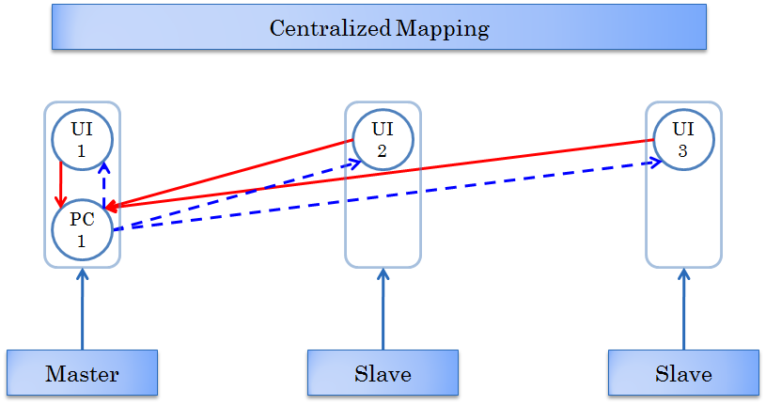
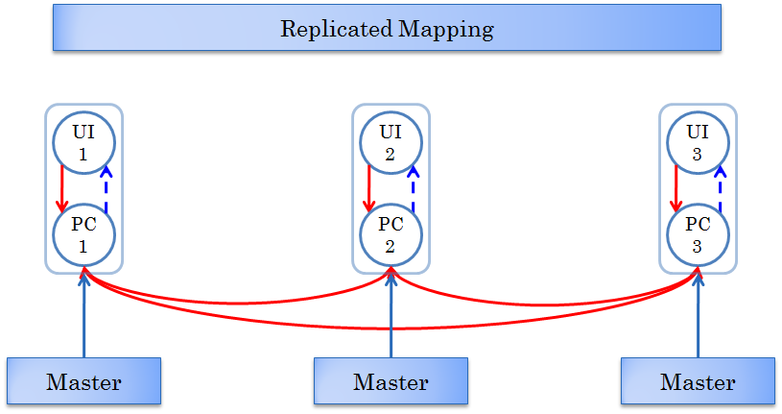
Collaboration Architecture and Multicast
How exactly to introduce multi-caster in architecture and evaluation?
Architecture shows logical processing connections
Actual physical connections may be different

Slide 35
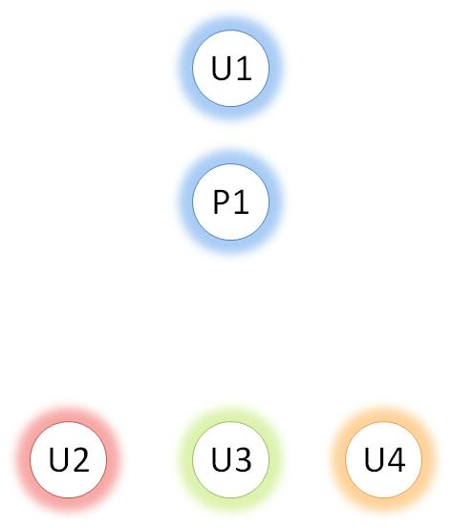
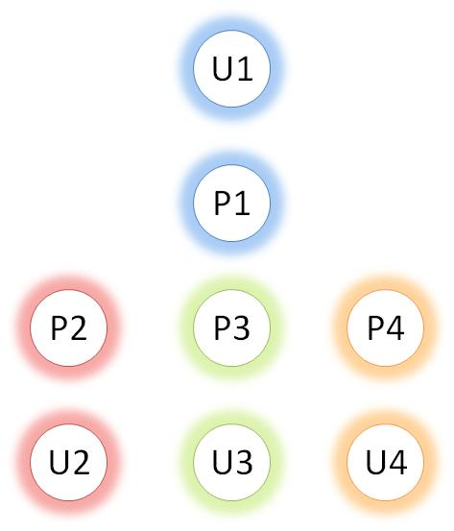
Logical vs. Physical Connections
Assume only user computers involved in communication (no proxies, infrastructure)
Processing Architecture
Logical-Connections
Dedicated powerful multi-casters will give better performance
Communication Architecture
Physical-Connections
How can multicast give better response?
Assume transmission cost is significant

Slide 36
Multicast Communication
Centralized Architecture
1
PC
1
UI
2
User₁ is Master
UI
1
2
3
1
2
UI
3
UI
4
UI
5
UI
6
Transmission Performed in Parallel
Potentially Quicker Distribution of Commands to all Destinations

Slide 37



Example Serial Unicast
Transmit Time = T
All Other Costs = 0
U1
Command arrives at time:
T
2T
3T
U2
U3
U4

Slide 38
Example Concurrent Multicast
Transmit Time = T
All Other Costs = 0
U1
Concurrent transmission
Multicast can provide better remote response times than unicast
Does multicast tree matter?
Command arrives at time:
T
2T
2T
U2
U3
U4

Slide 39
Serial Multicast
Transmit Time = T
All Other Costs = 0
U1
Multicast may not improve Remote Response times compared to unicast!
Special algorithms needed to build multicast tree take into account transmission times and network delays
Command arrives at time:
T
2T
3T
U2
U3
U4

Slide 40
Simplistic Scenario
U_{m}
U_{j}
U_{m’}
1
Forward Input
2
Process Input
Delay
3
Send Output
P_{m}
Delay
P_{m’}
4
Process Output

Slide 41
More Realistic Scenario with Transmit First
U_{m}
U_{j}
U_{m’}
1
Forward Input
2
Process Input
Delay
3
Send Output
P_{m}
Delay
P_{m’}
4
Process Output
Processing and transmission have non zero costs
Their order matters
Transmit first policy shown

Slide 42
More Realistic Scenario with Multicast
Transmit Time = T
Transmit Time: T
Process Time = P
U1
Network Latency = D
All Other Costs = 0
Transmit-First Scheduling Policy
Network Latency = D
U2
U3
U4

Slide 43
More Realistic Scenario with Multicast
Transmit Time = T
Transmit Time: T
Process Time = P
U1
Network Latency = D
All Other Costs = 0
Process-First Scheduling Policy
Network Latency = D
Command Arrives at Time T + D
Network Latency = D
Transmit Time: T
U2
U3
U4

Slide 44
More Realistic Scenario with Multicast
Transmit Time = T
Transmit Time: T
Process Time = P
U1
Network Latency = D
All Other Costs = 0
Process-First Scheduling Policy
Network Latency = D
Command Arrives at Time T + D
Command Arrives at Time 2T + 2D
Network Latency = D
Transmit Time: T
Process Time: P
U2
U3
U4
Response time of user 4 is 2T + P + 2D

Slide 45
More Realistic Scenario with Unicast
Transmit Time = T
Transmit Time: T
Process Time = P
U1
Transmit Time: T
Transmit Time: T
Network Latency = D
All Other Costs = 0
Transmit-First Scheduling Policy
Network Latency = D
Network Latency = D
Network Latency = D
U2
U3
U4

Slide 46
More Realistic Scenario with Unicast
Transmit Time = T
Transmit Time: T
Process Time = P
U1
Transmit Time: T
Transmit Time: T
Network Latency = D
All Other Costs = 0
Transmit-First Scheduling Policy
Network Latency = D
Network Latency = D
Network Latency = D
Command Arrives at Time 3T + D
Process Time: P
U2
U3
U4
Remote response time of user 4 is 3T + P + D

Slide 47
Unicast vs. Multicast
U4
Local Response Time?
Local master does less work before processing
With Multicast
Remote Response Time to User 4 is 2T + P + 2D
With Unicast
Remote Response Time to User 4 is 3T + P + D
T < D
Use Multicast
T > D
Do Not Use Multicast
Conclusion: Multicast can Improve or Degrade Remote Response Times Depending on Transmission Costs and Number of Users

Slide 48
Unicast Local Response Time
Transmit Time = T
Transmit Time: T
Process Time = P
U1
Transmit Time: T
Transmit Time: T
Network Latency = D
Process Time: P
All Other Costs = 0
Transmit-First Scheduling Policy
Network Latency = D
Network Latency = D
Network Latency = D
U2
U3
U4
User 1’s response time is 3T + P

Slide 49
Multicast Local Response Time
Transmit Time = T
Transmit Time: T
Process Time = P
U1
Transmit Time: T
Process Time: P
Network Latency = D
All Other Costs = 0
Transmit-First Scheduling Policy
Network Latency = D
Network Latency = D
U2
U3
U4
User 1’s response time is 2T + P

Slide 50
Transmit-First Response Time
U1
With Unicast
User ’s response time is 3T + P
With Multicast
User 1’s response time is 2T + P
Conclusion: Multicast can Improve Local Response Times with Transmit-First Scheduling

Slide 51
Intermediary and Performance
unprotected site
protected site
Network Traffic
Congestion Control
unprotected proxy
Response Time
session manager
unprotected proxy
protected site
unprotected site

Slide 52
Multicast Tree vs. Service vs. Server vs. Local Communication
Local: User sites communicate directly
  VNC, XTV, VConf, NetMeeting Regular
Server: Users in a LAN communicate through an intermediary on the LAN
  NetMeeting Enterprise, Sync
  Powerful server reduces transmission cost, network traffic without adding significantly to delay
Service: Users in a WAN communicate through a remote intermediary
  LiveMeeting, Webex
  Supports firewalls, reduces network traffic, increases path but reduces transmission time, especially if server is powerful
Multicast tree: A multicast tree built based on various parameters
  T 120
  Supports firewalls, reduces network traffic, increases path but reduces transmission time, especially if tree nodes are powerful, and increases concurrency

Slide 53




Response Times Parameters
Small and Large-Scale Collaborations
0 ms
72 ms
162 ms
Input and Output Processing Costs
Input and Output Transmission Costs
Collaboration Architecture
Network Latencies
Processing Powers
Think Time
Multicast
Scheduling
Response Time Parameters

Slide 54
Potential Single-Core Scheduling Policies
Transmit-First
1
Forward Input
U_{m}
U_{j}
U_{m’}
2
Process Input
Delay
Process-First
P_{m}
Delay
P_{m’}
1
Process Input
2
Forward Input
Concurrent (Interleaved)
1
Forward Input
1
Process Input

Slide 55
Intuitive Choice of Scheduling Policy
Local Response Times Important?
Remote Response Times Important?
Yes
No
Yes
No
Use Process-First Scheduling
Yes
No
Yes
No
Use Transmit-First Scheduling
Yes
No
Yes
No
Use Concurrent Scheduling

Slide 56
Intuition vs. Logic
Worst Remote Response Times better in Transmit-First than Process-First
All Remote Response Times better in Transmit-First than Process-First
In unicast, true, as destinations do not have to wait for source to finish processing.
In multicast, nodes do not have to wait for upstream nodes to finish processing, so first intuition correct.
In multicast, intermediate nodes have to delay feedback to their users as they have to transmit to downstream nodes, so second intuition wrong

Slide 57
Running Example
Transmit Time = T
User₁ Enters All Commands
Input Processing Time = P
User₁
User₄
Replicated Multicast Architecture
Output Processing Time = 0
Input
UI
1
UI
4
Output
1
Network Latency = D
PC
1
PC
4
2
3
1
2
UI
2
UI
3
UI
5
UI
6
PC
2
PC
3
PC
5
PC
6
User₂
User₃
User₅
User₆

Slide 58
Running Example
Analyze Local Response Time
User₁
User₄
UI
1
UI
4
1
PC
1
PC
4
Analyze Remote Response Time
2
3
1
2
UI
6
PC
6
User₆

Slide 59
User₆’s Response Time
User₁
User₄
UI
1
UI
4
1
PC
1
PC
4
2
3
1
2
Total Network Delay
User₆’s Processing Time
Remote Reponse Time
UI
6
User₁’s Delay
User₄’s Delay
PC
6
User₆

Slide 60
User₆’s Response Time
User₁
User₄
UI
1
UI
4
1
PC
1
PC
4
2
3
1
2
2D
P
Total Network Delay
User₆’s Processing Time
Remote Response Time
UI
6
?
?
User₁’s Delay
User₄’s Delay
PC
6
User₆
Scheduling Policy Dependent

Slide 61
User₆’s Process-First Response Time
2D+3P+3T
Remote Reponse Time
User₁
User₄
UI
1
UI
4
1
PC
1
PC
4
2
3
1
2
P
+T
P
+T
+T
UI
6
User₁’s Delay
User₄’s Delay
PC
6
User₆

Slide 62
User₆’s Transmit-First Response Time
2D+P+3T
Remote Reponse Time
User₁
User₄
UI
1
UI
4
1
PC
1
PC
4
2
3
1
2
T
T
+T
UI
6
User₁’s Delay
User₄’s Delay
PC
6
User₆

Slide 63
Response Time Comparison
Process-First
Transmit-First
<
User₆’s Remote Reponse Time
2D + 3P + 3T
2D + P + 3T
?
?
User₄’s Remote Response Time
Transmit-First Remote Response Time is Better than the Process-First Remote Response Time
Improvement is Additive – the Longer the Path From Source to Destination, the Better the Improvement
First Remote Response Time Intuition is Correct!

Slide 64
User₄’s Response Time
User₁
User₄
UI
1
UI
4
1
PC
1
PC
4
2
3
1
2
D
?
Remote Response Time
Total Network Delay
User₄’s Delay
?
User₁’s Delay
Scheduling Policy Dependent

Slide 65
User₄’s Process-First Response Time
Remote Response Time
D+2P+T
User₁
User₄
UI
1
UI
4
1
PC
1
PC
4
2
3
1
2
User₄’s Delay
P
+T
P
User₁’s Delay

Slide 66
User₄’s Transmit-First Response Time
Remote Response Time
D+P+3T
User₁
User₄
UI
1
UI
4
1
PC
1
PC
4
2
3
1
2
User₄’s Delay
T
T
+T
+P
User₁’s Delay

Slide 67
Serial Response Time Comparison
Process-First
Transmit-First
>
User₆’s Remote Reponse Time
2D + 3P + 3T
2D + P + 3T
>
User₄’s Remote Reponse Time
D+2P+T
if P > 2T
D+P+3T
<
if P < 2T
Transmit-First Remote Response Time is Better than the Process-First Remote Response Time
Transmit-First Response may not be Better than the Process-First Response Time for All Users
Second Remote Response Time Intuition is Wrong!

Slide 68
Intuitive Choice of Scheduling Policy
Local Response Times Important?
Remote Response Times Important?
Yes
No
Yes
No
Use Process-First Scheduling
Yes
No
Yes
No
Use Transmit-First Scheduling
Yes
No
Yes
No
Use Concurrent Scheduling

Slide 69
Intuition vs. Logic
Process-first local response time < Concurrent local response time < Transmit-first local response time
Worst Process-first remote response times > Worst Concurrent remote response times > Worst Transmit-first remote response time
In concurrent, smaller task will take (about) twice as long than if it was done first but less than when it is run second.
In concurrent, longer or equal task will take as long as both tasks take.
Case 1: Process >> Transmit
In concurrent, process time takes as long as both tasks take
Process-first local response time < Concurrent local response time = Transmit-first local response time
In concurrent, transmit time twice as long than if it was done first but less than when it is run second.
Worst Process-first remote response times > Worst Concurrent remote response times > Worst Transmit-first remote response time

Slide 70
Intuition vs. Logic
Process-first local response time < Concurrent local response time < Transmit-first local response time
Worst Process-first remote response times > Worst Concurrent remote response times > Worst Transmit-first remote response time
In concurrent, smaller task will take (about) twice as long than if it was done first but less than when it is run second.
In concurrent, longer or equal task will take as long as both tasks take.
Case 2: Process << Transmit
In concurrent, transmit time takes as long as both tasks take.
Worst Process-first remote response times = Worst Concurrent remote response times > Worst Transmit-first remote response time
In concurrent, process time twice as long than if it was done first but less than when it is run second.
Process-first local response time < Concurrent local response time < Transmit-first local response time

Slide 71
Response Times with Concurrent Scheduling
Expected
Local Times
<
<
Process-First
Concurrent
Transmit-First
>
>
Remote Times
Process-First
Concurrent
Transmit-First
Worst Case
Processing Time > Transmission Time
=
Local Times
Concurrent
Transmit-First

Slide 72
Response Times with Concurrent Scheduling
Expected
<
<
Local Times
Process-First
Concurrent
Transmit-First
>
>
Remote Times
Process-First
Concurrent
Transmit-First
Worst Case
Processing Time < Transmission Time
=
Remote Times
Process-First
Concurrent

Slide 73
Response Times with Concurrent Scheduling
Expected
<
<
Local Times
Process-First
Concurrent
Transmit-First
>
>
Remote Times
Process-First
Concurrent
Transmit-First
Worst Case
Processing Time = Transmission Time
=
Local Times
Concurrent
Transmit-First
=
Remote Times
Process-First
Concurrent

Slide 74
Concurrent Execution Time
Task 1 Time = 3X
Task 2 Time = 2X
Quantum = 0.25X
time
X
2X
3X
4X
5X
Shorter Task Completes in Twice Time Required when It Runs Standalone
Longer Task Completes in the Time Required to Run Both Tasks Sequentially

Slide 75
User₆’s Concurrent Response Time
User₁
User₄
UI
1
UI
4
1
PC
1
PC
4
2
3
1
2
2D
P
Total Network Delay
User₆’s Delay
Response Time
UI
6
?
?
User₁’s Delay
User₄’s Delay
PC
6
User₆

Slide 76
User₆’s Concurrent Response Time
2D+P+6T
Remote Response Time
User₁
User₄
UI
1
Suppose
P > 2T
UI
4
1
PC
1
PC
4
2
3
1
2
2T
4T
UI
6
User₁’s Delay
User₄’s Delay
PC
6
User₆

Slide 77
User₆’s Concurrent Response Time
2D+3P+3T
Remote Response Time
User₁
User₄
UI
1
Suppose
P < T
UI
4
1
PC
1
PC
4
2
3
1
2
P+T
P+2T
UI
6
User₁’s Delay
User₄’s Delay
PC
6
User₆

Slide 78
Response Time Comparisons
Process-First
Concurrent
Transmit-First
>
>
2D + P + 6T
if P > 2T
=
2D + 3P + 3T
if P < T
>
User₆’s Remote Response Time
2D + 3P + 3T
2D + P + 3T
<
Also Possible
≤
Concurrent Remote Response Time is Between the Process-First and Transmit-First Remote Response Times
Concurrent Remote Response Time can be as Bad as the Process-First Remote Response Time
Remote Response Time Intuition is Wrong Again!
What about Local Response Times?

Slide 79
User₁’s Response Times
Total Processing Time = P
User₁
Total Transmission Time = 3T
UI
1
P
1
Process-First
PC
1
3T+P
Transmit-First
2
3
3T+P
Concurrent
if P > 3T
2P
Concurrent
if P < 3T

Slide 80
Response Time Comparisons
Process-First
Concurrent
Transmit-First
<
<
P + 3T
if P<3T
User₁’s Feedback Time
P
P + 3T
<
P + 3T
if P>3T
=
Concurrent Feedback Time is Between the Process-First and Transmit-First Feedback Times
Concurrent ReponseTime can be as Bad as the Transmit-First Feedback Time
Feedback Time Intuition is Also Wrong!

Slide 81
Summary
Intuitively …
>
>
Process-First Remote Response
Concurrent Remote Response
Transmit-First Remote Response
≤
≤
Theoretically
<
<
Process-First Response
Concurrent Response
Transmit-First Response
=
Theoretically

Slide 82
Potential Single-Core Scheduling Policies
Suppose want to optimize local response time
Transmit-First
Low T, Large P, but variable N
1
Forward Input
U_{m}
U_{j}
U_{m’}
2
Process Input
Policy?
Delay
Hint: T << 50ms (noticeable delay)
Process-First
P_{m}
Delay
P_{m’}
1
Process Input
2
Forward Input
Concurrent (Interleaved)
1
Forward Input
1
Process Input

Slide 83
New Policy?
Can we create a scheduling policy that provides response times that are never noticeably worse but can be noticeably better than those of the process-first policy.

Slide 84
Noticeable Response Time Differences
Local Response Times
Unnoticeable Increase
Remote Response Times
Noticeable Decrease

Slide 85
Lazy Scheduling Policy Implementation
Enters Command
Basic Idea
1
Temporarily Delay Processing
2
PC
Transmit during Delay
1
UI
1
3
Keep Delay Below Noticeable
Process
2
Complete Transmitting
3

Slide 86
Example
User₁ Enters All Commands
1
1
6
Multicast
2
3
4
5
1
2
3
4
2
3
4
5
7
8
9
10
Trans Time
Proc Time
Network Latencies
Noticeable Threshold
ms
25
50
75

Slide 87
Theoretical Example
User₇’s Remote Response Times
≥
≥
Trans Time
1
1
6
Proc Time
2
3
4
5
1
2
3
4
Network Latencies
2
3
4
5
7
8
9
10
Noticeable Threshold
ms
25
50
75
Process First
Lazy Noticeably Better Than Process-First
Lazy
Noticeable
50
100
150
200
250
300
350
400
450
ms

Slide 88
Example
User₇’s Remote Response Times
Lazy Improvement in Remote Response Times Compared to Process-First is Multiplicative!
Longer Multicast Path → More Noticeable Improvement
Process First
Lazy Noticeably Better Than Process-First
Lazy
Noticeable
50
100
150
200
250
300
350
400
450
ms

Slide 89
Example
User₅’s Remote Response Times
≥
≥
Trans Time
1
1
6
<
Proc Time
2
3
4
5
1
2
3
4
Network Latencies
2
3
4
5
7
8
9
10
Noticeable Threshold
ms
25
50
75
Lazy as Bad as Process-First
Process First
Lazy Never Worse than Process-First
Lazy
100
150
200
250
300
350
400
450
ms

Slide 90
New Scheduling Policy
Systems Approach
Transmit-First
Process-First
Concurrent
New Approach
Psychology
Scheduling
Lazy

Slide 91
Lazy Evaluation in Other Context
cat dictionary | head -2
Output production delayed until it is needed by piped process
java MyProgram| head -2
public class MyProgram {
static void main (String args[]) {
for (;;) {
System.out.println(“infinite output?);
}
}
Compiler did not compile a program that had no output!
If you delay assignment, d not have to deal with its errors

Slide 92
Information Push
Information source pushes information to destination by sending a message
Organization
protected site
send(1)
DMZ
open(1)
send(1)
unprotected proxy
open(1)
open(1’)
send(1’)
close(1’)
send(1’)
other party

Slide 93
Polling Pull
protected site
Information destination pulls information from source by sending a request
reply(1,0)
reply(1,0)
reply(1,m)
call (1,0)
call (1,0)
call (1,0)
unprotected proxy
reply(1’,0)
reply(1’,0)
reply(1’,m)
call(1’,0)
call(1’,0)
call(1’,0)
session manager
call(2’,m)
reply(2’,0)
unprotected proxy
call(2,m)
reply(2,0)
protected site

Slide 94
Pulling Blocking Call
protected site
Information destination pulls information from source by sending a request
reply(1,m)
call (1,0)
unprotected proxy
reply(1’,m)
call(1’,0)
session manager
call(2’,m)
reply(2’,0)
unprotected proxy
call(2,m)
reply(2,0)
protected site

Slide 95
Push vs. Pull
Source
Destination
Pull was introduced to fight firewalls
PC
1
PC
3
Requires an additional message on the network
send(d)
call()
Polling wastes sender, network, and received resources.
PC
1
PC
3
reply(d)
Performance benefit sometimes?

Slide 96

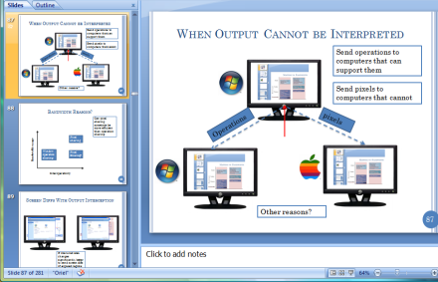
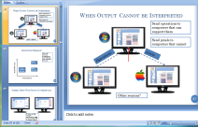
Pushing Information to Destination
Pixmap1, (0, 0)

Slide 97
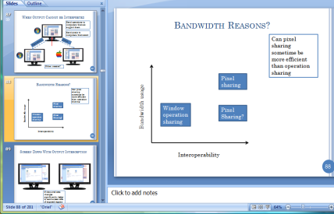
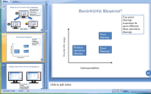
Pushing Information to Destination
Pixmap2, 0, 0

Slide 98
Pushing Information to Destination
Pixmap1, (0, 0)
Queue is building up and slow computer never catches up
Pixmap1, (0, 0)

Slide 99
Pulling Information From Destination
Source remembers what was pulled by every destination

Slide 100
Pushing Information to Destination

Slide 101
Pushing Information to Destination

Slide 102
Pulling Information to Destination
Null change
Multicast equivalent?

Slide 103
Multicast in Push
PC
4
PC
1
PC
3
Reduced network traffic
PC
5
PC
2
Concurrent processing

Slide 104




Proxy Servers in Pull
PC
4
PC
1
PC
3
Reduced network traffic
PC
5
PC
2
Concurrent processing
Node remembers what was last pulled by each downstream node.
At next poll, sends diff wrt last pulled state
Pull proxies used in streaming systems
Have application in distributed collaboration also

Slide 105
Push/Pull Performance
If information changes frequently and destination devices of varying power, pull can have performance benefits
  VNC
  IBM Same Time
  Second Life
How to reduce the source, destination, network overhead in polling?

Slide 106
Adapting Polling Frequency
Insight: Activity occurs in bursts
Increase polling frequency when data arrive when
Have a min and max polling frequency

Slide 107
Adaptive Polling
For example, whiteboard component
  initial interval 2 sec, min 1 sec, max 5 sec
  Adapt interval between min and max
    No data: increment interval by 1 until max (5)
    New data: reset to min (1)
WB
Adaptive
No update
New data
From Du Li’s MobiSys ‘09 talk

Slide 108
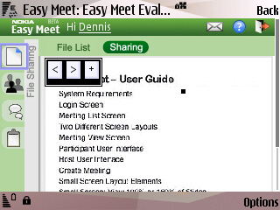
Using Multiple Applications Simultaneously
File sharing
Slide sharing
Gesturing
Participants
Chat
Minutes
Whiteboard
Screen shot on Nokia N95 phone
From Du Li’s MobiSys ‘09 talk

Slide 109
Multiple Poll Streams!
For example: 3 periodic polling tasks
  Chat every 3 sec, Whiteboard every 2 sec, Participants every 5 sec
Chat
WB
PA
As-is
From Du Li’s MobiSys ‘09 talk

Slide 110
All shared Apps in One server
The client components
Slides
2 sec
Gesture
1s
Chat
3s
WB
2s
Participants
10s
Files
10s
browser
The XMLHttpRequest Object
net
Apache Web Server
server
chat
wb
…
slides
The component servers
From Du Li’s MobiSys ‘09 talk

Slide 111
Multiplexing
Insight: Instead of sending N requests from N local applications to a server machine with N services, send a single request to the machine
Applications can be unaware of each other and hence multiplexing
From Du Li’s MobiSys ‘09 talk

Slide 112
Ajax Broker Architecture
Slides
1-5s
Gesture
1-5s
Chat
3-10s
WB
1-5s
Participants
10-15s
Files
10-15s
Ajax Broker Stub
The XMLHttpRequest Object
Heartbeat
Apache Web Server
Ajax Broker Skeleton
chat
wb
…
slides
The component servers
From Du Li’s MobiSys ‘09 talk

Slide 113
Multiplexing
For example: 3 periodic polling tasks
  Chat every 3 sec, Whiteboard every 2 sec, Participants every 5 sec
Can we synchronize pollings to further reduce traffic without multiplexing awareness?
Chat
WB
PA
As-is
Multiplexed
From Du Li’s MobiSys ‘09 talk

Slide 114
Our Solution: Mooching
Prioritize all periodic polling tasks
  Four levels (immediate, low, normal, high) with different min-max frequency ranges
  Each component adapts its own poll frequency
  Priority-switching by component visibility
One heartbeat multiplexes all requests
  Heartbeat frequency matching current (foreground) task with highest priority
    Low-priority tasks are piggy-backed
    As if only high-priority messages were sent
From Du Li’s MobiSys ‘09 talk

Slide 115
High-Frequency Heartbeat
Gesture
~2 sec
Ajax Broker Stub
The XMLHttpRequest Object
Heartbeat
~2 sec
Apache Web Server
Ajax Broker Skeleton
chat
wb
…
slides
The component servers
From Du Li’s MobiSys ‘09 talk

Slide 116
Low-Frequency Heartbeat
Chat
~10 sec
Ajax Broker Stub
The XMLHttpRequest Object
Heartbeat
~10 sec
Apache Web Server
Ajax Broker Skeleton
chat
wb
…
slides
The component servers
From Du Li’s MobiSys ‘09 talk

Slide 117
Extra Slides

Slide 118
More Realistic Scenario with Process First
U_{m}
U_{j}
U_{m’}
1
Process Input
2
Forward Input
Delay
P_{m}
Delay
P_{m’}
Process first policy

Slide 119
Concurrent
U_{m}
U_{j}
U_{m’}
1
Forward Input
1
Process Input
Delay
P_{m}
Delay
P_{m’}
Processing and transmission done concurrently in separate threads possibly on same or different cores

Slide 120
More Realistic Scenario with Multicast
Transmit Time = T
Process Time: P
Process Time = P
U1
Transmit Time: T
Network Latency = D
All Other Costs = 0
Process First Scheduling Policy
Network Latency = D
U2
U3
U4

Slide 121
More Realistic Scenario with Multicast
Transmit Time = T
Process Time: P
Process Time = P
U1
Transmit Time: T
Network Latency = D
All Other Costs = 0
Process First Scheduling Policy
Network Latency = D
Command Arrives at Time P + T + D
Network Latency = D
Process Time: P
Transmit Time: T
U2
U3
U4

Slide 122
More Realistic Scenario with Multicast
Transmit Time = T
Process Time: P
Process Time = P
U1
Transmit Time: T
Network Latency = D
All Other Costs = 0
Process First Scheduling Policy
Network Latency = D
Command Arrives at Time P + T + D
Command Arrives at Time 2P + 2T + 2D
Network Latency = D
Process Time: P
Transmit Time: T
Process Time: P
U2
U3
U4
Remote response time of user 4 is 2T + 3P + 2D

Slide 123
More Realistic Scenario with Unicast
Transmit Time = T
Process Time: P
Process Time = P
U1
Transmit Time: T
Transmit Time: T
Network Latency = D
Transmit Time: T
All Other Costs = 0
Process First Scheduling Policy
Network Latency = D
Network Latency = D
Network Latency = D
U2
U3
U4

Slide 124
More Realistic Scenario with Unicast
Transmit Time = T
Process Time: P
Process Time = P
U1
Transmit Time: T
Transmit Time: T
Network Latency = D
Transmit Time: T
All Other Costs = 0
Process First Scheduling Policy
Network Latency = D
Network Latency = D
Network Latency = D
Command Arrives at Time P + 3T + D
Process Time: P
U2
U3
U4
Remote Response time to user 4 is 3T + 2P + D

Slide 125
Unicast vs. Multicast
U4
With Multicast
Remote Response time to user 4 is 2T + 3P + 2D
With Unicast
Remote Response time to user 4 is 3T + 2P + D
P + D < T
Use Multicast
P + D > T
Do Not Use Multicast
Conclusion: Multicast can improve or degrade Remote Response times!
Notes:
In this example, the maximum multicast Remote Response time is 2T+3P+2D while the maximum unicast Remote Response time is 3T+2P+D. Hence, if P+D > T, then multicast should be used instead of unicast, and vice versa. So in this more realistic scenario, we see that multicast may improve or degrade Remote Response times. To see the extent to which this is true in a practical scenario, we simulated unicast and multicast Remote Response results using actual values of all of the parameters.

Slide 126
Intuition vs. Logic
Process-first local response time < Concurrent local response time < Transmit-first local response time
Worst Process-first remote response times > Worst Concurrent remote response times > Worst Transmit-first remote response time
In concurrent, smaller task will take twice as long than if it was done first but less than when it is run second.
If processing is smaller, Process-first local response time < Concurrent local response time < Transmit-first local response time
If transmit is smaller, Worst Process-first remote response times > Worst Concurrent remote response times > Transmit-first remote response time
.

Slide 127
Intuition vs. Logic
Process-first local response time < Concurrent local response time < Transmit-first local response time
Process-first remote response times > Concurrent remote response times > Transmit-first remote response time
In concurrent longer task will take as long as both tasks take to finish
If processing is longer, concurrent local response time as bad as transmit-first local response time.
If transmit is longer, worst concurrent remote response time as bad as worst process-first remote response time.

