Slide 1
LiveMeeting Tutorial
Prasun Dewan

Slide 2
Scheduling Meeting

Slide 3
Specifying Name and Attendees

Slide 4
Meeting Options

Slide 5
Password

Slide 6
Conference Phone Number

Slide 7
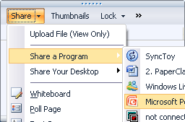
Sharing an application, desktop etc
Content→Share→Share Your Program

Slide 8
Record to Service

