Slide 1

Project Courses
Prasun Dewan (dewan@cs.unc.edu)
Department of Computer Science
University of North Carolina at Chapel Hill

Slide 2
What structure do you expect?
So I can adapt
So you think abstractly about the structure of a typical lecture
So I can learn from you

Slide 3
Lecture Goals
Definition of Project
Impact on Teaching Activities
Techniques
Tools
Principles/Data

Slide 4
Projects vs. Non-Projects
Compute the product of two numbers
✓
Tangible “Virtual or Physical” Artifact
Write an essay
Real-World Problem
Describe body’s response to a health problem
More than one Solution to Problem
Classify a species
Industrial-Strength Tools
Assemble a device
✓
Degree of Projectess!
Create a software program
✓
Theorem proof
✓
Krajcik, J. and N. Shin (2014). Project-Based Learning. The Cambridge Handbook of the Learning Sciences. R. K. Sawyer, Cambridge University Press: 275-297.

Slide 5
Pedagogy Styles
Compute the product of two numbers
Tangible “Virtual or Physical” Artifact
Write an essay
Inductive
Real-World Problem
Describe body’s response to a health problem
More than one Solution to Problem
Classify a species
Industrial-Strength Tools
Assemble a device
Deductive
Create a software program
Theorem proof

Slide 6
Inductive vs. Deductive
Example 1
Inductive
General Concept (Abstraction, Algorithm)
Example 2
Example N
Deductive
Inductive Sticks
Deductive used, inductive takes teacher long time to master
Some Students like deductive
Felder, Richard M , Reaching the Second Tier--Learning and Teaching Styles in College Science Education..
Journal of College Science Teaching, v22 n5 p286-90 Mar-Apr 1993

Slide 7
Maximum “Projectness” in CS
Intro to Programming
Theory of Computation
Algorithms
Compilers
Cumulative assignments addressing real-world problems using real-world tools on creating a semester-long project
Software Engineering
Compilers and Software Engineering can be taught without projects
Why cumulative?
Project-based learning is a principle easier applied to certain courses

Slide 8
Distributing the Work and Feedback
“Distributed” learning is more effective than “massed” learning
Assignment 4
Assignment 3
Incremental tutor feedback while doing assignment helps learning
Assignment 2
Assignment 1
Peer feedback in active learning helps learning
Kirkley, J. (2012). Distributed Learning. Encyclopedia of the Sciences of Learning. N. M. Seel, Springer: 1020-1021.
Roger Azeveo, Daniel C. Moos, Jeffrey A. Greene, Fielding I. Winters, Jennifer G. Cromley(2008). "Why is externally-facilitated regulated learning more effective than self-regulated learning with hypermedia?" Educational Technology Research and Development 56(1): 45-72..
Sarah L. Eddy* and Kelly A. Hogan (2014). "Getting Under the Hood: How and for Whom Does Increasing Course Structure Work?" CBE-Life Science Education

Slide 9
Principles
Student Efficiency
Project-based Learning
Instructor Efficiency
Inductive Learning
Teaching is Design!
Distributed Learning
Programming Projects make it easier or harder to make these tradeoffs?
Active Learning in Classroom
Incremental Feedback in Assignments
What is Special about Programming?
Collaborative Learning in Assignments
Collaborative Learning in Classroom

Slide 10
Programming vs Other Projects
Composing a Lecture
Programs can be manipulated by other programs more easily
Create a Software Program
Easier to tell if they are not right

Slide 11
Lecture Goals
Definition
✓
Impact on Teaching Activities
✓
Techniques
Tools
Principles/Data
✓

Slide 12
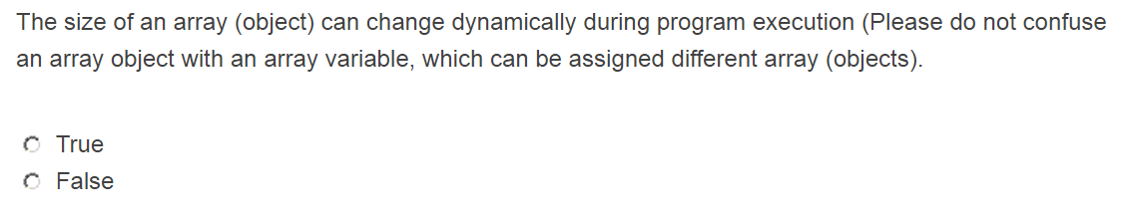
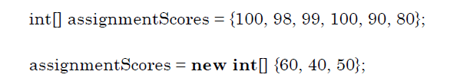
Discipline-Independent Approach: Quiz + Post-Quiz
Question
Reason for Confusion
On its own, not project-based learning
Post-quiz collaboration can resolve confusion
Sarah L. Eddy* and Kelly A. Hogan (2014). "Getting Under the Hood: How and for Whom Does Increasing Course Structure Work?" CBE-Life Science Education

Slide 13
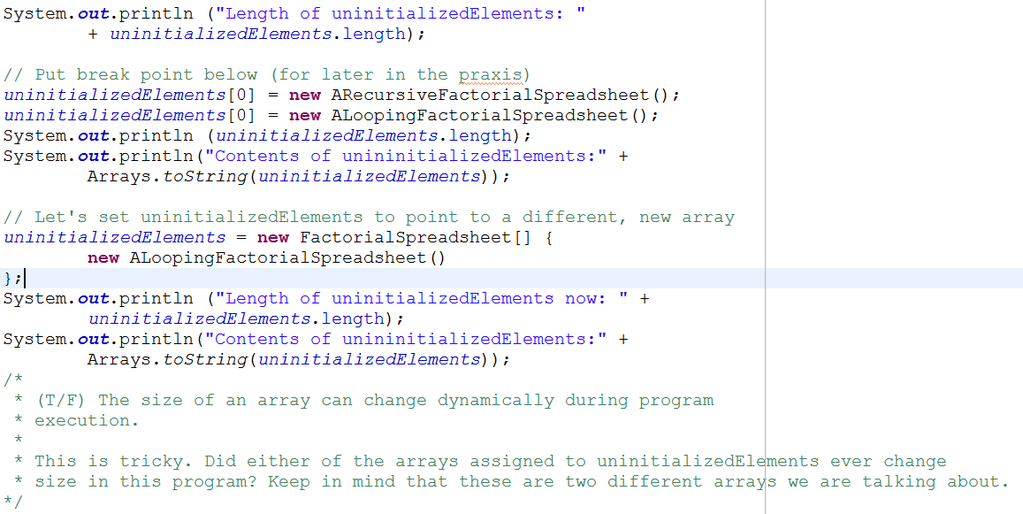
CS: Discovery-Promoting Praxis
Debugger and program output provide some answers learned inductively
They play the role of a collaborator in previous case
“Teach a person to fish”
Project-based learning
Alternative to lecture, not a step after it

Slide 14
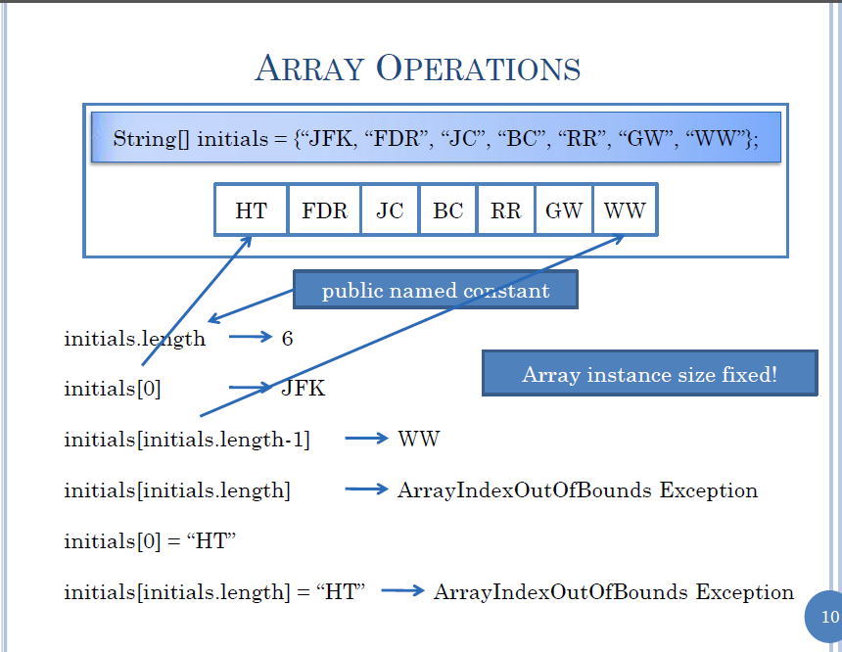
Live/Recorded Lecture
On its own, not project-based learning
Can be inductive
Efficient
Picture is worth a thousand words
You do not have to go to war to know it is wrong

Slide 15
Hybrid Approach with Quiz-Assignment Transaction
Quiz
Assignment
Deliverable
Recorded Lecture
Praxis
Leaning Means
Class time is used to view lecture, do praxis and sometimes ask assignment questions
Makes sense to view the recorded lecture after doing the assignment?
Makes sense to do the quiz after the assignment?

Slide 16
Lecture Goals
Definition
✓
Impact on Teaching Activities
✓
Techniques
✓
Tools
✓
Principles/Data

Slide 17
Discovery-based Praxis
Not solving a problem, degree of projectness is low

Slide 18
Grading Programming Problems
Problem: Write a recursive factorial function
Tools to grade it?
How do we adapt the problem to use the tool?
Consequences of using the tool?

Slide 19
Limits to Automatic Grading
Problem: Write a recursive factorial function
Source-code analysis runs into halting problem
Runtime testing checks a subset of the I/O pairs and cannot check for style such as recursion

Slide 20
Diffing Output Given an Input
Number?
3
Factorial: 6
Number?
3
Factorial: 3
✓
Used in Udacity for small assignments but not projects
Please enter a number?
3
Factorial: 6
Not tolerant to Inconsequential, intuitive mistakes in I/O
Allow tool to be invoked before submission
Student can hack solution and hardwire solution to test cases
Students do not have access to all tests
Reduced creativity
Reduces natural divergence and hence plagiarism detection

Slide 21
Unit Testing
public void testFactorial () {
Assert.assertTrue(“3! = 6”, Factorial.fact(3) == 6);
}
package functions;
public class Fact {
public static factorial (int n) { …. }}
Not tolerant to Inconsequential, intuitive mistakes in naming, parameter order and organization
Allow tool to be invoked before submission
Student can hack solution and hardwire solution to test cases
Students do not have access to all tests
Reduced creativity
Reduces natural divergence and hence plagiarism detection

Slide 22
Multi-Faceted Approach
Unit Testing
Source Testing
I/O Testing
Diff Testing
Regular Expression
Direct Calls
Reflection
Parsing
Check
Style
Check
Style Extensions
Student Tests
Rubric Management
Learning Management Systems
Halting problem opens a whole new research area
Grader Executed
Demos
Videos

Slide 23
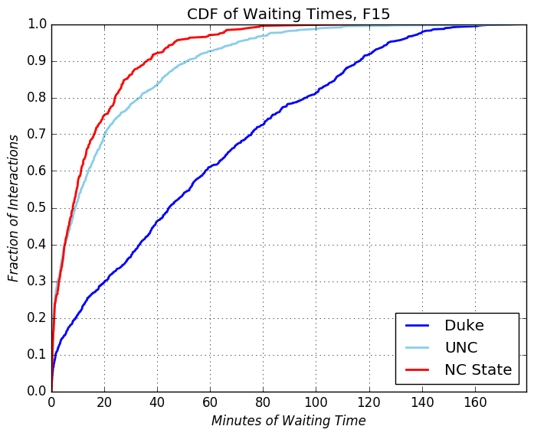
Excessive Waiting Times
40% of the time, students wait for over an hour
60% of the time, students wait for under an hour
Slide by Aaaron Smith
Notes:
First, excessive waiting times.
This graph is a cumulative distribution function of how long students had to wait before receiving help across all three universities.
To interpret this, pick a point on the graph. [Animate Slide] We’ll pick this point.
[Animate Slide] Now, this point corresponds to 60 minutes of waiting time and 60 percent of interactions.
[Animate Slide] This means that 60% of the time, students at Duke waited for less than an hour before receiving help.
[Animate Slide] Conversely, it also means that the other 40% of the time, students had to wait for more than an hour before seeing a peer teacher.
That’s a long time!
One last detail on this slide is that UNC and NC State both have similar curves. Remember, these two schools had similar office hour structures.
We believe the reason Duke’s waiting times were so long is because of their hectic evening office hour structure.

Slide 24
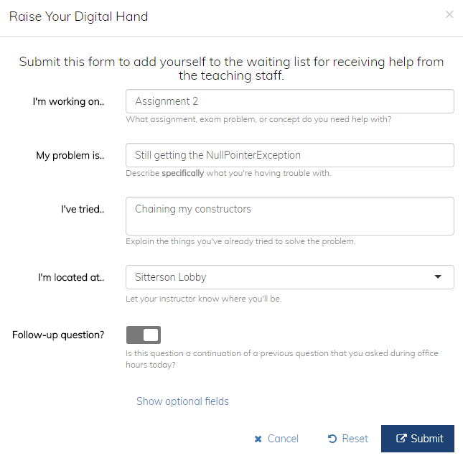
Feature: Student Question Prompts
Student “Raise Hand” Form
The “raise hand” form prompts students to think critically about their issue before asking for help
Slide by Aaaron Smith
Notes:
This is the form students must fill out to request help at office hours.
We require students to specify what their working on, what their problem is, and what they’ve already tried to solve the problem.
They also have the ability to specify whether their question is a “follow up” to a previous question.

Slide 25
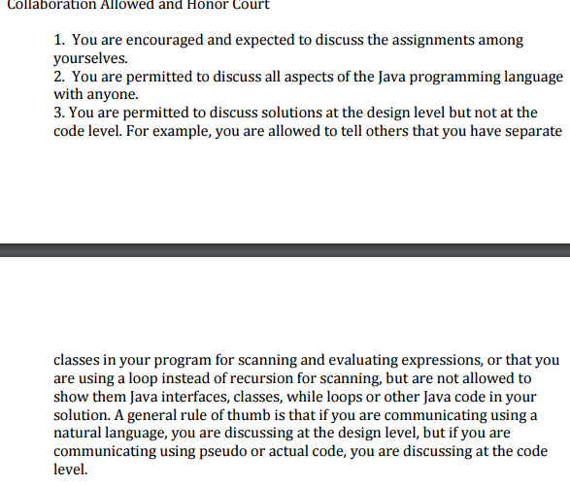
Collaboration on Design

Slide 26
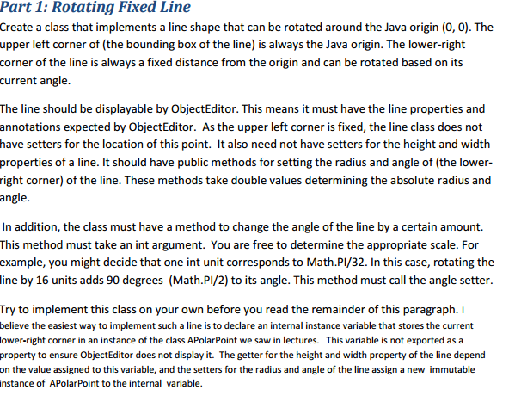
Give Design Away (in small print)

Slide 27
Students Getting Behind
Assignment 4
Assignment 4 Due Date
Assignment 3
Assignment 3 Due Date
Assignment 2
Assignment 2 Due Date
Assignment 1
Assignment 1 Due Date
What if you get permanently behind?
Can shift assignment dates N times if last N assignments will not be done.
But you sacrifice the last N assignments, whose scores will go in fudge factor.

Slide 28
Summary
Principles
  Project-based learning, Inductive learning, Distributed learning, Active-learning, Incremental Feedback, Collaborative learning, Student and Instructor Efficiency
Techniques
  Discovery-enabling Praxes as an Alternative
  Quiz/Assignment Transaction
  Give design away
Tools
  Graders based on diff and unit tests
  Reduce project-based learning and conflict with plagiarism (detectors)
  Can be mixed and integrated with manual and semi-automatic techniques
  Research area
Design space and tradeoffs
  Constantly evolving and challenging design activity

