Slide 1

Implementing User Interfaces
Prasun Dewan
Department of Computer Science
University of North Carolina at Chapel Hill
dewan@cs.unc.edu

Slide 2
Classifying Implementation Issues
✓
Software engineering architectures
Distributed/concurrency architectures
Algorithms
✓
Abstractions (interactive)

Slide 3
Layering/Awareness
User Awareness
Real-time Collaboration
Collaborative
Multiuser
Multi-view
Distributed
Single-View

Slide 4
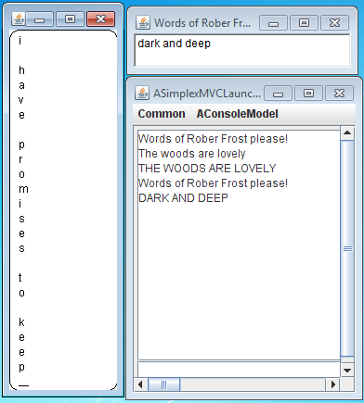
Single-View Implementation
Single-View
Distribution, view, unaware

Slide 5
1-User Layer Stack
Layer 0
Layer 0
Layer 1
Layer 1
Increasing Abstraction
Communication Layers
I/O Layers
Layer N-1
Layer N-1
Layer N
Layer N
PC
Physical Devices

Slide 6
Example Stack
10
6.2
Data
Abstraction
Increasing Abstraction
Interactor
Widget
Abstraction
6.2
Abstraction Representation
Syntactic Sugar
Window
Interactor
Abstraction
PC
Framebuffer
Interactor
Syntactic sugar ~ IF keyword, packet header

Slide 7
Framebuffer Hierarchy
Display¹
Display²
Framebuffer¹
PC
Window hierarchy?

Slide 8
Window Hierarchy
Display
Top Level
Window¹
Window²
Sub Windows
Window¹²
Window¹²
Sub Windows
Window¹²¹
Window¹²²
Toolkit hierarchy?

Slide 9
Widget/Window Hierarchy
Display
Top Level
Window¹
Window²
Container
Widget¹²
Window¹²
Component
Widget¹²¹
Widget¹²²

Slide 10
FrameBuffer I/O
Input: Mouse and character events with screen coordinates
Framebuffer Client
a ^, x, y
drawImage image
Framebuffer
Output: Draw pixel images
press a
a

Slide 11
Window I/O
Input: Mouse and character events with window coordinates
Window Client
a ^, win¹, x, y
draw a, win¹, x, y
Window System
Output: Draw shapes
press a
a
Window move, resize?

Slide 12
Window Manager
Input: Window move, resize user operations
Window Client
Win¹, x, y
Move window x, y
Window Manager
Output: Window move, resize
Window moved
Window moves
Window manager separate from window system

Slide 13
Window Manager vs. System
Window Client
win¹, x, y
Move window x, y
draw a, win¹, x, y
a ^, win¹, x, y
Window Manager
Window System
Window moved
press a
a
Window manager is a separate module/process
Puts decorations on window for moving resizing

Slide 14
Widget I/O
Input: Higher level event
Toolkit Client
win¹, ‘abc’
setText “ABC”
Toolkit
Output: Higher level output
Enter ‘abc’
abc
ABC

Slide 15
Layers Summary
I/O is processed by a series of layers
Each layer acts provided interactors for the abstractions in the layer above it (and hence abstractions for the layers below it)
The topmost layer is the semantics, data or model layer and provides abstractions that are not interactors
The bottom most layer is the Framebuffer layer and provides interactors that are not abstractions.
Two typical layers between the data and Framebuffer layers are the toolkit and window systems, which provide (hiearchical) widget and window abstractions/interactors respectively.
A window is a rectangular area on the screen that can be associated with I/O behavior
A widget is a window that has been associated with I/O behavior such as that of a text field or a slider.
A window manager is separate from the window system

Slide 16
Case Study: Java AWT
Hides the underlying window system from programmer
Portability

Slide 17
Window System Classes
Top Level
Window¹
Window²
Sub Windows
Window¹²
Window¹²
Sub Windows
Window¹²¹
Window¹²²

Slide 18
AWT Window System Classes
Top Level
Window¹
(J)Frame²
Sub Windows
Container¹²
(J)Panel¹²
Sub Windows
(J)Component¹²¹
Canvas¹²²

Slide 19
Toolkit Hierarchy
Top Level
Window¹
Window²
Container
Widget¹²
Window¹²
Component
Widget¹²¹
Widget¹²²

Slide 20
AWT Toolkit Hierarchy
Top Level
Window¹
(J)Frame²
Sub Windows
Container¹²
Panel¹²
Sub Widgets
(J)TextField¹²¹
(J)Slider¹²²

Slide 21
Window I/O: Output
Window Client
a ^, win¹, x, y
draw a, win¹, x, y
Window System
press a
a

Slide 22
Java Helper Class: Graphics(2D) Context
drawString()
Graphics(2D)
setColor()
drawOval()
fillOval()
drawLine()
fillLine ()
drawRect()
fillRect()

Slide 23
Example Graphics Calls
Font font = g.getFont();
FontMetrics metrics = g.getFontMetrics(font);
int height = metrics.getHeight();
g.drawRoundRect(0,
0,
getWidth(),
getHeight(),
ROUND_RECTANGLE_ARC_WIDTH,
ROUND_RECTANGLE_ARC_WIDTH
for(int i = 0; i < stringBuffer.length(); i++) {
char drawnChar = stringBuffer.charAt(i);
g.drawString("" + drawnChar, X_OFFSET, height*(i + 1));
}
g.drawLine(X_OFFSET,
height* (stringBuffer.length() + 1),
X_OFFSET + CARAT_WIDTH,
height* (stringBuffer.length() + 1));
Called when?

Slide 24
Expose Events
Window Client
expose win, rect(s)
draw complete win
OR
draw exposed win
Window Manager
Window System
Window moved
Window resized
Application can requests expose event
When a window is resized, or (un) obscured expose event is sent to it with exposed region(s)
May draw complete window
What is the API for receiving expose events?
Window system clips in case it app. drawn outside window bounds
Application is expected to draw only exposed regions

Slide 25
Review
Font font = g.getFont();
FontMetrics metrics = g.getFontMetrics(font);
int height = metrics.getHeight();
g.drawRoundRect(0,
0,
getWidth(),
getHeight(),
ROUND_RECTANGLE_ARC_WIDTH,
ROUND_RECTANGLE_ARC_WIDTH
for(int i = 0; i < stringBuffer.length(); i++) {
char drawnChar = stringBuffer.charAt(i);
g.drawString("" + drawnChar, X_OFFSET, height*(i + 1));
}
g.drawLine(X_OFFSET,
height* (stringBuffer.length() + 1),
X_OFFSET + CARAT_WIDTH,
height* (stringBuffer.length() + 1));
Called when?
When what is to be drawn changes
stringBuffer
When exposed area changes?

Slide 26
Overlapping Windows (Vertical Window on Top)
Exposed rectangle

Slide 27
Overlapping Windows (Vertical Window on Top)
Multiple exposed rectangles

Slide 28
Overlapping Windows (Vertical Window on Top)
Single exposed rectangle
Drawing outside exposed region will be clipped
Window system could also keep last drawn pixels of each window as backing store
Repainting trades off time efficiency for space
Important if windows are lightweight and nested

Slide 29
Calling Painting Code
Font font = g.getFont();
FontMetrics metrics = g.getFontMetrics(font);
int height = metrics.getHeight();
g.drawRoundRect(0,
0,
getWidth(),
getHeight(),
ROUND_RECTANGLE_ARC_WIDTH,
ROUND_RECTANGLE_ARC_WIDTH
for(int i = 0; i < stringBuffer.length(); i++) {
char drawnChar = stringBuffer.charAt(i);
g.drawString("" + drawnChar, X_OFFSET, height*(i + 1));
}
g.drawLine(X_OFFSET,
height* (stringBuffer.length() + 1),
X_OFFSET + CARAT_WIDTH,
height* (stringBuffer.length() + 1));
Called when?
When what is to be drawn changes
When exposed area changes
How to accommodate both?

Slide 30
AWT based Expose Event Processing
paint (Graphics)
Window Client Class
Window manager queues paint/expose event for window
Processing queue results in (paint event) in paint method of window to be called
IS-A
Call
Window Class (JPanel)
paint (Graphics)
repaint()
Repaint method can be called by application to queue an expose event for window
Application can override paint to draw

Slide 31
Overriding Paint Method
public class AVerticalTextDrawer extends JPanel {
…
public void paint(Graphics g) {
super.paint(g);
Font font = g.getFont();
FontMetrics metrics = g.getFontMetrics(font);
…
}

Slide 32
Window I/O: Input
Window Client
✓
a ^, win¹, x, y
draw a, win¹, x, y
Window System
press a
a

Slide 33
Java Inheritance based Input Event Processing
public final dispatchEvent() in window called in response to input event in that window
processEvent(AWTEvent)
Window Client Class
dispatchEvent() calls protected processEvent
IS-A
Window Class (JPanel)
processEvent(AWTEvent)
dispatchEventAWTEvent)
processEvent can be overridden by application subclasses
This was the approach used in Java 1.0

Slide 34
Single-Inheritance Problem
Window Client Class
Client Class
IS-A
IS-A
Window Class (JPanel)

Slide 35
Conceptual Problem with Inheritance
Window Client Class
Client Class
IS-A
IS-A
Window input processor (or drawer) is not a window
Window Class (JPanel)

Slide 36
Delegating to window system
Window Client Class
Client Class
IS-A
HAS-A
Window Class (JPanel)

Slide 37
Java Inheritance based Input Event Processing
processEvent (AWTEvent)
Window Client Class
IS-A
Window Class (JPanel)
processEvent (AWTEvent)
dispatchEvent (AWTEvent)

Slide 38
Java Delegation-based Input Event Processing
Window Client Class
eventDispatched (AWTEvent)
addAWTListener()
Toolkit
HAS-A
Window Class (JPanel)
processEvent (AWTEvent)
dispatchEvent (AWTEvent)
Must distinguish between mouse and event and key pressed, key typed, mousepressed, mousedragged, and other actions

Slide 39
Higher-Level Processing
KeyPressed (MouseEvent)
Window Client Class
mousePressed (MouseEvent)
HAS-A
Window Class (JPanel)
addMouseListener()
processEvent (AWTEvent)
addKeyListener()
addMouseMotion Listener()

Slide 40
Input Processing
public void keyTyped(KeyEvent keyEvent) {
stringBuffer.append(keyEvent.getKeyChar());
repaint();
}

Slide 41
Input Processing: Delegation
KeyPressed (MouseEvent)
Window Client Class
mousePressed (MouseEvent)
HAS-A
Window Class (JPanel)
addMouseListener()
processEvent (AWTEvent)
addKeyListener()
addKeyListener()

Slide 42
Output Processing: Inheritance
paint (Graphics)
Window Client Class
IS-A
Window Class (JPanel)
paint (Graphics)

Slide 43
Output Processing: Delegation
Must create a delegate class for each window class
paint(Graphics)
Window Client Class
Delegate classes not related by subtype relationship !(DelegateContainer IS-A DelegateComponent)
HAS-A
Window Class (Delegate JPanel)
addPaintListener()
paint(Graphics)
SWT supports delegation model in toolkit

Slide 44
Usage Pattern
public void keyTyped(KeyEvent keyEvent) {
stringBuffer.append(keyEvent.getKeyChar());
repaint();
}
Abstraction?
public class AVerticalTextDrawer extends JPanel {
…
public void paint(Graphics g) {
super.paint(g);
Font font = g.getFont();
FontMetrics metrics = g.getFontMetrics(font);
…
g.drawString("" + drawnChar, X_OFFSET, height*(i + 1));
…
}

Slide 45
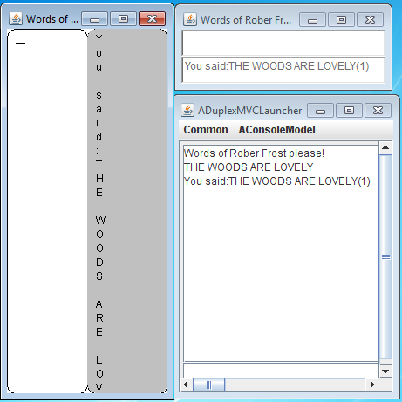
Code Pattern
Client of Window Client
Window Client (AVerticalTextDrawer)
Window Class (JPanel)

Slide 46
Abstraction
Widget Client
Widget Class (AVerticalTextField)
Window System (JPanel)
Methods of AVerticalTextField?

Slide 47
Using AVerticalTextField Abstraction
public static void main (String[] args) {
Frame frame = new Frame();
frame.setLayout(new GridLayout(1, ));
AVerticalTextField field1 =
new AVerticalTextField("hello");
AVerticalTextField field2 =
new AVerticalTextField("goodbye");
field1.setText("hello hello");
frame.add(field1);
frame.add(field2);
frame.setSize(100, 400);
frame.setVisible(true);
}

Slide 48
AVerticalTextField: State
public class AVerticalTextField extends JPanel implements TextComponentInterface, KeyListener {
int eventId;
StringBuffer stringBuffer;
List<ActionListener> actionListeners = new ArrayList();
public static final int X_OFFSET = 10;
public static final int CARAT_WIDTH = 10;
public static final int ROUND_RECTANGLE_ARC_WIDTH = 20;
public static final int ROUND_RECTANGLE_ARC_HEIGHT = 20;
Color windowBackground;
public AVerticalTextField(String aString) {
stringBuffer = new StringBuffer(aString);
this.addKeyListener(this);
this.setFocusable(true);
windowBackground = this.getBackground();
}

Slide 49
Higher Level Listeners
public void addActionListener(ActionListener actionListener) {
if (actionListeners.contains(actionListener)) return;
actionListeners.add(actionListener);
}
public void notifyActionListeners() {
for (ActionListener actionListener: actionListeners) {
actionListener.actionPerformed(new ActionEvent(this, eventId, stringBuffer.toString()));
}
eventId++;
}

Slide 50
State Change
public void keyTyped(KeyEvent keyEvent) {
if (!isEnabled()) return;
if (keyEvent.getKeyChar() == '\n') {
notifyActionListeners();
return;
}
stringBuffer.append(keyEvent.getKeyChar());
repaint();
}
@Override
public String getText() {
return stringBuffer.toString();
}
@Override
public void setText(String newVal) {
stringBuffer.delete(0, stringBuffer.length());
stringBuffer.append(newVal);
repaint();
}

Slide 51
Paint
public void paint(Graphics g) {
super.paint(g);
Font font = g.getFont();
FontMetrics metrics = g.getFontMetrics(font);
int height = metrics.getHeight();
if (isEnabled()) {
g.setColor(Color.WHITE);
g.fillRoundRect(0, 0, getWidth(), getHeight(),
ROUND_RECTANGLE_ARC_WIDTH,
ROUND_RECTANGLE_ARC_WIDTH);
g.setColor(Color.BLACK);
g.drawLine(X_OFFSET, height* (stringBuffer.length() + 1),
X_OFFSET + CARAT_WIDTH,
height* (stringBuffer.length() + 1));
}
}

Slide 52
Paint (Contd.))
else {
g.setColor(windowBackground);
g.fillRoundRect(0, 0, getWidth(), getHeight(),
ROUND_RECTANGLE_ARC_WIDTH, ROUND_RECTANGLE_ARC_WIDTH);
}
g.setColor(Color.BLACK);
for(int i = 0; i < stringBuffer.length(); i++) {
char drawnChar = stringBuffer.charAt(i);
g.drawString("" + drawnChar, X_OFFSET, height*(i + 1));
}
}
What if buffer size reduces?
Window cleared before paint method is called

Slide 53
Paint vs. Update
paint ()
Window Client Class
Paint event is dispatched to the update() method
update ()
update() method clears area and calls paint()
IS-A
paint ()
Window Class (JPanel)
repaint()
If you do not want clearing, do painting in overridden update method
update ()

Slide 54
Enhanced Toolkit
Widget Clients
AVerticalTextField
JTextField
TextField
Window System
Code sharing among two implementations?

Slide 55
Reusing Code
factory
abstract
abstract
layoutAndSizeFrame()
ADuplexFrostyGUI
createTextField()
Return Type?
IS-A
ADuplexFrostyAWTGUI
ADuplexFrostyVerticalGUI
Factory method: An abstract method that can be overridden by different classed to create different alternative implementations
No common type to unify alternative widgets in Swing!

Slide 56
Factory Methods
protected abstract void layoutAndSizeFrame (Frame frame);
protected abstract TextComponentInterface
createTextField(String text);
protected void layoutAndSizeFrame (Frame frame) {
frame.setLayout(new GridLayout(1, 2));
frame.setSize(new Dimension(200, 400));
}
protected TextComponentInterface createTextField(String text) {
return new AVerticalTextField(text);
}
protected void layoutAndSizeFrame (Frame frame) {
frame.setLayout(new GridLayout(2, 1));
frame.setSize(new Dimension(250, 100));
}
protected TextComponentInterface createTextField(String text) {
return new AJTextField(text);
}

Slide 57
Retrofitting Interfaces to AWT/Swing
package util.awt;
import java.awt.TextField;
public class ATextField extends TextField
implements TextComponentInterface {
public ATextField(String text) {
super(text);
}
}
package util.awt;
import javax.swing.JTextField;
public class AJTextField extends JTextField
implements TextComponentInterface {
public AJTextField(String text) {
super(text);
}
}

Slide 58
AVerticalTextField: Interfaces
public class AVerticalTextField extends JPanel
implements TextComponentInterface, KeyListener {
..
}

Slide 59
Text Methods
package util.awt;
public interface TextComponentInterface extends
ComponentInterface, ActionListenable {
String getText();
void setText(String newVal);
}

Slide 60
Component Methods
package util.awt;
public interface ComponentInterface {
boolean isEnabled();
void setEnabled(boolean newVal);
}

Slide 61
AddActionListener
package util.awt;
import java.awt.event.ActionListener;
public interface ActionListenable {
void addActionListener(ActionListener anActionListener);
}

Slide 62
Text Methods
package util.awt;
public interface TextComponentInterface extends
ComponentInterface, ActionListenable {
String getText();
void setText(String newVal);
}
Case conventions?

Slide 63
Java Window Summary
In Java several classes such as Component, Container, JPanel, and Panel define windows that are not widgets, that is, not associated with I/O behavior.
Input from instances of these classes is trapped through delegation by defining mouse and key listeners
Output is sent to instances of these classes through inheritance by sub-classing them and redefining the paint or update method
If the current widget set does not serve your purposes, ideally, do not build directly on top of the window system to serve your application needs; instead build a new general purpose widget that can be used by other apps
A factory method returns an object of some class that is an implementation of its return type.
Different subclasses of the class defining a factory method can provide different overridings of the factory method to choose different implementations of the return type of the method.
Factory methods provide a convenient way to share code among applications that type variables using interfaces and differ only in the implementation of the interface used in the applications.

Slide 64
Java Case Conventions
Start Class Names With Upper Case Letters
aBMICalculator
ABMICalculator
Start Variable and Method Names With Lower Case Letters
weight
Weight
Square
square
Start Variable and Method Names With Lower Case Letters
Each New Word in the Name Starts with a Capital Letter
converttoinches
convertToInches
ABMICalculator
aBMICalculator

Slide 65
Retrofitting Interfaces to AWT/Swing (Review)
package util.awt;
import java.awt.TextField;
public class ATextField extends TextField
implements TextComponentInterface {
public ATextField(String text) {
super(text);
}
}
package util.awt;
import javax.swing.JTextField;
public class AJTextField extends JTextField
implements TextComponentInterface {
public AJTextField(String text) {
super(text);
}
}

Slide 66
Window Hierarchy
Display
Top Level
Window¹
Window²
Sub Windows
Window¹²
Window¹²
Sub Windows
Window¹²¹
Window¹²²
Can we create a DAG or graph?

Slide 67
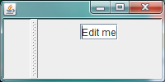
Window DAGCreator
public static JFrame createTree {
JFrame frame = new JFrame();
JSplitPane splitPane = new JSplitPane();
frame.add(splitPane);
JPanel leftPanel = new JPanel();
JPanel rightPanel = new JPanel();
splitPane.setLeftComponent(leftPanel);
splitPane.setRightComponent(rightPanel);
JTextField textField = new JTextField("Edit me");
leftPanel.add(textField);
rightPanel.add(textField);
frame.setSize(200, 100);
frame.setVisible(true);
return frame;
}
JPanel
JTextField
JFrame
JSplitPane
JPanel
DAG Converted to a Tree

Slide 68
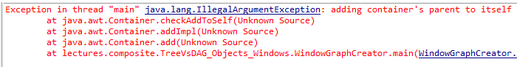
Window (Cyclic) Graph Creator
public static JFrame createTree {
JFrame frame = new JFrame();
JSplitPane splitPane = new JSplitPane();
frame.add(splitPane);
JPanel leftPanel = new JPanel();
JPanel rightPanel = new JPanel();
splitPane.setLeftComponent(leftPanel);
splitPane.setRightComponent(rightPanel);
JTextField textField = new JTextField("Edit me");
leftPanel.add(textField);
rightPanel.add(splitPane);
frame.setSize(200, 100);
frame.setVisible(true);
return frame;
}
JPanel
JTextField
JFrame
JSplitPane
JPanel

Slide 69
Window Hierarchy
Display
Top Level
Window¹
Window²
Sub Windows
Window¹²
Window¹²
Sub Windows
Window¹²¹
Window¹²²
Semantic issues with Tree?

Slide 70
Event Destination (Mouse Event)
leftMouse^
In AWT/Swing, event goes to deepest window with a mouse listener
Window system gives mouse event to top level window containing the pointer
Adding a mouse event listener in a window can disable listeners on parent components
Window can process it and/or dispatch it to deepest or all sub-windows containing the pointer
Not so for AWT event listener

Slide 71
Java Delegation-based Input Event Processing
Window Client Class
eventDispatched (AWTEvent)
addAWTListener()
Toolkit
HAS-A
Window Class (JPanel)
processEvent (AWTEvent)
dispatchEvent (AWTEvent)

Slide 72
Higher-Level Processing
KeyPressed (MouseEvent)
Window Client Class
mousePressed (MouseEvent)
HAS-A
Window Class (JPanel)
addMouseListener()
processEvent (AWTEvent)
addKeyListener()
addMouseMotion Listener()

Slide 73
AWT Event Destination (Key Event)
Unique focus (sub) window
Usually mouse clicking makes the deepest component in which the pointer was last clicked the focus window
a^
Key event dispatched to top-level window containing focus window
Another approach is look simply at the mouse position
Top-level window (always?) dispatches to focus window
Can define (un)focus listener for a window

Slide 74
Dispatch vs. Process Event
public final dispatchEvent() in top window called in response to input event in that window
processEvent (AWTEvent)
Window Client Class
dispatchEvent() calls protected processEvent in window or subwindows
IS-A
Window Class (JPanel)
processEvent (AWTEvent)
dispatchEvent (AWTEvent)
Dispatch/processing separation makes shared window systems easier to write
Can simply dispatch to remote frame

Slide 75
Drawing in multiple windows

Slide 76
Java Hierarchical Painting
Paint event associated with a specific window and results in paint method of that window to be called
paint (Graphics)
Window Client Class
That window can call paint methods of sub windows (pre/post/in order)
IS-A
Call
Window Class (JPanel)
paint (Graphics)
repaint()
Repaint method on window queues paint method for that window
Window manager associates paint event with top level windows in response to new area being exposed

Slide 77


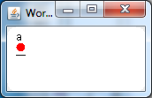
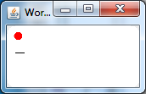
Repainting Child
@Override
public void keyTyped(KeyEvent keyEvent) {
if (keyEvent.getKeyChar() == '\n') {
notifyActionListeners();
return;
}
stringBuffer.append(keyEvent.getKeyChar());
repaint();
}
}
Fix?
Parent Paint
public class DrawingPanel extends JPanel {
…
public void paint(Graphics g) {
super.paint(g);
g.setColor(Color.RED);
g.fillOval(x, y, DIAMETER, DIAMETER);
}
Paint method of parent called after children?
Swing components can be made opaque to not show parent

Slide 78
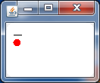
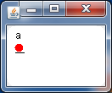
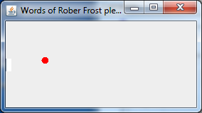
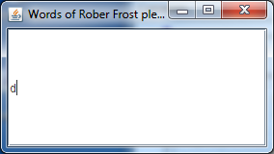
Repainting Parent
@Override
public void keyTyped(KeyEvent keyEvent) {
if (keyEvent.getKeyChar() == '\n') {
notifyActionListeners();
return;
}
stringBuffer.append(keyEvent.getKeyChar());
getParent().repaint();
}
}
Parent Paint
public class DrawingPanel extends JPanel {
…
public void paint(Graphics g) {
super.paint(g);
g.setColor(Color.RED);
g.fillOval(x, y, DIAMETER, DIAMETER);
}
Do existing toolkit components call ancestor paint methods?

Slide 79
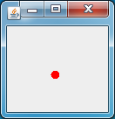
No Super Call in Parent Paint
@Override
public void keyTyped(KeyEvent keyEvent) {
if (keyEvent.getKeyChar() == '\n') {
notifyActionListeners();
return;
}
stringBuffer.append(keyEvent.getKeyChar());
getParent().repaint();
}
}
Parent Paint
public class DrawingPanel extends JPanel {
…
public void paint(Graphics g) {
super.paint(g);
g.setColor(Color.RED);
g.fillOval(x, y, DIAMETER, DIAMETER);
}
Paint method of children not being called

Slide 80
Tele-pointer Implementation?
@Override
public void keyTyped(KeyEvent keyEvent) {
if (keyEvent.getKeyChar() == '\n') {
notifyActionListeners();
return;
}
stringBuffer.append(keyEvent.getKeyChar());
getParent().repaint();
}
}
Replace the top-level frame’s window with one that draws movable telepointer shape?
Parent Paint
public class DrawingPanel extends JPanel {
…
public void paint(Graphics g) {
super.paint(g);
g.setColor(Color.RED);
g.fillOval(x, y, DIAMETER, DIAMETER);
}

Slide 81
Opacity
@Override
public void keyTyped(KeyEvent keyEvent) {
if (keyEvent.getKeyChar() == '\n') {
notifyActionListeners();
return;
}
stringBuffer.append(keyEvent.getKeyChar());
getParent().repaint();
}
}
If child components are opaque, frame containers will not show
Parent Paint
JPanel is opaque (by default)
public class DrawingPanel extends JPanel {
…
public void paint(Graphics g) {
super.paint(g);
g.setColor(Color.RED);
g.fillOval(x, y, DIAMETER, DIAMETER);
}

Slide 82
Binding time
@Override
public void keyTyped(KeyEvent keyEvent) {
if (keyEvent.getKeyChar() == '\n') {
notifyActionListeners();
return;
}
stringBuffer.append(keyEvent.getKeyChar());
getParent().repaint();
}
}
Early binding of telepointer
Parent Paint
Replacement must be done before child components are added
public class DrawingPanel extends JPanel {
…
public void paint(Graphics g) {
super.paint(g);
g.setColor(Color.RED);
g.fillOval(x, y, DIAMETER, DIAMETER);
}
Need access to source code of application
Cannot add and remove tele-pointer dynamically without recreating the frame tree

Slide 83
Tele-pointer Implementation? Widget Reuse
@Override
public void keyTyped(KeyEvent keyEvent) {
if (keyEvent.getKeyChar() == '\n') {
notifyActionListeners();
return;
}
stringBuffer.append(keyEvent.getKeyChar());
getParent().repaint();
}
}
All drawing components must be changed to call the telepointer panel paint method
Parent Paint
Popular existing Swing widgets such as JTextField do not seem to do so
public class DrawingPanel extends JPanel {
…
public void paint(Graphics g) {
super.paint(g);
g.setColor(Color.RED);
g.fillOval(x, y, DIAMETER, DIAMETER);
}

Slide 84
Event Handling
@Override
public void keyTyped(KeyEvent keyEvent) {
if (keyEvent.getKeyChar() == '\n') {
notifyActionListeners();
return;
}
stringBuffer.append(keyEvent.getKeyChar());
getParent().repaint();
}
}
If a child component listens to mouse events, telepointer cannot be moved
Popular existing Swing widgets such as JTextField do so
Parent Paint
public class DrawingPanel extends JPanel {
…
public void paint(Graphics g) {
super.paint(g);
g.setColor(Color.RED);
g.fillOval(x, y, DIAMETER, DIAMETER);
}
Telepointer window not given key events in case it needs them (Will it really need them?)

Slide 85
Layered Glass Pan
Frame
Frame and components
setGlassPane()
Glass Pane
Nesting: smaller component overrides drawing and input processing of enclosing static components
Layering: Higher dynamic layer overrides drawing and input processing of lower, possibly smaller components. Can simulate dynamic multiple parents of a child

Slide 86
(Swing) Parent vs. GlassPane: Opacity
Covers the area of children
Covers the area of frame children
Can be made opaque or not
Can be made opaque or not
If components are opaque, parent drawing will not show
If glass pane is opaque, frame components will not show
Making it invisible makes its children invisible
Making it invisible has no effect on frame component visibility
Must recreate tree to dynamically hide/show parent drawing
Can dynamically make glass pane visible/invisible

Slide 87
(Swing) Parent vs. GlassPane: Awareness
Need to change source code to support parent drawing
Just need reference to frame
User Awareness
Real-time Collaboration
Collaborative
Multiuser
Multi-view
Distributed
Single-View

Slide 88
Event Processing
If a child has mouse listeners for some event type, parent listeners do not get event
If a glass pane has mouse listeners for some event type, frame components do not get event
How to get events such a telepointer move to go to both?

Slide 89
Re-dispatch
Parent and children have high-level listeners
Glasspane and children have high-level listeners
Children do re-dispatching
Glasspane does re-dispatching
Existing multiple widgets must be changed
Glass pane must be changed

Slide 90
Coarse-Grained AWTEvent Listener
Child components register low-level event listeners with Toolkit
Glasspane registers low level coarse grained event listeners with Toolkit
Existing applications likely to use high level listeners
Glass pane code can do so

Slide 91
Re-dispatch vs. Coarse-Grained Listener
Glasspane does re-dispatching
Glasspane registers low level coarse grained event listeners with Toolkit
Must determine destination component and coordinates relative to that component
Must determine if event coordinates are within glass component and high-level attributes of the event such as if it is mouse click or drag

Slide 92
Coarse-Grained Event Example
public void eventDispatched(AWTEvent event) {
if (event instanceof MouseEvent) {
MouseEvent me = (MouseEvent) event;
if (!SwingUtilities.isDescendingFrom(me.getComponent(), frame)) {
return;
}
if (me.getID() == MouseEvent.MOUSE_EXITED &&
me.getComponent() == frame) {
point = null; }
else {
MouseEvent converted =
SwingUtilities.convertMouseEvent(me.getComponent(),
me, frame.getGlassPane());
point = converted.getPoint();
}
repaint();
}
}
http://weblogs.java.net/blog/alexfromsun/archive/2006/09/a_wellbehaved_g.html

Slide 93
Calling Redispatch Example
//In the implementation of the glass pane's mouse listener:
public void mouseMoved(MouseEvent e) {
redispatchMouseEvent(e, false);
}
public void mouseReleased(MouseEvent e) {
redispatchMouseEvent(e, true);
}
.../* The mouseDragged, mouseClicked, mouseEntered, * mouseExited, and mousePressed methods have the same * implementation as mouseMoved. */...

Slide 94
Re-dispatch Example
private void redispatchMouseEvent(MouseEvent e, boolean repaint) {
Point glassPanePoint = e.getPoint();
Container container = contentPane;
Point containerPoint = SwingUtilities.convertPoint(
glassPane, glassPanePoint, contentPane);
if (containerPoint.y < 0) { //we're not in the content pane
//Could have special code to handle mouse events over
//the menu bar or non-system window decorations, such as
//the ones provided by the Java look and feel. }
else { //The mouse event is probably over the content pane.
//Find out exactly which component it's over.
Component component = SwingUtilities.getDeepestComponentAt(
container, containerPoint.x, containerPoint.y);
…
//Update the glass pane if requested.
if (repaint) {
glassPane.setPoint(glassPanePoint); glassPane.repaint();
}
}
Messy
http://docs.oracle.com/javase/tutorial/uiswing/components/rootpane.html

Slide 95
Snippet vs. Abstracion
private void redispatchMouseEvent(MouseEvent e, boolean repaint) {
Point glassPanePoint = e.getPoint();
Container container = contentPane;
Point containerPoint = SwingUtilities.convertPoint(
glassPane, glassPanePoint, contentPane);
if (containerPoint.y < 0) { //we're not in the content pane
//Could have special code to handle mouse events over
//the menu bar or non-system window decorations, such as
//the ones provided by the Java look and feel. }
else { //The mouse event is probably over the content pane.
//Find out exactly which component it's over.
Component component = SwingUtilities.getDeepestComponentAt(
container, containerPoint.x, containerPoint.y);
…
//Update the glass pane if requested.
if (repaint) {
glassPane.setPoint(glassPanePoint); glassPane.repaint();
}
}
Glasspane independent
Glasspane specific
http://docs.oracle.com/javase/tutorial/uiswing/components/rootpane.html

Slide 96
Code Snippets
Frame tree
setGlassPane()
Frame-independent Glass pane + event processing

Slide 97
Abstraction
Frame tree
setGlassPane()
GlassPane
Frame and glass pane independent event processor

Slide 98
Dispatch Based
Frame tree
setGlassPane()
mouseMoved()
GlassPane
addMouse(Motion)Listener()
Frame and glass pane independent event processor
setGlassPane()
setFrame()

Slide 99
Coarse Grained Event Processor
Frame tree
setGlassPane()
mouseMoved()
GlassPane
setEventProcessor()
mouseMoved()
Frame and glass pane independent event processor
eventDispatched()
addMouse(Motion) Listener()

Slide 100
Tree Summary
A window system and toolkit can handle only trees. However the API they often provide allows creation of arbitrary graphics
In Java, a call to create a graph results in a run time error and a call to create an additional link to a node results in the previous link being deleted
Because of the tree structure:
  A mouse or key event in a top-level window logically belongs to all nodes containing it.
    A special dispatch operation decides which of these nodes actually processes it, which is typically the deepest.
    Separating dispatch from processing makes shared window systems easier to write
  The painting of a region can be done by all windows containing it
    When repaint is called on a specific window, the paint method of the window can call the paint methods of parent and chidren windows
    Paint methods of predefined Java windows calls those of their chidren but not their parents
    In Swing, a window can be made opaque, in which case the ancesor’s paint method do not actually do any painting, calling only their descendents’ paint methods
    When a window is exposed, the repaint method of the top most frame is called.

Slide 101
Telepointers and Glass Pane
A telepointer is some shape that is shape displayed on a user’s frame that can be moved by a remote user to any location in the window.
A glass pane is a rectangular region that contains other windows but unlike an ancestor of these windows, gets precedence in input and output processing over the contained windows.
Because of this property it is better to implement the telepointer capability in a glass pane that covers the frame rather than in the top most frame container
Implementing a telepointer requires a way to give mouse events to both the frame glass pane and the frame components.
Two techniques can be used: events first go to the glass pane and then are redispatched to the frame components or the glass pane or the glass pane gets events not through mouse listeners but through a coarse-grained event listener
Ideally these techniques should be in an abstraction that makes the event distribution independent of the glass pane semantics for drawing and processing mouse events.

Slide 102
Classifying Implementation Issues
✓
Software engineering architectures
Distributed/concurrency architectures
Algorithms
✓
Abstractions (interactive)

Slide 103
Layering/Awareness
✓
User Awareness
Real-time Collaboration
Collaborative
Multiuser
Multi-view
Distributed
✓
Single-View

Slide 104
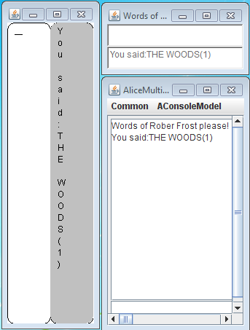
Multiple User Interfaces

Slide 105
MVC Pattern and Distributed Computing
Application to distributed computing?
Controller
View
Performs Input
Performs Output
Model
Write Methods
Read Methods
View can be on computer with big screen and controller on smart phone

Slide 106
Multiple Views and Controllers
Controller 1
View 1
Controller 2
Model
View 2
Controller 3
View 3
Controller 4
View 4

Slide 107
Syncing Controllers & View
Controller 1
View 1
Controller 2
Model
View 2
Controller 3
View 3
Controller 4
View 4

Slide 108
Observer Pattern
Observable
Observers
View 1
Model
View 2
Changed model notifies views
View 3
View 4

Slide 109
Observer/Observable Pattern
Observer 1
register()
Event
register()
Observable
Observer 2
Event

Slide 110
Notifications in MVC Pattern
Controller
Notification Method
View
Performs Input
Performs Output
Model
Write Methods
Read Methods
Observer Registration Method

Slide 111
MVC and Toolkits
Observable Widget (Button, TextField)
Observer Registration Method
Notification Method
Controller
Notification Method
View
Performs Input
Performs Output
Model
Write Methods
Read Methods
Observer Registration Method
Controller and View are Tightly Coupled

Slide 112
Model/Interactor Pattern
View + Controller
Interactor
Notification Method
Model
Write Methods
Read Methods
Observer Registration Method

Slide 113
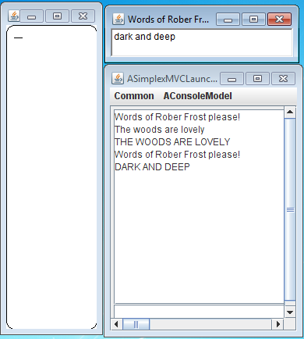
Simplex UI Model
Simplex because no notification to the views
Print upper case is model function simulating some complex model activity
Model
Write Methods
Read Methods
Observer Registration Method

Slide 114
Model and Interactor Methods
Model (SimplexFrosty Model )
setInput
Interactor (Simplex FrostyInteractor)
interact

Slide 115
Simplex Model
public class ASimplexFrostyModel implements SimplexFrostyModel {
protected SimplexUpperCaser upperCaser;
protected String input = "";
public ASimplexFrostyModel(SimplexUpperCaser anUpperCaser) {
upperCaser = anUpperCaser;
}
protected void printUpperCase(String anInput) {
upperCaser.printUpperCase(anInput);
}
public void setInput(String anInput) {
printUpperCase(anInput);
}
}

Slide 116
Simplex Model Service
public class ASimplexUpperCaser implements SimplexUpperCaser{
public ASimplexUpperCaser() {
}
protected String toUpperCase(String anInput) {
return anInput.toUpperCase();
}
public void printUpperCase(String anInput) {
System.out.println(toUpperCase(anInput));
}
}

Slide 117
Simplex Console Interactor
public class ASimplexFrostyConsoleUI implements SimplexUserInterfaceManager {
protected SimplexFrostyModel clientModel;
public void interact(SimplexFrostyModel aModel) {
clientModel = aModel;
while (true) {
System.out.println(clientModel.FROSTY_PROMPT)
clientModel.setInput (Console.readString()); ;
}
}
}
Loop must be the last step the main program executes

Slide 118
Simplex GUI Interactor
public abstract class ASimplexFrostyGUI implements
SimplexUserInterfaceManager, ActionListener{
protected JFrame frame;
protected TextComponentInterface inputField;
protected SimplexFrostyModel clientModel;
protected abstract void layoutAndSizeFrame (Frame frame);
protected abstract TextComponentInterface
createTextField(String text);
public void interact() {
clientModel = aModel;
createAndAddFrameComponents();
layoutAndSizeFrame(frame);
frame.setVisible(true);
}
…

Slide 119
Composing Model and Interactor
Model SimplexFrosty Model
setInput()
Interactor (Simplex FrostyInteractor)
interact()
ProgramLauncher
launch()

Slide 120
Simplex Launcher
public class ASimplexFrostyLauncher implements ProgramLauncher{
public void launch() {
SimplexFrostyModel clientModel = getFrostyModel();
(new ASimplexFrostyAWTGUI()).interact(clientModel);
(new
ASimplexFrostyVerticalGUI()).
interact(clientModel);
(new
ASimplexFrostyConsoleUI()).interact(clientModel);
}
protected SimplexFrostyModel getFrostyModel() {
SimplexUpperCaser upperCaser = new ASimplexUpperCaser();
return new ASimplexFrostyModel(upperCaser);
}
public static void main (String[] args) {
(new ASimplexFrostyLauncher()).launch();
}
}
Factory Method
Loop is the last step the main program executes

Slide 121
Simplex Launcher
public class ASimplexFrostyLauncher implements ProgramLauncher{
public void launch() {
SimplexFrostyModel clientModel = getFrostyModel();
(new ASimplexFrostyAWTGUI()).interact(clientModel);
(new
ASimplexFrostyVerticalGUI()).
interact(clientModel);
(new
ASimplexFrostyConsoleUI()).interact(clientModel);
}
protected SimplexFrostyModel getFrostyModel() {
SimplexUpperCaser upperCaser = new ASimplexUpperCaser();
return new ASimplexFrostyModel(upperCaser);
}
public static void main (String[] args) {
(new ASimplexFrostyLauncher()).launch();
}
}
Will the application terminate?

Slide 122

With Only Console View

Slide 123
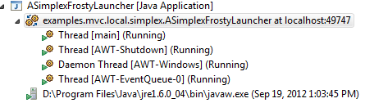
With all Three Views

Slide 124
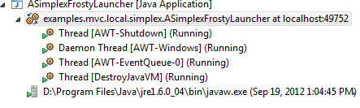
With Single GUI

Slide 125
With Both GUIs

Slide 126
Simplex GUI Interactor
public abstract class ASimplexFrostyGUI implements
SimplexUserInterfaceManager, ActionListener{
protected JFrame frame;
protected TextComponentInterface inputField;
protected SimplexFrostyModel clientModel;
protected abstract void layoutAndSizeFrame (Frame frame);
protected abstract TextComponentInterface
createTextField(String text);
public void interact() {
clientModel = aModel;
createAndAddFrameComponents();
layoutAndSizeFrame(frame);
frame.setVisible(true);
}
…
Creates AWT thread if not created already

Slide 127
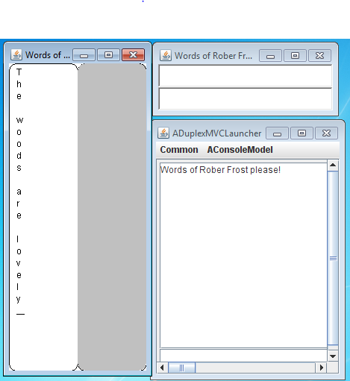
Duplex Model?
Model
Write Methods
Read Methods
Observer Registration Method

Slide 128
Model Methods
Model (DuplexFrosty Model)
setInput()
addPropertyChange Listener()
getInput()
getOutput()
Interactor (DuplexFrosty
Interactor )
propertyChanged()
interact()

Slide 129
Standard Listener and Event
package java.beans;
public interface PropertyChangeListener {
public void propertyChange (PropertyChangeEvent evt);
}
package java.beans;
public class PropertyChangeEvent extends java.util.EventObject {
public PropertyChangeEvent (Object source, String propertyName,
Object oldValue, Object newValue) {…}
public Object getNewValue() {…}
public Object getOldValue() {…}
public String getPropertyName() {…}
….
}

Slide 130
Standard Registration Signature
package util.models;
import java.beans.PropertyChangeListener;
public interface PropertyListenerRegisterer {
void addPropertyChangeListener(
PropertyChangeListener aListener);
}

Slide 131
Duplex Model
public class ADuplexFrostyModel extends ASimplexFrostyModel implements DuplexFrostyModel {
Counter counter;
protected String output = "";
protected PropertyChangeSupport propertyChangeSupport =
new PropertyChangeSupport(this);
public ADuplexFrostyModel(DuplexUpperCaser anUpperCaser,
Counter aCounter) {
super(anUpperCaser);
counter = aCounter;
}
public String getInput() {return input;}
public String getOutput() {return output;}
public void setInput(String anInput) {
counter.increment(1);
super.setInput(anInput);
input = "";
propertyChangeSupport.
firePropertyChange("input", anInput, input);
processUpperCase(toCountedUpperCase(anInput));
}

Slide 132
Duplex Model
protected void processUpperCase(String aString) {
String oldOutput = output;
output = "You said:" + aString;
propertyChangeSupport.firePropertyChange("output", oldOutput, output);
}
protected String toCountedUpperCase(String anInput ) {
return ((DuplexUpperCaser)
upperCaser).toCountedUpperCase(anInput);
}
public void addPropertyChangeListener(
PropertyChangeListener aListener) {
propertyChangeSupport.
addPropertyChangeListener(aListener);
}

Slide 133
ADuplexUpperCaser
public class ADuplexUpperCaser extends ASimplexUpperCaser
implements DuplexUpperCaser{
protected Counter counter;
public ADuplexUpperCaser(Counter aCounter) {
counter = aCounter;
}
public ADuplexUpperCaser() {}
public String toCountedUpperCase(String anInput) {
return toUpperCase(anInput) + counterFeedback();
}
protected Object getCounterValue() {
return counter.getValue();
}
protected String counterFeedback(Object aCallerCounterValue) {
return "(" + toStringCounterValue(aCallerCounterValue) + ")";
}
protected String toStringCounterValue(Object aCounterValue) {
return ""+ aCounterValue;
}
protected String counterFeedback() {
return counterFeedback(getCounterValue());
}
}

Slide 134
ACounter
public class ACounter implements Counter{
public ACounter() {
super();
}
Integer value = 0;
public Object getValue() {
return value;
}
public void increment(int val) {
value += val;
}
public boolean equals(Object otherObject) {
if (!(otherObject instanceof Counter))
return false;
return getValue() == ((Counter) otherObject).getValue();
}
}

Slide 135
Model Methods
Model (DuplexFrosty Model)
getInput()
addPropertyChange Listener()
setInput()
getOutput()
Interactor SimplexUser InterfaceManager
propertyChanged()
interact()

Slide 136
Duplex Counter Interactor
public class ADuplexFrostyConsoleUI
extends ASimplexFrostyConsoleUI
implements DuplexUserInterfaceManager {
public void interact (SimplexFrostyModel aModel) {
((PropertyListenerRegisterer) aModel).
addPropertyChangeListener(this);
super.interact(aModel); }
public void propertyChange(PropertyChangeEvent aPropertyChange) {
if
(aPropertyChange.getPropertyName().equalsIgnoreCase("output"))
System.out.println(aPropertyChange.getNewValue());
}
}

Slide 137
Duplex GUI Interactor
public abstract class ADuplexFrostyGUI extends ASimplexFrostyGUI
implements DuplexUserInterfaceManager{
protected TextComponentInterface outputField;
public void interact (SimplexFrostyModel aModel) {
super.interact(aModel);
((PropertyListenerRegisterer)
clientModel).addPropertyChangeListener(this);
}
protected void createAndAddFrameComponents(){
super.createAndAddFrameComponents();
outputField = createTextField("");
outputField.setEnabled(false);
frame.add((Component) outputField);
}
}

Slide 138
Duplex GUI Interactor
public void propertyChange(PropertyChangeEvent aPropertyChange) {
if
(aPropertyChange.getPropertyName().equalsIgnoreCase("output"))
outputField.setText((String) aPropertyChange.getNewValue());
else if
(aPropertyChange.getPropertyName().equalsIgnoreCase("input"))
inputField.setText((String) aPropertyChange.getNewValue());
}
}

Slide 139
UI Layers and Models?
Widget Clients
Interactor
Notification Method
Toolkit
Window System
Model
Write Methods
Read Methods
Observer Registration Method

Slide 140
UI Layers and Models?
Model
Interactor
Interactor
Notification Method
Toolkit
Window System
Model
Write Methods
Read Methods
Observer Registration Method

Slide 141
MVC
An interactive application with I/O is divided into one or more models, views, and controllers, and launching code that composes them together
A model stores the highest level data abstraction in the UI layer stack
It is an observable object supporting registration and notification of observers
A controller processes input, by calling write methods in the model in response user actions
A view performs output, by displaying the model state. It uses read methods and notifications to get the state to be displayed
A view and controller that are tightly coupled with each other (through for example a widget) can be combined into an interactor.

Slide 142
System vs. Application Layers
Model
Application defined
Interactor
Toolkit
System provided
Window System
System provided?
Motivation?

Slide 143
UI Implementation
Interactive Application
50%
Semantics
User
Interface
50%
Library
Toolkit
Console I/O
Myers ‘95
Sutton & Sprague ‘78

Slide 144
System vs. Application Layers
Model
Application defined
Interactor
Toolkit
System provided and application-independent
Window System
System provided but application-based.

Slide 145
System vs. Application Layers
User Interface generator
Model
Application defined
Interactor
Toolkit
System provided and application-independent
Window System
System provided but application-based.

Slide 146
User Interface Generator
Model
A la scanner and parser generator
UI Generator
User Interface Impl (Interactor, Model/View)

Slide 147
Procedures/Types to Widget (Compositions)
Conventional Languages
Record
Array
Sequence
Enum
Boolean
Procedure
Widget(Composition)

Slide 148
Procedures/Types to Widget (Compositions)
Conventional Languages
Record
Array
Sequence
Enum
Boolean
Procedure
form
List/table
Menu/
radiobox
checkbox
Menu/ form

Slide 149
Example
public class SampleRecord {
public String string = "edit me";
public int number = 0;
public boolean flag = false;
public enum Color {red, green, blue};
public Color color = Color.red;
public void inc (int value) {
number += value;
}
public static void main (String[] args) {
ObjectEditor.edit(new SampleRecord());
}

Slide 150
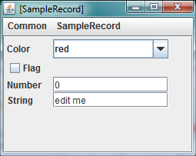
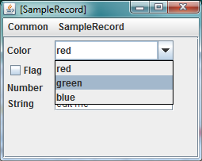
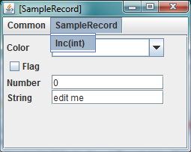
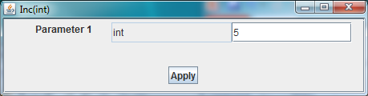
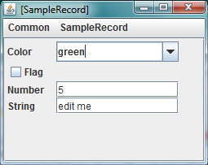
Record + Procedure
Array of SampleRecord?

Slide 151
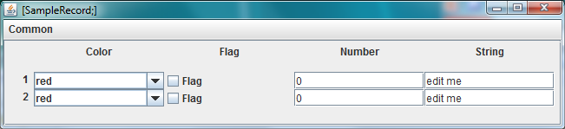
Array
public static void main (String[] args) {
SampleRecord[] array =
{new SampleRecord(), new SampleRecord()};
ObjectEditor.edit(array);
}

Slide 152
Data Type to Widget (Composition)
Data Type
Record
Enum
Automatic creation of widget
Automatic widget update
Automatic data update
Form
Menu

Slide 153
Conventional Types vs. Encapsulated Types
Conventional Languages
Record
Array
Sequence
Table
OO Languages
Objects with private instance variables
Record
Array
Sequence
Table

Slide 154
Object Oriented Languages
Encapsulated Model
Data Type
Record
Enum
Abstraction Flexibility: Range of object types for which the UI code can be generated
Automatic creation of widget
User Interface generator
Automatic widget update
Automatic data update
User Interface
Form
Menu

Slide 155
Solution 1: Predefined Interfaces
Tool-defined interfaces (JTable, JTree)
Data Type
Record
Enum
Abstraction Flexibility?
Automatic creation of widget
User Interface generator
Automatic widget update
Encapsulation with no programmer-defined types
Automatic data update
Low abstraction flexibility
User Interface
Form
Menu

Slide 156
Solution 2: Public Variables
Objects with Public Variables
Data Type
Record
Enum
Abstraction Flexibility?
Automatic creation of widget
User Interface generator
Automatic widget update
Programmer-defined types with no encapsulation
Automatic data update
Low abstraction flexibility
User Interface
Form
Menu

Slide 157
Solution 3: Logical Structure and Manual Mapping
Mapping
Encapsulated Objects
Data Type
Record
Enum
Abstraction Flexibility?
Automatic creation of widget
User Interface generator
Automatic widget update
Arbitrary
Effort?
Automatic data update
Tedious/error prone, special language
User Interface
Form
Menu
Only one level structure in implementations

Slide 158
Solution 4: Programming Patterns
Programming Patterns
Encapsulated Objects
Data Type
Record
Enum
Abstraction Flexibility?
Automatic creation of widget
User Interface generator
Automatic widget update
Those following patterns
Effort?
Automatic data update
None
User Interface
Form
Menu

Slide 159
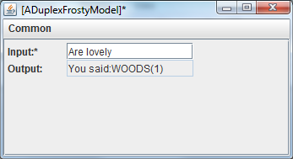
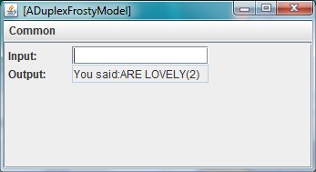
Encapsulated Object
public class ADuplexFrostyModel extends ASimplexFrostyModel implements DuplexFrostyModel {
Counter counter;
protected String output = "";
protected PropertyChangeSupport propertyChangeSupport =
new PropertyChangeSupport(this);
public ADuplexFrostyModel(DuplexUpperCaser anUpperCaser,
Counter aCounter) {
super(anUpperCaser);
counter = aCounter;
}
public String getInput() {return input;}
public String getOutput() {return output;}
public void setInput(String anInput) {
counter.increment(1);
super.setInput(anInput);
input = "";
propertyChangeSupport.
firePropertyChange("input", anInput, input);
processUpperCase(toCountedUpperCase(anInput));
}

Slide 160
Bean Programming Pattern
Property: Typed, Named Unit of Exported Object State
public class C
{
Name <P>
Type <T>
public <T> get<P>() {
...
}
Read-only
Editable
public void set<P>(<T> newValue) {
...
}
Relationship among method signatures allowing extraction of object semantics.
}
Prolog-like Unification
obtainP()
Design pattern

Slide 161
User Interface Generator (Review)
Model
A la scanner and parser generator
UI Generator
User Interface Impl (Interactor, Model/View)

Slide 162
Example (review)
public class SampleRecord {
public String string = "edit me";
public int number = 0;
public boolean flag = false;
public enum Color {red, green, blue};
public Color color = Color.red;
public void inc (int value) {
number += value;
}
public static void main (String[] args) {
ObjectEditor.edit(new SampleRecord());
}

Slide 163
Record + Procedure
Array of SampleRecord?

Slide 164
Solution 4: Programming Patterns (Review)
Programming Patterns
Encapsulated Objects
Data Type
Record
Enum
Abstraction Flexibility?
Automatic creation of widget
User Interface generator
Automatic widget update
Those following patterns
Effort?
Automatic data update
None
User Interface
Form
Menu

Slide 165
Encapsulated Object (Review)
public class ADuplexFrostyModel extends ASimplexFrostyModel implements DuplexFrostyModel {
Counter counter;
protected String output = "";
protected PropertyChangeSupport propertyChangeSupport =
new PropertyChangeSupport(this);
public ADuplexFrostyModel(DuplexUpperCaser anUpperCaser,
Counter aCounter) {
super(anUpperCaser);
counter = aCounter;
}
public String getInput() {return input;}
public String getOutput() {return output;}
public void setInput(String anInput) {
counter.increment(1);
super.setInput(anInput);
input = "";
propertyChangeSupport.
firePropertyChange("input", anInput, input);
processUpperCase(toCountedUpperCase(anInput));
}

Slide 166
Generating the User Interface
public void launch() {
DuplexFrostyModel clientModel = getFrostyModel();
ObjectEditor.edit(clientModel);
(new ADuplexFrostyAWTGUI()).interact(clientModel);
(new ADuplexFrostyVerticalGUI()).interact(clientModel);
(new ADuplexFrostyConsoleUI()).interact(clientModel);
}

Slide 167
Physical vs. Logical Structure
public class ADuplexFrostyModel extends ASimplexFrostyModel implements DuplexFrostyModel {
Counter counter;
protected String output = "";
protected PropertyChangeSupport propertyChangeSupport =
new PropertyChangeSupport(this);
public ADuplexFrostyModel(DuplexUpperCaser anUpperCaser,
Counter aCounter) {
super(anUpperCaser);
counter = aCounter;
}
public String getInput() {return input;}
public String getOutput() {return output;}
public void setInput(String anInput) {
counter.increment(1);
super.setInput(anInput);
input = "";
propertyChangeSupport.
firePropertyChange("input", anInput, input);
processUpperCase(toCountedUpperCase(anInput));
}
Physical Structure: instant vars
Logical Structure: properties

Slide 168
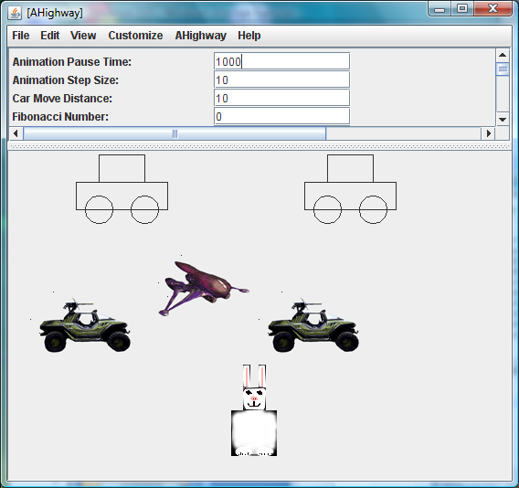
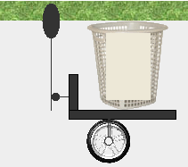



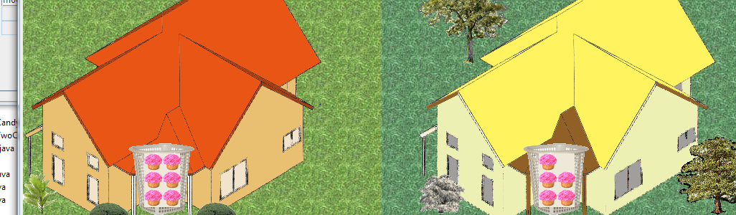
Graphics and Collections
Graphics
No existing conventions
for graphics and collections
Collections

Slide 169
Patterns for Graphics
@StructurePattern(StructurePatternNames.OVAL_PATTERN)
public interface Oval {
public int getX();
public void setX(int newVal);
public int getY();
public void setY(int newVal);
public int getWidth();
public void setWidth(int newVal);
public int getHeight() ;
public void setHeight(int newVal);
public void setFilled(boolean newVal);
public Color getColor() ;
public void setColor(Color newVal);
}

Slide 170
ObjectEditor Graphics
Can automatically display and change objects representing points, rectangles, ovals, and lines as corresponding graphics
  Java provides libraries to manually display graphics
Has rules for recognizing these objects
Rules based on Java graphics standards
  Inverted coordinate system
  Cartesian coordinates for points
  Bounding rectangles for lines, rectangles, ovals
Plus naming conventions and annotations

Slide 171
ObjectEditor Bounding Box Rules
A shape object describes its bounding box if it:
  represents the size of the bounding box using int (read-only or editable) properties, “Height”, and “Width”
  describes the location of the upper left corner of the bounding box using “X”, “Y” properties of type int
X, Y
Height
Width

Slide 172
ObjectEditor Line/Shape/Oval Rules
An object is recognized as a rectangle/line/oval if:
  Its interface or class has the string “Rectangle”/”Oval”/”Line” in its name or has a Point/Oval/Line annotation
  It has (readonly or editable) properties describing the bounding box of the shape
  Can have additional properties
    These attributes can specify font, color, fill
import util.annotations.StructurePattern;
import util.annotations.StructurePatternNames;
@StructurePattern(StructurePatternNames.LINE_PATTERN)
public interface Line{
…
}

Slide 173
An Oval Implementation
public class AnOval implements Oval, PropertyListenerRegisterer {
int x, y, width, height;
boolean filled;
Color color;
PropertyChangeSupport propertyChangeSupport =
new PropertyChangeSupport(this);
public AnOval (int initX, int initY, int initWidth,
int initHeight) {
x = initX;
y = initY;
width = initWidth;
height = initHeight;
}
public int getX() {return x;}
public void setX(int newX) {
x = newX;
propertyChangeSupport.firePropertyChange("x", null, x);
}
…

Slide 174
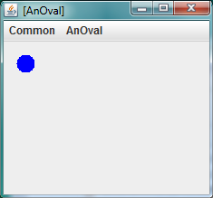
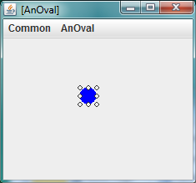
An Oval Launcher
public static void main(String args[]) {
Oval oval = new AnOval(10, 10, 20, 20);
oval.setColor(Color.BLUE);
oval.setFilled(true);
bus.uigen.ObjectEditor.edit (oval);
}

Slide 175
XY-based String and Image Rules
X, Y
hello
Text
X, Y
ImageFileName
Location is the lower right corner in the case of a String (based on Java draw primitives)!
String and Image shapes can keep additional properties – in particular height and width.

Slide 176
ObjectEditor String Shape Rules
An object is recognized as a string shape if:
  Its interface or class has the string “String” in its name or a String annotation
  It has a (readonly/editable) “Text” of type String describing the string to be displayed
  It has (readonly or editable) int “X”, “Y” properties describing the location of the lower left corner of the bounding box of the shape
  Can have additional properties
public interface StringShape {
public int getX();
public void setX(int newX);
public int getY();
public void setY(int newY);
public String getText() ;
public void setText(String newVal);
}

Slide 177

AString Shape
public class AStringShape implements StringShape {
String text;
int x, y;
public AStringShape(String initText, int initX, int initY) {
text = initText;
x = initX;
y = initY;
}
public int getX() {return x;}
public void setX(int newX) {x = newX;}
public int getY() { return y;}
public void setY(int newY) {y = newY;}
public String getText() {return text;}
public void setText(String newVal) {text = newVal;}
}
public static void main(String args[]) {
StringShape hello= new AStringShape("hello", 0, 10);
ObjectEditor.edit(hello);
}

Slide 178
ObjectEditor Image Shape Rules
An object is recognized as an image shape if:
  Its interface or class has the string “Image” in its name
  It has a (readonly/editable) String “ImageFileName” property describing the name of the image file to be displayed
  It has (readonly or editable) int X, Y properties describing the location of the upper left corner of the bounding box of the shape
  Can have additional properties
public interface ImageShape {
public int getX();
public void setX(int newX);
public int getY();
public void setY(int newY);
public String getImageFileName() ;
public void setImageFileName(String newVal);
}

Slide 179

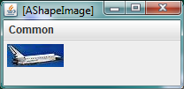
Image Implementation
public class AShapeImage implements ImageShape {
String imageFileName;
int x, y;
public AShapeImage (String initImageFileName, int initX, int initY) {
imageFileName = initImageFileName;
x = initX;
y = initY;
}
public int getX() {return x;}
public void setX(int newX) {x = newX;}
public int getY() { return y; }
public void setY(int newY) {y = newY;}
public String getImageFileName() {return imageFileName;}
public void setImageFileName(String newVal) {imageFileName = newVal ;}
}
public static void main (String args[]) {
ImageShape shuttle = new AShapeImage("shuttle2.jpg", 0, 0);
ObjectEditor.edit(shuttle);
}

Slide 180
Graphics and Collections
Graphics
✓
Collections

Slide 181
Conventions for Variable-Sized Collection
Write method (optional)
Convention based on Vector
@StructurePattern(StructurePatternNames.VECTOR_PATTERN)
public interface C{
  public T elementAt (int index);
  public int size();
  public Any setElementAt(T t, int index);
  …
}
Arbitrary Type.
Read methods
Unconstrained Type (void or T in practice)

Slide 182
Conventions for Variable-Sized Collection
Write method (optional)
Convention based on List
@StructurePattern(StructurePatternNames.LIST_PATTERN)
public interface C {
  public T get (int index);
  public int size();
  public Any set (int index) T 2);
  …
}
Arbitrary Type.
Read methods
Unconstrained Type (void or T in practice)

Slide 183
Without Notifications
@StructurePattern(StructurePatternNames.VECTOR_PATTERN)
public class AStringHistory implements StringHistory {
  public final int MAX_SIZE = 50;
  String[] contents = new String[MAX_SIZE];
  int size = 0;
  public int size() { return size;}
  public String elementAt (int index) { return contents[index]; }
  boolean isFull() { return size == MAX_SIZE; }
  public void addElement(String element) {
  if (isFull())
    System.out.println("Adding item to a full history");
  else {
    contents[size] = element;
    size++;
    }
}
}

Slide 184
Collection Notifications
Controller
updateVector (VectorChangeEvent)
View
Model
Write Methods
Read Methods
addVectorListener(VectorListener)
Works for any variable sized collection defined using ObjectEditor convention (originally derived for Vectors)

Slide 185
VectorListener and VectorListenerRegisterer Interfaces
package util.models;
public interface VectorListener {
public void updateVector(VectorChangeEvent evt);
}
package util.models;
public interface VectorListenerRegisterer {
public void addVectorListener(
VectorListener aListener);
}

Slide 186
VectorChangeEvent
package util.models;
public class VectorChangeEvent {
Object source;
Object otherSource;
// constants for event types
public static final int AddComponentEvent = 1,
DeleteComponentEvent = 2,
ChangeComponentEvent = 3,
InsertComponentEvent = 4,
CompletedComponentsEvent = 5,
ClearEvent = 6,
UndefEvent = 1000;
// constructor, oldObject can be null when no value is replaced
public VectorChangeEvent(Object theSource, int type, int posn,
Object oldObject, Object newObject, int newSize) {..}

Slide 187
Collection Notifications
public class AnObservableStringHistory
implements StringHistory, VectorListenerRegisterer{
VectorListenerSupport vectorListenerSupport =
new AVectorListenerSupport();
…
public void addElement(String element) {
if (isFull())
System.out.println("Adding item to a full history");
else {
contents[size] = element;
size++;
vectorListenerSupport.notifyAllListeners(
new VectorChangeEvent(this,
VectorChangeEvent.AddComponentEvent,
size -1, null, element, size));
}
}
public void addVectorListener(VectorListener aListener) {
vectorListenerSupport.addElement(aListener);
}
…

Slide 188
Programmer-Defined Composable Structure Types
Conventional Languages
Record
Array
Sequence
Table
Composable
O-O Languages
Objects with private instance variables
Physical Structure
Record
Shapes
Sequence
Table
Logical Structure

Slide 189
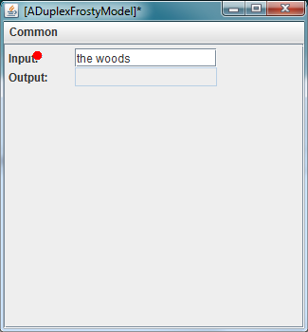
Automatically Generated Telepointer?

Slide 190
Encapsulated Object
DuplexFrostyModel clientModel = getFrostyModel();
OEFrame oeFrame = ObjectEditor.edit(clientModel);
Oval oval = new AnOval(30, 30, 10, 10);
oval.setFilled(true);
oval.setColor(Color.RED);
oeFrame.setTelePointerModel(oval);

Slide 191
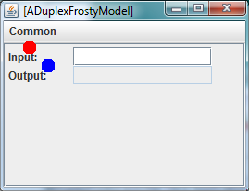
Multiple Pointers?

Slide 192
Oval List
public void launch() {
DuplexFrostyModel clientModel = getFrostyModel();
OEFrame oeFrame = ObjectEditor.edit(clientModel);
Oval oval = new AnOval(20, 20, 15, 15);
oval.setFilled(true);
oval.setColor(Color.RED);
Oval anotherOval = new AnOval(40, 40, 15, 15);
anotherOval.setFilled(true);
anotherOval.setColor(Color.BLUE);
List telepointers = new AListenableVector();
telepointers.add(oval);
telepointers.add(anotherOval);
oeFrame.setTelePointerModel(telepointers);
}
Vector + Notifications

Slide 193
Feedback Time
public class ADuplexFrostyModel extends ASimplexFrostyModel implements DuplexFrostyModel {
Counter counter;
protected String output = "";
protected PropertyChangeSupport propertyChangeSupport =
new PropertyChangeSupport(this);
public ADuplexFrostyModel(DuplexUpperCaser anUpperCaser,
Counter aCounter) {
super(anUpperCaser);
counter = aCounter;
}
public String getInput() {return input;}
public String getOutput() {return output;}
public void setInput(String anInput) {
counter.increment(1);
super.setInput(anInput);
input = "";
propertyChangeSupport.
firePropertyChange("input", anInput, input);
processUpperCase(toCountedUpperCase(anInput));
}
Notification on each character entry?

Slide 194
VectorChangeEvent
package util.models;
public class VectorChangeEvent {
Object source;
Object otherSource;
// constants for event types
public static final int AddComponentEvent = 1,
DeleteComponentEvent = 2,
ChangeComponentEvent = 3,
InsertComponentEvent = 4,
CompletedComponentsEvent = 5,
ClearEvent = 6,
UndefEvent = 1000;
// constructor, oldObject can be null when no value is replaced
public VectorChangeEvent(Object theSource, int type, int posn,
Object oldObject, Object newObject, int newSize) {..}
Works for stringbuffer also

Slide 195
AMutableString
public class AMutableString implements VectorInterface<Character {
StringBuffer stringBuffer;
public AMutableString(String s) {
stringBuffer = new StringBuffer(s);
}
public int size() {
return stringBuffer.length();
}
public void addElement(char c) {
stringBuffer.append(c);
}
…
}
Converting stringbuffer interface to Vector interface

Slide 196
AListenableString
public class AListenableString extends AMutableString implements
ListenableString {
public AListenableString(String s) {
super(s);
}
public void addElement(char c) {
super.addElement(c);
stringChangeSupport.elementAdded(new Character(c));
}
…
Firing notifications

Slide 197
Predefined ObjectEditor Classes
bus.uigen.shapes
AnOvalModel
ARectangleModel
ALineModel
AStringModel
AnImageModel
util.models
AListenableVector
AListenableString
AListenableHashtable

Slide 198
Duplex Counter Interactor
public class ADuplexFrostyConsoleUI
extends ASimplexFrostyConsoleUI
implements DuplexUserInterfaceManager {
public void interact (SimplexFrostyModel aModel) {
super.interact(aModel);
((PropertyListenerRegisterer)
clientModel).addPropertyChangeListener(this);
}
public void propertyChange(PropertyChangeEvent aPropertyChange) {
if
(aPropertyChange.getPropertyName().equalsIgnoreCase("output"))
System.out.println(aPropertyChange.getNewValue());
}
}

Slide 199
Language-Based User Interface Generator
Provides a user interface to automatically display and manipulate the logical structure of a model, that is, automatically provide the controller and view of a model.
In an encapsulated object, this structure can be derived using programming patterns
Programming patterns can be map encapsulated objects to records, variable-length lists, and tables.
Additional graphics programming patterns can be used to map records to various graphic shapes such as point, line, rectangle and oval
These patterns are associated with notification and listener types that allow the generator to receive events from the model.

Slide 200
extra

Slide 201
Event Flow
Controller
Notification Method
View
Performs Input
Performs Output
Model
Write Methods
Read Methods

Slide 202
Cycle in Model/Interactor Pattern
Change is echoed back
No cycle as no user event listener called
View + Controller
New property value can be compared with existing one
Interactor
Notification Method
New size can be compared with new one
Model
Write Methods
Read Methods
But vector events are not idempotent
For efficiency and non idempotent events, view should check its current state with event and/or model state
Ideally local event should contain information to ease diffing

Slide 203
Cycle in Replicated Models and Diffing
In Coupler
In Coupler
Write Methods
Write Methods
Model
Model
Out Coupler
Out Coupler
In coupler could use event state and model state to perform diff and not propagate event it has received

Slide 204
Multiple Write Methods
In Coupler
In Coupler
Write Methods
Write Methods
Local Write Methods
Model
Model
Local Observers
Out Coupler
Out Coupler
Model could have different write methods and events for local objects and couplers
External write methods invoked by in coupler propagate local but not remote events

Slide 205
Cycles in Single-User UIs
Cycles can result when a view and controller are combined into an interactor as an interactor can receive a change it sent to the model.
This cycle is not self perpetuating as interactors fire changes in response to user input and not model methods.
For efficiency reasons, an interactor or view should process a model notificaton only if it will change the display and has not been bounced back. To do so it must do a diff between the model state and the displayed state
  In particular, a view or interactor displaying a property as text can use a property change event to compare the textual representation of the new property value with content of the text field.
  A view or interactor displaying a list can use a list insert or delete event to compare the new size with the number of items it is displaying. If the size is the same, this is a bounced back change.

Slide 206
Cycles in Multi-User UIs
In a multi-user UI with replicated models, a change is sent by a model to a remote model through a local out coupler and a remote in coupler.
Write methods in a model can be called by local controllers or in couplers receiving changes from remote models.
Like an interactor, an in coupler should use received changes and model state to make sure it does not send to the model bounced changes. Otherwise a self perpetuating cycle can result.
Alternatively a model could provide different versions of write methods for local controllers and in couplers.
Local write methods send notifications to both views/interactors and out couplers but in coupler write methods send notifications only to local views and interactors

