Slide 1

Comp 790-063
Course Overview
Instructor: Prasun Dewan (FB 150, help401@cs.unc.edu)
Course page: http://www.cs.unc.edu/~dewan/290/f14/index.html

Slide 2
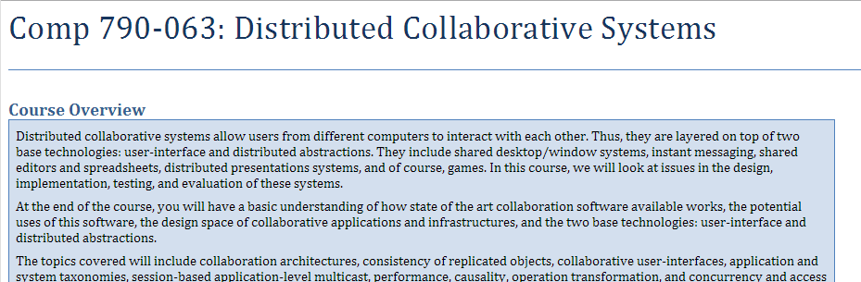
Course Page
Linked from my home page (google my name to find it) and UNC course pages

Slide 3
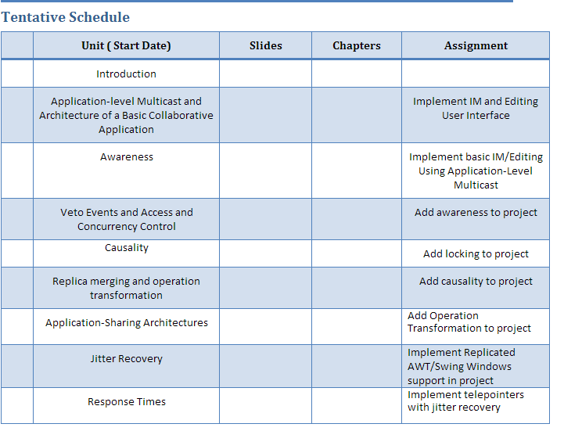
Class Material
No book
Each unit will have PPT slides (with recordings), sometimes Word document, and assignment

Slide 4
COLLABORATION
Notes:
Ask for definitions

Slide 5

COMPUTER SUPPORTED COLLABORATION
Notes:
Ask for definitions

Slide 6
TECHNIQUES AND ABSTRACTIONS FOR SUPPORTING
COLLABORATIVE APPLICATIONS
Notes:
Ask for definitions

Slide 7
Abstractions
Reusable hardware or software component that can be used by some large set (domain) of applications
Array, class, file, database, textfield

Slide 8
Techniques
Concept applicable to a large set of applications that may or may not be converted to an abstraction
User-interface (graphical, …); algorithm (bubble sort, ..), design pattern (observer, ..); architecture (client-server, p2p, …)

Slide 9
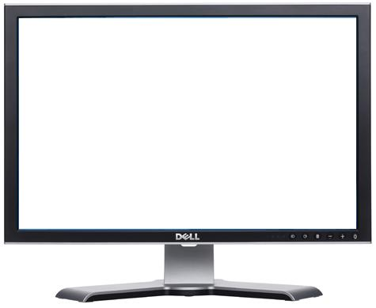
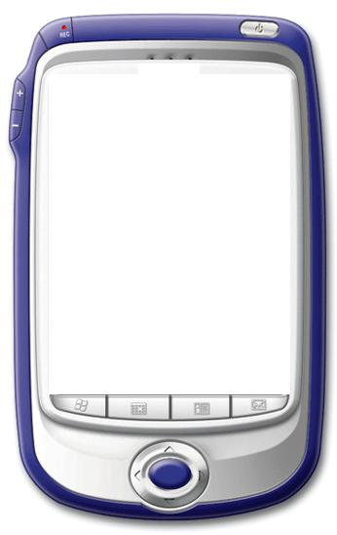
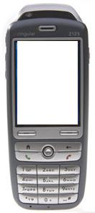
COLLABORATIVE APPLICATION
A user’s output can be influenced by the input of at least one other user
Application
User inputs “draw red circle”
Or a user’s input can influence the output of at least one other user
U1
U2
U3
Coupling
Coupling
Why collaborative applications?

Slide 10
TOWARDS BEING THERE
Face-to-face Interaction
Computer Supported Interaction
Network

Slide 11
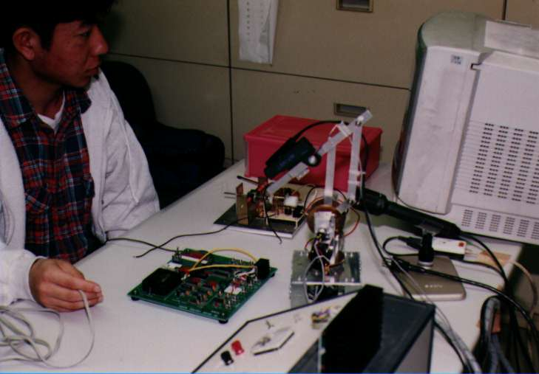
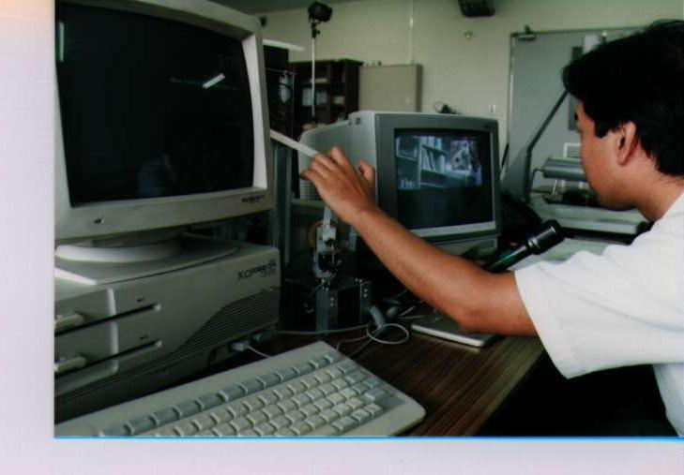
GESTURECAM: REMOTE SURROGATE
Control GestureCam in another location
Both users see what the GestureCam is “looking” at on TV screens
Controller can “zoom in” visually and physically to point at an item

Slide 12
TOWARDS BEING THERE
Face-to-face Interaction
Computer Supported Interaction
Network
Computer Supported < Face to Face
Second best – used to overcome time and cost constraints

Slide 13
BENEFIT: BEYOND BEING THERE
Face-to-face Interaction
Hollan & Stornetta
Computer Supported Interaction
Network
Computer Supported > Face to Face
Use it even when face to face option available

Slide 14
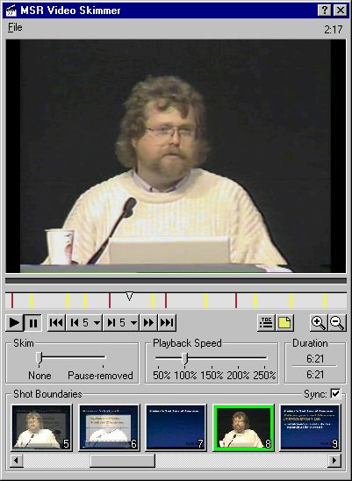
MEETING VIDEO BROWSING
Basic Video Controls:
Play, Pause, etc.
Beyond Being There
Video Processing
Bookmark Video
Pause Removal
Time Compress Without Changing Pitch
Automatic TOC Generation
Automatic Slide Summaries

Slide 15
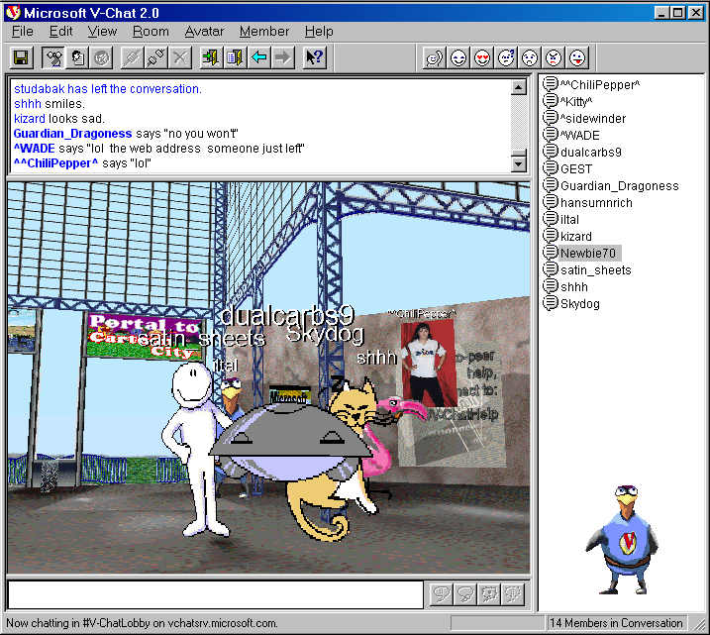
COMBINING BOTH GOALS
Chat Rooms
Toward Being There
Feel Transported to a Common Virtual World
Beyond Being There
Avatar Selection
Anonymity

Slide 16
Base Technologies
Application
Interactive → User-Interface
Distributed → Inter-process Communication
U1
U2
Coupling
Coupling
Multi-Threaded

Slide 17
Base Technologies
Collaborative Software
User-Interface Toolkit (Swing/AWT/SWT)
Inter-Process Communication Primitives (RMI/Sockets)
Will learn to apply these technologies and not learn in depth the principles behind them
These technologies are not easy to use!

Slide 18
Class Abstractions
Collaborative Software
Class Library
Class Library
User-Interface Toolkit (Swing/AWT/SWT)
Inter-Process Communication Primitives (RMI/Sockets)
Will provide Java libraries to allow you to focus on the what rather than the how
Java/Object-Oriented Programming!

Slide 19
Collaborative Abstractions vs Applications
Collaborative Applications
Challenges?
Collaborative Abstractions/Toolkit
Class Library
Class Library
User-Interface Toolkit (Swing/AWT/SWT)
Inter-Process Communication Primitives (RMI/Sockets)
Middleware

Slide 20
Base Technologies
Design of coupling UI, algorithms, design patterns, architectures and abstractions
Application
Other functions?
U1
U2
Coupling
Coupling

Slide 21
ISSUES: SEMANTIC
Collab. Function
Description
Session Management
How do distributed users create, destroy, join, and leave collaborative sessions?
Coupling
What is the remote feedback of a user command and when is it given?
Awareness
How are users made aware of uncoupled commands of their collaborators, that is, “out of band” commands?

Slide 22
ISSUES: SEMANTIC
Collab. Function
Description
Access Control
How do we ensure that users do not execute unauthorized commands?
Concurrency Control
How do we ensure that concurrent users do not enter inconsistent authorized commands?

Slide 23
ISSUES: SEMANTIC
Collab. Function
Description
Merging
How do we merge conflicting commands entered by different users?
Undo/Redo
What are the semantics of undo/redo operations in a collaboration session?
Many more!

Slide 24
ISSUES: IMPLEMENTATION
Issue
Description
Objects
What kind of objects are composed in a collaborative application?
Collaboration Awareness
Which of these objects are collaboration aware? How are these objects integrated with existing collaboration-unaware objects?
Concurrency
How is the application decomposed into concurrent threads?
Distribution
How are the application objects placed on different hosts?

Slide 25
ISSUES: IMPLEMENTATION
Issue
Description
Replication/Migration
Which of these objects are centralized (in a server) and which are replicated (on peers)?
Performance
What kind of services are provided to overcome jitter and latency?
Many more!

Slide 26
Layered Assignments = Project
Assignment 4
Assignment 3
Assignment 2
Assignment 1
Assignments will build on each other to create a semester project
Due dates normally separated by two weeks (holidays, exams can cause more separation)

Slide 27
Getting Help
Can discuss solutions with each other at a high level
Not at the code level
Sharing of code is honor code violation
Can help each other with debugging as long as it does not lead to code sharing
Will give algorithms for assignments

Slide 28
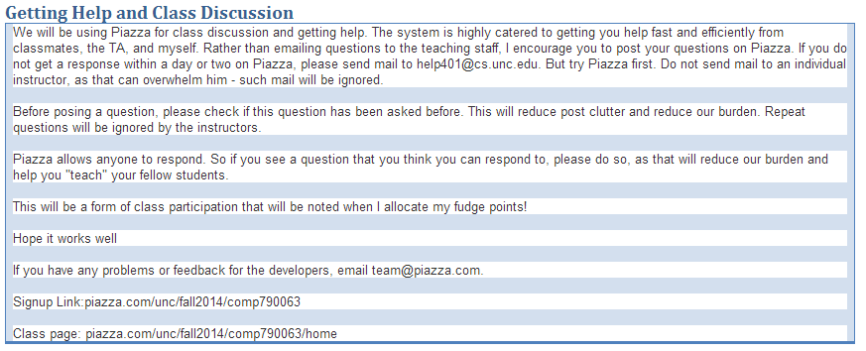
Piazza for Getting Help and Class Discussion

Slide 29
Grade Distribution
Exams (Two midterms, no final) | 40%
Assignments (Home work) | 60%
Fudge Factor (Class/piazza participation, other distinguishing factors), particularly useful for borderline cases | 10%
Project Heavy but No final!

Slide 30
Projects
Demo of Projects

