Slide 1
Anatomy of an Interactive Application
Prasun Dewan
Department of Computer Science
University of North Carolina at Chapel Hill
dewan@cs.unc.edu
Code available at: https://github.com/pdewan/ColabTeaching

Slide 2
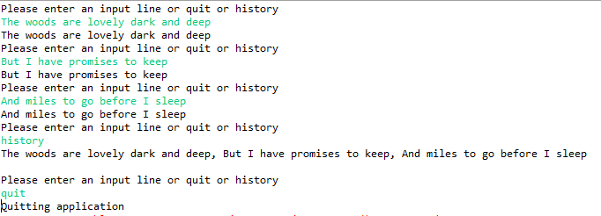
Single-User UI: An Input Echoer
Displays arbitrary number of messages entered by the user.
Echoes input until user enters “quit”

Slide 3
Implementation: Main Method
public class MonolithicEchoer {
protected static List<String> history = new ArrayList();
public static void main(String[] anArgs) {
for (;;) {
System.out.println(PROMPT);
Scanner scanner = new Scanner(System.in);
String nextInput = scanner.nextLine();
if (nextInput.equals(QUIT)) {
processQuit();
break;
} else if (nextInput.equals(HISTORY))
printHistory();
else
processInput(nextInput);
}
}
Data
UI
Issues with this implementation?
The UI and data are both in one class

Slide 4
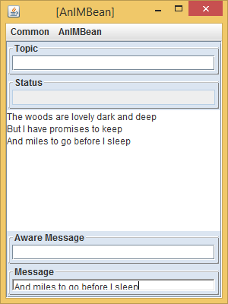
Multiple User-Interfaces
A single user may or may not want multiple user interfaces
Different users are very likely to want multiple user interfaces unless all of them are sharing the exact same state through desktop/window sharing
Collaboration ➔ Data/UI Separation

Slide 5
Separation of Concerns
History Semantics
History Semantics
History Display 1
History Display 2
Can change display without changing other aspects of history
Display and semantics should go in different classes

Slide 6
Separation of Concerns
A
A
B
B’
if a part B of a class can be changed without changing some other part A of the class, then refactor and put A and B in different classes

Slide 7
Model/Interactor(Editor, View) Pattern
Interactor/Editor/View
UI Code
Computation Code
Model
Interactor(Editor, View) = MVC View + MVC Controller

Slide 8
Multiple Consistent Interactors
Observable (Listenable)
Observer (Listener)
Input Entered
Model Changed
Interactor 1
Output Shown
Model
Interactor 2
Interactor 3
Changed observable notifies observers in a subpattern
Interactor 4
Change Announced

Slide 9
List Model
public class ASimpleList<ElementType>
implements SimpleList<ElementType> {
List<ElementType> simpleList = new ArrayList();
List<ListObserver<ElementType>> observers = new ArrayList();
public void add(ElementType anElement) {
simpleList.add(simpleList.size(), anElement);
}
public void observableAdd(int anIndex, ElementType anElement) {
add(anIndex, anElement);
notifyAdd(anIndex, anElement);
}
public void notifyAdd(List<ListObserver<ElementType>> observers,
int index, ElementType newValue) {
for (ListObserver<ElementType> observer:observers)
observer.elementAdded(index, newValue);
}
…
}
History ArrayList encapsulated
Observer list
Model Changed
Change Announced
UI Unaware Code

Slide 10
List Interactor
public class AnEchoInteractor implements EchoerInteractor {
protected SimpleList<String> history;
public AnEchoInteractor(SimpleList<String> aHistory) {
history = aHistory;
}
…
protected void processInput(String anInput) {
addToHistory(computeFeedback(anInput));
}
protected void addToHistory(String newValue) {
history.observableAdd(newValue);
}
public void elementAdded(int anIndex, Object aNewValue) {
displayOutput(history.get(anIndex));
}
protected void displayOutput(String newValue) {
System.out.println(newValue);
}
…
Model bound
Input Entered
Model Changed
Change Announced
Output Displayed
Who created and connected the model and interactor

Slide 11
Composer
public class AnEchoComposerAndLauncher implements EchoerComposerAndLauncher{
protected SimpleList<String> history;
protected EchoerInteractor interactor;
// factory method
protected SimpleList<String> createHistory() {
return new ASimpleList();
}
// factory method
protected EchoerInteractor createInteractor() {
return new AnEchoInteractor(history);
}
protected void connectModelInteractor() {
interactor = createInteractor();
history.addObserver(interactor);
}
…
Model Created
Interactor Created
Interactor Registered

Slide 12
Example
Interactor
size()
ASimpleList
add()
get()
Read methods
Write methods
Write methods send notifications

Slide 13
General Pattern
Interactor
Model
Read methods
Write methods
Write methods send notifications

Slide 14
Model with Multiple Interactors
Interactor 1
Model
Interactor 2
Interactor 3
Interactor 4
Dual?

Slide 15
Interactors with Multiple Models
Interactor 1
Model
Interactor 2
Model
Interactor 3
A UI showing multiple tanks, people, and other models
Interactor 4

Slide 16
Summary of Concepts in Creating Extensible Interactive Application
Collaborative ➔ Multi-View Apps
Separation of Computation and UI Code
Model /Interactor Pattern
Observer/Observable Subpattern
A model can have multiple interactors and vice versa

Slide 17
Next
Interactor
Types of interactors?
Model
Types of models?

