Slide 1
Types of Models
Prasun Dewan
Department of Computer Science
University of North Carolina at Chapel Hill
dewan@cs.unc.edu
Code available at: https://github.com/pdewan/ColabTeaching

Slide 2
Pre-Requisites
Model-Interactor Separation

Slide 3
Model Types
Interactor
Model
Types of models?

Slide 4
General Pattern
Interactor
Model
Read methods
Write methods

Slide 5
Example
Interactor
size()
ASimpleList
add()
get()
Read methods
Write methods

Slide 6
List Models
Interactor
size()
List Model
add()
get()
delete()
Read methods
Write methods
Models define methods to read and write indexed elements in variable length lists
They differ in the set of write methods

Slide 7
Logical vs. Physical Structure
public class ASimpleList<ElementType>
implements SimpleList<ElementType> {
List<ElementType> simpleList = new ArrayList();
List<ListObserver<ElementType>> observers = new ArrayList();
public void add(ElementType anElement) {
simpleList.add(simpleList.size(), anElement);
}
public void observableAdd(int anIndex, ElementType anElement) {
add(anIndex, anElement);
notifyAdd(anIndex, anElement);
}
public void notifyAdd(List<ListObserver<ElementType>> observers,
int index, ElementType newValue) {
for (ListObserver<ElementType> observer:observers)
observer.elementAdded(index, newValue);
}
…
}
ArrayList→Array?
Replacing array list with array does not change logical structure of model, which is determined by public methods

Slide 8
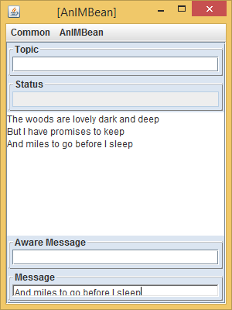
Other Models?
Interactor
Other important kinds of models?
size()
List Model
add()
get()
delete()
Read methods
Write methods
Models define methods to read and write indexed elements in variable length lists
They differ in the set of write methods

Slide 9
Bean Models
Interactor
getP1()
Bean Model
setP1()
getP2()
setP2()
Read methods
Write methods
Models define getter and setter methods to read fixed number of typed properties

Slide 10
Read-only and Editable Properties
Typed, Named Unit of Exported Object State
public class C
{
Name P
Type T
Bean
public T getP() {
...
}
Read-only
Editable
public void setP(T newValue) {
...
}
Getter method
Setter method
Bean convention:
For humans and tools
}
obtainP
Violates Bean convention
newP

Slide 11
Indexed Bean
Bean also defines fixed length indexed collections which we will ignore

Slide 12
Model Composition
Bean Model
List Model
Bean Model
Bean Model

Slide 13
Composing History Model
We already have a model for History

Slide 14
Example Model Composition
IM Bean Model
Simple List<String>
Simple List<Character>
History
Topic

Slide 15
Connecting Model/Interactor Hierarchies
Model
Interactor
Model
Model
Interactor
Interactor
A model subtree can be connected to a single interactor
Bean Model
A model can be connected to an interactor subtree

Slide 16
Summary of Models
Lists
Variable length indexed lists
Differ based on subsets of list operations exposed
Beans
Property collections
Differ in properties
Table model is another important kind not needed in this course
Model composition
Useful when user interfaces are composed
Model hierarchies can be connected to interactor hierarchies in arbitrary ways

