Slide 1

Traceable Algorithms
Prasun Dewan
Department of Computer Science
University of North Carolina at Chapel Hill
dewan@cs.unc.edu
Code available at: https://github.com/pdewan/ColabTeaching

Slide 2
Pre-Requisites
Model-Interactor Separation

Slide 3
Algorithm vs. Program
Description of solution to a problem.
Can be in any “language”
  graphical
  natural or programming language
  natural + programming language (pseudo code)
Can describe solution to various levels of detail
  A program is an algorithm
  An algorithm may not be a program
Level of detail depends on the task of the reader
  If debugging or maintaining, then depends on which aspect is faulty or being changed
  If describing solution depends on what is considered algorithm challenge

Slide 4
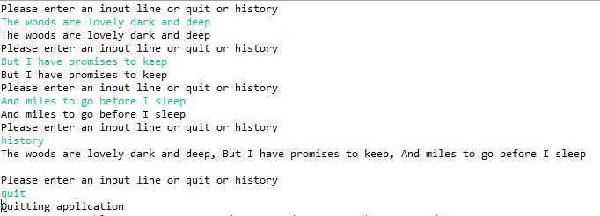
Algorithm
Read input
Algorithm/program separation more useful in monolithic or modular program?
Store input in history
Display input

Slide 5
How Useful in Monolithic Program?
public class MonolithicEchoer {
protected static List<String> history = new ArrayList();
public static void main(String[] anArgs) {
for (;;) {
System.out.println(PROMPT);
Scanner scanner = new Scanner(System.in);
String nextInput = scanner.nextLine();
if (nextInput.equals(QUIT)) {
processQuit();
break;
} else if (nextInput.equals(HISTORY))
printHistory();
else
processInput(nextInput);
}
}

Slide 6
How Useful in Monolithic Program?
protected static void processInput(String anInput) {
String aFeedback = EchoUtilities.echo(anInput);
addToHistory(aFeedback);
displayOutput(aFeedback);
}
protected static void displayOutput(String newValue) {
System.out.println(newValue);
}
protected static void addToHistory(String newValue) {
history.add(history.size(), newValue);
}
}

Slide 7
How Useful in More Modular Program?
public class ASimpleList<ElementType>
implements SimpleList<ElementType> {
List<ElementType> simpleList = new ArrayList();
List<ListObserver<ElementType>> observers = new ArrayList();
public void add(ElementType anElement) {
simpleList.add(simpleList.size(), anElement);
}
public void observableAdd(int anIndex, ElementType anElement) {
add(anIndex, anElement);
notifyAdd(anIndex, anElement);
}
public void notifyAdd(List<ListObserver<ElementType>> observers,
int index, ElementType newValue) {
for (ListObserver<ElementType> observer:observers)
observer.elementAdded(index, newValue);
}
…
}

Slide 8
How Useful in More Modular Program?
public class AnEchoInteractor implements EchoerInteractor {
protected SimpleList<String> history;
public AnEchoInteractor(SimpleList<String> aHistory) {
history = aHistory;
}
…
protected void processInput(String anInput) {
addToHistory(computeFeedback(anInput));
}
protected void addToHistory(String newValue) {
history.observableAdd(newValue);
}
public void elementAdded(int anIndex, Object aNewValue) {
displayOutput(history.get(anIndex));
}
protected void displayOutput(String newValue) {
System.out.println(newValue);
}
…

Slide 9
How Useful in More Modular Program?
public class AnEchoComposerAndLauncher implements EchoerComposerAndLauncher{
protected SimpleList<String> history;
protected EchoerInteractor interactor;
// factory method
protected SimpleList<String> createHistory() {
return new ASimpleList();
}
// factory method
protected EchoerInteractor createInteractor() {
return new AnEchoInteractor(history);
}
protected void connectModelInteractor() {
interactor = createInteractor();
history.addObserver(interactor);
}
…
Modularity scatters algorithm among multiple objects
Need for higher-level algorithm more in multi-class programs
With observer pattern and interfaces sometimes algorithm not known until runtime

Slide 10
Which Comes First?
Algorithm
Program
→
←
Top-down, bottom-up, middle-out

Slide 11
Separate?
Algorithm
Program
Can get inconsistent
Embellish the program with the algorithm

Slide 12
In-Line Algorithm
protected static void processInput(String anInput) {
// received input
String aFeedback = EchoUtilities.echo(anInput);
addToHistory(aFeedback);
// added input to history
displayOutput(aFeedback);
// displayed the input
}
Can extract comments from code to view algorithm
Do not get a linear path from scattered objects

Slide 13
Print Statements
protected static void processInput(String anInput) {
System.out.println("received input");
EchoUtilities.echo(anInput);
addToHistory(aFeedback);
System.out.println("added input to history");
displayOutput(aFeedback);
System.out.println("displayed the input");
}
Can get a linear path
Cannot disable them easily
Cannot separate them from other output

Slide 14
Tracing with Debugger
Debugger makes it difficult to test race conditions
Cannot see the history of actions
Break points do not transfer to another computer
No static documentation

Slide 15
Logging Frameworks
Log rather than print traces
Can display selected portions of the log
Can separate log output from the rest
Will describe log framework developed before Java’s

Slide 16
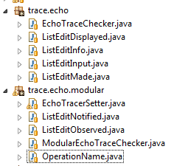
Special Class for Each Algorithm Step/Event
Trace objects and source code in separate packages
Info vs. Warnings vs Error
Algorithm steps can be in separate packages
Settings for checkers
Algorithm steps associated with checkers based on event and source
Concrete events vs. Abstract Classes
Each trace event object has a source or announcer

Slide 17
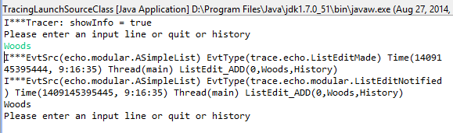
Source Class Filtering
Why ListEditMade and ListEditNotified and not other events
All events fired by (instances of) ASimpleList.class
Tracer.showInfo(true);
Tracer.setImplicitPrintKeywordKind
(ImplicitKeywordKind.OBJECT_CLASS_NAME);
Tracer.setMessagePrefixKind
(MessagePrefixKind.FULL_CLASS_NAME);
TraceableInfo.setPrintTraceable(true);
TraceableInfo.setPrintSource(true);
TraceableInfo.setPrintTime(true);
TraceableInfo.setPrintThread(true);
Tracer.setKeywordPrintStatus(ASimpleList.class, true)
Can enumerate multiple classes
Alternative to class-based filtering?

Slide 18
Separate? (Review)
Algorithm
Program
Can get inconsistent
Embellish the program with the algorithm

Slide 19
Special Class for Each Algorithm Step/Event
Each trace event object has a source or announcer

Slide 20
Source Class Filtering
Why ListEditMade and ListEditNotified and not other events
All events fired by (instances of) ASimpleList.class
Tracer.showInfo(true);
Tracer.setImplicitPrintKeywordKind
(ImplicitKeywordKind.OBJECT_CLASS_NAME);
Tracer.setMessagePrefixKind
(MessagePrefixKind.FULL_CLASS_NAME);
TraceableInfo.setPrintTraceable(true);
TraceableInfo.setPrintSource(true);
TraceableInfo.setPrintTime(true);
TraceableInfo.setPrintThread(true);
Tracer.setKeywordPrintStatus(ASimpleList.class, true)
Can enumerate multiple classes
Alternative to source-based filtering?

Slide 21
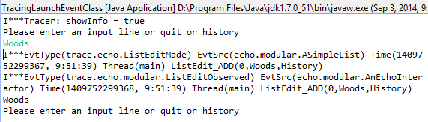
Event Class Filtering
All events of type ListEditMade or ListEditObserved
Tracer.showInfo(true);
Tracer.setImplicitPrintKeywordKind
(ImplicitKeywordKind.OBJECT_CLASS_NAME);
Tracer.setMessagePrefixKind
(MessagePrefixKind.FULL_CLASS_NAME);
TraceableInfo.setPrintSource(true);
TraceableInfo.setPrintTime(true);
TraceableInfo.setPrintThread(true);
Tracer.setKeywordPrintStatus(ListEditMade.class, true);
Tracer.setKeywordPrintStatus(ListEditObserved.class, true);
Can be announced by different sources
Alternative (source/event) class-based filtering?

Slide 22
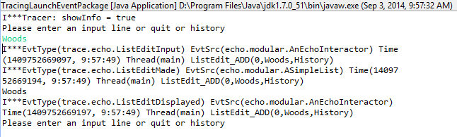
Package-based Filtering
All events of types that are in the package of ListEditMade
Tracer.showInfo(true);
Tracer.setImplicitPrintKeywordKind
(ImplicitKeywordKind.OBJECT_PACKAGE_NAME);
Tracer.setMessagePrefixKind
(MessagePrefixKind.FULL_CLASS_NAME);
TraceableInfo.setPrintSource(true);
TraceableInfo.setPrintTime(true);
TraceableInfo.setPrintThread(true);
Tracer.setKeywordPrintStatus(ListEditMade.class, true);
Filtering by class and package in other contexts?

Slide 23
Assertions
public double getBMI() {
assert weight > 0 && height > 0:“height and weight should be >0”;
return weight/(height*height);
}
Assertion error is like exception, but it can be disabled
java –ea assignment9.MainClass –da bus.uigen
Can enable/disable assertions for specific classes and packages
Enable assertions for MainClass
Disable assertions for bus.uigen package
Similarity between trace objects and assertions is not a coincidence as both support disablable testing
State vs events

Slide 24
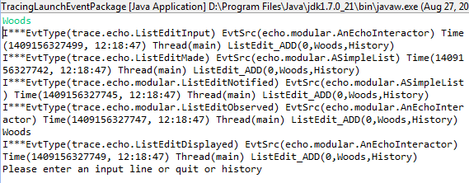
Trace Object vs. Events
a la event type, class of object
a la event firing, source object
computed automatically
a la event parameters
Announcing a trace object is “asserting” an algorithm event

Slide 25
Example Traceable Event Class
Message to be printed
public class ListEditInput extends ListEditInfo{
public ListEditInput(String aMessage,
OperationName anOperationName, int anIndex,
Object anElement, String aList, Object aFinder) {
super(aMessage, anOperationName, anIndex,
anElement, aList, aFinder);
}
…
public static ListEditInput newCase(
OperationName anOperationName, int anIndex,
Object anElement, String aList, Object aFinder) {
String aMessage = toString(anOperationName, anIndex,
anElement, aList);
ListEditInput retVal = new ListEditInput(aMessage,
anOperationName, anIndex, anElement, aList, aFinder);
retVal.announce();
return retVal;
}
Step-specific parameters
Network wide list name
Finder: source object that created that step
Thread and time automatically computed
Static method to construct a message from the other args and to log the object

Slide 26
Traceable Event Creation
protected static void processInput(String anInput) {
ListEditInput.newCase(OperationName.ADD, history.size(),
anInput, ApplicationTags.HISTORY,
MonolithicEchoer.class);
String aFeedback = EchoUtilities.echo(anInput);
addToHistory(aFeedback);
ListEditMade.newCase(OperationName.ADD, history.size(),
anInput, ApplicationTags.HISTORY,
MonolithicEchoer.class);
displayOutput(aFeedback);
ListEditDisplayed.newCase(OperationName.ADD,
history.size(), anInput, ApplicationTags.HISTORY,
MonolithicEchoer.class);
}
Source of static (instance) methods is class (instance)
Can go from code to typed algorithm steps
Algorithm step to code?

Slide 27
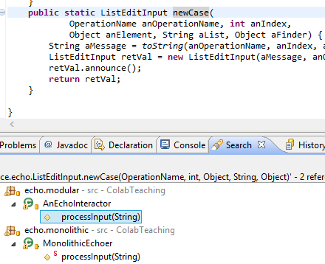
Find all uses of a Method

Slide 28
Formal Algorithm Description and Testing?
LauncherOfMonolithicEchoTester
LauncherOfModularEchoTester
How is testing done today?

Slide 29
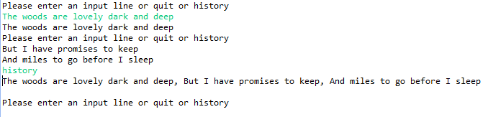
I/O Diff-Based Testing
Compare “correct” transcript with test transcript
No creativity allowed in implementation defined I/O such as debugging statements and prompts
Cannot distinguish between algorithms that have the same I/O behavior – e.g. monolithic and modular echo
Thread scheduling and other non determinism can effect the trace of a correct algorithm

Slide 30
Trace Diffs
Compare “correct” trace with test trace
Can use filtering to test algorithms at multiple levels of abstractions and different aspects of algorithms
No formal description of algorithm – who checks the correct implementation

Slide 31
Inter-Trace vs Intra-Trace
Find relationships among steps within a trace
Other aspects of the trace such as source may have relationships
User input should be followed by a certain sequence of events which are different for different algorithms
The arguments of these events should have certain relationships

Slide 32
Monolithic Specification and testing
For each input I
I should be followed by ListEditInput, ListEditMade, and ListEditDisplayed
The operation name, index, element, and list should be the same in the events above
The element should be echo(I)

Slide 33
Modular Specification and Testing
For each input I
I should be followed by ListEditInput, ListEditMade, ListEditNotified, ListEditObserved, and ListEditDisplayed
The operation name, index, element, and list should be the same in the events above
The element should be echo(I)
The source of ListEditNotified and ListEditObserved should be different
The source of other objects can also be different as a model/interactor may be divided into multiple submodels/interactors
A program that passes the modular tester will pass the monolithic tester
Demoed OT algorithm was tested using traces

Slide 34
Summary
Algorithm needed for understanding programs, testing, debugging
Modularity increases need as steps scattered through many classes
Important to be able to tie program to algorithm and keep them consistent
Prints cannot be disabled and easily separated from real output,
Debugging does not support race conditions and does not provide persistent tracing
Untyped-event log can be turned off and on and filtered based on keyword, class, package
Typed events allow algorithm steps to be in separate packages, filtering by event type, and ways to find implementations of a step
Inter-trace diffs allow algorithm rather than I/O comparisons
Intra-trace processing allows specification of algorithms and testing without correct traces.

Slide 35
Not Covered
Types events can be listened through a message bus
A message bus connects observers to observables
Can block events when certain conditions are met
Less heavweight untyped traces also possible
Following slides from previous class cover this
  They duplicate some of the material here

Slide 36
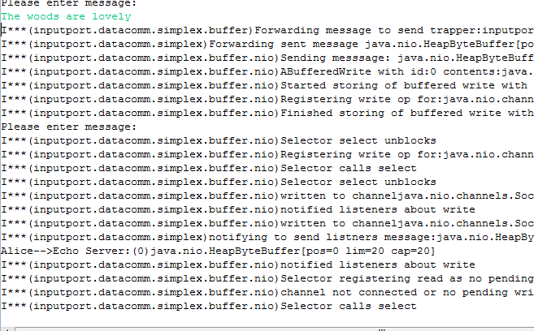
Trace
Tracer.showInfo(true");
May not want to to know about nio
Filtering: Selecting which events to print?

Slide 37
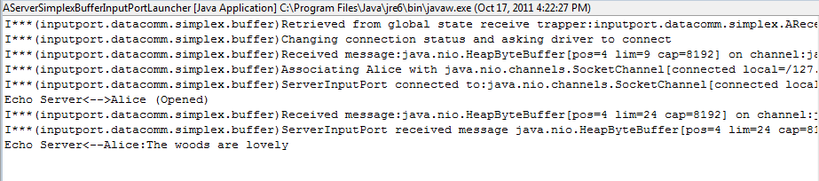
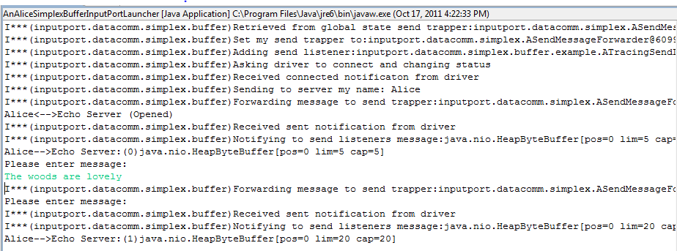
Only InputPort.DataComm.Simplex.Buffer

Slide 38
Explicit Keywords
public static void info(String keyWord, String info);
Tracer.info(“inputport.datacomm.simplex.buffer", "Asking driver to connect and changing status");
public static void setKeywordPrintStatus(
String keyWord,
Boolean status);
Tracer.setKeywordPrintStatus(“inputport.datacomm.simplex.buffer", true)
Tracer.setKeywordPrintStatus(Tracer.ALL_KEYWORDS, false);
Have to specify package name each time
Package name can change

Slide 39
Implicit KeyWords
public static void info(Object object, String info);
Tracer.info(this, "Asking driver to connect and changing status");
public static void setKeywordPrintStatus(Class c, Boolean status);
Tracer.setKeywordPrintStatus(
AGenericSimplexBufferClientInputPort.class,
false);

Slide 40
Showing Package Names
Cannot identify classes of the objects printing out messages
Need to not only specify which events to display but what information to display about each event
Tracer.showInfo(true);
Tracer.setKeywordPrintStatus(Tracer.ALL_KEYWORDS, false);
Tracer.setKeywordPrintStatus(
AGenericSimplexBufferClientInputPort.class, true);
Tracer.setMessagePrefixKind(MessagePrefixKind.PACKAGE_NAME);

Slide 41
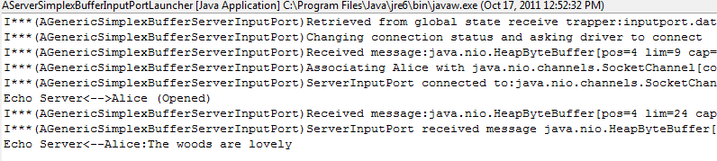
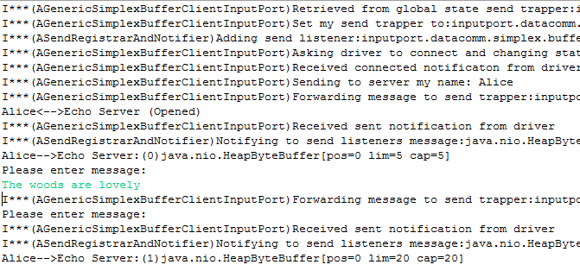
Showing Short Class Names
Tracer.showInfo(true);
Tracer.setKeywordPrintStatus(Tracer.ALL_KEYWORDS, false);
Tracer.setKeywordPrintStatus(
AGenericSimplexBufferClientInputPort.class, true);
Tracer.setMessagePrefixKind(MessagePrefixKind.SHORT_CLASS_NAME)

Slide 42
MessagePrefix
public static void setMessagePrefixKind(
MessagePrefixKind newValue)
public enum MessagePrefixKind {
NONE,
OBJECT_TO_STRING,
SHORT_CLASS_NAME,
FULL_CLASS_NAME,
PACKAGE_NAME
}

Slide 43
Displaying All Classes in Package
Tracer.showInfo(true);
Tracer.setKeywordPrintStatus(Tracer.ALL_KEYWORDS, false);
Tracer.setKeywordPrintStatus(
AGenericSimplexBufferClientInputPort.class, true);
Tracer.setMessagePrefixKind(MessagePrefixKind.SHORT_CLASS_NAME)
What if we want to focus on one class?
Narrow down which events

Slide 44

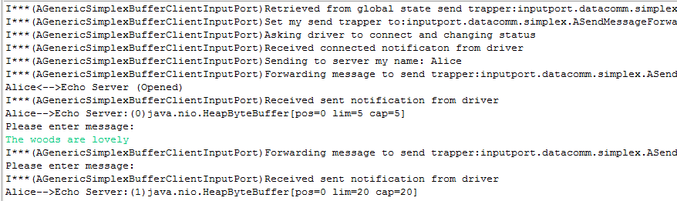
Controlling Implicit Keyword
Tracer.showInfo(true);
Tracer.setKeywordPrintStatus(Tracer.ALL_KEYWORDS, false);
Tracer.setImplicitKeywordKind(ImplicitKeywordKind.OBJECT_CLASS_NAME);
Tracer.setKeywordPrintStatus(
AGenericSimplexBufferClientInputPort.class, true);
Tracer.setMessagePrefixKind(MessagePrefixKind.SHORT_CLASS_NAME);

Slide 45
Implicit Keyword
public static void setImplicitKeywordKind(
ImplicitKeywordKind newValue)
public enum ImplicitKeywordKind {
OBJECT_TO_STRING,
OBJECT_CLASS_NAME,
OBJECT_PACKAGE_NAME
}

Slide 46
Tracer Static Methods Summary
setKeywordPrintStatus(String keyWord Boolean status);
info(String keyWord, String info);
setImplicitKeywordKind(ImplicitKeywordKind newValue)
info(Object obj, String info);
public enum ImplicitKeywordKind {
OBJECT_TO_STRING,
OBJECT_CLASS_NAME,
OBJECT_PACKAGE_NAME
}
setKeywordPrintStatus(Class cls, Boolean status);
public enum MessagePrefixKind {
NONE,
OBJECT_TO_STRING,
SHORT_CLASS_NAME,
FULL_CLASS_NAME,
PACKAGE_NAME
}
setMessagePrefixKind(MessagePrefixKind newValue)

Slide 47
Debugging Capabilities in Tracer?
Blocking but separate windows for different processes
See state at traced actions (with and without blocking)
Separate state for different threads (with and without blocking)
Have application-specific code learn about traced calls (perhaps in different processes)

Slide 48
Tracing Strings→Objects
setKeywordPrintStatus(String keyWord Boolean status);
info(String keyWord, String info);
setImplicitKeywordKind(ImplicitKeywordKind newValue)
info(Object obj, String info);
public enum ImplicitKeywordKind {
OBJECT_TO_STRING,
OBJECT_CLASS_NAME,
OBJECT_PACKAGE_NAME
}
setKeywordPrintStatus(Class cls, Boolean status);
public enum MessagePrefixKind {
NONE,
OBJECT_TO_STRING,
SHORT_CLASS_NAME,
FULL_CLASS_NAME,
PACKAGE_NAME
}
setMessagePrefixKind(MessagePrefixKind newValue)

Slide 49
String→Object
@DisplayToString(true)
@ComponentWidth(1000)
public class MVCTraceableInfo extends TraceableInfo{
public MVCTraceableInfo(String aMessage, Object anAnnouncer) {
super(aMessage, anAnnouncer);
}
public static MVCTraceableInfo newInfo(String aMessage, Object aFinder) {
MVCTraceableInfo retVal = new MVCTraceableInfo(aMessage, aFinder);
retVal.announce();
return retVal;
}
}
Tracer.info(this, “MVC structure built”)
MVCTraceableInfo( “MVC structure built”, this);

Slide 50
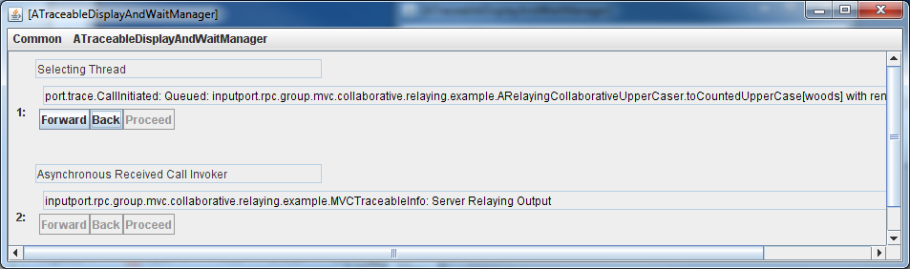
Tracing Objects
TraceableBus
newEvent ()
addTraceableListener()
Event Announcer Thread
AWT Thread
ATraceable DisplayAndWaitManager
newEvent ()
Traceable
Listener ()
Traceable
ObjectEditor.edit(
TraceableDisplayAndWaitManagerFactory.
getTraceableDisplayAndPrintManager());
announce()
synchronized waitForUser()
ASingleStepperAndListBrowser
synchronized proceed()
wait()
notify()

Slide 51
Message Bus
TraceableBus
newEvent ()
addTraceableListener()
Like an observable it has registration method
Has an announce method
Does not generate events – simply communicates them to observers

Slide 52
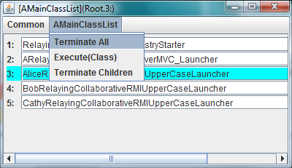
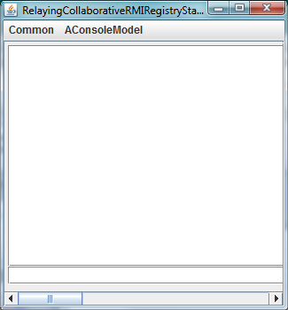
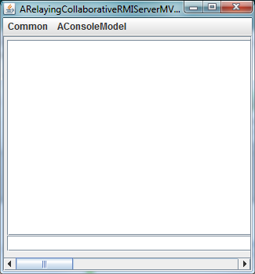
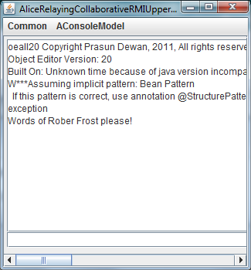
Run Functionality

Slide 53
Debug Functionality
public ADuplexRPCClientRelayingCollaborativeMVCLauncher(
String aClientName, String aServerHost,
String aServerId, String aServerName) {
super(aClientName, aServerHost, aServerId, aServerName);
ObjectEditor.edit
(TraceableDisplayAndWaitManagerFactory.
getTraceableDisplayAndPrintManager());
Tracer.setKeywordDisplayStatus(this, true);
}

Slide 54
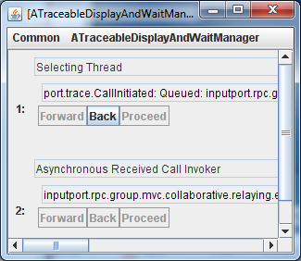
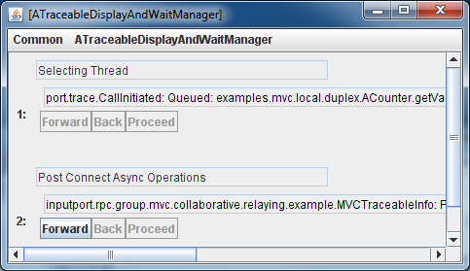
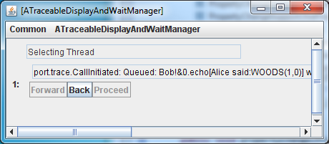
Each Process Can Have Separate Trace Window
Server
Alice
Bob

Slide 55
Each Trace Window has Separate Thread Area
Thread interacting with underlying communication channel
Thread invoking remote calls

Slide 56
Thread display
Thread name
Other info

Slide 57
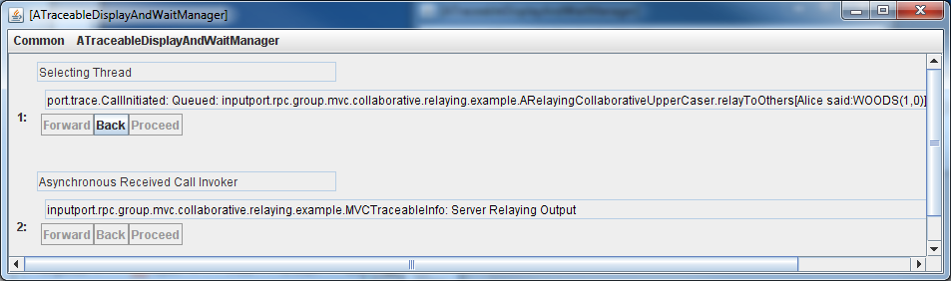
Goals
Set break point
Debugger allows programmer to set breakpoint, resume, and at each breakpoint, pause and see stack trace, variable values, and console message when some line of code is executed
BP Resume
BP Console message
Tracer should provide equivalent
BP Variable Values

Slide 58
Console output Equivalent: Typed Tracing Message
GIPC-Defined Call Initiated Type
Instance specific message
Programmer-defined MVCTraceable Type
Instance specific message
getMessage()
Traceable
announce()
setMessage()

Slide 59
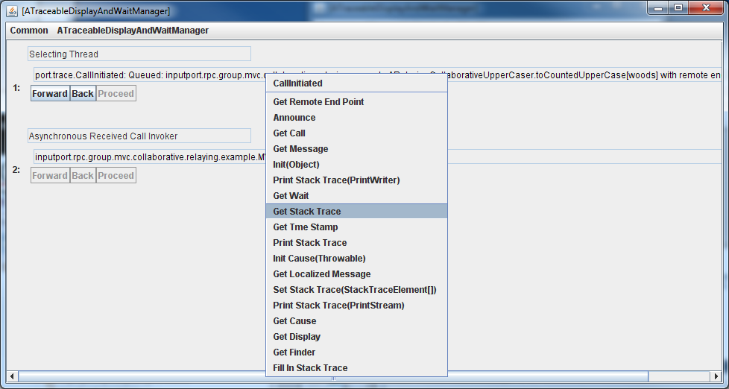
Stack Trace Equivalent: Stack Trace

Slide 60
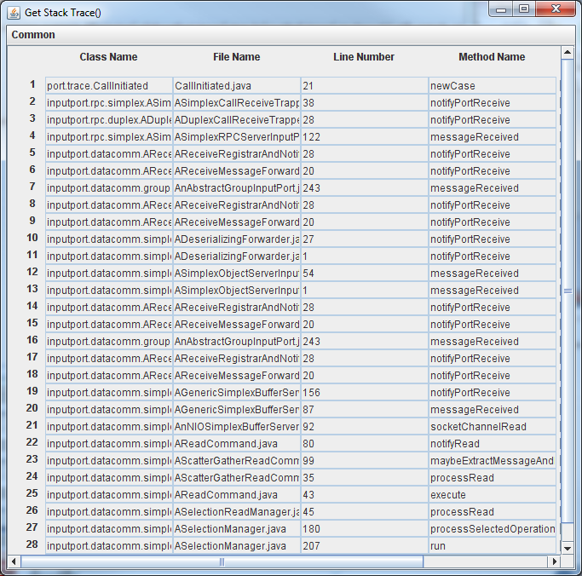
Stack Trace Display
Display of StackTrace Object

Slide 61
Inheritance Hierarchy
getStackTrace()
RuntimeException
IS-A
getMessage()
Traceable
announce()
setMessage()

Slide 62
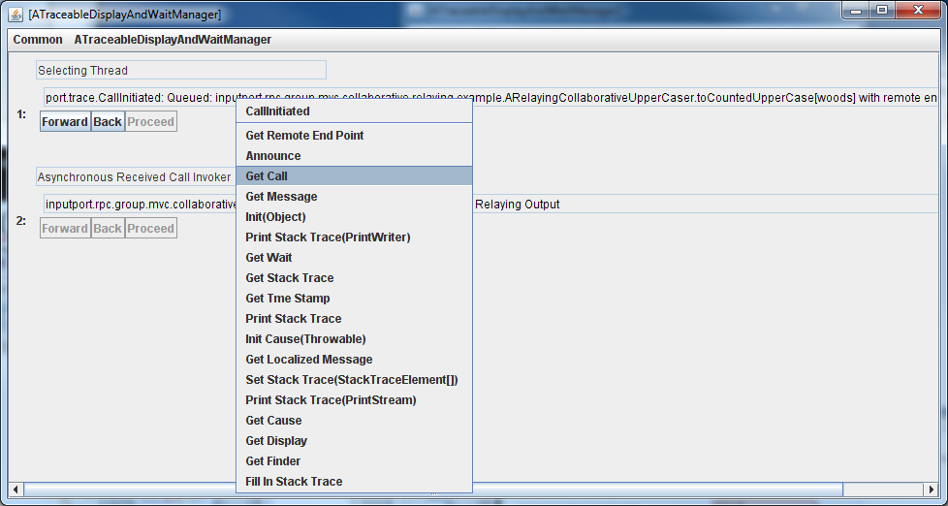
Exploring Variables: Event Properties
Can see properties of event by calling getters

Slide 63
Thread Has History of Typed Trace Info
Thread interacting with underlying communication channel

Slide 64
Browsing: Last to Last Call

Slide 65
Resume: Proceed Button

Slide 66
Set Break Point: Pause/Display all Announced Messages?
getMessage()
Traceable
announce()
setMessage()
May want to pause only some of the announcements
May want to display only some of the announcements
How to specify a set of related announcements that should be displayed or paused?

Slide 67
Using Announcer Object Attributes
Tracer
static setKeywordDisplayStatus (Object announcer, boolean status)
static setImplicitDisplayKeywordKind (ImplicitKeywordKind val)
static setImplicitWaitKeywordKind (ImplicitKeywordKind val)
public enum ImplicitKeywordKind {
OBJECT_TO_STRING,
OBJECT_CLASS_NAME,
OBJECT_PACKAGE_NAME }
default
setKeywordDisplay(Wait)Status(announcer, true(false)) says that if an event is announced by an object whose toString()/class/package attribute is that of the announcer then it should be displayed(wait).
Print, Display and Wait are three different things you can do with traced information
setImplicitDisplay(Wait)KeywordKind determines if toString(), class or package attribute is used for all events

Slide 68
Using Event Object
getMessage()
Traceable
announce()
setMessage()
setWait()
setDisplay()
IS-A
MVCTraceable

Slide 69
Debugger Issues Resolved
Debugger makes it difficult to test race conditions
All threads and processes mapped to a single code window
Cannot see the history of actions taken by a thread
Break points do not transfer to another computer
Cannot use a mechanism to set multiple related debug points

Slide 70
Event Class Filtering
Two sources, as the same event fired twice, first by the real source and then by the event object pretending to be the source
All events of type ListEditMade or ListEditObserved
Tracer.showInfo(true);
Tracer.setImplicitPrintKeywordKind
(ImplicitKeywordKind.OBJECT_CLASS_NAME);
Tracer.setMessagePrefixKind
(MessagePrefixKind.SHORT_CLASS_NAME);
TraceableInfo.setPrintSource(true);
TraceableInfo.setPrintTime(true);
TraceableInfo.setPrintThread(true);
Tracer.setKeywordPrintStatus(ListEditMade.class, true);
Tracer.setKeywordPrintStatus(ListEditObserved.class, true);
Can be announced by different sources
Alternative (source/event) class-based filtering?

