Slide 1
Distributed Systems
Instructor: Prasun Dewan (FB 150, dewan@unc.edu)

Slide 2
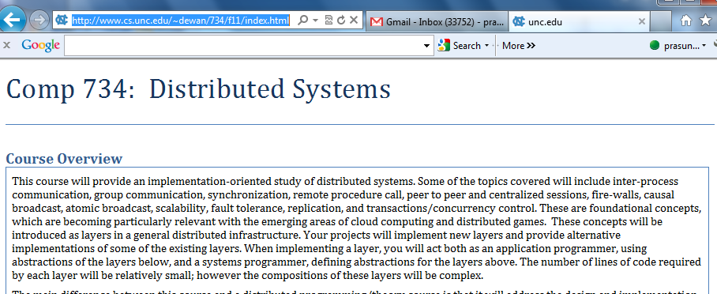
Course Home Page
http://www.cs.unc.edu/~dewan/734/current/index.html

Slide 3
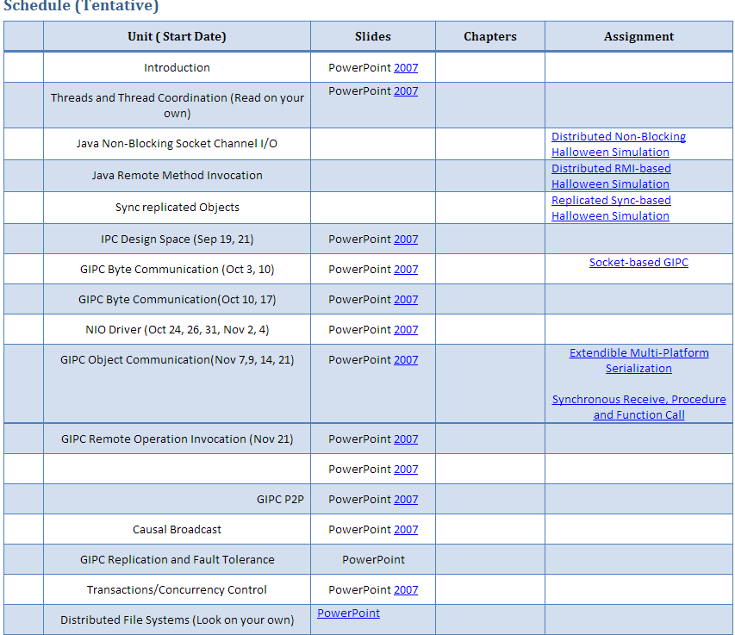
Lectures and Assignments
No book
PPT slides and sometimes word doc
Current assignment is on the web - start working ASAP on it
Outline of other assignments given

Slide 4
Software
Software to be continuously updated

Slide 5
Grade Distribution
Exams (Two midterms, no final) | 40%
Assignments (Home work) | 60%
Fudge Factor (Class participation, other factors) | 10%

Slide 6
Getting Help
Can discuss solutions with each other at a high level
Not at the code level
Sharing of code is honor code violation
Can help each other with debugging as long as it does not lead to code sharing
Assignments may contain solution in English (read only if stuck)

Slide 7
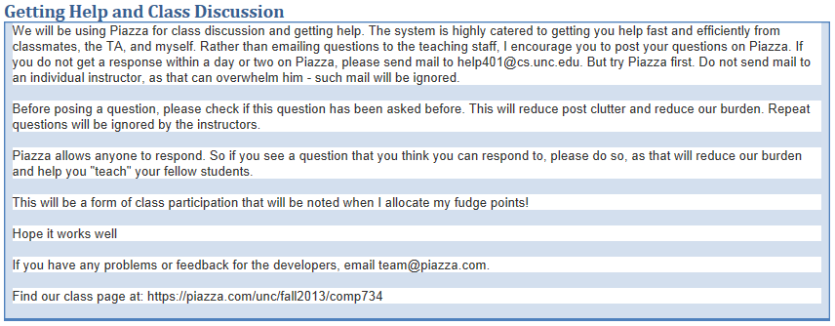
Piazza

Slide 8
Distributed Program?
A program “involving” multiple computers
Specific computers must be bound at run time
→ Program can run on a single computer
Definition involves processes

Slide 9
Program vs. Process vs. Thread
Program
Execution instance
Process
Thread
Thread
Process is execution instance of program, associated with program and memory
Processes are independent activities that can interleave or execute concurrently
Same program can result in multiple processes
Thread is also an independent activity, but within a process, associated with a process and a stack

Slide 10
Distribution of Processes/Threads
Process
Process
Thread
Thread
Thread
Thread
Different processes can execute on different (distributed) computers
Process
Thread
A single process executes on one machine
Thread

Slide 11
Distributed Program
Process
Process
Thread
Thread
Connection
Thread
Thread
Connected process pair : Some computation of a process can be influenced by or influence computation of the other process
Connected process group: each process is coupled to at least one other process in the group
Execution instance
Execution instance
Graph crated by creating pair-wise dependency links is not partitioned– every node reachable from every other node

Slide 12
Logical vs. Physical Inter Process Connection Links
Process
Process
Physical coupling links are physical inter process communication links along which information flows in the network
Thread
Logical Connection
Thread
Thread
Thread
Logical links indicate computational dependencies
Physical m & Logical Connection
Physical & Logical Connection
Can have logical links without physical links
Physical links usually imply logical links
Process
Thread
Relayer
Thread

Slide 13
Distributed Applications
Distributed applications?
Non distributed applications?
In today’s world, what is or should not be distributed?

Slide 14
Some Distributed Domains
Distributed Repositories (Files, Databases)
Remotely Accessible Services (Printers, Desktops)
Collaborative Applications (Games, Shared Desktops)
Distributed Sensing (Disaster Prediction)
Computation Distribution (e.g. Simulations)
Full courses on some of these areas, with concepts specific to them (Distributed Databases, Collaborative Applications)
Will look at domain-independent concepts at the intersection of them
Will not take an application-centric view
Fundamental Issues?

Slide 15
Distribution vs. Concurrency
Process
Process
Connection
Distribution, no fine-grained concurrency
Process
Thread
Concurrency, not distribution
Thread
Process
Thread
Process
Thread
Connection
Distribution and fine-grained concurrency (typical)
Thread
Thread

Slide 16
Non-Distributed vs. Distributed Program
Non-Distributed
Distributed
Creates a single process logically and physically unconnected to any other process
Creates a pair or larger group of connected processes
Must deal with sequential and possibly concurrency issues
Must also deal with distribution and usually concurrency issues

Slide 17
Systems ViewPoint
System
Computer abstractions to implement some class of programs
Operating System
Processes, Files, Memory Management , Threads…,
Database Management System
Query Language, Transactions, …
Programming Languages
Arrays, Loops, Classes, …
Distributed Systems
Data Communication, Remote Procedure Call (RPC), …
RPC assumes communication consists of procedure requests and return value responses
Byte/object communication consists of byte/object of exchange

Slide 18
Distributed Systems
Study of design and/or implementation of computer abstractions for developing distributed programs
Why distributed systems?
Why systems?
Alternatives to understand how to program some domain of applications?
Non distributed programs?

Slide 19
Alternatives to Understanding
Programming: Abstraction use
Programming: Use of a specific set of non distributed abstractions (e.g. , functional, MATLAB programming)
Distributed Programming : Use of a set of distributed abstractions (e.g. Socket/RPC Programming)
Systems: Abstraction design and/or implementation
Design and implementation of non distribution abstractions (Object-Oriented vs. Functional Languages, Compilers/Interpreters)
Design and implementation of distributed system abstractions (e.g. Data Communication /RPC Design and/or Implementation)
Theory: Models and algorithms
Non distributed model and algorithms ( Turing Machines, HeapSort,)
Distributed Models and Algorithms(e.g. 2-Phase commit, Group Comm. Model)

Slide 20
Rationale
Abstraction Design vs. Implémentation
Abstraction design linked to implementation: Designs are done of only efficiently implementable abstractions
Abstractions vs. Theory (Models, Algorithms)
Abstractions are implemented operational models and have (the more) practical algorithms in them
Abstraction Design & Implementation vs. Use
Maturity with design and implementation issues allows you to better understand the semantics of a specific abstraction.
Abstract implementations require advanced programming/ software engineering techniques– “you cant really program if you have not written a compiler”

Slide 21
Teaching Abstraction Design & Implementation?
Lectures address design; assignments, implementation (e.g. Implement a PL interpreter in another PL)
Implementations can be complex and need instruction
Lectures give high-level pseudo code for complex algorithms; assignments full implementation (e.g. compilers)
Pain/gain ratio high, semester barely enough time for compiler
Lectures discuss code for a system of abstractions : assignments extend/modify this code
Code must be understandable and ideally also elegant

Slide 22
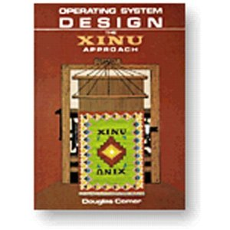
The Xinu Approach to Teaching OS
Layering
Interrupt Management
Approach not used in distributed computing
Thread Communication
Thread Synchronization
Need distributed system layers
Thread Management
Reuse of previous layers keeps code short (and hence presentable in class)
Can unravel a system in stages to a class
Layering good for software engineering as well as pedagogical reasons

Slide 23
Layers Exist in Networking
UDP
TCP/IP
IP
Link-Level Communication
Physical Communication
Physical communication in networking involves machines and used hardware machine addresses
Physical communication in distributed systems is between processes and indicates routing of information among processes

Slide 24
Distributed vs. Network Layers
Networking addresses physical connections and byte communication among processes
Process
Process
Thread
Logical Connection
Thread
Thread
Thread
No separate logical connections, object communication, synchronization, fault tolerance
Physical Connection
Physical Connection
Low-level (hidden from programmers) abstractions
Process
Thread
Thread

Slide 25
Distributed System vs. Networking Abstractions
Programming Language Abstractions
Just as programming language abstractions are built on top of assembly language abstractions
Assembly Language Abstractions
Distributed system abstractions are built on top of networked abstractions
Distributed Abstractions
Networked Abstractions
Knowledge of assembly/networked abstractions important to implement PL/distributed abstractions
Distributed Abstractions
Byte communication APIs, close to networked abstractions, is provided by operating systems (e.g. sockets), which hide networking abstractions
OS Byte Communication API

Slide 26
Domain Independent?
Distributed Repositories (Files, Databases)
Remotely Accessible Services (Printers, Desktops)
Collaborative Applications (Games, Shared Desktops)
Distributed Sensing (Disaster Prediction)
Computation Distribution (e.g. Simulations)
Distributed Abstractions
Will look at domain-independent concepts at the intersection of them
OS Byte Communication API
Even though OS abstractions developed to build distributed OS (file systems), they are by definition domain-independent

Slide 27
Language vs. OS Abstractions
Both operating systems and programming languages provide domain-independent abstractions
Operating systems support processes and language-independent abstractions for accessing protected info and sharing information among processes (files, IPC)
Programming languages must provide fine-grained abstractions needed within a process
They also provide an interface to OS abstractions through libraries or language constructs
They can also extend the OS abstractions (e.g. typed files)

Slide 28
Language vs. OS, Distributed Abstractions
Byte communication is all that operating systems provide
Non distributed programming languages such as C provide only OS abstractions
Distributed programming languages such as Java provide a richer variety of abstractions
Java provides threads and reflection, making it easy to implement our own replacements and extensions of Java abstractions
Will use Java as implementation language
To extend and replace Java abstractions/layers, knowledge of them useful

Slide 29
Objectives
At the end of the course you will …..

Slide 30
Distributed Computing
Distributed Repositories (Files, Databases)
Remotely Accessible Services (Printers, Desktops)
Collaborative Applications (Games, Shared Desktops)
Distributed Sensing (Disaster Prediction)
Computation Distribution (e.g. Simulations)
Internet/Cloud computing increasing relevance of the fundamental concepts

Slide 31
Practical Relevance
For distributed applications, likely to use the code you implemented than existing abstractions
Can send objects over NIO socket channels
Existing Java RPC does not work on Android devices, but the one you implement will
Use Sync, which apparently is the basis of some new Mobile platforms
Will implement many abstractions not part of standard Java

Slide 32
Software Engineering Principles
Classes
Existing classes will be used, inherited but not modified directly
Interfaces
Alternative implementations will create new classes implementing existing interfaces
Factories and Abstract factories
These will allow easy switching between different implementations
Generics
Implementation rather than use of generics to unite buffer and object communication
Will be both a distributed computing and software engineering course

Slide 33
Relevance to OS
Inter-process communication key to design of new OS’s, even non distributed OS
Extensive use of bounded buffers
Will study and use thread synchronization in depth
Will study how distributed OS are implemented
Will gain understanding of fundamental OS concepts except memory management

Slide 34
Introduction to Systems
Systems: Abstraction design and implementation
Design and implementation of non distribution abstractions (Object-Oriented vs. Functional Languages, Compilers/Interpreters)
Design and implementation of distributed system abstractions (e.g. Data Communication /RPC Design and/or Implementation)
Distributed systems covers concepts from many fields

