Slide 1
Comp 734 Distributed Systems
Instructor: Prasun Dewan (FB 150, dewan@unc.edu)

Slide 2
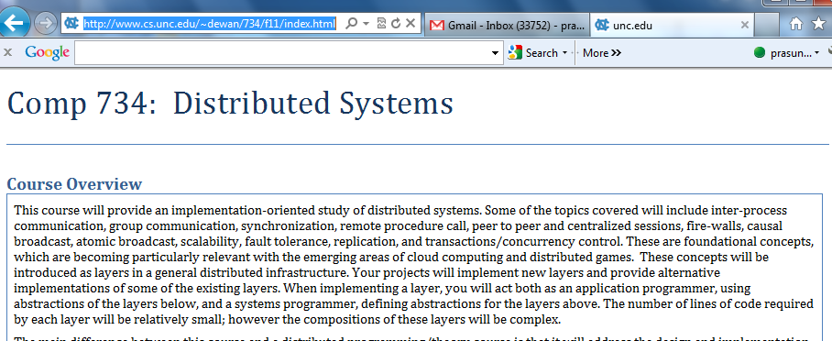
Course Home Page
http://www.cs.unc.edu/~dewan/734/current/index.html

Slide 3
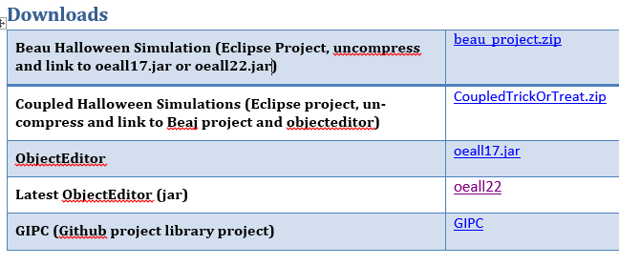
Software

Slide 4
Grade Distribution
Exams (Two midterms, no final) | 40%
Assignments (Home work) | 50%
Class work (10%) | 10%
Fudge Factor (Class participation, other factors) | 10%

Slide 5
Getting Help
Can discuss solutions with each other at a high level
Not at the code level
Sharing of code is honor code violation
Can help each other with debugging as long as it does not lead to code sharing
Assignments may contain solution in English (read only if stuck)

Slide 6
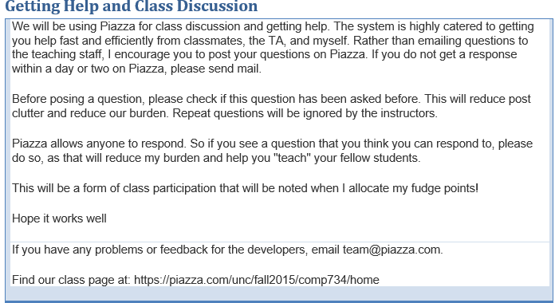
Piazza

Slide 7
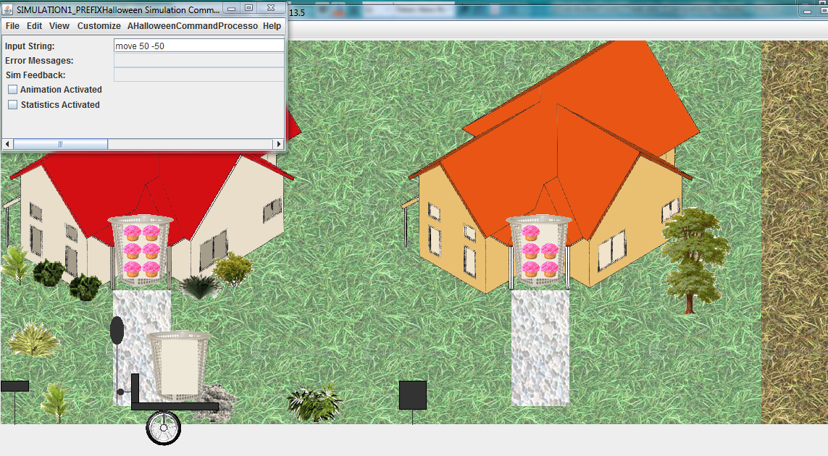
Halloween Simulation
Make Beau Anderson’s 401 Halloween implementation distributed

Slide 8
Use Non Blocking I/O
Distributed Non Blocking Simulation
Existing non distributed simulation
Java NIO

Slide 9
Use Synchronous RMI
Distributed RMI-based Simulation
Existing non distributed simulation
RMI
Java Object Serialization
Sockets

Slide 10
Asynchronous GIPC
Distributed RMI-based Simulation
Existing non distributed simulation
GIPC
Java Object Serialization
Java NIO

Slide 11
Custom Serialization
Distributed RMI-based Simulation
Existing non distributed simulation
GIPC
Custom Serialization (a la Web Services)
Java NIO

Slide 12
Atomic Broadcast and Fault Tolerance
Distributed RMI-based Simulation
Fault Tolerant Atomic Broadcast
Existing non distributed simulation
GIPC
Custom Serialization (a la Web Services)
Java NIO

Slide 13
Inverted Class
Live Atomic Fault Tolerant Lectures
Slides and Youtube videos from Fall 13 offering
Class will involve quizzes, discussion and project work

Slide 14
Lectures and Assignments
Current assignment is on the web - start working ASAP on it

