Slide 1
Distributed Consensus- Part 4: (Dynamic) Centralization
Instructor: Prasun Dewan (FB 150, dewan@unc.edu)

Slide 2
(Semi) Synchronous Consistency Scenarios (Last Slide of Part 3
✓
Multiple client UIs commit to single server
Browser-Sakai
Nested transaction involving multiple logical servers
Travelocity (non replicated)
Physical replication with multiple changers
Diff-based with divergence (Git)
Snapshot-based (Google Drive, OneDrive)
Command-based: replicated state machines (Google Docs, LiveMeeting)
Lock and other meta/configuration state
Live Meeting
Physical mirroring
Akamai
Master (primary)-slave(backup) replication
Master-master replication
Disjoint writes
Overlapping writes
✓
✓
✓
✓

Slide 3
Multi Proposing General
Dawn
Dusk

Slide 4
Coordinating: Multi Proposing General
Dawn
Dusk
Dusk

Slide 5
Synchronous
Acceptors
Proposers
Learners

Slide 6
Centralized-Synchronous
Acceptors
Proposers
Learners

Slide 7
Centralized-Asynchronous
Proposers
Learners

Slide 8
Asynchronous Centralized Algorithm
Meaning of Life
rPropose(1, 42)
rPropose(1, 29)
learn(1,42)
propose(1.42)
learn(1,29)
Value
State
0
42
29
Pending
Consensus
Consensus
1
propose (2, 29)
0
42
29
Consensus
Pending
Consensus
2
0
3
42
29
Consensus
42
0
Consensus
4
29

Slide 9
Synchronous Centralized Algorithm
Meaning of Life
rPropose(1, 42)
rPropose(1, 29)
accept(1,42)
propose(1.42)
accept(1,29)
Value
State
0
Pending
Consensus
1
propose (2, 29)
0
Consensus
Pending
2
0
Pending
3
Consensus
0
Pending
Consensus
4

Slide 10
Synchronous Centralized Algorithm
Meaning of Life
rPropose(1, 42)
Should second pending proposal be accepted?
rPropose(1, 29)
accept(1,42)
propose(1.42)
accept(1,29)
Value
State
0
Pending
Atomic!
Consensus
1
propose (2, 29)
Not serializable
0
Consensus
Pending
2
0
Pending
3
Consensus
0
Pending
Consensus
4

Slide 11
Concurrency Control
put (k¹, v¹)
put (k², v²)
put (k¹, v¹)
put (k¹, v²)
put (k¹, v¹)
del (k¹)
C¹
S
C²
C¹
S
C²
C¹
S
C²
C¹
C²
C¹
C¹
S¹
S²
S¹
S¹
C²
C¹
C²
S¹²
S²¹
S¹²
Non atomic
Atomic
Serializable
Type-independent Concurrency Control

Slide 12
Synchronous Centralized Algorithm (Review)
Meaning of Life
rPropose(1, 42)
Should second pending proposal be accepted?
rPropose(1, 29)
accept(1,42)
propose(1.42)
accept(1,29)
Value
State
0
Pending
Atomic!
Consensus
1
propose (2, 29)
Not serializable
0
Consensus
Pending
2
0
Pending
3
Consensus
0
Pending
Consensus
4

Slide 13
Concurrency Control
put (k¹, v¹)
put (k², v²)
put (k¹, v¹)
put (k¹, v²)
put (k¹, v¹)
del (k¹)
C¹
S
C²
C¹
S
C²
C¹
S
C²
C¹
C²
C¹
C¹
S¹
S²
S¹
S¹
C²
C¹
C²
S¹²
S²¹
S¹²
Non atomic
Atomic
Serializable
Type-independent Concurrency Control

Slide 14
Concurrency Kind
public enum ConcurrencyKind {
NON_ATOMIC,
ATOMIC,
SERIALIZABLE
}

Slide 15
Propose Client and Server
protected void dispatchPropose(float aProposalNumber, StateType aProposal) {
if (!isCentralized ()) {
localPropose(aProposalNumber, aProposal);
} else {
sendProposeRequest(aProposalNumber, aProposal);
}
}
public void remotePropose(float aProposalNumber, StateType aProposal) {
recordProposalState(aProposalNumber, aProposal);
if (someOtherProposalIsPending(aProposalNumber) && isSerializable()) {
sendLearnNotification(aProposalNumber, aProposal,
ProposalFeedbackKind.CONCURRENCY_CONFLICT);
return;
}
localPropose(aProposalNumber, aProposal);
}
localPropose() can be synchronous or asynchronous

Slide 16
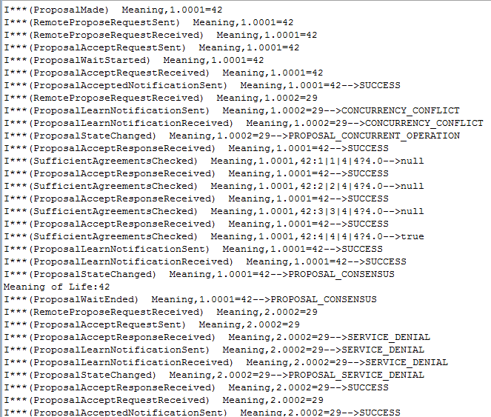
Server Proposer 1
1

Slide 17
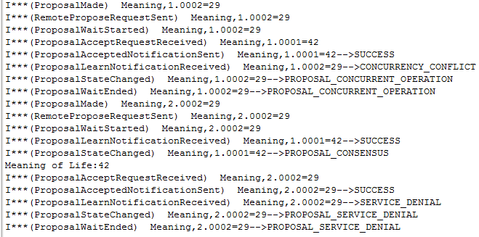
Rejected Proposer 2
2

Slide 18
Accepting Acceptor 3 (Synchronous)
3

Slide 19
Rejecting Acceptor 4 (Synchronous)
3

Slide 20
Coordinating: Multi Proposing General
Dawn
Dusk
Dusk
Problems?

Slide 21
Failure in Centralized Algorithm
Meaning of Life
rPropose(1, 42)
Inconsistency!
rPropose(1, 29)
learn(1,42)
propose(1.42)
learn(1,29)
Value
State
0
42
29
Pending
Consensus
Consensus
1
New sequencer may be arbitrarily behind
propose (2, 29)
0
Correct state is with at least one alive member
42
29
Consensus
Pending
Consensus
2
That member may die in middle of switchover
0
3
42
29
Consensus
We could use the voice of more than one member
42
0
Consensus
4
29

Slide 22
Switching Central Replicas
Consensus Problem
If A sends to B via C and B sends A via D, then C == D as central replica replica is unique
Need non centralized algorithm during switchover as no common central replica to solve consensus problem
Can use 0 phases.
Order the replicas by id and pick the next one in the list

Slide 23
Auto Select Server
public String getServerName() {
if (serverName == null) {
return getSortedMembers().get(0); // at least this one is alive
}
return serverName;
}
}
Non centralized algorithm with replica proposing itself necessary if sorted list not sufficient

Slide 24
Killing Central Process

Slide 25
Server Proposer 1
1

Slide 26
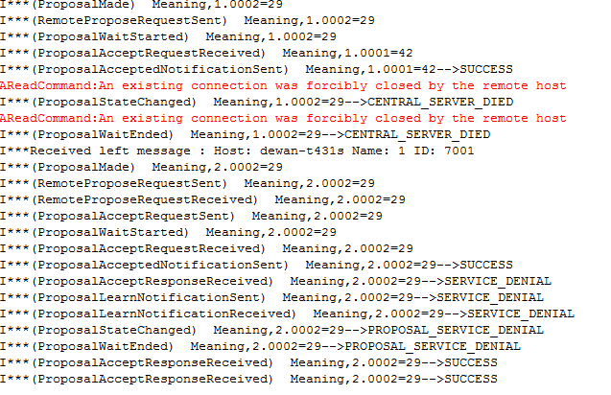
Rejected Proposer 2
2

Slide 27
Accepting Acceptor 3 (Synchronous)
3

Slide 28
Rejecting Acceptor 4 (Synchronous)
3

Slide 29
Auto Select Server
Non centralized algorithm with replica proposing itself necessary if sorted list not sufficient
Different consensus states possible even if ids used for switchover
We could use the voice of more than one member

