Slide 1
Distributed Consensus- Part 6: Paxos Implementation and Executions
Instructor: Prasun Dewan (FB 150, dewan@unc.edu)

Slide 2
Basic (Non Centralized) Paxos
Acceptors
Proposers
Learners

Slide 3
(Central) Synchronous
Acceptors
Proposers
Learners

Slide 4
Consensus Mechanism Hierarchy
AnAsynchronous
ConsensusMechanism
propose();
learn();
addConsensusListener();
Local application operations
accept()
ASynchronous
ConsensusMechanism
setAcceptSynchrony()
accepted()
Internal distributed operations
remotePropose()
ACentralizable
ConsensusMechanism
Selected application operations shown
prepare()
APaxos
ConsensusMechanism
Code outline for Paxos
prepared()

Slide 5
When to Not Use Paxos
protected boolean isNotPaxos() {
return isNonAtomic() || isCentralizedPropose());
}

Slide 6
Propose First Phase
protected void localPropose(float aProposalNumber, StateType aProposal) {
if (isNotPaxos()) {
super.localPropose(aProposalNumber, aProposal);
} else {
startPreparePhase(aProposalNumber, aProposal);
}
}}
protected void startPreparePhase(float aProposalNumber, StateType aProposal) {
recordAndSendPrepareRequest(aProposalNumber, aProposal);
}

Slide 7
Prepare Query
public void prepare(float aProposalNumber, StateType aProposal) {
float aPreparedOrAcceptedProposalNumber = maxProposalNumberSentInSuccessfulAcceptedNotification ;
StateType anAcceptedState = null;
if (aPreparedOrAcceptedProposalNumber != -1) {
anAcceptedState = proposal(aPreparedOrAcceptedProposalNumber);
} else if (sendPrepardNumberIfNoAccept()) {
PreparedOrAcceptedProposalNumber =
maxProposalNumberReceivedInPrepareOrAcceptRequest;
}
prepare(aPreparedOrAcceptedProposalNumber,
anAcceptedState, aProposalNumber, aProposal,
checkPrepareRequest(aProposalNumber, aProposal));
}
Each acceptor calculates and sends back last accepted value and its proposal number (or optionally last seen proposal number if no acceptance so far) and updates last seen proposal number

Slide 8
State-based Rejection
State-based rejection should be done as early as possible, so in prepare rather than accept phase and makes the safety condition in Lamport’s algorithm stronger
protected synchronized ProposalFeedbackKind checkPrepareRequest(float
aProposalNumber, StateType aProposal ) {
return isPrepareConcurrencyConflict(aProposalNumber, aProposal)?
ProposalFeedbackKind.CONCURRENCY_CONFLICT:
checkWithVetoer(aProposalNumber, aProposal);
}
Single site cannot veto if majority used, rejection equal to not responding, which means majority wins if its response not considered

Slide 9
Prepare Concurrency-based Rejection
protected boolean isPrepareConcurrencyConflict (float aProposalNumber,
StateType aState ) {
return
maxProposalNumberReceivedInPrepareOrAcceptRequest > aProposalNumber;
}
Preparer abandons proposal if it learns about a higher number proposal

Slide 10
Prepare Query
public void prepare(float aProposalNumber, StateType aProposal) {
float aPreparedOrAcceptedProposalNumber = maxProposalNumberSentInSuccessfulAcceptedNotification ;
StateType anAcceptedState = null;
if (aPreparedOrAcceptedProposalNumber != -1) {
anAcceptedState = proposal(aPreparedOrAcceptedProposalNumber);
} else if (sendPrepardNumberIfNoAccept()) {
PreparedOrAcceptedProposalNumber =
maxProposalNumberReceivedInPrepareOrAcceptRequest;
}
prepare(aPreparedOrAcceptedProposalNumber,
anAcceptedState, aProposalNumber, aProposal,
checkPrepareRequest(aProposalNumber, aProposal));
}
Each acceptor calculates and sends back last accepted value and its proposal number (or optionally last seen proposal number if no acceptance so far) and updates last seen proposal number

Slide 11
Helper Prepare
protected void prepare(float aLastPreparedOrAcceptedProposalNumber, StateType aLastAcceptedProposal, float aPreparedProposalNumber,
StateType aProposal, ProposalFeedbackKind aFeedbackKind) {
recordReceivedPrepareRequest(aPreparedProposalNumber, aProposal);
if (
// we accepted this proposal before preparing for it
aPreparedProposalNumber == aLastPreparedOrAcceptedProposalNumber
// peparer has started the accept phase
|| !isPending(aPreparedProposalNumber)) {
return;
}
if (!isSuccess(aFeedbackKind)) {
processPrepareRejection(aLastPreparedOrAcceptedProposalNumber,
aLastAcceptedProposal, aPreparedProposalNumber, aFeedbackKind);
} else {
recordAndSendPrepareResponse(aLastPreparedOrAcceptedProposalNumber,
aLastAcceptedProposal, aPreparedProposalNumber, aFeedbackKind);
}
}
Each acceptor calculates and sends back sends back last accepted value and its proposal number (or optionally last seen proposal number if no acceptance so far) and updates last seen proposal number

Slide 12
Prepared
public void prepared(float aPreparedOrAcceptedProposalNumber,
StateType anAcceptedProposal, float aPreparedProposalNumber,
ProposalFeedbackKind aFeedbackKind) {
recordReceivedPreparedNotification(aPreparedOrAcceptedProposalNumber,
anAcceptedProposal, aPreparedProposalNumber, aFeedbackKind);
if (!isPending(aPreparedProposalNumber)
|| isPreparePhaseOver(aPreparedProposalNumber)) {
return;
}
if (aFeedbackKind == ProposalFeedbackKind.CONCURRENCY_CONFLICT) {
newProposalState( aPreparedProposalNumber,
proposal(aPreparedProposalNumber),
toProposalState(
aPreparedProposalNumber,anAcceptedProposal, aFeedbackKind));
return;
}
aggregatePreparedNotification(aPreparedOrAcceptedProposalNumber,
anAcceptedProposal, aPreparedProposalNumber, aFeedbackKind);
}
Preparer abandons proposal if it learns about a higher number proposal

Slide 13
Prepare Aggregation
protected void aggregatePreparedNotification(
float anAcceptedProposalNumber, StateType anAcceptedProposal,
float aPreparedProposalNumber, ProposalFeedbackKind aFeedbackKind) {
Boolean isSufficientPreparers = sufficientPeparers(
getPrepareSynchrony(), aPreparedProposalNumber);
if (isSufficientPreparers == null)
return;
setPreparePhaseOver(aPreparedProposalNumber);
if (isSufficientPreparers) {
startAcceptPhase(aPreparedProposalNumber,
preparedProposal(aPreparedProposalNumber));
} else {
newProposalState( aPreparedProposalNumber,
proposal(aPreparedProposalNumber),
ProposalState.PROPOSAL_AGGREGATE_DENIAL);
return;
}
}

Slide 14
Prepared Proposal
protected StateType preparedProposal(float aPreparedProposalNumber) {
float aChosenProposalNumber = maxAcceptedProposalNumberReceivedInPreparedNotification <= 0 ? aPreparedProposalNumber
: maxAcceptedProposalNumberReceivedInPreparedNotification;
return proposal(aChosenProposalNumber);
}
Proposer sends its proposal and value if majority acceptors have not yet accepted any value
Proposer (re) proposes with highest accept proposal number as its own value (which may also be a majority value in majority acceptors)

Slide 15
Proposal Phase 2
protected void startAcceptPhase(float aProposalNumber, StateType aProposal) {
super.startAcceptPhase(aProposalNumber, aProposal);
}

Slide 16
Accept Check
protected synchronized ProposalFeedbackKind checkAcceptRequest(float aProposalNumber, StateType aProposal ) {
if (isNotPaxos()) {
return super.checkAcceptRequest(aProposalNumber, aProposal);
}
return (isAcceptConcurrencyConflict(aProposalNumber, aProposal))?
ProposalFeedbackKind.CONCURRENCY_CONFLICT:
ProposalFeedbackKind.SUCCESS;
}
No application-specific check in this phase under Paxos

Slide 17
Prepare-Accept Integration
protected boolean isAcceptConcurrencyConflict (float aProposalNumber, StateType aState ) {
return isPrepareConcurrencyConflict(aProposalNumber, aState);
}
protected void recordReceivedAcceptRequest(float aProposalNumber,
StateType aProposal) {
super.recordReceivedAcceptRequest(aProposalNumber, aProposal);
maxProposalNumberReceivedInPrepareOrAcceptRequest = Math.max(
maxProposalNumberReceivedInPrepareOrAcceptRequest, aProposalNumber);
}
Rejection reasons same for prepare and accept
Last seen proposal number updated by both

Slide 18
Synchronous Accept Phase
Acceptors
Proposers
Learners

Slide 19
Basic (Non Centralized) Paxos Accept Phase
Acceptors
Proposers
Learners

Slide 20
Do not Broadcast Learned Information
Super class code
protected void sendLearnNotification(float aProposalNumber,
StateType aProposal, ProposalFeedbackKind anAgreement) {
localLearn(aProposalNumber, aProposal, anAgreement);
sendLearnNotificationToOthers(aProposalNumber, aProposal, anAgreement);
}
Paxos-specific code
protected void sendLearnNotificationToOthers(float aProposalNumber,
StateType aProposal, ProposalFeedbackKind anAgreement) {
if (isNotPaxos()) {
super.sendLearnNotificationToOthers(aProposalNumber,
aProposal, anAgreement);
}
}
Learned values are not broadcast in Basic Paxos

Slide 21
Broadcast Accepted Notification
protected void sendAcceptedNotification(float aProposalNumber,
StateType aProposal, ProposalFeedbackKind aFeedbackKind) {
if (isNotPaxos()) {
super.sendAcceptedNotification(aProposalNumber, aProposal,
aFeedbackKind);
return;
}
sendAcceptedNotificationToLearners(aProposalNumber, aProposal,
aFeedbackKind);
}
Accepted notifications sent to everyone

Slide 22
Example Scenarios
1
2
3
1
proposeMeaning(MEANING_1);
3
proposeMeaning(MEANING_2);

Slide 23
Paxos Algorithm Properties
Proposer sends its proposal and value if majority acceptors have not yet accepted any value
Each acceptor accepts a proposal if its proposal number is higher than what it has seen so far.

Slide 24
Case 1 Properties
1 and 3 finds no previous acceptance and 1 finds no previous prepare
1’s accept is rejected by majority, 3’s accept goes through

Slide 25
Case 1: In-Order Prepares Before Accepts
Breaks in startPreparePhase() and startAcceptPhase()
1-Prepare
Resume 1.startPrepare Phase()
3-Prepare
Resume 3.startPrepare Phase()
1-Accept
Resume 1.startAcceptPhase()
3-Accept
Resume 3.startAcceptPhase()

Slide 26
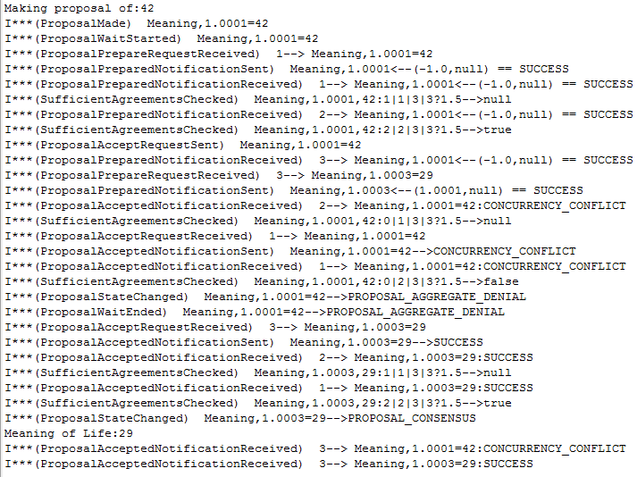
In-Order Prepares Before Accepts
1
1-Prepare→3-Prepare→1-Accept→3-Accept

Slide 27
Paxos Algorithm Properties
Preparer abandons proposal if it learns about a higher number proposal

Slide 28
Case 2 Properties
1 finds a higher proposal in prepare phase

Slide 29
Case 2: Reverse-Order Prepares Before Accepts
Breaks in startPreparePhase() and startAcceptPhase() in 1 and 3
3-Prepare
Resume 3.startPrepare Phase()
1-Prepare
Resume 1.startPrepare Phase()
1-Accept
Resume 1.startAcceptPhase()
3-Accept
Resume 3.startAcceptPhase()

Slide 30
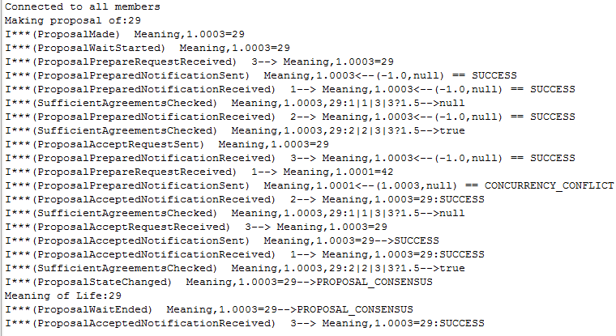
Case 2: Abandoning Lower Proposal in Prepare Phase
3
1-Prepare→3-Prepare→3-Accept
Proposer abandons proposal if it learns about a higher number proposal

Slide 31
Paxos Algorithm Property
Proposer (re) proposes majority value learned from the prepare phase as its own value

Slide 32
Case 3 Property
3 finds majority acceptances from 1 in prepare phase

Slide 33
Case 3: 1 Before 3
Breaks in startPreparePhase() and startAcceptPhase() in 1 and 3
1-Prepare
Resume 1.startPrepare Phase()
1-Accept
Resume 1.startAcceptPhase()
3-Prepare
Resume 3.startPrepare Phase()
3-Accept
Resume 3.startAcceptPhase()

Slide 34
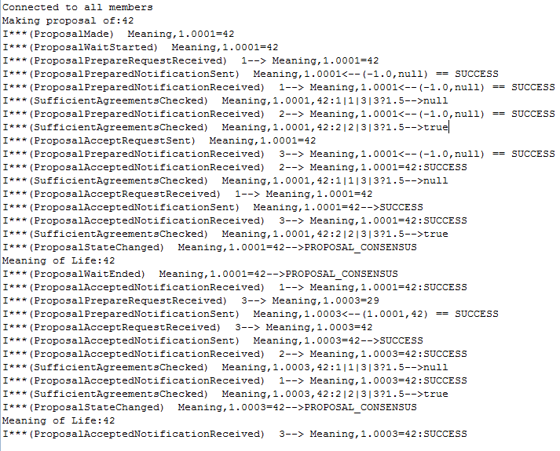
Case 3
1
1-Prepare-1-Accept

Slide 35
Late Messages and Re-proposals
1
3-Prepare-3-Accept

Slide 36
Why Re-propose with Majority?
Proposer (re) proposes majority value learned from the prepare phase as its own value
A prepare phase can prevent some nodes from accepting the previous (to be) majority value
If some of the nodes in current majority die, some learner nodes may not get consensus value even though majority of nodes are alive and can converge to a value
Want consensus value to propagate to all acceptors for fault tolerance

Slide 37
Case 4: Properties
A prepare phase prevents node 3 from accepting the previous majority value of 1’s proposal accepted by 1 and 2
If node 2 dies, node 3 will not get consensus value even though majority of nodes (1 and 3) are alive and can converge to a value
Want consensus value to propagate to all acceptors for fault tolerance

Slide 38
Case 2: Construction
Break in startAcceptPhase() at start, sendAcceptedFrom2() before sending to 3, sendPrepareFrom3() before sending to 1,2
1-Prepare-*
3-Prepare-3
3 will not get 1’s proposal but 1 and 2 will
1-Accept-*
Resume 1.startAcceptPhase
1-Accepted-*
2-Accepted-1,2
3-Prepare-1,2
Resume 3.sendPrepareFrom3()
2’s accepted notification will not reach 3 but will reach 1 and 2
Kill 2
Resume Break 3. startAcceptPhase)
So 3 should re-propose
3-Accept-*

Slide 39
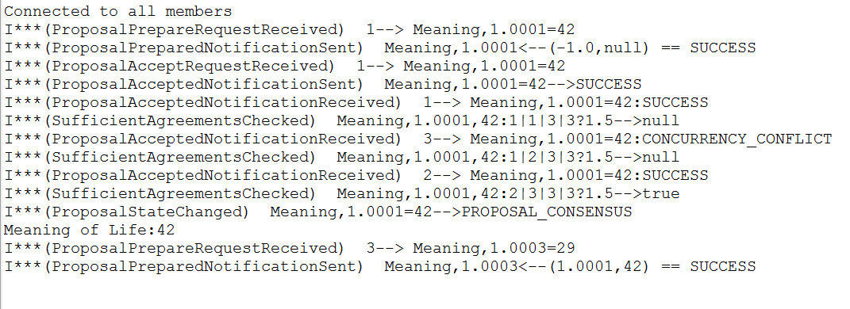
Case 4: 2 Learns Before Dying
2
3-Prepare-3-Accept

Slide 40
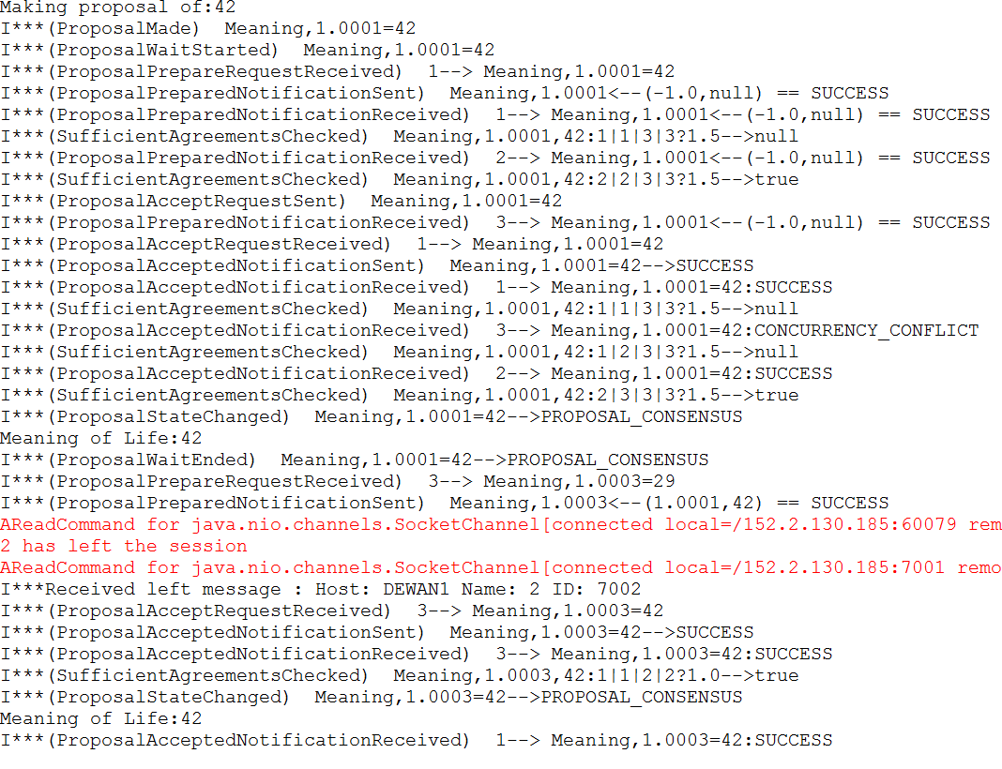
Case 4:1 Learns Twice
1
Two read failures as each process creates a connection to the other

Slide 41
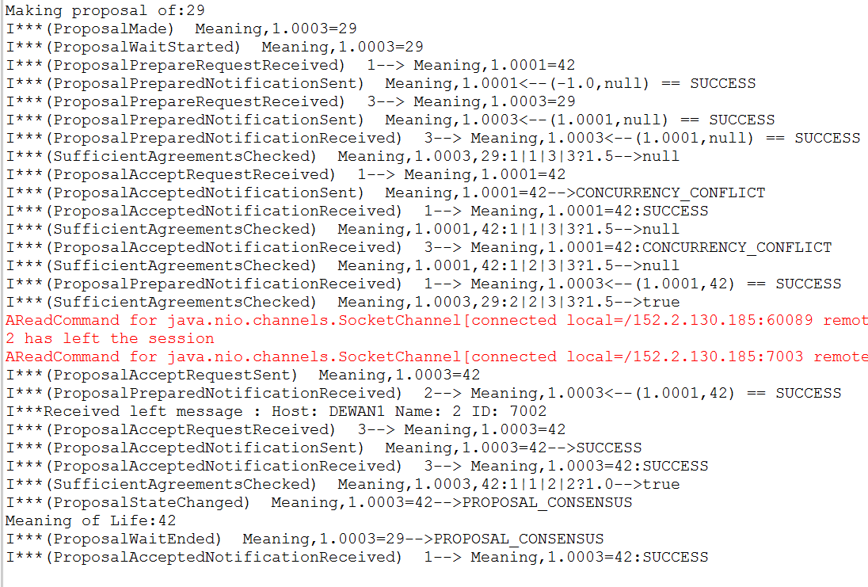
Case 4: 3 Learns Once
3

Slide 42
Why Re-propose with Minority
Proposer (re) proposes value of highest accept proposal number as its own value
The value with highest proposal number may or may not be or become majority value
If it does become majority value then prepare phase may have locked some nodes from accepting it

Slide 43
Case 5: Properties
Node 1’s minority proposal will become majority value
3’s prepare phase has locked itself from accepting it

Slide 44
Case 5: Construction
Break in sendPrepareFrom3() before sending to 1,2, start of startAcceptPhase()
1-Prepare-*
3-Prepare-3
Resume 1.startAcceptPhase()
3’s prepare sees acceptance from 1 and rejection from 3 though 2 has accepted to create majority value
1-Accept-1,2,3
3-Prepare-1
Step Over sendPrepareFrom3()
3-Accept-*
Resume 3.sendAcceptFrom3() and sendPrepareFrom3()
So 3 should re propose 1’s value
3-Prepare-2

Slide 45
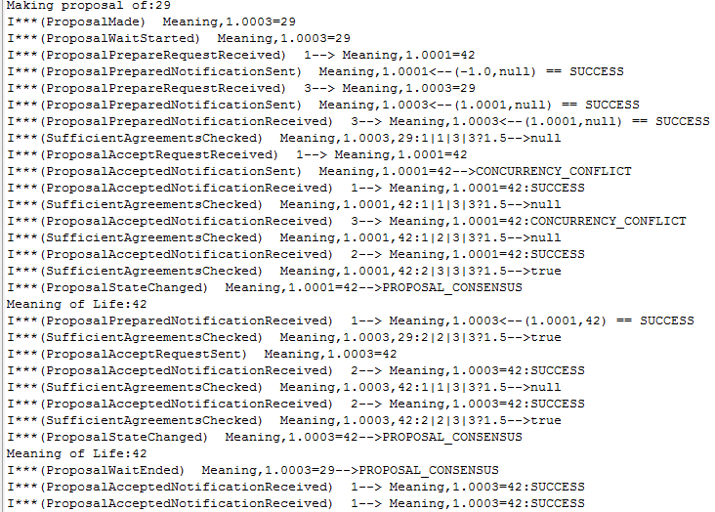
Case 5: Execution
3

Slide 46
Case 6: Properties
Node 1’s minority proposal will not become majority value
But 3 does not know that at start of accept phase, so re-proposes

Slide 47
Construction
Break in sendPrepareFrom3() before sending to 1,2, and start of sendAcceptFrom1() and sendAcceptFrom3()
1-Prepare-*
3-Prepare-3
Step Over 1.sendAcceptFrom1()
3’s prepare sees acceptance from 1 and rejection from 3
1-Accept-1
3-Prepare-*
Resume sendPrepareFrom3()
3 re propose 1’s value,
3-Accept-*
Resume 3.sendAcceptFrom3()
Though 2 will reject 1’s value as 3 does not know in what order the acceptances will reach 2
1-Accept-2, 3
Resume sendAcceptFrom1()

Slide 48
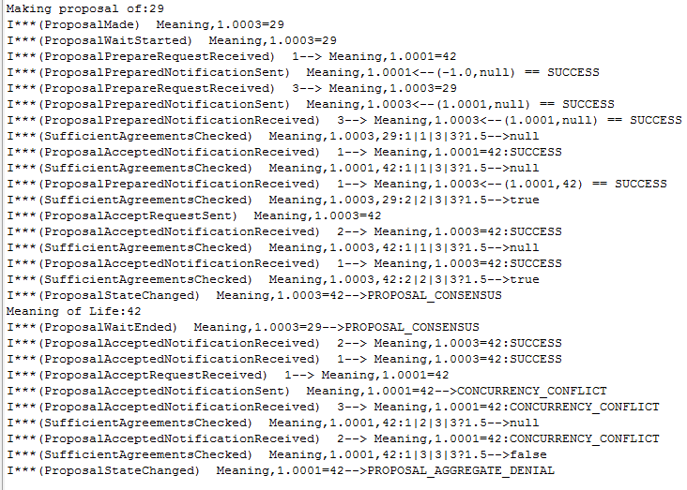
Case 6: Execution
3

Slide 49
Paxos Algorithm Property
Re-proposals can prevent any successful acceptance

Slide 50
Case 7 Properties
1 ‘s first acceptance prevented from 3’s first prepare
3’s first acceptance is prevented from 1’s second prepare
1’s second acceptance is prevented from 3’s second prepare
3’s secnd acceptance is prevented from 1’s third prepare

Slide 51
Case 7: Paxos Livelock with Retries
(resume 1.startPrepare())
1¹-Prepare (Succeeds)
1¹-Accept Blocks
(resume 3.startAccept()) 3¹-Accept Unblocks and Fails (wait for retry)
(resume 3.startPrepare)
3¹-Prepare Succeeds
(resume 3.startPrepare) 3²-Reprepare Succeeds
3¹-Accept Blocks
3²-Accept Blocks
(resume 1.startAccept()) 1¹-Accept-Unblocks and Fails (wait for retry)
(resume 1.startAccept()) 1²-Accept-Unblocks and Fails (wait for retry)
(resume 1.startPrepare) 1²-Reprepare (Succeeds)
1²-Reprepare Succeeds
1²-Accept Blocks
Breaks in startPreparePhase() and startAcceptPhase() in 1 and 3

Slide 52
Case 7: 3-Prepare 1-Accept
1
1-Prepare Succeeds
1-Accept-Unblocks and Fails and 1 retries

Slide 53
Case 7: 1-Reprepare Succeeds
1

Slide 54
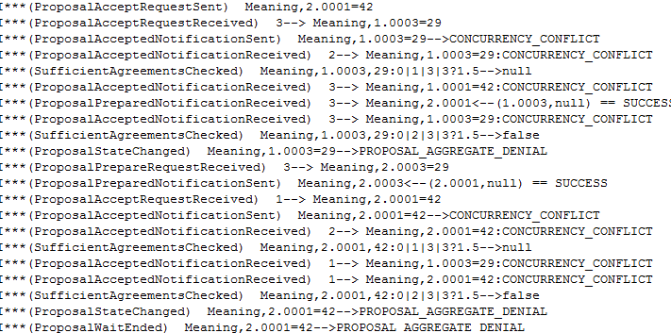
Case 7: 3-(Re) Accept After 1-(Re-Re) Prepare
1
3-Accept Fails
3-Reproposes
1-Reaccept Fails

Slide 55
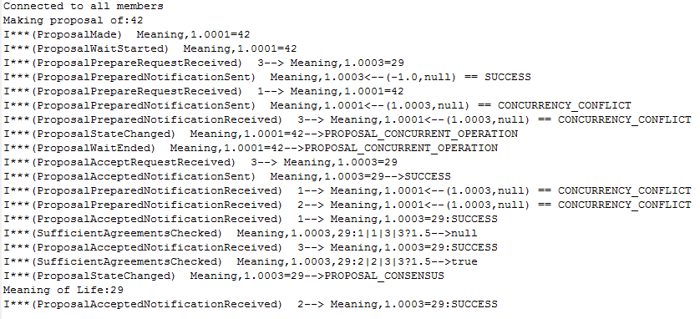
Case 8: Uncontrolled Execution-1 (Conflict in Prepare Phase)

Slide 56
Paxos vs. Centralized Synchronous
Multiple client UIs commit to single server
Browser-Sakai
Nested transaction involving multiple logical servers
Travelocity (non replicated)
Physical replication with multiple changers
Diff-based with divergence (Git)
Snapshot-based (Google Drive, OneDrive)
Command-based: replicated state machines (Google Docs, LiveMeeting)
Lock and other meta/configuration state
Live Meeting
Physical mirroring
Akamai
Master (primary)-slave(backup) replication
Master-master replication
Disjoint writes
Overlapping writes
✓

Slide 57
Consensus Mechanism Hierarchy
AnAsynchronous
ConsensusMechanism
propose();
learn();
addConsensusListener();
Local application operations
accept()
ASynchronous
ConsensusMechanism
setAcceptSynchrony()
accepted()
Internal distributed operations
remotePropose()
ACentralizable
ConsensusMechanism
Selected application operations shown
prepare()
APaxos
ConsensusMechanism
Use most efficient scheme for needs
prepared()

Slide 58
Customization
public interface ConsensusCustomization {
public ConcurrencyKind getConcurrencyKind();
public void setConcurrencyKind(ConcurrencyKind consistencyStrength) ;
public ProposalFeedbackKind getProposalVetoKind();
public void setProposalVetoKind(ProposalFeedbackKind proposalRejectionKind);
public ReplicationSynchrony getAcceptSynchrony();
public void setAcceptSynchrony(ReplicationSynchrony consensusSynchrony);
public void setSendRejectionInformation(boolean newVal);
public boolean isSendRejectionNotification();
public boolean isAllSynchronous();
public void setAllowVeto(boolean newVal);
public ConsensusMemberSetKind getConsensusMemberSetKind() ;
public void setConsensusMemberSetKind(ConsensusMemberSetKind consensusMemberSet) ;
public boolean isValueSynchrony();
public void setValueSynchrony(boolean newVal) ;
public boolean isSendAcceptReplyForResolvedProposal();
public void setSendAcceptReplyForResolvedProposal(
boolean newVal) ;
public boolean isClient() ;
public boolean isServer();
public boolean isCentralizedPropose() ;

Slide 59
Summary
Distributed → Replicated Systems
RPC → Replicated Object
Pure replication synchrony → Global clock, time bounds
Replication Synchrony ➔Propose, Invalid State, Listeners, rather than pure get and set
Replication Synchrony ➔ Two phase algorithm
Shared abstraction and algorithms for replication synchrony and distributed proposal rejection
Degree of replication synchrony and vetoing based on set synchronized with/consulted by proposer
Safety vs Progress
Concurrent proposes in asynchronous and synchronous case can be handled with centralized coordinator
Centralized Synchronous is Two Phase Commit if invalidation step involves transaction set up and checks
Coordinator switch-offs can be done using consensus protocol or zero phase id choice
Central solution can lead to inconsistency even if majority alive
3-Phase Paxos supports consistency if majority alive
Centralization and timeouts for practical reasons
Atomic setting of proposal number and getting of state in acceptor
Convergence towards proposals with higher proposal numbers and re-proposing of acceptances
To update a value multiple times, multiple paxos mechanisms instantiated, once for each update
Centralization to achieve consensus about update sequence number

