Slide 1
Java Remote Method Invocation (RMI)
Prasun Dewan
Department of Computer Science
University of North Carolina at Chapel Hill
dewan@cs.unc.edu

Slide 2
Communication Layers
Client Object
Server Object
Language Layer (e.g. Java Remote Method Invocation)
OS Layers (e.g. Sockets)
Network Layers (e.g. TCP/IP)
Higher layer, higher abstraction, lower OS and language interoperability.

Slide 3
Remote Method Invocation
Client Object
Server Object
Language Layer (Java Remote Method Invocation)

Slide 4
Counter
public interface Counter {
void increment(int val);
int getValue() throws RemoteException;
}

Slide 5
Counter
public class ACounter implements Counter{
public ACounter() {
super();
}
Integer value = 0;
public Object getValue() {
return value;
}
public void increment(int val) {
value += val;
}
public String toString() {
return "Counter:" + value;
}
public boolean equals(Object otherObject) {
if (!(otherObject instanceof Counter))
return false;
return getValue() == ((Counter) otherObject).getValue();
}
}

Slide 6
Remote Method Invocation
Client Object
Server Object
How do separate processes share object references?

Slide 7
Local References in Both Address Spaces
Client Object
Server Object
m(p¹, … p^{N})
Server Proxy
m(p¹, … p^{N})
Proxy is generate by RMI System.
Proxy and server objects connected through external name

Slide 8
Local References in Both Address Spaces
Client Object
Server Object
m(p¹, … p^{N})
Server Proxy
m(p¹, … p^{N})
Remote method invocation has the same syntax as local method invocation.
However, caller and callee are distribution-aware

Slide 9
Checked RemoteException
Client Object
Server Object
Checked RemoteException occurs if network or server errors occur
m(p¹, … p^{N})
Server Proxy
m(p¹, … p^{N})
Something the client programmer cannot control, so it is checked
Method call must catch RemoteException
Method declaration must indicate it may throw RemoteException in header
How to make programmer put the throws clause?

Slide 10
Labeling Remote Methods
Client Object
Server Object
m(p¹, … p^{N})
Server Proxy
m(p¹, … p^{N})
Programmer must label methods as remotely invokable
If an interface “extends” or a class “implements” the Remote interface, then every method in that class/interface labeled as Remote
Java ensures that every labeled method has the throws clause and generates proxy method for only such a method

Slide 11
Local vs. Distributed Counter
public interface Counter {
void increment(int val);
Object getValue();
}
public interface DistributedRMICounter extends Remote {
void increment(int val) throws RemoteException;
Object getValue() throws RemoteException;
}
Caller should handle errors
Checked exceptions
Distribution awareness

Slide 12
ACounter
public class ACounter implements Counter{
public ACounter() {
super();
}
Integer value = 0;
public Object getValue() {
return value;
}
public void increment(int val) {
value += val;
}
public String toString() {
return "Counter:" + value;
}
public boolean equals(Object otherObject) {
if (!(otherObject instanceof Counter))
return false;
return getValue() == ((Counter) otherObject).getValue();
}
}
Class header need not have throws class as interface is used by client.
DistributedRMICounter does not extend Counter
How is it changed?

Slide 13
DistributedRMICounter
public class ADistributedInheritingRMICounter extends ACounter implements DistributedRMICounter{
@Override
public boolean equals(Object otherObject) {
if (!(otherObject instanceof DistributedRMICounter))
return super.equals(otherObject);
try {
return getValue().equals(
((DistributedRMICounter) otherObject).getValue());
} catch (RemoteException e) {
e.printStackTrace();
return false;
}
}
}
How to do client specific processing?
Inherited methods implement two different methods, with and without throws clause

Slide 14
Caller-Specific Processing
public class ADistributedInheritingRMICounter extends ACounter implements DistributedRMICounter{
@Override
public boolean equals(Object otherObject) {
…
}
public int getValue() {
try {
System.out.println(RemoteServer.getClientHost());
} catch (ServerNotActiveException e) {
e.printStackTrace();
}
return super.equals(otherObject); }
}
RemoteServer
static String getClientHost()

Slide 15
How to create a local proxy
Client Object
Server Object
m(p¹, … p^{N})
Server Proxy
m(p¹, … p^{N})
How to connect the two?
Proxy and server objects connected through external name and transfer of serialized proxies

Slide 16
External Name and Internal Name Binding
Objects shared among processes have external names.
file name for files
<machine, port> for socket
A mechanism is provided to bind a local reference to an external name
File is opened in write mode giving file name
Server socket is bound to <machine, port>
A mechanism is provided to bind the external name to local reference
File is opened in read mode giving file name
Clients socket is connected to server socket using <machine, port>

Slide 17
Local References in Both Address Spaces
Client Object
Server Object
m(p¹, … p^{N})
Server Proxy
m(p¹, … p^{N})
How to connect the two?
Proxy and server objects connected through external name and transfer of serialized proxies
How exactly?

Slide 18
Name Server
RMI Registry
Caller
Callee
Name server keeps (name, object) pairs
Caller registers (name, proxy) pair
Caller gets object registered for name

Slide 19
Name Server Methods
Registry
Remote lookup(String name)
rebind(String name, Remote obj)
RMI Registry
Caller
Callee
Only instances of Remote can be registered because of special error handling requirement
RMIRegistry must have specific subtype of Remote in path so it can store it in memory

Slide 20
Name Server Methods
Registry
Remote lookup(String name)
rebind(String name, Remote obj)
RMI Registry
Caller
Callee
Name server keeps (name, object) pairs
How to start RMI Registry Server?
How to get proxy reference to name server?
Bootstrapping problem!

Slide 21
Starting RMI Registry From Console
set javabin=D:\"Program Files"\Java\jre1.6.0_03\bin
set CLASSPATH=D:/dewan_backup/java/gipc/bin
%javabin%\rmiregistry 1099
LocateRegistry
static void createRegistry(int port)
static Registry getRegistry(String host, int port)
RMI Registry is started as part of calling process

Slide 22
Starting RMI Server From a Program
public class RMIRegistryStarter {
public static void main (String[] args) {
try {
LocateRegistry.createRegistry(1099);
Scanner scanner = new Scanner(System.in);
scanner.nextLine();
} catch (Exception e) {
e.printStackTrace();
}
}
}
Prevents termination
Usually RMIRegistry started though LocateRegistry is part of server process

Slide 23
Name Server
Registry
Remote lookup(String name)
rebind(String name, Remote obj)
RMI Registry
Caller
Callee
RMI Registry simply stores what was sent to it by rebind
How to create and store references rather than copies?
If a stub has been created, then instance of stub is sent as reference

Slide 24
Proxies (Review)
Client Object
Server Object
Checked RemoteException occurs if network or server errors occur
m(p¹, … p^{N})
Server Proxy
m(p¹, … p^{N})
Something the client programmer cannot control, so it is checked
Method call must catch RemoteException
Method declaration must indicate it may throw RemoteException in header
The class of server object must implement Remote
When is proxy class created? When is proxy created?

Slide 25
Generating Proxy Class: Compilation
set javabin=D:\"Program Files"\Java\jdk1.6.0_03\bin
cd D:/dewan_backup/java/distTeaching/bin
%javabin%\rmic rmi.examples. ADistributedInheritingRMICounter
Directory of D:\dewan_backup\Java\distTeaching\bin\rmi\examples
11/20/2011 09:12 AM <DIR> .
11/20/2011 09:12 AM <DIR> ..
11/19/2011 08:17 PM 933 ADistributedInheritingRMICounter.class
11/20/2011 09:12 AM 1,977 ADistributedInheritingRMICounter_Stub.class
11/20/2011 09:13 AM 264 DistributedRMICounter.class
11/19/2011 07:35 PM 1,112 DistributedRMICounterClient.class
11/19/2011 06:17 PM 1,154 DistributedRMICounterServer.class
11/19/2011 08:14 PM 908 RMIRegistryStarter.class
6 File(s) 6,348 bytes
2 Dir(s) 125,598,871,552 bytes free
Pre-compiler works from object code and produces object stub code
Eclipse will delete object code it has not generated

Slide 26
Interpretive Reflection-based Class and Proxy Creation
UnicastRemoteObject
static exportObject(Remote object, int port)
Proxy (ADistributednInheritingCounter_Stub instace)
Proxy Class
(ADistributedInheritingCounter_Stub)
m(…)
m(…)
Creates a proxy object for the remote object at the server end that can later be sent to client
Remote Object
ADistributedInheritingCounter instance
m(…)
If the stub class for the proxy had not been created so far, then it is conceptually created at runtime
Stub object keeps forwarding information (host and port and id of remote object at server)

Slide 27
Invalid Remote Interface
public interface DistributedCounter extends Remote, Serializable {
void increment(int val) throws RemoteException;
int getValue() throws RemoteException;
}
Interpretation
java.rmi.server.ExportException: remote object implements illegal remote interface; nested exception is:
java.lang.IllegalArgumentException: illegal remote method encountered: public abstract void rmi.examples.DistributedCounter.increment(int)
at sun.rmi.server.UnicastServerRef.exportObject(Unknown Source)
Compilation
D:\dewan_backup\Java\distTeaching\bin>%javabin%\rmic rmi.examples.AnInheritingDistributedRMICounter
error: rmi.examples.DistributedCounter is not a valid remote interface: method void increme
nt(int) must throw java.rmi.RemoteException.
1 error

Slide 28
Local Method Parameter Passing
Either a copy or reference to a parameter is passed determined by whether it is a call-by-value or call-by-reference
Caller and caller can share memory if language has call-by-reference or pointers

Slide 29
Remote Method Parameter Passing
Either a serialized copy or proxy to a parameter is passed determined by … ?
Caller and caller cannot share memory, so an address cannot be passed

Slide 30
Copy or Proxy?
Should a parameter to a remote method be passed as a proxy or a serialized copy?
Exported? (Remote)
Serializable?
Not Serializable Exception
Proxies generated by callee process through export
Proxy
Serialized
Only Remote instances can be exported

Slide 31
Serialization →Marshalling
ObjectOutput Stream
ObjectInput Stream
Object replaceObject (Object)
extends
RMI Marshaller
Object replaceObject (Object)
ObjectOutputStream calls replaceObject(object) to determine what object is actually serialized and sent
RMI Marshaller returns stub if object IS-A Remote and has been exported (at compile or runtime)
ObjectInputStream uses stub or copy
Marshaller and Serializer are tied to each other through inheritance

Slide 32
Name Server (Review)
Registry
Remote lookup(String name)
rebind(String name, Remote obj)
RMI Registry
Caller
Callee

Slide 33
Proxy Communcation after export
Callee
m(…)
Proxy
RMI Registry
export()
Remote Object
rebind()
m(…)
m(…)
Proxy
lookup()
m(…)
Proxy
Proxies are sent only for exported remote objects
Caller
Exporting an object creates a proxy and creates a byte communication mechanism if such a mechanism has not been created already

Slide 34
Starting RMI Server From a Program (Review)
public class RMIRegistryStarter {
public static void main (String[] args) {
try {
LocateRegistry.createRegistry(1099);
Scanner scanner = new Scanner(System.in);
scanner.nextLine();
} catch (Exception e) {
e.printStackTrace();
}
}
}
Prevents termination
Usually RMIRegistry started though LocateRegistry is part of server process

Slide 35
Server Launcher && Export Object
Use default port
public class CounterServer {
public static void main (String[] args) {
try {
Registry rmiRegistry = LocateRegistry.getRegistry();
DistributedCounter counter = new
ADistributedInheritingRMICounter ();
UnicastRemoteObject.exportObject(counter, 0);
rmiRegistry.rebind(DistributedCounter.class.getName(), counter);
counter.increment(50);
} catch (Exception e) {
e.printStackTrace();
}
}
}
Serialized copy will be sent if object is serializable
Increment action will not be seen
When does server terminate?

Slide 36
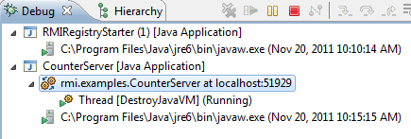
Persistent Thread in Server
public class CounterServer {
public static void main (String[] args) {
try {
Registry rmiRegistry = LocateRegistry.getRegistry();
DistributedCounter counter = new
ADistributedInheritingRMICounter ();
UnicastRemoteObject.exportObject(counter, 0);
rmiRegistry.rebind(DistributedCounter.class.getName(), counter);
counter.increment(50);
} catch (Exception e) {
e.printStackTrace();
}
}
}
Does not terminate

Slide 37
Counter Client
public class CounterClient {
public static void main (String[] args) {
try {
Registry rmiRegistry = LocateRegistry.getRegistry();
DistributedCounter counter = (DistributedCounter )
rmiRegistry.lookup(DistributedCounter.class.getName());
System.out.println(counter.getValue());
} catch (Exception e) {
e. printStackTrace();
}
Two different ways to get references, one for bootstrapping

Slide 38
Understanding Equals (SERVER)
public class ServerRMICounterComparer extends RMICounterLauncher {
public static void main (String[] args) {
try {
Registry rmiRegistry = LocateRegistry.getRegistry();
DistributedRMICounter counter1 =
new ADistributedInheritingRMICounter();
DistributedRMICounter counter2 =
new ADistributedInheritingRMICounter();
UnicastRemoteObject.exportObject(counter1, 0);
UnicastRemoteObject.exportObject(counter2, 0);
rmiRegistry.rebind(COUNTER1, counter1);
rmiRegistry.rebind(COUNTER2, counter2);
DistributedRMICounter proxy1 =
(DistributedRMICounter) rmiRegistry.lookup(COUNTER1);
System.out.println(counter1.equals(counter2));
System.out.println(counter1.equals(proxy1));
System.out.println(counter1.hashCode() == proxy1.hashCode());
System.out.println(proxy1);
} catch (Exception e) {
e.printStackTrace();
}
}
}

Slide 39
Understanding Equals (SERVER) (Review)
public class ServerRMICounterComparer extends RMICounterLauncher {
public static void main (String[] args) {
try {
Registry rmiRegistry = LocateRegistry.getRegistry();
DistributedRMICounter counter1 =
new ADistributedInheritingRMICounter();
DistributedRMICounter counter2 =
new ADistributedInheritingRMICounter();
UnicastRemoteObject.exportObject(counter1, 0);
UnicastRemoteObject.exportObject(counter2, 0);
rmiRegistry.rebind(COUNTER1, counter1);
rmiRegistry.rebind(COUNTER2, counter2);
DistributedRMICounter proxy1 =
(DistributedRMICounter) rmiRegistry.lookup(COUNTER1);
System.out.println(counter1.equals(counter2));
System.out.println(counter1.equals(proxy1));
System.out.println(counter1.hashCode() == proxy1.hashCode());
System.out.println(proxy1);
} catch (Exception e) {
e.printStackTrace();
}
}
}

Slide 40
Understanding Equals (Client)
public class ClientRMICounterTester extends RMICounterLauncher {
public static void main (String[] args) {
try {
Registry rmiRegistry = LocateRegistry.getRegistry();
DistributedRMICounter counter11 =
(DistributedRMICounter) rmiRegistry.lookup(COUNTER1);
DistributedRMICounter counter12 =
(DistributedRMICounter) rmiRegistry.lookup(COUNTER1);
DistributedRMICounter counter2 =
(DistributedRMICounter) rmiRegistry.lookup(COUNTER2);
System.out.println(counter12 == counter11);
System.out.println(counter12.equals(counter11));
System.out.println(counter11.hashCode() == counter12.hashCode());
System.out.println(counter11.equals(counter2));
System.out.println(counter11.hashCode() == counter2.hashCode());
System.out.println(counter12);
} catch (Exception e) {
e.printStackTrace();
}
}
}

Slide 41
Add Equals in Remote Interface?
public interface Counter {
void increment(int val);
Object getValue();
}
public interface DistributedRMICounter extends Remote {
void increment(int val) throws RemoteException;
Object getValue() throws RemoteException;
boolean equals(Object otherObject) throws RemoteException;
}

Slide 42
Add Equals in Remote Interface?
public static void remoteEqualsIssue () {
Object counter1 = null;
Object counter2 = null;
try {
Registry rmiRegistry = LocateRegistry.getRegistry();
counter1 = rmiRegistry.lookup(COUNTER1);
counter2 = rmiRegistry.lookup(COUNTER2);
} catch (Exception e) {
e.printStackTrace();
}
System.out.println(counter1.equals(counter2));
}
Exception not caught
Conceptual issues arise because every object has equals
Remote IS-A Object
Interface IS-A Class!!

Slide 43
RMI Limitation
Cannot call Object methods remotely
e.g. equals()
e.g. toString() (ObjectEditor uses it extensively)

Slide 44
RMI Repository Shared by Multiple Clients
public class ARemoteRepository implements RemoteRepository {
List<Remote> remotes = new ArrayList();
public void deposit(Remote anObject) {
remotes.add(anObject);
}
public List<Remote> getObjects() {
return remotes;
}
}

Slide 45
RMI Server Holding Repository
public class AnRMIRepositoryServerLauncher
extends RemoteRepositoryLauncher {
public static void main (String[] args) {
try {
Registry rmiRegistry = LocateRegistry.getRegistry();
RemoteRepository repository = new ARemoteRepository();
UnicastRemoteObject.exportObject(repository, 0);
rmiRegistry.rebind(COUNTER_REPOSITORY, repository);
} catch (Exception e) {
e.printStackTrace();
}
}
}

Slide 46
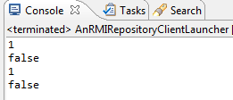
Sharing Client
public class AnRMIRepositoryClientLauncher
extends RemoteRepositoryLauncher{
public static void main (String[] args) {
try {
Registry rmiRegistry = LocateRegistry.getRegistry();
RemoteRepository counterRepository = (RemoteRepository)
rmiRegistry.lookup(COUNTER_REPOSITORY);
DistributedRMICounter exportedCounter = new
ADistributedInheritingRMICounter();
UnicastRemoteObject.exportObject(exportedCounter, 0);
counterRepository.deposit(exportedCounter);
exportedCounter.increment(1);
List<Remote> objects = counterRepository.getObjects();
for (Remote counter:objects) {
System.out.println(((DistributedRMICounter) counter).getValue());
System.out.println(counter == exportedCounter);
}
} catch (Exception e) {
e.printStackTrace();
}
}
}

Slide 47
Inheriting DistributedRMICounter
public class ADistributedInheritingRMICounter extends ACounter implements DistributedRMICounter{
@Override
public boolean equals(Object otherObject) {
if (!(otherObject instanceof DistributedRMICounter))
return super.equals(otherObject);
try {
return getValue().equals(
((DistributedRMICounter) otherObject).getValue());
} catch (RemoteException e) {
e.printStackTrace();
return false;
}
}
}
IS-A link statically bound to reused code but requires less work

Slide 48
Delegation to Counter
public class ADistributedDelegatingRMICounter
extends UnicastRemoteObject implements DistributedRMICounter{
Counter counter = new ACounter();
public ADistributedDelegatingRMICounter() throws RemoteException {
super();
}
public Object getValue() {
return counter.getValue();
}
public void increment(int val) {
counter.increment(val);
}
public boolean equals(Object otherObject) {
if (!(otherObject instanceof DistributedRMICounter))
super.equals(otherObject);
try {
return getValue().equals(
((DistributedRMICounter) otherObject).getValue());
} catch (RemoteException e) {
e.printStackTrace();
return false;
}
}
}
Super constructor automatically exports object
Correct semantics of hashcode
HAS-A link can be dynamically bound to reused code but requires more work

Slide 49
Comparer
public class DelegatingServerRMICounterComparer
extends RMICounterLauncher {
public static void main (String[] args) {
try {
Registry rmiRegistry = LocateRegistry.getRegistry();
DistributedRMICounter counter1 =
new ADistributedDelegatingRMICounter();
DistributedRMICounter counter2 =
new ADistributedDelegatingRMICounter();
rmiRegistry.rebind(COUNTER1, counter1);
rmiRegistry.rebind(COUNTER2, counter2);
DistributedRMICounter proxy1 =
(DistributedRMICounter) rmiRegistry.lookup(COUNTER1);
System.out.println(counter1.equals(counter2));
System.out.println(counter1.equals(proxy1));
System.out.println(counter1.hashCode() == proxy1.hashCode());
} catch (Exception e) {
e.printStackTrace();
}
}
}
No exportObject()

Slide 50
Summary: Distributed Architecture
Callee
m(…)
Proxy
RMI Registry
export()
Remote Object
rebind()
m(…)
m(…)
Proxy
lookup()
m(…)
Proxy
RMIRegistry can run as part of Callee (or even caller)
Caller

Slide 51
Summary: RMI API
Registry
Remote lookup(String name)
rebind(String name, Remote obj)
Caller
Callee
Registry getRegistry (String host, int port)
Registry createRegistry(port)
LocateRegistry
UnicastRemoteObject
RMI Registry
static exportObject
(Remote object, int port)

Slide 52
Summary
Java RMI is built on a data communication layer
To allow methods of an object to be invoked remotely, the process containing an object must first generate a proxy for it and then register the proxy in an RMI registry
Such a process does not terminate when its main method exits.
The process wishing to invoke methods on a remote object must fetch a serialized version of its proxy from the registry, which contains proxy methods for the remote methods of the remote object.
Both a client and a server can register and lookup objects.
The lookup must be done after the register.
This means that a server must wait for some call from the client before looking up a proxy for it.
A remote method call can ask RMI for the host of the caller to generate the proxy
Usually the client will send a proxy with a call as we will see later, but we have illustrated the getHost() call

Slide 53
Summary
Proxy methods marshal method calls into messages on the data communication and unmarshal received message into return values.
Errors on the communication channel are not under the control of the programmer, so remotely invoked methods must acknowledge the checked RemoteException
In a proxy for a remote object, proxy methods are generated only for remote methods of the object
All methods of a class implementing and an interface extending Remote are remote methods.
A remote method must acknowledge the checked RemoteException
This checking is done when the proxy is generated.

Slide 54
Summary
This means Object methods such as equals(), toString() and hashcode() cannot be invoked remotely
It also means that if we want to create a central model connected to distributed views/controllers, then all of these classes must be made distribution aware.
Can reuse existing non distribution unaware versions of these classes by inheriting from them or delegating to them.

Slide 55
Summary
In RMI, each remote object associated with a server communication channel, that is, a channel to which any process can connect.
As a result a proxy to a remote object can be sent to any other process.
In RMI a parameter to a remote method is sent by reference (as a proxy) if it is of type Remote and by copy if it is Serializable.
In RMI, two proxies to the same remote object are not == to each other
If an exported object is fetched, a proxy rather than the original object is returned, but the equal() method is locally called correctly.

Slide 56
Launching Multiple Processes on One Host in Eclipse
Must remember which programs are to be launched
Must remember the order (.eg. Registry before Server before client)
Can see the console I/ of only one process at one time
Must manually start and kill each process and select the console-window process
Running from the command window is unfamiliar and requires swithcing away from Eclipse

Slide 57
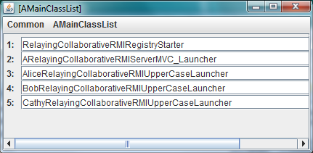
Launching Multiple Processes: UI

Slide 58
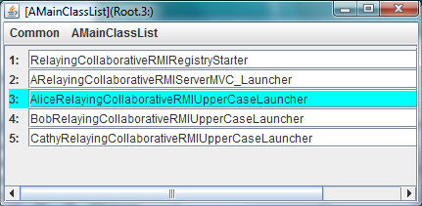
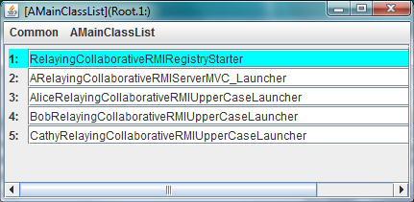
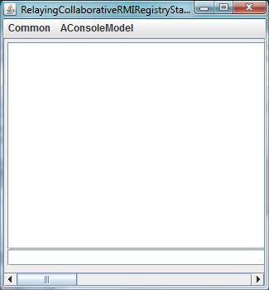
Double clicking On Registry

Slide 59
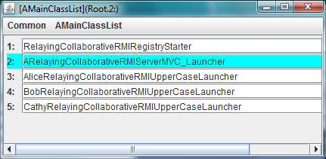
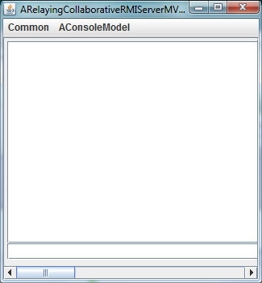
Double clicking On Server

Slide 60
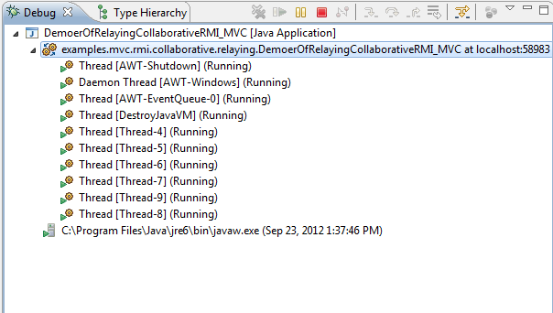
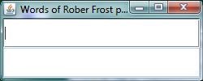
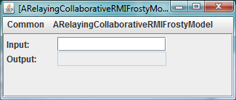
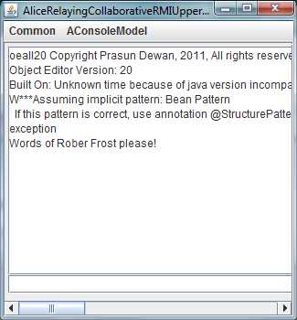
Double clicking On Alice Launcher
Implementation?
No debugger for app processes
Except for OE Code

Slide 61
Eclipse vs. Java Processes
How may Eclipse processes?
No debugger for app processes
Killing Eclipse Process?
All processes

Slide 62
Killing Eclipse Process
All consoles destroyed
Processes reading from standard I/O killed as producers of these streams are destroyed
Processes exporting remote object or having AWT thread not killed
Could eclipse process not detect its killing an destroy its forked processes?
Eclipse calls Process.destroy() and not OS kill
Regular but not eclipse process cannot

Slide 63
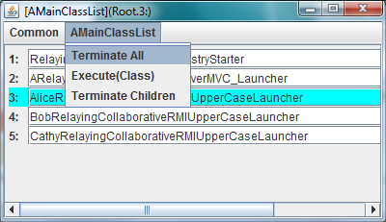
Killing from AMainClassList

Slide 64
All Processes Killed

Slide 65
Local and Remote Response
Programming Interface?

Slide 66
Multi-Process Launcher API
import bus.uigen.models.MainClassListLauncher;
public class DemoerOfRelayingCollaborativeRMI_MVC {
public static void main(String args[]) {
demo();
}
public static void demo() {
Class[] classes = {
RelayingCollaborativeRMIRegistryStarter.class,
ARelayingCollaborativeRMIServerMVC_Launcher.class,
AliceRelayingCollaborativeRMIUpperCaseLauncher.class,
BobRelayingCollaborativeRMIUpperCaseLauncher.class,
CathyRelayingCollaborativeRMIUpperCaseLauncher.class
};
MainClassListLauncher.launch(classes);
}
}

Slide 67
Multi-Process Launcher
package bus.uigen.models;
import util.models.ListenableVector;
import bus.uigen.ObjectEditor;
public class MainClassListLauncher {
public static void launch(Class[] classes) {
ListenableVector<Class> classList = new AMainClassList();
for (Class aClass:classes) {
classList.add(aClass);
}
ObjectEditor.edit(classList);
}
}

Slide 68
Main Class List
import java.util.ArrayList;
import java.util.List;
import util.annotations.Visible;
import util.models.AListenableVector;
import util.remote.ProcessExecer;
import bus.uigen.misc.OEMisc;
public class AMainClassList extends AListenableVector<Class>
implements Runnable {
List<ProcessExecer> executed = new ArrayList();
public AMainClassList() {
Thread thread = new Thread(this);
Runtime.getRuntime().addShutdownHook(thread);
}
@Visible(false)
public void run() {
killAllChildren();
}

Slide 69
Main Class List
public void open(Class element) {
executed.add(OEMisc.runWithObjectEditorConsole(element, ""));
}
public void execute(Class element) {
open(element);
}
public void terminateChildren() {
killAllChildren();
}
public void terminateAll() {
System.exit(0);
}
void killAllChildren() {
for (ProcessExecer processExecer: executed) {
processExecer.getProcess().destroy();
}
}
}

Slide 70
Instantiating and Editing Process Execer
public static ProcessExecer runWithObjectEditorConsole(
Class aJavaClass, String args) {
ProcessExecer processExecer =
new AProcessExecer(aJavaClass, args);
Process process = processExecer.execProcess();
ConsoleModel consoleModel = processExecer.consoleModel();
OEFrame frame = ObjectEditor.edit(consoleModel);
consoleModel.initFrame(
(Frame) frame.getFrame().getPhysicalComponent());
frame.setTitle(consoleModel.getTitle());
return processExecer;
}

Slide 71
Process Execer
public class AProcessExecer implements ProcessExecer {
Process process;
String className;
String args;
ConsoleModel consoleModel;
String command;
String title;
public AProcessExecer( Class aJavaClass, String anArgs) {
className = aJavaClass.getName();
args = anArgs;
String classPath =
System.getProperty("java.class.path");
command = "java -cp " + classPath + " " + className + " " + args;
title = aJavaClass.getSimpleName() + " " + args;
}

Slide 72
Process Execer
public Process execProcess() {
try {
Runtime rt = Runtime.getRuntime();
System.out.println("Execing command " + command);
System.out.println("Working Directory = " +
System.getProperty("user.dir"));
File binDirectory = new File ("bin");
process = rt.exec(command, null, binDirectory);
consoleModel = new AConsoleModel(process, title);
} catch (Exception e) {
e.printStackTrace();
return null;
}
return process;
}
}

Slide 73
Exporting State
public Process getProcess() {
return process;
}
public ConsoleModel consoleModel() {
return consoleModel;
}
public void destroy() {
process.destroy();
}
public String getTitle() {
return title;
}
}

Slide 74
AConsoleModel
public class AConsoleModel implements ConsoleModel {
String input = "";
StringBuilder output = new StringBuilder("");
Thread outputThread, errorThread;
PrintStream printStream;
Process process;
String title;
PropertyChangeSupport propertyChangeSupport;
public AConsoleModel(Process aProcess, String aTitle) {
propertyChangeSupport = new PropertyChangeSupport(this);
process = aProcess;
title = aTitle;
printStream = new PrintStream(process.getOutputStream());
outputThread = new Thread(new AConsoleModelStreamReader
("out", process.getInputStream(), this));
errorThread = new Thread(new AConsoleModelStreamReader("error",
process.getErrorStream(), this));
outputThread.start();
errorThread.start();
}

Slide 75
AConsoleModel
@ComponentWidth(1200) @Position(1)
public String getInput() {
return input;
}
public void setInput(String newVal) {
addOutput(newVal);
printStream.println(newVal);
printStream.flush();
propertyChangeSupport.firePropertyChange(
new PropertyChangeEvent(this, "input", null, input ));
}
@Visible(false)
public void addOutput(String newVal) {
output.append(newVal + "\n");
propertyChangeSupport.firePropertyChange(
new PropertyChangeEvent(this, "output", null, output ));
}
@DisplayToString(true) @PreferredWidgetClass(JTextArea.class)
@ComponentWidth(1200) @Position(0)
public StringBuilder getOutput() {
return output;
}

Slide 76
AConsoleModel
@Visible(false)
public String getTitle() {
return title;
}
public void exit() {
process.destroy();
}
public void addPropertyChangeListener(PropertyChangeListener aListener) {
propertyChangeSupport.addPropertyChangeListener(aListener);
}
@Visible(false)
public void initFrame(Frame aFrame) { }
}

Slide 77
Stream Reader
public class AConsoleModelStreamReader implements Runnable {
BufferedReader bufferedReader;
String type;
ConsoleModel consoleModel;
public AConsoleModelStreamReader(String aType,
InputStream anInputStream, ConsoleModel aConsoleModel) {
consoleModel = aConsoleModel;
bufferedReader = new BufferedReader(
new InputStreamReader(anInputStream));
}
public void run() {
try {
String line = null;
while ((line = bufferedReader.readLine()) != null) {
consoleModel.addOutput(line);
}
} catch (IOException ioe) {
ioe.printStackTrace();
}
}
}

Slide 78
Launcher
Need latest version of oeall22
Tracer.showWanrings(false) at start of main to suppress warnings from Beau’s project, which does not conform to new version

Slide 79
Summary
Need to give local host as the location of all processes, no change needed in the rest of the application.
Eclipse and other programming environments allow launching of only one process at a time and do not allow the console I/O of all processes to be viewed simultaneously
We can use a script to run the processed in different command windows but then we must set the class path for launching programs from console windows.
Java provides several for us to write a general mechanism to launch multiple processes from another process, set their paths, and redirect their I/O to our own simulations of command windows.
The launching process can be a process launched by a programming environment such as Eclipse.

Slide 80
Summary
The Java Runtime.getRunTime().exec() call can be used to run (exec) the java command to create a non programming environment Java process represented by the Process object returned by the call.
This command can be given the class path of the programming environment process that creates the non programming environment processes
The class path of a process is in a property fetchable from the System class.
A Process object has properties representing its input, output, and error streams, which can be used to create our own console for it.
Two threads can be created to read the output and error of the process and display it in our own console
Input trapped by our console can be written to the processes’s input stream.
Counter-intuitevly a processes’s input(output) stream is fetched by calling the getOutput(Input)Stream() method of the Process object representing it because these streams are output(input) streams for the process invoking methods on these objects.

Slide 81
Summary
When the launching process is killed we want to destroy all processes launched by it.
A programming environment does not know about these processes, so it cannot kill them.
So we must write our own code to kill these child processes.
Java provides a mechanism for a process to detect when it is shutting down.
However, this code is not called when a programming environment kills the process because it destroys the process rather than shuts it down.
Shutting down can be done only by the OS
The launching process can provide a user interface to manually call this code

Slide 82
Summary
We have used OE and these facilities to create a general abstraction for launching processes with separate consoles.
The abstraction requires the programmer to specify a list of main classes to be executed and provides an API.
The open method can then be called on this abstraction with one of these classes as an argument to start the program and bind it to a console.
The abstraction can be displayed using ObjectEditor, which displays each of the main classes and allows a programmer to click on a class to invoke the open method with the class as an argument.
A process object is wrapped in a ProcessExecer object which launches the process and stores information about the process displayed to the user

Slide 83
Summary
The console is simply a Bean with an input String property displayed in a text field and an output String property displayed in a text area.
It does not provide a setter to set the output directly.
Instead it provides an addOutput() method to append the next line of output to the console.
Each console Bean is connected to a process whose I/O it handles
Its setInput() method writes to the input stream of the stream of the process.
It creates the threads to read the processe’s output and error, which call the addOutput() method

Slide 84
Extra Slides

Slide 85
Double clicking On Alice Launcher
Implementation?

Slide 86
Double clicking On Alice Launcher

Slide 87
Issue
How to use RMI for implementing various properties of a collaborative applications?
In particular one implemented using MVC?
Will use our MVC-based uppercasing application as an example

Slide 88
Issue
How to use RMI for implementing various properties of a collaborative applications?
In particular one implemented using MVC?

