Slide 1
GIPC Extensibility
Instructor: Prasun Dewan (FB 150, dewan@unc.edu)

Slide 2
Goals
Customizable Implementation
Unlike RMI runs on Android
Informed by the IPC Design Space
✓
How can we “improve” distributed IPC without language support?

Slide 3
Implementation Goal
Extendible Implementation
Open Source
Almost no comments
“Layered”
Pluggable
Traceable

Slide 4
Multi-Dimension Layering?
public enum PortKind {
CLIENT_INPUT_PORT,
SERVER_INPUT_PORT,
SESSION_PORT,
MULTI_SERVER_PORT
}
public enum PortMessageKind {
BUFFER,
OBJECT,
RPC
}
extends
???
public enum PortAccessKind {
SIMPLEX,
DUPLEX,
GROUP
}
extends
public interface PortDescription {
PortKind getPortKind();
void setPortKind(PortKind aPortKind);
PortAccessKind getPortAccessKind();
setPortAccessKind(PortAccessKind aPortAccessKind);
PortMessageKind getPortMessageKind();
setPortMessageKind(PortMessageKind aPortMessageKind);
…
}

Slide 5
GIPC Message-Based “Layering” Dimension
public enum PortMessageKind {
BUFFER,
OBJECT,
RPC
}
Remote procedure call
Common generic interfaces for object and byte communication
Object Communication
Byte Communication
Object hides byte but RPC sees Object

Slide 6
GIPC Access-Kind Based Layering
public enum PortAccessKind {
SIMPLEX,
DUPLEX,
GROUP
}
Scalability
Fault Tolerance
Group
Duplex
Simplex

Slide 7
Port-Kind
public enum PortKind {
CLIENT_INPUT_PORT,
SERVER_INPUT_PORT,
SESSION_PORT,
MULTI_SERVER_PORT
}
Session Port
Multi-Server Port
Client Port
Server Port

Slide 8
Implementation Goal
Extendible Implementation
Open Source
No comments
“Layered”
✓
Pluggable
Traceable

Slide 9
Plug in Models
✓
Add Observer
Replace existing layer
Interpose new layer between two existing layers

Slide 10
Replace Example
Application Code
Channel: Mechanism that delivers and receives messages on the network
GIPC Interfaces
GIPC Port Skeletons and Helper Classes
May want to choose which driver to use
Input Port (Server and Client) Reliable Socket Drivers
Input Port (Server and Client) Reliable Socket Driver
Others Channel-Specific Drivers
Socket
NIO
Other

Slide 11
Factory-Based Instantiation
Factory
void create¹(…)
Factory instantiates a set of related types such as ports
void create²(…)
Provides a method for creating each type of object
Each method takes instantiation parameters
implements
AFactory
AnotherFactory
Different implementations can instantiate different classes
Typically instantiation parameters become constructor parameters

Slide 12
Simplex Input Port Factory Interface
SimplexInput PortFactory <MessageType>
SimplexServerInputPort<MessageType> createSimplexServerInputPort(String aServerId, String aServerName);
SimplexClientInputPort<MessageType> createSimplexClientInputPort( String aHost,
String aServerId, String aServerName,
String aClientName);

Slide 13
Simplex Input Port Factory
SimplexInput PortFactory <MessageType>
SimplexServerInputPort<MessageType> createSimplexServerInputPort(String aServerId, String aServerName);
SimplexClientInputPort<MessageType> createSimplexClientInputPort( String aHost,
String aServerId, String aServerName,
String aClientName);
Specific factories depend on message type
implements
Classes instantiated depend on whether Socket or NIO is used for channel
AnNIOSimplex BufferInputPort Factory <ByteBuffer>
ASocketSimplexBufferInputPortFactory <ByteBuffer>
How to choose between different factories?

Slide 14
Global Abstract Factory
Static Global Registry
SimplexBufferInputPortFactory
Has link to all factory instances
Static methods to change and get references
DuplexBufferInputPortFactory
Static Properties
Can create a specification file to set the factories
GroupBufferInputPortFactory
SimplexObjectInputPortFactory
Must change registry each time a new port is added

Slide 15
Multiple GIPC Abstract Factories
Factory Selector
static Factory getFactory()
General Idea
Helps choose between factories
static setFactory(Factory f)
GIPC
static create¹(…)
Has a link to a Factory instance
static create²(…)
Static methods to change and get reference
Has-A
Can get reference to factory and invoke factory methods
Factory
Abstract factory provides static versions of factory creation methods for convenience
create¹(…)
create²(…)

Slide 16
GIPC Simplex Abstract Factories
BufferSimplex InputPort Selector
static setSimplexBufferInputPortFactory( SimplexInputPortFactory<ByteBuffer> factory)
static SimplexInputPortFactory<ByteBuffer> getSimplexBufferInputPortFactory()
static SimplexServerInputPort<ByteBuffer> createSimplexServerInputPort(String aServerId, String aServerName);
static SimplexClientInputPort<ByteBuffer> createSimplexClientInputPort(String aHost,
String aServerId, String aServerName,
String aClientName);
Getter and setters for bytebuffer simplex factories
Has-A
SimplexInput PortFactory <ByteBuffer>
Static versions of Factory operations bound to byte buffer

Slide 17
Selector
SimplexServerInputPort<ByteBuffer> aServerInputPort =
BufferSimplexInputPortSelector.createServerSimplexInputPort(
SERVER_PORT, SERVER_NAME);
aServerInputPort.connect();
SimplexClientInputPort<ByteBuffer> clientInputPort =
BufferSimplexInputPortSelector.createClientSimplexInputPort(
SERVER_HOST, SERVER_PORT, SERVER_NAME, clientName);
clientInputPort.connect();
How to assign factories to selectors?
How to reduce overhead of setting related factories for each configuration?

Slide 18
For each Port: Port Launcher Support
AnAbstract PortLauncher Support
setTracing()
setFactories()
init()
extends*
ADuplexRPC InputPort Launcher Support
ASyncReceive DuplexRPC InputPort Launcher Support
setFactories()
setFactories()
Port launcher support sets factories for a set of related selectors
Can do additional actions such as set tracing for objects created by these selectors
Before a port is created, the init() call is expected to be called on one or more PortLauncherSupport objects, which are expected to set the factories needed to instantiate that port and set constructor parameters of the objects created by the factories

Slide 19
Launcher vs. Launcher Support
launch()
gets port launcher support for main, auxilliary and tertiary ports) and initializes them (to create factories)
get(Auxilliary, Tertiary)PortLauncherSupport()
AbstractPortLauncher
get(Auxiliary, Tertiary)Port()
createProxies()
registerRemoteObjects()
getConnectionListener()
doPostConnectAsyncOperations()
createUI()

Slide 20
Plug in Models
✓
Add Observer
Replace existing layer
✓
Interpose new layer between two existing layers

Slide 21
Interposition Motivation
What if we want to add delays with messages?
Application Code
Do not want to duplicate code in different drivers
GIPC Interfaces
GIPC Port Skeletons and Helper Classes
Can change or subclass skeletons
Input Port (Server and Client) Reliable Socket Drivers
Input Port (Server and Client) Reliable Socket Driver
Others Channel-Specific Drivers
Need to worry about several unrelated concepts such as connection
Socket
NIO
Other
Sometimes all we want to do is trap receives and sends

Slide 22
Pipe-Based Extensibility
Send
Receive
Application Code
Producer
Consumer
GIPC Interfaces
GIPC Port Skeletons and Helper Classes
Consumer
Consumer
Producer
Producer
Input Port (Server and Client) Reliable Socket Drivers
Input Port (Server and Client) Reliable NIO Driver
Others Channel-Specific Drivers
Consumer
Producer
Producer
Consumer
Socket
NIO
Other
Consumer
Producer
Can add arbitrary long chains of application message trappers between a producer/consumer pair

Slide 23
Proxies vs. Translators
Sender <Object> (Object Port)
Receive Notifier<Object>
Send Forwarder <Object, Object>
Proxy
ReceiveForwarder <Object, Object>
Serializer <Object, ByteBuffer>
Translator
Deserializer <ByteBuffer, Object>
Sender<ByteBuffer> (Buffer Skeleton)
Receive Listener <ByteBuffer> (Buffer Skeleton)

Slide 24
Shared Trappers and Synchronizations
Sender <Object> (RPC Port)
Receive Notifier<Object>
Call Message and Return Message SendTrapper <Object, Object>
Synchronizing Shared Data Structures
Call Message and Return Message ReceiveTrapper <Object, Object>
Sender <Object> (Object Port)
Receive Listener <Object> (RPC Port)
Send trapper may need to block sender to implement synchronous operation
Send and receive trapper may need to share information about remote references sent and received

Slide 25
Send Trapper
UniNamingSender <OutMessageType>
send(String aRemoteEnd, MessageType aMessage)
Implementation of SendTrapper <InMessageType, OutMessageType>
has-a
extends
implements
SendTrapper <InMessageType, OutMessageType>
UniNamingSender <OutMessageType> Destination
Property with getter and setter
UniNamingSender <OutMessageType> getDestination()
void setDestination(UniNamingSender <OutMessageType> d)

Slide 26
Receive Trapper
ReceiveNotifier <InMessageType>
notifyPortReceive(String aRemoteEnd, MessageType aMessage);
Implementation of AReceive Trapper <InMessageType, OutMessageType>
has-a
extends
implements
Receive Trapper <InMessageType, OutMessageType>
ReceiveNotifier <OutMessageType> destination

Slide 27
Attaching Trappers
Receive Trapper <InMessageType, OutMessageType>
ReceiveTrapper
<InMessageType, OutMesageType> receiverTrapper
GIPC Datacomm Port <MessageType>
SendTrapper
<InMessageType, OutMesageType> sendTrapper
Application-defined trappers can be statically/dynamically attached to a data communication port
Send Trapper <InMessageType, OutMessageType>
Factory selector used by port to initialize trapper (chain)
Port provides setters/getters for replacing or changing trapper chain
Predefined trappers for fault tolerance, causality, delays, and (de)serialization

Slide 28
Implementation Goal
Extendible Implementation
Open Source
No comments
“Layered”
✓
Pluggable
✓
Traceable

Slide 29
Tracing with Debugger
Debugger makes it difficult to test race conditions
All threads and processes mapped to a single code window
Cannot see the history of actions taken by a thread
Break points do not transfer to another computer
Cannot use a mechanism to set multiple related debug points from a program

Slide 30
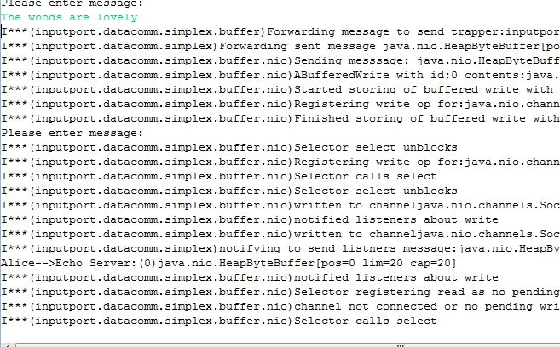
Trace
Tracer.showInfo(true");
May not want to to know about nio
Filtering: Selecting which events to print?

Slide 31
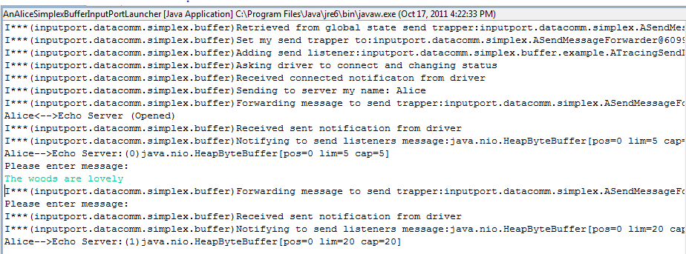
Only InputPort.DataComm.Simplex.Buffer

Slide 32
Explicit Keywords
public static void info(String keyWord, String info);
Tracer.info(“inputport.datacomm.simplex.buffer", "Asking driver to connect and changing status");
public static void setKeywordPrintStatus(
String keyWord,
Boolean status);
Tracer.setKeywordPrintStatus(“inputport.datacomm.simplex.buffer", true)
Tracer.setKeywordPrintStatus(Tracer.ALL_KEYWORDS, false);
Have to specify package name each time
Package name can change

Slide 33
Implicit KeyWords
public static void info(Object object, String info);
Tracer.info(this, "Asking driver to connect and changing status");
public static void setKeywordPrintStatus(Class c, Boolean status);
Tracer.setKeywordPrintStatus(
AGenericSimplexBufferClientInputPort.class,
false);

Slide 34
Showing Package Names
Cannot identify classes of the objects printing out messages
Need to not only specify which events to display but what information to display about each event
Tracer.showInfo(true);
Tracer.setKeywordPrintStatus(Tracer.ALL_KEYWORDS, false);
Tracer.setKeywordPrintStatus(
AGenericSimplexBufferClientInputPort.class, true);
Tracer.setMessagePrefixKind(MessagePrefixKind.PACKAGE_NAME);

Slide 35
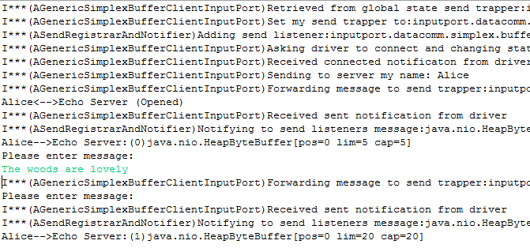
Showing Short Class Names
Tracer.showInfo(true);
Tracer.setKeywordPrintStatus(Tracer.ALL_KEYWORDS, false);
Tracer.setKeywordPrintStatus(
AGenericSimplexBufferClientInputPort.class, true);
Tracer.setMessagePrefixKind(MessagePrefixKind.SHORT_CLASS_NAME)

Slide 36
MessagePrefix
public static void setMessagePrefixKind(
MessagePrefixKind newValue)
public enum MessagePrefixKind {
NONE,
OBJECT_TO_STRING,
SHORT_CLASS_NAME,
FULL_CLASS_NAME,
PACKAGE_NAME
}

Slide 37
Displaying All Classes in Package
Tracer.showInfo(true);
Tracer.setKeywordPrintStatus(Tracer.ALL_KEYWORDS, false);
Tracer.setKeywordPrintStatus(
AGenericSimplexBufferClientInputPort.class, true);
Tracer.setMessagePrefixKind(MessagePrefixKind.SHORT_CLASS_NAME)
What if we want to focus on one class?
Narrow down which events

Slide 38
Controlling Implicit Keyword
Tracer.showInfo(true);
Tracer.setKeywordPrintStatus(Tracer.ALL_KEYWORDS, false);
Tracer.setImplicitKeywordKind(ImplicitKeywordKind.OBJECT_CLASS_NAME);
Tracer.setKeywordPrintStatus(
AGenericSimplexBufferClientInputPort.class, true);
Tracer.setMessagePrefixKind(MessagePrefixKind.SHORT_CLASS_NAME);

Slide 39
Implicit Keyword
public static void setImplicitKeywordKind(
ImplicitKeywordKind newValue)
public enum ImplicitKeywordKind {
OBJECT_TO_STRING,
OBJECT_CLASS_NAME,
OBJECT_PACKAGE_NAME
}

Slide 40
Tracer Static Methods Summary
setKeywordPrintStatus(String keyWord Boolean status);
info(String keyWord, String info);
setImplicitKeywordKind(ImplicitKeywordKind newValue)
info(Object obj, String info);
public enum ImplicitKeywordKind {
OBJECT_TO_STRING,
OBJECT_CLASS_NAME,
OBJECT_PACKAGE_NAME
}
setKeywordPrintStatus(Class cls, Boolean status);
public enum MessagePrefixKind {
NONE,
OBJECT_TO_STRING,
SHORT_CLASS_NAME,
FULL_CLASS_NAME,
PACKAGE_NAME
}
setMessagePrefixKind(MessagePrefixKind newValue)

Slide 41
Debugging Capabilities in Tracer?
Blocking but separate windows for different processes
See state at traced actions (with and without blocking)
Separate state for different threads (with and without blocking)
Have application-specific code learn about traced calls (perhaps in different processes)

Slide 42
Tracing Strings→Objects
setKeywordPrintStatus(String keyWord Boolean status);
info(String keyWord, String info);
setImplicitKeywordKind(ImplicitKeywordKind newValue)
info(Object obj, String info);
public enum ImplicitKeywordKind {
OBJECT_TO_STRING,
OBJECT_CLASS_NAME,
OBJECT_PACKAGE_NAME
}
setKeywordPrintStatus(Class cls, Boolean status);
public enum MessagePrefixKind {
NONE,
OBJECT_TO_STRING,
SHORT_CLASS_NAME,
FULL_CLASS_NAME,
PACKAGE_NAME
}
setMessagePrefixKind(MessagePrefixKind newValue)

Slide 43
String→Object
@DisplayToString(true)
@ComponentWidth(1000)
public class MVCTraceableInfo extends TraceableInfo{
public MVCTraceableInfo(String aMessage, Object anAnnouncer) {
super(aMessage, anAnnouncer);
}
public static MVCTraceableInfo newInfo(String aMessage, Object aFinder) {
MVCTraceableInfo retVal = new MVCTraceableInfo(aMessage, aFinder);
retVal.announce();
return retVal;
}
}
Tracer.info(this, “MVC structure built”)
MVCTraceableInfo( “MVC structure built”, this);

Slide 44
Tracing Objects
TraceableBus
newEvent ()
addTraceableListener()
Event Announcer Thread
AWT Thread
ATraceable DisplayAndWaitManager
newEvent ()
Traceable
Listener ()
Traceable
ObjectEditor.edit(
TraceableDisplayAndWaitManagerFactory.
getTraceableDisplayAndPrintManager());
announce()
synchronized waitForUser()
ASingleStepperAndListBrowser
synchronized proceed()
wait()
notify()

Slide 45
Message Bus
TraceableBus
newEvent ()
addTraceableListener()
Like an observable it has registration method
Has an announce method
Does not generate events – simply communicates them to observers

Slide 46
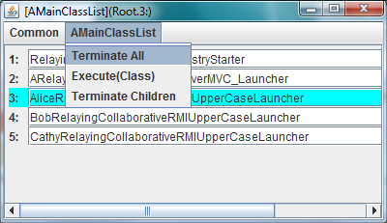
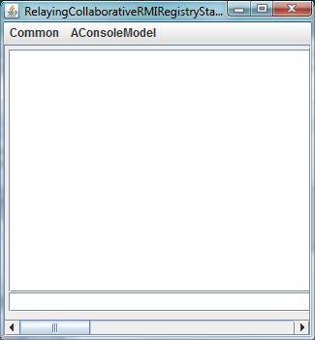
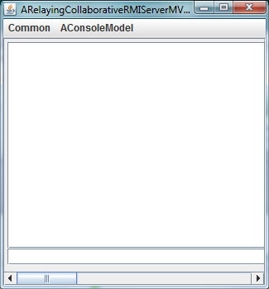
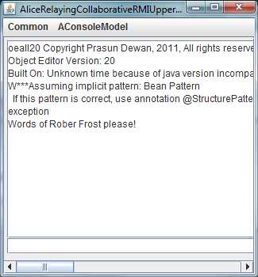
Run Functionality

Slide 47
Debug Functionality
public ADuplexRPCClientRelayingCollaborativeMVCLauncher(
String aClientName, String aServerHost,
String aServerId, String aServerName) {
super(aClientName, aServerHost, aServerId, aServerName);
ObjectEditor.edit
(TraceableDisplayAndWaitManagerFactory.
getTraceableDisplayAndPrintManager());
Tracer.setKeywordDisplayStatus(this, true);
}

Slide 48
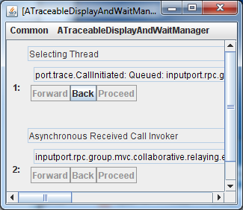
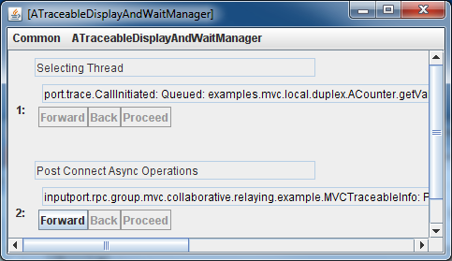
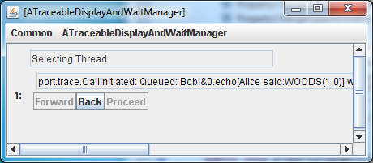
Each Process Can Have Separate Trace Window
Server
Alice
Bob

Slide 49
Each Trace Window has Separate Thread Area
Thread interacting with underlying communication channel
Thread invoking remote calls

Slide 50
Thread display
Thread name
Other info

Slide 51
Goals
Set break point
Debugger allows programmer to set breakpoint, resume, and at each breakpoint, pause and see stack trace, variable values, and console message when some line of code is executed
BP Resume
BP Console message
Tracer should provide equivalent
BP Variable Values

Slide 52
Console output Equivalent: Typed Tracing Message
GIPC-Defined Call Initiated Type
Instance specific message
Programmer-defined MVCTraceable Type
Instance specific message
getMessage()
Traceable
announce()
setMessage()

Slide 53
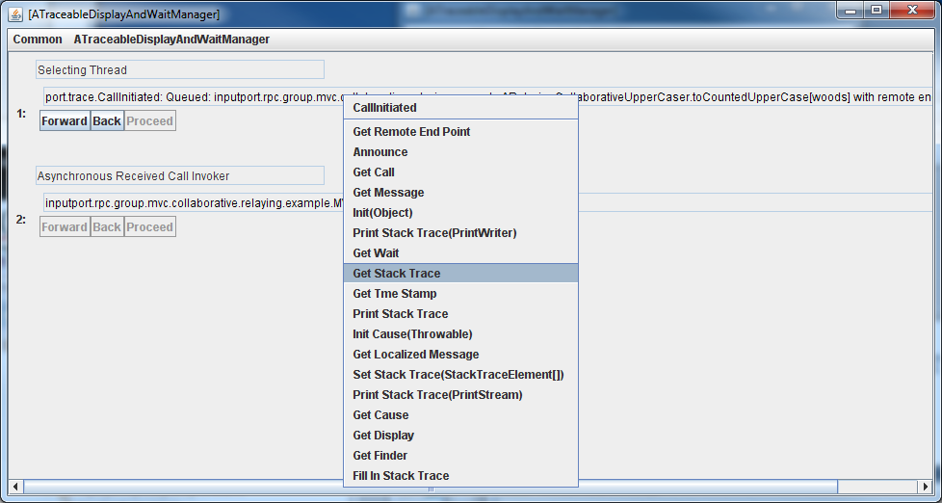
Stack Trace Equivalent: Stack Trace

Slide 54
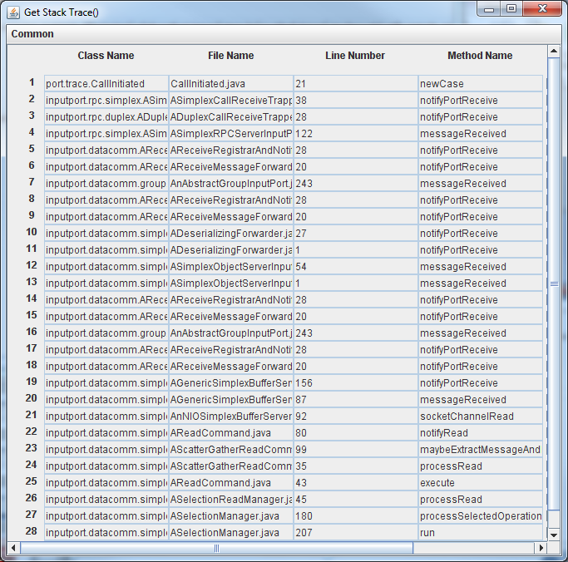
Stack Trace Display
Display of StackTrace Object

Slide 55
Inheritance Hierarchy
getStackTrace()
RuntimeException
IS-A
getMessage()
Traceable
announce()
setMessage()

Slide 56
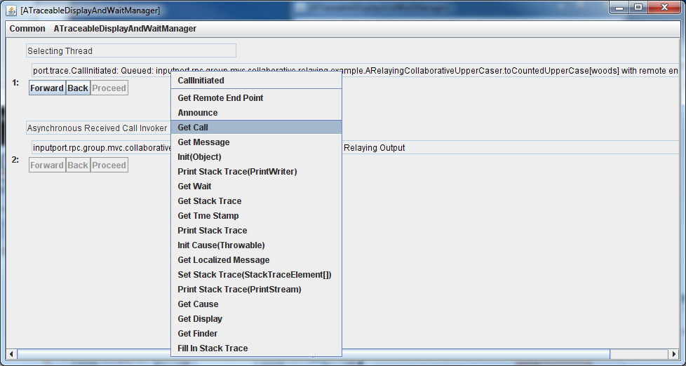
Exploring Variables: Event Properties
Can see properties of event by calling getters

Slide 57
Thread Has History of Typed Trace Info
Thread interacting with underlying communication channel

Slide 58
Browsing: Last to Last Call

Slide 59
Resume: Proceed Button

Slide 60
Set Break Point: Pause/Display all Announced Messages?
getMessage()
Traceable
announce()
setMessage()
May want to pause only some of the announcements
May want to display only some of the announcements
How to specify a set of related announcements that should be displayed or paused?

Slide 61
Using Announcer Object Attributes
Tracer
static setKeywordDisplayStatus (Object announcer, boolean status)
static setImplicitDisplayKeywordKind (ImplicitKeywordKind val)
static setImplicitWaitKeywordKind (ImplicitKeywordKind val)
public enum ImplicitKeywordKind {
OBJECT_TO_STRING,
OBJECT_CLASS_NAME,
OBJECT_PACKAGE_NAME }
default
setKeywordDisplay(Wait)Status(announcer, true(false)) says that if an event is announced by an object whose toString()/class/package attribute is that of the announcer then it should be displayed(wait).
Print, Display and Wait are three different things you can do with traced information
setImplicitDisplay(Wait)KeywordKind determines if toString(), class or package attribute is used for all events

Slide 62
Using Event Object
getMessage()
Traceable
announce()
setMessage()
setWait()
setDisplay()
IS-A
MVCTraceable

Slide 63
Debugger Issues Resolved
Debugger makes it difficult to test race conditions
All threads and processes mapped to a single code window
Cannot see the history of actions taken by a thread
Break points do not transfer to another computer
Cannot use a mechanism to set multiple related debug points

Slide 64
Summary
A Message bus allows communication of events among a set of related objects such as debugger and editor.
An event announced by an object are sent to all objects listening to it.
A Message bus can use a semi-wait free algorithm to avoid conflicting conecurrent announcements.

Slide 65
Summary
A Traceable bus is a message bus that allows one to simultaneously see the values of Traceable objects announced by different threads of a process.
One of the listeners of these objects is a single ATraceable DisplayAndWaitManager
The notification callback called in this object in response to the announcement of a Traceable:
Displays information about the Tracable if its Display property is true.
Blocks the thread until the user unblocks it if the Wait property of the Traceable is true.
Primitives are provided to set the display and wait property of all Traceables announced by
all code in a class,
all coce in a package
A Message bus can use a semi-wait free algorithm to avoid conflicting conecurrent announcements.

