Slide 1
Atmosphere Tutorial
Brennan Proudfoot
Prasun Dewan (dewan@cs.unc.edu)
Department of Computer Science
University of North Carolina at Chapel Hill
Acknowledgement: Calvin McLean, CyVerse

Slide 2
PowerPoint/PDF Link with URLS
PDF
http://www.cs.unc.edu/~dewan/734/current/lectures/AtmosphereTutorial.pdf
PPTX
http://www.cs.unc.edu/~dewan/734/current/lectures/AtmosphereTutorial.pptx
Search for unique words in this presentation

Slide 3
Distributed Java Interactive Programs in Multiple Virtual Computers
CyVerse Access
Atmosphere Access
Creating Atmosphere Instances
Exporting Jars
Transferring Files to Instances
Interacting with Instances
Suspending and Resuming Instances
Shared Atmosphere Instances

Slide 4
Atmosphere Page
http://www.cyverse.org/atmosphere

Slide 5
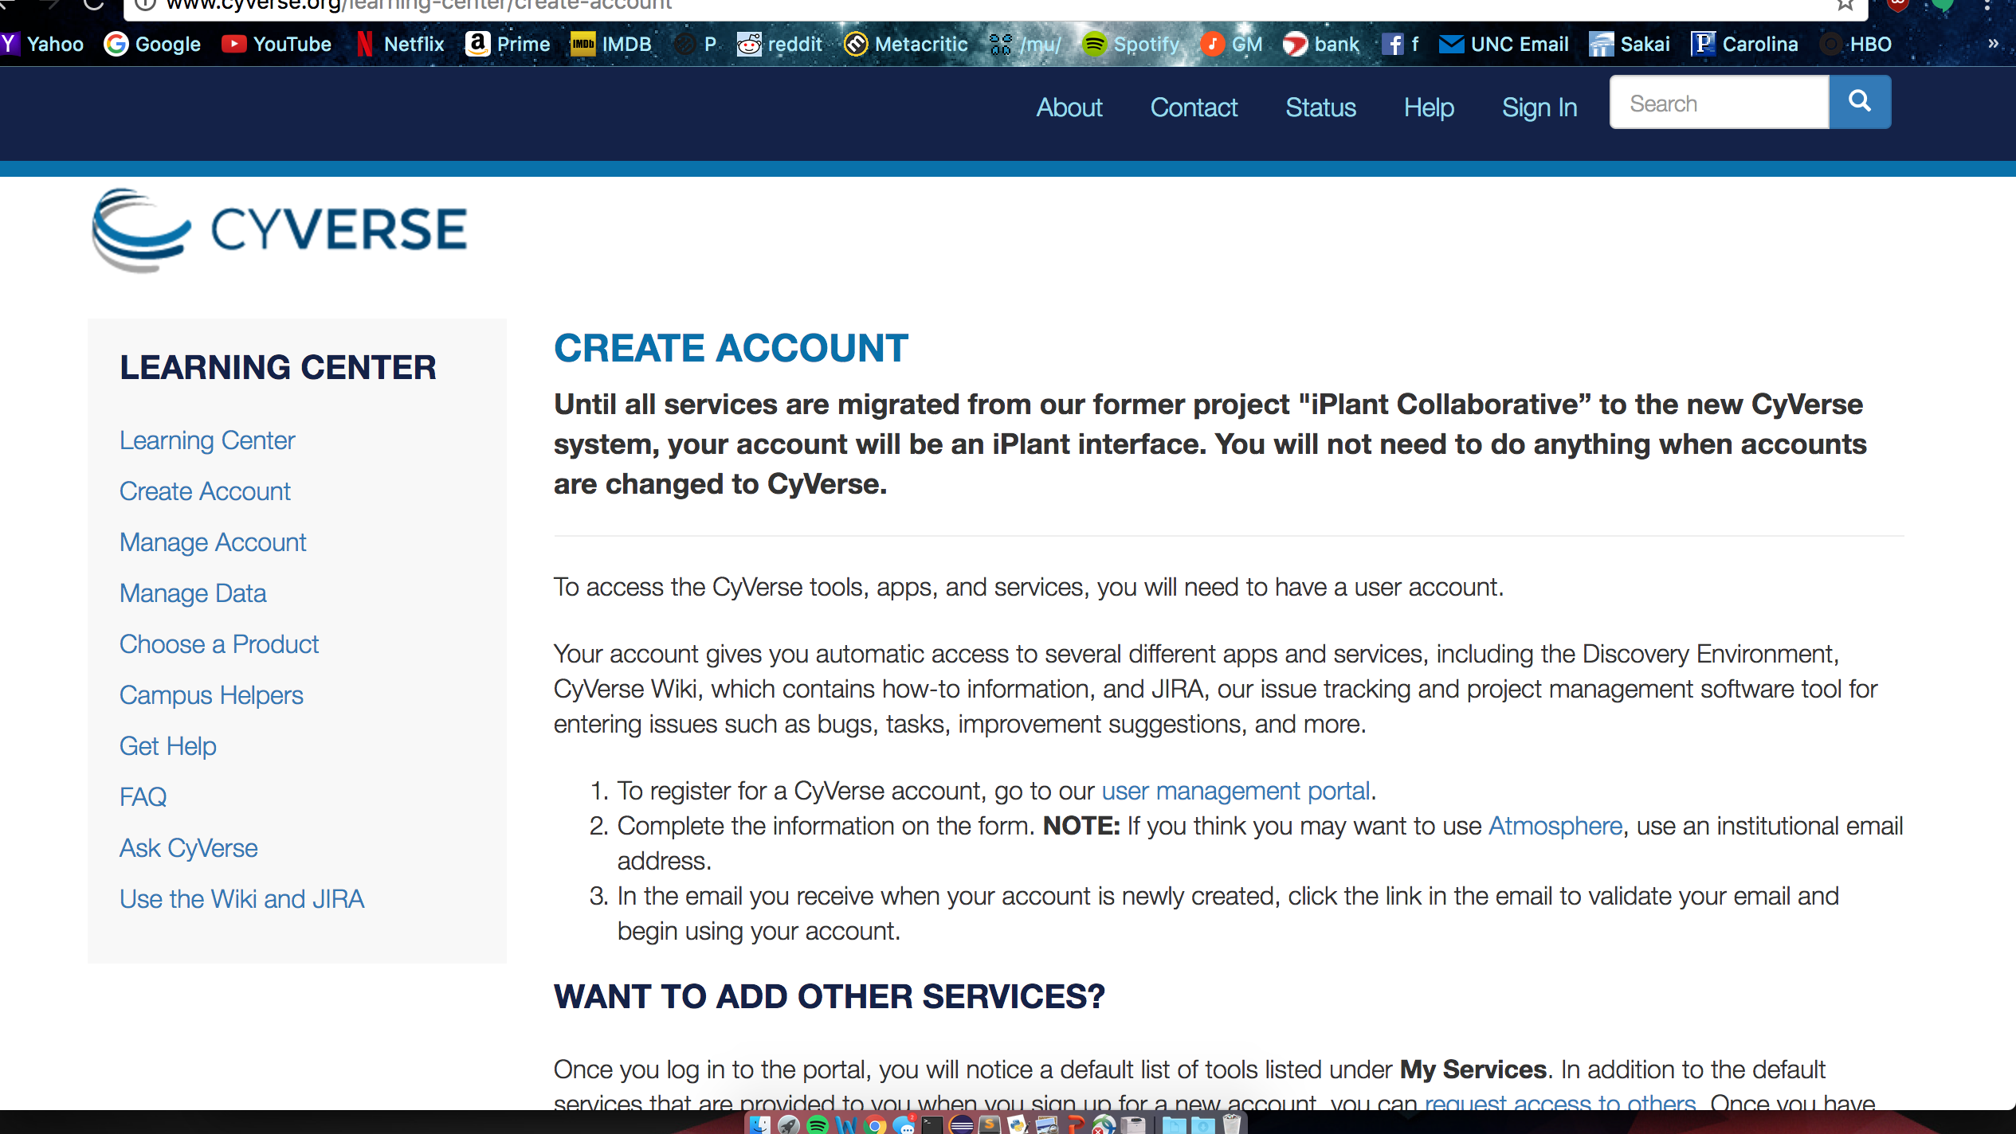
CyVerse Account Creation Section
Scroll Down and Click on User Management Portal

Slide 6
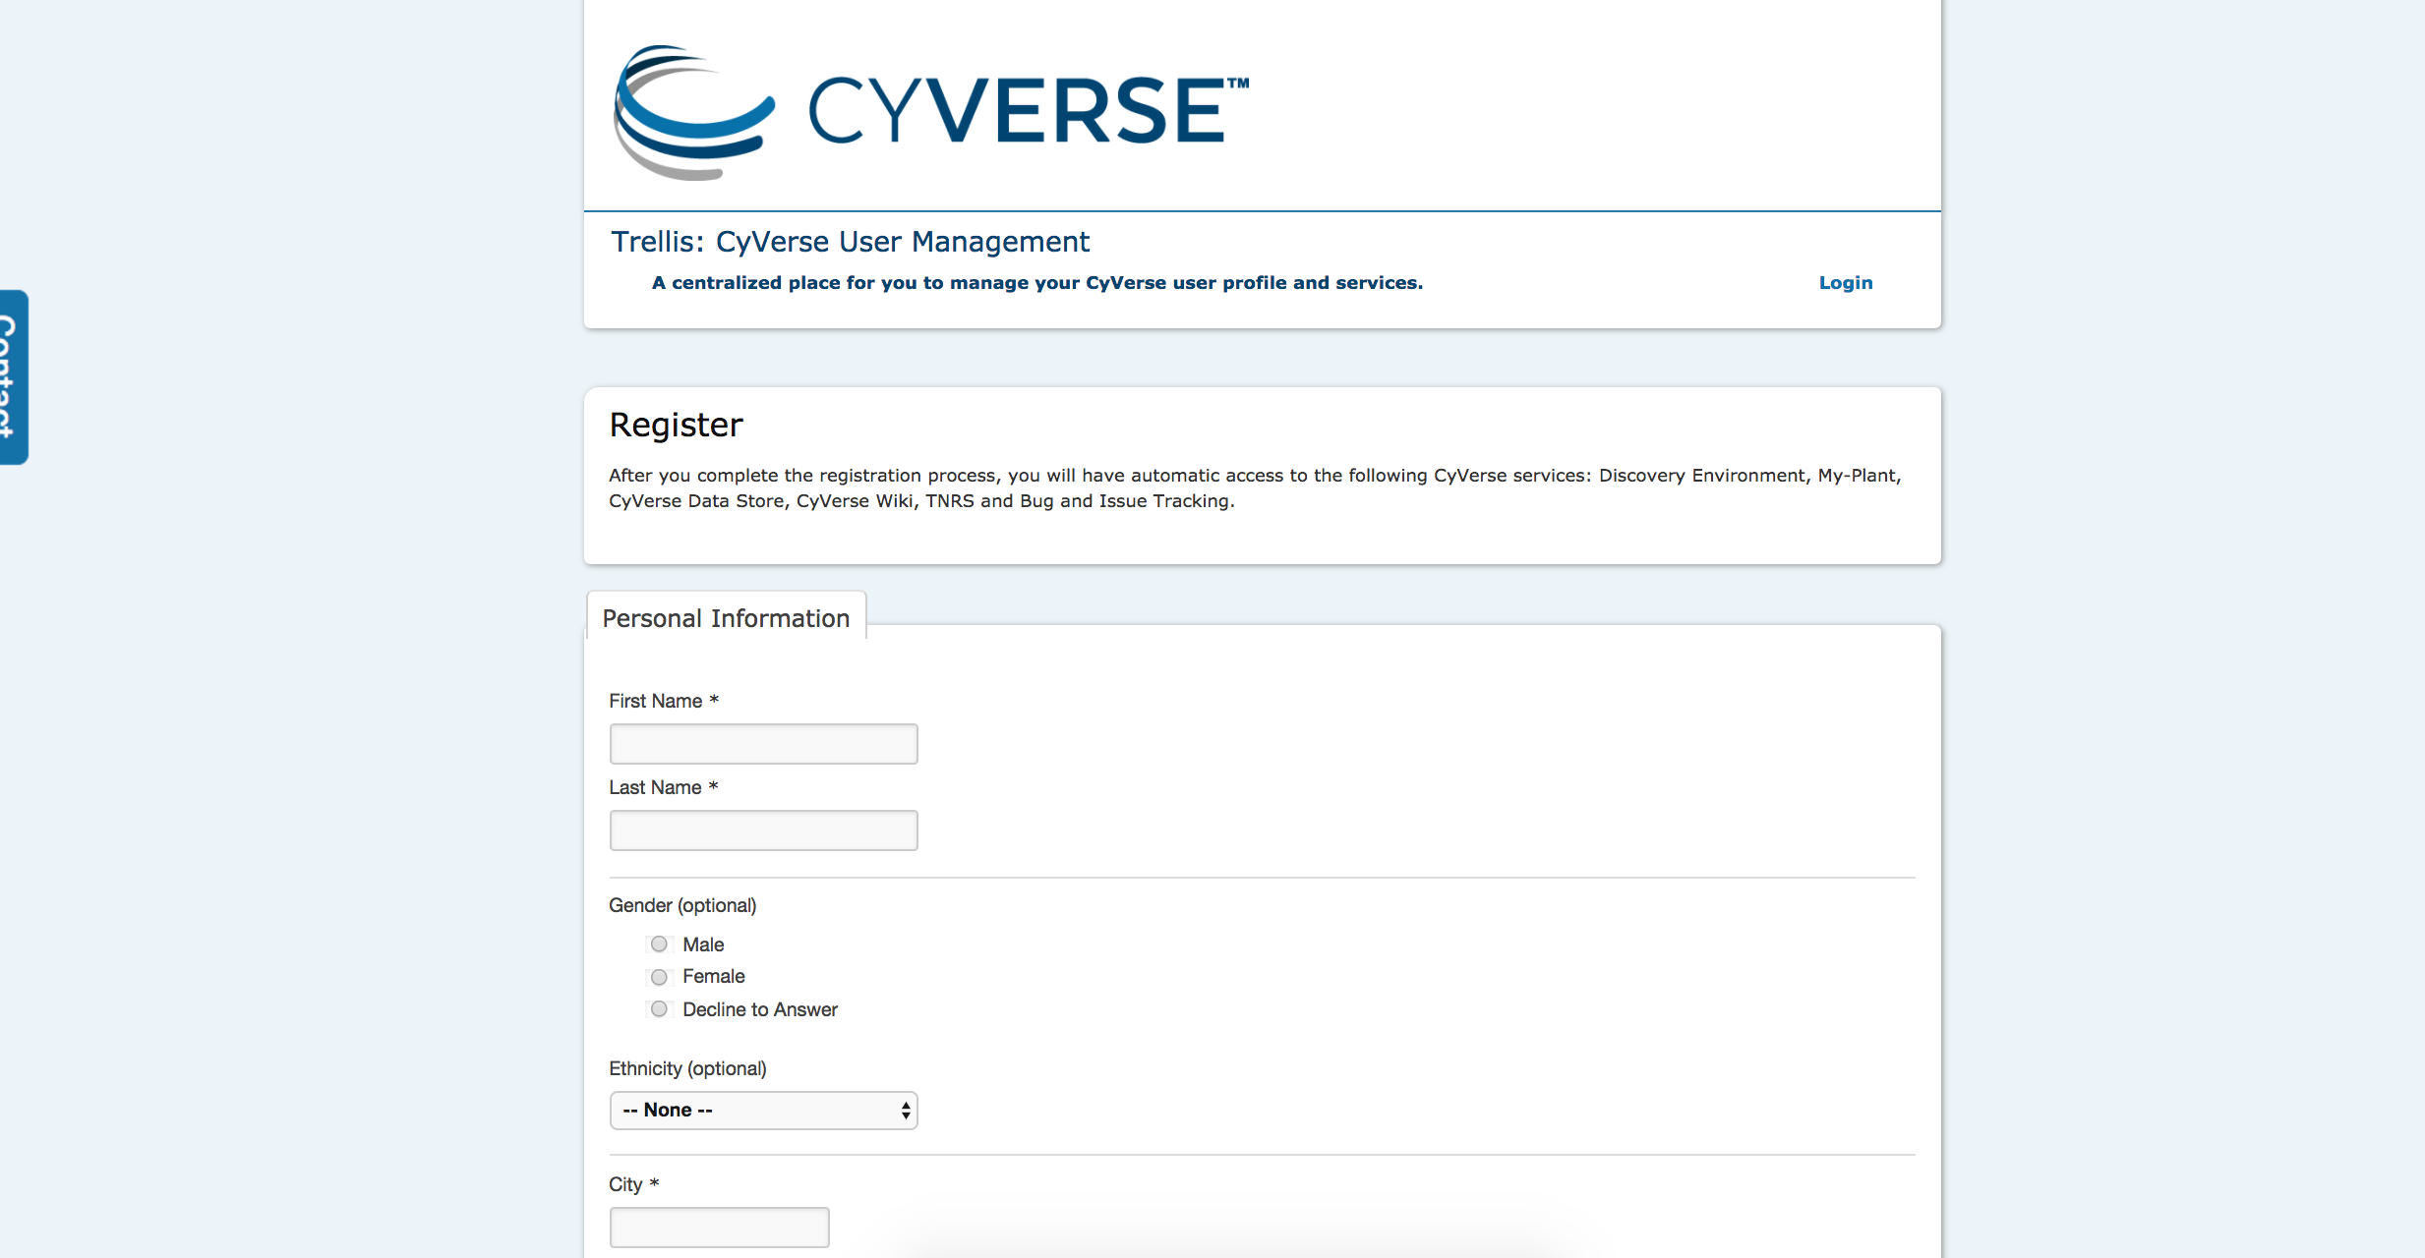
Fill Registration Form

Slide 7
Distributed Java Interactive Programs in Multiple Virtual Computers
CyVerse Access
Atmosphere Access
Creating Atmosphere Instances
Exporting Jars
Transferring Files to Instances
Interacting with Instances
Suspending and Resuming Instances
Shared Atmosphere Instances

Slide 8
Requesting Atmosphere Access
http://www.cyverse.org/atmosphere
After being registered, go back to the homepage and click on request access to Atmosphere

Slide 9
Requesting Atmosphere Access
Click on User Management

Slide 10
Requesting Atmosphere Access

Slide 11
Requesting Atmosphere Access
Click on Request Access under Available Services

Slide 12
Identify Professor/Course

Slide 13
Waiting for Atmosphere Access
Wait for your request to get fulfilled

Slide 14
Access Given
After a (possibly long ) while, if you refresh you will see that you have access

Slide 15
Access Email Notification
You should receive an email that saying your account has been granted access

Slide 16
Distributed Java Interactive Programs in Multiple Virtual Computers
CyVerse Access:
Atmosphere Access
Creating Atmosphere Instances
Exporting Jars
Transferring Files to Instances
Interacting with Instances
Suspending and Resuming Instances
Shared Atmosphere Instances

Slide 17
Launching Atmosphere
http://www.cyverse.org/atmosphere

Slide 18
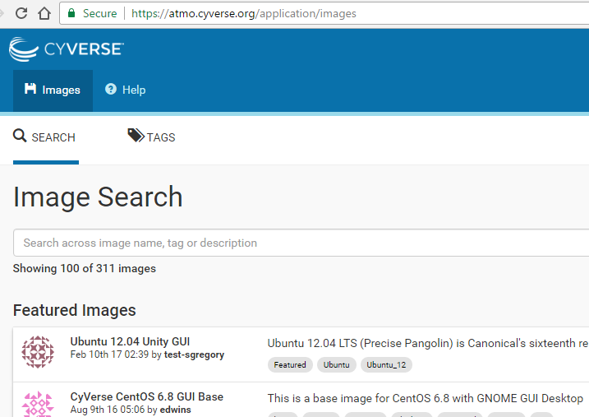
The Images Page
https://atmo.cyverse.org/application/images

Slide 19
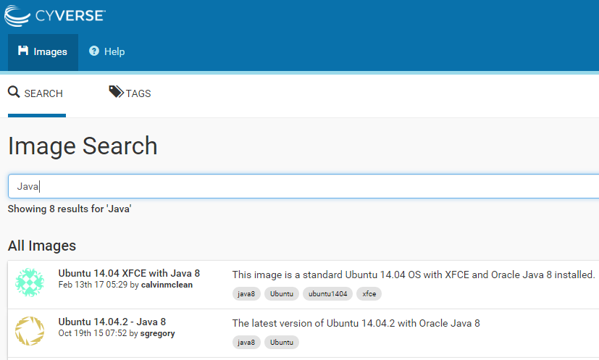
Java Images Page
https://atmo.cyverse.org/application/images

Slide 20
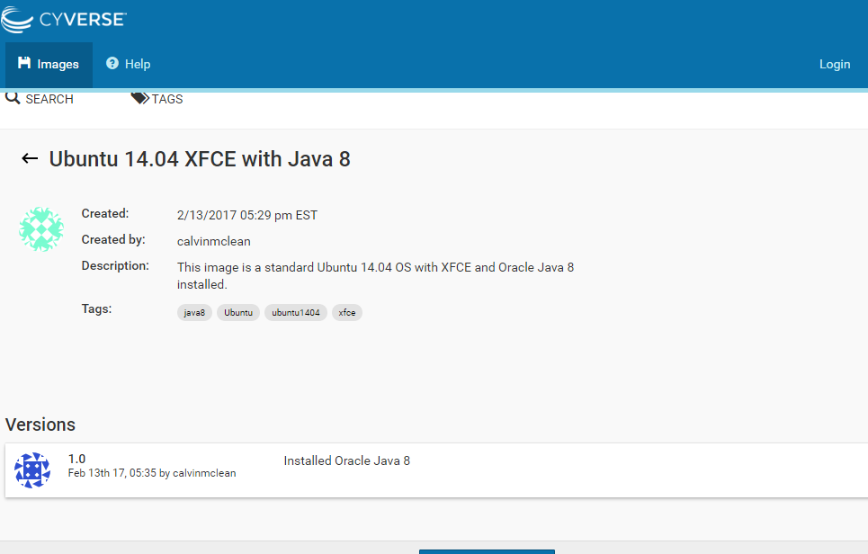
Launching Java 8 Image
https://atmo.cyverse.org/application/images/1418
Login

Slide 21
Launching Java 8 Image

Slide 22
Create Project and Launch Image
You’ll be prompted to create a new project. After creating the project launch the image

Slide 23
Launching Takes Time: Build Phase
You’ll be redirected to a screen that looks like this until you get access, which can take some time

Slide 24
Active Instance
After getting access your window will look like this with the status active and the IP address of the new “machine” that has been computed for you

Slide 25
Email about Created Instance
This email provides you with both the ip address and your ssh username

Slide 26
Distributed Java Interactive Programs in Multiple Virtual Computers
CyVerse Access:
Atmosphere Access
Creating Atmosphere Instances
Exporting Jars
Transferring Files to Instances
Interacting with Instances
Suspending and Resuming Instances
Shared Atmosphere Instances

Slide 27
Exporting an Eclipse Project

Slide 28
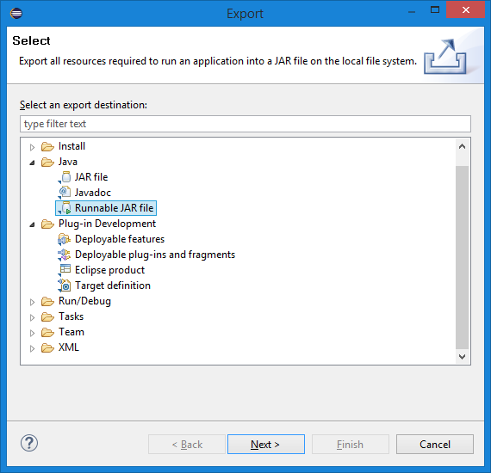
Runnable Jar
Runnable jar includes identity of the main class

Slide 29
Identifying the Main in Jar
Export your client and server as different executable jar files with different launch configurations

Slide 30
Distributed Java Interactive Programs in Multiple Virtual Computers
CyVerse Access:
Atmosphere Access
Creating Atmosphere Instances
Exporting Jars
Transferring Files to Instances
Interacting with Instances
Suspending and Resuming Instances
Shared Atmosphere Instances

Slide 31
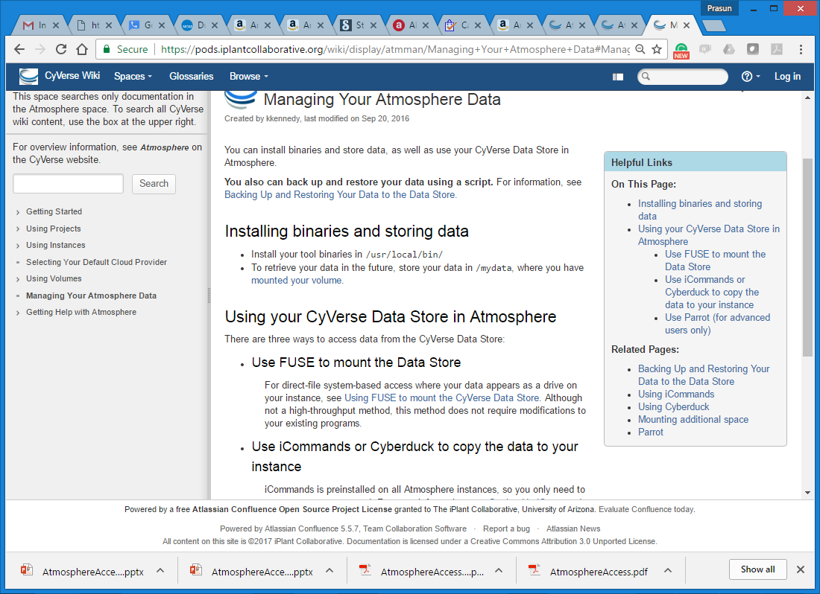
Transferring Files
https://pods.iplantcollaborative.org/wiki/display/atmman/Managing+Your+Atmosphere+Data

Slide 32
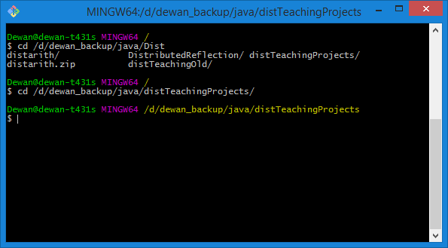
SFTP (not FTP) Client
Git Bash is an SFTP Client
Change directory to folder containing the files to be uploaded

Slide 33
Uploading Files
sftp into the ip address you are emailed with your username and upload your client and server and any files they access such as image files

Slide 34
Distributed Java Interactive Programs in Multiple Virtual Computers
CyVerse Access:
Atmosphere Access
Creating Atmosphere Instances
Exporting Jars
Transferring Files to Instances
Interacting with Instances
Suspending and Resuming Instances
Shared Atmosphere Instances

Slide 35
SSH Connection
Enter CyVerse login name and password

Slide 36
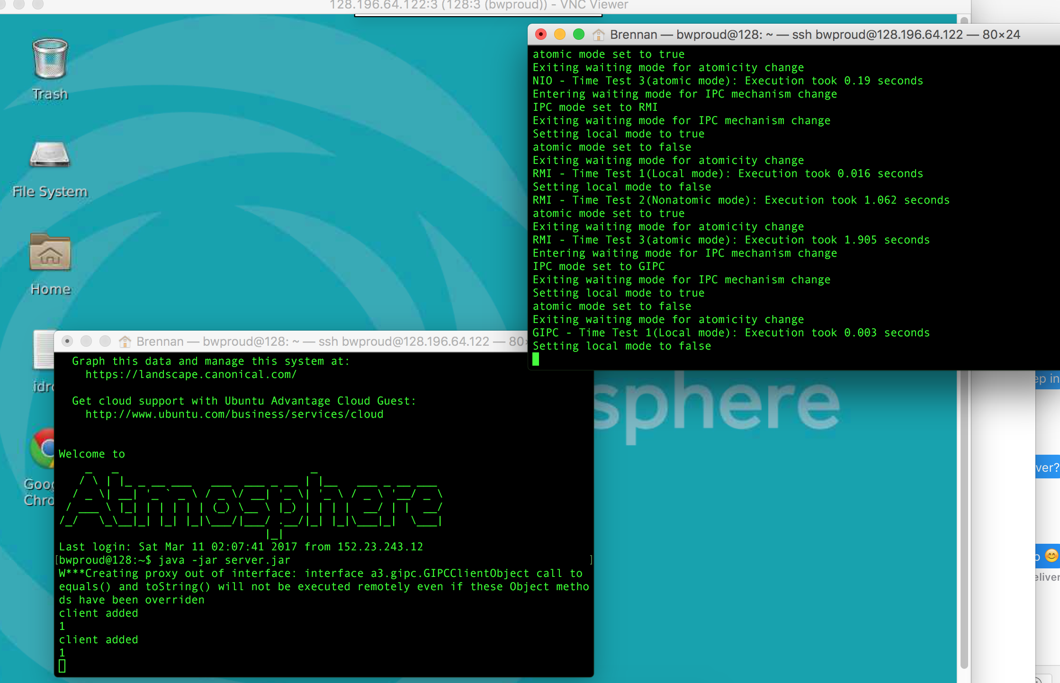
Two SSH Sessions to Same Instance
To run your program (in headless mode), ssh into the ip address and run your jars using the “java –jar” commands
GUI program will either not run saying no X server or run in headless mode

Slide 37
VNC Viewer Remote Desktop
Download and launch VNCViewer and in the address bar put your images ip address at port 1
A VNC Server is automatically started for the owner of the instance

Slide 38
Logging in using CyVerse Credentials
Login using your cyverse username and password

Slide 39
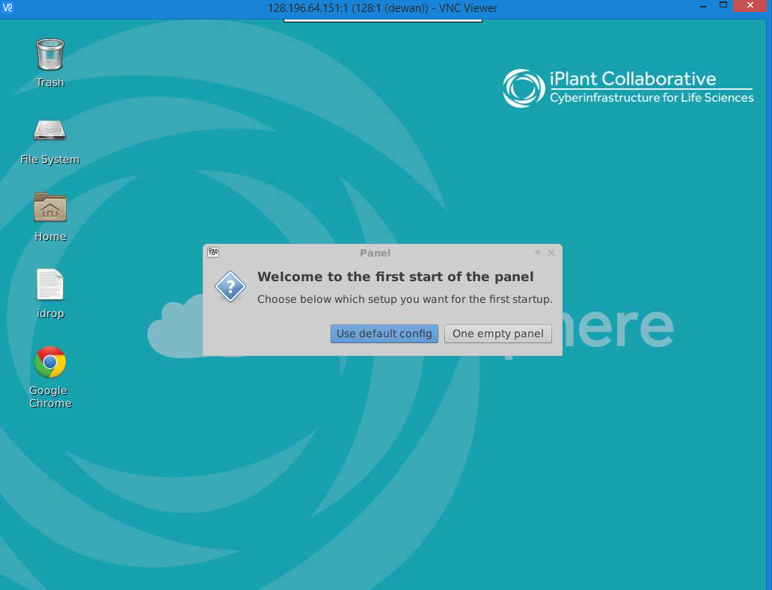
Remote Desktop to Instance

Slide 40
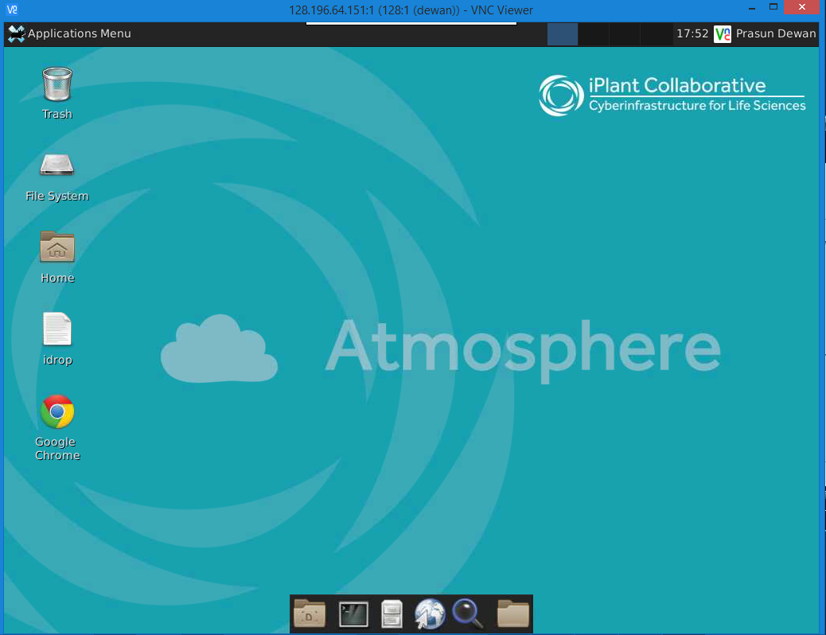
Launch Terminal Emulator

Slide 41
Using a Terminal
After you’ve logged in, open up a terminal and run your server using “java –jar server.jar” or whatever you named your jar

Slide 42
Running Client on Same Instance
If you do the same with client jar, your program should run

Slide 43
Interacting with Multiple Instances
Can have multiple VNC or SSH sessions to different instances
To create each new instance, go to the Image URL and launch it (see “Launching Java 8 Image” )

Slide 44
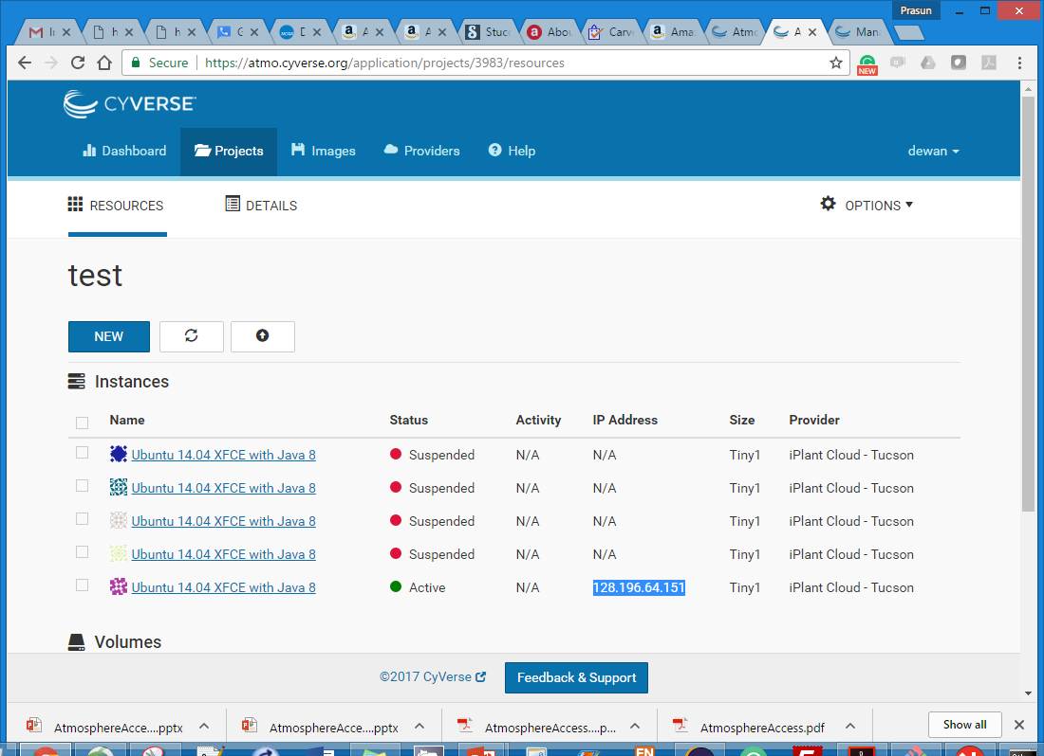
Conserving Resources
Go to Projects Tab to see Instances
If you exhaust your quota, instance will be automatically suspended but will need to wait to accumulate credit a la free calling minutes
Click on instance to manipulate it

Slide 45
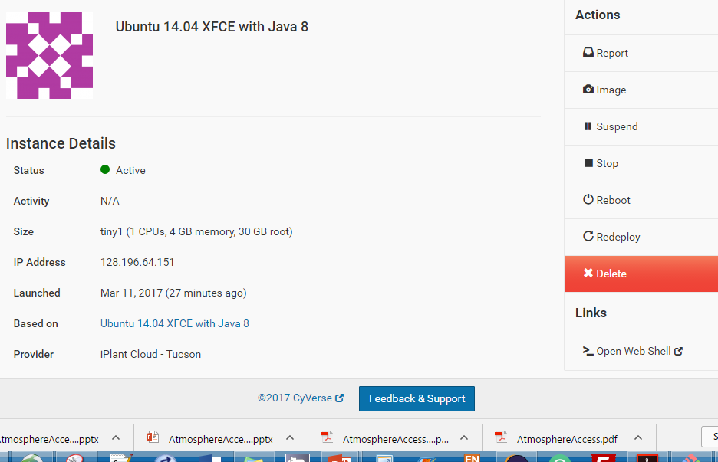
Instance Operations

Slide 46
Reactivating
Wil get new IP address when unsuspended.

Slide 47
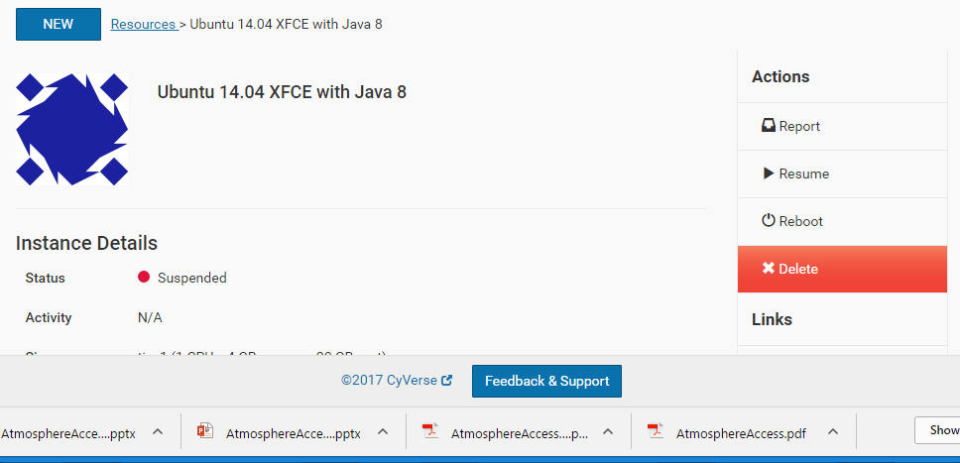
Reactivating
Uploaded files should still be accessible

Slide 48
Resuming Problems
May get deployment error or resuming may hang, so save changed files before suspending

Slide 49
Distributed Java Interactive Programs in Multiple Virtual Computers
CyVerse Access:
Atmosphere Access
Creating Atmosphere Instances
Exporting Jars
Transferring Files to Instances
Interacting with Instances
Suspending and Resuming Instances
Shared Atmosphere Instances

Slide 50
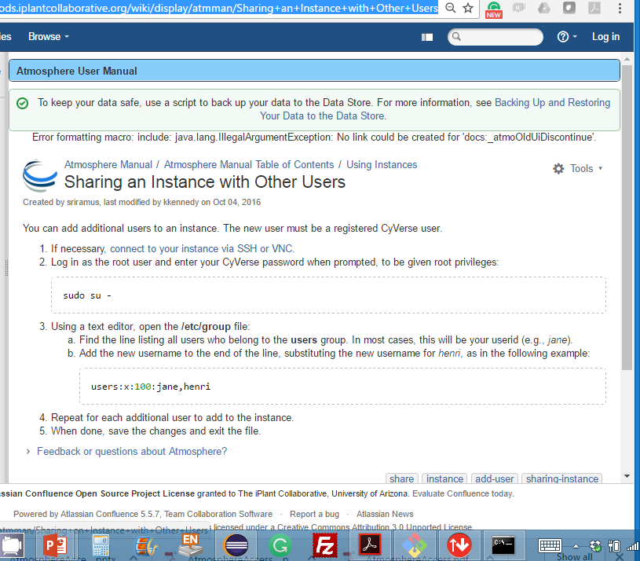
Sharing an Instance
https://pods.iplantcollaborative.org/wiki/display/atmman/Sharing+an+Instance+with+Other+Users

Slide 51
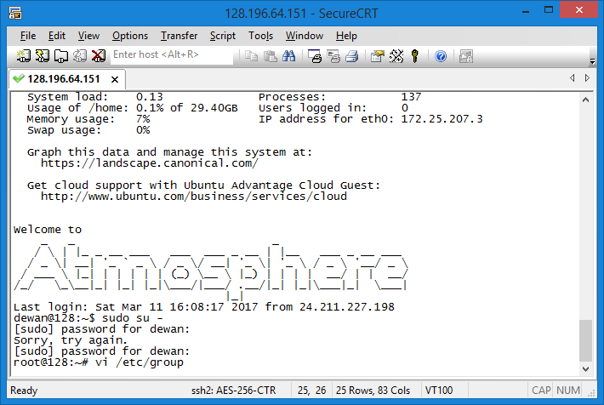
Sharing an Instance

Slide 52
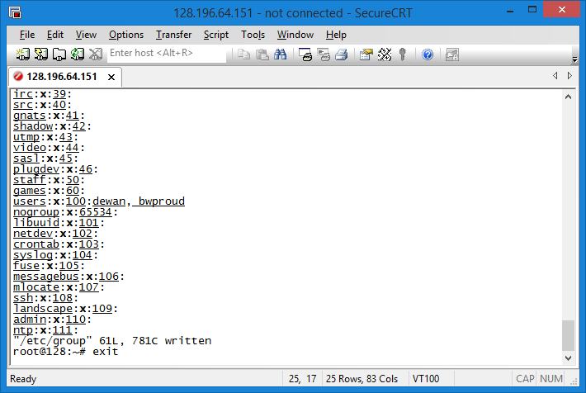
Sharing an Instance

Slide 53
New User Can SSH

Slide 54
New User Needs VNCServer
Run the vncserver command to find the ip address with port to access the GUI

Slide 55
VNC Client Now Uses Different Port

Slide 56
Killing VNC Server
vncserver -kill :3

Slide 57
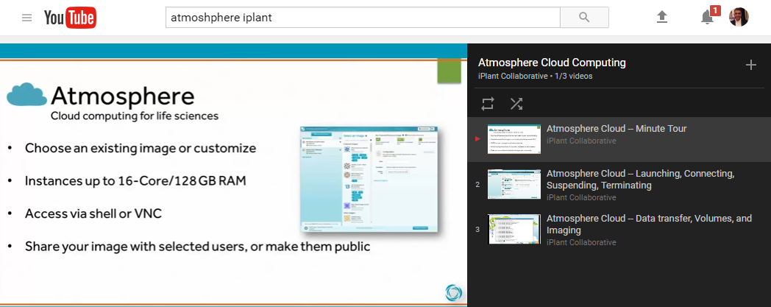
Other Resources

