Slide 1

Comp 401
Animation: MVC
Instructor: Prasun Dewan

Slide 2
Prerequisite
Animation: Loops

Slide 3
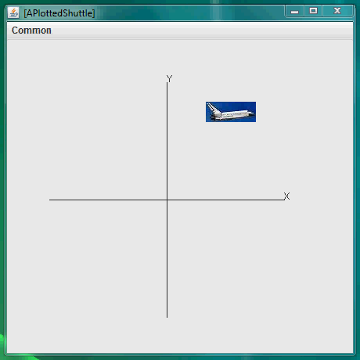
Shuttle Animation

Slide 4
Basic Architecture
APlotted
Shuttle
setShuttleX(Y)()
animateFromOrigin()
AShuttleAnimator
Main Class
main

Slide 5
AnimateFromOrigin
public void animateFromOrigin(PlottedShuttle shuttle,
int animationStep, int animationPauseTime) {
int originalX = shuttle.getShuttleX();
int originalY = shuttle.getShuttleY();
int curX = 0;
int curY = 0;
shuttle.setShuttleX(curX);
shuttle.setShuttleY(curY);
animateYFromOrigin(shuttle, animationStep,
animationPauseTime, curY, originalY);
animateXFromOrigin(shuttle, animationStep,
animationPauseTime, curX, originalX);
}

Slide 6
Animation in Y Direction
protected void animateYFromOrigin(PlottedShuttle shuttle,
int animationStep, int animationPauseTime,
int startY, int endY) {
// make sure we don’t go past final Y position
while (startY < endY) {
ThreadSupport.sleep(animationPauseTime);
startY += animationStep;
shuttle.setShuttleY(startY);
}
// move to destination Y position
shuttle.setShuttleY(endY);
}

Slide 7
Main Method
public static void main(String[] args) {
PlottedShuttle shuttle = new APlottedShuttle(50, 100);
OEFrame oeFrame = ObjectEditor.edit(shuttle);
oeFrame.hideMainPanel();
oeFrame.setSize (450, 450);
ShuttleAnimator shuttleAnimator = new AShuttleAnimator();
shuttleAnimator.animateFromOrigin(aShuttle, 5, 100, anOEFrame);
}
No animation, nothing happens on the screen
Using non observable version of plotted shuttle

Slide 8
Manual Full Refresh
protected void animateYFromOrigin(PlottedShuttle shuttle,
int animationStep, int animationPauseTime,
int startY, int endY, OEFrame frame) {
// make sure we don’t go past final Y position
while (startY < endY) {
ThreadSupport.sleep(animationPauseTime);
startY += animationStep;
shuttle.setShuttleY(startY);
frame.refresh();
}
// move to destination Y position
shuttle.setShuttleY(endY);
}

Slide 9
Manual Full Refresh
public class ShuttleAnimationDriver {
public static void demoShuttleAnimation(
ShuttleAnimator aShuttleAnimator,
PlottedShuttle aShuttle,
OEFrame anOEFrame) {
aShuttleAnimator.animateFromOrigin(aShuttle, 5, 100);
aShuttleAnimator.animateFromOrigin(aShuttle, 5, 100, anOEFrame);
}
public static void main(String[] args) {
PlottedShuttle shuttle = new APlottedShuttle(50, 100);
OEFrame oeFrame = ObjectEditor.edit(shuttle);
oeFrame.hideMainPanel();
oeFrame.setSize (450, 450);
ShuttleAnimator shuttleAnimator = new AShuttleAnimator();
demoShuttleAnimation(shuttleAnimator, shuttle, oeFrame);
}
}
Both animateFromOrigins take the same amount of time
The refreshing one changes the display, the other one does not

Slide 10
Refreshing Architecture
APlotted
Shuttle
Component
setShuttleX(Y)()
repaint()
paint()
ObjectEditor
refresh()
animateFromOrigin()
AShuttleAnimator
animateFromOrigin
Main Class
main

Slide 11
Problem with Full Refresh
The entire UI is refreshed, not just the part that changes
Multiple GUIs (views) may be displaying the same object
Should create animated objects as observables

Slide 12
Using MVC
public static void demoShuttleAnimation(
ShuttleAnimator aShuttleAnimator,
PlottedShuttle aShuttle,
OEFrame anOEFrame) {
aShuttleAnimator.animateFromOrigin(aShuttle, 5, 100);
aShuttleAnimator.animateFromOrigin(aShuttle, 5, 100, anOEFrame);
}
public static void main(String[] args) {
PlottedShuttle shuttle = new APlottedShuttle(50, 100);
OEFrame oeFrame = ObjectEditor.edit(shuttle);
oeFrame.hideMainPanel();
oeFrame.setSize (450, 450);
ShuttleAnimator shuttleAnimator = new AShuttleAnimator();
demoShuttleAnimation(shuttleAnimator, shuttle, oeFrame);
}
}
public class ObservableShuttleAnimationDriver extends ShuttleAnimationDriver {
public static void main(String[] args) {
ObservablePlottedShuttle shuttle =
new AnObservablePlottedShuttle(50, 100);
OEFrame oeFrame = ObjectEditor.edit(shuttle);
oeFrame.hideMainPanel();
oeFrame.setSize (400, 400);
oeFrame.setLocation(400, 0);
PropertyChangeListener view = new APlottedShuttleView(shuttle);
shuttle.addPropertyChangeListener(view);
JFrame frame = new JFrame("Plotted Shuttle");
frame.add((Component) view);
frame.setSize(400, 400);
frame.setVisible(true);
ShuttleAnimator shuttleAnimator = new AShuttleAnimator();
demoShuttleAnimation(shuttleAnimator, shuttle, oeFrame);
}

Slide 13
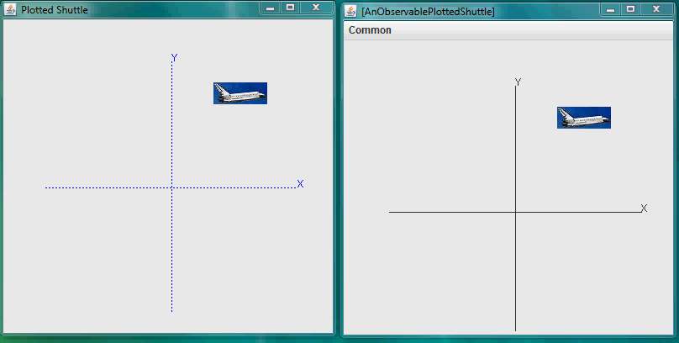
Animation and MVC

Slide 14
Non Observable Architecture
APlotted
Shuttle
Component
setShuttleX(Y)()
repaint()
paint()
ObjectEditor
refresh()
animateFromOrigin()
AShuttleAnimator
animateFromOrigin
Main Class
main

Slide 15
Observable Architecture
APlotted
Shuttle
Component
setShuttleX(Y)()
repaint()
paint()
ObjectEditor
refresh()
animateFromOrigin()
AShuttleAnimator
animateFromOrigin
Main Class
main

Slide 16
Incremental Updates
After each animation step, all displays of the animation must be updated
The refresh operation can be used to do ensure these updates are made.
Better, the observable-observer concept can be used to ensure these updates are made
  for each graphical property changed by the animation, the class of the property should allow observers to be registered and the setter of the property informs the observers about the update
ObjectEditor requires the JavaBeans observer-observer approach based around the PropertyChangeListener interface

Slide 17
Extra

Slide 18
Main vs. Interactive Animation
public static void main(String[] args) {
PlottedShuttle shuttle = new APlottedShuttle(50, 100);
OEFrame oeFrame = ObjectEditor.edit(shuttle);
oeFrame.hideMainPanel();
oeFrame.setSize (450, 450);
ShuttleAnimator shuttleAnimator = new AShuttleAnimator();
shuttleAnimator.animateFromOrigin(aShuttle, 5, 100);
}
public static void main (String[] args) {
PlottedShuttle shuttle = new APlottedShuttle(50, 100);
OEFrame oeFrame = ObjectEditor.edit(shuttle);
oeFrame.hideMainPanel();
oeFrame.setSize (450, 450);
FancyShuttleAnimator shuttleAnimator = new AFancyShuttleAnimator();
ObjectEditor.edit(shuttleAnimator);
}

Slide 19
Fancy Animator
public class AFancyShuttleAnimator extends AShuttleAnimator
implements FancyShuttleAnimator {
int animationStep = 5;
int animationPauseTime = 100;
PlottedShuttle shuttle;
public AFancyShuttleAnimator(PlottedShuttle theShuttle) {
shuttle = theShuttle;
}
public int getAnimationStep() {
return animationStep;
}
public void setAnimationStep(int animationStep) {
this.animationStep = animationStep;
}
public int getAnimationPauseTime() {
return animationPauseTime;
}
public void setAnimationPauseTime(int animationPauseTime) {
this.animationPauseTime = animationPauseTime;
}
public void animateShuttle() {
animateFromOrigin(shuttle, animationStep, animationPauseTime);
}
}

Slide 20
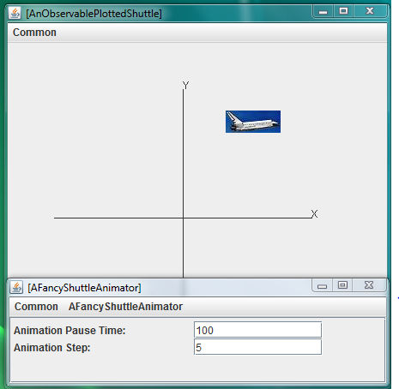
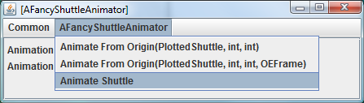
GUI

Slide 21
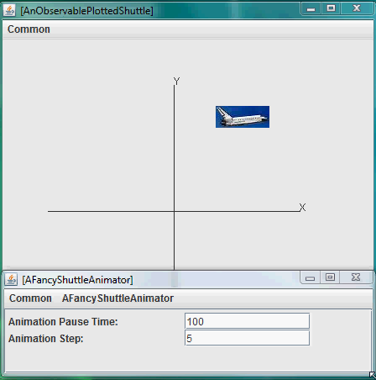
Video

Slide 22
UI vs Main Thread
Problem is that the user interface both executes loop and does the redraws the screen
Redrawing of screen done after loop is over
In the main case, the man thread or activity, executes loop
The UI thread or activity redraws the screen

Slide 23
Asking ObjectEditor to Interactive Call in Separate Thread
@SeparateThread(true)
public void animateShuttle() {
animateFromOrigin(shuttle, animationStep, animationPauseTime);
}

