Slide 1
Comp 110/401 Collection Kinds
Instructor: Prasun Dewan

Slide 2
Prerequisite
Arrays Collections Implementation

Slide 3
Collection Types
StringHistory, StringDatabase, StringSet
Array
ArrayList, List
Map
Stack
Queue

Slide 4
Structured vs. Atomic Types
Atomic Types
Structured Types
Primitive types
Classes
double
int
ACartesianPoint
StringHistory
Classes
ABMICalculator
Interfaces
Interfaces
BMICalculator
Point
AStringHistory
Instances of structure type decomposed into one or more smaller values

Slide 5
Logical Structure Point
int
int
Property name
X
Y
Point
double
Angle
Radius
double
Interface, Class or primitive type of property value

Slide 6
Logical Structure Array
int
int
index
0
1
{5, 6, 7, 8}
int
2
3
int
Interface, Class or primitive type of property value

Slide 7
Bean vs. Array
int
int
int
int
X
0
Y
1
Point
double
{5, 6, 7, 8}
int
Angle
2
Radius
3
double
int
Property Name
Heterogenous
Homogenous
Index
Components can be of different types and serve different functions
Components are of same type (which may be a super type of the specific types of the components) and are handles in the same way
Object[] objects = { “Joe Doe”, new AStringDatabase(), new AStringHistory()};

Slide 8
Bean vs. (Indexed) Collection
point.getX()
point.setY(100)
Bean: Program fragment can refer to only a particular kind of component of composite object
scores[position + 1]
Collection: Program fragment can refer to any component of the composite object
Indexed collection: components referred explicitly by int expressions

Slide 9
Indexed Collections
Each element identified by a unique index
Successive elements have consecutive indices

Slide 10
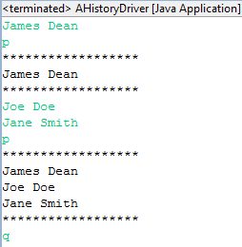
StringHistory?
size()
String
History
elementAt()
addElement()

Slide 11
StringHistory
String
String
index
0
1
stringHistory
String
2
3
String
stringHistory.elementAt(position + 1)
Collection: Program fragment can refer to any component of the composite object
Indexed collection: components referred explicitly by int expressions

Slide 12
StringHistory vs. Array
size()
String
History
elementAt()
addElement()
Dynamic: After creation, can grow
Programmer-defined
String[] strings= { “James Dean”, “Joe Doe”, “Jane Smith”)};
Static and Language-defined

Slide 13
Static vs. Dynamic Structures
Static
Beans have fixed number of properties
Arrays have fixed number of elements
Though an array variable can be assigned arrays of different sizes
Dynamic
Can create new edges in logical structure

Slide 14
History
public interface StringHistory {
public void addElement(String element);
public int size();
public String elementAt(int index);
}

Slide 15
Database
public interface StringDatabase {
//from history
public int size();
public void addElement(String element);
public String elementAt(int index);
//additional methods
public void removeElement(String element);
public boolean member(String element);
public void clear();
}
Do we need a history if we have a database?
Yes, principle of least privilege

Slide 16
Principle of Least Privilege/ Need to Know
Do not give a user of some code more rights than it needs
Code is easier to change
Need to learn less to use code
Less likelihood of accidental or malicious damage to program
Like hiding engine details from car driver

Slide 17
Visibility of A Type and its Members: Some Type are More Equal than Others
All classes
private
Subtypes
Co-Packaged
default
Increasing access
protected
public
Co-packaged a la co-workers, amplifier + speakers
Subtype a la family, deluxe amplifier
Encapsulation Rule: Do not make variables of a class public

Slide 18
Using Database as History
public interface StringDatabase {
//from history
public int size();
public void addElement(String element);
public String elementAt(int index);
//additional methods
public void removeElement(String element);
public boolean member(String element);
public void clear();
}
Programmer would be able to perform inappropriate operations on a logical history implemented physically as a database

Slide 19
Co-Existence
public interface StringDatabase extends StringHistory {
//additional methods
public void removeElement(String element);
public boolean member(String element);
public void clear();
}
Programmer would be able to perform inappropriate operations on a logical history implemented physically as a database

Slide 20
Vector: General Object Collection
public final int size();
public final Object elementAt(int index);
public final void addElement(Object obj) ;
public final void setElementAt(Object obj, int index);
public final void insertElementAt(Object obj, int index);
public final boolean removeElement(Object obj);
public final void removeElementAt(int index);
public final int indexOf(Object obj);
…
Do we need other collections if we have Vector
Yes, principle of least privilege
Yes, implementation considerations

Slide 21
Class ArrayList And Vector (List)
public final int size();
public final Object get(int index);
public final void add(Object obj) ;
public final void set(int index, Object obj);
public final void insert(int index, Object obj);
public final boolean remove(Object obj);
public final void remove(int index);
public final int indexOf(Object obj);
…
Vector has ArrayList (List) methods plus the additional original methods in the previous slides
Can add arbitrary objects to these collections

Slide 22
Array List and Vector User
import java.util.ArrayList;
import java.util.List;
import java.util.Vector;
public class VectorArrayListUser {
public static void main (String[] args) {
List names = new Vector();
List grandSlams = new ArrayList();
names.add("Nadal");
grandSlams.add(13);
names.add("Federer");
grandSlams.add(17);
names.add(“Borg");
grandSlams.add(11);
names.add(“Sampras");
grandSlams.add(14);
}
}
What kind of dynamic structure is being simulated?

Slide 23
Indexed Collections
Each element identified by a unique index
Successive elements have consecutive indices

Slide 24
Tables
Each element identified by a unique object called a key
Usually strings are used as keys

Slide 25
HashMap (Implements Map)
// associates key with value, returning last value associated with key
public final Object put (Object key, Object value);
// returns last value associated with key, or null if no association
public final Object get (Object key);
Final means method cannot be overridden

Slide 26
HashMap Use
public static void main (String[] args) {
Map aMap = new HashMap();
aMap.put("Nadal", 10);
aMap.put("Federer", 17);
aMap.put("Sampras", 14);
System.out.println(aMap.get("Nadal"));
System.out.println(aMap.get("nadal"));
aMap.put("Nadal", 11);
System.out.println(aMap.get("Nadal"));
System.out.println(aMap);
}

Slide 27
Explicit vs. Implicit Element Reference
Collection: Program fragment can refer to any component of the composite object
Indexed collection: components referred explicitly by int expressions
Table collection: components referred explicitly by Object expressions
Implicit reference to components?

Slide 28
Stack: Last in First Out
public interface StringStack {
public boolean isEmpty();
public String getTop();
public void push(String element);
public void pop();
}
public interface StringStack {
public boolean isEmpty();
public String getTop();
public void push(String element);
public void pop();
}
StringStack stringStack = new AStringStack();
stringStack.push("James Dean");
stringStack.push("Joe Doe");
stringStack.push("Jane Smith");
stringStack.push("John Smith");
System.out.println(stringStack.getTop());
stringStack.pop();
System.out.println(stringStack.getTop());
John Smith
Jane Smith

Slide 29
Queue: First in First Out
public interface StringStack {
public boolean isEmpty();
public String getTop();
public void push(String element);
public void pop();
}
public interface StringQueue {
public boolean isEmpty();
public String getHead();
public void enqueue(String element);
public void dequeue();
}
StringQueue stringQ = new AStringQueue();
stringQ.enqueue("James Dean");
stringQ.enqueue("Joe Doe");
stringQ.enqueue("Jane Smith");
stringQ.enqueue("John Smith");
System.out.println(stringStack.getHead());
stringQ.dequeue();
System.out.println(stringStack.getHead());
James Dean
Joe Doe

Slide 30
Structured Types
Static named
Static indexed
Dynamic indexed
(Static) Dynamic tables
Stack (LIFO)
Queue (FIFO)

Slide 31
Read-only and Editable Properties
Typed, Named Unit of Exported Class State
public class C
{
Name P
Type T
Bean
public static T getP() {
...
}
Read-only
Editable
public static void setP(T newValue) {
...
}
Getter method
Setter method
Bean convention:
For humans and tools
}
obtainP
Violates Bean convention
newP
Notes:
Add here that setP (v) followed by getP() returns v.

Slide 32
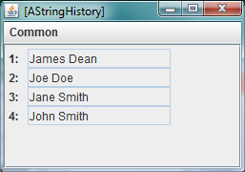
Visualizing Collections
public interface StringHistory {
public void addElement(String element);
public int size();
public String elementAt(int index);
}
public static void main (String[] args) {
StringHistory stringHistory = new AStringHistory();
stringHistory.addElement("James Dean");
stringHistory.addElement("Joe Doe");
stringHistory.addElement("Jane Smith");
stringHistory.addElement("John Smith");
ObjectEditor.edit(stringHistory);
}

Slide 33
Conventions for Variable-Sized Collection
Write method (optional)
Convention based on Vector
@StructurePattern(StructurePatternNames.VECTOR_PATTERN)
public interface C{
public T elementAt (int index);
public int size();
public Any setElementAt(T t, int index);
…
}
Arbitrary Type.
Read methods
Unconstrained Type (void or T in practice)

Slide 34
Alternative Conventions for Variable-Sized Collection
Write method (optional)
Convention based on ArrayList
@StructurePattern(StructurePatternNames.LIST_PATTERN)
public interface C {
public T get (int index);
public int size();
public Any set (int index) T 2);
…
}
Arbitrary Type.
Read methods
Unconstrained Type (void or T in practice)

Slide 35
Read vs. Write Methods
Read Methods
Used to get components of object
Getter methods
size(), elementAt()
Write Methods
Used to change components of object
Setter methods
addElement(), removeElement(), setElementAt()
some used by Object Editor
Distinction independent of conventions and important for Model-View-Controller and other paradigms you will see later
Conventions used in Object Editor

Slide 36
Conventions for Variable-Sized Collection
Write Method not recognized by OE
public interface PointHistory {
public void addElement (int x, int y);
public Point elementAt (int index);
public int size();
}
Read Methods
Arbitrary Type

Slide 37
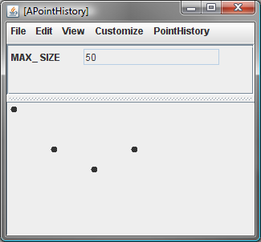
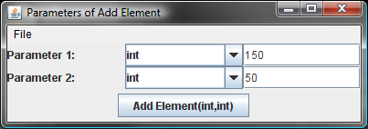
APointHistory
Variable-sized Collection
History
Methods added to menu associated with class
Graphic elements of dynamic collections added at their (X, Y) locations

Slide 38
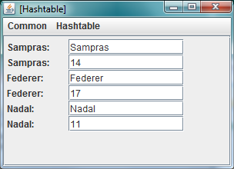
HashMap Use
public static void main (String[] args) {
Map aMap = new HashMap();
aMap.put("Nadal", 10);
aMap.put("Federer", 17);
aMap.put("Sampras", 14);
System.out.println(aMap.get("Nadal"));
System.out.println(aMap.get("nadal"));
aMap.put("Nadal", 11);
System.out.println(aMap.get("Nadal"));
System.out.println(aMap);
ObjectEditor.edit(aMap);
}

Slide 39
OE Conventions For Table
// associates key with value, returning last value associated with key
public <ValueType> put (<KeyType> key, <ValueType> value);
// returns last value associated with key, or null if no association
public <ValueType> get (<KeyType> key);
// optional, removes associated value, and returns it or null
public <ValueType> remove(<KeyType> key);
Necessary but not sufficient to displays all keys and elements

Slide 40
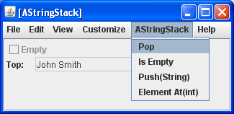
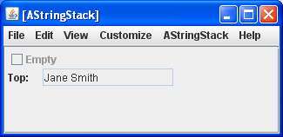
Displaying Stack (LIFO)
public interface StringStack {
public boolean isEmpty();
public String getTop();
public void push(String element);
public void pop();
}
Does not provide read methods for reading all elements
StringStack stringStack = new AStringStack();
stringStack.push("James Dean");
stringStack.push("Joe Doe");
stringStack.push("Jane Smith");
stringStack.push("John Smith");
ObjectEditor.edit(stringStack);

Slide 41
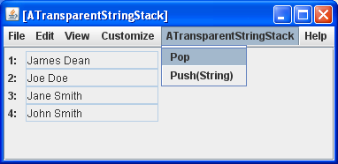
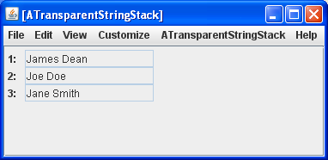
Displaying Transparent Stack (LIFO)
public interface TransparentStringStack {
public int size();
public String get(int index);
public void push(String element);
public void pop();
}
Provides read methods following OE collection conventions
StringStack stringStack = new AStringStack();
stringStack.push("James Dean");
stringStack.push("Joe Doe");
stringStack.push("Jane Smith");
stringStack.push("John Smith");
bus.uigen.ObjectEditor.edit(stringStack);
Can provide additional method for top value

