Slide 1
Comp 401 Advanced Assertions
Instructor: Prasun Dewan

Slide 2
Prerequisite
Documentation Assertions
Composite Visitors

Slide 3
Assertion Uses
Potentially useful for
specification
testing
formal correctness
documentation
user-interface automation

Slide 4
Expressing Assertions
Natural language
No collection element is null.
All collection elements are not odd.
All collection elements are either odd or positive.
Easy to read but ambiguous.
Programming language
Library or language constructs
Executable, unambiguous but language-dependent and awkward
Useful for debugging
Specification cannot be done before language decided.
Mathematical language
Unambiguous, time tested, convenient but not executable
∀j: 0 <= j < b.size() : b.get(j) != null

Slide 5
Propositional Calculus
Logic operators
not, and, or
We will use Java syntax.
Quantifiers
Universal (∀ )
Existential (∃ )
Propositional variables
Program
Others: Recording, Quantifier
Propositions
Boolean expressions involving operators, variables, and quantifiers
Simple/quantified propositions
Do not use/use quantifiers
∀j: 0 <= j < b.size() : b.get(j) != null && b.get(j) != a.get(0)

Slide 6
Propositional Algebra
Calculus based on algebra
Algebra defines
Arithmetic operations
Relations operations
We will use Java syntax
∀j: 0 <= j < b.size() : b.get(j) != null && b.get(j) == a.get(0)

Slide 7
Propositions
Simple propositions
True
False
weight > 0
(weight > 0 ) && (height > 0)
Quantified
∀j: 0 <= j < b.size() : b.get(j) != null
All elements of B are not null
∃j: 0 <= j < b.size(): b.get(j) != null
At least one element of B is not null.

Slide 8
Quantified Propositions
Quantified
∀j: 0 <= j < b.size(): b.get(j) != null
∃j: 0 <= j < b.size(): b.get(j) != null
General form:
Qx:D(x):P(x)
Q is either ∀ or ∃ quantifier
X is quantified variable
D(x) is domain description
P(x) is sub-proposition
Sub-proposition
Simple or quantified proposition in terms of quantifier
Domain
A collection of values used in sub-proposition evaluation
b.get(0), … b.get(b.size() – 1)
Domain description
Describes domain using quantified variable

Slide 9
Propositions
Simple propositions
True
False
weight > 0
(weight > 0 ) && (height > 0)
Quantified
∀j: 0 <= j < b.size() : b.get(j) != null
All elements of B are not null
∃j: 0 <= j < b.size(): b.get(j) != null
At least one element of B is not null.

Slide 10
Simple vs. Quantified Assertions
assert <Java Boolean Expression>
<Java Boolean Expression> → <Simple Expression>
<Java Boolean Expression> → <Quantified Expression>

Slide 11
Simple Propositions
Simple propositions
True
False
weight > 0
(weight > 0 ) && (height > 0)
assert true;
assert false;
assert weight > 0;
assert (weight > 0 ) && (height > 0);

Slide 12
Asserting false
switch c {
case ‘a’: …
case ‘b’: …
default: assert false: “unreachable statement”
}
Unreachable statement

Slide 13
Java Assertions
assert <Java Boolean Expression>
<Java Boolean Expression> → <Simple Expression>
assert weight > 0
<Java Boolean Expression> → <Quantified Expression>
assert ???

Slide 14
Quantified Assertions
Syntax
Qx:D(x):P(x)
∀j: 0 <= j < b.size(): b.get(j) != null
∃j: 0 <= j < b.size(): b.get(j) != null
Goal:
Programmer should not have to write the loops for the quantified assertions
Write general boolean functions that take as arguments encoding of the elements of domain and return true iff proposition is true

Slide 15
Expressing Quantified Assertions
public interface Asserter {
public boolean checkQuantified (String assertion);
}
Library must do parsing.
Cannot pass expression string as variables (such as b) in our scope have no meaning to library
Qx:D(x):P(x)
∀j: 0 <= j < b.size(): b.get(j) != null
assert asserter.checkQuantified(“∀j: 0 <= j < b.size(): b.get(j) != null”): “some element of b is null” ;

Slide 16
Problem with inaccessible variables
Syntax
Qx:D(x):P(x)
∀j: 0 <= j < b.size(): b.get(j) != null
∃j: 0 <= j < b.size(): b.get(j) != null
How to describe D(x) and P(x)?
Cannot pass expression string as variables involved have no meaning to library
Will pass one argument describing the domain
Collection of elements
Another argument describing the subproposition to be evaluated for each domain element.

Slide 17
Separate the Three Components
public interface Asserter {
public boolean checkUniversal (…, …);
public boolean checkExistential (…, …);
}
Separate functions for two quantifiers
One argument for domain and one for predicate
Assume domain is some collection
Qx:D(x):P(x)
∀j: 0 <= j < b.size(): b.get(j) != null
assert asserter.checkUniversal(…,…): “some element of b is null”

Slide 18
Collection Based Domain
public interface Asserter<ElementType> {
public boolean checkUniversal(Collection<ElementType> domain, …);
public boolean checkExistential(Collection<ElementType> domain, …);
}
Assume domain implements Collection
Supports histories, sets, databases. …
Qx:D(x):P(x)
∀j: 0 <= j < b.size(): b.get(j) != null
assert asserter.checkUniversal(b, ….): “some element of b is null” ;

Slide 19
Asserter Class
package util.assertions;
import java.util.Collection;
public class AnAsserter<ElementType> implements Asserter<ElementType> {
public boolean checkUniversal (Collection<ElementType> elements, …) {
for (ElementType element:elements)
if (!…) return false;
return true;
}
public void checkExistential (Collection<ElementType> elements, …) {
for (ElementType element:elements)
if (…) return true;
return false;
}
}

Slide 20
Describing the Domain Using Method Parameters
public boolean checkUniversal (Collection<ElementType> elements,
Method elementChecker ) {
…
}
Instead pass an object with a check method that takes argument of type <ElementType>
public boolean nonNullChecker(Object element) {
return element != null;
}
Qx:D(x):P(x)
∀j: 0 <= j < b.size(): b.get(j) != null
assert asserter.checkUniversal(b, nonNullCheckerMethod )
checkUniversal invokes elementChcker on each element of domain (elements)
Passing method raises typing issues
Method needs to visit each element of the domain

Slide 21
Subproposition Visitor Objects
public interface ElementChecker<ElementType>
public boolean check (ElementType element);
}
public class ANonNullChecker implements ElementChecker<Object> {
public boolean check(Object element) {
return element != null;
}
}
All subproposition objects implement same interface
The check method of a subproposition object visits each element
public boolean checkUniversal (Collection<ElementType> elements,
ElementChecker elementChecker ) {
for (ElementType element:elements)
if (!elementChecker.check(element)) return false;
return true;
}
assert asserter.checkUniversal(b, new ANonNullChecker()):
“some element of b is null” ;

Slide 22
Asserter Class
public class AnAsserter<ElementType>
implements Asserter<ElementType> {
public void checkUniversal(Collection<ElementType> elements,
ElementChecker elementChecker) {
for (ElementType element:elements)
if (!elementChecker.check(elements))
return false;
}
return true;
}
public void checkExistential(Collection<ElementType> elements,
ElementChecker elementChecker) {
for (ElementType element:elements)
if (elementChecker.check(element))
return true;
return false;
}
}

Slide 23
Accessing External Vars
public interface ElementChecker<ElementType> {
public boolean check (ElementType element);
}
public class ANonNullChecker implements ElementChecker<Object> {
public boolean check(Object element) {
return element != null;
}
}
∀j: 0 <= j < b.size(): b.get(j) != a.get(0)
assert asserter.checkUniversal(b, new ANonNullChecker())): “some element of b is null” ;

Slide 24
Subproposition accessing vars other than domain elements
import util.assertions.ElementChecker;
public class AnInequalityChecker implements ElementChecker<String> {
Strring testObject;
public AnInequalityChecker(String theTestObject) {
testObject = theTestObject;
}
public boolean check(String element) {
return !element.equals(testObject);
}
}
Each external var becomes constructor parameter and checker instance variable
∀j: 0 <= j < b.size(): b.get(j) != a.get(0)
assert asserter.checkUniversal(b, new AnInqualityChecker(a.get(0)): “some element of b == a.get(0)” ;

Slide 25
Visitor Pattern
NodeType
HAS-A
Calls
Traverser Method 1
NodeType
NodeType
Traverser Method 2
Node Visitor
visit(NodeType)
Calls
IS-A
ANodeVisitor1
ANodeVisitor2

Slide 26
Quantified Assertions Visitor Pattern
Collection<T>
HAS-A
Calls
checkUniversal()
<T>
<T>
checkExistential()
Element Checker
visit(NodeType)
Calls
IS-A
ANonNull Checker
AnInequality Checker

Slide 27
Abstract Visitor Pattern
NodeType
HAS-A
Calls
Traverser Method 1
NodeType
NodeType
Traverser Method 2
Node Visitor
visit(NodeType)
Calls
IS-A
ANodeVisitor1
ANodeVisitor2

Slide 28
Nested Assertions
public class AListChecker implements ElementChecker<List> {
public boolean check(List children) {
return asserter.checkUniversal(children, new ANonNullChecker()));
}
}
∀j: 0 <= j < b.size(): ∀k: 0 <= k < b.get(j).size(): b.get(j).get(k) != null
assert asserter.checkUniversal(b, new AListChecker ())

Slide 29
Extra

Slide 30
Actual Library
package util.assertions;
import java.util.Collection;
public class AnAsserter<ElementType> implements Asserter<ElementType> {
public void assertUniversal (Collection<ElementType> elements, ElementChecker elementChecker, String message) {
for (ElementType element:elements)
if (!elementChecker.check(element)) throw new AssertionError (message);
}
public void assertExistential (Collection<ElementType> elements, ElementChecker elementChecker, String message) {
for (ElementType element:elements)
if (elementChecker.check(element)) return;
throw new AssertionError (message);
}
}
asserter.assertUniversal(b, nonNullChecker, “some element of b is null” );
Fails regardless of Java options

Slide 31
Java Assertions
assert <Boolean Expression>
assert <Boolean Expression>: <Value>
Statement can be inserted anywhere to state that some condition should be true
If condition is false, Java throws AssertionError, which may be caught by programmer code.
If uncaught, generic message saying assertion failed is printed.
An assertion made at the beginning/end of a statement block (method, loop, if ..) is called its precondition/postcondition

Slide 32
Why Language Support
Can always define a library with assert(<Boolean Expression>) method that throws a special exception denoting assertion error.
Assertions can be dynamically turned on or off for package or Class
java –ea assignment11.MainClass –da bus.uigen…
public void myAssert (boolean boolExp, String message) throws AssertionError {
if (boolExp) throw new AssertionError (message);
}

Slide 33
Error vs. Exception
Java assertion failure results in AssertionError
Subclass of Error rather than RunTimeException
Reasoning:
Convention dictates that Exception should be caught
Should “discourage programmers from attempting to recover from assertion failures.”
Might do custom reporting, mail error report etc.
AssertionError is a subclass of Throwable and can indeed be caught
Decision was controversial

Slide 34
The Importance of Being Earnest
public class ABankAccount implements BankAccount {
int currentBalance = 0;
public static final int MIN_BALANCE = 100;
public ABankAccount (int initialBalance) {
currentBalance = initialBalance;
}
public int getCurrentBalance () {return currentBalance; }
public void deposit (int amount) {currentBalance += amount;}
public boolean withdraw (int amount) {
int minNecessaryBalance = MIN_BALANCE + amount;
if (minNecessaryBalance <= currentBalance) {
currentBalance -= amount;
return true;
} else return false;
}
}

Slide 35
The Importance of Being Earnest
public boolean safeWithdraw (int amount) {
assert amount > 0: "amount < 0";
boolean retVal = withdraw(amount);
assert currentBalance >= MIN_BALANCE: "currentBalance < MIN_BALANCE");
return retVal;
}

Slide 36
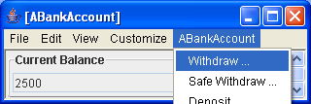
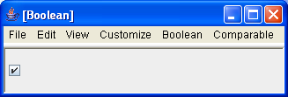
The Importance of Being Earnest

Slide 37
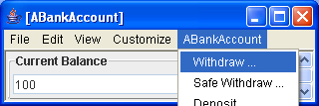
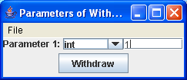
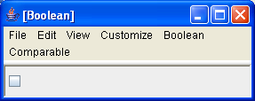
The Importance of Being Earnest

Slide 38
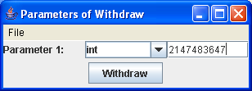
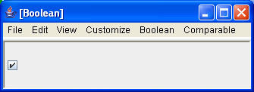
The Importance of Being Earnest
Integer.MAX_INT

Slide 39
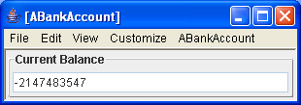
The Importance of Being Earnest

Slide 40
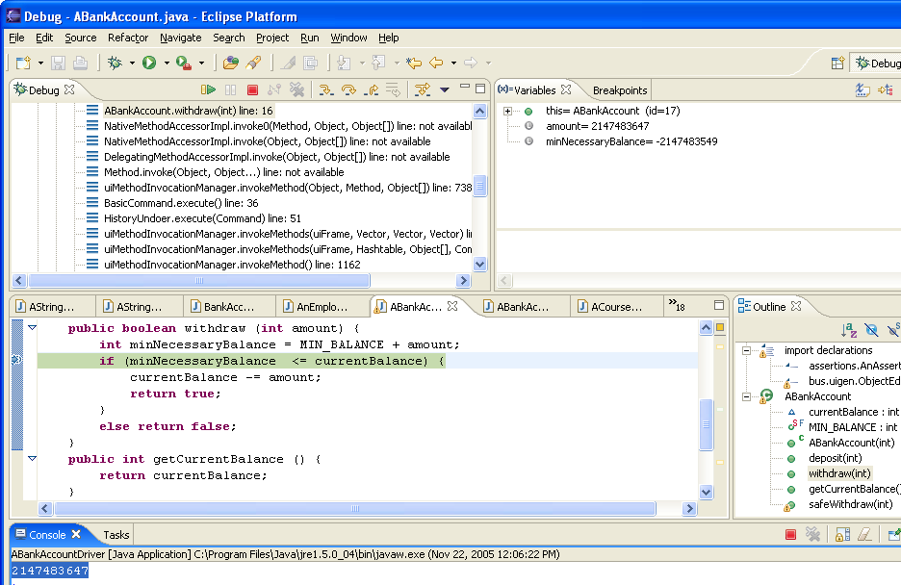
The Importance of Being Earnest
Most significant but of positive (negative) numbers is 0(1)

Slide 41
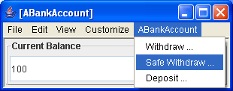
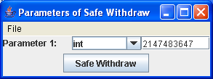
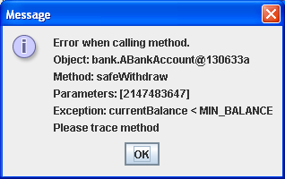
The Importance of Being Earnest

Slide 42
The Importance of Being Earnest
Google for “integer overflow security”

Slide 43
Extra Slides

Slide 44
Problem with inaccessible variables
Syntax
Qx:D(x):P(x)
∀j: 0 <= j < b.size(): b.get(j) != null
∃j: 0 <= j < b.size(): b.get(j) != null
How to describe D(x) and P(x)?
Cannot pass expression string as variables involved have no meaning to library
Will pass one argument describing the domain
Collection of elements
Another argument describing the subproposition to be evaluated for each domain element.

Slide 45
Complete Asserter
package util.assertions;
import java.util.Collection;
public class AnAsserter<ElementType> implements Asserter<ElementType> {
public void assertUniversal (Collection<ElementType> elements, ElementChecker elementChecker, String message) {
for (ElementType element:elements)
if (!elementChecker.check(element)) throw new AssertionError (message);
}
public void assertExistential (Collection<ElementType> elements, ElementChecker elementChecker, String message) {
for (ElementType element:elements)
if (elementChecker.check(element)) return;
throw new AssertionError (message);
}
}

Slide 46
Asserter Class
package util.assertions;
import java.util.Collection;
public class AnAsserter<ElementType> implements Asserter<ElementType> {
public void assertUniversal (Collection<ElementType> elements, …, String message) {
assert checkUniversal(elements, …, message);
}
public void assertExistential (Collection<ElementType> elements, ElementChecker elementChecker, String message) {
assert !checkExistential(elements, …, message)
}
public boolean checkUniversal (Collection<ElementType> elements, …) {
for (ElementType element:elements)
if (…) return false;
return true;
}
public void checkExistential (Collection<ElementType> elements, …) {
for (ElementType element:elements)
if (…) return true;
return false;
}
}

Slide 47
Goal
package util.assertions;
import java.util.Collection;
public interface Asserter<ElementType> {
public void assertUniversal (Collection<ElementType> enumParam, ElementChecker elementChecker, String message);
public void assertExistential (Collection<ElementType> enumParam, ElementChecker elementChecker, String message);
}
Need to fill the …

Slide 48
Goal
package util.assertions;
public interface Asserter<ElementType> {
public void assertUniversal (Iterator<ElementType> enumParam, ElementChecker elementChecker, String message);
public void assertExistential (Iterator<ElementType> enumParam, ElementChecker elementChecker, String message);
}

Slide 49
Problem with inaccessible variables
Syntax
Qx:D(x):P(x)
∀j: 0 <= j < b.size(): b.get(j) != null
∃j: 0 <= j < b.size(): b.get(j) != null
How to describe D(x) and P(x)?
Cannot pass expression string as variables involved have no meaning to library
Will pass one argument describing the domain
Collection of elements
Another argument describing the subproposition to be evaluated for each domain element.

Slide 50
How to describe domain?
Syntax
Qx:D(x):P(x)
∀j: 0 <= j < b.size(): b.get(j) != null
∃j: 0 <= j < b.size(): b.get(j) != null
Domain can be
Array, Vector, StringHistory, …
Need a common interface to describe elements
java.util.Iterator

Slide 51
Describing the Domain
public interface Asserter<ElementType> {
public void assertUniversal (Iterator<ElementType> domain, …, String message);
public void assertExistential (Iterator<ElementType> domain, …, String message);
}
asserter.assertUniversal (B.iterate(), …, "Some element of B is null");
asserter.assertExistential(B.iterate(), …, "All elements of B are null");
Need to fill …

Slide 52
Describing the Domain Using Method Parameters
public interface Asserter<ElementType> {
public void assertUniversal (Iterator<ElementType> domain, (<ElementType→ boolean)elementChecker , String message);
public void assertExistential (Iterator<ElementType> domain, (<ElementType→ boolean)elementChecker, String message);
}
asserter.assertUniversal (B.iterate(), …, "Some element of B is null");
asserter.assertExistential(B.iterate(), …, "All elements of B are null");
Need to fill …

Slide 53
Describing the Domain
public interface Asserter<ElementType> {
public void assertUniversal (Iterator<ElementType> enumParam, ElementChecker elementChecker, String message);
public void assertExistential (Iterator<ElementType> enumParam, ElementChecker elementChecker, String message);
}

Slide 54
Describing the domain
package assertions;
import java.util.Enumeration;
public class AQuantifier {
public static boolean forAll ((Enumeration domain, …) {
for (domain.hasMoreElements())
…
}
public static boolean thereExists ((Enumeration domain, …) {
for (domain.hasMoreElements())
…
}
}
AnAsserter.assert(AQuantifier.forAll(B.elements(), …, "Some element of B is null");
AnAsserter.assert(AQuantifier.thereExists(b.elements(), …, "All elements of B are null");
Need to fill …

Slide 55
How to describe Subproposition
Syntax
Qx:D(x):P(x)
∀j: 0 <= j < b.size(): b.get(j) != null
∃j: 0 <= j < b.size(): b.get(j) != null
Cannot pass expression string as variables involved have no meaning to library
But can pass function that evaluates it.
boolean isNotNull(Object element) {
return element != null;
}
Function will be evaluated for each domain element by our libraries

Slide 56
Subproposition as a function
package assertions;
import java.util.Enumeration;
public class AQuantifier {
public static boolean forAll (Enumeration domain, (object → boolean) subProposition) {
for (domain.hasMoreElements())
if (!subProposition (domain.nextElement()) return false;
return true;
}
public static boolean thereExists ((Enumeration domain, (object → boolean) subProposition) {
for (domain.hasMoreElements())
if (!subProposition (domain.nextElement()) return true;
return false;
}
}
AnAsserter.assert(AQuantifier.forAll(B.elements(), isNotNull), "Some element of B is null");
AnAsserter.assert(AQuantifier.thereExists(b.elements(), isNotNull), "All elements of B are null");

Slide 57
How to describe Subproposition
import util.assertions;
public interface ElementChecker<ElementType> {
public boolean check (ElementType element);
}
Cannot pass expression string.
But can pass function that evaluates it.
boolean isNotNull(Object element) {
return element != null;
}
Java does not support function parameters
But allows object parameters
Object = data + functions
All subproposition objects implement same interface
A subproposition object visits each element
public class ANonNullChecker implements ElementChecker<Object> {
public boolean check(String element) {
return element != null;
}
}

Slide 58
Describing the subproposition
package assertions;
import java.util.Enumeration;
public class AQuantifier {
public static boolean forAll (Enumeration domain, ElementChecker subProposition) {
for (domain.hasMoreElements())
if (!subProposition.visit(domain.nextElement())) return false;
return true;
}
public static boolean thereExists (Enumeration domain, ElementChecker subProposition) {
for (domain.hasMoreElements())
if (subProposition.visit(domain.nextElement())) return true;
return false;
}
}
Call
Callback
AnAsserter.assert(AQuantifier.forAll(b.elements(), new ANonNullChecker()), "Some element of B is null");
AnAsserter.assert(AQuantifier.thereExists(b.elements(), new ANonNullChecker()), "All elements of B are null");

Slide 59
Goal
public interface Asserter<ElementType> {
public void assertUniversal (Iterator<ElementType> enumParam, ElementChecker elementChecker, String message);
public void assertExistential (Iterator<ElementType> enumParam, ElementChecker elementChecker, String message);
}
Need to fill the …

Slide 60
Calls vs. Callbacks
Calls
calls from reusing class to reused class
Callbacks
calls from reused class to reusing class.
not to implement a symbiotic relationship
done to service calls

Slide 61
Subproposition accessing vars other than domain elements
∀j: 0 <= j < b.size(): b.get(j) != a.get(0)
∃j: 0 <= j < b.size(): b.get(j) != a.get(0)
public class ANonNullChecker implements ElementChecker<Object> {
public boolean check(String element) {
return element != null;
}
}
No constructor
AnAsserter.assert(AQuantifier.forAll(b.elements(), new ANonNullChecker()), "Some element of B is null");

Slide 62
Subproposition accessing vars other than domain elements
Each external var becomes constructor parameter
∀j: 0 <= j < b.size(): b.get(j) != a.get(0)
∃j: 0 <= j < b.size(): b.get(j) != a.get(0)
package util.assertions;
import assertions.ElementChecker;
public class AnInequalityChecker implements ElementChecker<String> {
Strring testObject;
public AnInequalityChecker(String theTestObject) {
testObject = theTestObject;
}
public boolean check(String element) {
return !element.equals(testObject);
}
}
AnAsserter.assert(AQuantifier.forAll(b.elements(), new AnInequalityChecker(a.get(0))), "Some element of b is equal to a.get(0)");

Slide 63
Visitor Pattern
Some collection C of elements of type T
Visitor interface
public interface ElementChecker { public boolean visit (Object element);}
public interface V {public T2 m (T p);}
One or more traverser methods that use collection and visitor interface to pass one or more collection elements to the method.
public static boolean forAll (Enumeration domain, ElementChecker subProposition) {…subProposition.visit(domain.nextElement());
traverser1 (C c, V v) { …v.m(element of C)…}
Implementation of interface whose constructors take as arguments external variables that need to be accessed by the visitor method
public class AnInequalityChecker implements ElementChecker {
Object testObject;
public AnInequalityChecker(Object theTestObject) {…}
public boolean visit(Object element) {…};
}
public class AV1 implements V {
public AV1 (T1 p1, … Tn pN) { …}
public T2 m (T p) { … }
}
Client passes traverser visitor implementation and collection
AQuantifier.forAll(b.elements(), new AnInequalityChecker(a.get(0)));
traverser1(c, new AV1(a1,.. aN));

Slide 64
ActionObject
Action Object
execute (targetObject, params)
Provides an execute operation to perform some action.
The execute operation takes the object on which the target operation is to invoked and an array of parameters of the target method.

Slide 65
Command Object
Command Object
execute ()
Constructor (targetObject, params)
Constructor takes parameters of operation as arguments.
Provides a execute operation to perform some action.
Action is an operation that can be invoked on many different arguments
The execute operation takes no arguments.
A command is a specific action invocation.

Slide 66
Visitor Object
Visitor Object
execute (targetObject)
Constructor (params)
Constructor in (a) command takes target and params, (b) action takes no params, and (c) visitor takes oparams as arguments.
Provides a execute operation to perform some action.
Execute in (a) command takes no params, (b) action takes target object and params, (c) visitor takes target object
The execute operation takes target object as argument

Slide 67
Visitor Pattern
Collection Interface C with elements of type T
uses
component
Traverser 1
element1: T
element1: T
Traverser 2
Visitor Interface
implements
Visitor Class 1
Visitor Class 2

Slide 68
Example of Visitor Pattern
Iterator<T>
uses
component
assertUniversal ()
T
T
assertExistential()
ElementChecker
implements
ANonNull
Checker
AnInequality
Checker

Slide 69
Nested Assertions
∀j: 0 <= j < b.size(): ∀k: 0 <= k < b.get(j).size(): b.get(j).get(k) != null
package visitors;
import assertions.ElementChecker;
public class ANonNullChecker implements ElementChecker {
public boolean visit(Object element) {
return (element != null);
}
}
Visiting Hierarchical Structures (Trees)
package visitors;
import assertions.ElementChecker;
public class AListChecker implements ElementChecker<List> {
public boolean check(List element) {
Iterator children = element.iterate();
return asserter.assertUniversal(children, new ANonNullChecker()));
}
}
AnAsserter.assert(AQuantifier.forAll(b.elements(), new AForAllChecker(), "Some leaf-level element of b is null”);

Slide 70
Example of Pattern in Everyday Applications
Program tree
A visitor for printing all nodes.
Another for type checking.
Yet another for generating code
Do not want to put all of this code in tree class.
In any case, printing should not be in tree.

Slide 71
Subproposition accessing vars other than domain elements
public class ANonNullChecker implements ElementChecker<Object> {
public boolean check(Object element) {
return element != null;
}
}
No Parameterized constructor
∀j: 0 <= j < b.size(): b.get(j) != a.get(0)
assert checkUniversal(b.iterator(), new ANonNullChecker()): “some element of b is null” )

Slide 72
Check Method
public boolean nonNullChecker(Object element) {
return element != null;
}

Slide 73
Iterating the Domain
public interface Asserter<ElementType> {
public boolean checkUniversal (Iterator<ElementType> domain, …);
public boolean checkExistential (Iterator<ElementType> domain, …);
}
Iterator describes any sequence of ordered/unordered items.
Qx:D(x):P(x)
∀j: 0 <= j < b.size(): b.get(j) != null
assert asserter.checkUniversal(b.iterator(), ….): “some element of b is null” )

Slide 74
Collection Based Domain
public interface Asserter<ElementType> {
public boolean checkUniversal(Collection<ElementType> domain, …);
public boolean checkExistential(Collection<ElementType> domain, …);
}
Assume domain implements Collection
Want to support histories, sets, databases , streams …
Qx:D(x):P(x)
∀j: 0 <= j < b.size(): b.get(j) != null
assert asserter.checkUniversal(b, ….): “some element of b is null” ;

Slide 75
Asserter Class
package util.assertions;
import java.util.Iterator;
public class AnAsserter<ElementType> implements Asserter<ElementType> {
public boolean checkUniversal (Iterator<ElementType> elements, …) {
for (ElementType element:elements)
if (!…) return false;
return true;
}
public void checkExistential (Iterator<ElementType> elements, …) {
for (ElementType element:elements)
if (…) return true;
return false;
}
}

Slide 76
Describing the Domain Using Method Parameters
public boolean checkUniversal (Iterator<ElementType> elements, (<ElementType→ boolean)elementChecker ) {
for (ElementType element:elements)
if (!elementChecker(element)) return false;
return true;
}
Method must be invoked on some object
Passing method and object separately raises typing issues
public boolean nonNullChecker(Object element) {
return element != null;
}
Qx:D(x):P(x)
∀j: 0 <= j < b.size(): b.get(j) != null
assert asserter.checkUniversal(b.iterator(), nonNullChecker, “some element of b is null” )

Slide 77
Describing the Domain Using Method Parameters
public boolean checkUniversal (Iterator<ElementType> elements, ElementChecker elementChecker ) {
for (ElementType element:elements)
if (!elementChecker.check(element)) return false;
return true;
}
Pass an object with a check method that takes argument of type <ElementType>
Qx:D(x):P(x)
∀j: 0 <= j < b.size(): b.get(j) != null
assert asserter.checkUniversal(b.iterator(), new ANonNullChecker())): “some element of b is null” ;

Slide 78
Subproposition Visitor Objects
package util.assertions;
public interface ElementChecker<ElementType> {
public boolean check (ElementType element);
}
import util.assertions.ElementChecker;
public class ANonNullChecker implements ElementChecker<Object> {
public boolean check(Object element) {
return element != null;
}}
All subproposition objects implement same interface
The check method of a subproposition object visits each element
public boolean checkUniversal (Iterator<ElementType> elements, ElementChecker elementChecker ) {
for (ElementType element:elements)
if (!elementChecker.check(element)) return false;
return true;
}
assert asserter.checkUniversal(b.iterator(), new ANonNullChecker())): “some element of b is null” ;

Slide 79
Accessing External Vars
package util.assertions;
public interface ElementChecker<ElementType> {
public boolean check (ElementType element);
}
import util.assertions.ElementChecker;
public class ANonNullChecker implements ElementChecker<Object> {
public boolean check(Object element) {
return element != null;
}}
∀j: 0 <= j < b.size(): b.get(j) != a.get(0)
assert asserter.checkUniversal(b.iterator(), new ANonNullChecker())): “some element of b is null” ;

Slide 80
Subproposition accessing vars other than domain elements
import util.assertions.ElementChecker;
public class AnInequalityChecker implements ElementChecker<String> {
Strring testObject;
public AnInequalityChecker(String theTestObject) {
testObject = theTestObject;
}
public boolean check(String element) {
return !element.equals(testObject);
}
}
Each external var becomes constructor parameter and checker instance variable
∀j: 0 <= j < b.size(): b.get(j) != a.get(0)
assert asserter.checkUniversal(b.iterator(), new AnInqualityChecker(a.get(0)): “some element of b == a.get(0)” ;

Slide 81
Example of Visitor Pattern
Collection<T>
uses
component
checkUniversal ()
T
T
checkExistential()
ElementChecker
implements
ANonNull
Checker
AnInequality
Checker

