Slide 1
Comp 110/401 Composite Annotations
Instructor: Prasun Dewan

Slide 2
Prerequisite
Composite Objects Shapes

Slide 3
Interpreted How?
public interface RectangleWithPoint {
public int getX();
public int getY();
public void getWidth();
public void getHeight();
public Point getPoint();
}
Object interpreted as either an atomic rectangle or an atomic point depending on whether Point or Rectangle in the name gets precedence
Bad programming as code for defining Rectangle cannot be used in situations where rectangle without point is needed

Slide 4
Reusable Design
public interface Rectangle {
public int getX();
public int getY();
public void getWidth();
public void getHeight();
}
public interface RectangleWithPoint {
public Rectangle getRectangle();
public Point getPoint();
}

Slide 5
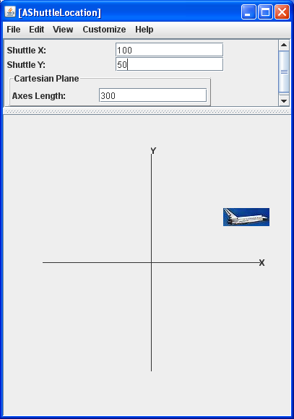
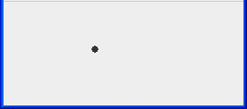
ObjectEditor Graphics Rules
public interface ShuttleLocation {
public FancyCartesianPlane getCartesianPlane();
public ImageLabel getShuttleLabel();
public int getShuttleX();
public void setShuttleX(int newVal);
public int getShuttleY();
public void setShuttleY(int newVal);
}
public interface NotAPoint {
public FancyCartesianPlane
getCartesianPlane();
public ImageLabel getShuttleLabel();
public int getX();
public void setX(int newVal);
public int getY();
public void setY(int newVal);
public Point getLocation();
}
Type interpreted as a Point as its name contains “Point” and has X and Y Properties

Slide 6
IS_ATOMIC_SHAPE Class Annotation
import util.annotations.IsAtomicShape;
@IsAtomicShape(false)
//same as AShuttleLocation except interface name
public class AShuttleLocationImplementingABadlyNamedInterface implements NotAPoint {
Annotation is like a comment except it is typed and available at runtime
IsAtomicShape(false) before class name says do not interpret the class as an atomic shape (it can be a composition)

Slide 7
ShuttleLocation Alternatives
public interface ShuttleLocation {
public FancyCartesianPlane getCartesianPlane();
public ImageLabel getShuttleLabel();
public int getShuttleX();
public void setShuttleX(int newVal);
public int getShuttleY();
public void setShuttleY(int newVal);
}
public interface ShuttleLocationWithPoint {
public FancyCartesianPlane getCartesianPlane();
public ImageLabel getShuttleLabel();
public Point getShuttleLocation();
public void setShuttleLocation(Point newVal);
}

Slide 8
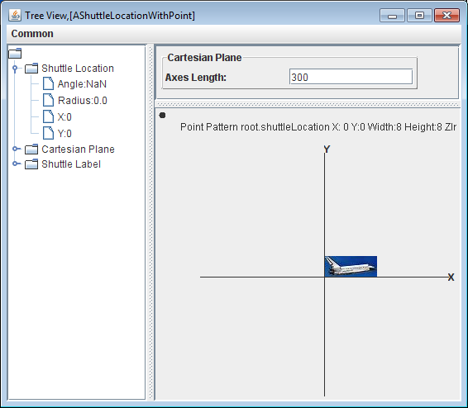
Point Property
public class AShuttleLocationWithPoint implements ShuttleLocationWithPoint {
public Point getShuttleLocation() {
return shuttleLocation;
}
…
}
Does not have X and Y properties, so not a point
But location displayed as a point shape

Slide 9
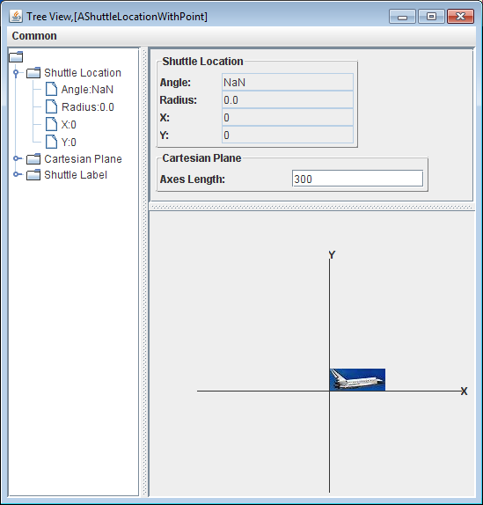
IS_ATOMIC_SHAPE Annotation of Class Getter
import util.annotations.IsAtomicShape;
public class AShuttleLocationWithPoint implements ShuttleLocationWithPoint {
@IsAtomicShape(false)
public Point getShuttleLocation() {
return shuttleLocation;
}
…
}
IsAtomicShape(false) before getter of a property means property not displayed as an atomic shape
ShuttleLocation is not a textual property displayed in main panel
What if we do not want it in main panel either?

Slide 10
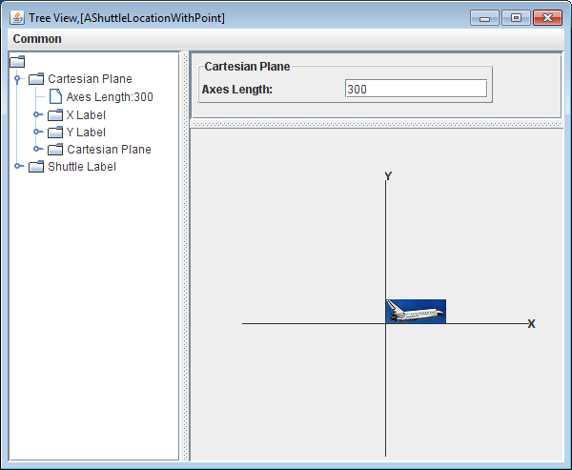
Visible Annotation of Class Getter
import util.annotations.Visible;
public class AShuttleLocationWithPoint implements ShuttleLocationWithPoint {
@Visible(false)
public Point getShuttleLocation() {
return shuttleLocation;
}
…
}
Visible(false) before getter of a property means property not displayed at all

Slide 11
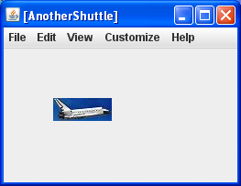
Automatic Label Pattern
public class AShuttle implements SpecificImageLabel {
…
}

Slide 12
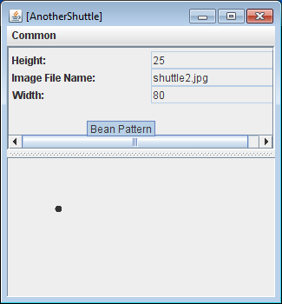
Not Following Automating Label Pattern
public class AShuttle implements Shuttle {
…
}

Slide 13
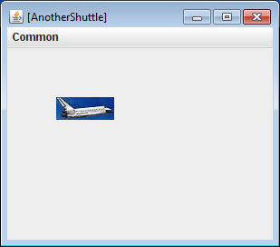
Explicit Pattern Specification
import util.annotations.StructurePattern;
import util.annotations.StructurePatternNames;
@StructurePattern(StructurePatternNames.LABEL_PATTERN)
public class AShuttle implements Shuttle{
…
}
Structure(<PatternName>) before class asserts that the class is following the pattern. ObjectEditor ignores class name and gives warnings if methods do not follow the pattern

Slide 14
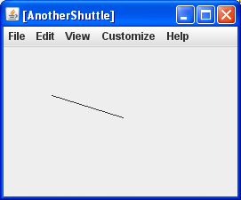
Explicit Pattern Specification
import util.annotations.StructurePattern;
import util.annotations.StructurePatternNames;
@StructurePattern(StructurePatternNames.LINE_PATTERN)
public class AShuttle implements Shuttle{
…
}

Slide 15
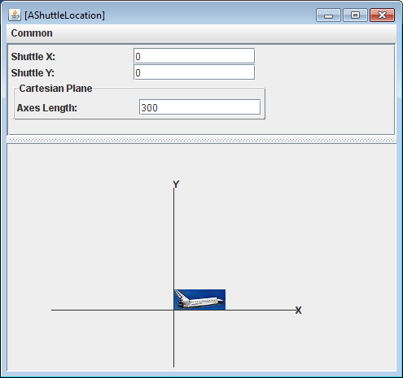
Explicit Pattern Specification
public class AShuttleLocation implements ShuttleLocation {
…
}

Slide 16
Explicit Pattern Specification
import util.annotations.StructurePattern;
import util.annotations.StructurePatternNames;
@StructurePattern(StructurePatternNames.LINE_PATTERN)
public class AShuttleLocation implements ShuttleLocation {
…
}

Slide 17
Explicit and Implicit Label Pattern
import util.annotations.StructurePattern;
import util.annotations.StructurePatternNames;
@StructurePattern(StructurePatternNames.LABEL_PATTERN)
public class AnotherShuttle implements SpecificImageLabel {
static final String IMAGE = "shuttle2.jpg“;
static final int WIDTH = 80;
static final int HEIGHT = 25;
Point location;
public AShuttle (int initX, int initY) {
location = new ACartesianPoint(initX, initY);
}
public AShuttle () {
location = new ACartesianPoint(50, 50);
}
public Point getLocation() {return location;}
public void setLocation(Point newVal) {location = newVal;}
public int getWidth() { return WIDTH;}
public int getHeight() {return HEIGHT;}
public String getImageFileName() {return IMAGE;}
}

Slide 18
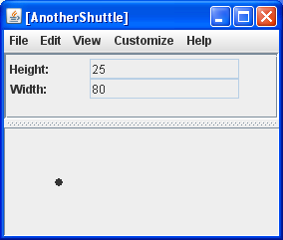
Explicit and Attempted Implicit Label Pattern
import util.annotations.StructurePattern;
import util.annotations.StructurePatternNames;
@StructurePattern(StructurePatternNames.LABEL_PATTERN)
public class AnotherShuttle implements SpecificImageLabel {
static final String IMAGE = "shuttle2.jpg“;
static final int WIDTH = 80;
static final int HEIGHT = 25;
Point location;
public AShuttle (int initX, int initY) {
location = new ACartesianPoint(initX, initY);
}
public AShuttle () {
location = new ACartesianPoint(50, 50);
}
public Point getLocation() {return location;}
public void setLocation(Point newVal) {location = newVal;}
public int getWidth() { return WIDTH;}
public int getHeight() {return HEIGHT;}
//public String getImageFileName() {return IMAGE;}
}

Slide 19
BMI Calculator Pattern?
public class ABMICalculator {
public double calculateBMI(double height, double weight) {
return weight/(height*height);
}
}

Slide 20
BMI Calculator Pattern?
@StructurePattern(StructurePatternNames.NO_PATTERN)
public class AnAnnotatedBMICalculator {
public double calculateBMI(double height, double weight) {
return weight/(height*height);
}
}

Slide 21
BMI Calculator Pattern?
@StructurePattern(StructurePatternNames.BEAN_PATTERN)
public class AnAnnotatedBMICalculator {
public double calculateBMI(double height, double weight) {
return weight/(height*height);
}
}

Slide 22
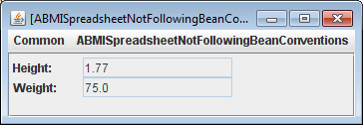
Bean Pattern?
@StructurePattern(StructurePatternNames.BEAN_PATTERN)
public class ABMISpreadsheetNotFollowingBeanConventions {
double height = 1.77;
double weight = 75;
public double getWeight() {
return weight;
}
public void set(double newWeight, double newHeight) {
weight = newWeight;
height = newHeight;
}
public double getHeight() {
return height;
}
public void setHeight(int newHeight) {
height = newHeight;
}
public double BMI() {
return weight/(height*height);
}
}

Slide 23
(Editable) Property Name Annotations
@StructurePattern(StructurePatternNames.BEAN_PATTERN)
@PropertyNames({ "Height", "Weight", "BMI"})
@EditablePropertyNames({"Height", "Weight"})
public class ABMISpreadsheetNotFollowingBeanConventions {
double height = 1.77;
double weight = 75;
public double getWeight() {
return weight;
}
public void set(double newWeight, double newHeight) {
weight = newWeight;
height = newHeight;
}
public double getHeight() {
return height;
}
public void setHeight(int newHeight) {
height = newHeight;
}
public double BMI() {
return weight/(height*height);
}
}

Slide 24
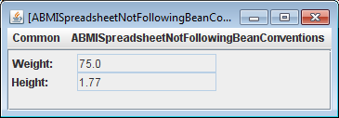
Order of Properties
@StructurePattern(StructurePatternNames.BEAN_PATTERN)
@PropertyNames({ "Weight", "Height", "BMI"})
@EditablePropertyNames({"Height", "Weight"})
public class ABMISpreadsheetNotFollowingBeanConventions {
double height = 1.77;
double weight = 75;
public double getWeight() {
return weight;
}
public void set(double newWeight, double newHeight) {
weight = newWeight;
height = newHeight;
}
public double getHeight() {
return height;
}
public void setHeight(int newHeight) {
height = newHeight;
}
public double BMI() {
return weight/(height*height);
}
}

Slide 25
Bean Pattern?
@StructurePattern(StructurePatternNames.BEAN_PATTERN)
public class ABMISpreadsheetNotFollowingBeanConventions {
double height = 1.77;
double weight = 75;
public double getWeight() {
return weight;
}
public void set(double newWeight, double newHeight) {
weight = newWeight;
height = newHeight;
}
public double getHeight() {
return height;
}
public void setHeight(int newHeight) {
height = newHeight;
}
public double BMI() {
return weight/(height*height);
}
}
Warning if (editable) properties not declared?
Overhead, chances of mistake low, C# has built in support for properties
Why warning if no structure annotation?

Slide 26
Why Warnings
Accidental patterns
Efficiency

Slide 27
Large Search Space
public class StructurePatternNames {
public static final String NO_PATTERN = "No Pattern";
public static final String BEAN_PATTERN = "Bean Pattern";
public static final String POINT_PATTERN = "Point Pattern";
public static final String LINE_PATTERN = "Line Pattern";
public static final String OVAL_PATTERN = "Oval Pattern";
public static final String RECTANGLE_PATTERN = "Rectangle Pattern";
public static final String ARC_PATTERN = "Arc Pattern";
public static final String LABEL_PATTERN = "Label Pattern";
public static final String TEXT_PATTERN = "Text Pattern";
public static final String STRING_PATTERN = "String Pattern";
public static final String CURVE_PATTERN = "Curve Pattern";
public static final String VECTOR_PATTERN = "Vector Pattern";
public static final String LIST_PATTERN = "List Pattern";
public static final String STACK_PATTERN = "Stack Pattern";
public static final String HASHTABLE_PATTERN = "Hashtable Pattern";
public static final String MAP_PATTERN = "Hashmap Pattern";
public static final String ENUM_PATTERN = "Enum Pattern";
…
}
Accidental patterns
Efficiency

