Slide 1
Comp 401 Composite Design Pattern
Instructor: Prasun Dewan

Slide 2
Prerequisite
Composite Objects Shapes
Inheritance Multiple.
Recursion

Slide 3
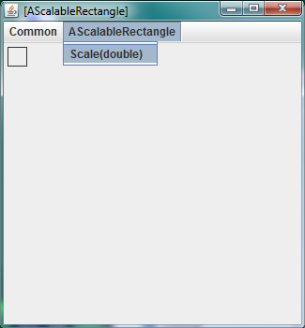
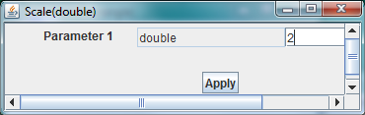

Scalable Rectangle

Slide 4
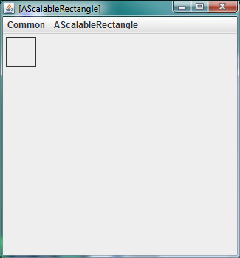
Scalable Rectangle

Slide 5
Scalable Shape
public interface ScalableShape {
public int getX();
public int getY();
public int getWidth();
public int getHeight();
public void scale(double fraction);
}

Slide 6
Scalable Shape Implementation
public class AScalableShape implements ScalableShape {
int x, y, width, height;
public AScalableShape(int theX, int theY,
int theWidth, int theHeight) {
x = theX;
y = theY;
width = theWidth;
height = theHeight;
}
public int getX() {return x;}
public int getY() {return y;}
public int getWidth() {return width;}
public int getHeight() { return height;}
public void setHeight(int newVal) {height = newVal;}
public void setWidth(int newVal) {width = newVal;}
public void scale(double fraction){
width = (int) (width*fraction);
height = (int) (height*fraction);
}
}

Slide 7
Scalable Rectangle Implementation
@StructurePattern(StructurePatternNames.RECTANGLE_PATTERN)
public class AScalableRectangle extends AScalableShape {
public AScaleableRectangle(int theX, int theY,
int theWidth, int theHeight) {
super(theX, theY, theWidth, theHeight);
}
}

Slide 8
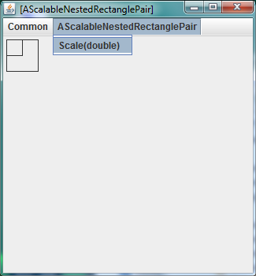
Scalable Nested Rectangle Pair

Slide 9
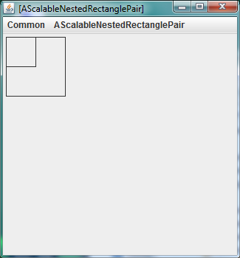
Scalable Nested Rectangle Pair

Slide 10
Nester Pair Interface
public interface ScalableNestedShapePair {
public ScalableShape getInner();
public ScalableShape getOuter() ;
public void scale(double fraction);
}

Slide 11
Nester Pair Implementation
public class AScalableNestedShapePair
implements ScalableNestedShapePair {
ScalableShape inner;
ScalableShape outer;
public AScalableNestedShapePair(ScalableShape theInner,
ScalableShape theOuter) {
inner = theInner;
outer = theOuter;
}
public ScalableShape getInner() {
return inner;
}
public ScalableShape getOuter() {
return outer;
}
@Override
public void scale(double percentage) {
inner.scale(percentage);
outer.scale(percentage);
}
}

Slide 12
Nested Pair Creator
public class ScalableNestedRectanglePairCreator {
public static final int RELATIVE_SIZE = 2;
public static ScalableShape innermost() {
return new AScalableRectangle (0, 0, 20, 20);
}
public static ScalableShape toOuter (ScalableShape anInner) {
return new AScalableRectangle(anInner.getX(), anInner.getY(),
anInner.getWidth()*RELATIVE_SIZE,
anInner.getHeight()*RELATIVE_SIZE);
}
public static ScalableNestedShapePair createPair () {
ScalableShape inner = innermost();
return new AScalableNestedShapePair (inner, toOuter(inner));
}
public static void main (String[] args) {
ObjectEditor.edit(createPair());
}
}
inner(most) rectangle
Nesting rectangle from nested rectagle
pair

Slide 13
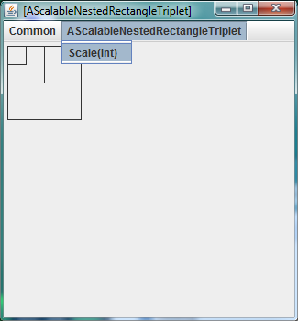
Scalable Nested Rectangle Triplet

Slide 14
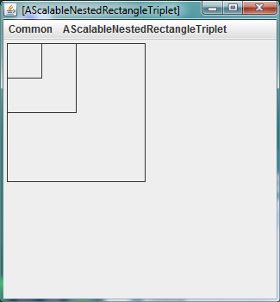
Scalable Nested Rectangle Triplet

Slide 15
Triplet Interface
public interface ScalableNestedShapeTriplet {
public ScalableNestedShapePair getInner();
public ScalableShape getOuter() ;
public void scale(int percentage);
}
Reusing ScalableNestedShapePair

Slide 16
Triplet Implementation
public class AScalableNestedShapeTriplet
implements ScalableNestedShapeTriplet {
ScalableNestedShapePair inner;
ScalableShape outer;
public AScalableNestedShapeTriplet(
ScalableNestedShapePair theInner,
ScalableShape theOuter) {
inner = theInner;
outer = theOuter;
}
public void scale(int percentage){
outer.scale(percentage);
inner.scale(percentage);
}
public ScalableNestedShapePair getInner() {
return inner;
}
public ScalableShape getOuter() {
return outer;
}
}

Slide 17
Triplet Main
public class ScalableNestedRectangleTripletCreator
extends ScalableNestedRectanglePairCreator {
public static ScalableNestedShapeTriplet createTriplet () {
ScalableNestedShapePair pair = createPair();
return new AScalableNestedShapeTriplet(pair,
toOuter(pair.getOuter()) );
}
public static void main (String[] args) {
ObjectEditor.edit(createTriplet());
}
}
Triplet outer from pair outer
Reusing ScalableNestedRectanglePairCreator

Slide 18
Composition Problems
Each time we add another rectangle, we create a new class and interface
Infinite number of nesting possibilities
What if we do not know the number of nester rectangles at program writing time?

Slide 19
Problem in Logical Structure Tree
ScalableShapeTriplet
Composite
Root
inner
outer
ScalableShapePair
ScalableShape
Composite
inner
outer
ScalableShape
ScalableShape
Leaf
Problem: Type of inner property changes each time we add a new nesting level
Leaf node is not the same as composite node as it does not have children
But they can share a common type

Slide 20
Key: Composite Design Pattern
Common Type
IS-A
HAS-A
Composite Type
Leaf Type
Single common type for all composite nodes and types
Composite node has-a and is-a common type

Slide 21
Common, Leaf and Composite Type?
public interface ScalableShape {
public int getX();
public int getY();
public int getWidth();
public int getHeight();
public void scale(double fraction);
}
LeafShape
IS-A
Scalable
public interface ScalableNestedShapePair {
public ScalableShape getInner();
public ScalableShape getOuter() ;
public void scale(double fraction);
}
IS-A
CompositeShape
public interface ScalableNestedShapeTriplet {
public ScalableNestedShapePair getInner();
public ScalableShape getOuter() ;
public void scale(int percentage);
}

Slide 22
Common, Leaf and Composite Types
public interface LeafShape extends Scalable {
public int getX();
public int getY();
public int getWidth();
public int getHeight();
}
IS-A
public interface Scalable {
public void scale(double fraction);
}
IS-A
public interface CompositeShape extends Scalable {
public Scalable getInner();
public LeafShape getOuter();
}
Making outer LeafShape rather than Scalable (or Object) allows us to perform more operations on us. Make type as specific “as it needs to be”.

Slide 23
Scalable Shape Implementation
public class AScalableShape implements ScalableShape {
int x, y, width, height;
public AScalableShape(int theX, int theY,
int theWidth, int theHeight) {
x = theX;
y = theY;
width = theWidth;
height = theHeight;
}
public int getX() {return x;}
public int getY() {return y;}
public int getWidth() {return width;}
public int getHeight() { return height;}
public void setHeight(int newVal) {height = newVal;}
public void setWidth(int newVal) {width = newVal;}
public void scale(double fraction){
width = (int) (width*fraction);
height = (int) (height*fraction);
}
}

Slide 24
LeafShape Implementation
public class ALeafShape implements LeafShape {
int x, y, width, height;
public AScalableShape(int theX, int theY,
int theWidth, int theHeight) {
x = theX;
y = theY;
width = theWidth;
height = theHeight;
}
public int getX() {return x;}
public int getY() {return y;}
public int getWidth() {return width;}
public int getHeight() { return height;}
public void setHeight(int newVal) {height = newVal;}
public void setWidth(int newVal) {width = newVal;}
public void scale(double fraction){
width = (int) (width*fraction);
height = (int) (height*fraction);
}
}

Slide 25
LeafRectangle Implementation
@StructurePattern(StructurePatternNames.RECTANGLE_PATTERN)
public class ALeafRectangle extends ALeafShape {
public ALeafRectangle(int theX, int theY,
int theWidth, int theHeight) {
super(theX, theY, theWidth, theHeight);
}
}

Slide 26
Nester Pair Implementation
public class AScalableNestedShapePair
implements ScalableNestedShapePair {
ScalableShape inner;
ScalableShape outer;
public AScalableNestedShapePair(ScalableShape theInner,
ScalableShape theOuter) {
inner = theInner;
outer = theOuter;
}
public ScalableShape getInner() {
return inner;
}
public ScalableShape getOuter() {
return outer;
}
public void scale(double percentage) {
inner.scale(percentage);
outer.scale(percentage);
}
}

Slide 27
Composite Shape Implementation
public class ACompositeShape
implements CompositeShape{
Scalable inner;
LeafShape outer;
public AScalableNestedShapePair(Scalable theInner,
LeafShape theOuter) {
inner = theInner;
outer = theOuter;
}
public Scalable getInner() {
return inner;
}
public LeafShape getOuter() {
return outer;
}
public void scale(double percentage) {
inner.scale(percentage);
outer.scale(percentage);
}
}

Slide 28
Composite Pair Creator
public class CompositeScalableNestedPairCreator {
public static final int RELATIVE_SIZE = 2;
public static LeafShape innermost() {
return new ALeafRectangle (0, 0, 20, 20);
}
public static LeafShape toOuter (LeafShape anInner) {
return new ALeafRectangle(anInner.getX(), anInner.getY(),
anInner.getWidth()*RELATIVE_SIZE,
anInner.getHeight()*RELATIVE_SIZE);
}
public static CompositeShape createPair () {
LeafShape inner = innermost();
return new ACompositeShape (inner, toOuter(inner));
}
public static void main (String[] args) {
ObjectEditor.edit(createPair());
}
}

Slide 29
Composite Triplet Creator
public class CompositeScalableNestedTripletCreator
extends CompositeScalableNestedPairCreator {
public static CompositeShape createTriplet () {
CompositeShape pair = createPair();
return new ACompositeShape(pair, toOuter(pair.getOuter()) );
}
public static void main (String[] args) {
ObjectEditor.edit(createTriplet());
}
}
Making use of fact that outer is LeafShape rather than just a Scalable

Slide 30
Recursive Logical Structure
CompositeShape
Recursive Structure
inner
outer
Number of levels is not fixed
CompositeShape
LeafShape
Composite parent and children share not only common interface but also implementation
inner
outer
CompositeShape
LeafShape
Recursive structure →
Composite design pattern

Slide 31
Composite Design Pattern
Common Node Type
IS-A
HAS-A
Composite Type
Leaf Type
Single common node type for all composite nodes and types
Composite node has-a and is-a common type

Slide 32
Composite Design Pattern in Example
Scalable
IS-A
HAS-A
CompositeShape
LeafShape
Single common node type for all scalable objects
CompositeShape has-a and is-a Scalable

Slide 33
Composite Design Pattern in Graphics Assignment(s)
Locatable
IS-A
HAS-A
Avatar
Line
Single common node type for all objects with a location
Avatar has-a and is-a Locatable

Slide 34
Composite Design Pattern in Interpreter Assignment(s)
Command (Runnable)
IS-A
HAS-A
CommandList
AnimateShuttle Command
Single common node type for all command objects
CommandList has-a and is-a Command

Slide 35
Composite Design Pattern in Statements
{
width = (int) (width*fraction);
height = (int) (height*fraction);
}
Statement
IS-A
HAS-A
StatementList
If Statement
Single common node type for all statement objects
StatementList has-a and is-a Statement

Slide 36
Composite Design Pattern (Review)
Common Node Type
IS-A
HAS-A
Composite Type
Leaf Type
Single common node type for all composite nodes and types
Composite node has-a and is-a common type

Slide 37

Composite Design Pattern in Family Tree
Person
IS-A
HAS-A
Parent
Child
Single common node type for all people
Parent has-a and is-a person

Slide 38
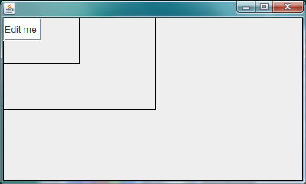
Composite Design Pattern in Toolkit
Component, Container and JPanel methods used here?
Component
IS-A
HAS-A
JPanel
Container
JTextField
IS-A
Single common node type for all UI components
Container has-a and is-a Component

Slide 39
Relevant Component Methods
public void setSize (int width, int height) {
…
}
public Dimension setSize (Dimension size) {
…
}
public Dimension getSize () {
…
}
public int getWidth() {
…
}
public int getHeight() {
…
}

Slide 40
Relevant Container Methods
// allows a dynamic number of components
public void add(Component component) {
…
}
// automatically manages the size
public void setLayout (Layout layout) {
…
}

Slide 41
Relevant Jpanel Methods
public void setBorder(Border border) {
…
}

Slide 42
Example Structure
Component
IS-A
HAS-A
JPanel
Container
JTextField
HAS-A
JPanel
HAS-A
JPanel
HAS-A
JTextField

Slide 43
Composite User
public class ACompositeSwingComponentCreator {
static final int RELATIVE_SIZE = 2;
static Border border = new LineBorder(Color.black);
static final Dimension LEAF_SIZE = new Dimension (50, 30);
static int NUM_LEVELS = 3;
public static void main(String[] args) {
Component leaf = createLeaf(LEAF_SIZE);
Component root = createComponentTree(leaf);
displayInWindow(root);
}
public static Component createComponentTree(Component leaf) {
Component retVal = leaf;
for (int i = 1; i <= NUM_LEVELS; i++) {
retVal = nestComponent(retVal);
}
return retVal;
}

Slide 44
Using Component and Container Methods
public static Component createLeaf(Dimension size) {
Component retVal = new JTextField("Edit me");
retVal.setSize(size);
return retVal;
}
public static Container nestComponent(Component inner) {
JPanel retVal = new JPanel();
retVal.setBorder(border); // show outline
retVal.setSize(
inner.getWidth() * RELATIVE_SIZE,
inner.getHeight()* RELATIVE_SIZE);
retVal.setLayout(null); // do not mess with the size
retVal.add(inner);
return retVal;
}

Slide 45
Displaying on the Screen
public static void displayInWindow(Component aComponent) {
JFrame frame = new JFrame();
frame.add(aComponent);
frame.setSize(aComponent.getSize());
frame.setVisible(true);
}
}

Slide 46
Scalable Nested Rectangle Triplet (Revisited)

Slide 47
Non Composite Multi-Level Tree
ScalableShapeTriplet
inner
outer
ScalableShapePair
ScalableShape
inner
outer
ScalableShape
ScalableShape

Slide 48
Recursive Multi-Level Tree with Composite Pattern
CompositeShape
inner
outer
CompositeShape
LeafShape
inner
outer
CompositeShape
LeafShape

Slide 49
Non Recursive, Flat, Logical Structure
ScalableShapeList
LeafShape
LeafShape
LeafShape

Slide 50
ScalableShapeList
public interface ScalableShapeList extends Scalable {
public int size();
public LeafShape get(int index);
public void add(LeafShape aLeafShape);
}

Slide 51
AScalableShapeList
public class AScalableShapeList implements ScalableShapeList{
List list = new ArrayList();
public void scale(double fraction) {
for (int index=0; index < list.size(); index++) {
((LeafShape) (list.get(index))).scale(fraction);
}
}
public void add(LeafShape aLeafShape) {
list.add(aLeafShape);
}
public int size() {
return list.size();
}
public LeafShape get(int index) {
return (LeafShape) list.get(index);
}
}

Slide 52
ScalableShapeListCreator
public class ScalableShapeListCreator extends
CompositeScalableNestedPairCreator {
public static ScalableShapeList createShapeList (int numShapes){
ScalableShapeList shapeList = new AScalableShapeList();
LeafShape curShape = innermost();
for (int curElementNum = 0; curElementNum < numShapes;
curElementNum ++) {
shapeList.add(curShape);
curShape = toOuter(curShape);
}
return shapeList;
}
public static void main (String[] args) {
ObjectEditor.edit(createShapeList(3));
}
}

Slide 53
Non Recursive, Flat, Logical Structure Pattern
ScalableShapeList
ScalableShapeList IS-A Scalable
LeafShape
LeafShape
LeafShape
Equivalent to previous structures?
Same leaf nodes
Only two levels and one group
Cannot perform a single operation on a subgroups of leaf nodes

Slide 54
Multiple Levels and Groups
Each composite node groups all leaf (and composite ) nodes in the subtree below it
CompositeShape
inner
outer
Can perform one operation to get, set, mutate the entire sub tree of a composite node
CompositeShape
LeafShape
inner
outer
CompositeShape
LeafShape

Slide 55
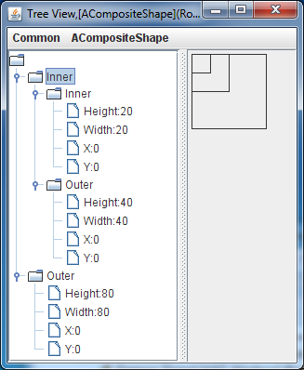
3-Level Tree
Going to do operations on the inner property of the root node (root.inner)

Slide 56
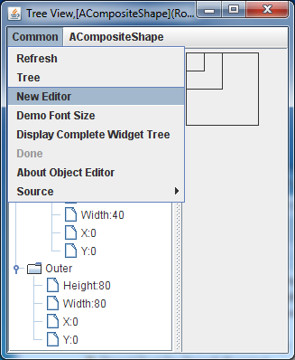
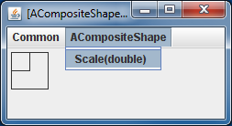
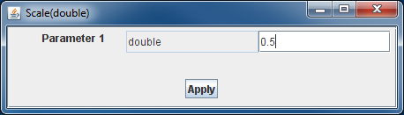
3-Level Tree: Displaying root.inner
Another operation: Scaling root.inner

Slide 57
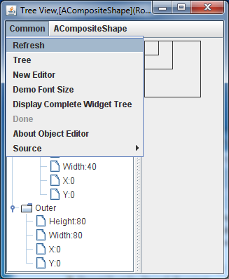
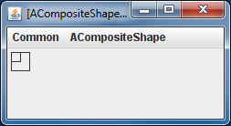
Inner Pair Scales in Right Window

Slide 58
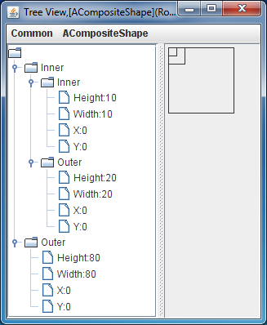
Also in Left Window after Refresh

Slide 59
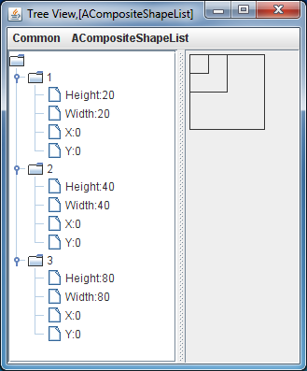
Flat Structure
Can do operations on root and leaves but no intermediate nodes exist
In this example cannot display or scale inner.outer as such a node does not exist
Can create a new list with first two elements but that requires new copy
As in real life flat vs heirarchical structures can be created with pros and cons

Slide 60
Composite Pattern and Recursive Structure
Composite design pattern useful for creating composite and leaf nodes in a composite (tree/DAG/graph) structure
Composite type is-a and has-a type
Must identify a type common to leaf and composite nodes
Common type implemented differently by lead and composite nodes
Leads to recursive structures
Used in many contexts
Some recursive structures can be replaced by lists in some applications

Slide 61
Extra Slides

Slide 62
Nester Pair Implementation Revisited
public class AScalableNestedShapePair
implements ScalableNestedShapePair {
ScalableShape inner;
ScalableShape outer;
public AScalableNestedShapePair(ScalableShape theInner,
ScalableShape theOuter) {
inner = theInner;
outer = theOuter;
}
public ScalableShape getInner() {
return inner;
}
public ScalableShape getOuter() {
return outer;
}
@Override
public void scale(double percentage) {
inner.scale(percentage);
outer.scale(percentage);
}
}
Pair imposes no constraint on the inner and outer shapes

Slide 63
Triplet Implementation
public class AScalableNestedShapeTriplet
implements ScalableNestedShapeTriplet {
ScalableNestedShapePair inner;
ScalableShape outer;
public AScalableNestedShapeTriplet(
ScalableNestedShapePair theInner,
ScalableShape theOuter) {
inner = theInner;
outer = theOuter;
}
public void scale(int percentage){
outer.scale(percentage);
inner.scale(percentage);
}
public ScalableNestedShapePair getInner() {
return inner;
}
public ScalableShape getOuter() {
return outer;
}
}
Triplet imposes no constraint on the inner and outer shapes

Slide 64
Another Pair
public class AnotherScalableNestedShapePair
implements ScalableNestedShapePair {
ScalableShape inner;
ScalableShape outer;
public AScalableNestedRectanglePair(ScalableShape theInner) {
inner = theInner;
outer = new AScalableRectangle(inner.getX(), inner.getY(),
inner.getWidth()*RELATIVE_SIZE,
inner.getHeight()*RELATIVE_SIZE);
}
public ScalableShape getInner() {
return inner;
}
public ScalableShape getOuter() {
return outer;
}
@Override
public void scale(double percentage) {
inner.scale(percentage);
outer.scale(percentage);
}
}

Slide 65
Another Triplet
public class AnotherScalableNestedShapeTriplet
implements ScalableNestedShapeTriplet {
ScalableNestedShapePair inner;
ScalableShape outer;
public AScalableNestedRectangleTriplet(
ScalableShape theInnerMost) {
inner = new AScalableNestedRectanglePair(theInnerMost);
outer = new AScalableRectangle(
inner.getOuter().getX(), inner.getOuter().getY(),
inner.getOuter().getWidth()*
ScalableNestedShapePair.RELATIVE_SIZE,
inner.getOuter().getHeight()*
ScalableNestedShapePair.RELATIVE_SIZE);
}

Slide 66
Triplet Implementation
public void scale(int percentage){
outer.scale(percentage);
inner.scale(percentage);
}
public ScalableNestedShapePair getInner() {
return inner;
}
public ScalableShape getOuter() {
return outer;
}
}

Slide 67
Triplet Main
public class ScalableNestedRectangleTripletCreator {
public static void main (String[] args) {
ScalableShape rectangle = new AScalableRectangle (0, 0, 20, 20);
ScalableNestedShapeTriplet triplet =
new AScalableNestedRectangleTriplet(rectangle);
ObjectEditor.edit(triplet);
}
}

Slide 68
Another Pair
public class AnotherScalableNestedShapePair
implements ScalableNestedShapePair {
ScalableShape inner;
ScalableShape outer;
public AScalableNestedRectanglePair(ScalableShape theInner) {
inner = theInner;
outer = new AScalableRectangle(inner.getX(), inner.getY(),
inner.getWidth()*RELATIVE_SIZE,
inner.getHeight()*RELATIVE_SIZE);
}
public ScalableShape getInner() {
return inner;
}
public ScalableShape getOuter() {
return outer;
}
@Override
public void scale(double percentage) {
inner.scale(percentage);
outer.scale(percentage);
}
}
Need getters for properties of bounding rectangle of inner shape
Need the scale method of inner shape

Slide 69
Controlling Triplet
public class AnotherScalableNestedShapeTriplet
implements ScalableNestedShapeTriplet {
ScalableNestedShapePair inner;
ScalableShape outer;
public AScalableNestedRectangleTriplet(
ScalableShape theInnerMost) {
inner = new AScalableNestedRectanglePair(theInnerMost);
outer = new AScalableRectangle(
inner.getOuter().getX(), inner.getOuter().getY(),
inner.getOuter().getWidth()*
ScalableNestedShapePair.RELATIVE_SIZE,
inner.getOuter().getHeight()*
ScalableNestedShapePair.RELATIVE_SIZE);
}
Need getters for properties of bounding rectangle of outer rectangle of inner object
Inner object could implement shape methods to read properties of the outer rectangle it creates
Need getters for properties of bounding rectangle of inner shape

Slide 70
Triplet Implementation
public void scale(int percentage){
outer.scale(percentage);
inner.scale(percentage);
}
public ScalableNestedShapePair getInner() {
return inner;
}
public ScalableShape getOuter() {
return outer;
}
}
Need the scale method of inner shape

Slide 71
Pair Implementation
public class AScalableNestedRectanglePair
implements ScalableNestedShapePair {
ScalableShape inner;
ScalableShape outer;
public AScalableNestedRectanglePair(ScalableShape theInner) {
inner = theInner;
outer = new AScalableRectangle(inner.getX(), inner.getY(),
inner.getWidth()*RELATIVE_SIZE,
inner.getHeight()*RELATIVE_SIZE);
}
public ScalableShape getInner() {
return inner;
}
public ScalableShape getOuter() {
return outer;
}
@Override
public void scale(double percentage) {
inner.scale(percentage);
outer.scale(percentage);
}
}
Need getters for properties of bounding rectangle of inner shape
Need the scale method of inner shape

Slide 72
Triplet Implementation
public class AScalableNestedRectangleTriplet
implements ScalableNestedShapeTriplet {
ScalableNestedShapePair inner;
ScalableShape outer;
public AScalableNestedRectangleTriplet(
ScalableShape theInnerMost) {
inner = new AScalableNestedRectanglePair(theInnerMost);
outer = new AScalableRectangle(
inner.getOuter().getX(), inner.getOuter().getY(),
inner.getOuter().getWidth()*
ScalableNestedShapePair.RELATIVE_SIZE,
inner.getOuter().getHeight()*
ScalableNestedShapePair.RELATIVE_SIZE);
}
Need getters for properties of bounding rectangle of outer rectangle of inner object
Inner object could implement shape methods to read properties of the outer rectangle it creates
Need getters for properties of bounding rectangle of inner shape

Slide 73
Implementing Composite Node
public class ACompositeScalableNestedPair
implements NestedShapePair, ScalableShape {
ScalableShape inner, outer;
public ACompositeScalableNestedPair(ScalableShape theInner) {
inner = theInner;
outer = new AScalableRectangle(
inner.getX(), inner.getY(),
inner.getWidth()*RELATIVE_SIZE,
inner.getHeight()*RELATIVE_SIZE);
}

Slide 74
Implementing Composite Node
public int getX() {
return outer.getX();
}
public int getY() {
return outer.getY();
}
public int getWidth() {
return outer.getWidth();
}
public int getHeight() {
return outer.getHeight();
}
public void scale(double fraction){
outer.scale(fraction);
inner.scale(fraction);
}
public ScalableShape getInner() {
return inner;
}
public ScalableShape getOuter() {
return outer;
}
}
Properties of bounding box of (outer rectangle of ) composite shape
Scales the shape
Extra methods in NestedShapePair

Slide 75
Composite Pair/Triplet Creator
public class ACompositeScalableNestedPairCreator {
public static void main (String[] args) {
ScalableShape rectangle =
new AScalableRectangle (0, 0, 20, 20);
ObjectEditor.edit(
new ACompositeScalableNestedPair(rectangle));
}
}
public class ACompositeScalableNestedTripletCreator {
public static void main (String[] args) {
ScalableShape rectangle =
new AScalableRectangle (0, 0, 20, 20);
ScalableShape rectanglePair =
new ACompositeScalableNestedPair(rectangle);
ObjectEditor.edit(
new ACompositeScalableNestedPair(rectanglePair));
}
}

Slide 76
Composite Triplet Creator
public class ACompositeScalableNestedTripletCreator {
public static void main (String[] args) {
ScalableShape rectangle =
new AScalableRectangle (0, 0, 20, 20);
ScalableShape rectanglePair =
new ACompositeScalableNestedPair(rectangle);
ObjectEditor.edit(
new ACompositeScalableNestedPair(rectanglePair));
}
}

Slide 77
Problem in Logical Structure Tree
ScalableShapeTriplet
Composite
inner
outer
ScalableShapePair
ScalableRectangle
Composite
inner
outer
ScalableRectangle
ScalableRectangle
Leaf
Leaf node does not have components so cannot have the same interface as composite node

Slide 78
Implementing Multiple Interfaces
A class must provide method bodies for all interfaces it implements
Interface1
Interface2
An instance of it can be typed using any of the interfaces it implements
implements
implements
A la a teaching assistant following duties of both a student and an employee
AClass
public class AClass implements Interface1, Interface2 { …}
Interface1 anInterface1 = new AClass();
Interface2 anInterface2 = new AClass();

Slide 79
Problem in Logical Structure
ACompositeScalable NesterPair
Composite
inner
outer
ACompositeScalable NesterPair
AScalableRectangle
Composite
inner
outer
AScalableRectangle
AScalableRectangle
Leaf
The inner property is of some type implemented by both AScalableRectangle and ACompositeScalableNestedPair

Slide 80
Kind of Logical Structure
ACompositeScalable NesterPair
Tree, DAG, Graph?
Linked list: special kind of tree that chains nodes with next link, branching only on one side
inner
outer
Next node in composite nodes
ACompositeScalable NesterPair
AScalableRectangle
inner
outer
ACompositeScalable NesterPair
AScalableRectangle
Node content
inner
outer
AScalableRectangle
AScalableRectangle

Slide 81
Triplet Implementation
public void scale(int percentage){
outer.scale(percentage);
inner.scale(percentage);
}
public ScalableNestedShapePair getInner() {
return inner;
}
public ScalableShape getOuter() {
return outer;
}
}

Slide 82
Triplet Main
public class ScalableNestedRectangleTripletCreator {
public static void main (String[] args) {
ScalableShape rectangle = new AScalableRectangle (0, 0, 20, 20);
ScalableNestedShapeTriplet triplet =
new AScalableNestedRectangleTriplet(rectangle);
ObjectEditor.edit(triplet);
}
}
Reusing AScalableNestedShapePair

Slide 83
Triplet Main
public class ACompositeScalableNestedTripletCreator {
public static void main (String[] args) {
ScalableShape rectangle =
new AScalableRectangle (0, 0, 20, 20);
ScalableShape rectanglePair =
new ACompositeScalableNestedPair(rectangle);
ObjectEditor.edit(
new ACompositeScalableNestedPair(rectanglePair));
}
}
Reusing AScalableNestedShapePair

Slide 84
Pair Implementation
public class AScalableNestedRectanglePair
implements ScalableNestedShapePair {
ScalableShape inner;
ScalableShape outer;
public AScalableNestedRectanglePair(ScalableShape theInner) {
inner = theInner;
outer = new AScalableRectangle(inner.getX(), inner.getY(),
inner.getWidth()*RELATIVE_SIZE,
inner.getHeight()*RELATIVE_SIZE);
}
public ScalableShape getInner() {
return inner;
}
public ScalableShape getOuter() {
return outer;
}
@Override
public void scale(double percentage) {
inner.scale(percentage);
outer.scale(percentage);
}
}
Need getters for properties of bounding rectangle of inner shape
Need the scale method of inner shape

Slide 85
Triplet Implementation
public class AScalableNestedRectangleTriplet
implements ScalableNestedShapeTriplet {
ScalableNestedShapePair inner;
ScalableShape outer;
public AScalableNestedRectangleTriplet(
ScalableShape theInnerMost) {
inner = new AScalableNestedRectanglePair(theInnerMost);
outer = new AScalableRectangle(
inner.getOuter().getX(), inner.getOuter().getY(),
inner.getOuter().getWidth()*
ScalableNestedShapePair.RELATIVE_SIZE,
inner.getOuter().getHeight()*
ScalableNestedShapePair.RELATIVE_SIZE);
}
Need getters for properties of bounding rectangle of outer rectangle of inner object
Inner object could implement shape methods to read properties of the outer rectangle it creates
Need getters for properties of bounding rectangle of inner shape

Slide 86
Triplet Implementation
public void scale(int percentage){
outer.scale(percentage);
inner.scale(percentage);
}
public ScalableNestedShapePair getInner() {
return inner;
}
public ScalableShape getOuter() {
return outer;
}
}
Need the scale method of inner shape

Slide 87
Implementing Composite Node
public class ACompositeScalableNestedPair
implements NestedShapePair, ScalableShape {
ScalableShape inner, outer;
public ACompositeScalableNestedPair(ScalableShape theInner) {
inner = theInner;
outer = new AScalableRectangle(
inner.getX(), inner.getY(),
inner.getWidth()*RELATIVE_SIZE,
inner.getHeight()*RELATIVE_SIZE);
}

Slide 88
Implementing Composite Node
public int getX() {
return outer.getX();
}
public int getY() {
return outer.getY();
}
public int getWidth() {
return outer.getWidth();
}
public int getHeight() {
return outer.getHeight();
}
public void scale(double fraction){
outer.scale(fraction);
inner.scale(fraction);
}
public ScalableShape getInner() {
return inner;
}
public ScalableShape getOuter() {
return outer;
}
}
Properties of bounding box of (outer rectangle of ) composite shape
Scales the shape
Extra methods in NestedShapePair

Slide 89
Composite Pair/Triplet Creator
public class ACompositeScalableNestedPairCreator {
public static void main (String[] args) {
ScalableShape rectangle =
new AScalableRectangle (0, 0, 20, 20);
ObjectEditor.edit(
new ACompositeScalableNestedPair(rectangle));
}
}
public class ACompositeScalableNestedTripletCreator {
public static void main (String[] args) {
ScalableShape rectangle =
new AScalableRectangle (0, 0, 20, 20);
ScalableShape rectanglePair =
new ACompositeScalableNestedPair(rectangle);
ObjectEditor.edit(
new ACompositeScalableNestedPair(rectanglePair));
}
}

Slide 90
Composite Triplet Creator
public class ACompositeScalableNestedTripletCreator {
public static void main (String[] args) {
ScalableShape rectangle =
new AScalableRectangle (0, 0, 20, 20);
ScalableShape rectanglePair =
new ACompositeScalableNestedPair(rectangle);
ObjectEditor.edit(
new ACompositeScalableNestedPair(rectanglePair));
}
}

Slide 91
Relevant Component Methods
public void setSize (int width, int height) {
…
}
public Dimension setSize (Dimension size) {
…
}
public Dimension getSize () {
…
}
public int getWidth() {
…
}
public int getHeight() {
…
}
Like Shape methods (setters instead of scale)

Slide 92
Relevant Container Methods
// allows a dynamic number of components
public void add(Component component) {
…
}
// automatically manages the size
public void setLayout (Layout layout) {
…
}
Like composite pair except a dynamic number of components

Slide 93
Java Composite User
public class ACompositeSwingComponentCreator {
static final int RELATIVE_SIZE = 2;
static Border border = new LineBorder(Color.black);
static final Dimension LEAF_SIZE = new Dimension (50, 30);
static int NUM_LEVELS = 3;
public static void main(String[] args) {
Component leaf = createLeaf(LEAF_SIZE);
Component root = createComponentTree(leaf);
displayInWindow(root);
}
public static Component createComponentTree(Component leaf) {
Component retVal = leaf;
for (int i = 1; i <= NUM_LEVELS; i++) {
retVal = nestComponent(retVal);
}
return retVal;
}

Slide 94
Using Component and Container Methods
public static Component createLeaf(Dimension size) {
Component retVal = new JTextField("Edit me");
retVal.setSize(size);
return retVal;
}
public static Container nestComponent(Component inner) {
JPanel retVal = new JPanel();
retVal.setBorder(border); // show outline
retVal.setSize(
inner.getWidth() * RELATIVE_SIZE,
inner.getHeight()* RELATIVE_SIZE);
retVal.setLayout(null); // do not mess with the size
retVal.add(inner);
return retVal;
}

Slide 95
Displaying on the Screen
public static void displayInWindow(Component aComponent) {
JFrame frame = new JFrame();
frame.add(aComponent);
frame.setSize(aComponent.getSize());
frame.setVisible(true);
}
}

Slide 96
Composite Design Pattern in Problem
ScalableRectangle
NestedShapePair
implements
implements
implements
AScalableRectangle
ACompositeScalable NesterPair
Usually implemented with inheritance
Can do without inheritance

Slide 97
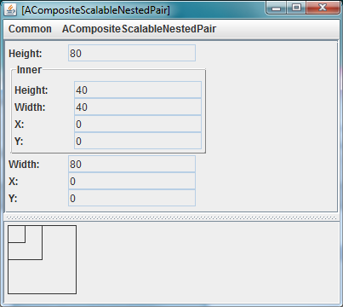
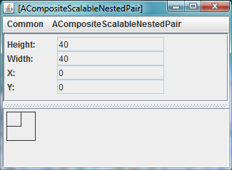
User Interfaces
Can use @Visible annotation to get rid of main panel properties

Slide 98
Key: Composite Design Pattern
Common Type
IS-A
IS-A
Composite Implementation
Leaf Implementation
Usually implemented with inheritance
Can do without inheritance

Slide 99
Java Toolkit Example
Component
Container
IS-A
IS-A
IS-A
JTextField
JPanel
Usually implemented with inheritance
Can do without inheritance

Slide 100
Java Swing Example
Component
Container
IS-A
IS-A
IS-A
JTextField
JPanel

