Slide 1
Comp 401 Concluding Remarks
Instructor: Prasun Dewan

Slide 2
Course → Future
Project
Advanced Courses
Topics
LAship
Praxes
Internships
Diaries
Research
Quizzes
Building an app
Exam(s)

Slide 3
Topics
Topics
Scanning
Objects
Overloading
Properties
Interfaces
Shape objects
Composite objects
Collections
Inheritance
MVC, Observer
Toolkits
Graphics (painting) views
Assertions
Animation
Command Objects
Threads
Synchronized Methods
Wait and Notify
Abstract Classes
Recursive Parsing and Grammars
Trees, DAGs
Generics
Factories, Adapter, Delegation
Exceptions
Advanced Algorithms
Design Patterns
Advanced Java Features
Complex Data Structures

Slide 4
Quick Review of Design Patterns
The design patterns taught in Comp 401 | Prasun Dewan, Teaching Inter-Object Design Patterns to Freshmen. Proceedings of ACM SIGCSE. 2005 | PPT

Slide 5
Future Optional Courses
Topics
Scanning
Objects
Overloading
Properties
Interfaces
Shape objects
Composite objects
Collections
Inheritance
MVC, Observer
Toolkits
Graphics (painting) views
Assertions
Animation
Command Objects
Threads
Synchronized Methods
Wait and Notify
Abstract Classes
Recursive Parsing and Grammars
Trees, DAGs
Generics
Factories, Adapter, Delegation
Exceptions
Human Computer Interaction
Software Engineering (Design Patterns)
Operating Systems
Compilers/PL/Internet Protocols

Slide 6
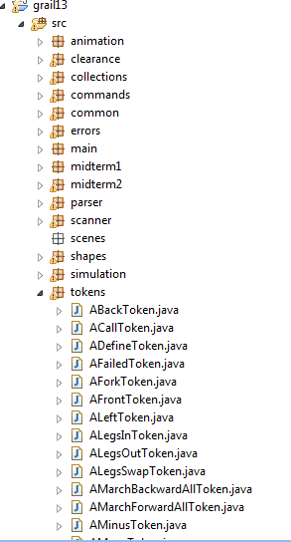
Large-Scale Object-Oriented Programming!
Large in terms of number of number of classes/types
Defined by you (Programmer-defined)
Count them!
Army of “paint listeners”
Largest (in terms of components) you may write at UNC or elsewhere
Refactoring

Slide 7
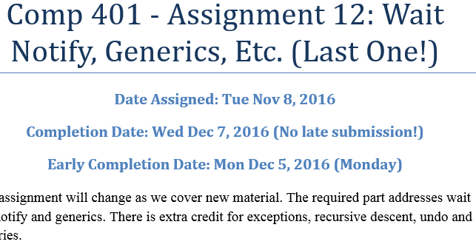
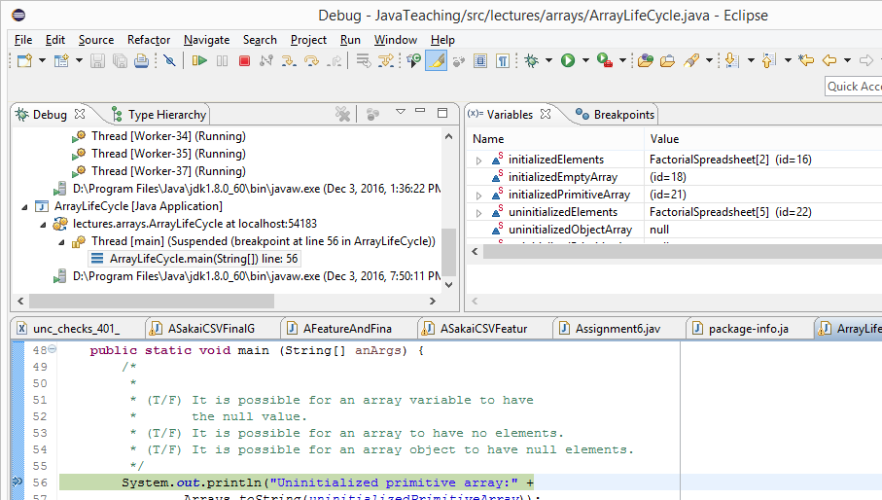
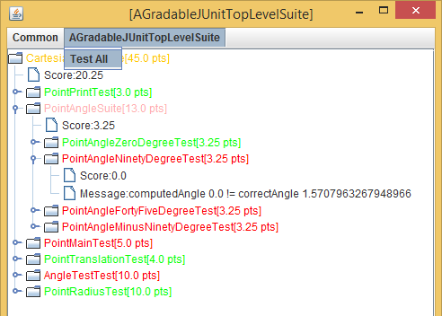
Programming Process and Tools
Class path and libraries (Eclipse)
Following Requirements
Using a Test Suite (JUnit)
Debugging (Eclipse)

Slide 8
Style Checks (Check Style) → Security

Slide 9
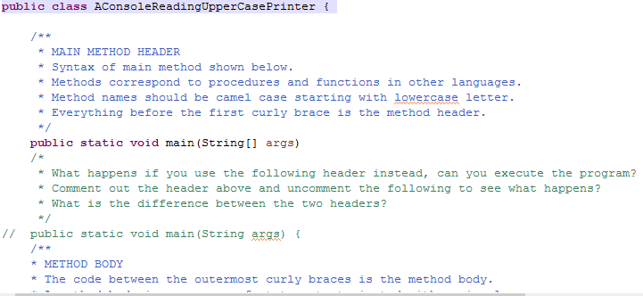
Praxis: Active Learning, Maintenance, Version Control
Sharing code and version control (GIT)

Slide 10
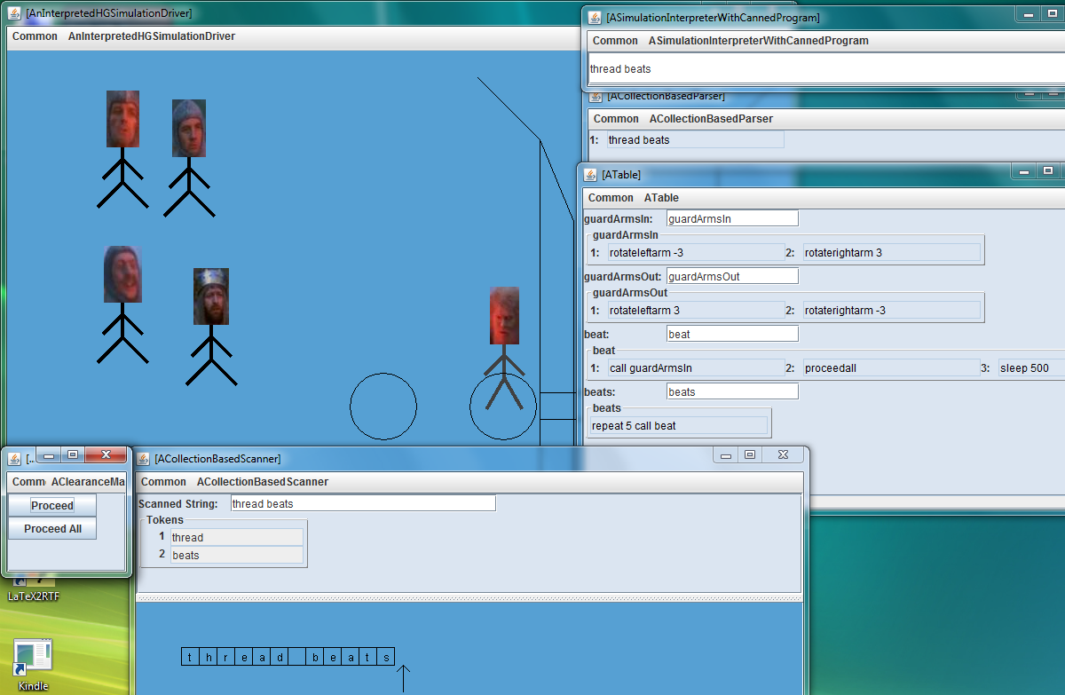
Interpreter of Programming Language

Slide 11
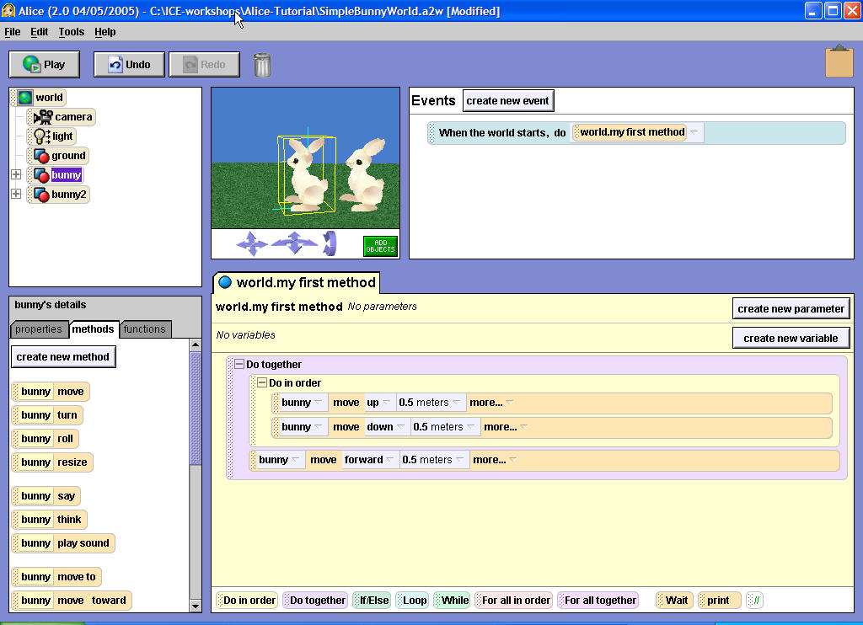
Use Methods
Drag method names from the details window Methods area
to world.my first method
Can Group Methods
Do in order
One after the other
Or Do together
At the same time
You built an Alice-like visual programming environment that can be used by others to program
Beginning programmers learn how to use Alice

Slide 12
Building an app
Handling of User and Internal Errors
Concurrency
Flexible, Multiple User Interface
Scanning
Parsing
Geometry Processing
Use of Window Systems and Toolkits

Slide 13
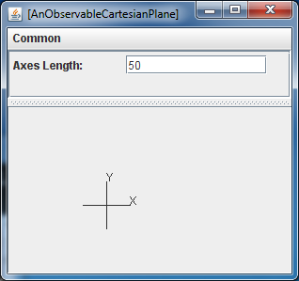
Logical Data Structure Visualizer, Style-based Tool, Training Wheels (ObjectEditor)
public Line getXAxis() {return xAxis;}
public Line getYAxis() {return yAxis;}
public StringShape getXLabel() {return xLabel;}
public StringShape getYLabel() {return yLabel;}
public int getAxesLength() {return axesLength;}
public void setAxesLength(int anAxesLength) {
axesLength = anAxesLength;
xAxis.setWidth(axesLength);
yAxis.setHeight(axesLength);
xAxis.setX(toXAxisX());
xAxis.setY(toXAxisY());
yAxis.setX(toYAxisX());
…
}

Slide 14
Diaries and Q/A
Written and oral skills
Abstraction

Slide 15
Quizzes and Exams
Make you (and me) think about and identify what you have programmed

Slide 16
Modularity
Class Decomposition into Methods: Recursive descent programming
Program Decomposition into Classes: Design Patterns
Process Decomposition into Threads: wait, notify, synchronized methods, command objectys

Slide 17
What did you not Learn
Distributed Systems
Efficient and Complex Data Structures and Algorithms (Implemented by Java)
How a computer system works on regular and mobile computing (Architecture, OS, Compilers)
Proving things about what your program can (not) do
Team Programming

