Slide 1

Comp 401 Course Overview
Instructor: Prasun Dewan (FB 150, help401@cs.unc.edu)
Course page: http://www.cs.unc.edu/~dewan/comp401/current/

Slide 2
Not in Course?
About 20% of class drops in 2 weeks
Put your name, PID and email in one of the passed sheets (even if you are in the course)

Slide 3
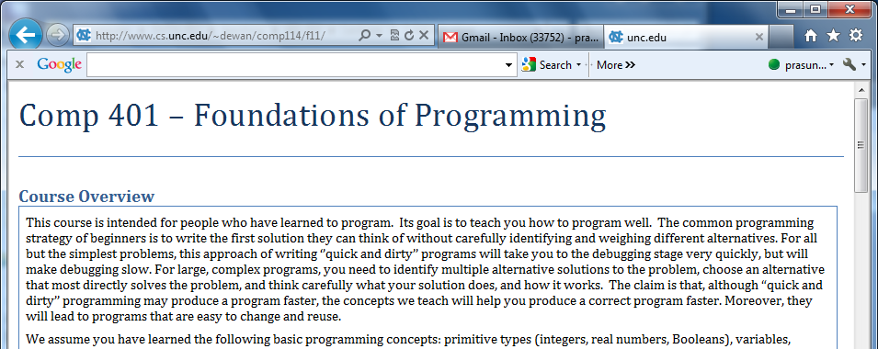
Course Page
Linked from my home page (google my name to find it) and UNC course pages

Slide 4
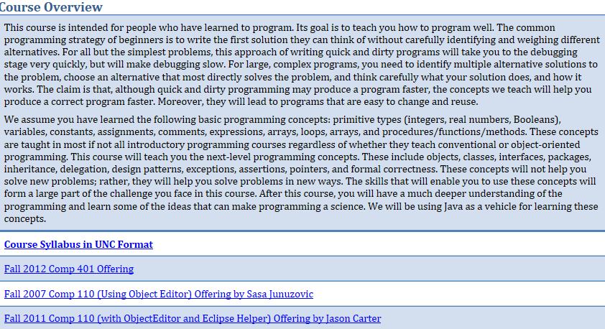
Detailed Overview: Course Syllabus

Slide 5
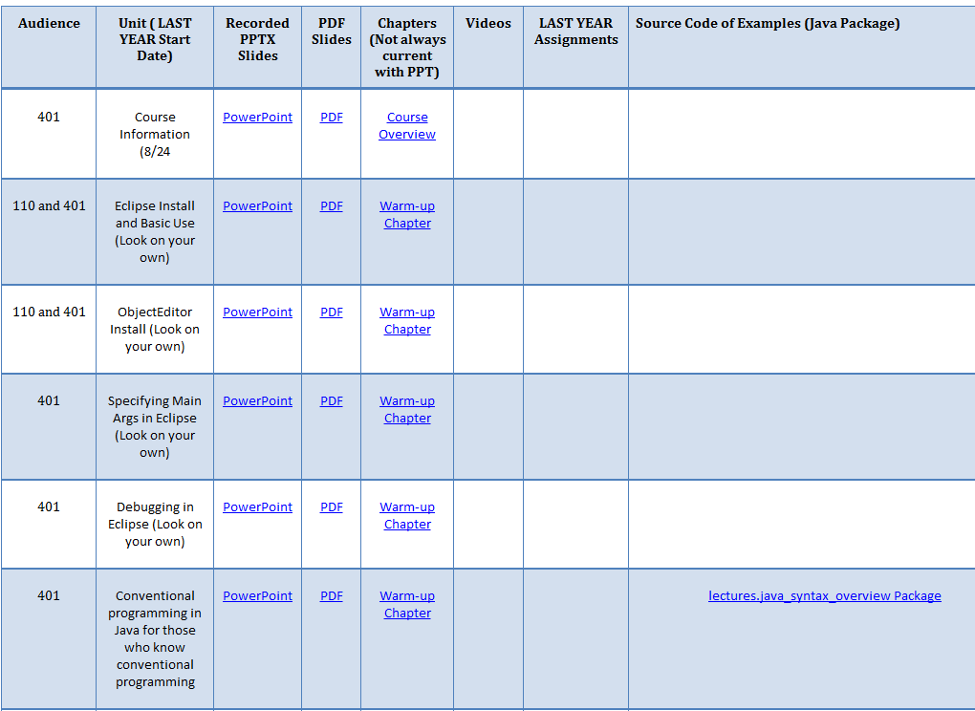
Class Material
No book: a Java reference might help but is not necessary
Each unit has PPT slides (with recordings), Word document, and assignment
Both background (110) and class material

Slide 6
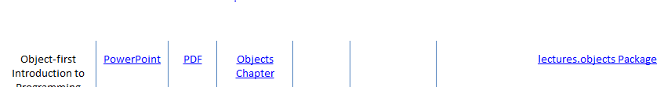
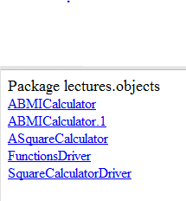
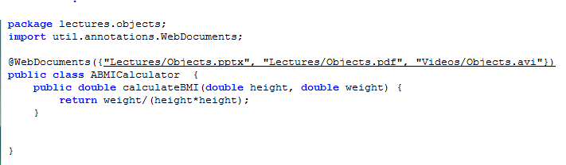

Source Code Linked to Class Material

Slide 7
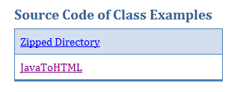
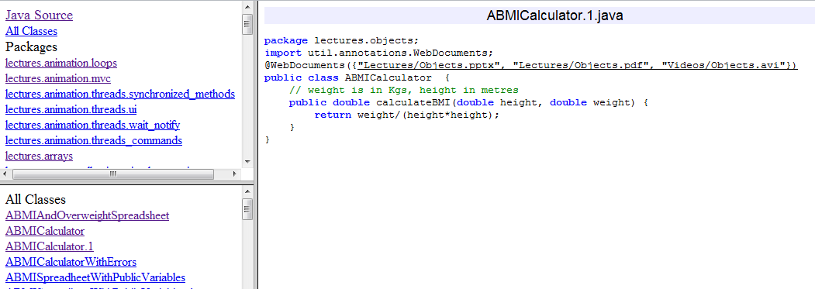
Special Source Code Browser

Slide 8
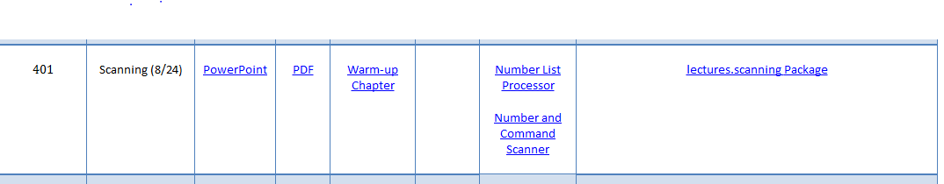
Linked Assignments
First assignment is due next week, so start on it ASAP ( on the web site)
Will help you decide if you belong in this class

Slide 9
Comp 401 vs. 110
Majors vs. Non Majors?
Majors usually start with 401
But many 110 students become majors.
Object-oriented vs. Conventional?
Both 401 and (current) 110 focus on objects.
Java vs. Non-Java?
110 and 401 are both in Java
Language is not the issue
Expected to use only those Java features taught in class
Course is not about Java
401
110
CS Majors
Psychology, Biology, …
Object-Oriented
Functional, Imperative, …
Java
C++, Python, …

Slide 10
Comp 401 vs. 110
“Intermediate” vs. “introductory” programming
Introductory may be object-oriented
Introductory may be conventional
Assume background in conventional programming and will teach Java syntax for it.
Repetition for those who know object-oriented programming.
401
110
Intermediate
Introductory

Slide 11
Introductory Conventional Programming
Types, variables, assignment , constants, expression
Conditionals, loops.
Input and output
Arrays/Strings
Procedures/Functions/Subroutines/Methods
Comments
Program vs. algorithm

Slide 12
Layered Assignments = Project
Assignment 4
Assignment 3
Assignment 2
Assignment 1
Assignments will build on each other to create a semester project
Due dates normally separated by a week (holidays, exams can cause more separation)

Slide 13
Working vs. Almost Working
Big difference between getting code working and almost working
Big differences in grades also
Very little partial credit if program not working
Errors will accumulate because of layered assignments

Slide 14
Grade Distribution
Exams (Two midterms, no final) | 44%
Assignments (Home work) | 46%
Recitation (Class work) | 10%
Fudge Factor (Class/piazza participation, other distinguishing factors), particularly useful for borderline cases | 10%
No final!

Slide 15
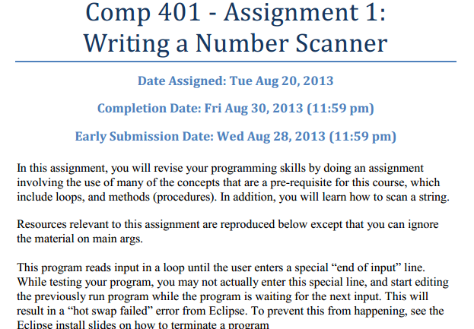
Two Submission Dates
Extra credit if submitted early on a Wednesday
Normal submission date is a Friday

Slide 16
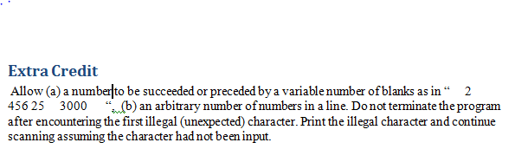
Extra Credit Programming
Students have varying interests and abilities
Make up or insurance against bad grade in other assignments or exams
Better to give early without extra credit than late with
But if you are already late, might as well do extra credit to make up for late points

Slide 17
Layered Assignments = Project
Assignment 4
Assignment 4 Due Date
Assignment 3
Assignment 3 Due Date
Assignment 2
Assignment 2 Due Date
Assignment 1
Assignment 1 Due Date
Can submit up to two class days (1 week) late with penalty

Slide 18
Shifting Dates
Assignment 4
Assignment 4 Due Date
Assignment 3
Assignment 3 Due Date
Assignment 2
Assignment 2 Due Date
Assignment 1
Assignment 1 Due Date
What if you get permanently behind?
Can shift assignment dates N times if last N assignments will not be done.
But you sacrifice the last N assignments, whose scores will go in fudge factor.

Slide 19
Skipping Once
Assignment 3
Assignment 4 Due Date
Assignment 2
Assignment 3 Due Date
Assignment 1
Assignment 2 Due Date
Assignment 1 Due Date

Slide 20
Skipping Twice
Assignment 2
Assignment 4 Due Date
Assignment 1
Assignment 3 Due Date
Assignment 2 Due Date
Assignment 1 Due Date
Do submit sacrifice assignments if you catch up – will take this work into account in fudge factor

Slide 21
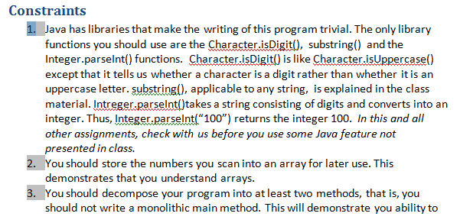
Constraints
Forbid use of certain Java libraries
Goal is not to teach Java and its libraries
It is to teach you how to build these libraries
Usually Java features not covered in class will be banned
Require use of certain programming techniques
Correctness is only one of the goals
Program must also be efficient and well crafted

Slide 22
Getting Help
Can discuss solutions with each other at a high level
Not at the code level
Sharing of code is honor code violation
Can help each other with debugging as long as it does not lead to code sharing
Assignments may contain solution in English (read only if stuck)

Slide 23
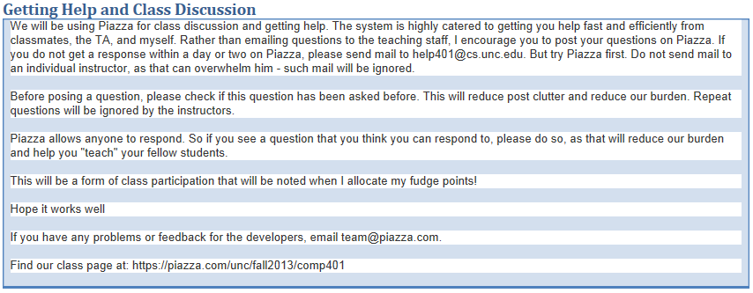
Piazza for Getting Help and Class Discussion

Slide 24
Dos and Don’ts
Do
Don’t
Attend class even though material is online
Look at class material if you have to miss class for extenuating circumstances or did not understand
Use Piazza for questions
Use help401@cs.unc.edu for grades and other private queries
Look at your laptop while in class unless it is to take notes
Come to class late or leave class early
Send mail to individual instructors

