Slide 1
Comp 401-F16 Course Overview
Instructor: Prasun Dewan (FB 150, help401-002-f16@cs.unc.edu)

Slide 2
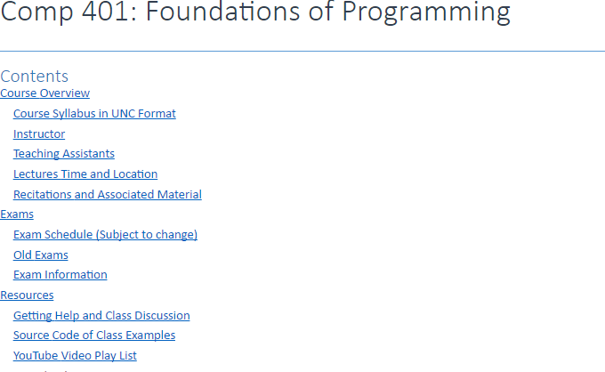
Getting Started
Course page: http://www.cs.unc.edu/~dewan/comp401/current/
Google (dewan comp401) to find page.
Also linked from my home page (google “dewan”)
Use index and local web search to find parts

Slide 3
Piazza
Piazza link available from course page (Search piazza)
Sign up on Piazza asap, as all announcements will be made there

Slide 4
Assignments and Associated Resources
First assignment is due in a week!
Search (assignments) for table column with assignments or go to link “Resources by Topics”

Slide 5
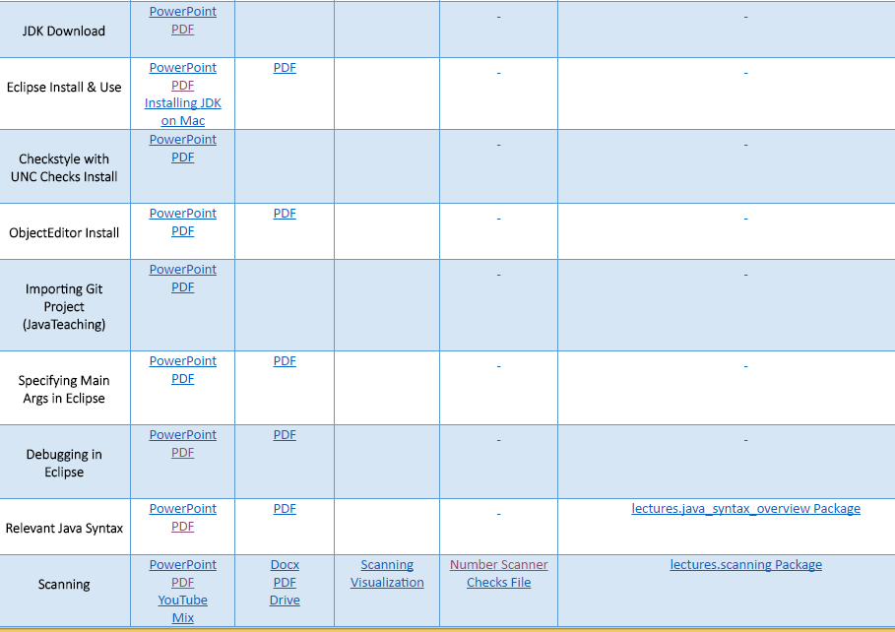
Before Next Class
✓
✓
✓
✓
✓

Slide 6
Background?
Java vs. Non-Java?
Course is not about Java
Expected to use only those Java features taught in class.
Object-Oriented vs. Conventional Programming
Assume background in conventional programming: Types, variables, assignment , constants, expression, conditionals and loops, input and output, arrays and/or strings, procedures/methods.
Weeding out first assignment.
Will teach all aspects of object-oriented programming.
Repetition for those who know object-oriented programming.

Slide 7
Course Content
110
Introductory Programming
Small number of simple code fragments connected by you
401
Intermediate Programming
Large number (~40)
of simple code fragments connected by you
410
Data Structures
Small number of complex code fragments connected by you
Only the optional compiler course will involve more components!
Component Complexity
410
401
110
No. of Components

Slide 8
Layered Assignments = Project
Assignment 11
Assignment 2
Assignment 1
Weekly assignments will build on each other to create a semester project
Each assignment with its own due date and points

Slide 9
Extra Credit
Students have varying interests and abilities
Make up or insurance against bad grade in other assignments or exams
Better to give early without extra credit than late with
But if you are already late, might as well do extra credit to make up for late points

Slide 10
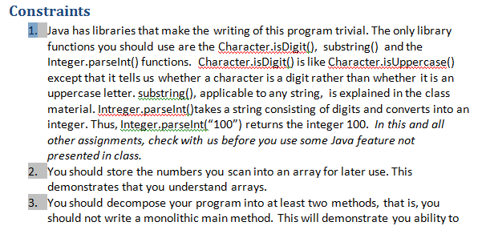
Constraints
Forbid use of certain Java libraries
Goal is not to teach Java and its libraries
It is to teach you how to build these libraries
Usually Java features not covered in class will be banned
Correctness is only one of the goals
Require use of certain programming techniques
Program must also be efficient and well crafted

Slide 11
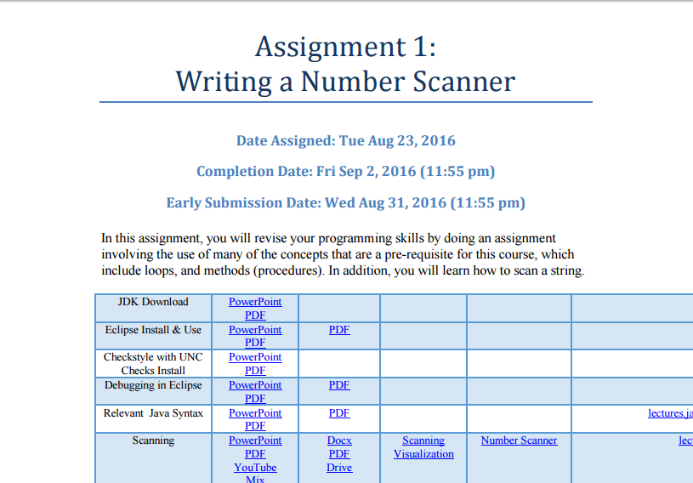
Early Reward
5% Extra credit if submitted early on a Wednesday
Normal submission date is a Friday
If you shoot for Wednesday you should be ready by Friday with TA help
End of day is 11:55pm for regular and late deadlines

Slide 12
Late Penalty
5% late if submitted next Monday, 10% late if submitted next Friday
20% late if submitted any day after that, but no manual grading points
0% for manual grading component – fairly high in later assignments
No correction of auto grading results

Slide 13
Why Small Late Penalty?
Big difference between getting code working and almost working
Big differences in grades also
Very little partial credit if program not working
Errors will accumulate because of layered assignments
Better late than not working
But being more than 1 week late for multiple assignments is recipe for failing

Slide 14
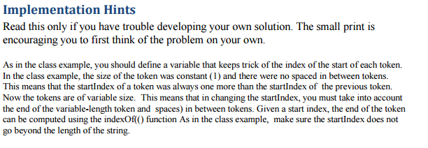
Coding vs Design/Debugging
The TAS and I are here to help you debug and design (but not write code)
Assignments may contain solution in English (read only if stuck)
Can help each other with design and debugging as long as it does not lead to code sharing

Slide 15
Honor Code
Sharing of code is honor code violation
More or less same project as last time, but do not look at past solutions
Automatic grader may be extended with plagiarism detector
Why We Lie : TED Radio Hour : NPR

Slide 16
Out of Office Help
Do
Don’t
Use Piazza for out of class questions
Use help401-002-f16@cs.unc.edu for grades and other private queries
Send mail to individual instructors

Slide 17
Automated Checking
Warn against requirements not met
Indicate potential sources of error

Slide 18
Automatic Checking: Code Analyzer
Code analyzer runnable from Eclipse

Slide 19
Code Analyzer: In-Place Messages

Slide 20
Code Analyzer: Problems Pane

Slide 21
Assignment Specification

Slide 22
Checks File

Slide 23
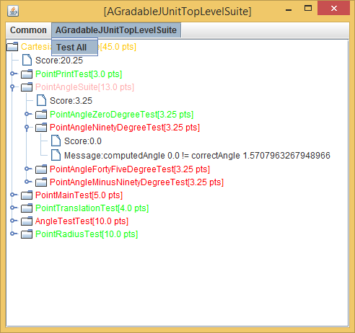
Automatic Checking: Local Code Executor

Slide 24
Automatic Checking: Server Code Analyzer and Code Executor

Slide 25
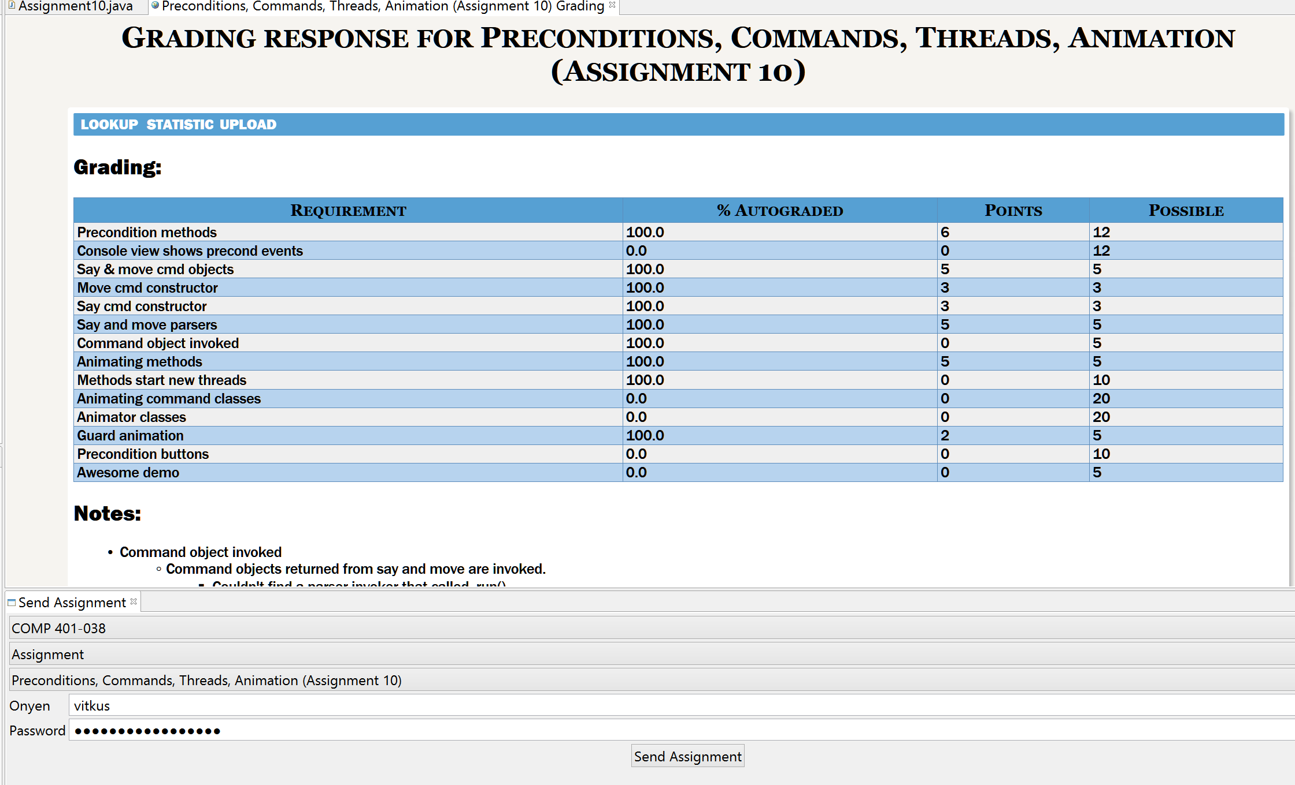
Automatic Checking: Server Code Analyzer and Code Executor

Slide 26
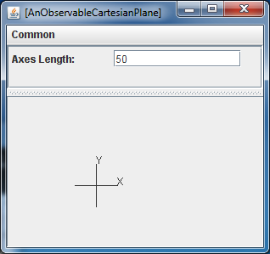
ObjectEditor: Code Analyzer, Executor, Visualizng Checker
public Line getXAxis() {return xAxis;}
public Line getYAxis() {return yAxis;}
public StringShape getXLabel() {return xLabel;}
public StringShape getYLabel() {return yLabel;}
public int getAxesLength() {return axesLength;}
public void setAxesLength(int anAxesLength) {
axesLength = anAxesLength;
xAxis.setWidth(axesLength);
yAxis.setHeight(axesLength);
xAxis.setX(toXAxisX());
xAxis.setY(toXAxisY());
yAxis.setX(toYAxisX());
…
}

Slide 27
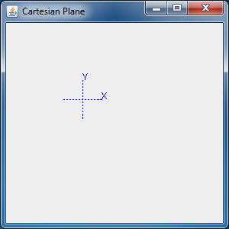
ObjectEditor: Training Wheels

Slide 28
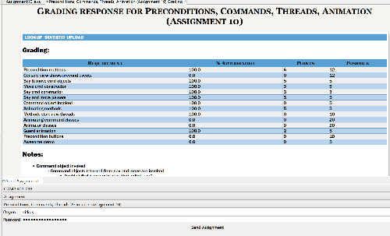
Research vs Required Tools
✓
Only ObjectEditor is required
Others are optional, research tools with consent form

Slide 29
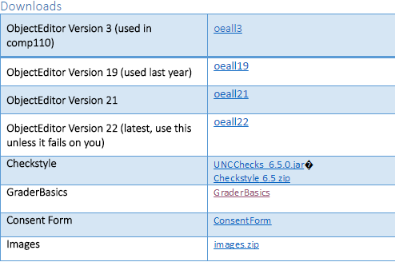
Downloads and Consent Form

Slide 30
Unusual Course
Only the optional compiler course will involve more components!
Component Complexity
410
Some creativity in number and nature of components
401
110
Unusual course – no textbook at this level covers such large programs
No. of Components

Slide 31
Learning Resources
No textbook!
Alternatives?

Slide 32
PDF of Slides

Slide 33
PowerPoint of Slides

Slide 34
Slide Show → Synchronized Recording and Animations
Can escape out into unsynchronized or no audio mode (WPS Office on Android will play synchronized audio)

Slide 35
PowerPoint Slides With Unsynchronized Recordings and Media Control

Slide 36
Recorded YouTube Videos
Play 2X,
rewind, pause, fast-forward to match understanding pace
Youtube video generated from PPT Recordings, does not allow slide-based browsing
PPT modes allow slide-based browsing but requires downloading PPT

Slide 37
Office Mix
Slide markers

Slide 38
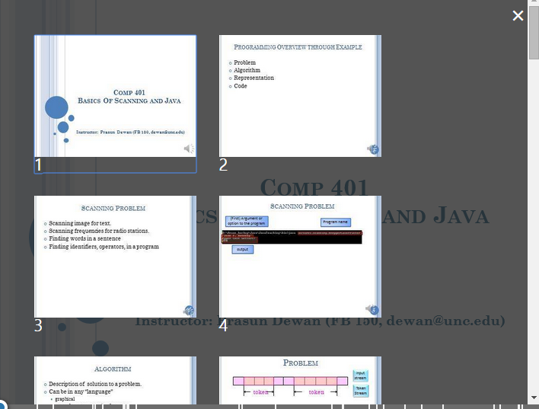
Slide-Based Browsing

Slide 39
Video Nature
Long pauses, you may know the answer
Recordings of live lectures with q/a rather than 15 minute lessons
Cannot hear student answer
Can fast forward
Audio is not the fastest way to get information, specially when studying for an exam
You can get a clue from my answer

Slide 40
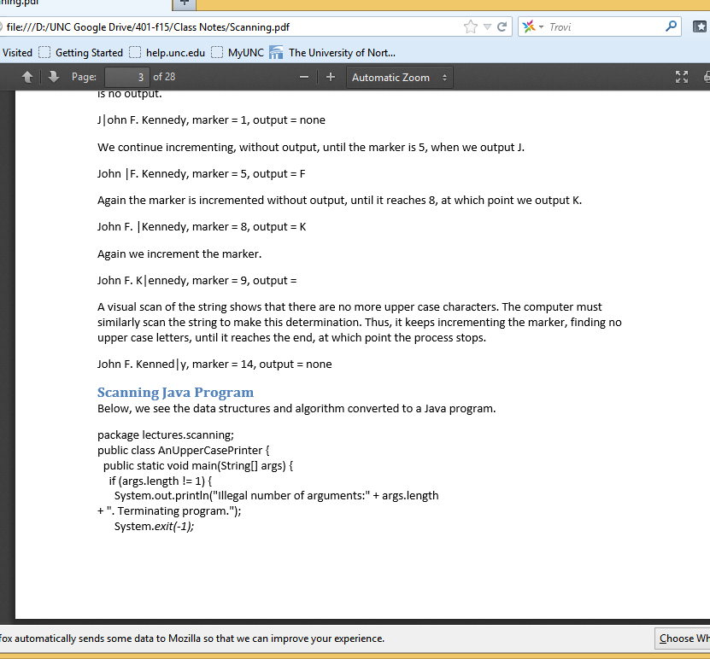
PDF of Word Documents
Little graphics, designed for mobile reading on mobile computers
Lots of (obvious) mistakes

Slide 41
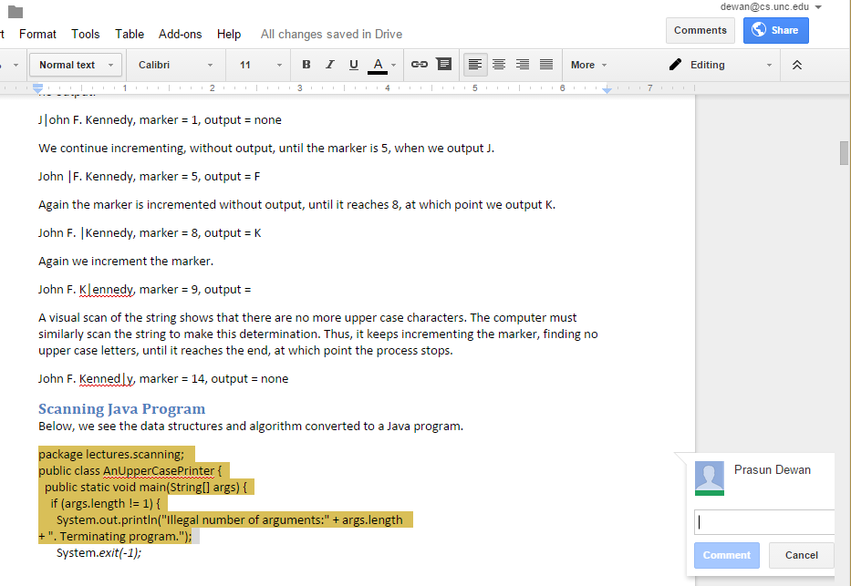
Publicly Commentable Google Docs

Slide 42
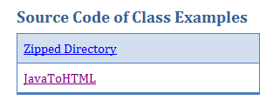
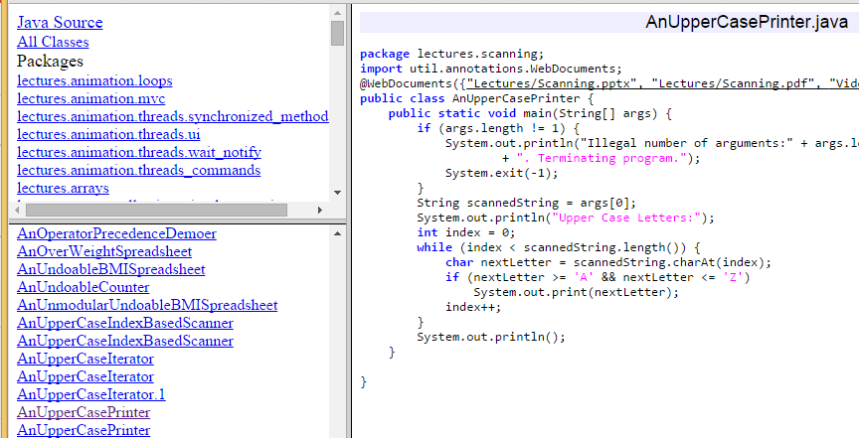
Web-Based Browsable Code
May not be up-to date

Slide 43
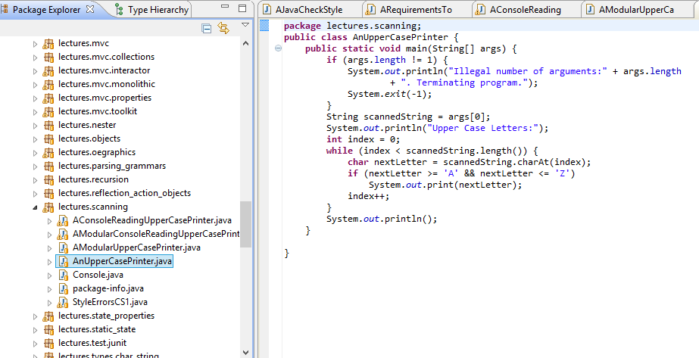
Eclipse Java Project of Lecture Code on GIT

Slide 44
Design Space of Study Modes!
You Tube video
Slides without audio
Slides with unsynchronized audio
Slideshow with synchronized recording
Office Mix
Word PDFs
Shared Google Docs
Eclipse Project
Browsable Project

Slide 45
Web Site Links

Slide 46
What do we do in class?
Live Lecture?
Value
Without resources
With resources

Slide 47
Discussion is About Concrete Programs
Pace at which you understand lecture in general and code in particular varies

Slide 48
Pacing Yourself
A variety of sources with different amounts of information
Each source can be browsed at your own pace

Slide 49
What do we do in class?
Homework?
Deep thinking done solo?
Limited discussion with classmates?

Slide 50
What do we do in class?
Quizzes: Test that you understood support material?
One hour means deep testing, puts pressure
May not have discipline to access material

Slide 51
What do we do in class?
I code in class, you watch.
I am not a touch typist!
You learn more as a driver than passenger

Slide 52
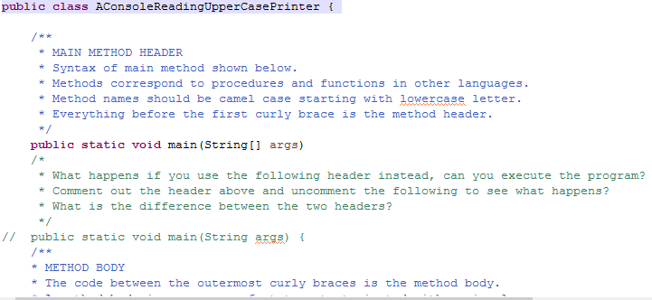
Praxis

Slide 53
Class Structure
Introduction to Praxis
Do praxis with as large a group as possible for 50 minutes and answer associated Sakai quiz
Answer class questions on the material
Finish praxis based on the answers and further understanding
If you ask for help from us, you are pledging that you have done the praxis

Slide 54
Attendance
Do
Don’t
Come to class
Come to class late or leave class early

Slide 55
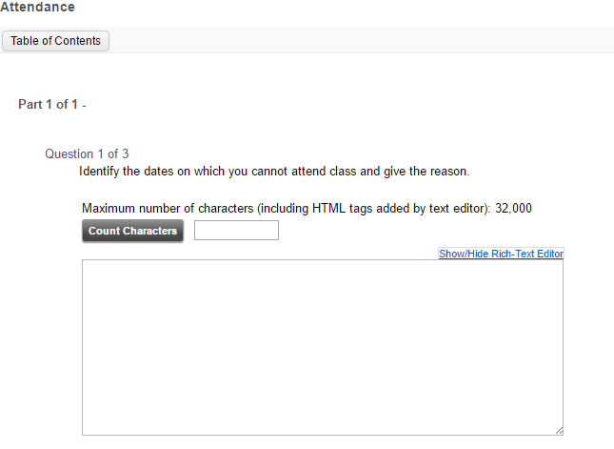
Attendance Sakai “Quiz”

Slide 56
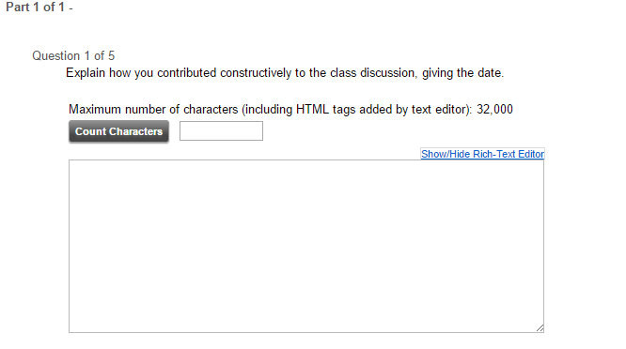
Class Discussion “Quiz”

Slide 57
Grade Distribution (Current Plan)
Midterm | 22%
Final | 28%
In-Class Work (Recitations & Lecture Quizzes, Discussion, Attendance) | 15%
Assignments | 35%
Fudge Factor (Special participation, other distinguishing factors), particularly useful for borderline cases | 5%

