Slide 1
Comp 110/401 Documentation: Annotations
Instructor: Prasun Dewan

Slide 2
Prerequisite
Documentation Comments
.

Slide 3
Programming Style: The Art of Programming
Use Interfaces
✓
Efficiency
✓
Document Program
Avoid Code Repetition
✓
✓
Giving Least Privilege
✓
Use Named Constants

Slide 4
Documentation
Comments are one form of documentation about a program
External descriptions of a program are also useful
{@link http://www.oracle.com/technetwork/java/javase/documentation/index-137868.html#exampleresult}
Annotations: Internal descriptions available at runtime (to runtime tools) also useful

Slide 5
Annotation vs. Comment
import util.annotations.Explanation; @StructurePattern(StructurePatternNames.NO_PATTERN)
@Explanation("Height is in meters, weight in centimeters")
public class AnAnnotatedBMICalculator {
public double calculateBMI(double height, double weight) {
return weight/(height*height);
}
}
Annotation not removed by compiler
Available to ObjectEditor

Slide 6
Explanation Annotation?

Slide 7
Annotated Interface and Class
@Explanation("Calculates BMI from height in metres and weight in kgs.")
public interface AnnotatedBMISpreadsheet {
public double getHeight();
public void setHeight(double newVal);
@Explanation("Weight is in Kilograms. ")
public double getWeight();
@Explanation("Changing weight automatically recalculates BMI.")
public void setWeight(double newVal);
public double getBMI();
}
@Explanation("Stores previously computed BMI value in a variable.")
public class AnAnnotatedBMISpreadsheet implements AnnotatedBMISpreadsheet
{…}

Slide 8
Explanation and UI Documentation
Menu item tooltip text
Explanation annotation of associated method
Property tooltip text
Sum of getter and setter explanations
Object tooltip text
Sum of interface and class explanations
Some documentation is outside a class
In PPT, PDF, and other Web Docs

Slide 9
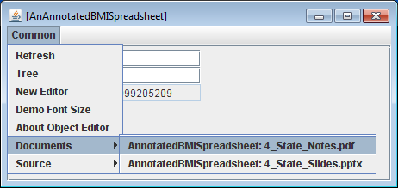
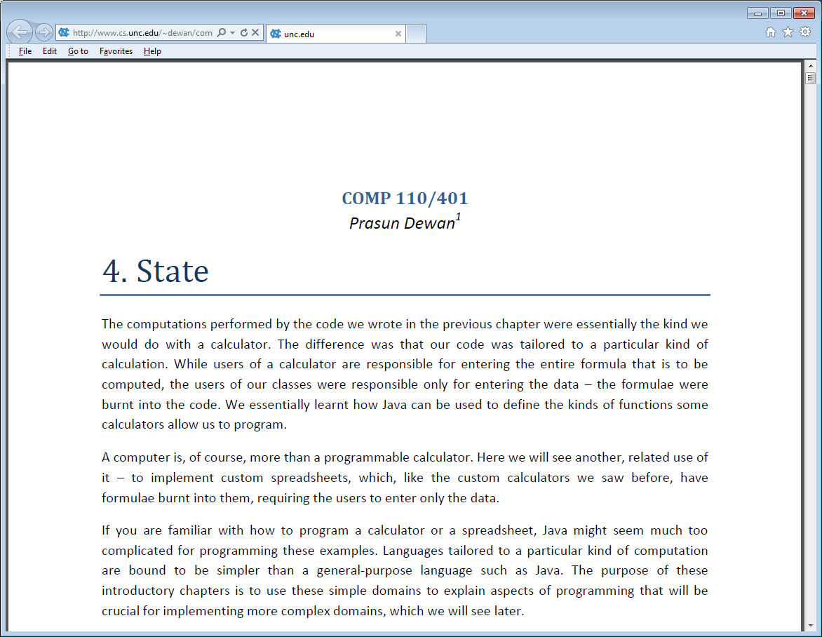
Web Documents
@WebDocuments({
"http://www.cs.unc.edu/~dewan/comp114/f11/Class%20Notes/4_State_Notes.pdf",
"http://www.cs.unc.edu/~dewan/comp114/f11/Lectures/4_State_Slides.pptx"
})
public interface AnnotatedBMISpreadsheet {public interface AnnotatedBMISpreadsheet {
…
}

Slide 10
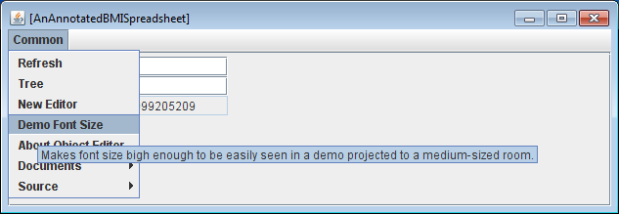
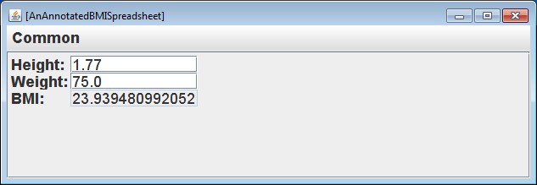
Common Menu

Slide 11
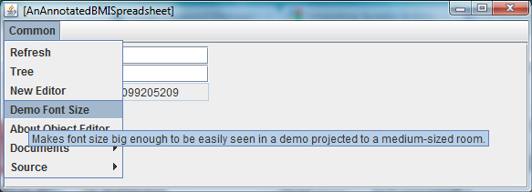
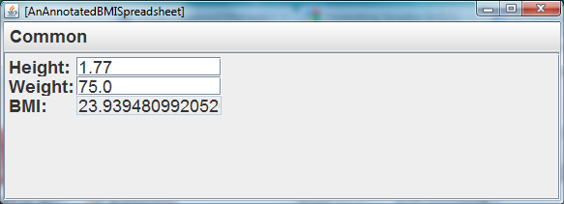
Common Menu

Slide 12
Tooltip Texts in Common and Object Menu
ObjectEditor used to build itself
Meta circularity – a la Interpreter “interpeting” itself
Bootstrapping – a la OS loading itself
Requires a layered implementation

Slide 13
Layered Implementation
public class ADemoFontOperationsModel implements FrameModel {
@Explanation ("Makes font size big enough to be easily seen in a demo projected to a medium-sized room.")
public void demoFontSize() {
…
}
…
}

Slide 14
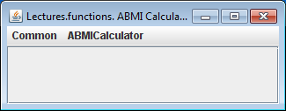
Editing Object Editor
import bus.uigen.ObjectEditor;
public class AnObjectEditorEditor {
public static void main (String[] args) {
ObjectEditor.edit(new ObjectEditor());
}
}
Can instantiate and edit objects without using knowing about or using main

