Slide 1
Comp 110/401 Documentation: Assertions
Instructor: Prasun Dewan

Slide 2
Prerequisite
Documentation Annotations

Slide 3
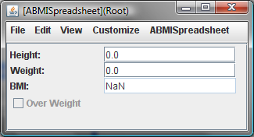
Invalid BMI
public double getBMI() {
return weight/(height*height);
}
getBMI() should really not have been asked to compute with zero height and weight

Slide 4
Comments to Describe Pre-Requisite
/**
* height and weight should be >=0
*/
public double getBMI() {
return weight/(height*height);
}
How to locate problem at execution time?

Slide 5
Runtime Error Checking
public double getBMI() {
if(weight <= 0 || height <= 0)
System.out.println(“height and weight should be >0
”);
return weight/(height*height);
}
Code is always executed even when the program is correct
Value must be still returned
Conditional compilation of an “if” that does not have to return a value ?

Slide 6
Assertions
public double getBMI() {
assert weight > 0 && height > 0:“height and weight should be >0”;
return weight/(height*height);
}
assert <Condition>: object → announces assertion error (object.toString() if !<Condition>
Assertion error is like exception, no return value needed
If assertion checking on
java –ea assignment9.MainClass –da bus.uigen
By default checking is off
Can enable/disable assertions for specific classes and packages
Enable assertions for MainClass
Disable assertions for bus.uigen package

Slide 7
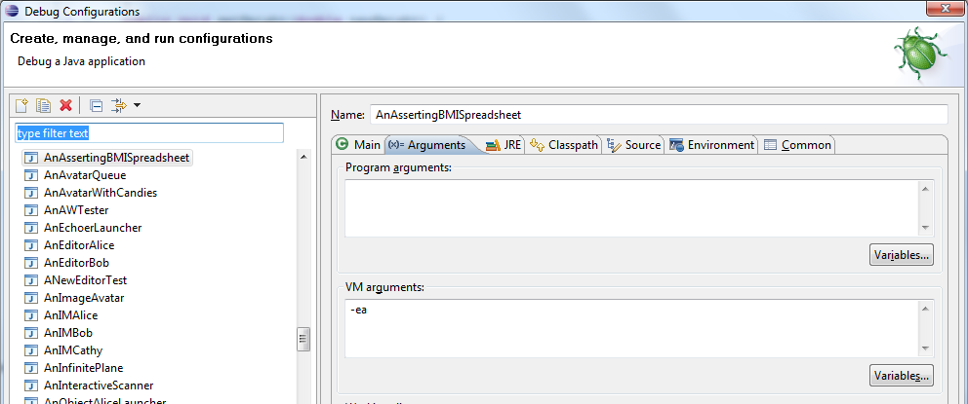
Enabling Assertions in Eclipse
Enable all assertions

Slide 8
Assertions
State some expected property of the program before/after some statement
Before getBMI() is called, height and weight should be greater than 0
A la some expected property of an enrollee
Before 401 you must know loops, arrays, methods

Slide 9
Compile time vs. runtime properties
Some “assertions” are language-supported
Compile time
String s = nextElement()
@Override
Runtime
((String) nextElement())
@util.annotations.ObserverRegisterer(util.annotations.ObserverTypes.VECTOR_LISTENER) addVectorListener(VectorListener)
We will consider runtime properties.
Casting is application-independent.

Slide 10
Application-independent vs. dependent
Language can provide us with fixed number of application-independent assertions.
Cannot handle
First character of String is a letter.
Letter concept not burnt into language.
Class Character defines it
Innumerable assertions about letters possible
Second elements of string is letter.
Third element of string is letter.
Need mechanism to express arbitrary assertions.
Originally Java had no assertions.
In 1.4, assertions were added

Slide 11
Java Assertions
assert <Boolean Expression>
assert <Boolean Expression>: <Value>
Statement can be inserted anywhere to state that some condition should be true
If condition is false, Java throws AssertionError, and (by default):
depending on which assert used, prints either:
generic message saying assertion failed, or
<Value>.toString()
prints stack trace
terminates program
No value needs be returned by the method in which the assertion fails

Slide 12
Individual Statement vs. Block of Code
Assert statement
States some expected property of the program before/after some individual statement
Preconditions/Postconditions of block of code (e.g. method)
States some expected property of the program before/after some block of code
Invariant of block of code
Precondition that is also a postcondition

Slide 13
Preconditions, Postconditions, Invariants
public boolean preGetBMI() {
return weight > 0 && height > 0;
}
public double getBMI() {
assert preGetBMI();
return weight/(height*height);
}
Pre (post) condition of block of code: an assertion that is expected to be true before (after) the block is executed
A la course prerequiste (objectives)
Invariant of a piece of code: a precondition that is also a post condition
GPA > Threshold

Slide 14
Assertions as Documentation
public boolean preGetBMI() {
return weight > 0 && height > 0;
}
public double getBMI() {
assert preGetBMI();
return weight/(height*height);
}
/**
* height and weight should be >0
*/
public double getBMI() {
return weight/(height*height);
}

Slide 15
Assertion Uses
Potentially useful for
documentation
specification
testing
formal correctness
user-interface adaptation

Slide 16
Precondition Public Method, UI adaptation, and Conventions, Testing
Convention could also be used by Grading (Testing) Program
public boolean preGetBMI() {
return weight > 0 && height > 0;
}
public double getBMI() {
assert preGetBMI();
return weight/(height*height);
}
A user-interface class (e.g. ObjectEditor or manual View class) can hide or disable a widget displaying some component of a model if the precondition of the method for reading the component is false
Public method allows other classes to discover preconditions and not violate them
A user-interface class (e.g. OE or controller class) can disable a widget (e.g. menu item/text widget) for invoking a write method if its precondition is false
A user-interface class (ObjectEditor, manual controller or view) should not call a method if its preconditon is false
OE Convention: Precondition of method M() is preM(). M could be a read, write or some other method

Slide 17
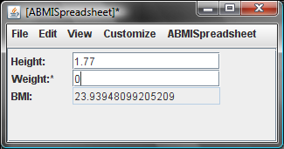
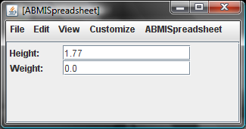
Precondition of BMI is True (False): Display shown (False)
Property display is removed rather than disabled
Works for graphics and text properties

Slide 18
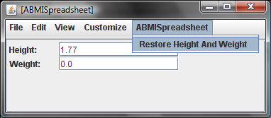
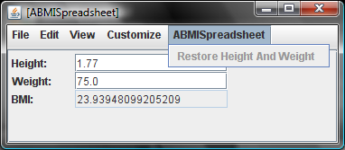
Input UI Item Disabled/Enabled
The menu item for a method is disabled when its precondition not met

Slide 19
Restoring Height and Weight
public class AnAssertingBMISpreadsheet implements BMISpreadsheet {
double height;
double weight;
double initialHeight, initialWeight;
public AnAssertingBMISpreadsheet(
double theInitialHeight, double theInitialWeight) {
setHeight(theInitialHeight);
setWeight(theInitialWeight);
initialHeight = theInitialHeight;
initialWeight = theInitialWeight;
}
public boolean preRestoreHeightAndWeight() {
return height != initialHeight || weight != initialWeight;
}
public void restoreHeightAndWeight() {
assert preRestoreHeightAndWeight();
height = initialHeight;
weight = initialWeight;
}
…

Slide 20
Method Precondition Style Rule
If a method M(…) has a precondition that should be checked by another class, write a precondition boolean method, preM() for it that takes no arguments. (For overloaded methods there is a special rule we will not cover.)
ObjectEditor will not invoke a method whose precondition is false and will not give the user a way to invoke it. If the method is a getter for a property, OE will not display the property.
Call the precondition method in an assert statement before executing the method body.

Slide 21
Method Assertions
Precondition: assertion true before the method is executed (regardless of parameters)
Post condition: assertion true after the method is executed.
Invariant: a precondition that is also a post condition

Slide 22
Class Assertions
Class precondition: precondition of all public methods
Class post condition: post condition of a all public methods
Class invariant: invariant of all public methods (weight and height >= 0)

