Slide 1
Comp 110/401 Documentation: Comments
Instructor: Prasun Dewan

Slide 2
Prerequisite
State Properties

Slide 3
Programming Style: The Art of Programming
Use Interfaces
✓
Efficiency
✓
Document Program
Avoid Code Repetition
✓
✓
Giving Least Privilege
✓
Use Named Constants

Slide 4
Comment?
Any code in the program removed by the compiler.
Useful for documentation
double bmi; //computed by setWeight and setHeight
Also for enclosing debugging code
// System.out.println(newHeight);

Slide 5
What to Comment?
Any code fragment needing explanation
Class
Top-level algorithm, author, date modified
Variable declaration
Purpose, where used, how its value is computed
Method declaration
params, return value, algorithm, author, date modified
Statement sequence
Explanation
Debugging code
Summarizing and/or Elaborating Comments

Slide 6
Comment Types
Single line comments
double bmi; //computed by setWeight and setHeight
Single or multi-line arbitrary comments
/* recompute dependent properties */
bmi = weight/(height*height);
/* recompute dependent
properties */
bmi = weight/(height*height);

Slide 7
Removing Debugging Code
System.out.println(newHeight); /*debugging statement */
/*
System.out.println(newHeight); /*debugging statement */
*/
/*
System.out.println(newHeight); // debugging statement
*/

Slide 8
What to Write in a Comment?
double w; // weight
Bad variable name
double weight; // weight
Redundant
double weight;
Self-commenting
double bmi; // computed by setWeight and setHeight
Useful comment

Slide 9
Self Commenting Variable Names
public static final int NUMBER_WITH_LARGE_FACTORIAL = 15;
Eclipse CTRL-SPACE will complete name for you

Slide 10
Method Decomposition
Comment→long identifier name
public static void modularReadAndPrintStrings() () {
String[] strings = readStrings(readNumStrings());
printStrings(strings);
printString(strings[0]);// unsafe
}
Eclipse CTRL-SPACE will complete name for you
public static int readNumStrings() {
System.out.println("Number of Strings:");
return Console.readInt(); // reads the next line as integer
}
public static String[] readStrings(int numElements) {
System.out.println("Please enter " + numElements + " strings");
String[] strings = new String[numElements]; // dynamic array
for (int elementNum = 0; elementNum < numElements; elementNum++)
strings[elementNum] = Console.readString();
return strings;
}
Useful information assuming the reader does not know it

Slide 11
For Whom the Comments Toll
Other programmers who may have to maintain your code
Other programmers using the API provided by your code
They do not have the context of the code, so some comments may not be redundant
API comments useful in Web Documents and Tooltip Messages in Programming Environment
Follow special format so they can be extracted by web doc tools and programming environment

Slide 12
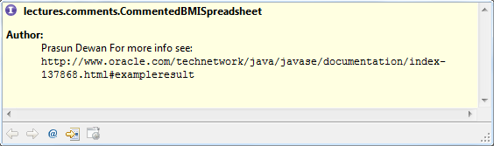
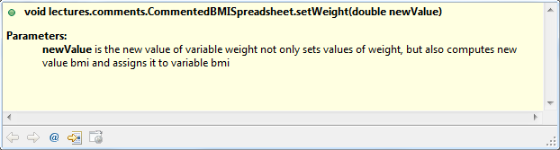
JavaDoc Conventions For Headers (API)
/**
* @author Prasun Dewan
* For more info see:
* {@link http://www.oracle.com/technetwork/java/javase/documentation/index-137868.html#exampleresult}
*/
public interface CommentedBMISpreadsheet {
/**
* @param newValue is the new value of variable weight
* not only sets values of weight,
* but also computes new value bmi and
* assigns it to variable bmi
*/
public void setWeight(double newValue);
JavaDoc Tags
Interface or Class?
Interface is the API

Slide 13
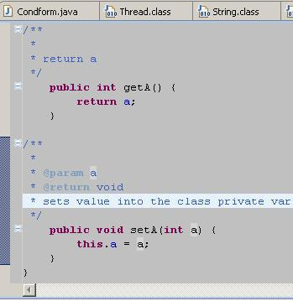
Example
In well written code, difficult to find opportunities to comment
Do not comment for the sake of commenting

