Slide 1
Comp 110/401 Appendix: Installing and Using Eclipse
Instructor: Prasun Dewan (FB 150, dewan@unc.edu)

Slide 2
Shortcuts (MSFT)/Commands
Block quote/unquote (CTRL-/)
Run project (CTRL-F11)
Search project for strings (Select project, Search→File)
Step into, over, return (F5, F6, F7)
Copy a project (CTRL-C, CTRL-V)
Copy a package, class file to another project (CTRL_C, CTRL-V)’
Show variable, class, interface (identifier) definition (click, F3 or Right Menu→ Open Declaration) and return back (ALT ←)
Find identifier (variable, class, interface) use (Click, CTRL-SHIFT-G, Right Menu→References)
Refactor (Click, CTRL-SHIFT-R or Right Menu→Refactor)
Complete identifier name (CTRL-Space)
Automatic imports (CTRL-SHIFT-O)
JUnit
Change Method Signature (Click ALT_SHIFT-C, Right Menu→Refactor)
Extract interface (Click ALT_SHIFT-C, Right Menu→Refactor)

Slide 3
Contents
Install JDK
Install Eclipse
Connect JDK to Eclipse
Create project
Edit project run project
Restore window
Search project for strings
Debugging
Adding a library
Add an existing project
Copy a project
Copy a package, class file to another project
Delete a project
Show variable, class, interface (identifier) definition and return back
Find identifier (variable, class, interface) use
Refactor
Complete identifier name
Understand, fix errors
Automatic imports
JUnit
Change Method Signature
Extract interface
Supply main argument
Create project from existing code

Slide 4
Contents
Install JDK
Install Eclipse
Connect JDK to Eclipse
Create project
Edit project run project
Restore window
Search project for strings
Debugging
Adding a library
Add an existing project
Copy a project
Copy a package, class file to another project
Delete a project
Show variable, class, interface (identifier) definition and return back
Find identifier (variable, class, interface) use
Refactor
Complete identifier name
Understand, fix errors
Automatic imports
JUnit
Change Method Signature
Extract interface
Supply main argument
Create project from existing code

Slide 5
Find JDK
http://www.oracle.com/technetwork/java/javase/downloads/index.html
Check with instructor which JDK version to get

Slide 6
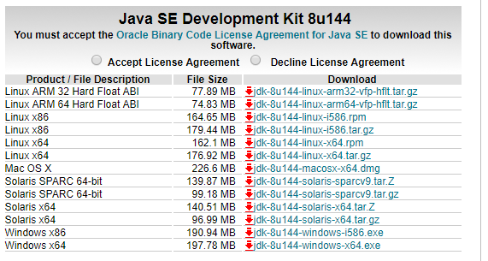
Follow Download Link: Accept License Agreement, Find JDK for Appropriate Platform, and Click on exe Link to Download EXE in some temporary folder

Slide 7
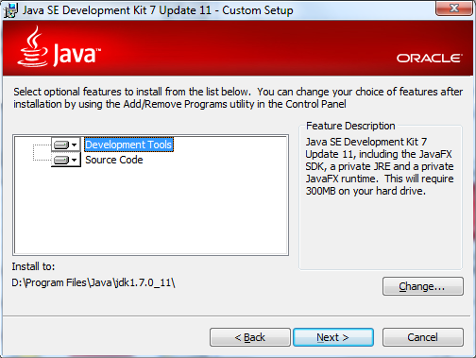
Run Exe and Choose JDK Folder

Slide 8
Contents
Install JDK
Install Eclipse
Connect JDK to Eclipse
Create project
Edit project run project
Restore window
Search project for strings
Debugging
Adding a library
Add an existing project
Copy a project
Copy a package, class file to another project
Delete a project
Show variable, class, interface (identifier) definition and return back
Find identifier (variable, class, interface) use
Refactor
Complete identifier name
Understand, fix errors
Automatic imports
JUnit
Change Method Signature
Extract interface

Slide 9
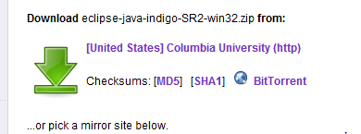
Download from www.eclipse.org (Windows)
Get the latest IDE for Java Developers, not Indigo

Slide 10
Download from www.eclipse.org (Windows)
Get the latest IDE for Java Developers, not Indigo

Slide 11
Extract All

Slide 12
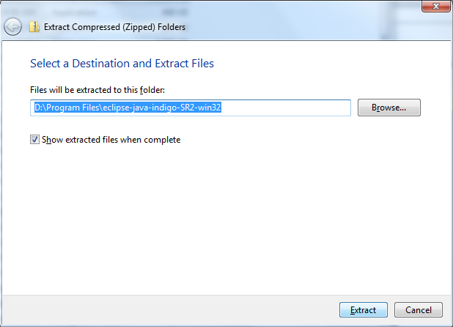
Select Destination Folder

Slide 13
Create some kind of Shortcut for Eclipse.exe

Slide 14
Run Eclipse.exe

Slide 15
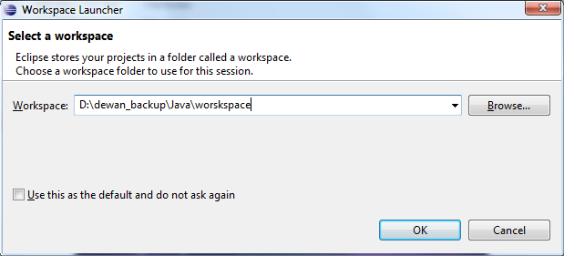
Specify Projects Directory

Slide 16
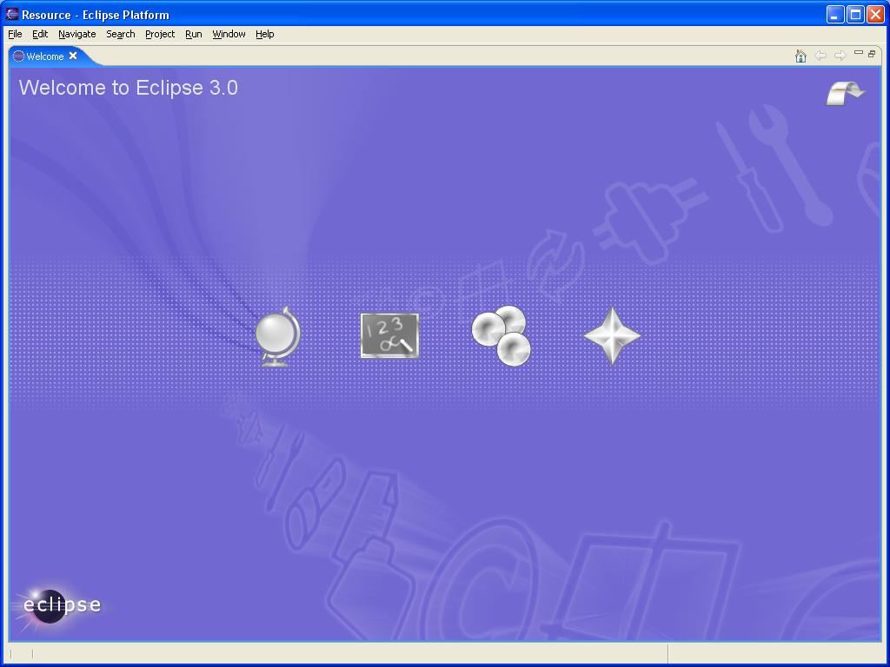
Remove Welcome Tab if it Appears

Slide 17
Contents
Install JDK
Install Eclipse
Connect JDK to Eclipse
Create project
Edit project run project
Restore window
Search project for strings
Debugging
Adding a library
Add an existing project
Copy a project
Copy a package, class file to another project
Delete a project
Show variable, class, interface (identifier) definition and return back
Find identifier (variable, class, interface) use
Refactor
Complete identifier name
Understand, fix errors
Automatic imports
JUnit
Change Method Signature
Extract interface

Slide 18
Change the Java Version: Window→Preferences

Slide 19
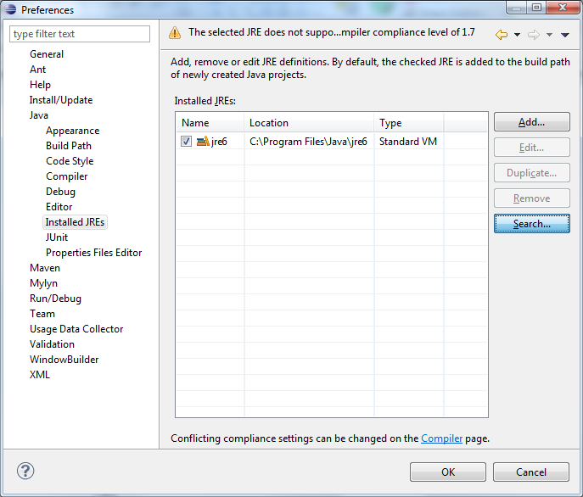
Press Search Browse Button

Slide 20
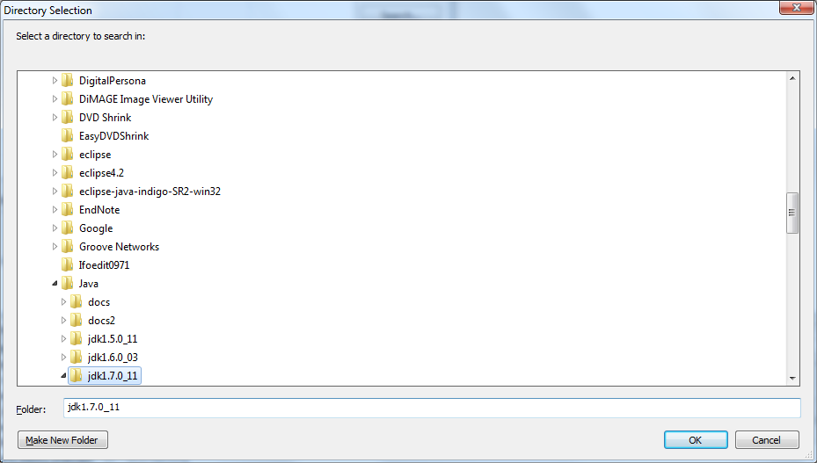
Press Search Browse Button to Installed JDK

Slide 21
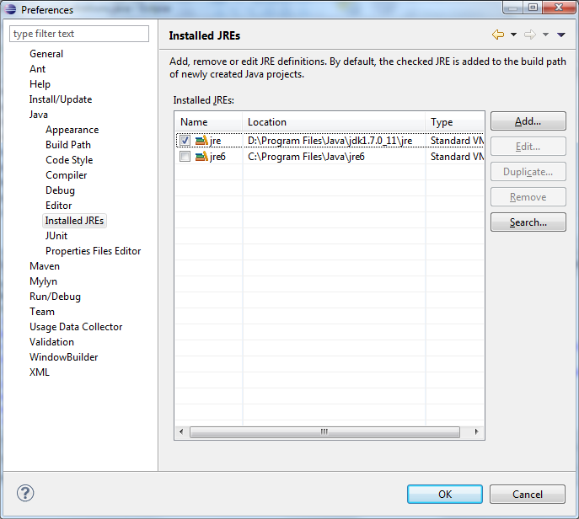
Jre added to Eclipse, Select it and Can Execute Without Errors

Slide 22
Some Explicit Instructions – for MAC (assume Java 7)
You can get that for mac here:
https://www.oracle.com/technetwork/java/javase/downloads/jdk10-downloads-4416644.html. Pick the Mac option and from there it should just be like installing any other application.
Or you can go here: http://download.oracle.com/otn-pub/java/jdk/7u40-b43/jdk-7u40-macosx-x64.dmg
The problem is Eclipse won't change the compiler to use 1.7 so you will have to specify that under: Eclipse -> Preferences -> Java -> Installed JREs
Click "Add..." then choose "MacOS X VM"
Next, then under directory copy/paste this:
/Library/Java/JavaVirtualMachines/jdk1.7.0_40.jdk/Contents/Home
Make sure it recognizes this as Java SE 7. Then name doesn't really matter. Now go to: Eclipse -> Preferences -> Java -> Compiler Change the compliance level to: "1.7" Now it probably still won't work (at least it didn't on mine) This is because your project is still set on 1.6 So, go to:
Project -> Properties -> Java Build Path -> Libraries Add Library...
JRE System Library
"Workspace default" should be automatically there as the 1.7, but if not find the 1.7 library. Then remove the 1.6 library
Also you need to change the compiler being used by the project: Project -> Properties -> Java Compiler and make sure everything is on 1.7 Now, if you're getting an error about the main class not being found or working.
You may just want to create a new project and when you select the 1.7 JRE.

Slide 23
Contents
Install JDK
Install Eclipse
Connect JDK to Eclipse
Create project
Edit project run project
Restore window
Search project for strings
Debugging
Adding a library
Add an existing project
Copy a project
Copy a package, class file to another project
Delete a project
Show variable, class, interface (identifier) definition and return back
Find identifier (variable, class, interface) use
Refactor
Complete identifier name
Understand, fix errors
Automatic imports
JUnit
Change Method Signature
Extract interface

Slide 24
Add a New Java Project

Slide 25
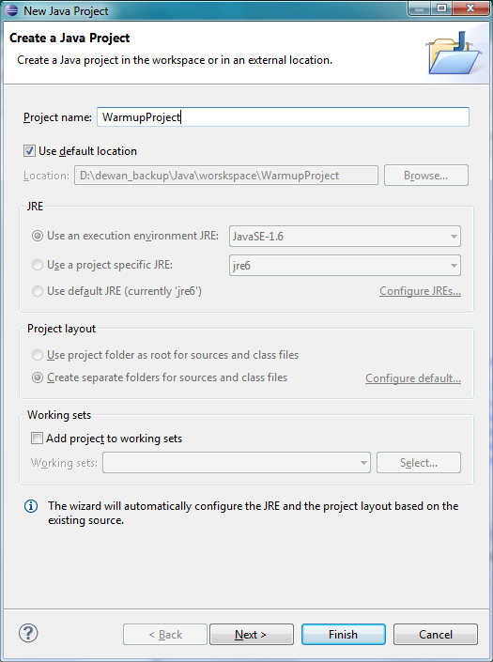
Project Name and Separate Folders
The separate folder option puts .java source files in src folder and .class files in bin folder – required for the auto grader

Slide 26
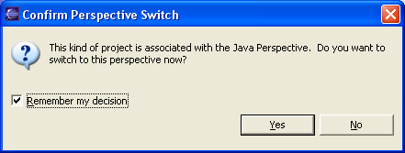
Switch to Java Perspective (May get this message)

Slide 27
Empty Project Created

Slide 28
Contents
Install JDK
Install Eclipse
Connect JDK to Eclipse
Create project
Edit run project
Restore window
Search project for strings
Debugging
Adding a library
Add an existing project
Copy a project
Copy a package, class file to another project
Delete a project
Show variable, class, interface (identifier) definition and return back
Find identifier (variable, class, interface) use
Refactor
Complete identifier name
Understand, fix errors
Automatic imports
JUnit
Change Method Signature
Extract interface

Slide 29
Add a Package to Selected Project
Select project and File→ Package

Slide 30
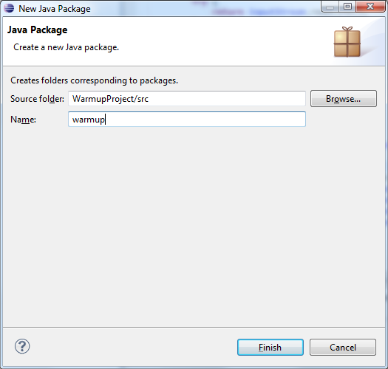
Enter Package Name

Slide 31
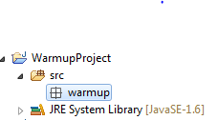
Empty Package in Non Empty Project

Slide 32
Add a Class
Select project and File→ Class

Slide 33
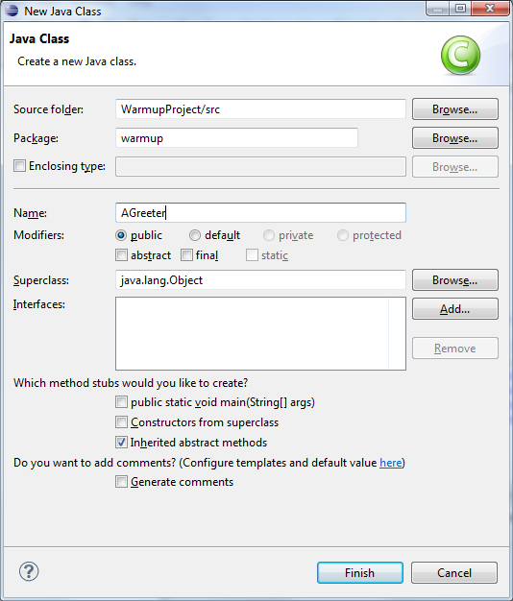
Name the Class

Slide 34
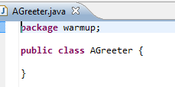
Empty Class in Non Empty Package

Slide 35
Edit the File (Copy and Paste Code)
package warmup;
import java.io.BufferedReader;
import java.io.InputStreamReader;
public class AGreeter {
static BufferedReader inputStream = new BufferedReader(new InputStreamReader(System.in));
public static void main(String[] args) {
System.out.println("Hello World");
if (args.length > 0) {
System.out.println(args[0]);
}
try {
System.out.println (inputStream.readLine());
} catch (Exception e) {
System.out.println("Could not read line");
e.printStackTrace();
}
}
}
Copy and paste code from:

Slide 36
Save (and Compile) the File
File→Save or CTRL+S

Slide 37
Workspace, Project, Source Package → Folder
Workspace
Project
Source Package
Class Source

Slide 38
Workspace, Project, Binary Package → Folder
Workspace
Project
Binary Package
Class Object (Binary) Code

Slide 39
Execute the Main Method on Selected Class
Right Menu→Debug As→ Java Application
Can also select Run but Debug is more defensive

Slide 40
Find or Switch Workspace Folder: File→Switch Workspace

Slide 41
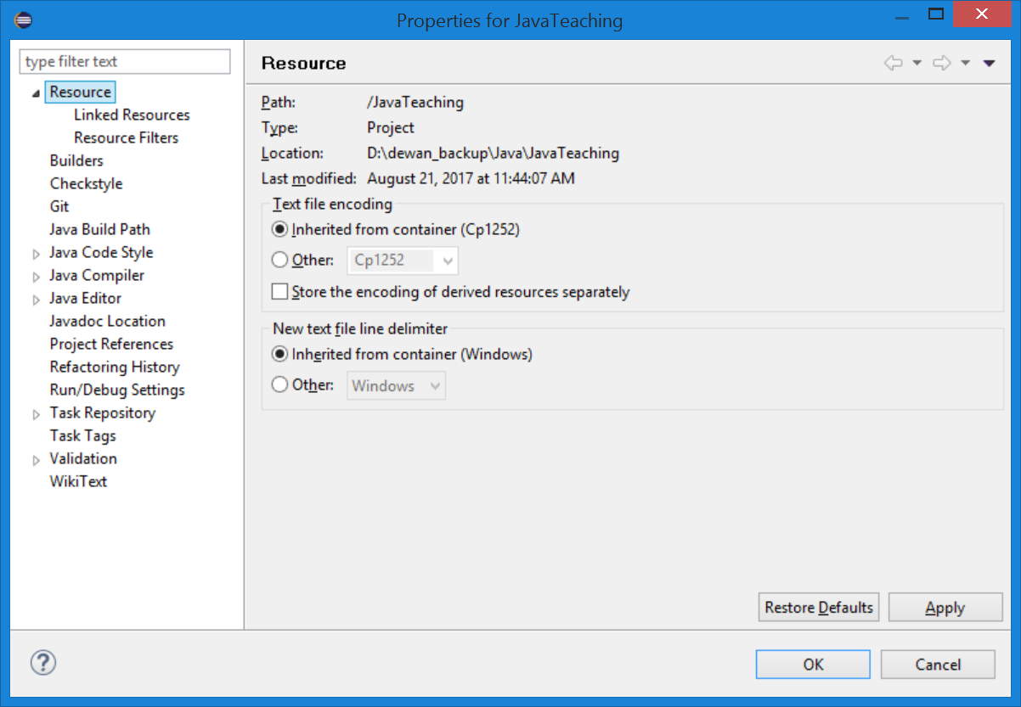
Find Project Folder: Select Project, Right Click→Properties→Resource

Slide 42
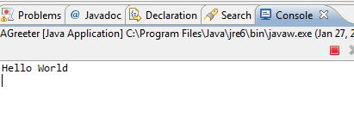
View Output in Console Window

Slide 43
Provide Input in Console Window

Slide 44
The Output after Enter

Slide 45
Contents
Install JDK
Install Eclipse
Connect JDK to Eclipse
Create project
Edit project run project
Restore window
Search project for strings
Debugging
Adding a library
Add an existing project
Copy a project
Copy a package, class file to another project
Delete a project
Show variable, class, interface (identifier) definition and return back
Find identifier (variable, class, interface) use
Refactor
Complete identifier name
Understand, fix errors
Automatic imports
JUnit
Change Method Signature
Extract interface

Slide 46
Closing a Window perhaps accidentally
Hide Console

Slide 47
Vanished Console

Slide 48
Window→Reset Perspective

Slide 49
Window→Show View
Can selectively remove and add sub-windows/views

Slide 50
Contents
Install JDK
Install Eclipse
Connect JDK to Eclipse
Create project
Edit project run project
Restore window
Search project for strings
Debugging
Adding a library
Add an existing project
Copy a project
Copy a package, class file to another project
Delete a project
Show variable, class, interface (identifier) definition and return back
Find identifier (variable, class, interface) use
Refactor
Complete identifier name
Understand, fix errors
Automatic imports
JUnit
Change Method Signature
Extract interface

Slide 51
File Search in a Project (useful in Java Teaching and Your projects)
Suppose you want to search the entire project for some string such as some text in a Sakai question: such as “println(c) displays”

Slide 52
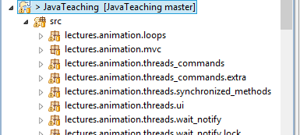
Select Project
Suppose you want to search the entire project for some string such as some text in a Sakai question: such as “println(c) displays”
Select project (not the src folder)

Slide 53
File→Search

Slide 54
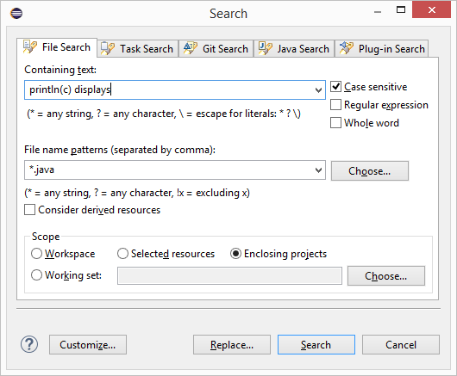
Search Dialog
Search string
Scope of search
Command

Slide 55
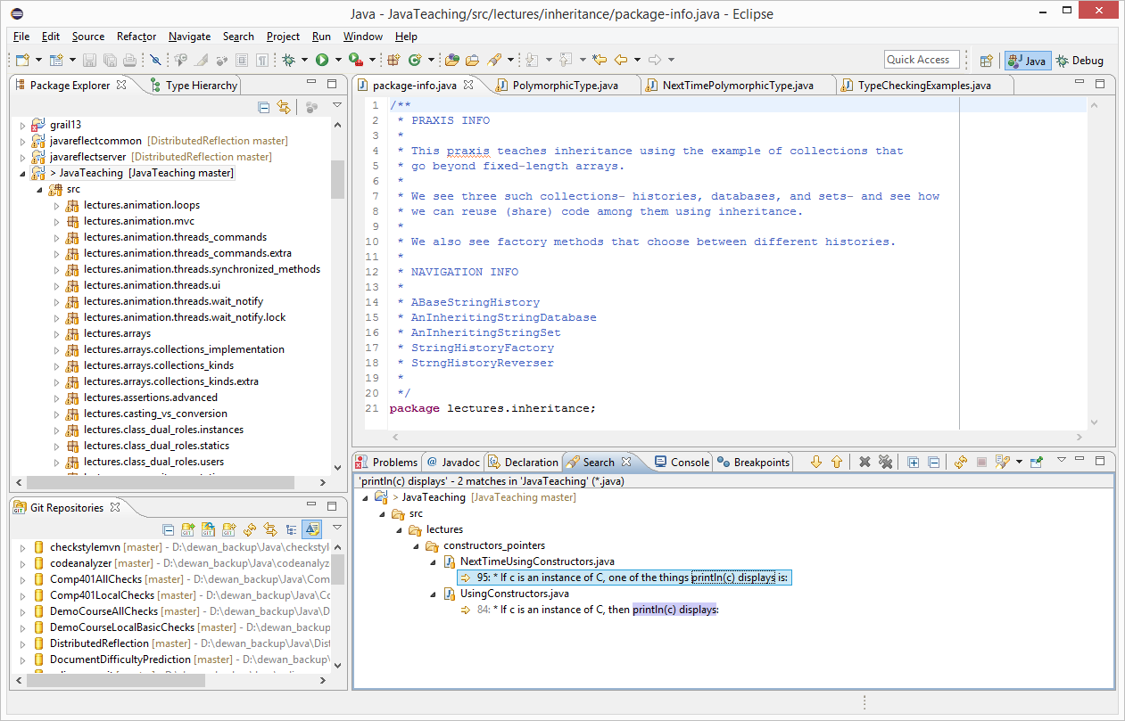
Search Results
Search view shown, console in another tab

Slide 56
Search Results Zoomed
Look at all the tabs availalale here

Slide 57
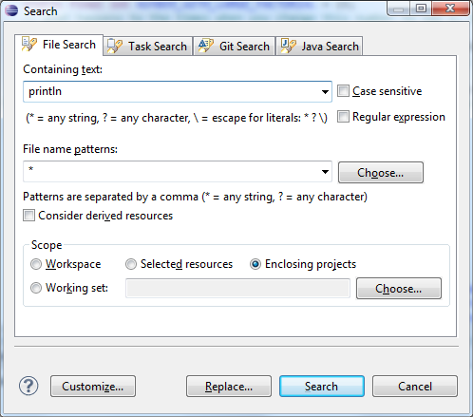
Multi File Text Search for Println

Slide 58
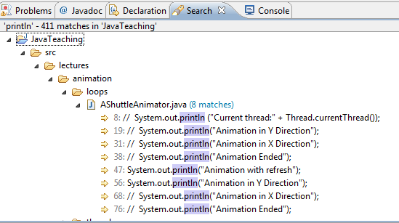
Search Results
Text search, shows uncommented println() also
Use CTR+SHIFT+G (shown earlier) to find active uses of the method

Slide 59
Contents
Install JDK
Install Eclipse
Connect JDK to Eclipse
Create project
Edit project run project
Restore window
Search project for strings
Debugging
Adding a library
Add an existing project
Copy a project
Copy a package, class file to another project
Delete a project
Show variable, class, interface (identifier) definition and return back
Find identifier (variable, class, interface) use
Refactor
Complete identifier name
Understand, fix errors
Automatic imports
JUnit
Change Method Signature
Extract interface

Slide 60
Setting a Break Point
Double click where you want program to stop

Slide 61
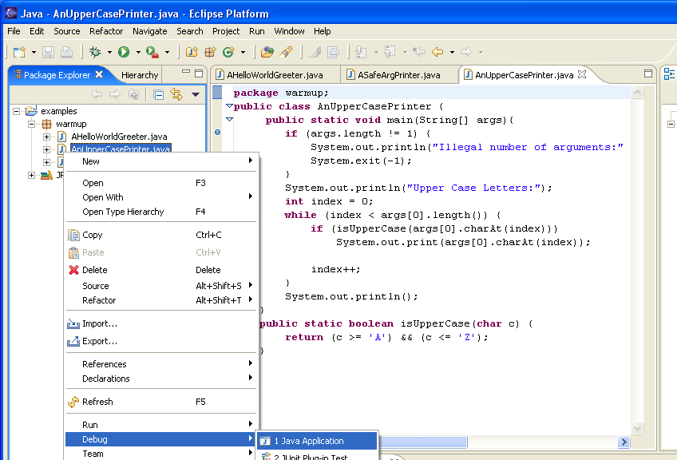
Debug-Run

Slide 62
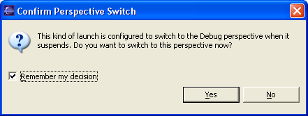
Starting the Debugger

Slide 63
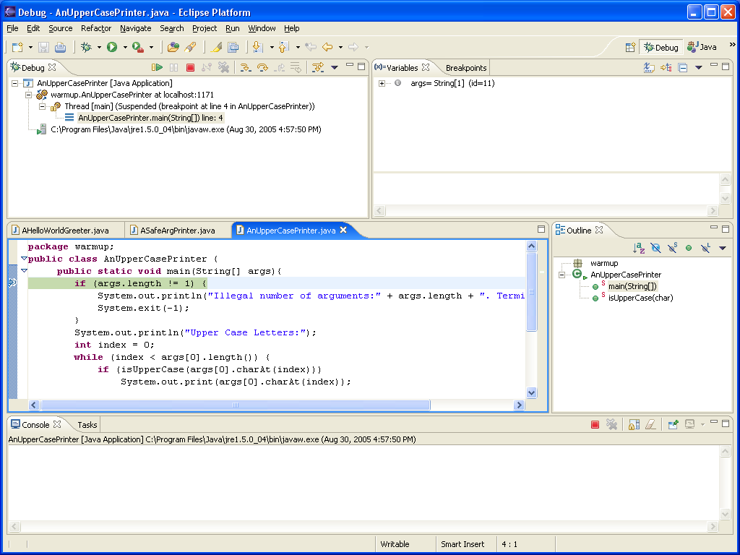
Stopping at Breakpoint
Debug Perspective
Next statement to be executed

Slide 64
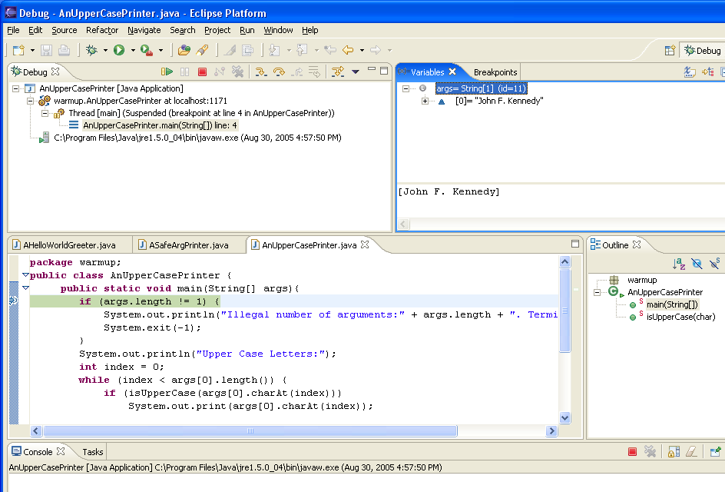
Examining Main Parameters
Main Parameters

Slide 65
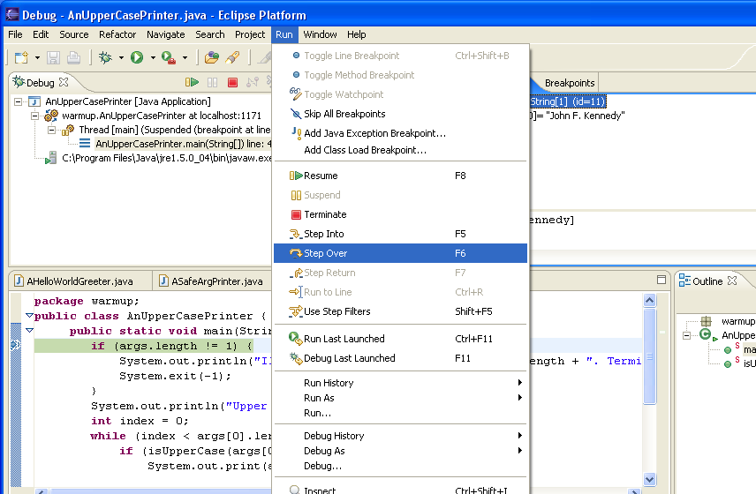
Stepping to next statement

Slide 66
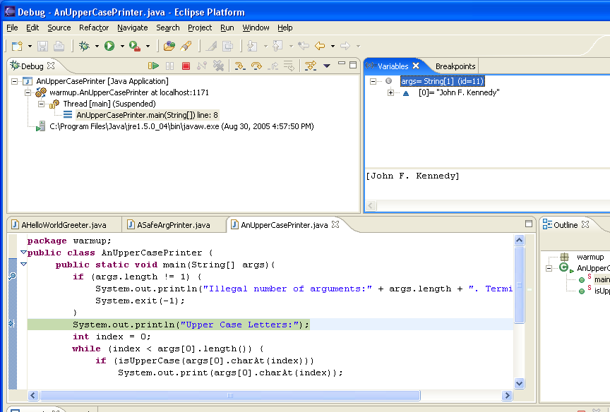
Next Statement

Slide 67
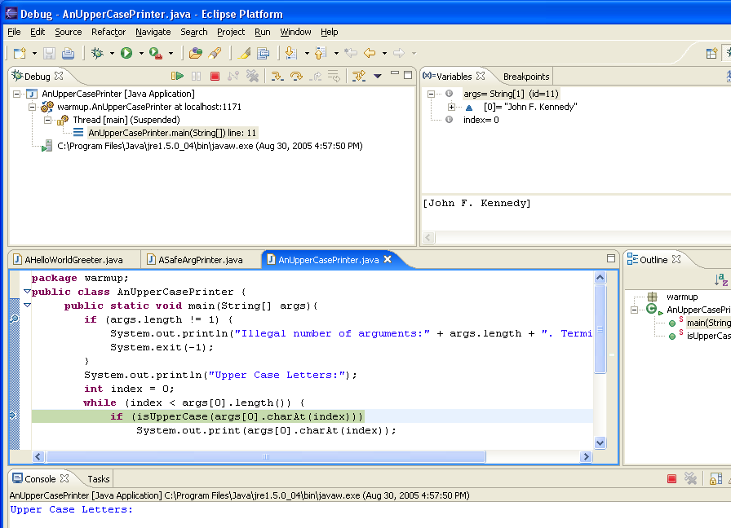
New Output and Local Variable
Index gets initialized
println() executed

Slide 68
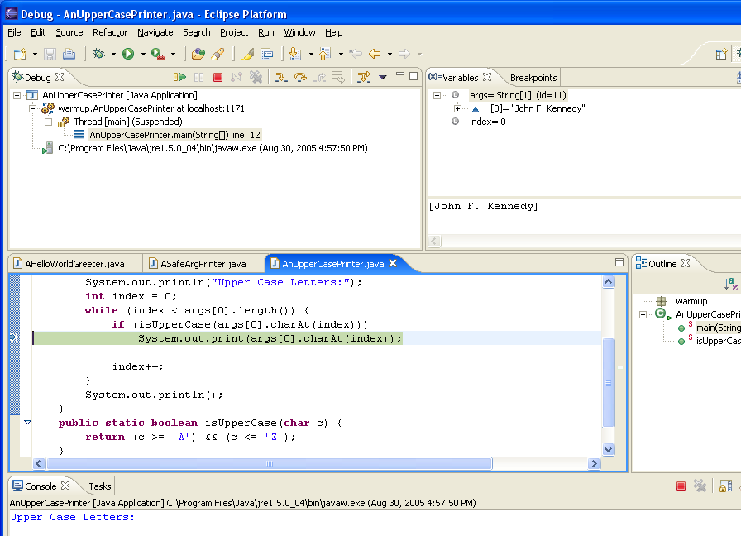
Step Over

Slide 69
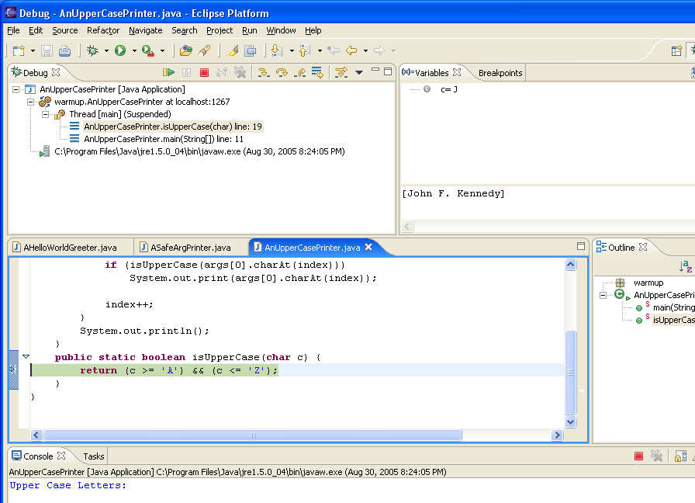
Step Into
Called method parameters
Call stack

Slide 70
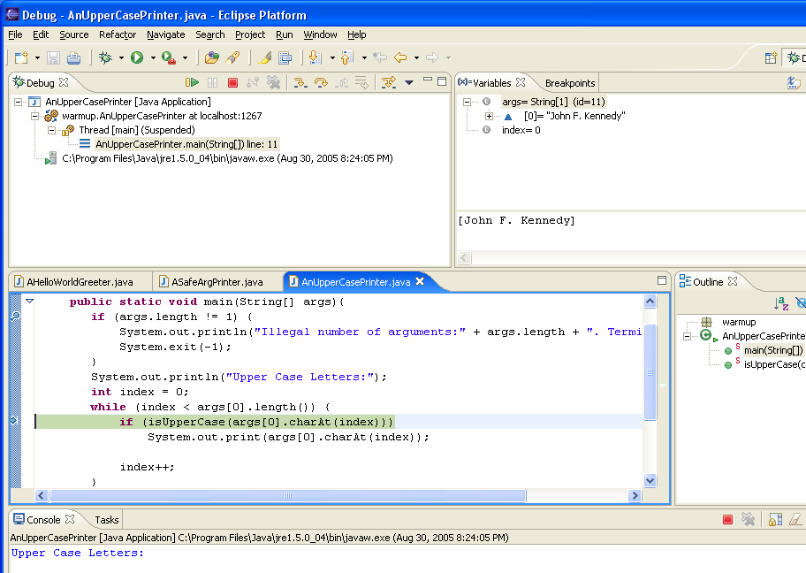
Step Return

Slide 71
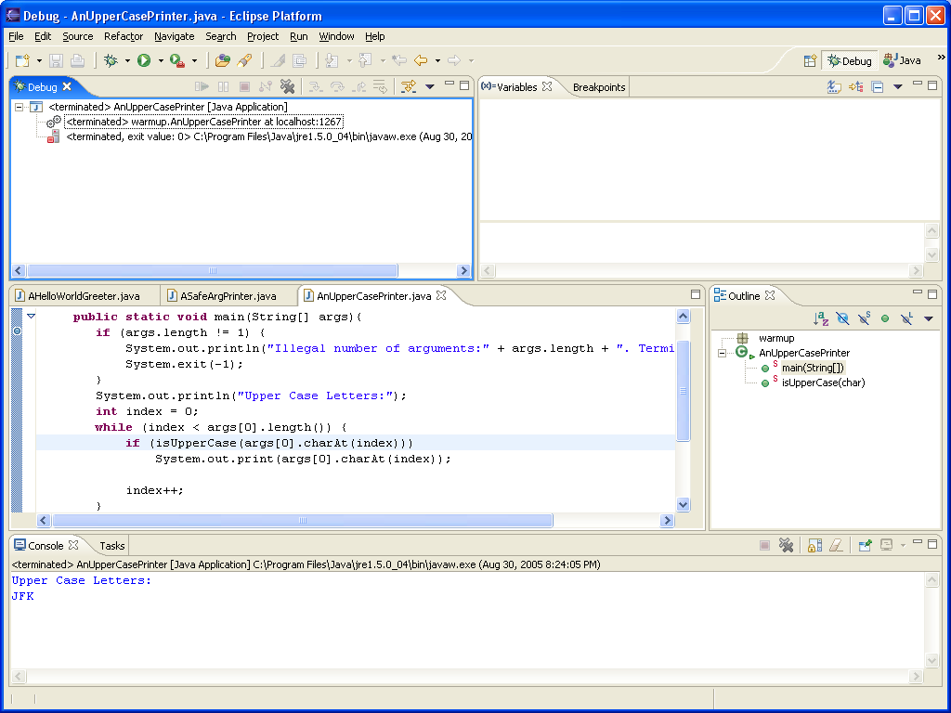
Resume

Slide 72
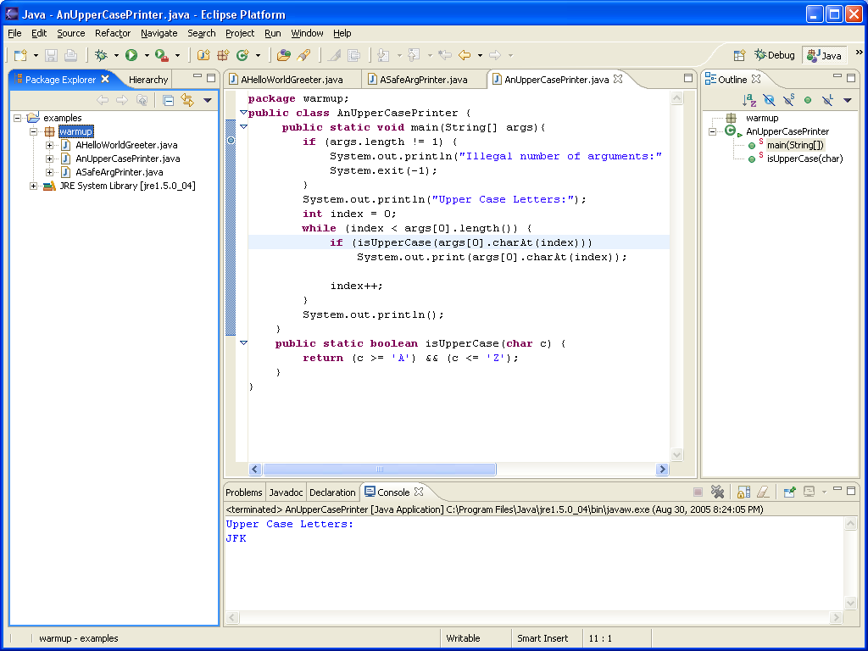
Returning to Java Perspective

Slide 73
Debug Last Main Launched: F11
No need to select a main class

Slide 74
Contents
Install JDK
Install Eclipse
Connect JDK to Eclipse
Create project
Edit project run project
Restore window
Search project for strings
Debugging
Adding a library
Add an existing project
Copy a project
Copy a package, class file to another project
Delete a project
Show variable, class, interface (identifier) definition and return back
Find identifier (variable, class, interface) use
Refactor
Complete identifier name
Understand, fix errors
Automatic imports
JUnit
Change Method Signature
Extract interface

Slide 75
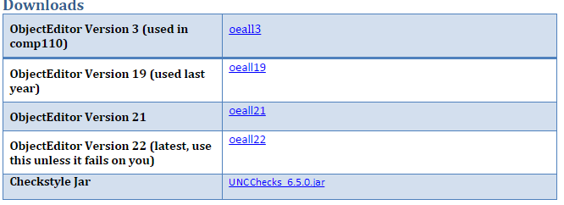
Library Location on the Web
Downloads
Click on the latest version (on my web page, not this page) to download the jar (same as zip) and do not unzip/unjar it

Slide 76
Download Library to Local Computer
Do not unzip/unjar it

Slide 77
Select Project, and Project→Properties
Must do this for each project!

Slide 78
Select Build Path, Add External Jar

Slide 79
Select Saved Jar

Slide 80
Select Build Path, Projects

Slide 81
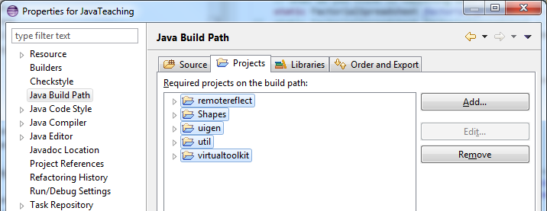
Remove Spurious Projects (if any)

Slide 82
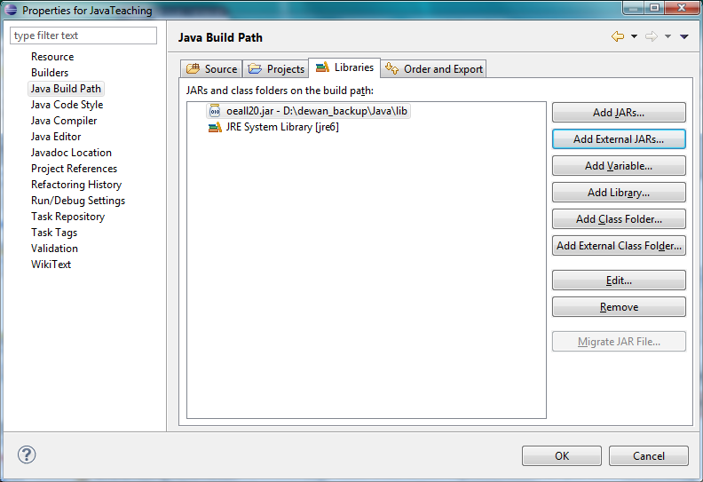
Press Ok to Commit

Slide 83
Contents
Install JDK
Install Eclipse
Connect JDK to Eclipse
Create project
Edit project run project
Restore window
Search project for strings
Debugging
Adding a library
Add an existing project
Copy a project
Copy a package, class file to another project
Delete a project
Show variable, class, interface (identifier) definition and return back
Find identifier (variable, class, interface) use
Refactor
Complete identifier name
Understand, fix errors
Automatic imports
JUnit
Change Method Signature
Extract interface

Slide 84
Create a Project out of Existing Code: File→New→Java Project

Slide 85
Uncheck Default Location Box
Uncheck

Slide 86
Enter Location and Name

Slide 87
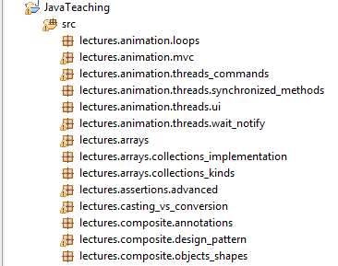
New Project Created
But it will have errors because of missing ObjectEditor library

Slide 88
Contents
Install JDK
Install Eclipse
Connect JDK to Eclipse
Create project
Edit project run project
Restore window
Search project for strings
Debugging
Adding a library
Add an existing project
Copy a project
Copy a package, class file to another project
Delete a project
Show variable, class, interface (identifier) definition and return back
Find identifier (variable, class, interface) use
Refactor
Complete identifier name
Understand, fix errors
Automatic imports
JUnit
Change Method Signature
Extract interface

Slide 89
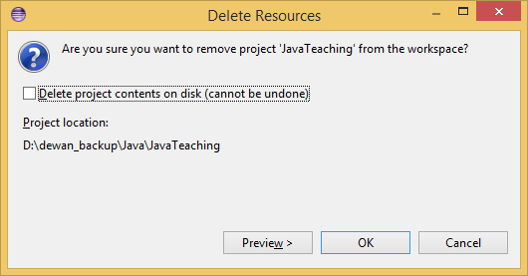
Copying a Project
Select project, CTRL CTRL-V

Slide 90
Contents
Install JDK
Install Eclipse
Connect JDK to Eclipse
Create project
Edit project run project
Restore window
Search project for strings
Debugging
Adding a library
Add an existing project
Copy a project
Copy a package, class file to another project
Delete a project
Show variable, class, interface (identifier) definition and return back
Find identifier (variable, class, interface) use
Refactor
Complete identifier name
Understand, fix errors
Automatic imports
JUnit
Change Method Signature
Extract interface

Slide 91
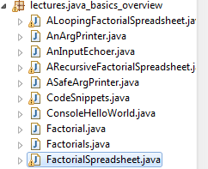
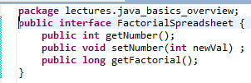
Copy Types (Classes, Interfaces, Enums) from Package to Another: Copy
Select type(s) in source project and package and press CTRL-C (or File→Copy right menu item)

Slide 92
Copy Types from One Package to Another: Paste
Select package in destination project and package and press CTRL-V (or File→Paste right menu item)

Slide 93
Copying Classes from One Package to Another: New Class in new Package and Project
Package name changed
Repackaged type added (and its imports are changed to other copied types if multiple types are copied and pasted together)

Slide 94
Contents
Install JDK
Install Eclipse
Connect JDK to Eclipse
Create project
Edit project run project
Restore window
Search project for strings
Debugging
Adding a library
Add an existing project
Copy a project
Copy a package, class file to another project
Delete a project
Show variable, class, interface (identifier) definition and return back
Find identifier (variable, class, interface) use
Refactor
Complete identifier name
Understand, fix errors
Automatic imports
JUnit
Change Method Signature
Extract interface

Slide 95
Deleting a Project
Right click project and delete. Usually not a good idea to delete project on disk, can always use the OS to do so, which will put it in the recycling bin

Slide 96
Contents
Install JDK
Install Eclipse
Connect JDK to Eclipse
Create project
Edit project run project
Restore window
Search project for strings
Debugging
Adding a library
Add an existing project
Copy a project
Copy a package, class file to another project
Delete a project
Show variable, class, interface (identifier) definition and return back
Find identifier (variable, class, interface) use
Refactor
Complete identifier name
Understand, fix errors
Automatic imports
JUnit
Change Method Signature
Extract interface

Slide 97
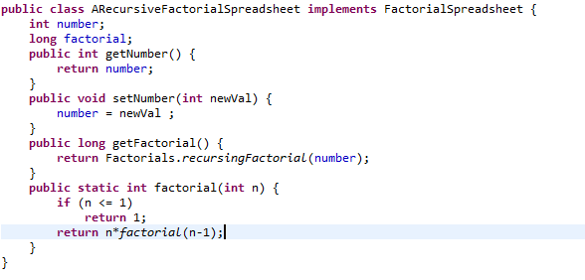
Jumping to Identifier Definition and Navigation Stack
Cursor position
ALT + Forward Arrow goes forwards in the navigation stack a la browser forward button
ALT + Back Arrow takes you back where you came from, a la Browser back button, can execute multiple times to back in in the stack of visited points
F3 when cursor is a start of an identifier
Makes Eclipse take you to the definition of the identifier in an edit window

Slide 98
Contents
Install JDK
Install Eclipse
Connect JDK to Eclipse
Create project
Edit project run project
Restore window
Search project for strings
Debugging
Adding a library
Add an existing project
Copy a project
Copy a package, class file to another project
Delete a project
Show variable, class, interface (identifier) definition and return back
Find identifier (variable, class, interface) use
Refactor
Complete identifier name
Understand, fix errors
Automatic imports
JUnit
Change Method Signature
Extract interface

Slide 99
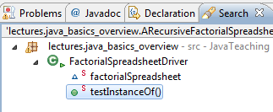
Find the Uses
CTRL-SHIFT-G when cursor is a start of an identifier
Cursor position
Makes Eclipse show the methods that reference the identifier in the search tab
Double clicking a method reference
Makes Eclipse show the method and highlight all references of the identifier

Slide 100
Contents
Install JDK
Install Eclipse
Connect JDK to Eclipse
Create project
Edit project run project
Restore window
Search project for strings
Debugging
Adding a library
Add an existing project
Copy a project
Copy a package, class file to another project
Delete a project
Show variable, class, interface (identifier) definition and return back
Find identifier (variable, class, interface) use
Refactor
Complete identifier name
Understand, fix errors
Automatic imports
JUnit
Change Method Signature
Extract interface

Slide 101
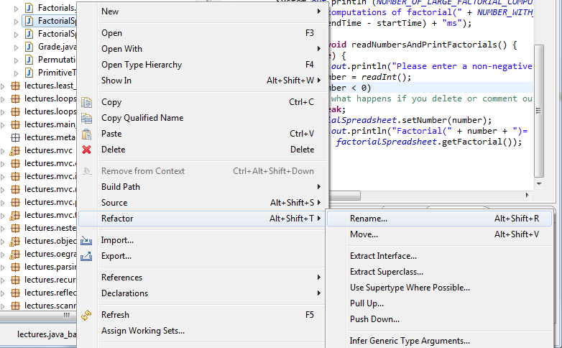
Menu→Refactor→Rename Identifier: ALT + Shift + R
Select type, right menu→Refactor→Rename
All references will be updated!

Slide 102
Contents
Install JDK
Install Eclipse
Connect JDK to Eclipse
Create project
Edit project run project
Restore window
Search project for strings
Debugging
Adding a library
Add an existing project
Copy a project
Copy a package, class file to another project
Delete a project
Show variable, class, interface (identifier) definition and return back
Find identifier (variable, class, interface) use
Refactor
Complete identifier name
Understand, fix errors
Automatic imports
JUnit
Change Method Signature
Extract interface

Slide 103
Complete Identifier: Ctrl + Space after Prefix
public static final long NUMBER_OF_LARGE_FACTORIAL_COMPUTATIONS = 1000000;
Give file name

Slide 104
Contents
Install JDK
Install Eclipse
Connect JDK to Eclipse
Create project
Edit project run project
Restore window
Search project for strings
Debugging
Adding a library
Add an existing project
Copy a project
Copy a package, class file to another project
Delete a project
Show variable, class, interface (identifier) definition and return back
Find identifier (variable, class, interface) use
Refactor
Complete identifier name
Understand, fix errors
Automatic imports
JUnit
Change Method Signature
Extract interface

Slide 105
Understand and Correct Errors
Hover to understand
Click for correction proposal

Slide 106
Contents
Install JDK
Install Eclipse
Connect JDK to Eclipse
Create project
Edit project run project
Restore window
Search project for strings
Debugging
Adding a library
Add an existing project
Copy a project
Copy a package, class file to another project
Delete a project
Show variable, class, interface (identifier) definition and return back
Find identifier (variable, class, interface) use
Refactor
Complete identifier name
Understand, fix errors
Automatic imports
JUnit
Change Method Signature
Extract interface

Slide 107
Correct All Import Errors in File: Ctrl + Shift + O
In Eclipse press CTRL-SHIFT-O to automatically import all used types that need to be imported but have not been imported
If class is in more than one package, Eclipse gives a choice
All unused imports are also removed
Can select multiple types or a project to refresh all imports in the selected types/project

Slide 108
Contents
Install JDK
Install Eclipse
Connect JDK to Eclipse
Create project
Edit project run project
Restore window
Search project for strings
Debugging
Adding a library
Add an existing project
Copy a project
Copy a package, class file to another project
Delete a project
Show variable, class, interface (identifier) definition and return back
Find identifier (variable, class, interface) use
Refactor
Complete identifier name
Understand, fix errors
Automatic imports
JUnit Testing
Change Method Signature
Extract interface

Slide 109
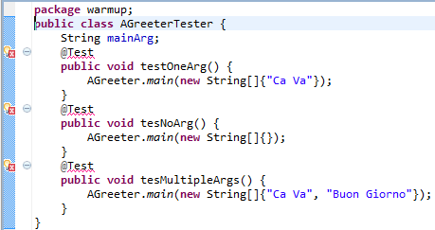
Junit: New Class without Main

Slide 110
Junit: Install JUnit

Slide 111
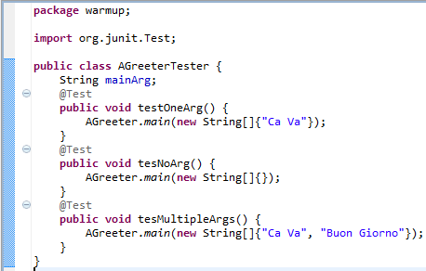
Junit added and imported

Slide 112
Run Junit

Slide 113
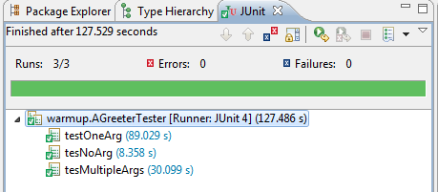
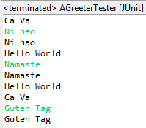
Junit Result

Slide 114
Returning to Java Perspective

Slide 115
Contents
Install JDK
Install Eclipse
Connect JDK to Eclipse
Create project
Edit project run project
Restore window
Search project for strings
Debugging
Adding a library
Add an existing project
Copy a project
Copy a package, class file to another project
Delete a project
Show variable, class, interface (identifier) definition and return back
Find identifier (variable, class, interface) use
Refactor
Complete identifier name
Understand, fix errors
Automatic imports
JUnit
Change Method Signature
Extract interface

Slide 116
Two Other useful but Complicated Refactor Options
Change method signature
Will try to update references to match the signature, which can be erroneous
Extract interface of class C
Will create interface of selected public methods and will make the interface the type of all variables declared to be of class type
Adds potentially unwanted comments to method headers and sometimes updates to references have not worked in the past for me
Maybe better to get all references and update them individually for both purposes

Slide 117
Contents
Install JDK
Install Eclipse
Connect JDK to Eclipse
Create project
Edit project run project
Restore window
Search project for strings
Debugging
Adding a library
Add an existing project
Copy a project
Copy a package, class file to another project
Delete a project
Show variable, class, interface (identifier) definition and return back
Find identifier (variable, class, interface) use
Refactor
Complete identifier name
Understand, fix errors
Automatic imports
JUnit
Change Method Signature
Extract interface
Supply main argument

Slide 118
Supply User Argument:
Right Menu→Debug As→ Debug Configuration

Slide 119
Select Main Class in Configuration

Slide 120
Contents
Install JDK
Install Eclipse
Connect JDK to Eclipse
Create project
Edit project run project
Restore window
Search project for strings
Debugging
Adding a library
Add an existing project
Copy a project
Copy a package, class file to another project
Delete a project
Show variable, class, interface (identifier) definition and return back
Find identifier (variable, class, interface) use
Refactor
Complete identifier name
Understand, fix errors
Automatic imports
JUnit
Change Method Signature
Extract interface
Supply main argument
Create project from existing code

Slide 121
Create a Project out of Existing Code: File→New→Java Project

Slide 122
Uncheck Default Location Box
Uncheck

Slide 123
Enter Location and Name

Slide 124
New Project Created
But it will have errors because of missing ObjectEditor library

Slide 125
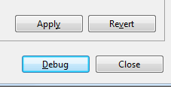
Specify and Apply Argument in Argument Tab and Press Debug
Argument must be in quotes. Args[0] = “Ca Va”
Without quotes Java will make each word a separate argument (args[0] = “Ca”, args[1] = “Va”

Slide 126
Execute with Supplied Arg

Slide 127
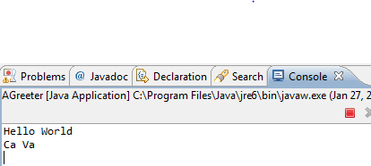
Arg Printed, Program, Still Running, Waiting for Input
Press
Button available in both Debug and Java Perspective, only of them is active

Slide 128
Terminated Program
Inactive button

