Slide 1
Comp 110/401 Appendix: Entering Args in Eclipse
Instructor: Prasun Dewan (FB 150, dewan@unc.edu)

Slide 2
Prerequisite
Eclipse

Slide 3
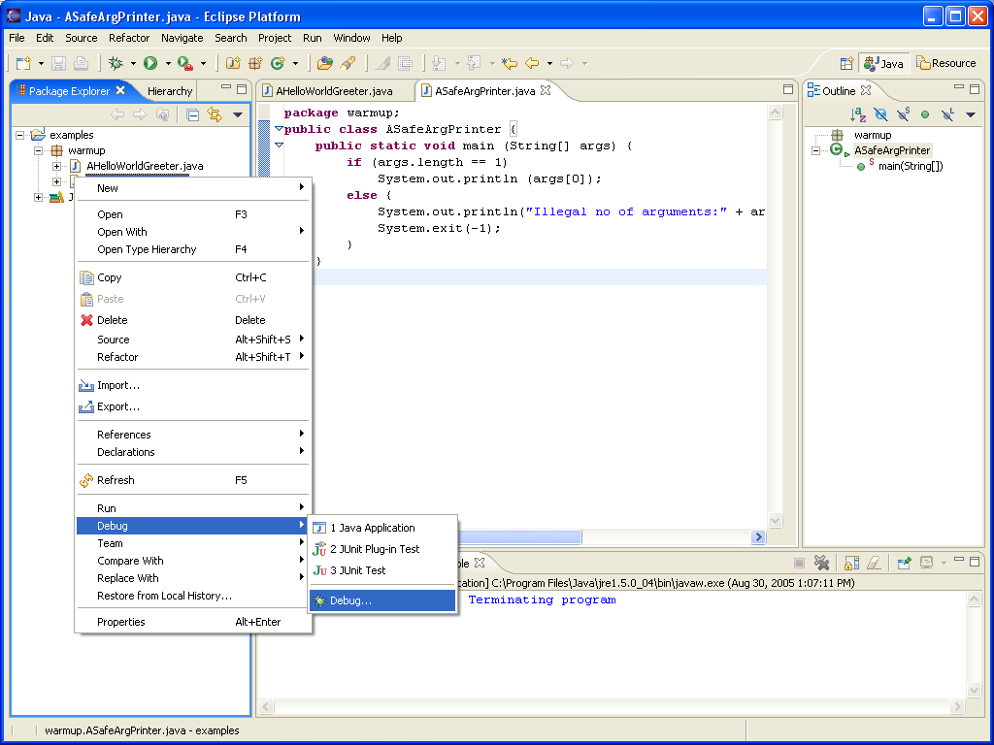
Selecting Debug(Run Configuration)

Slide 4
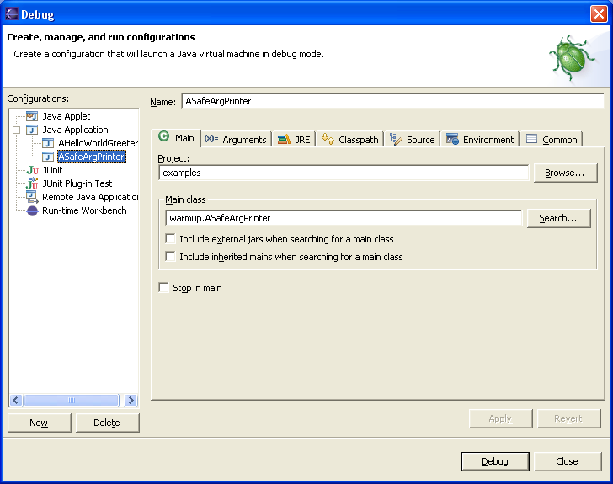
Selecting Main Class

Slide 5
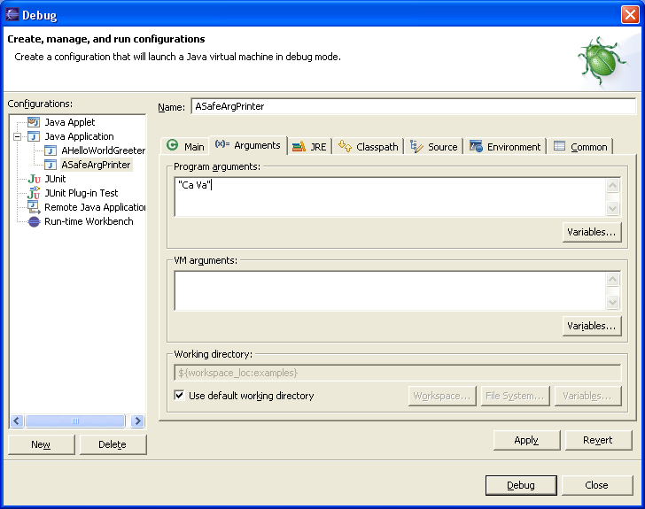
Specifying Argument in Argument Tab
Argument must be in quotes. Args[0] = “Ca Va”
Without quotes Java will make each word a separate argument (args[0] = “Ca”, args[1] = “Va”

Slide 6
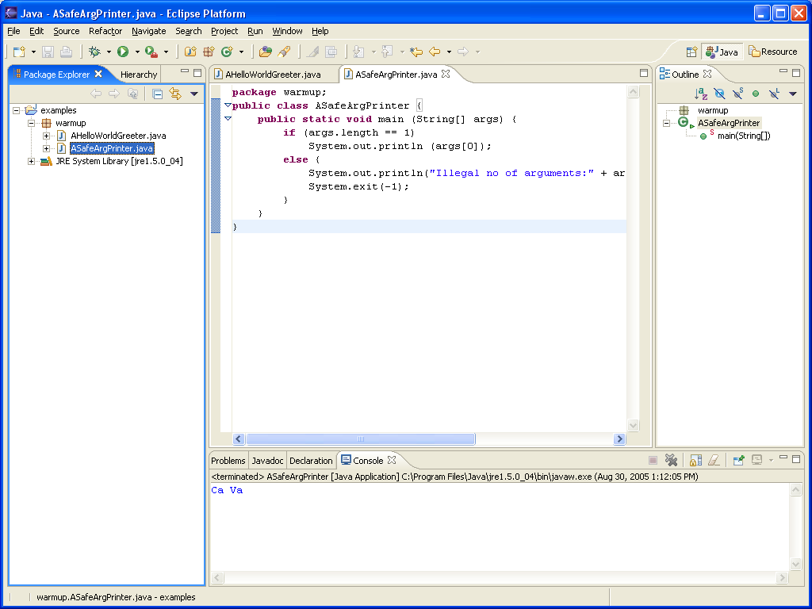
Executing With Arg

