Slide 1
Comp 110/401 Appendix: Debugging Using Eclipse
Instructor: Prasun Dewan (FB 150, dewan@unc.edu)

Slide 2
Prerequisite
Eclipse

Slide 3
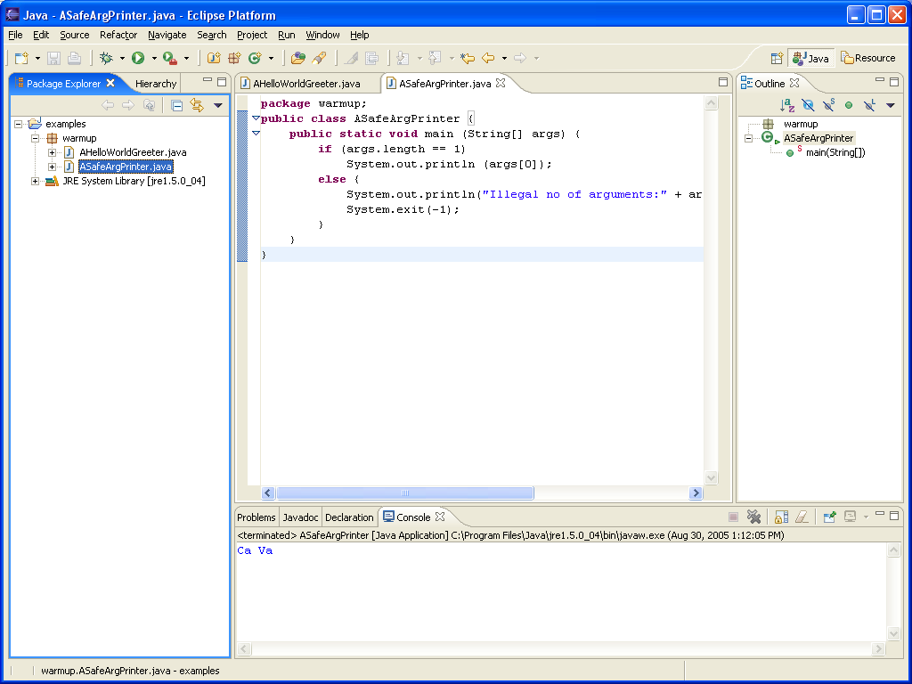
Executing Debug

Slide 4
Setting a Break Point
Double click where you want program to stop

Slide 5
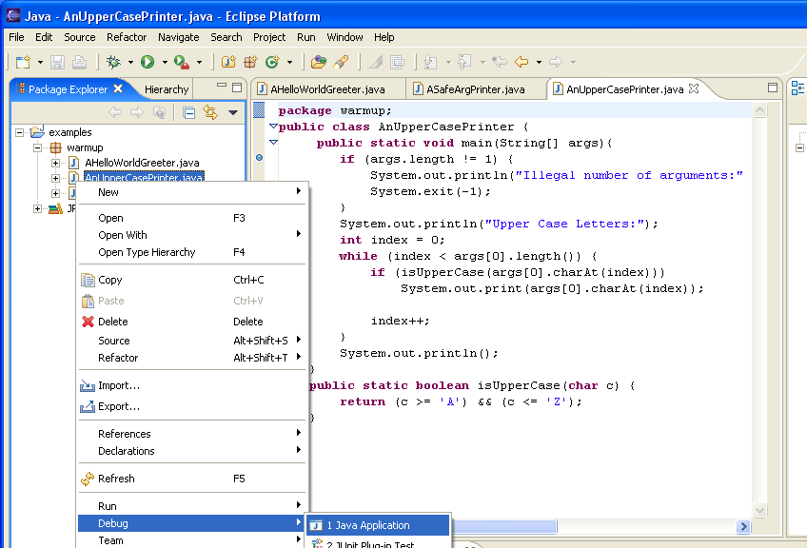
Executing Debug

Slide 6
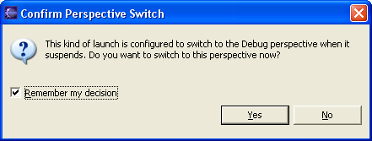
Starting the Debugger

Slide 7
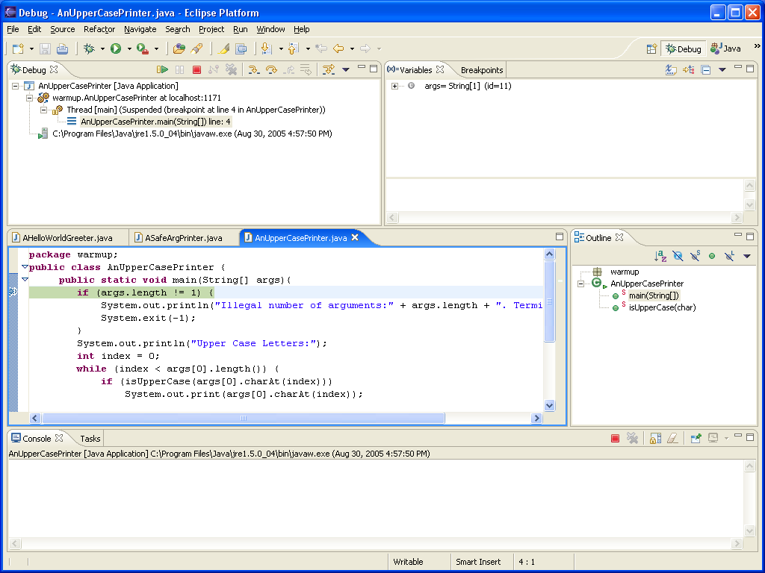
Stopping at Breakpoint
Debug Perspective
Next statement to be executed

Slide 8
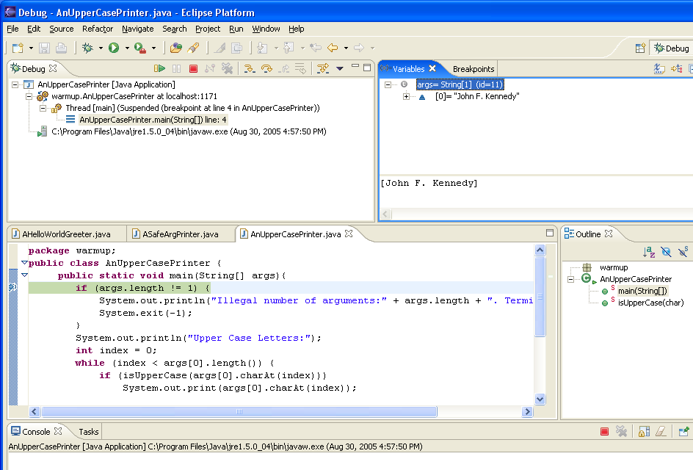
Examining Main Parameters
Main Parameters

Slide 9
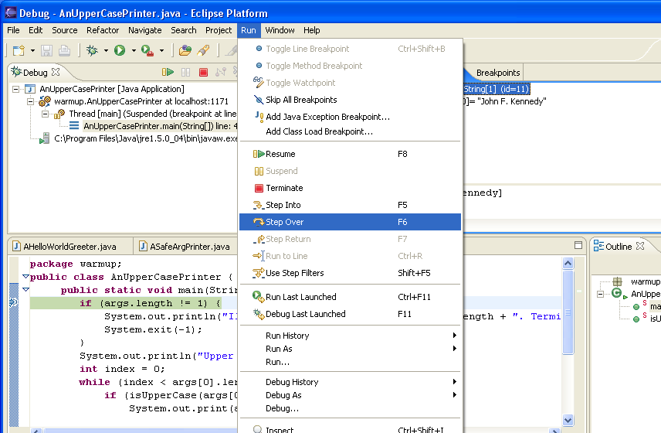
Stepping to next statement

Slide 10
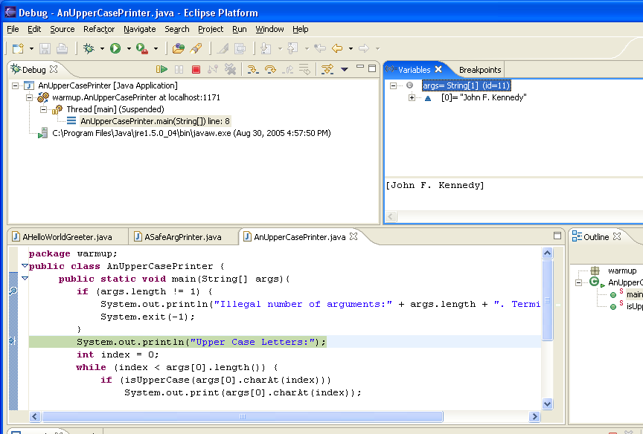
Next Statement

Slide 11
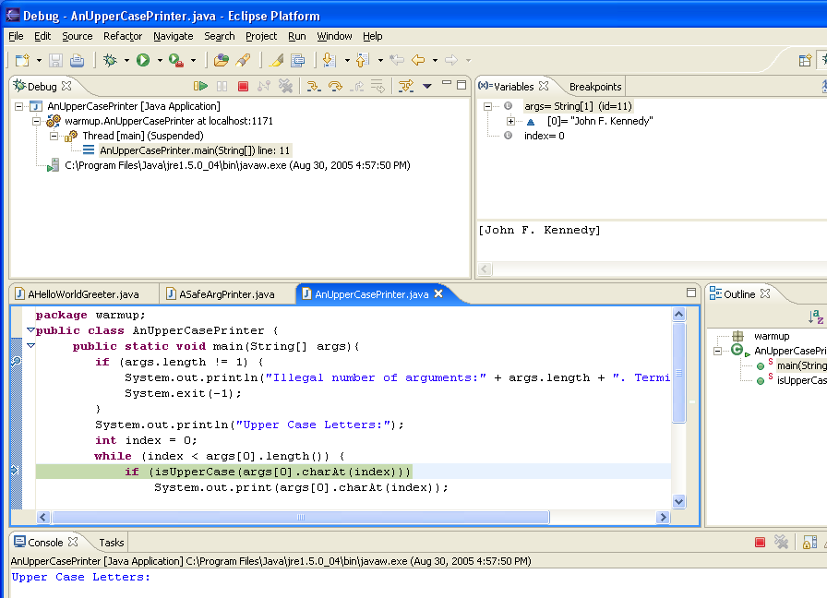
New Output and Local Variable
Index gets initialized
println() executed

Slide 12
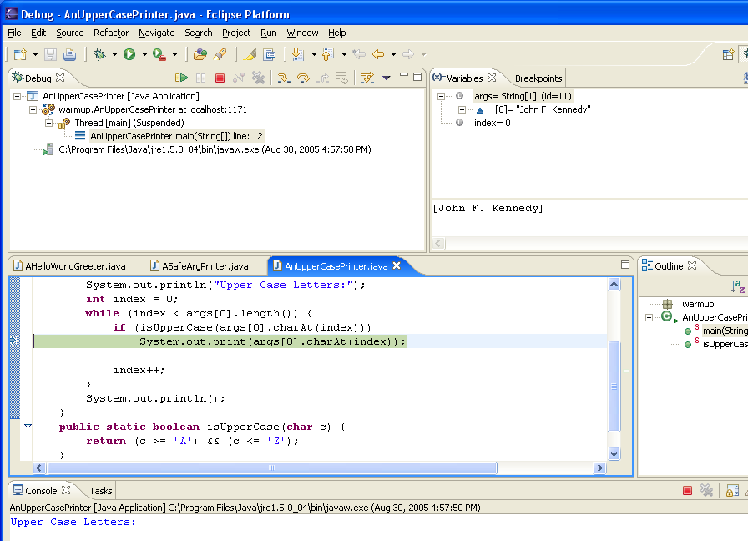
Step Over

Slide 13
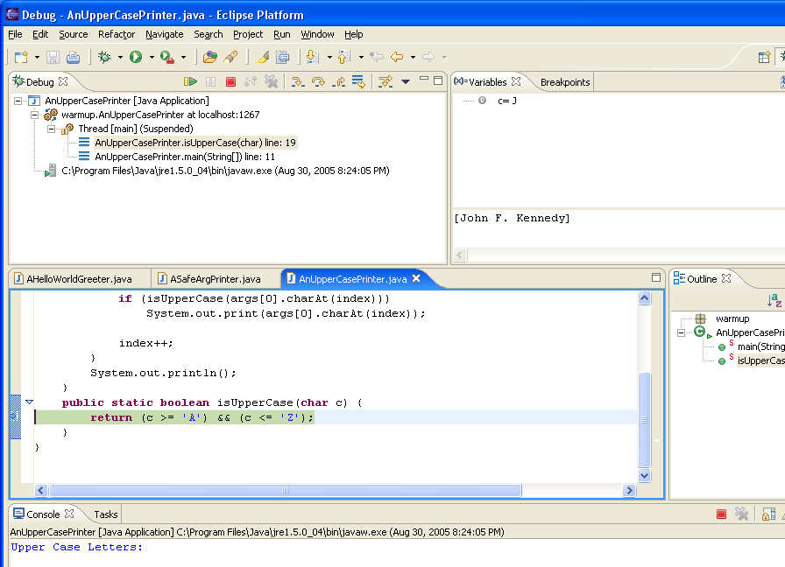
Step Into
Called method parameters
Call stack

Slide 14
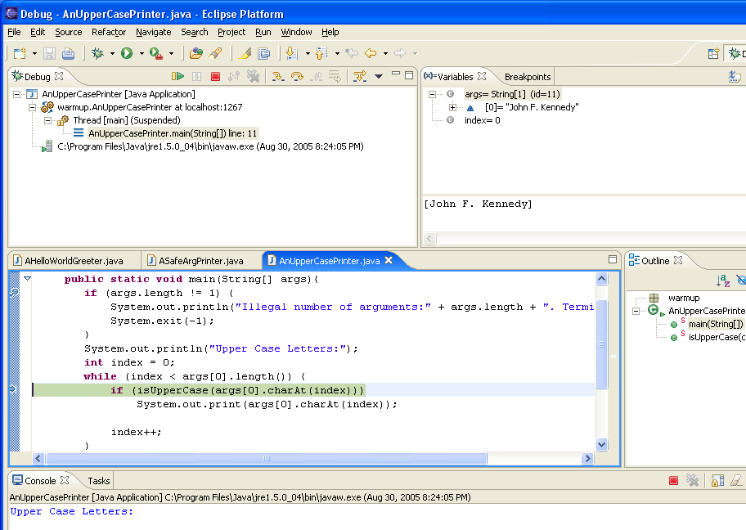
Step Return

Slide 15
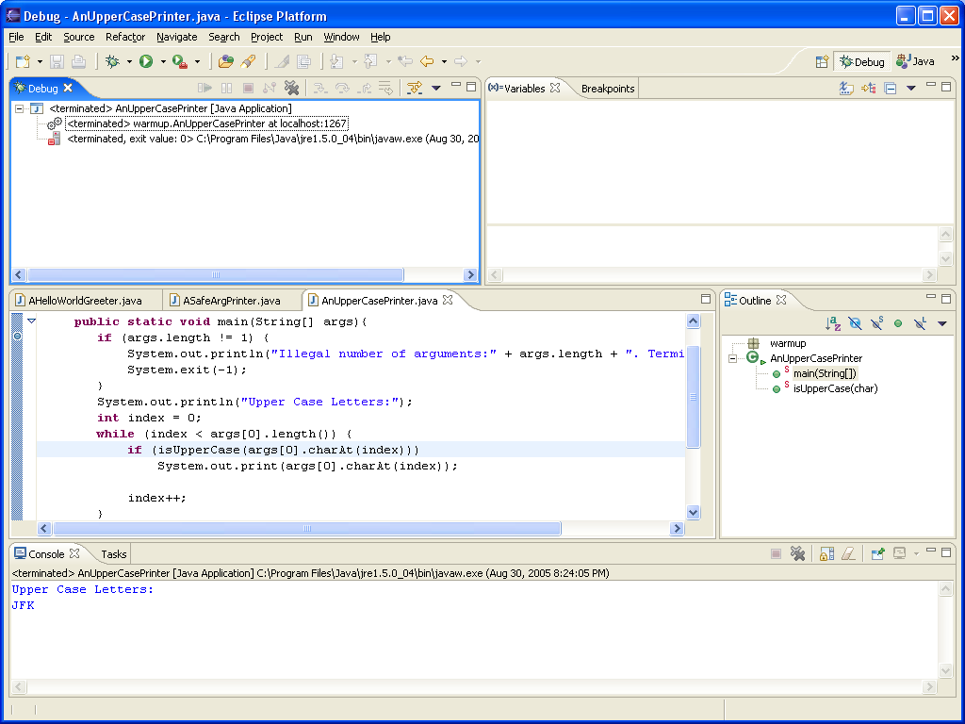
Resume

Slide 16
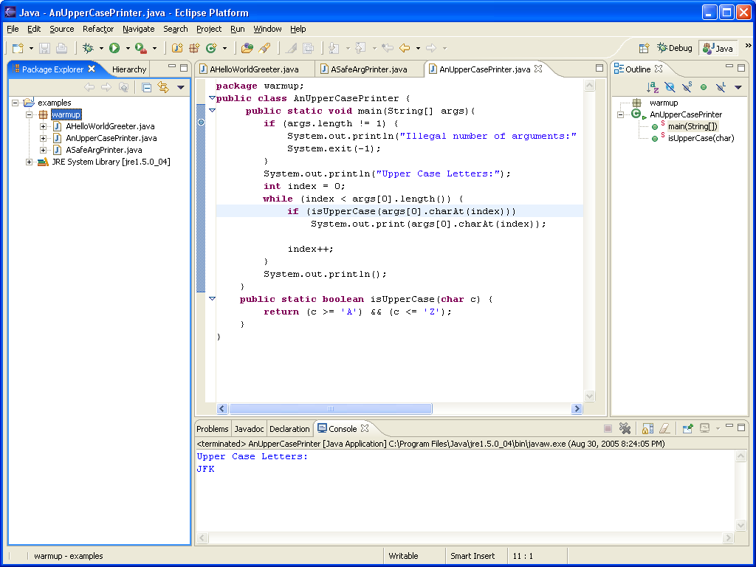
Returning to Java Perspective

