Slide 1
Comp 524-Programming Languages
Eclipse Difficulty/Helper Plugin
Instructor: Prasun Dewan (FB 150, dewan@unc.edu)

Slide 2
Table of Contents
Motivation for Difficulty Detection
Installing Plug-In
Setting Difficulty Status
Receiving Inferred Difficulty Notifications
Uninstalling Plug-in

Slide 3

Motivation: Why Detect Programmer Difficulty
Introspection: review your pain points and solutions.
Collaboration: Manual or automated help on difficulty detection
Inspection/testing: Correlation between difficulty and bugs?
Task and document adaptation
…

Slide 4
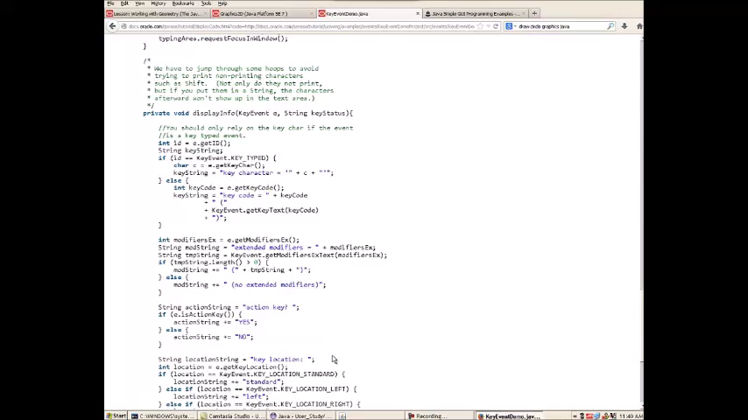
Detection of Programming Difficulty (Slow Progress)

Slide 5
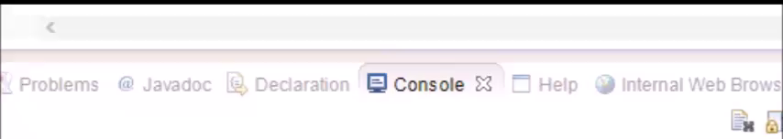
Status Inference → Status Communication
Notes:
Prasun )
Imagine a system that automatically
detects user difficulties
<do some typing and then press difficulty button>

Slide 6
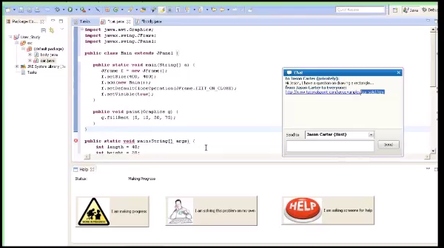
Status Inference → Collaborative Difficulty Resolution
Notes:
(Prasun)
and communicates this status to interested collaborators.
<press button to say Alice is in difficulty>

Slide 7
Data for Difficulty Detection
Program
Test case data
Programming Environment Commands
Web Accesses

Slide 8
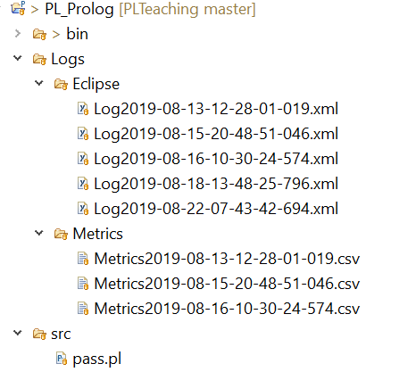
Data for Difficulty Detection

Slide 9
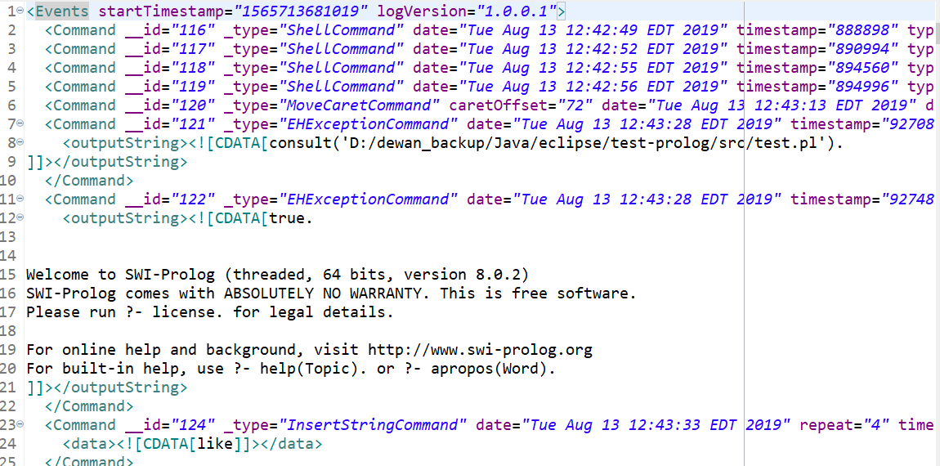
Raw Data: Eclipse Commands

Slide 10
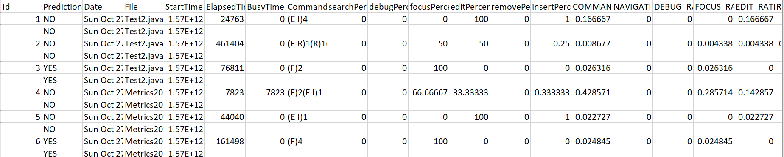
Metrics

Slide 11
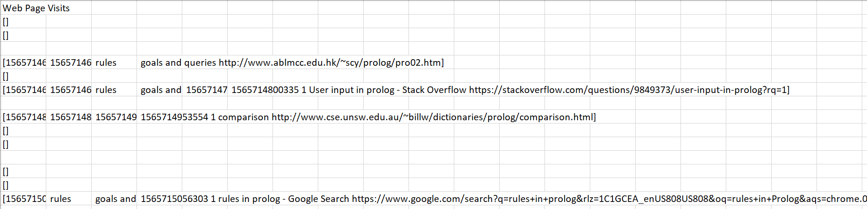
Chrome Accesses
No Facebook accesses, log “safe” accesses (piazza, stackoverflow, edu sites – can disable some)

Slide 12
(Un) Installing Plug-in
A plug-in can possibly misbehave/slow you down
We show you both how to install it and uninstall it

Slide 13
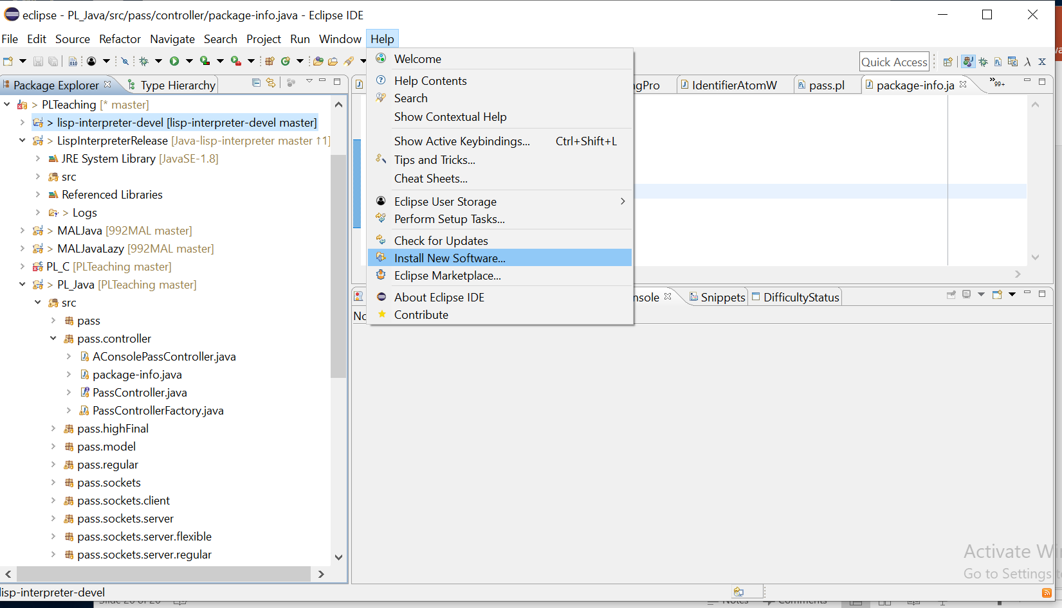
Help→Install New Software

Slide 14
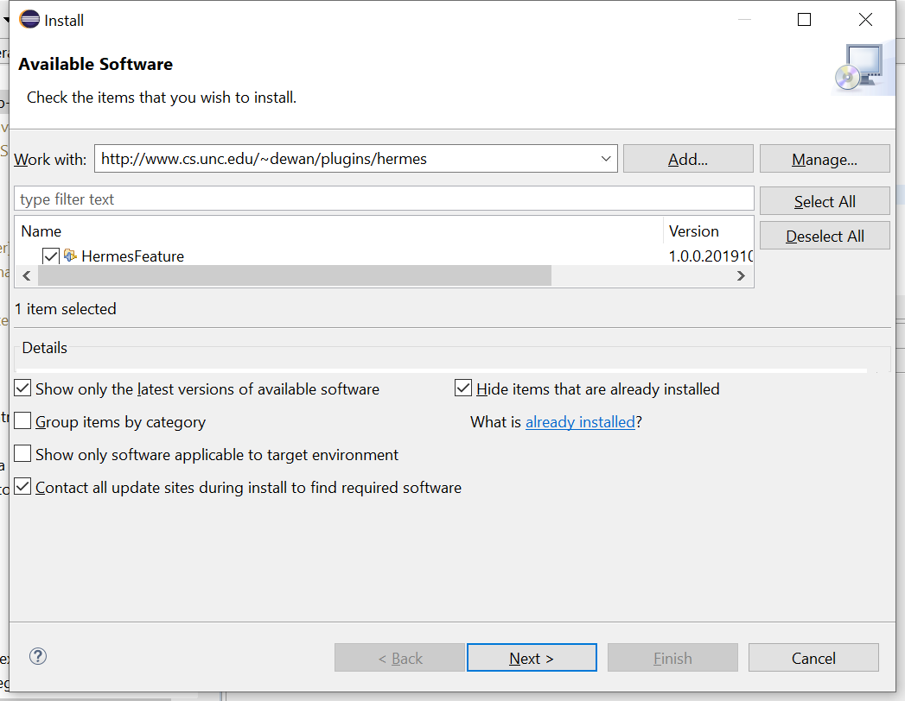
Hermes Plug-in Site and Check Hermes:
Enter: http://www.cs.unc.edu/~dewan/plugins/hermes in work with and hit return
Check HermesFeature
Next

Slide 15
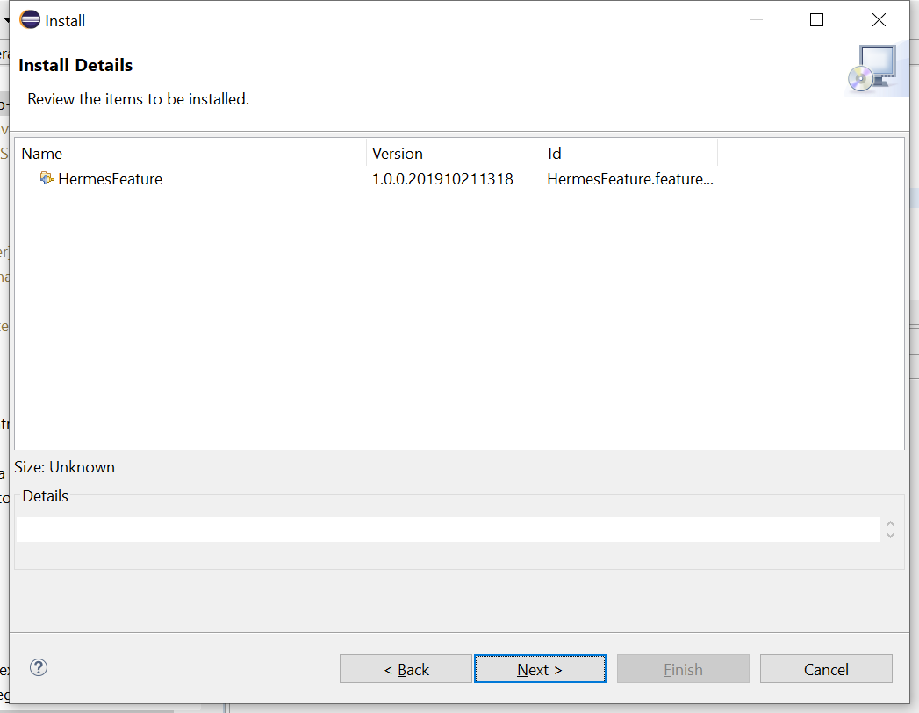
Confirm
Check HermesFeature

Slide 16
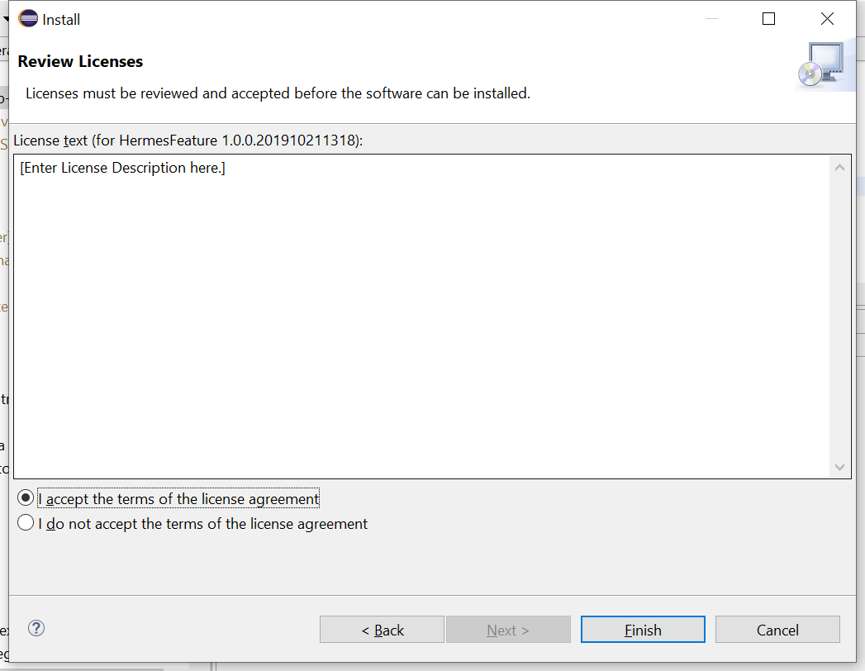
Accept License
License is empty now, but may add text

Slide 17
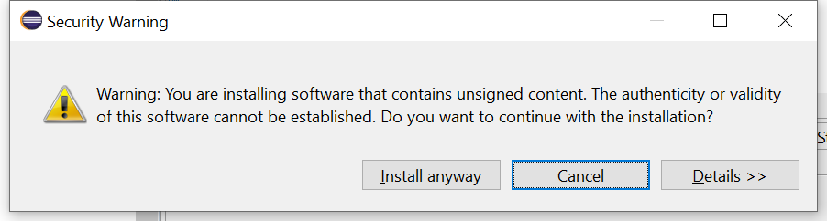
Trust Us

Slide 18
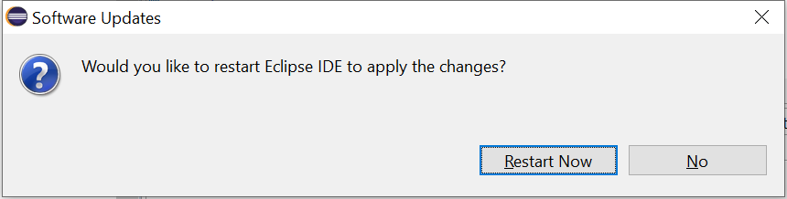
Restart Eclipse

Slide 19
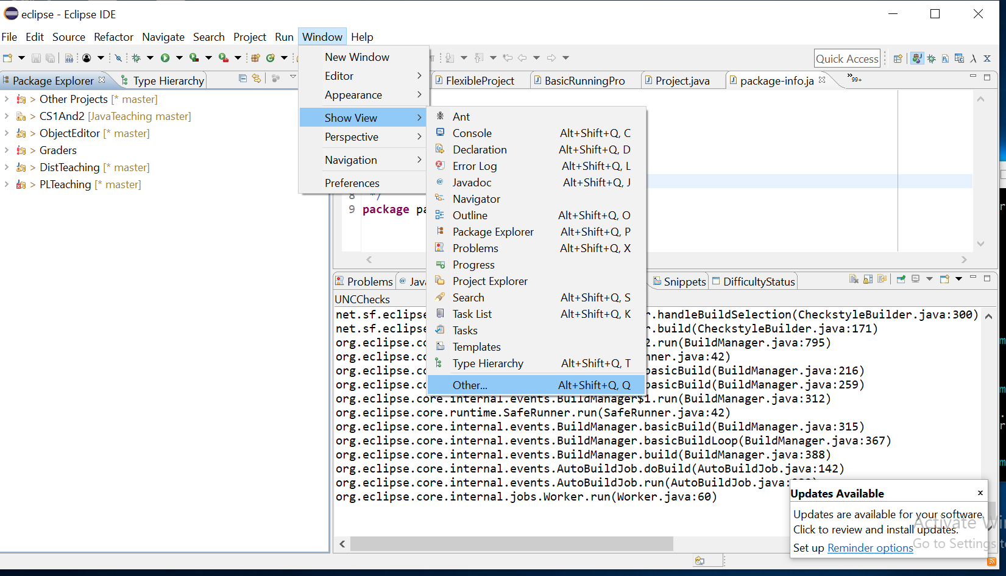
Getting to View to Record Difficulties
Window→Others

Slide 20
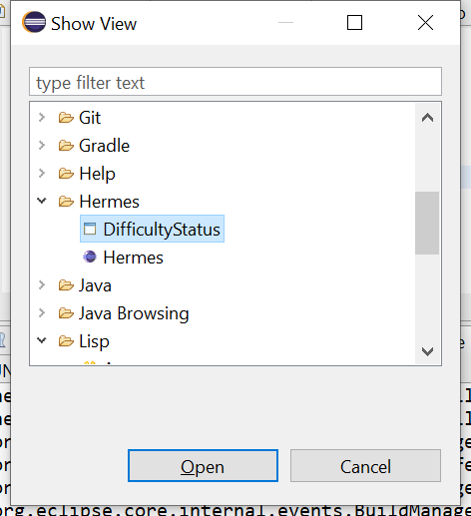
Open View
Hermes→DifficultyStatus

Slide 21
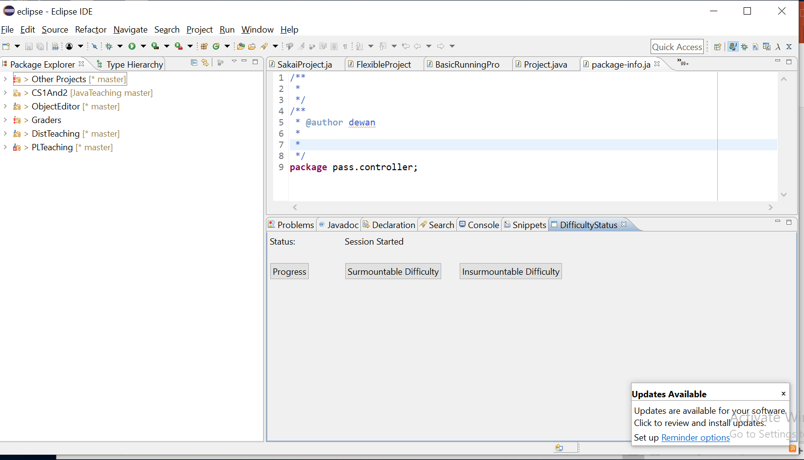
Difficulty Status View
When in Difficulty, press surmountable or insurmountable difficulty.
Progress: After having thought about it, you know exactly what to do (normal mode, no difficulty)
Surmountable: After having thought about it, you have some ideas on how the difficulty may be solved, but do not know the exact solution
Insurmountable: After having thought about it, you have no clue right now on how to solve the problem and are stopping to ask for help or think later

Slide 22
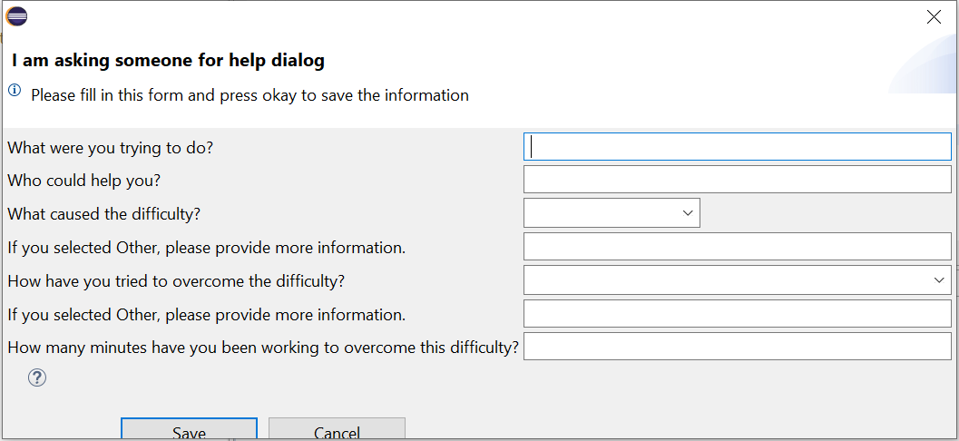
Elaborate on Surmountable or Insurmountable Difficulty

Slide 23
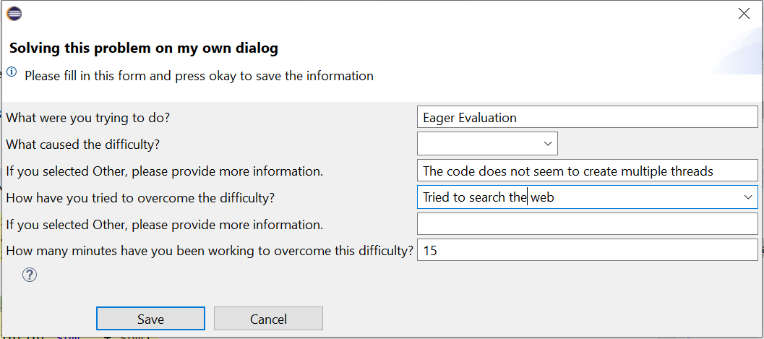
Example Filled Form

Slide 24
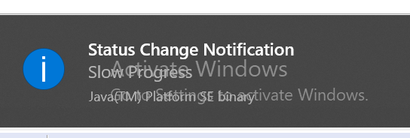
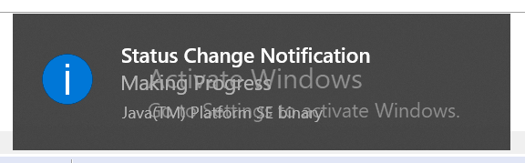
Configuring Plug-in Before or after Installing It
This is an optional step in case you want to receive difficult and non-difficulty notifications, called slow progress and making progress which you can correct

Slide 25
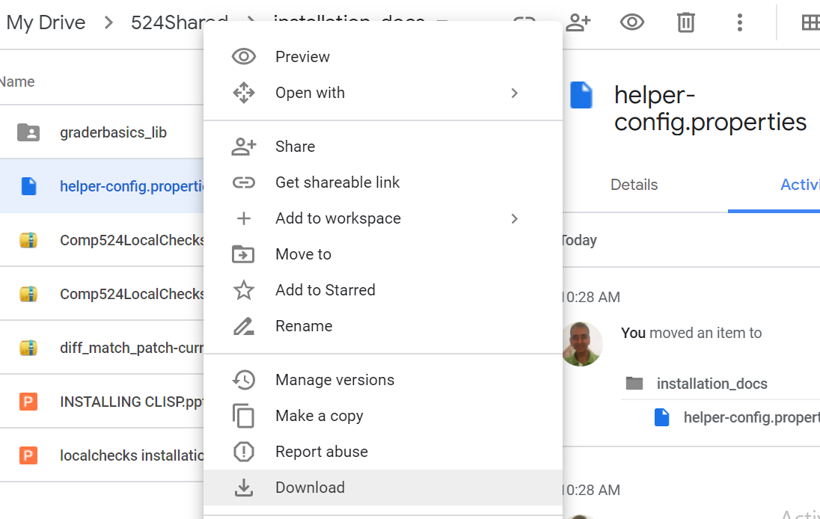
Download Configuration File
Go to google drive: https://drive.google.com/drive/u/1/folders/1AQrdEHvKSQZIAwEuezpkOhA8hiZBtMdj
Right Click helper-config.properties and select download

Slide 26
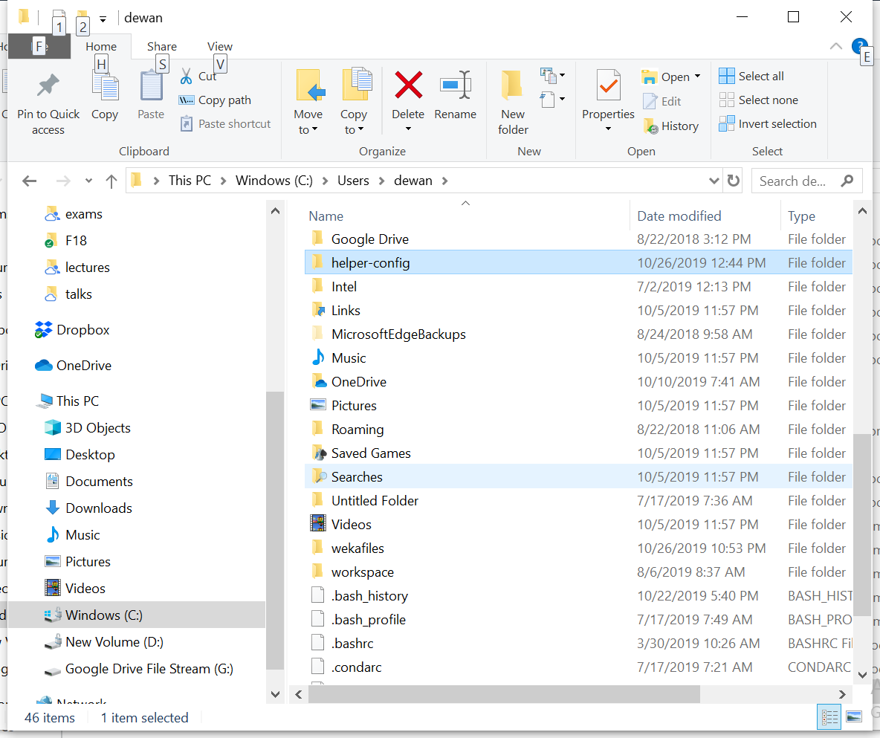
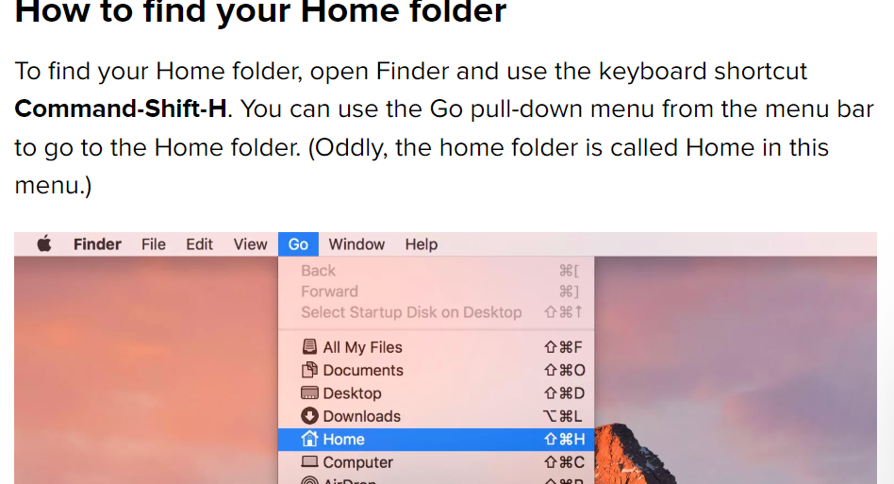
Navigate to Your Home Directory
Windows
Go to C:\Users\<user name>
Mac
Linux
Go to ~/<user name>

Slide 27
Create Sub Directory in Home
Create helper-config in Home directory

Slide 28
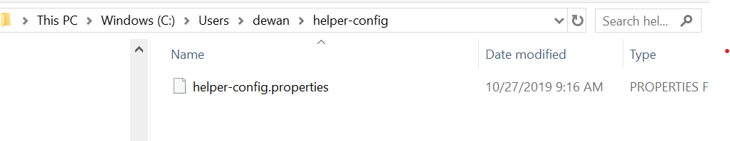
Move Downloaded File to Subdirectory

Slide 29
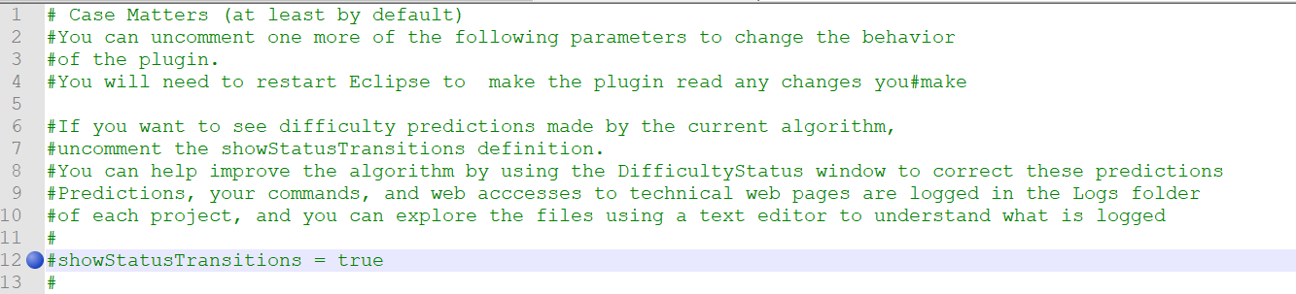
Use Text Editor to Open It

Slide 30
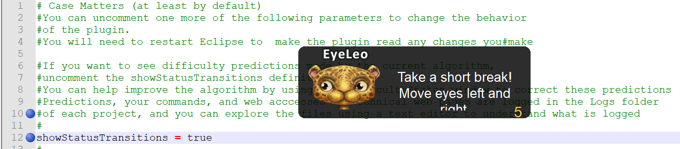
Uncomment showStatusTransitions
Line 12 to be uncommented

Slide 31
Restart Eclipse
File is read when Eclipse Starts Up

Slide 32
Uninstalling Plugin

Slide 33
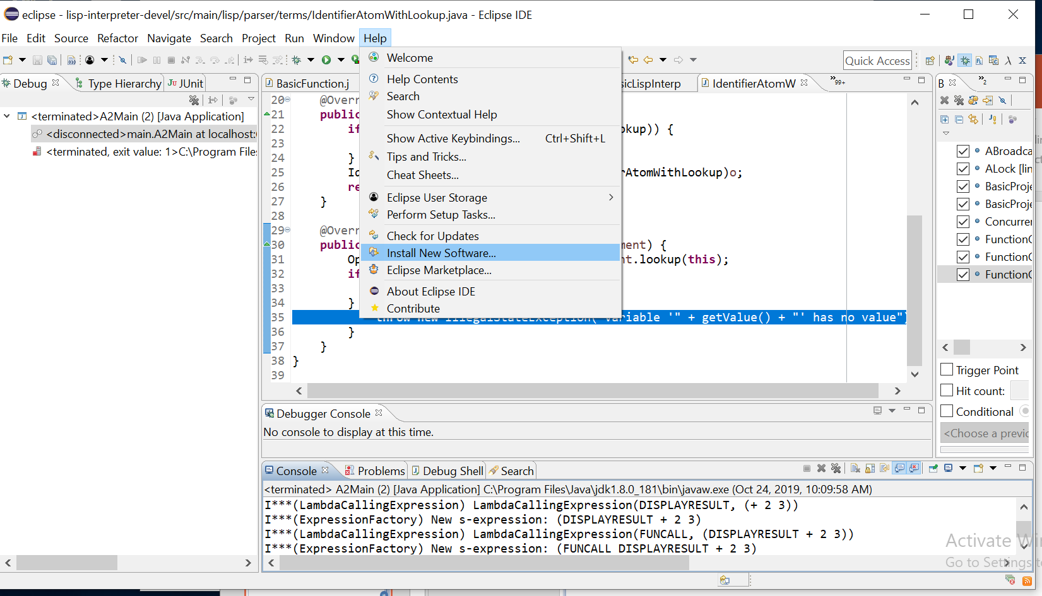
Help→Install New Software

Slide 34
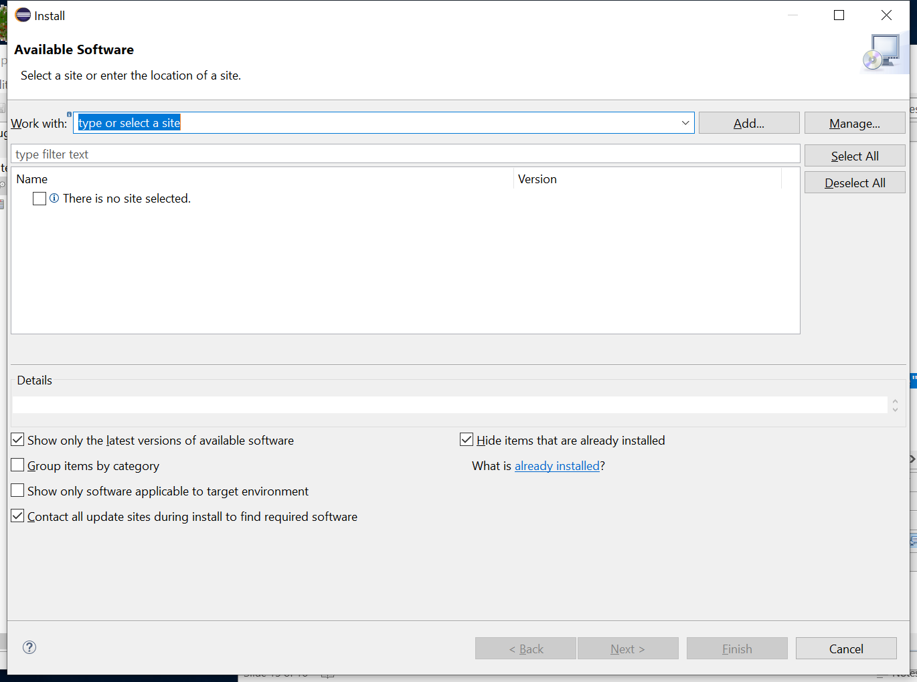
Click on: Already Installed

Slide 35
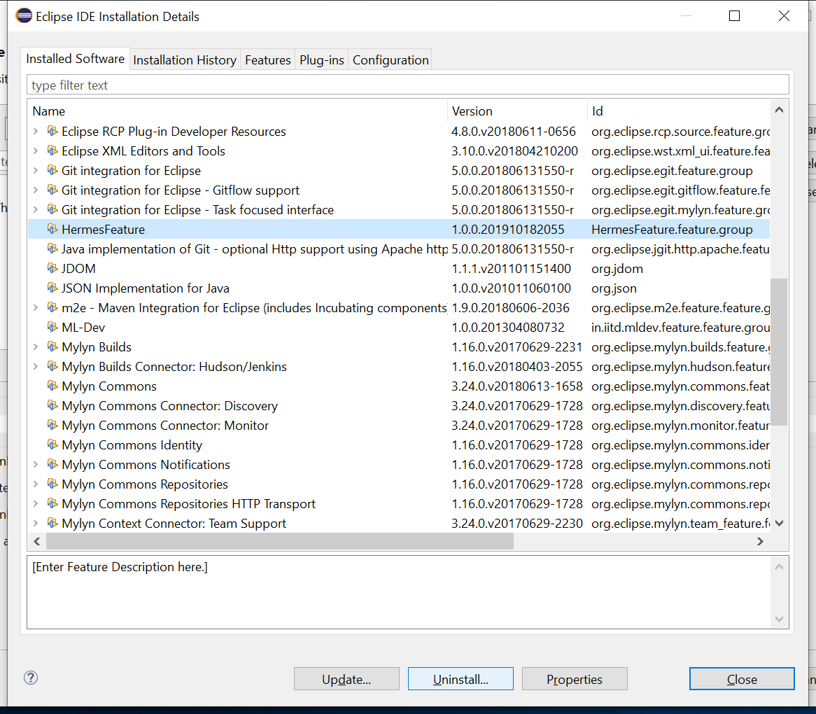
HermesFeature Uninstall

Slide 36
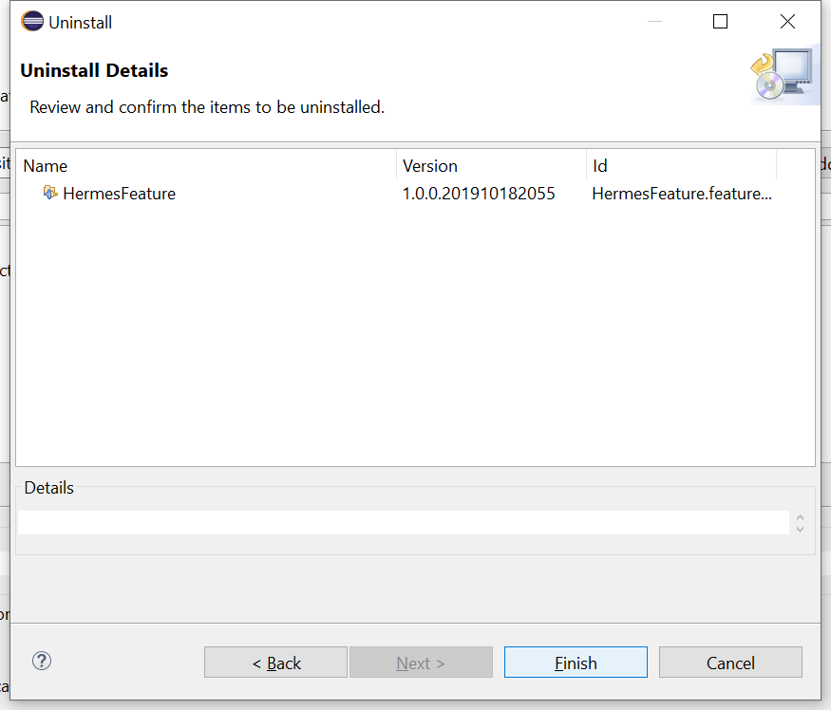
Click Finish

Slide 37
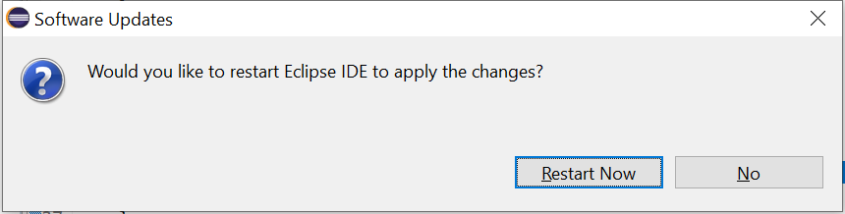
Restart Eclipse

