Slide 1
Install and Configure Egit
Dong Nie

Slide 2
Install Egit

Slide 3
Install Egit

Slide 4
Install Egit

Slide 5
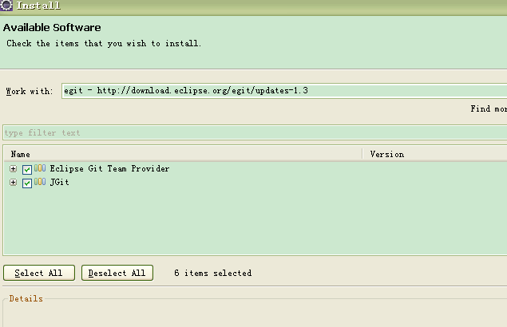
Install Egit

Slide 6
Click next and next…
Next, next …until finish

Slide 7
Configure Egit
The prerequisite is that you have installed GIT client on your computer.

Slide 8
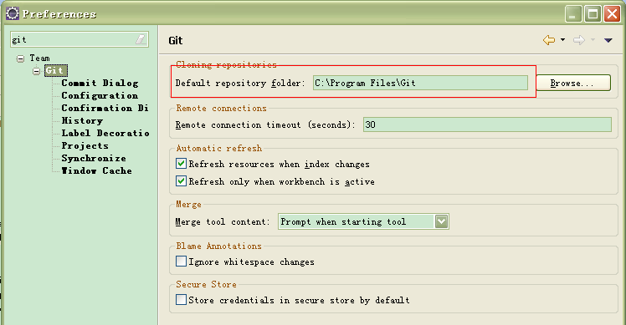
Configure Egit

Slide 9
Configure Egit

Slide 10
Configure Egit

Slide 11
Test: create A demo

Slide 12
File > Team > Share Project, choose git

Slide 13
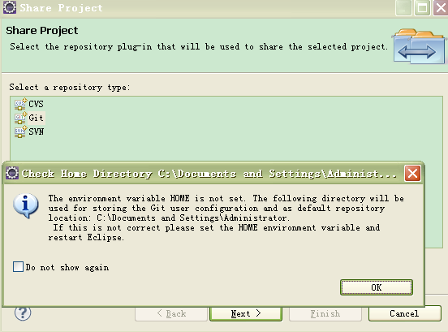
Set the environment variable

Slide 14
Set environment variable

Slide 15
Create a repository (empty)

Slide 16
Upload your project
You Need a github account at first, and then login.

Slide 17
Upload your project

